Slide 1




Assessment of crop yield in China simulated by 13 global gridded crop models
Dezheng Yin^{1,2} Email: yindezhen20@mails.ucas.ac.cn
Fang Li¹, Yaqiong Lu³, Xiaodong Zeng¹, and Yanqing Zhou^{4,2}
¹International Center for Climate and Environment Sciences, Institute of Atmospheric Physics, Chinese Academy of Sciences, Beijing, China
²University of Chinese Academy of Sciences, Beijing, China
³Institute of Mountain Hazards and Environment, Chinese Academy of Sciences, Chengdu, China
⁴State Key Laboratory of Desert and Oasis Ecology, Xinjiang Institute of Ecology and Geography, Chinese Academy of Sciences, Urumqi, China

Slide 2
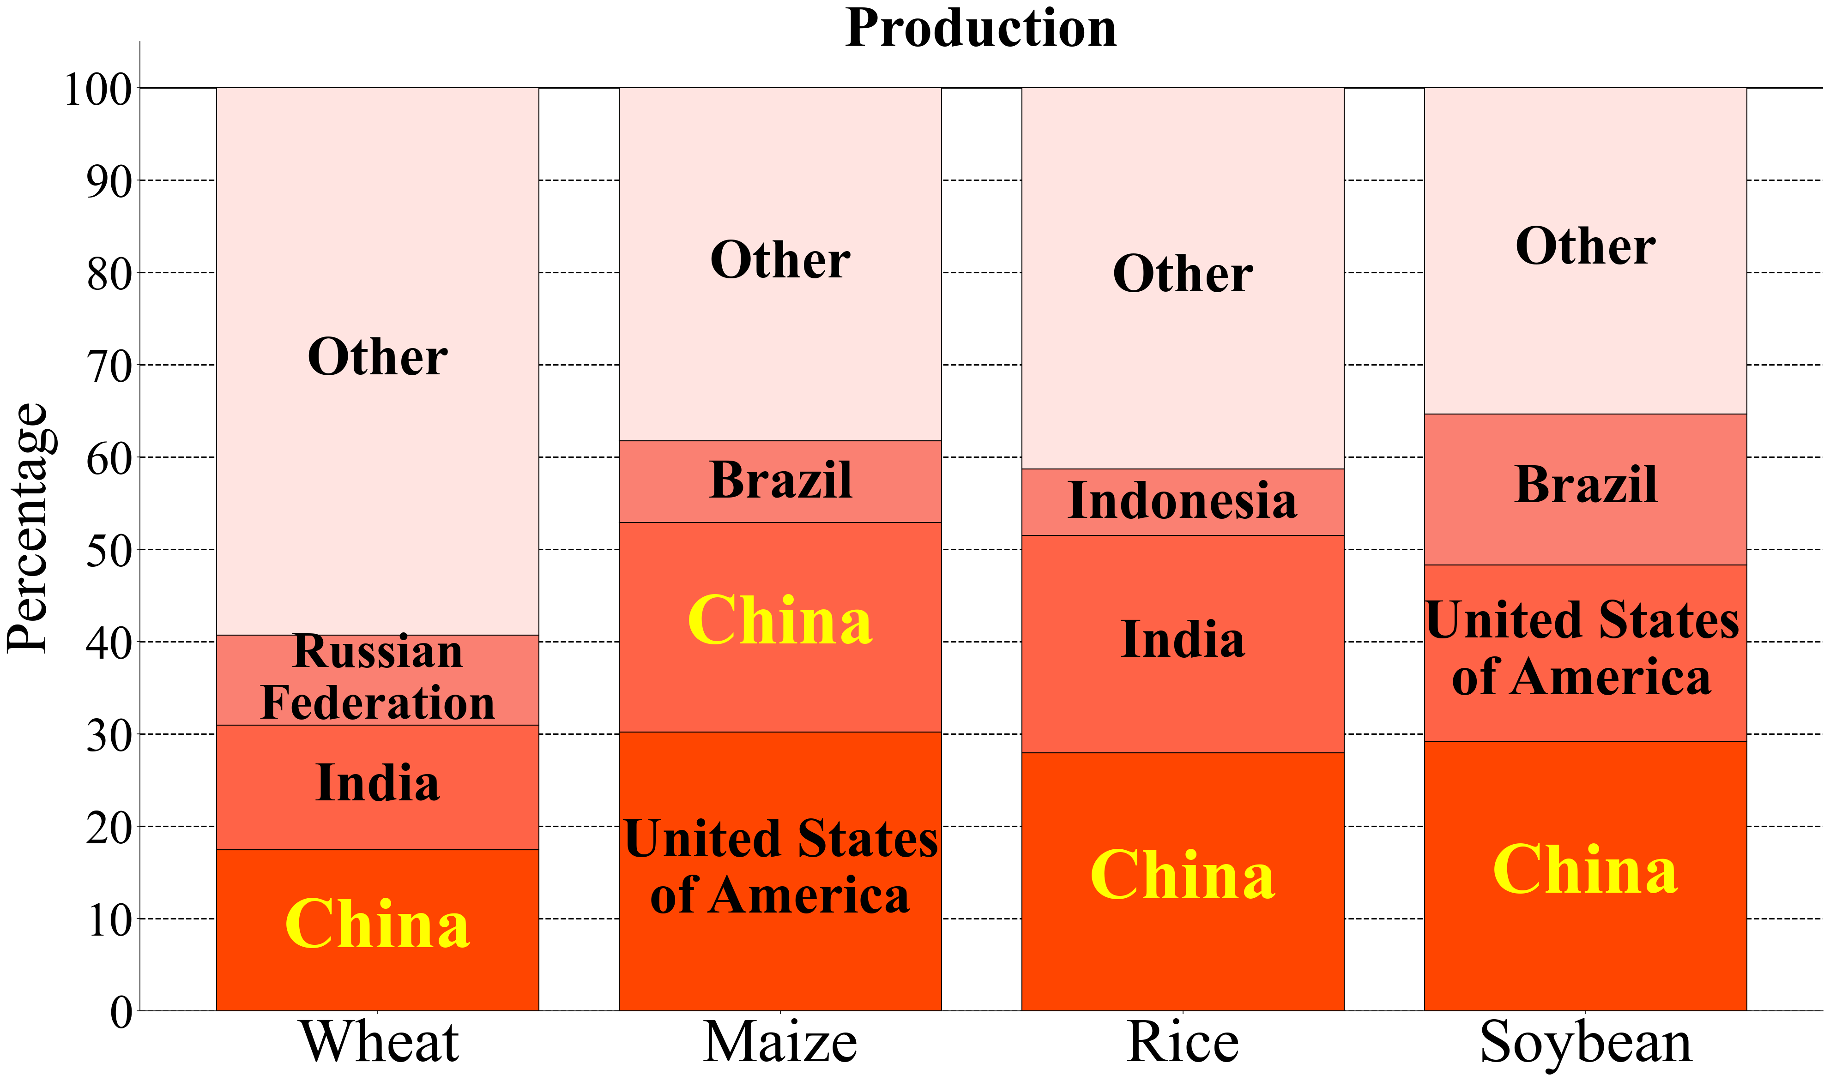
Background
Importance of crop yield in China
Largest producing country of wheat, rice and soybean and the second largest producer of maize in the world
Influence global food security and grain trade
(FAO, 2021)
1

Slide 3
Background
Global Gridded Crop Model (GGCM)
Developed and broadly applied
Global Gridded Crop Model Intercomparison (GGCMI), CLM5-crop
Earlier studies on GGCM evaluations
Interannual variability, global, national
Our study provides a comprehensive evaluation of China’s wheat, maize, rice and soybean yield simulations.
2

Slide 4
Data and methods
GGCMs
Period: 1980–2009
Crop model | Typeª | Crop^{b} | Scenarios^{c} | References
CLM4.5post-crop | E | whe, mai, ric, soy | D, F, H | Levis et al. (2018)
LPJ-GUESS | E | whe, mai, ric, soy | D, H | Lindeskog et al. (2013)
LPJmL | E | whe, mai, ric, soy | D, H | Bondeau et al. (2007), Waha et al. (2012)
ORCHIDEE-crop | E | whe, mai, ric, soy | D, F, H | Wu et al. (2016)
PEGASUS | E | whe, mai, soy | D, F, H | Deryng et al. (2016)
CGMS-WOFOST | S | whe, mai, ric, soy | D | de Wit and van Diepen (2008)
EPIC-Boku | S | whe, mai, ric, soy | D, F, H | Izaurralde et al. (2006)
EPIC-IIASA | S | whe, mai, ric, soy | D, F, H | Izaurralde et al. (2006)
GEPIC | S | whe, mai, ric, soy | D, F, H | Liu et al. (2007), Folberth et al. (2012)
pAPSIM | S | whe, mai, soy | D, F, H | Keating et al. (2003)
pDSSAT | S | whe, mai, ric, soy | D, F, H | Jones et al. (2003)
PEPIC | S | whe, mai, ric, soy | D, F, H | Liu et al. (2016)
CLM5-crop | E | whe, mai, ric, soy | D | Lombardozzi et al. (2020)
ªE: ecosystem model; S: site-based model. ^{b}whe: wheat; mai: maize; ric: rice; soy: soybean. ^{c}D: default; F: fullharm; H: harmnon.
3

Slide 5
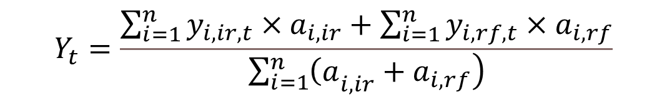
Data and methods
Benchmarks
National and 31 provincial crop yields during 1980-2009 (NBSC)
Aggregating simulated yield data
$$Y_{t}=\frac{\sum_{i=1}^{n}{y_{i,ir,t}×a_{i,ir}+\sum_{i=1}^{n}{y_{i,rf,t}×a_{i,rf}}}}{\left.\sum_{i=1}^{n}{{\left(a\right.}_{i,ir}}+a_{i,rf}\right)}$$
$t:$the index of year; $i :$the index of grid cell; $Y:$the aggregated yield; $y$: simulated yields; $a$: harvested areas; $ir$: fully irrigated conditions; $rf$: rain-fed conditions
Mask data for GGCMI: MIRCA2000
4

Slide 6
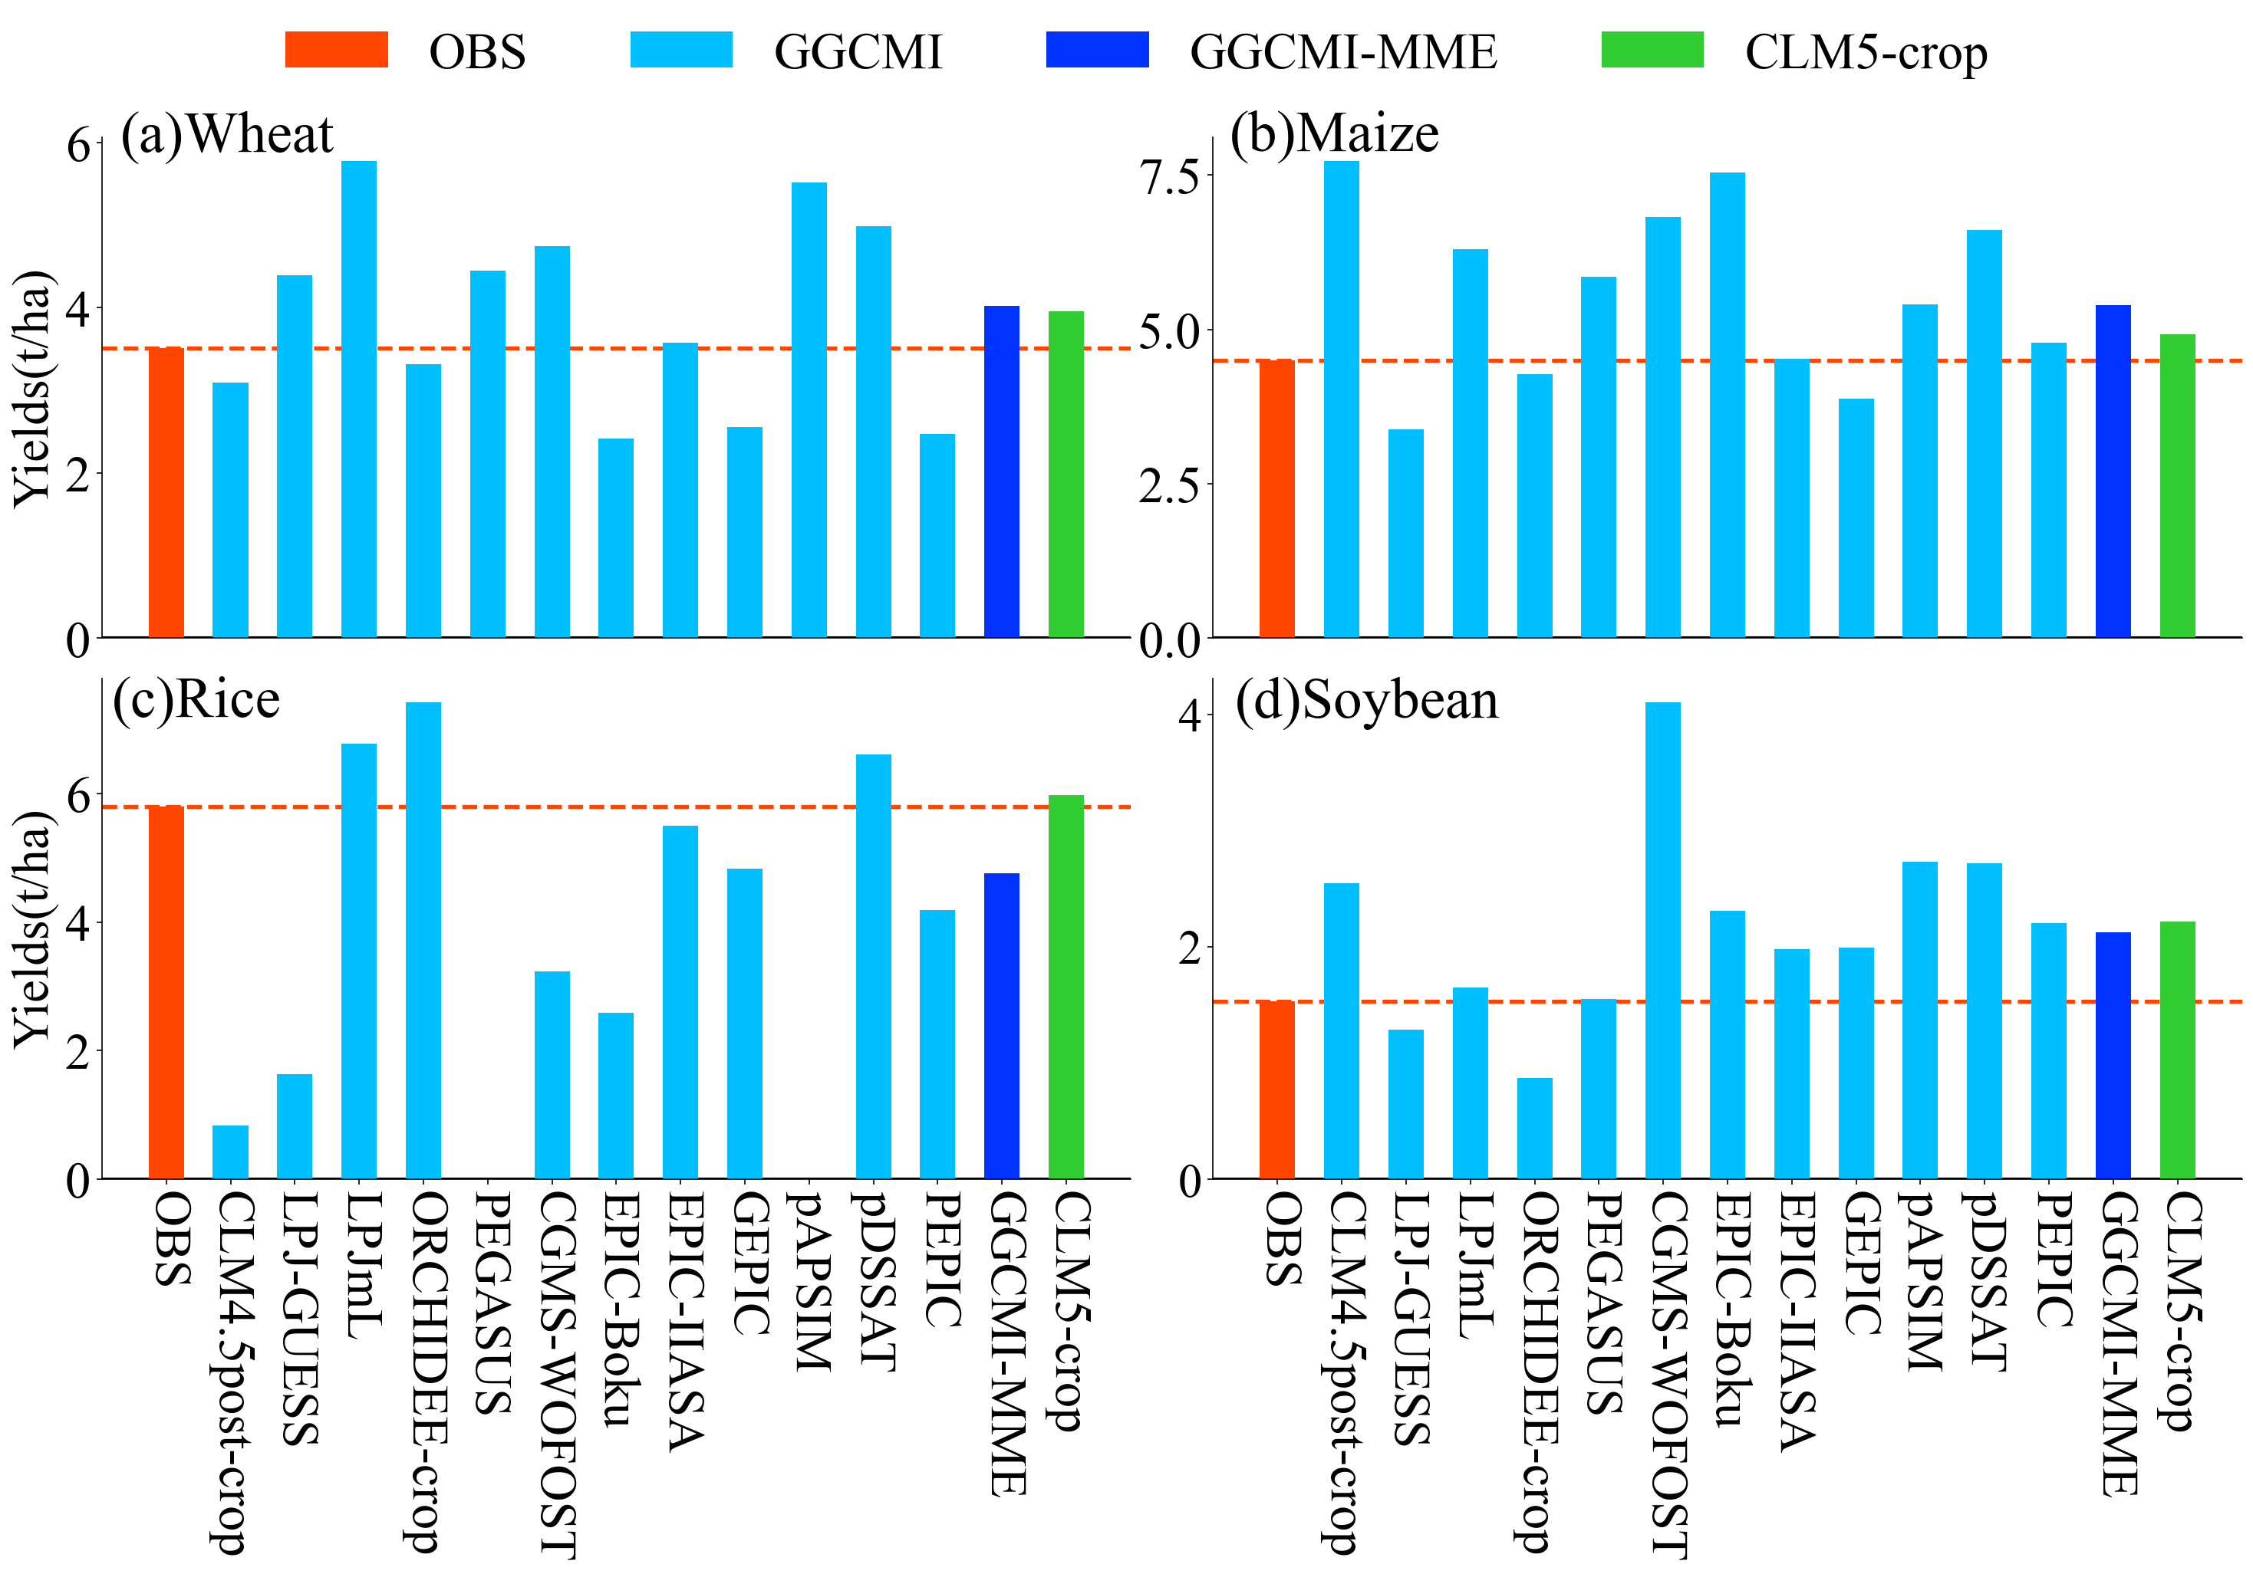
Results: Country average
GGCMI models underestimate rice but overestimate the other three crops
CLM5-crop performs well for wheat, maize, and rice
5

Slide 7
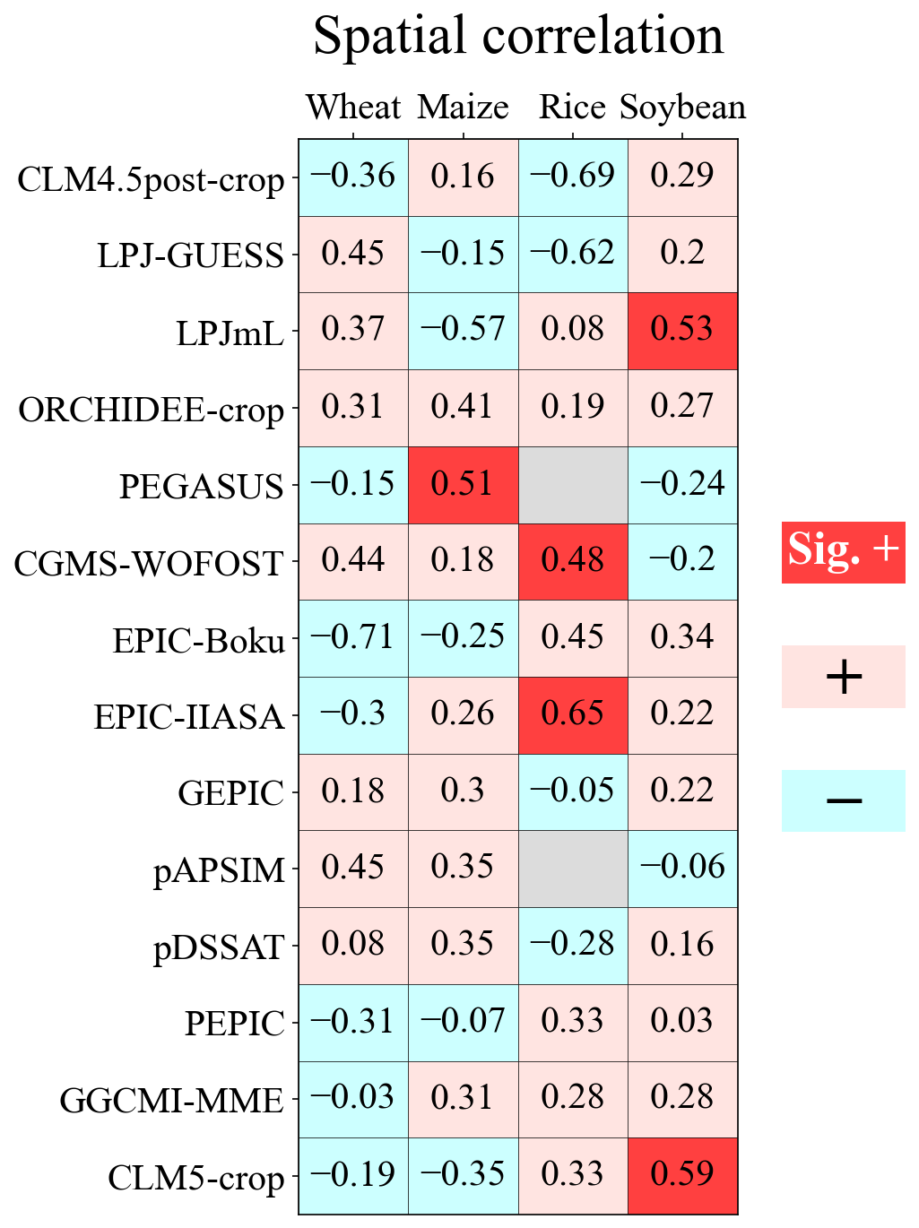
Results: Spatial pattern
GGCMs struggle to simulate the spatial pattern
6

Slide 8
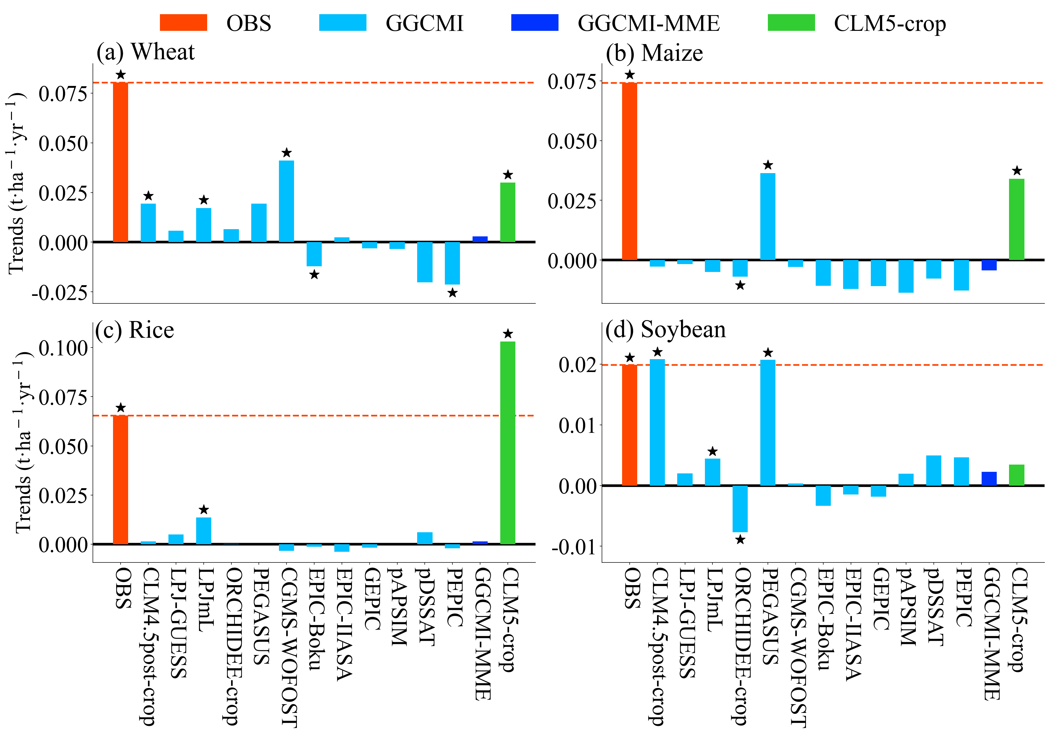
Results: Long-term trend
Most GGCMI models underestimate upward trend
CLM5-crop performs well for wheat, maize and rice
Trend (Mann-Kendall ★: p < 0.05)
Ecosystem
Ecosystem
7

Slide 9
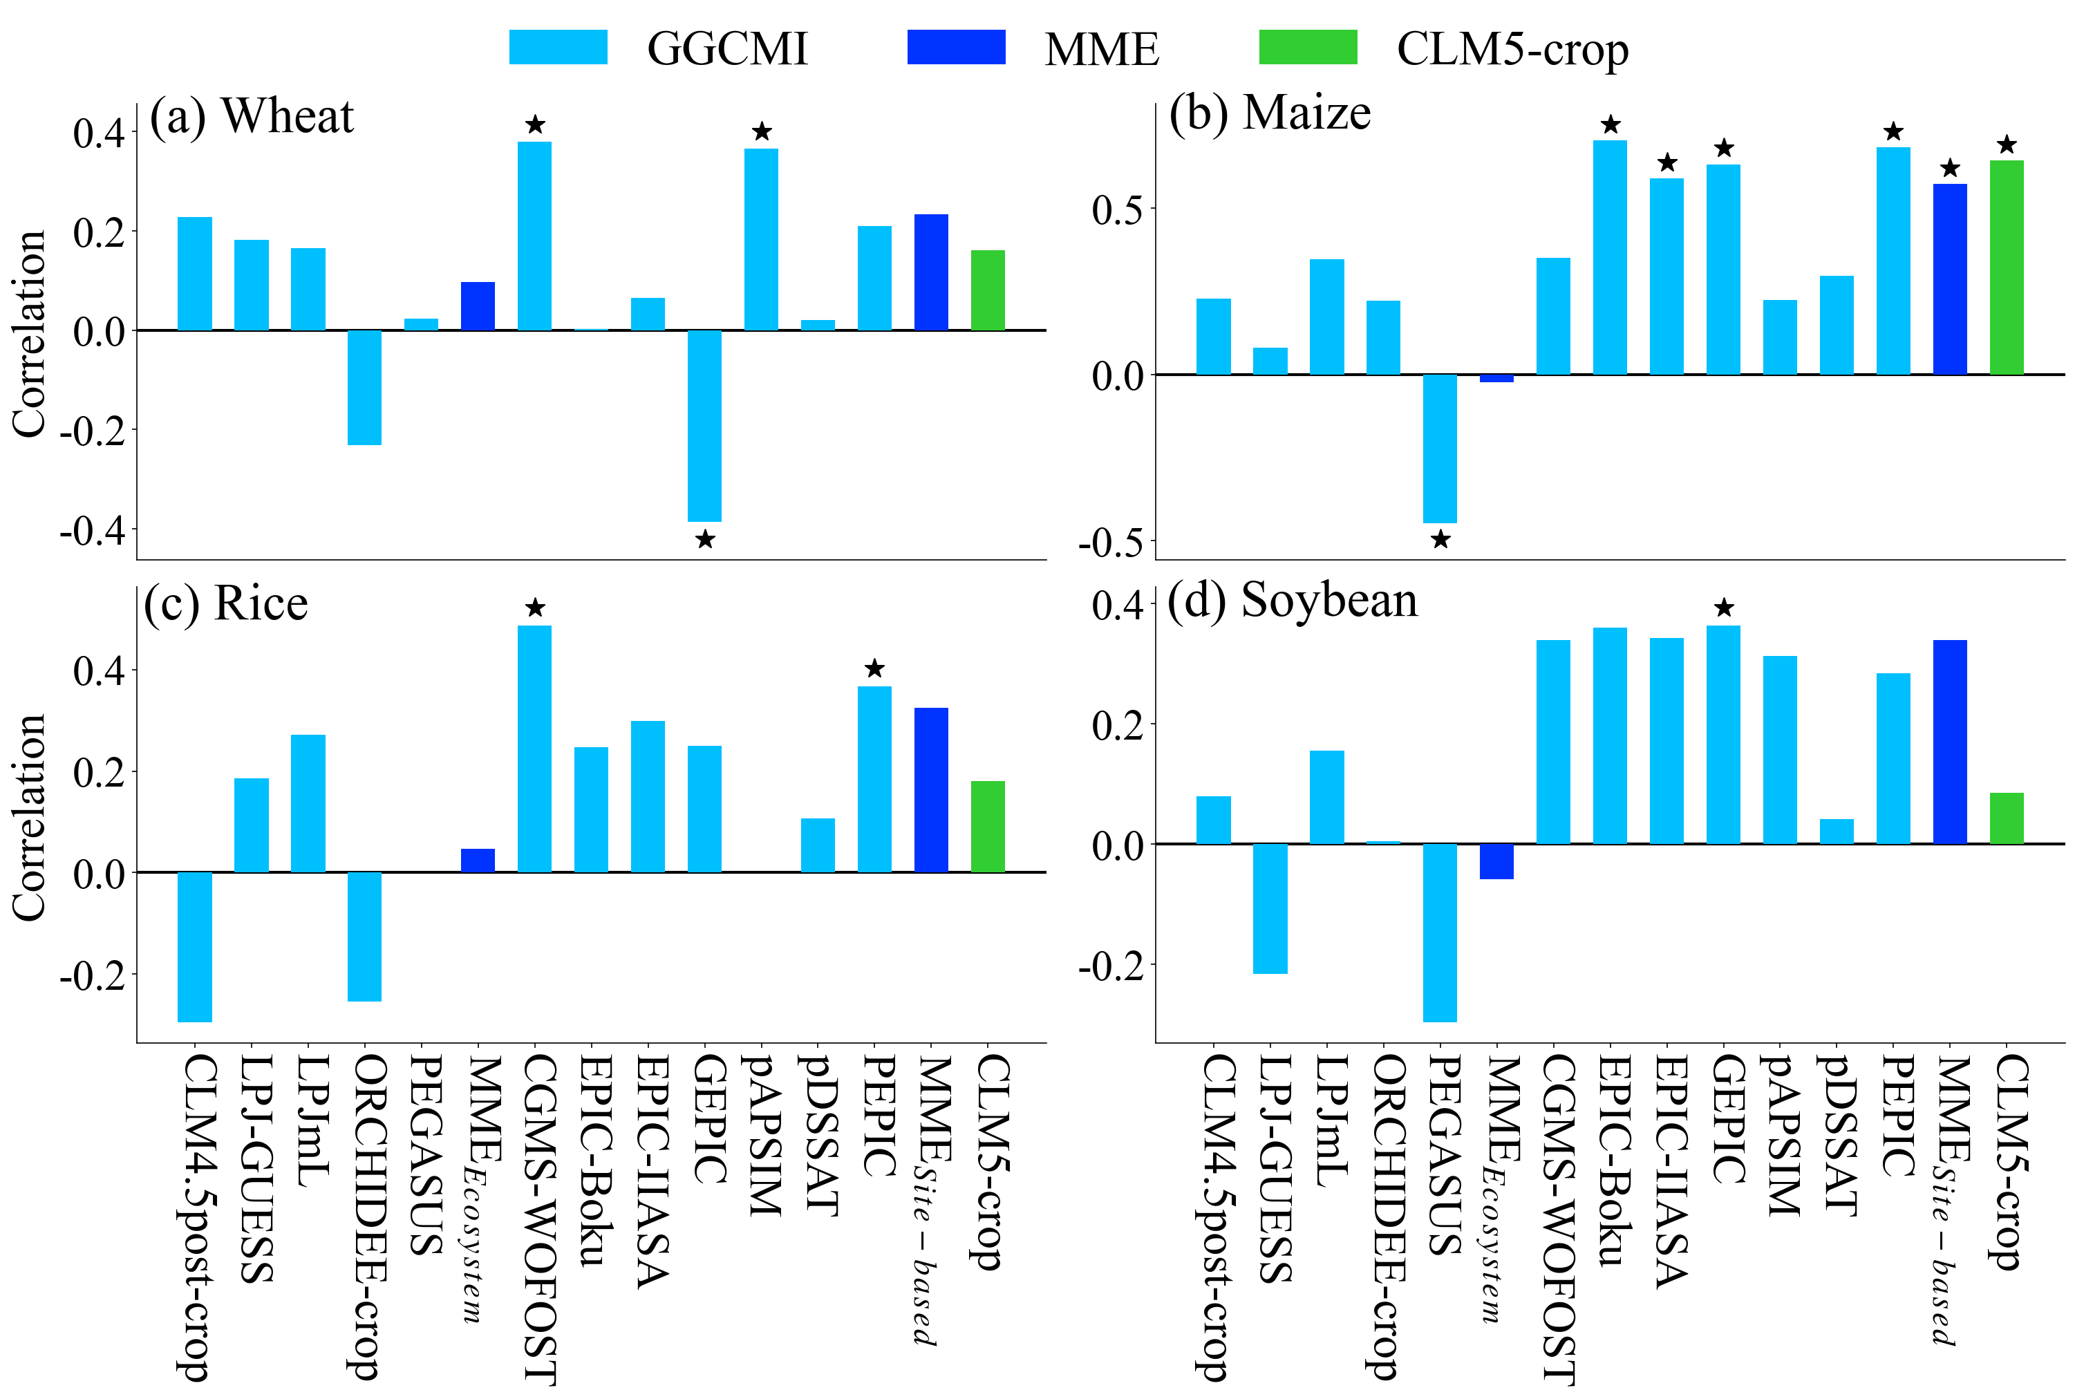
Results: Interannual variability
Site-based models are better
CLM5-crop simulates maize well
Temporal correlation
(Student’s t-test ★: p < 0.05)
Site-based
Site-based
8

Slide 10
Summary
GGCMI models generally underestimate rice yield and overestimate yield for other three crops
GGCMs struggle to simulate the spatial pattern
Most GGCMI models fail to simulate the upward trends, while CLM5-crop can capture the significant trends in wheat, maize and rice
Site-based models are more skillful in reproducing the interannual variability patterns
Thanks!
9

