Slide 1



Towards realistic plant hydraulics in the Arctic-Boreal Zone by modelling cold acclimation
in CLM5-Fates (hydro)
Marius Lambert, Hui Tang, Kjetil S. Aas, Frode Stordal, Rosie A. Fisher, Jarle W. Bjerke, and Frans-Jan W. Parmentier
Access to the abstract

Slide 2
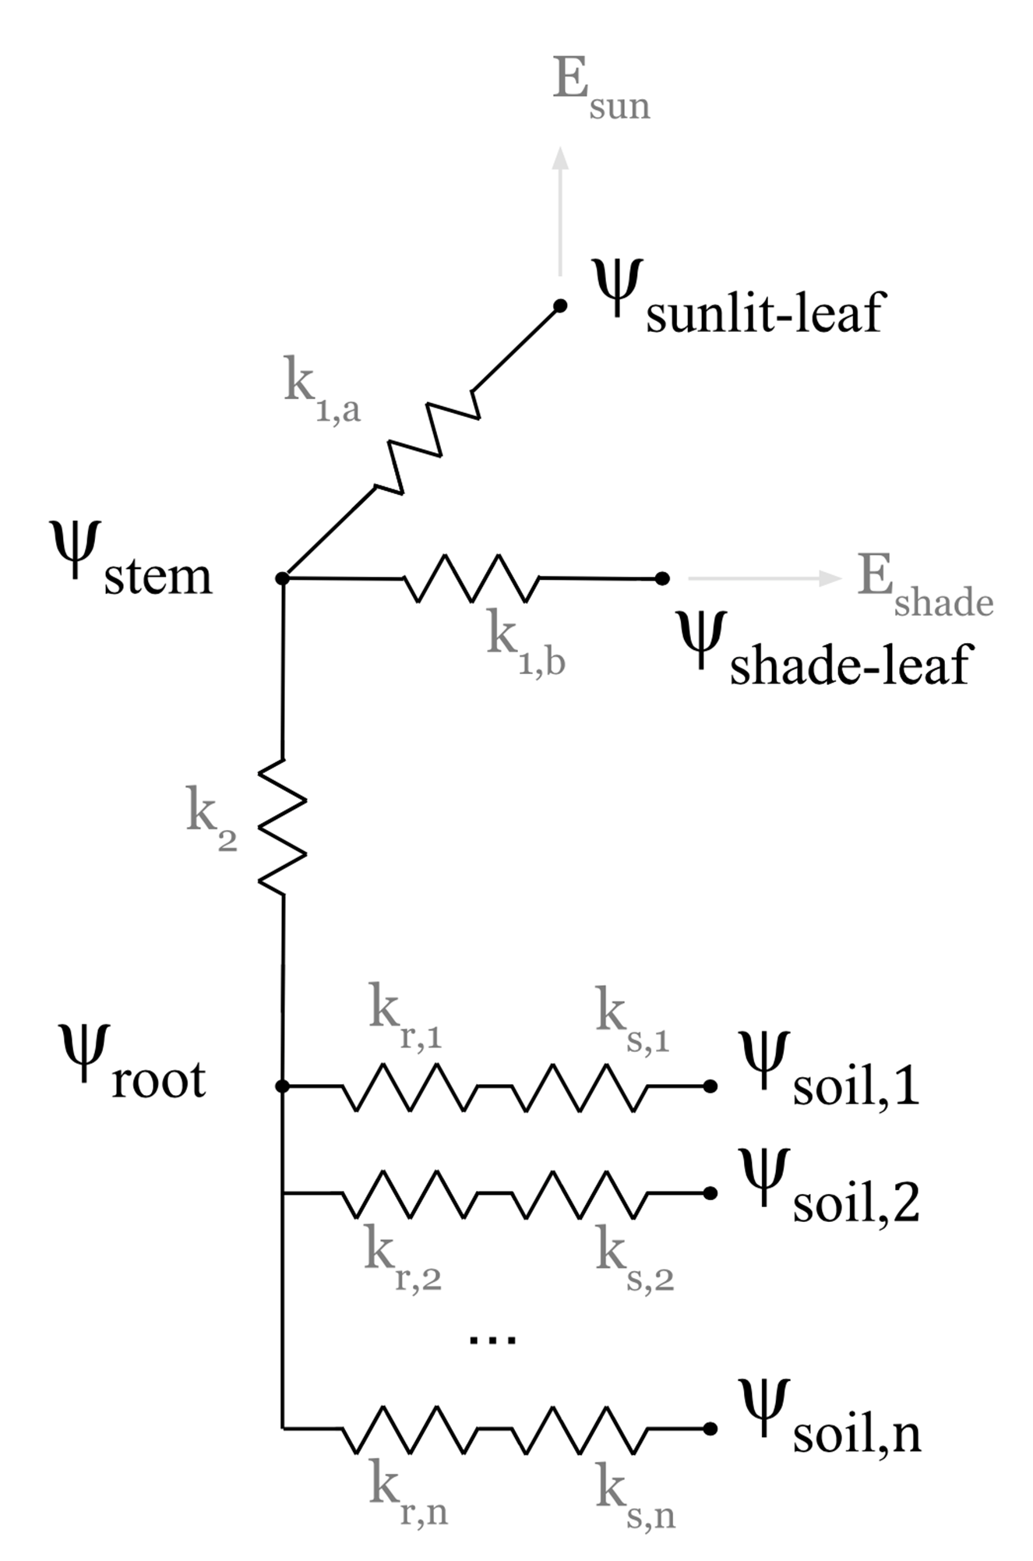

Plant hydraulics in FATES
Many ESMs simplify plant hydraulics by limiting transpiration when soil moisture is low
In reality, atmospheric moisture and leaf water potential control transpiration
Therefore, vegetation models have started to include advanced plant hydraulics (pressure gradient throughout the plant)
Kennedy et al. (2019)

Slide 3



Plant hydraulics in FATES
Many ESMs simplify plant hydraulics by limiting transpiration when soil moisture is low
In reality, atmospheric moisture and leaf water potential control transpiration
Therefore, vegetation models have started to include advanced plant hydraulics (pressure gradient throughout the plant)
In FATES-Hydro, this also includes internal plant water storage (remains liquid)
FATES-Hydro was initially developed for sites in the tropics
Kennedy et al. (2019)

Slide 4
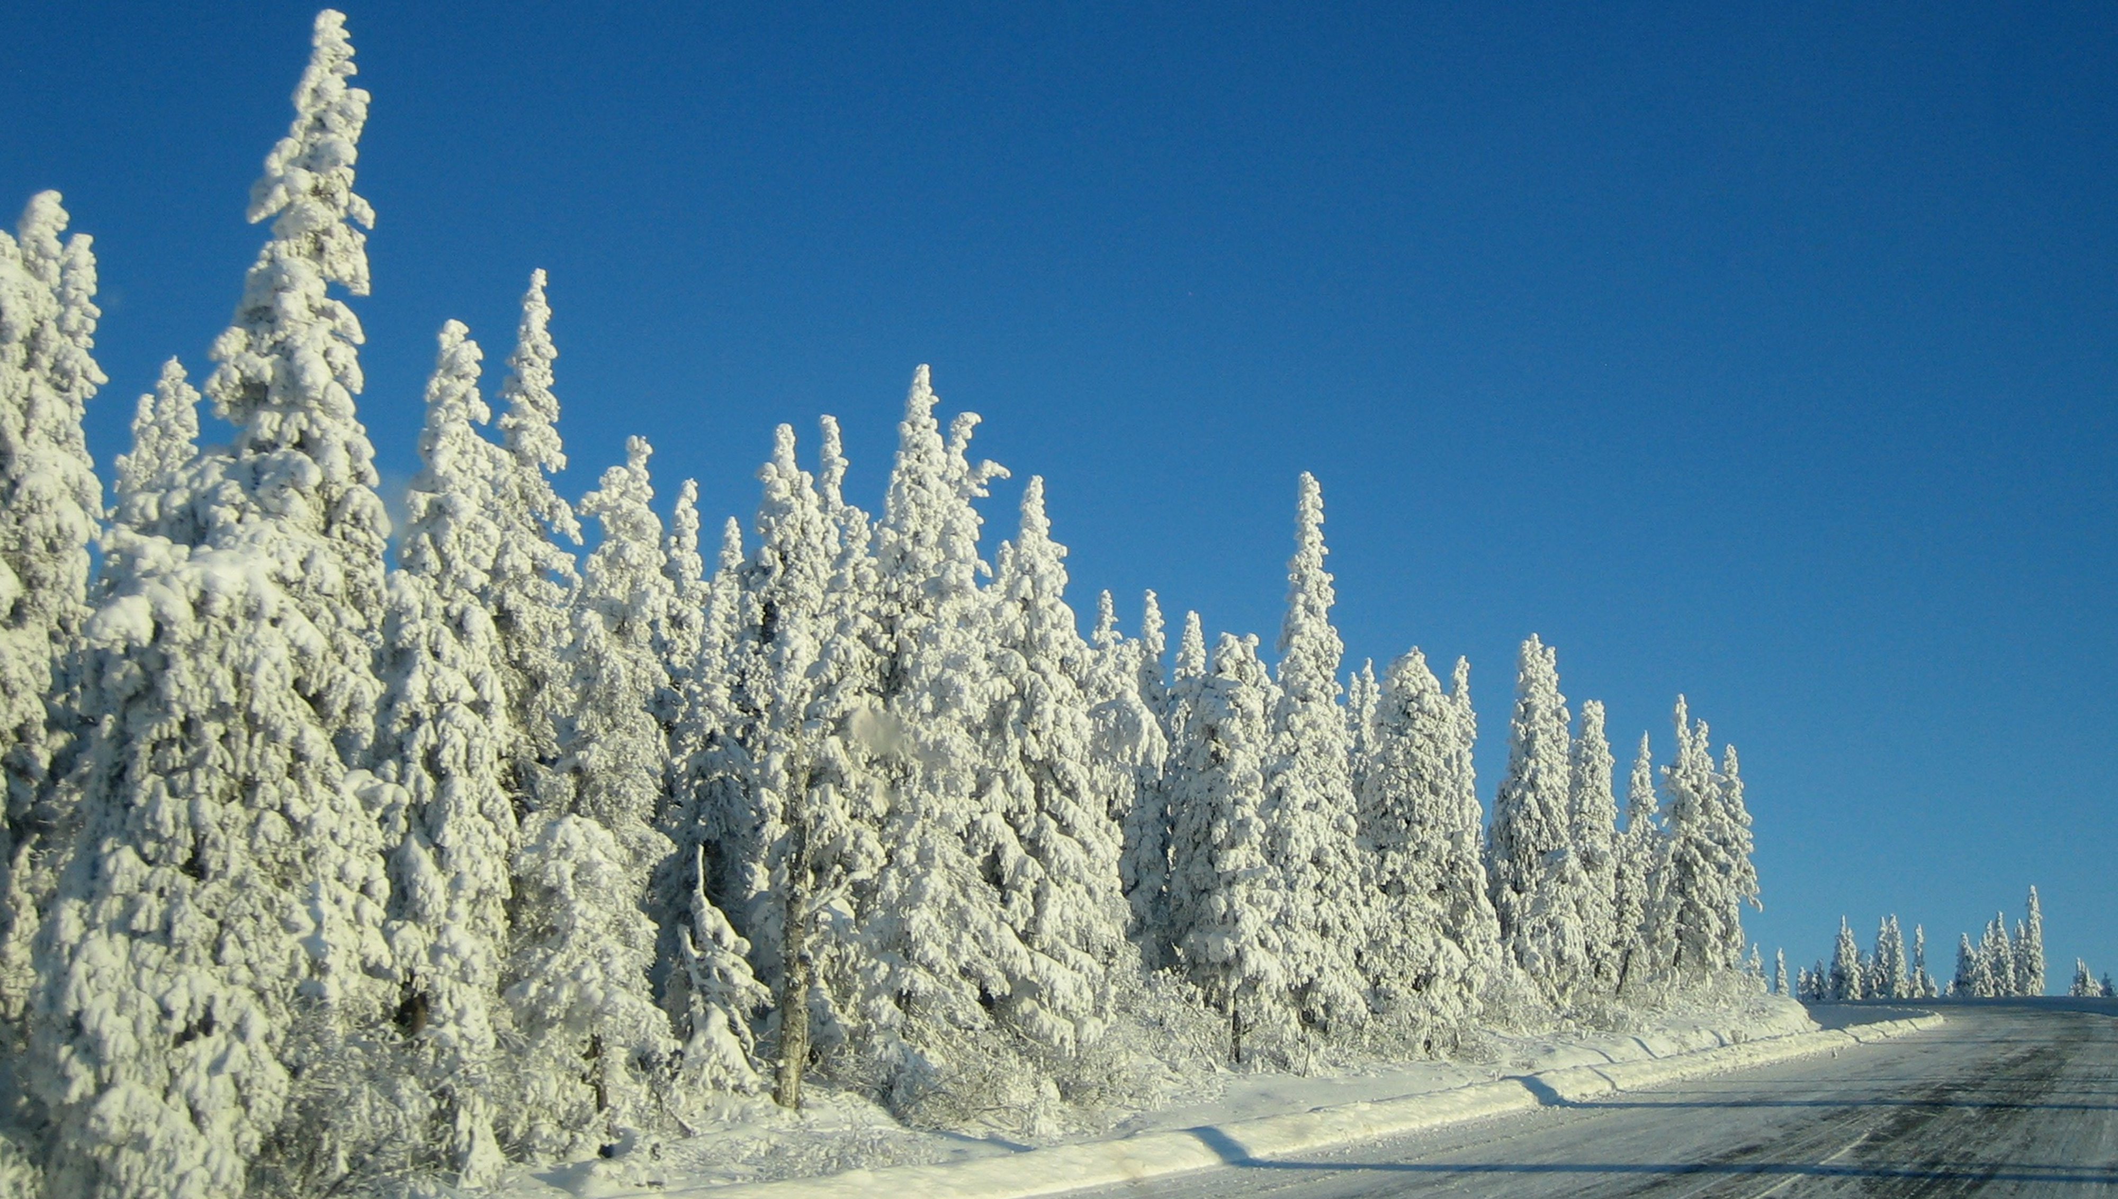



Slide 5
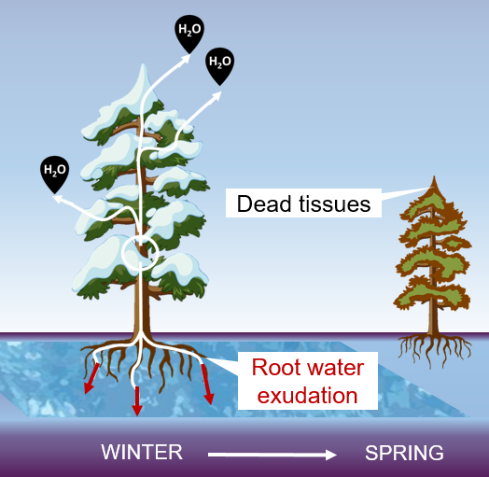
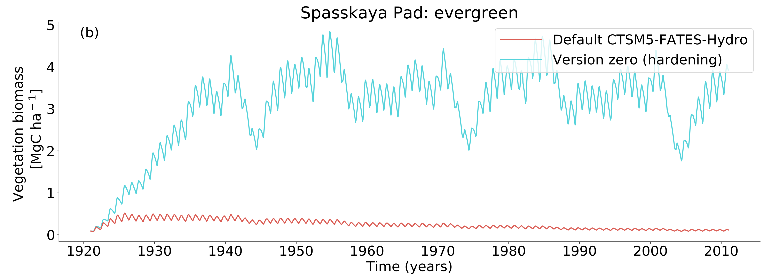
Root water exudation killed the trees
Needleleaf evergreen trees in Spasskaya Pad (Siberia)
modelled with FATES-Hydro

Slide 6
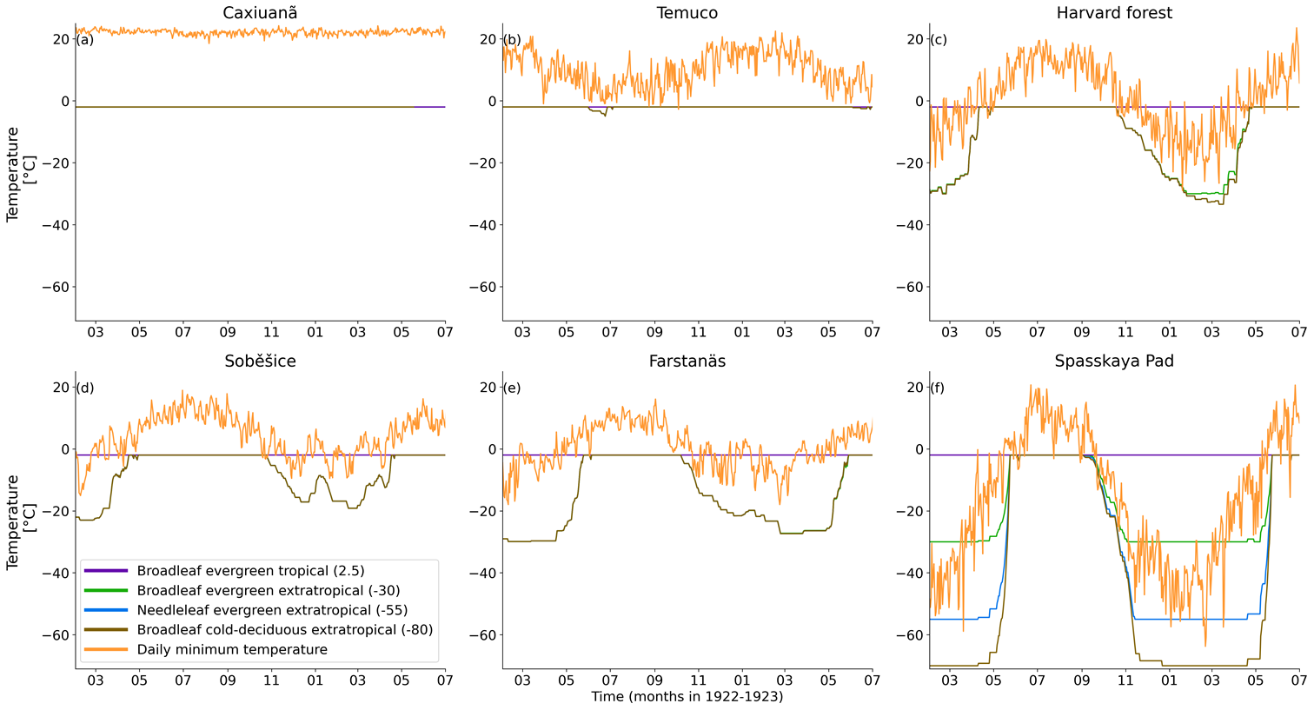
Solution: implement cold hardening
Each autumn plants go through a process known as ‘cold hardening’ which includes the formation of anti-freeze proteins
Hardening lowers the hydraulic conductivity of plant tissues, and root water exudation is limited
Hardening is temperature and PFT dependent, and now included in FATES
Time (months)

Slide 7
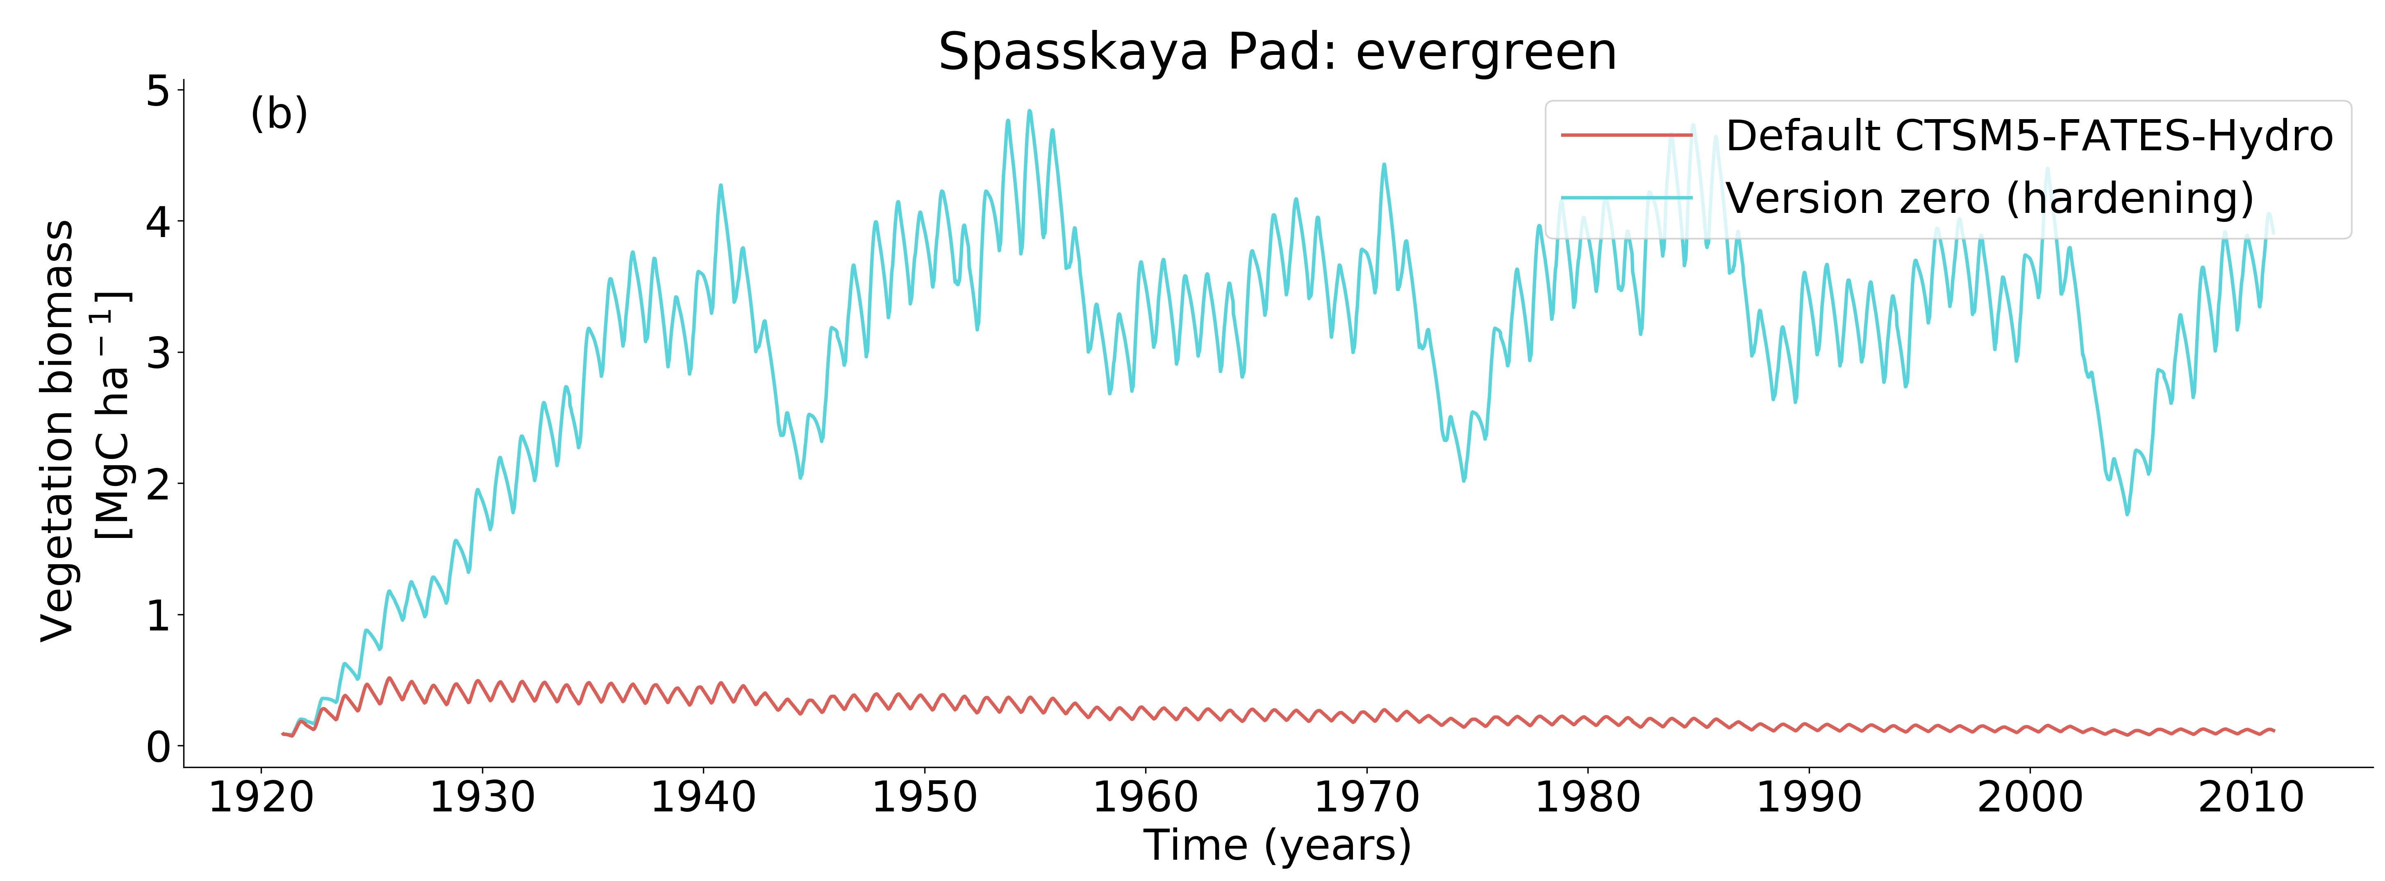
When trees reduce winter desiccation
Notes:
At farstanas, hardening leads to less growth during years with relatively mild winters. During harsh winters, with sudden cold episodes, mortality is lower than the reference, but still large drops, because conductivities are lowered proportionally to the hardiness level. The hardiness level at Farstanas is around -20°C in winter, which is much higher than at Spasskaya Pad. In Spasskaya Pad, the large drops of biomass are related to the weak winter precipitation rates, and thin snow pack. Without enough snow melt, It is late in the following summer that photosynthesis really started again. So the decrease in biomass is due to a lack of growth rather than larger mortality. It is also due to the increase in biomass that competition for water became high and carbon starvation remains longer.

Slide 8
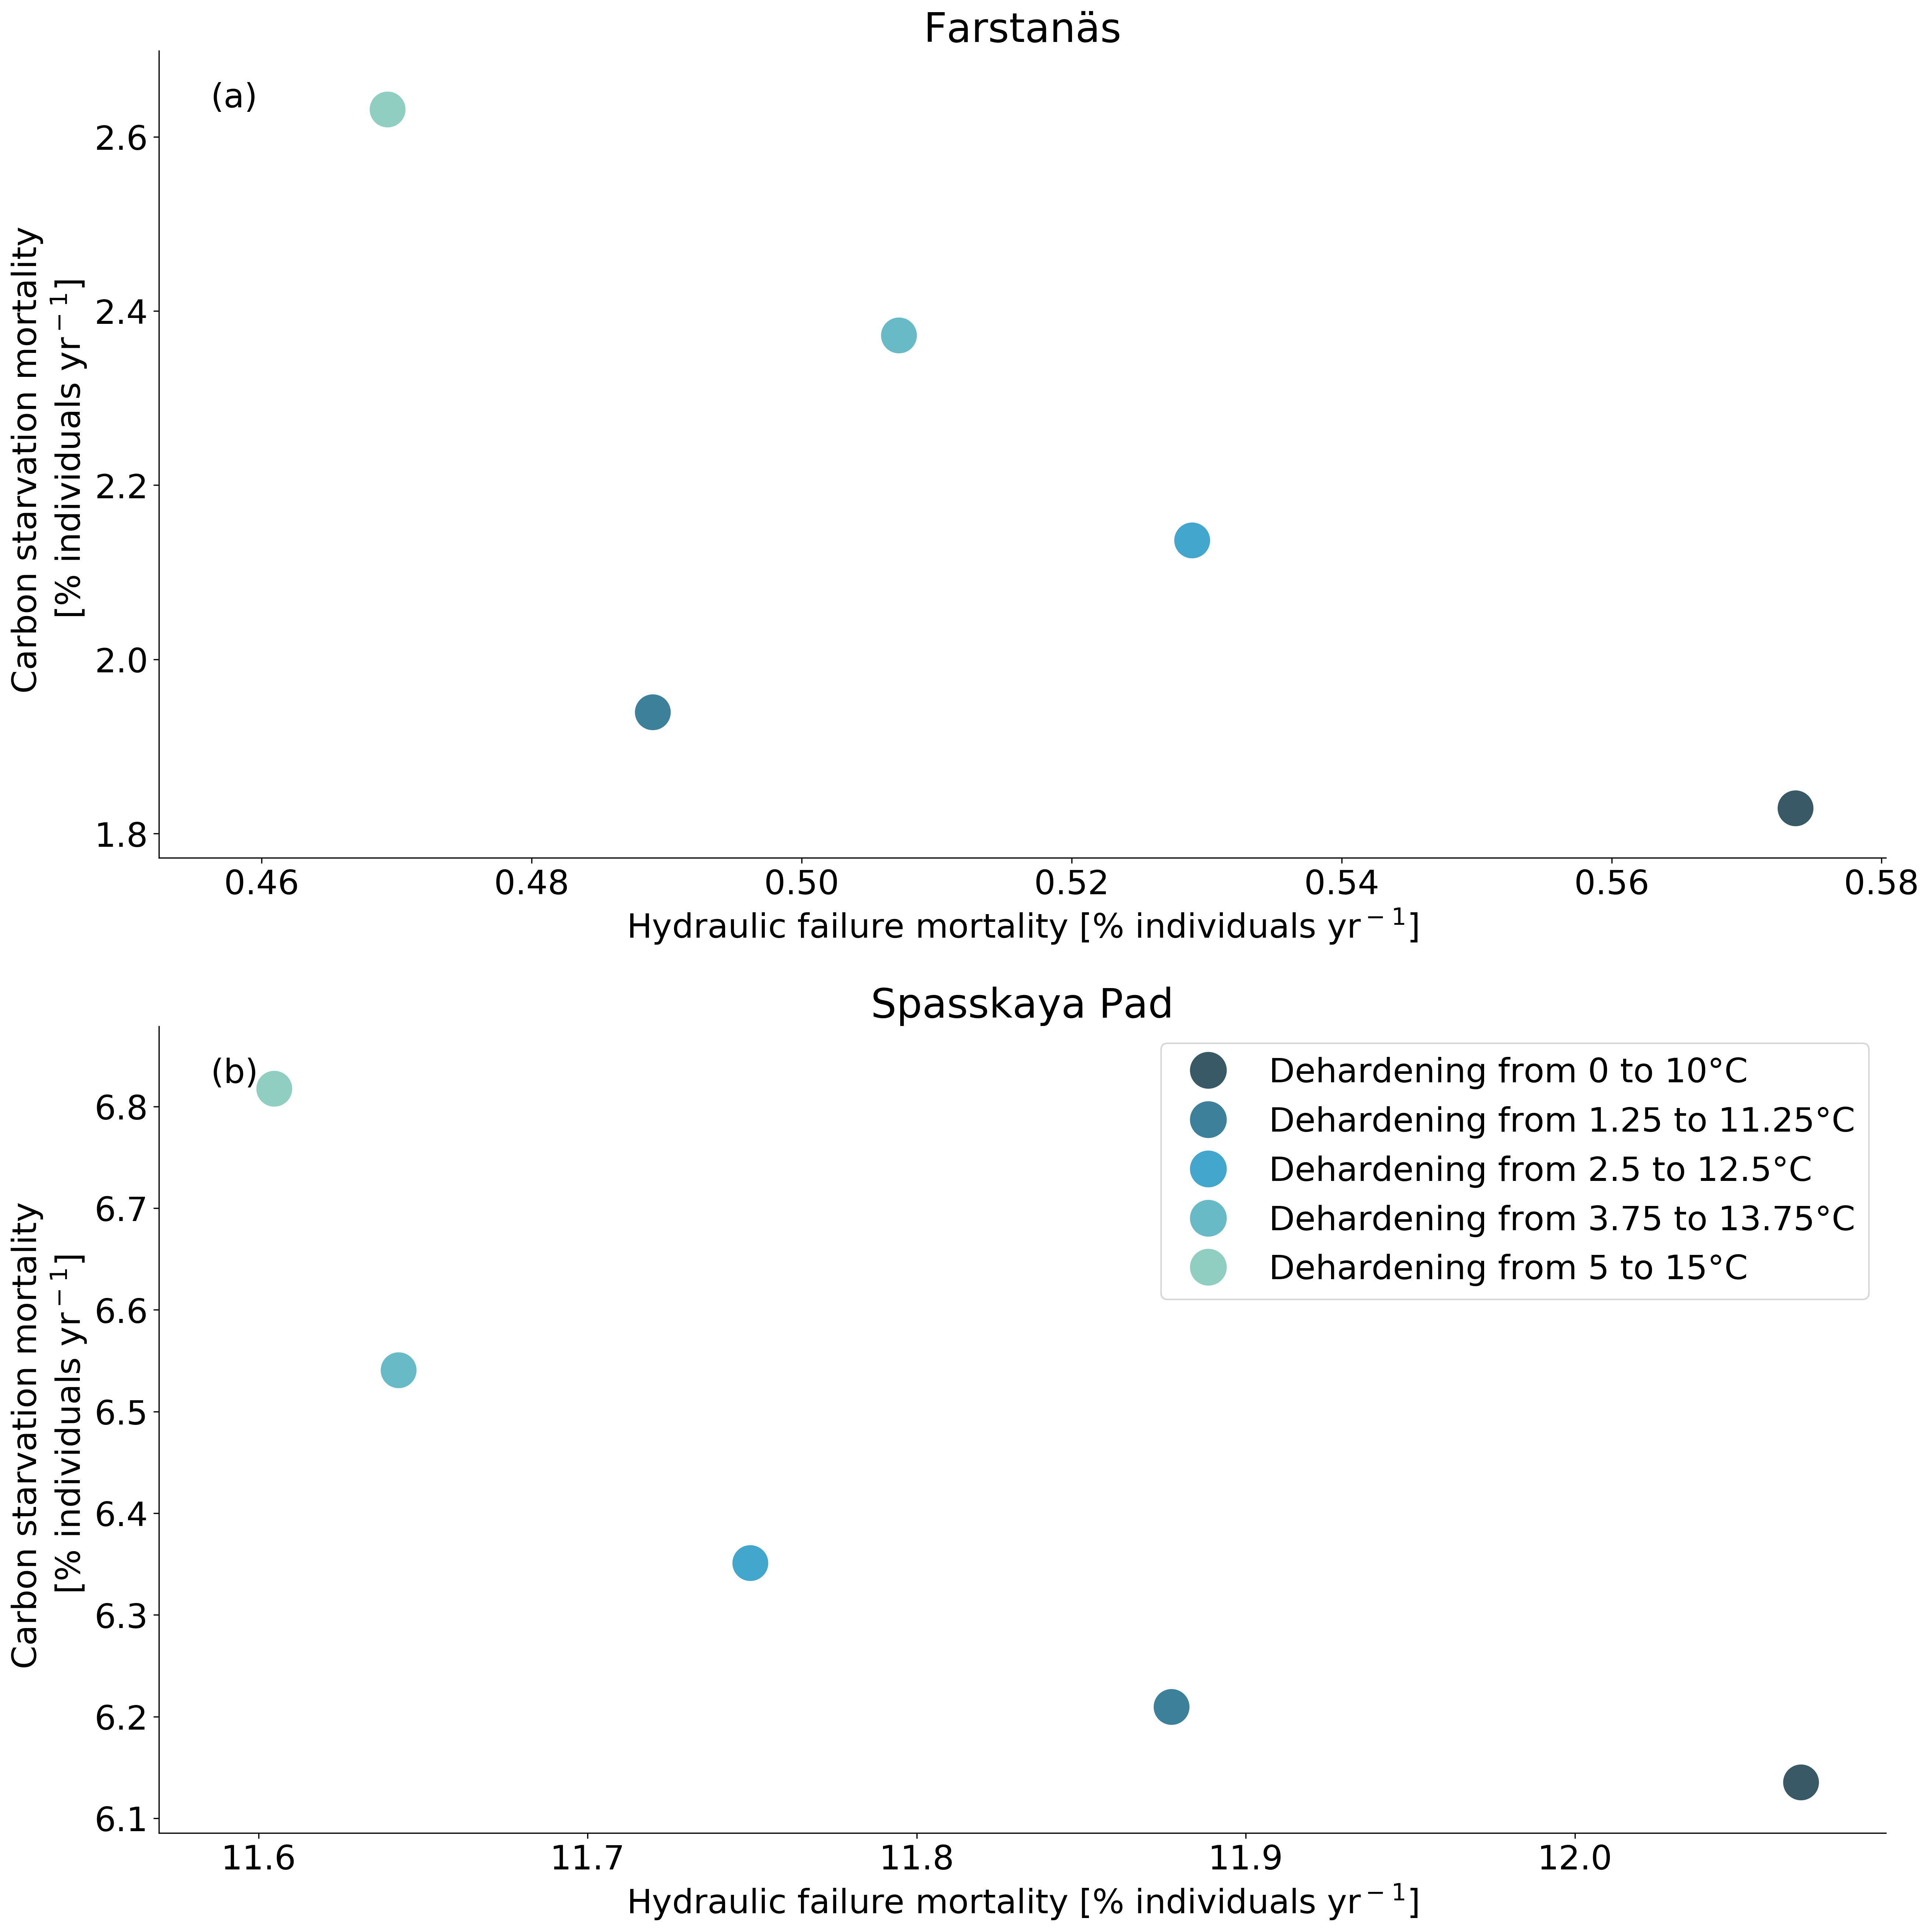
The cost of hardening

Slide 9
Summary
To cope with unrealistic winter desiccation we implement cold acclimation
The ‘Hydro-hardening’ scheme:
  Uses hardiness to lower plant conductance
  Leads to more realistic vegetation biomass productivity at temperate and boreal sites
  Captures the costs (in terms of reduced growth in spring) and benefits (in terms of reduced mortality rates) of cold acclimation

Slide 10






Acknowledgements
Hui Tang
Kjetil S. Aas
Rosie A. Fisher
Frode Stordal
Jarle W. Bjerke
Jennifer Holm
Yilin Fang
Junyan Ding
Ryan Knox
Frans-Jan W. Parmentier
Access to the abstract

Slide 11
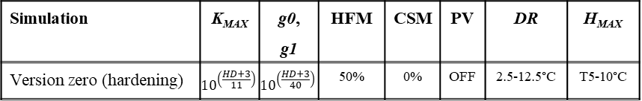
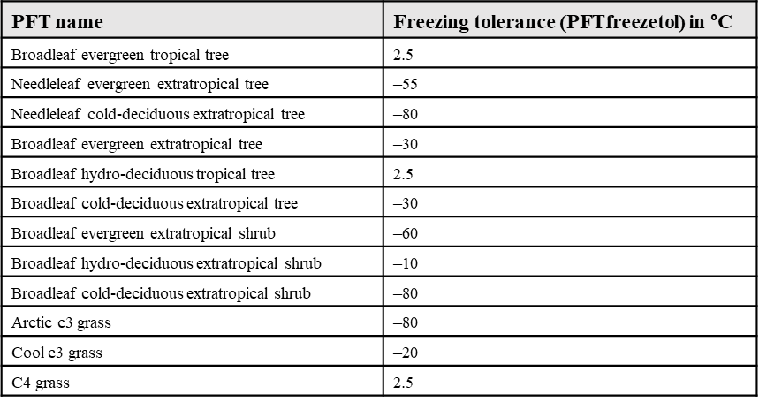
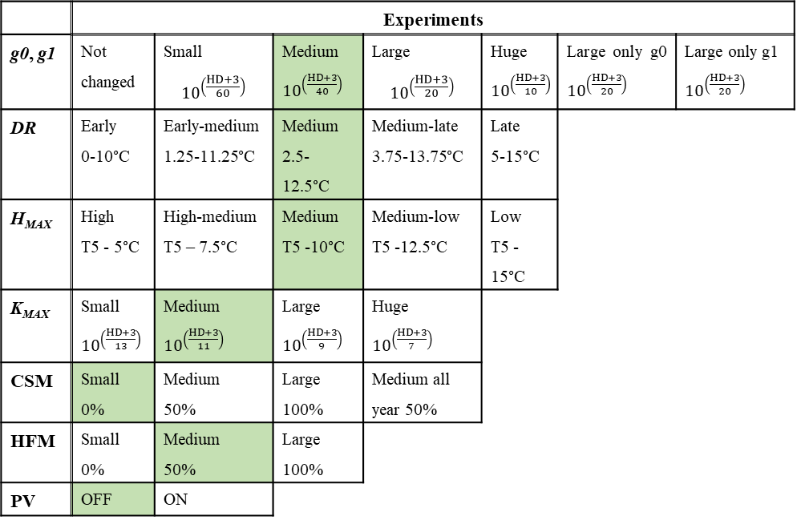
Methods: Impacts of hardening on…
1) HYDRAULICS
2) FROST MORTALITY
Freezing mortality equation of FATES is modified to become a function of the hardiness level instead of a fixed freezing tolerance threshold:

Slide 12
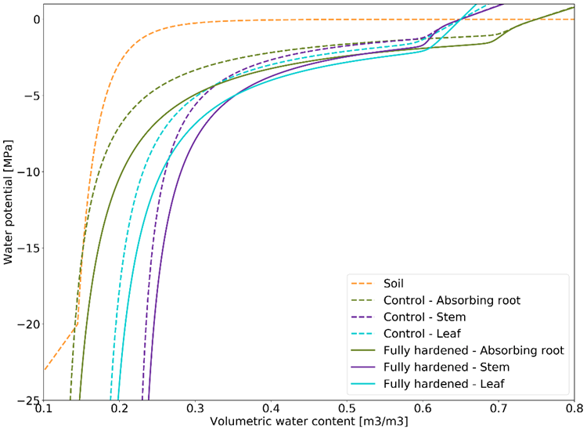
The PV curve experiments

Slide 13
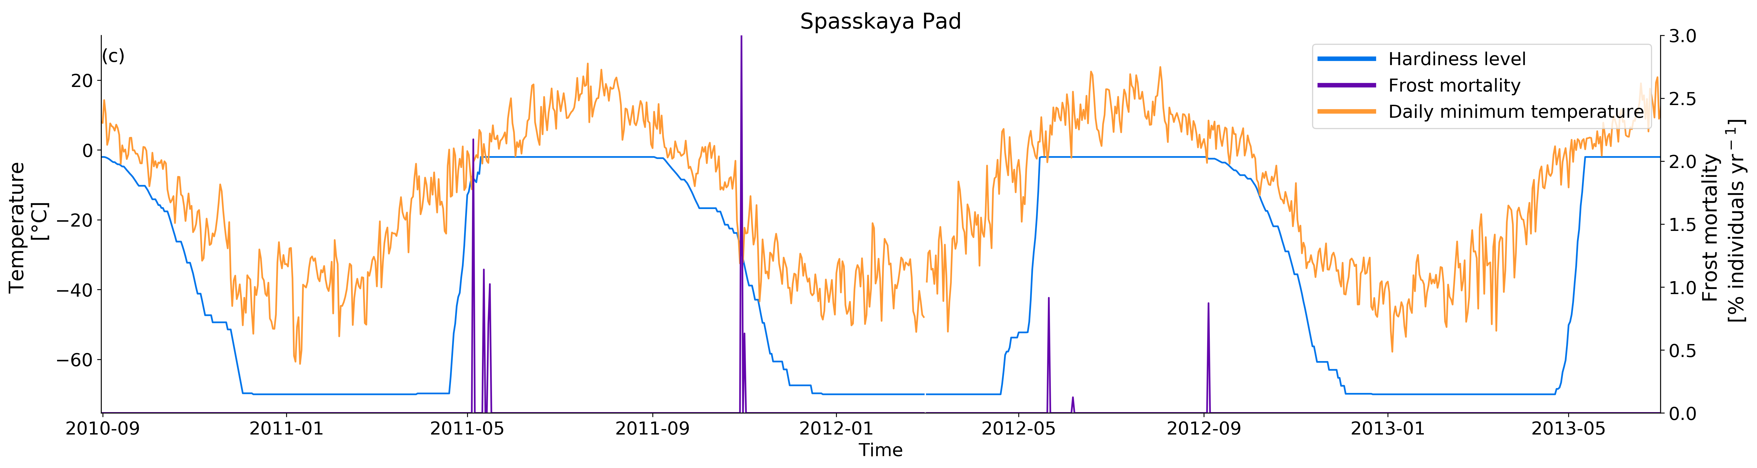
Frost experiment summary
  frost tolerance that is responding to the environment
  opens new ways to explore the impact of frost events in the context of global warming and investigate the spatial variability of both the occurrences and magnitudes of damaging frost events.

