Slide 1
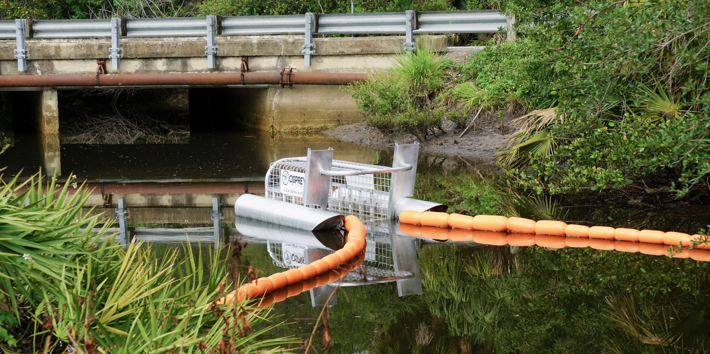






ASSISTING STAKEHOLDERS IN THEIR CHOICE OF RIVERINE AND ESTUARINE PLASTIC CLEAN-UP TECHNOLOGIES WITH THE AID OF BAYESIAN BELIEF NETWORKS
Giulia Leone^{a,b,c,f}, Ana I. Catarinoª, Ine Pauwels^{b}, Thomas Mani^{d}, Michelle Tishler^{d}, Matthias Egger^{d,e}, Marie Anne Eurie Forio^{c}, Peter L.M. Goethals^{c}, Gert Everaertª
ªFlanders Marine Institute, Ostend, Belgium, ^{b}Research Institute for Nature and Forest, Aquatic Management, Brussels, Belgium, ^{c}Ghent University, Research Group Aquatic Ecology, ^{d}Ghent, Belgium, The Ocean Cleanup, Rotterdam, The Netherlands, ^{e} Egger Research and Consulting, St. Gallen, Switzerland, ^{f} Research Foundation - Flanders – FWO, Brussels, Belgium
The authors Thomas Mani, Michelle Tishler and Matthias Egger are employed by The Ocean Cleanup, a non-profit organization aimed at advancing scientific understanding and developing solutions to rid the oceans of plastic,
headquartered in Rotterdam, the Netherlands. The other authors report no conflict of interest.
https://unsplash.com/ Photo of: Tampa Bay Estuary Program
Giulia Leone
EGU General Assembly 2022
23 May 2022

Slide 2
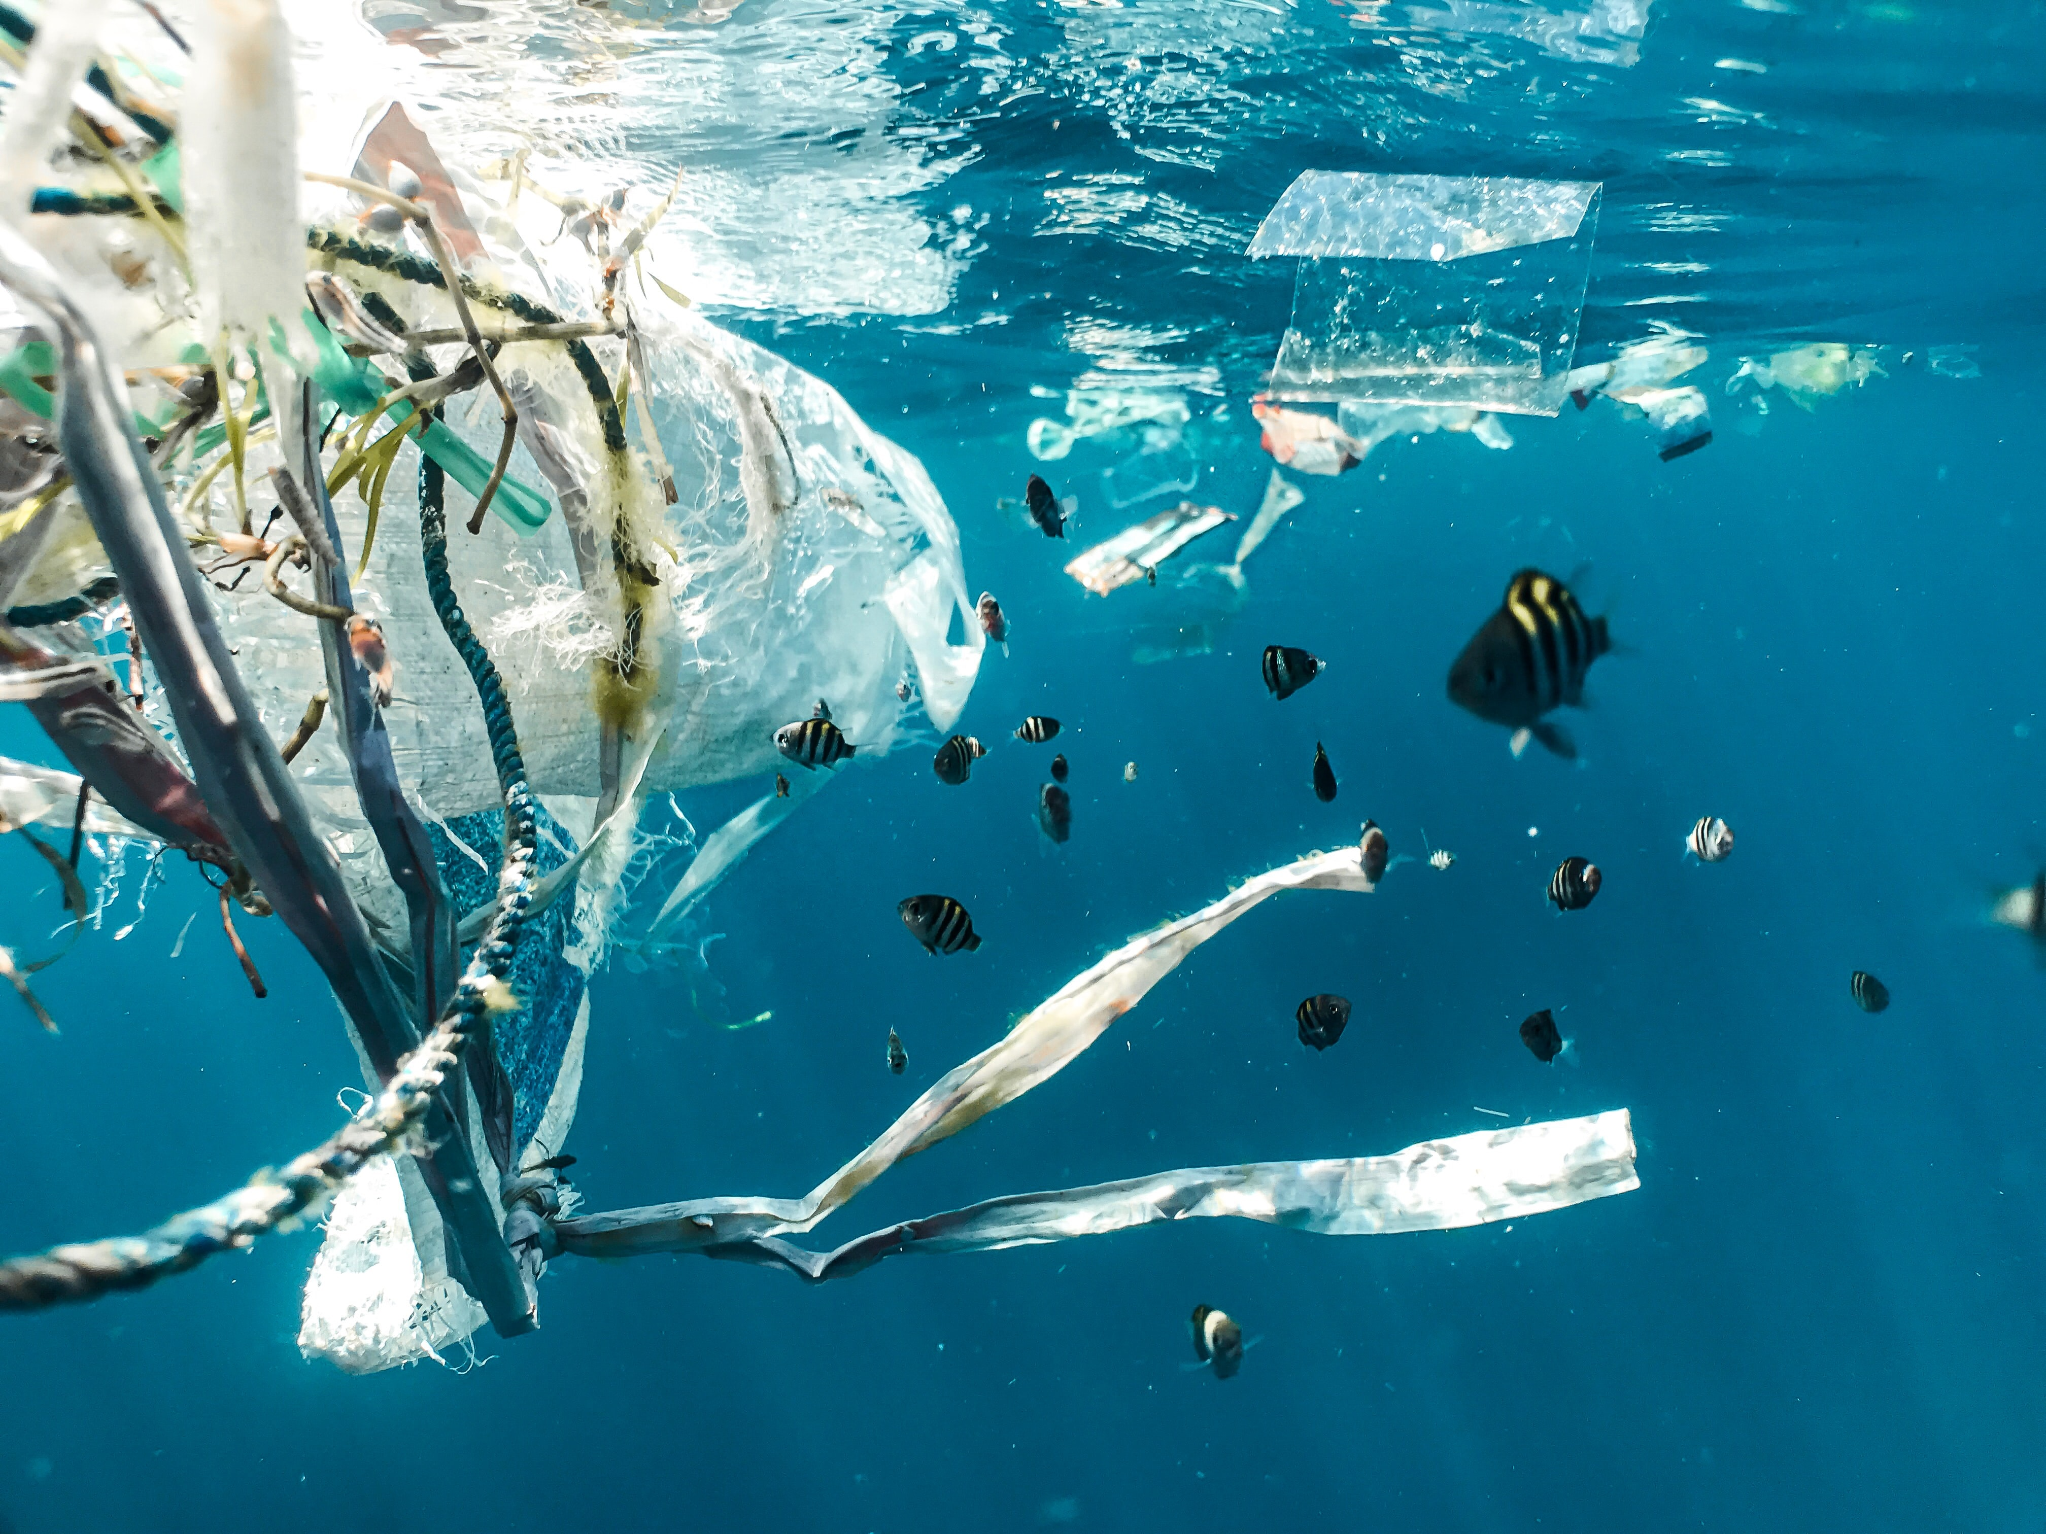
BACKGROUND
Plastic pollution has been found everywhere in the environment
Plastic clean-up technologies are crucial in the fight against plastic pollution
14 prevention technologies (Schmaltz, et al.2020)
39 collection technologies (Schmaltz, et al.2020)
https://unsplash.com/ photo of: Naja-Bertolt-Jensen

Slide 3
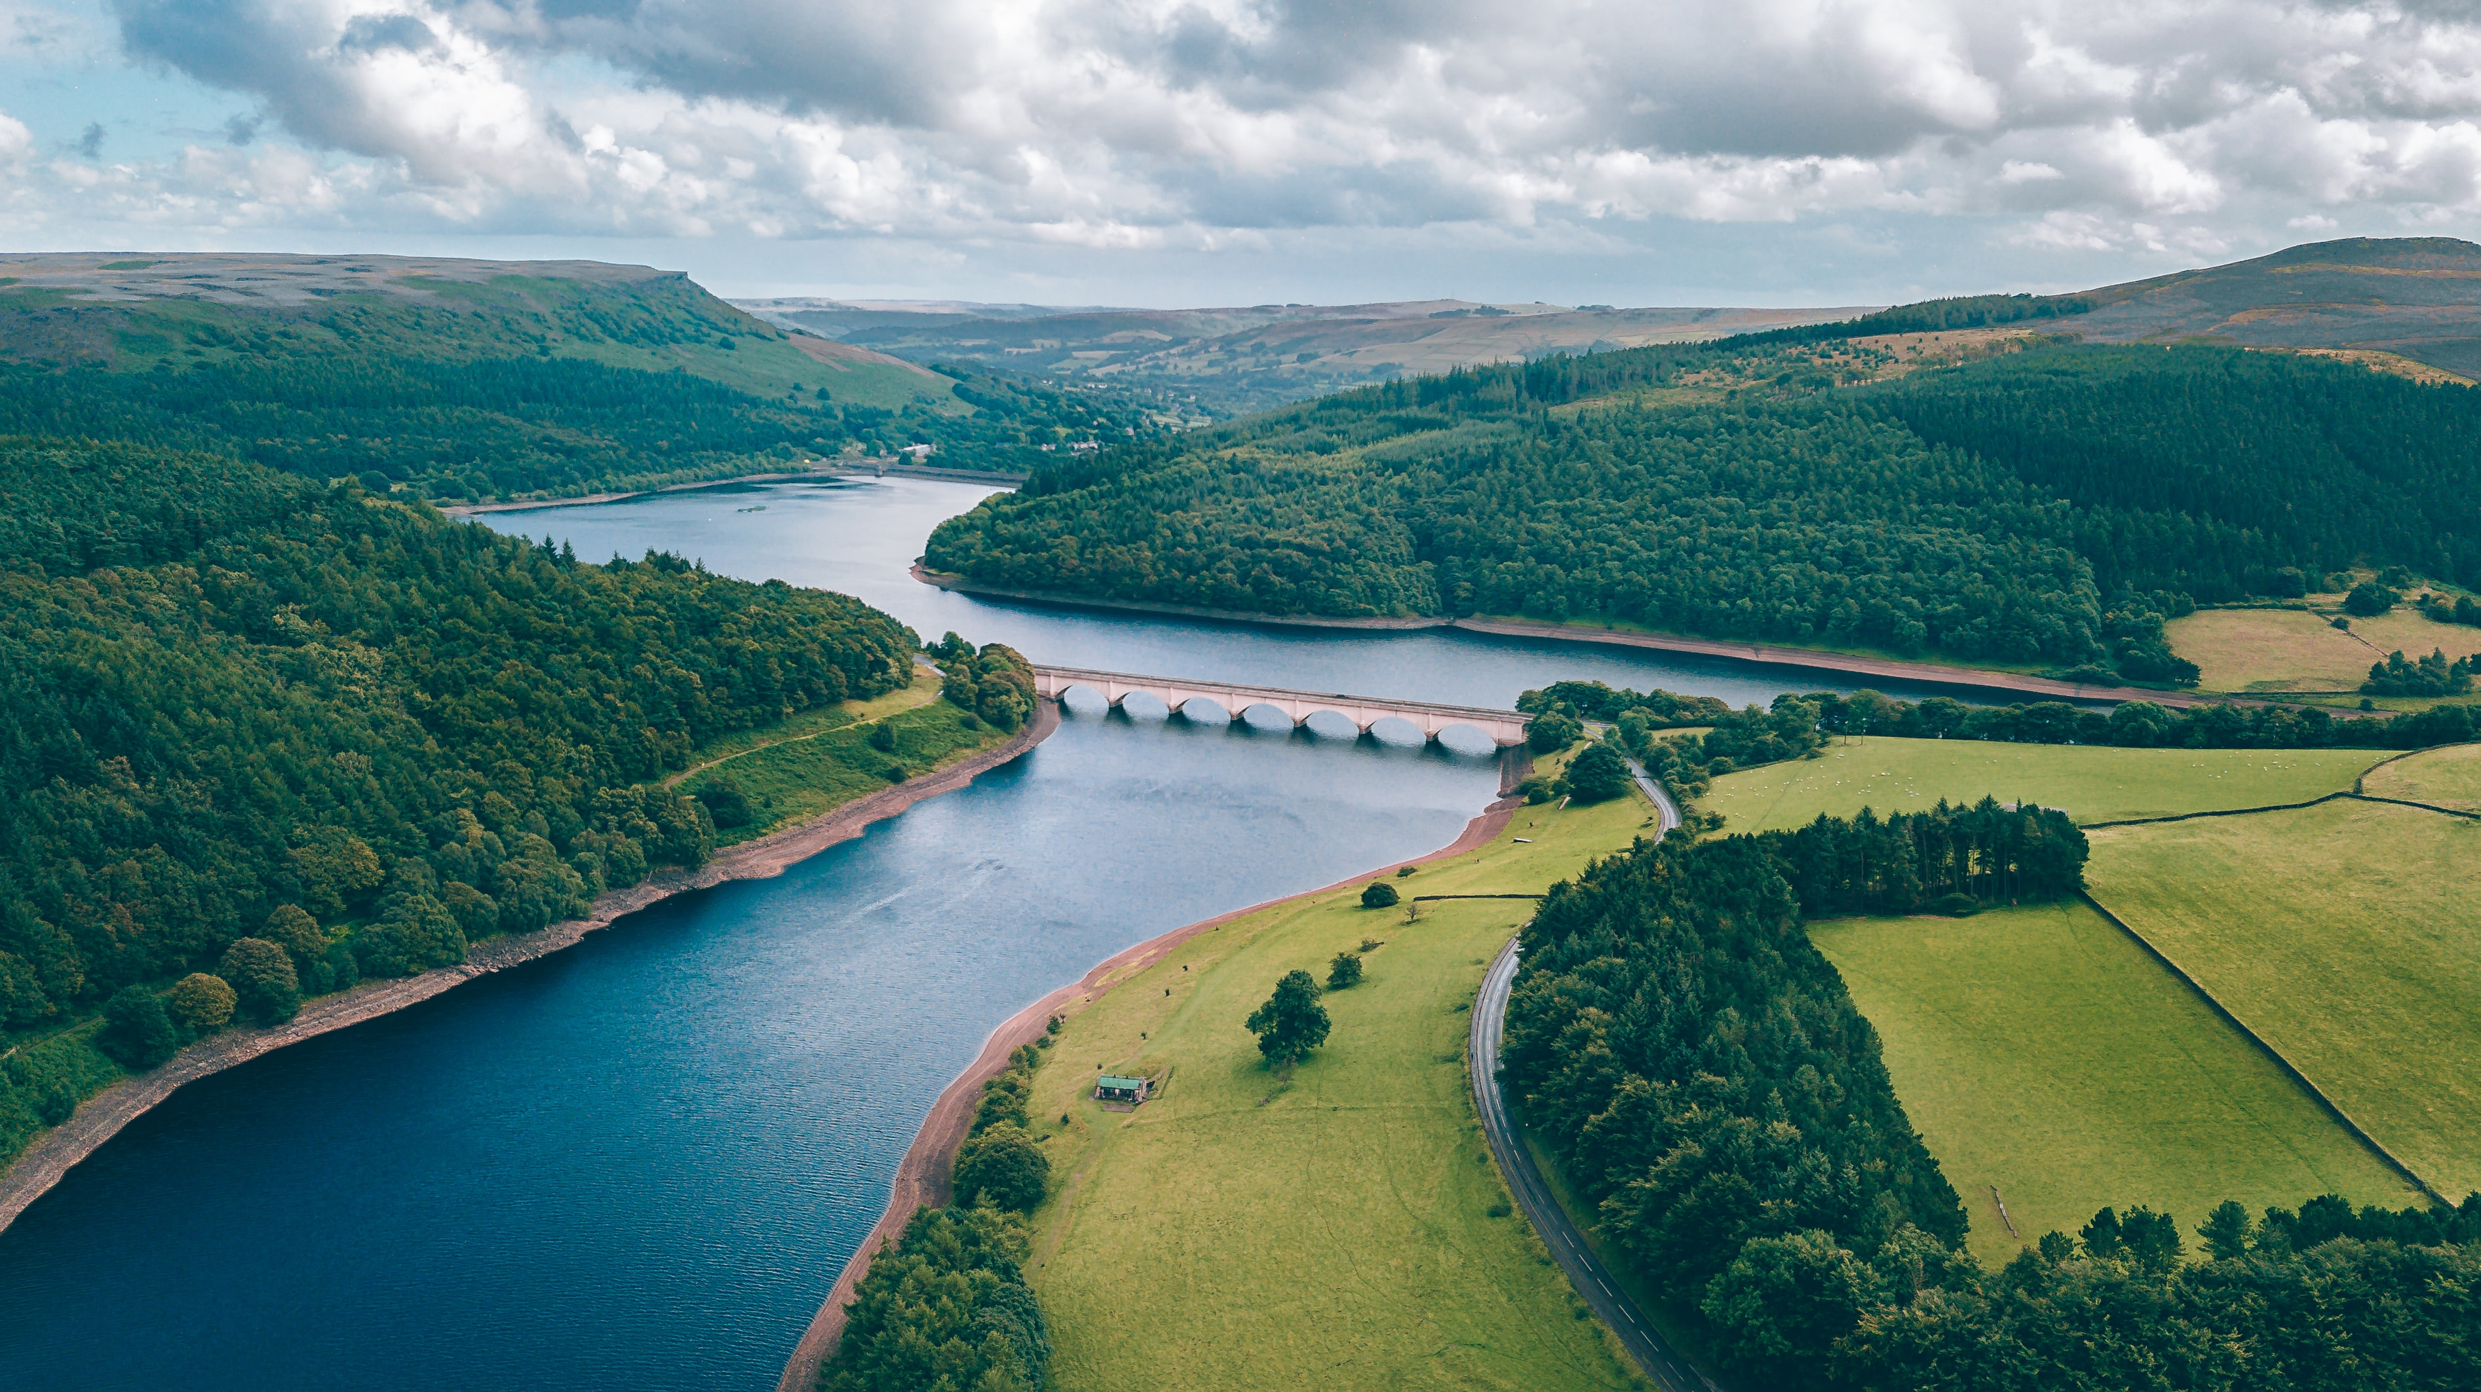
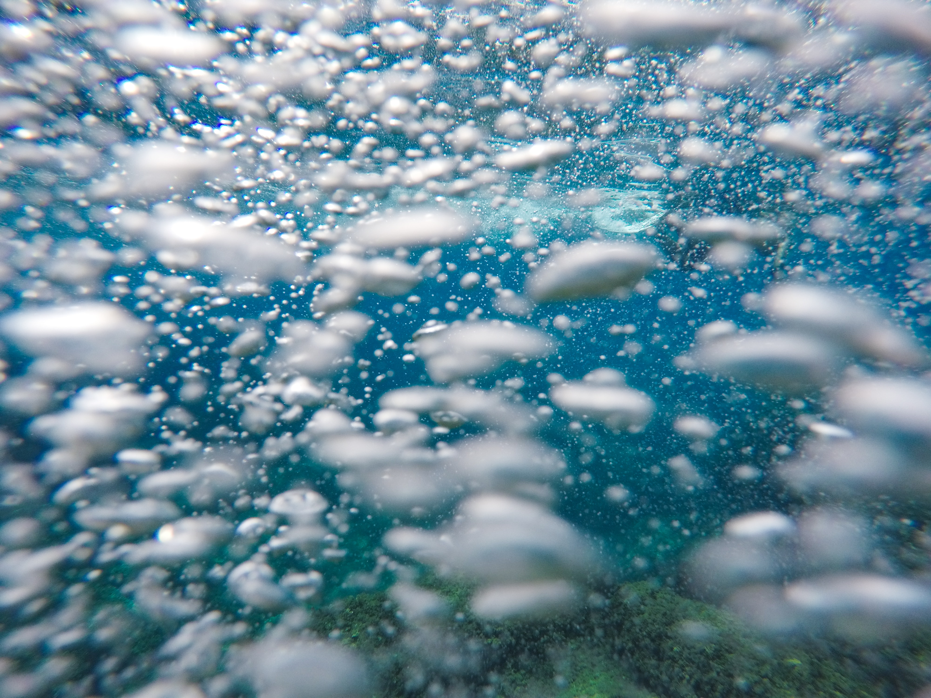
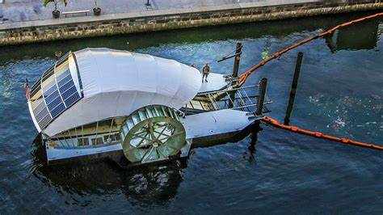

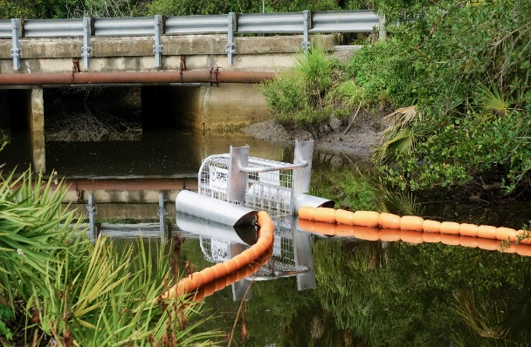
BACKGROUND
Rivers are a major way of transport of plastic with approximately 1.15 and 2.41 million tones of plastic moving to the ocean every year (Lebreton et al., 2017)
Multiple clean-up mechanisms to collect plastics in rivers and estuaries, before they reach the marine environment, where they would be harder to remove
Curtain of air bubbles
Photo credit: Vincenzo di-Giorgi (https://unsplash.com/ )
Wheels
Photo credit: Dicklyon via Wikimedia Commons, https://commons.wikimedia.org/wiki/File:Mr._Trash_Wheel--Baltimore_MD.jpg
Boats
Photo credit: Esteban Chinchilla (https://unsplash.com/ )
Booms
Photo credit: The Tampa Bay Estuary Program (https://unsplash.com/ )
https://unsplash.com/ photo of: Matthew Feeney

Slide 4
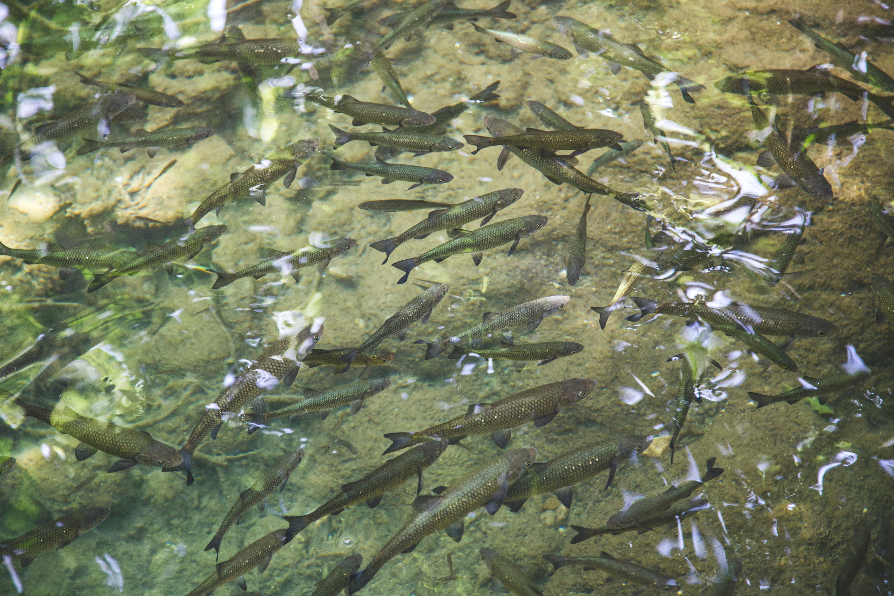
BACKGROUND
Rivers and estuaries are fundamental spawning and nursing grounds for commercially relevant and endangered species
+
Provide fundamental life support system for humans
Careful consideration has to be made when deploying any man-made device
https://unsplash.com/ photo of: Milada Vigerova

Slide 5


KNOWLEDGE GAP & RESEARCH AIMS
KNOWLEDGE GAP & RESEARCH AIMS
? Possible environmental impact of plastic clean-up technologies
To what extent and under which conditions biota and plastics are getting caught by plastic clean-up technologies
Support stakeholders in their selection of plastic clean-up technologies given local conditions
https://unsplash.com/ photo of: Fotis Fotopoulos / clipart from PowerPoint
https://unsplash.com/ photo of: Matthew Feeney

Slide 6

CLUSTERS OF PARAMETERS
River conditions (e.g., river flow)
Biota traits (e.g., size, shape, adhesiveness)
Plastic traits (e.g., size, shape, buoyancy)
Clean-up technology mechanisms (e.g., river booms, curtains of air bubble, water wheels)
Externalities (e.g., costs, legislations)
V
V
V
V
X
https://unsplash.com/ photo of:Chris Stenger
https://unsplash.com/ photo of: Matthew Feeney

Slide 7

ADVANTAGES BAYESIAN BELIEF NETWORS
Widely applied for river management purposes
Suitable for environmental management where uncertainty is a critical aspect
Simple causal graphical structure
Integration of multiple data types
https://unsplash.com/ photo of: Fotis Fotopoulos

Slide 8
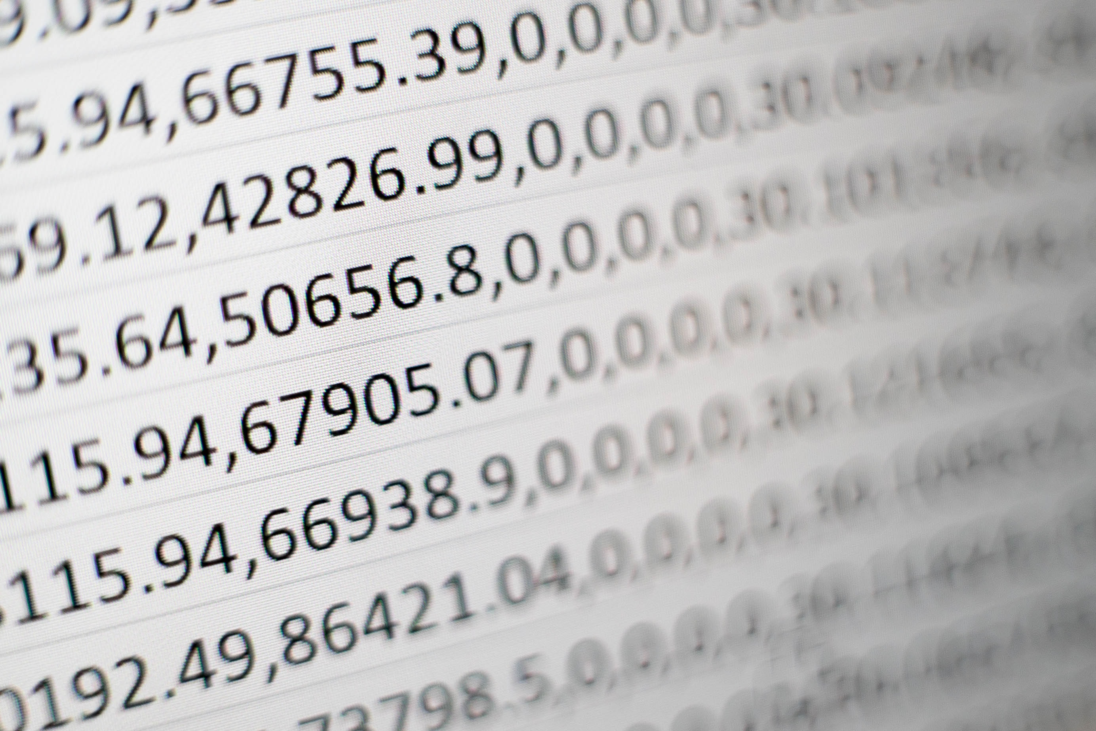
DATA COLLECTION
Existing data – scientific & grey literature to investigate the selected parameters
Expert knowledge – clean-up companies
Mesocosm experiments – artificial flume, prototypes, plastics and biota
https://unsplash.com/ photo of: Mika-Baumeister

Slide 9
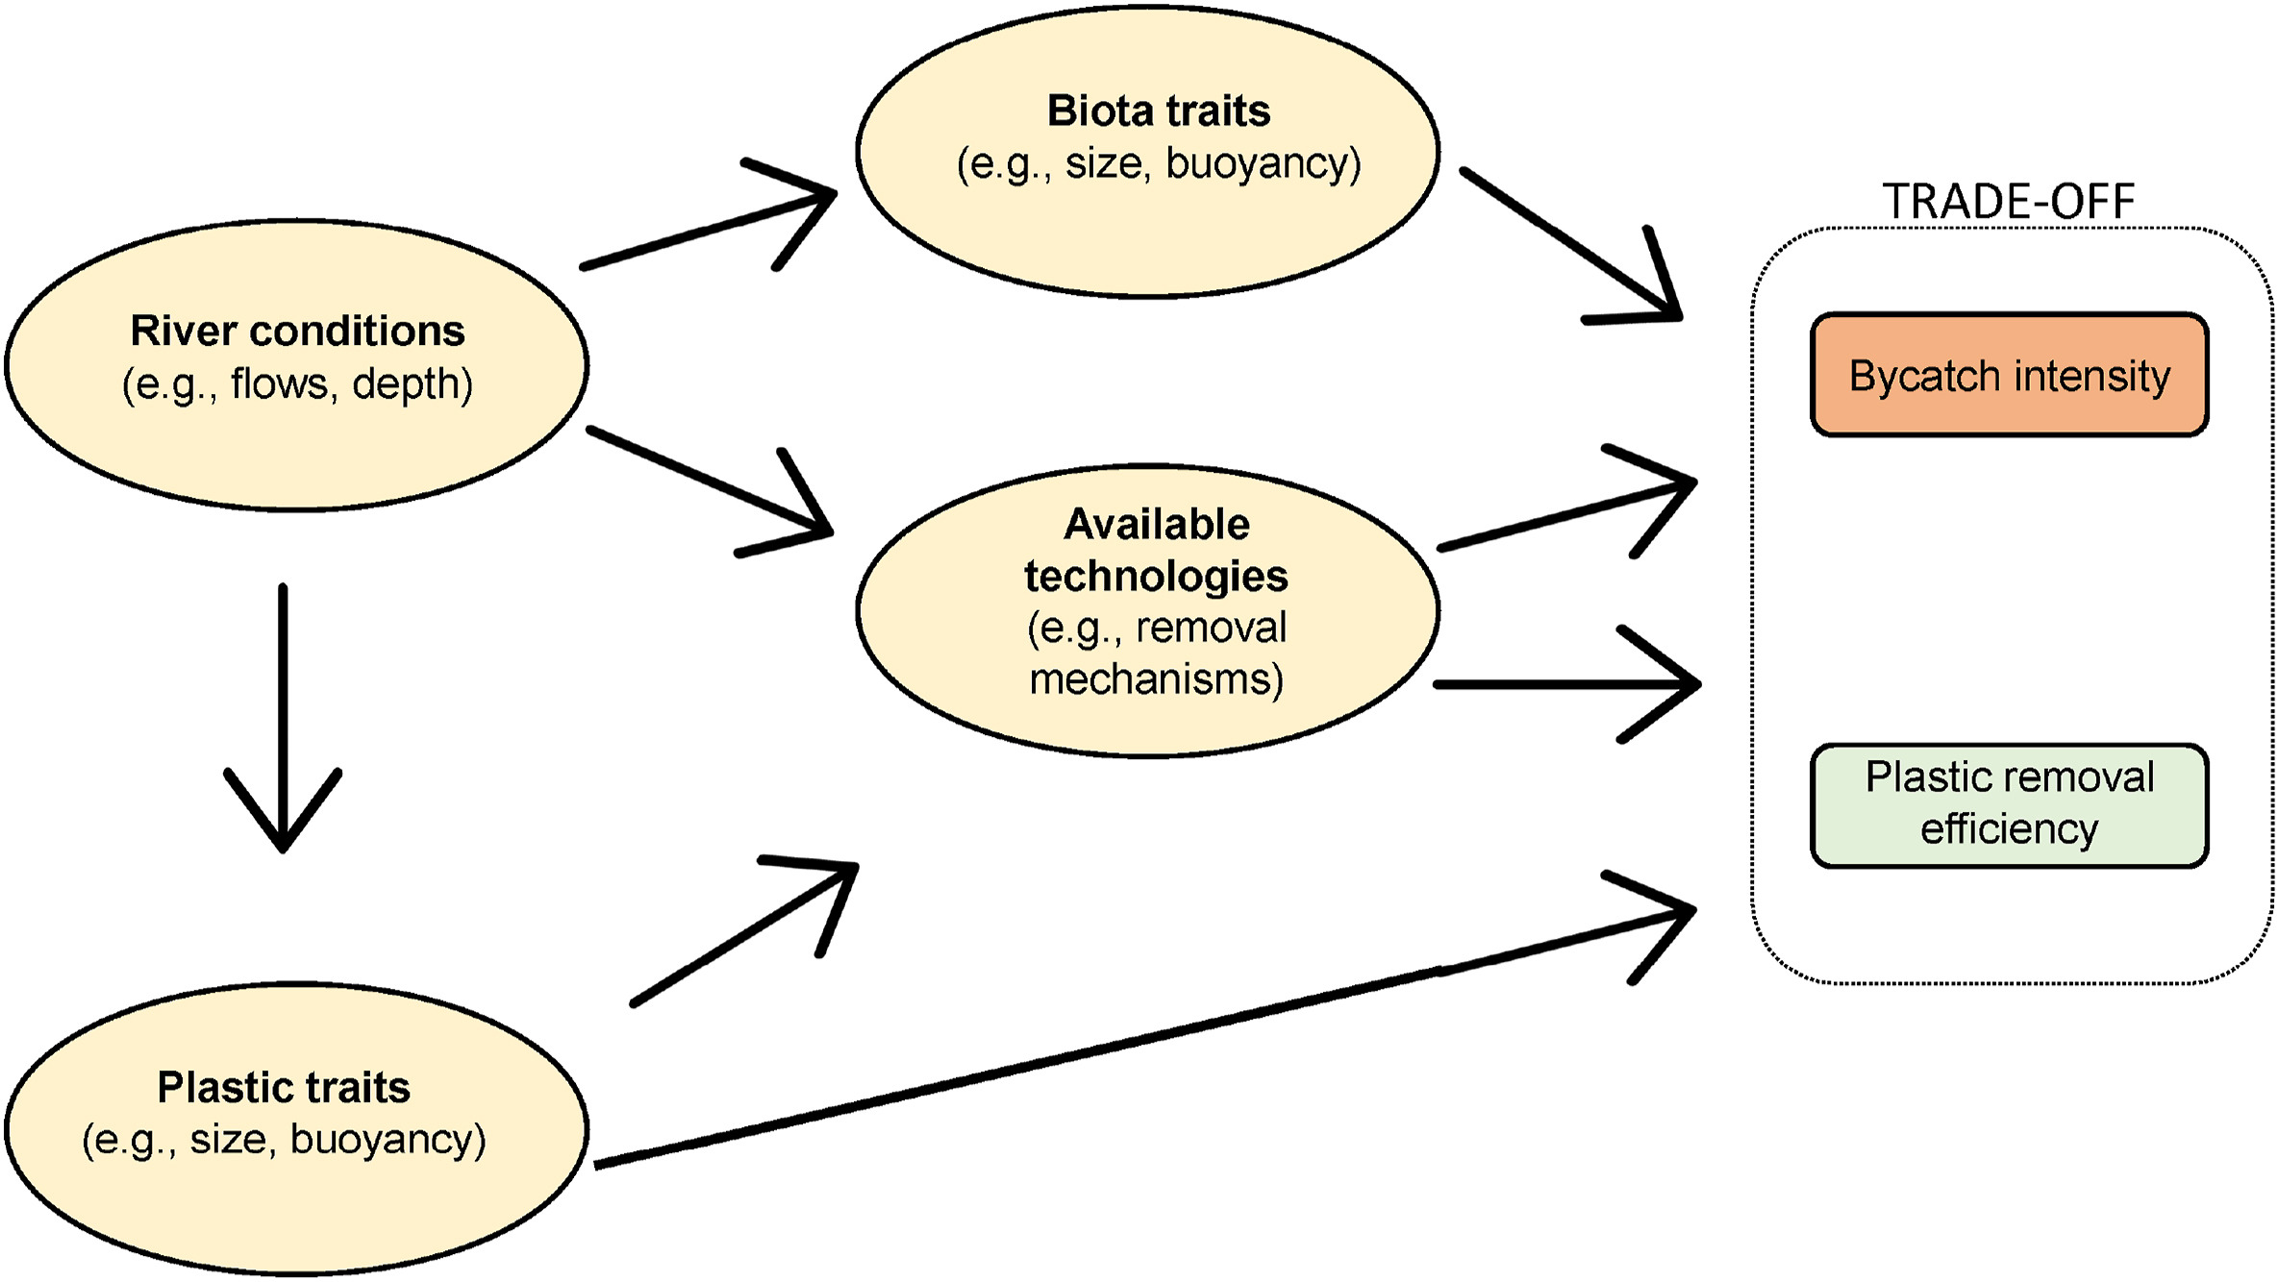
BAYESIAN BELIEF NETWORKS AS TRADE-OFF TOOL BETWEEN PLASTIC AND BIOTA REMOVAL
https://unsplash.com/ photo of: Matthew Feeney
Information flow for Bayesian Belief Network as a trade-off between bycatch intensity and plastic removal efficiency
(from Leone et al., 2022, https://doi.org/10.1016/j.envpol.2021.118721 CC BY NC ND).

Slide 10
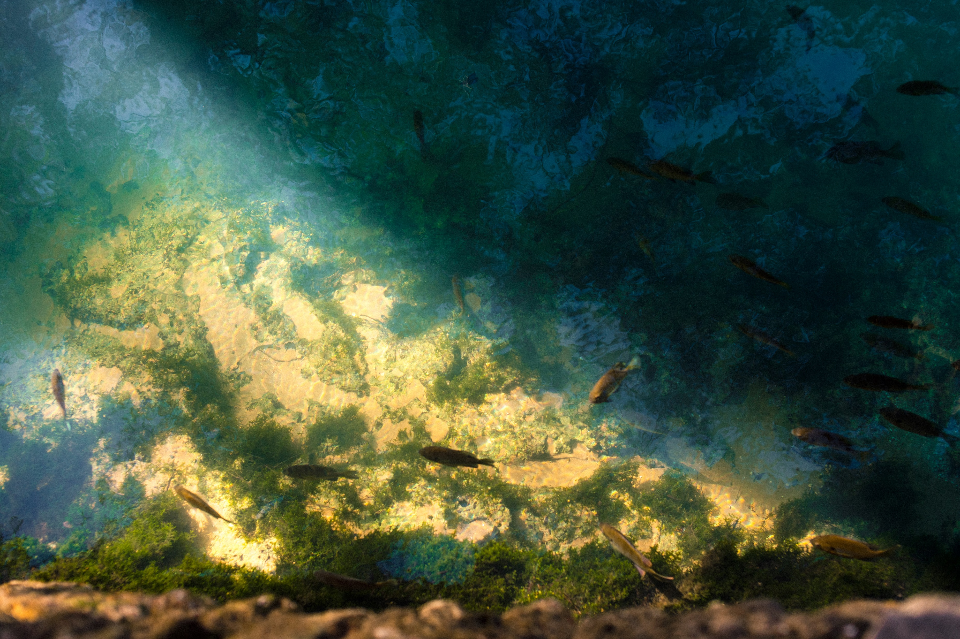
KEY POINTS
Crucial role of plastic clean-up technologies
Rivers and estuaries are important spawning and nursing grounds
Careful consideration needs to be made when deploying man-made structures
Multiple variables might play a role in the chances of plastics or biota being collected: 4 clusters of parameters
Probabilistic models, in particular Bayesian Belief Networks, as a trade-off tool between plastic and biota removal
https://unsplash.com/ photo of: Jordan Whitfield

Slide 11
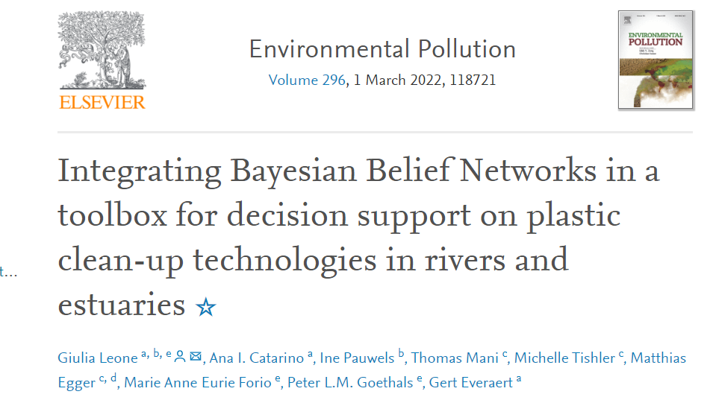


FOR EXTRA INFORMATION
ADDITIONAL QUESTIONS, SUGGESTIONS, COMMENTS:
giulia.leone@ugent.be
giulia.leone@vliz.be
http://linkedin.com/in/giulialeone
FOR REFERENCE & EXTRA INFO:

