Slide 1
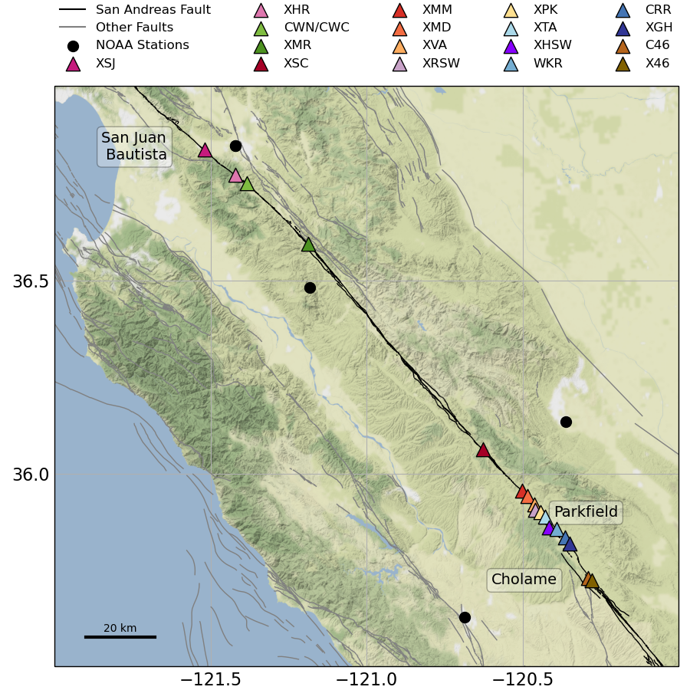
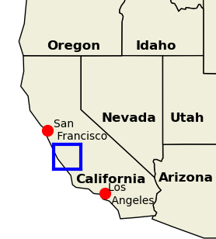





Human resources slide 3
Characterizing the rupture extent of creep events on the San Andreas Fault
Study Area
Daniel Gittins & Jessica Hawthorne| daniel.gittins@earth.ox.ac.uk|@Tees_Seis|EGU22-4107
The San Andreas Fault (black) has been observed to be creeping at the surface between San Juan Bautista and Cholame since the 1960s.
Two >100-km-long locked sections bound the creeping section.
Smaller (M≈6) earthquakes also occur near the edges of the creeping section, yet, no major (M≥7) earthquake has ever been reported within this creeping section.
Abstract here
Notes:
Locked section north of San Juan Bautista last ruptured in the 1906 Mw7.9 San Francisco and 1989 Mw6.9 Loma Prieta earthquakes
Southern locked section south of Cholame last ruptured in the 1857 Mw7.9 Fort Tejon earthquake.

Slide 2
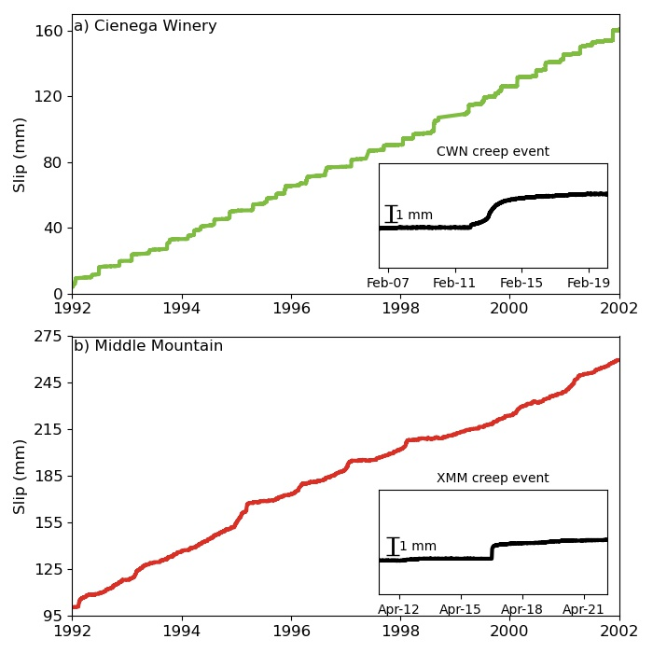
Human resources slide 3
Creep Events
San Andreas Fault is heavily instrumented with creepmeters, strainmeters, GPS, alignment arrays etc.
Creep events are few-mm bursts of slip, lasting a few hours to days that recur every few weeks to months.
Notes:
Instruments reveal that creep does not accumulate at a steady rate but in bursts known as creep events.
Despite creep events being abundant and observed since the 1960s we do not know:
How spatially large most creep events are.
The fault zone process that causes creep events.
Important to understand these events as they may play a key role in the physics of creeping faults that may then have a wider implication for understanding of fault physics which is important to consider in hazard assessment.

Slide 3
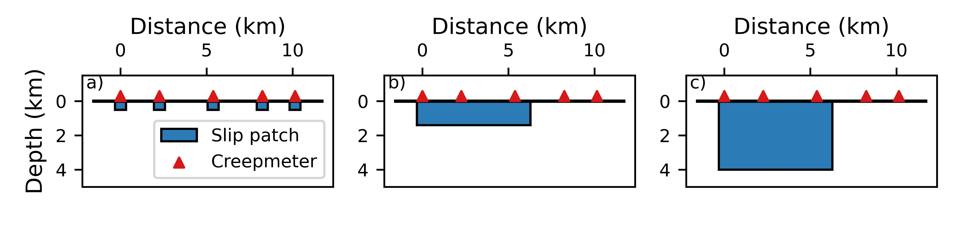
Human resources slide 3
How big are creep events?
Important to know how large creep events are as this changes their importance in the slip dynamics of the creeping section.
Three creep event size scenarios. a) Short, shallow ruptures. b) Long, shallow ruptures. c) Long, deep ruptures
Notes:
Two part investigation into the spatial extent of creep events.
Using 18 USGS creepmeters to determine the along-strike rupture extent of creep events

Slide 4
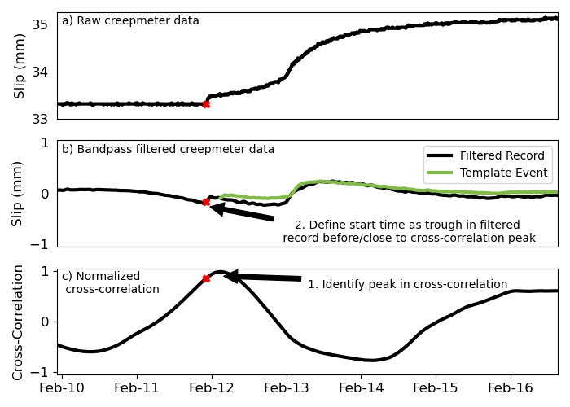
Human resources slide 3
Identifying Creep Events at Individual Creepmeters: Automated Detection
First step to determining the spatial extent of creep events is to know when they occur.
Automated detection using cross-correlation to identify creep events in the creepmeter record.
Notes:
Possible through visual inspection but extremely time-consuming.
Identified times of similarity to template that also have significant slip.

Slide 5
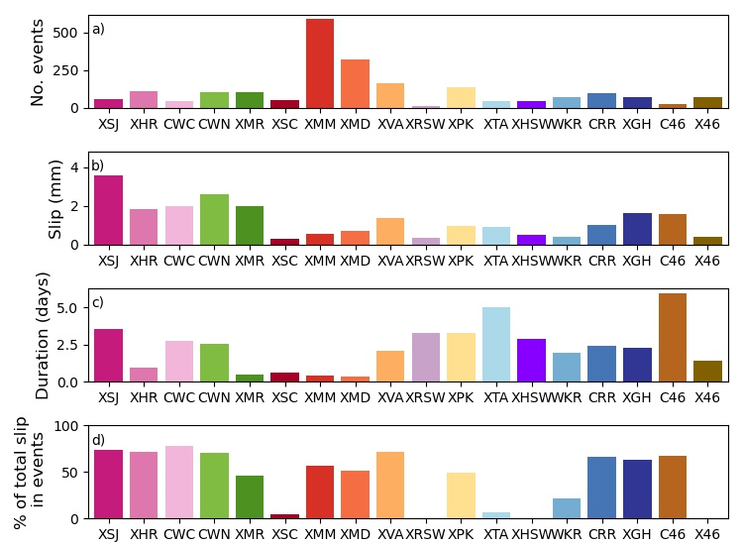
Identifying Creep Events at Individual Creepmeters: Results
North
South
Few events but larger and longer.
Lots of small and short events.
Creep events accommodate over 50% of slip observed at the surface for most creepmeters.
Creepmeters

Slide 6
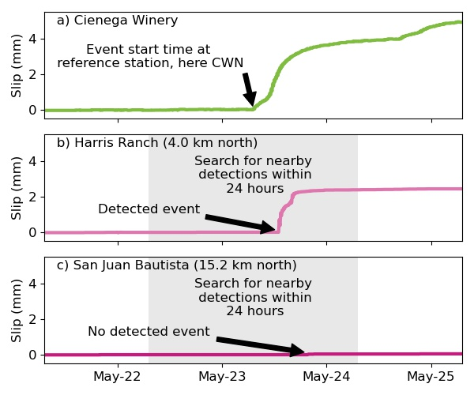
Human resources slide 3
Identifying Correlated Events Between Creepmeters
11km
4km
Second step in determining the spatial extent of creep events is to correlate events along-strike at different creepmeters.
Notes:
Identified the coincident timing of creep events within 24 hrs of an event at another, leading to the detection of 306 possible larger creep events recorded at two or more creepmeters.
Systematically search for/ and calculate percentage of events at other creepmeters within 24hrs of an event at the ‘main’ creepmeter.
24 hrs chosen as it allows for a balance between robust statistics and slowly propagating creep events. > 24hrs can get duplicate correlations, especially in the few years after the 2004 Parkfield Earthquake in which recurrence interval of creep events is reduced. < 24hrs will exclude the slowly propagating creep events.

Slide 7
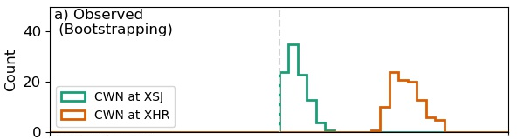
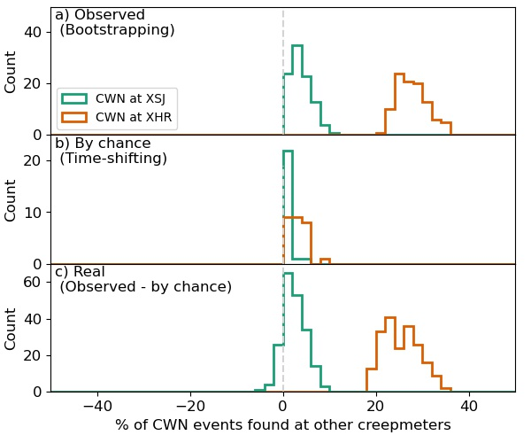
Human resources slide 3
Estimating the Frequency of Multi-creepmeter Ruptures
Bootstrapped to get uncertainty on the percentages of correlated events.
Randomly time-shifted creep events to understand if they are coincidently timed by chance.
Subtracted b) from a) to determine the percentage of truly connected events.

Slide 8
Human resources slide 3
Estimating the Frequency of Multi-creepmeter Ruptures
The percentage of CWN-XSJ events is around zero so coincident events are likely to be unrelated.
The percentage of CWN-XHR events is around 25, meaning that coincident events are related.

Slide 9
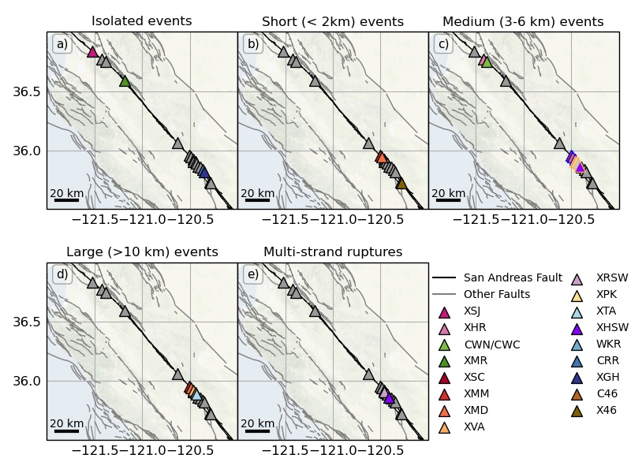
Human resources slide 3
Summary of Creep Event Behaviours
creepmeter not involved.

Slide 10
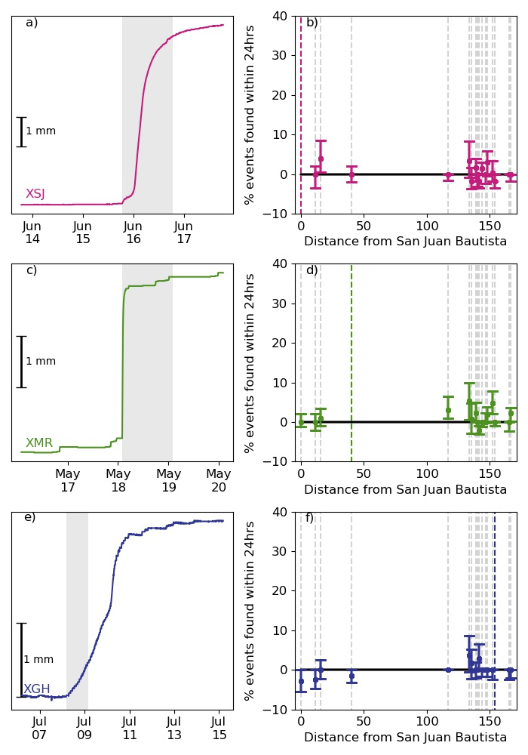
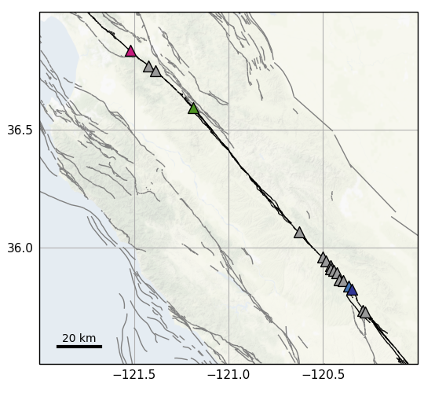
Human resources slide 3
Isolated Events

Slide 11
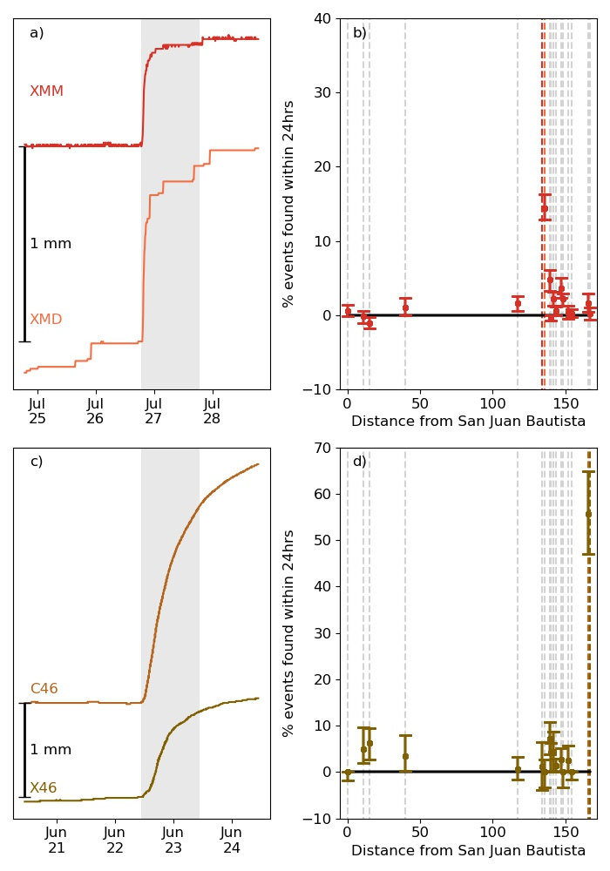
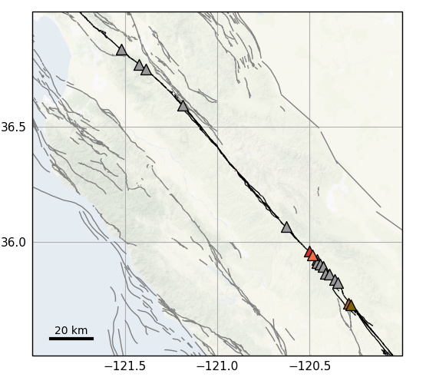
Human resources slide 3
Small Events (2 km or less) Recorded at Two Creepmeters

Slide 12
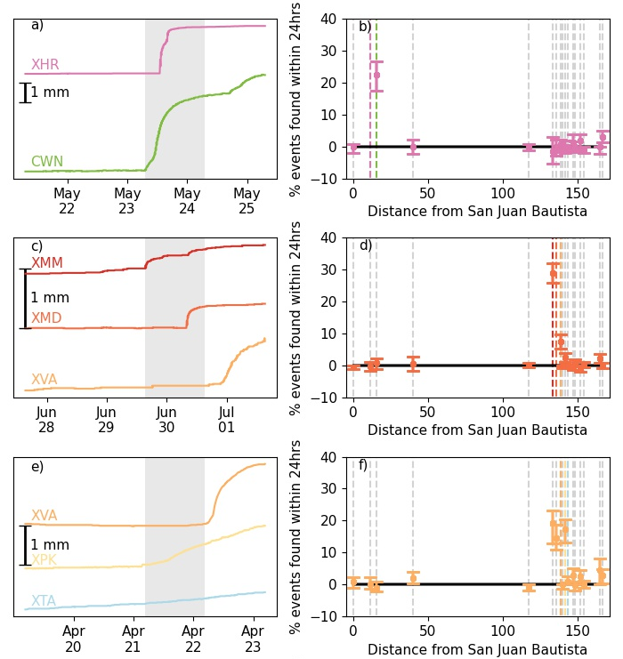
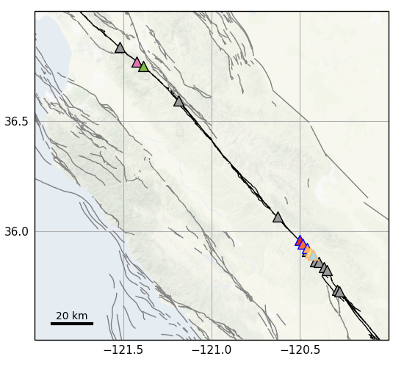
Human resources slide 3
Medium-sized Events (3 – 6km) Recorded at Two or Three Creepmeters

Slide 13
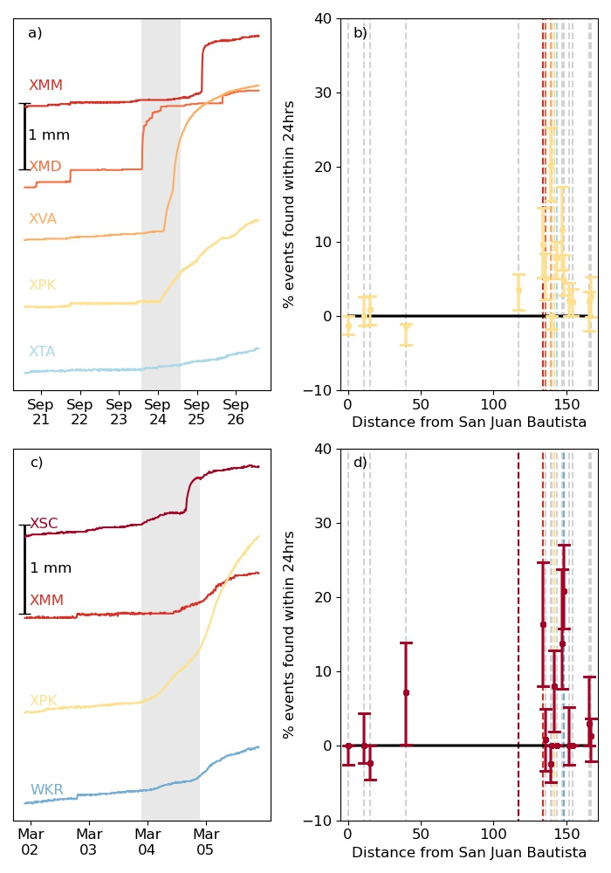
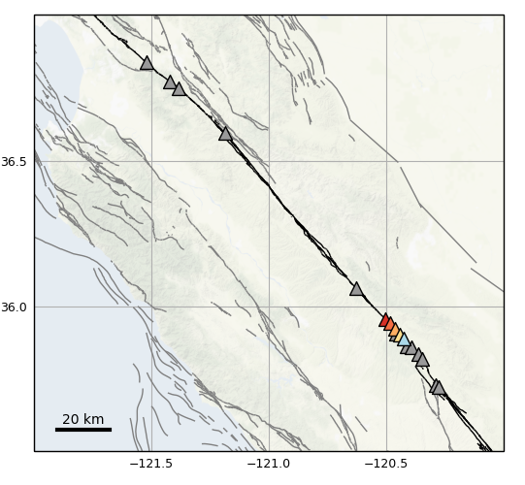
Human resources slide 3
Large Events (10 km or more), Sometimes Skipping Creepmeters

Slide 14

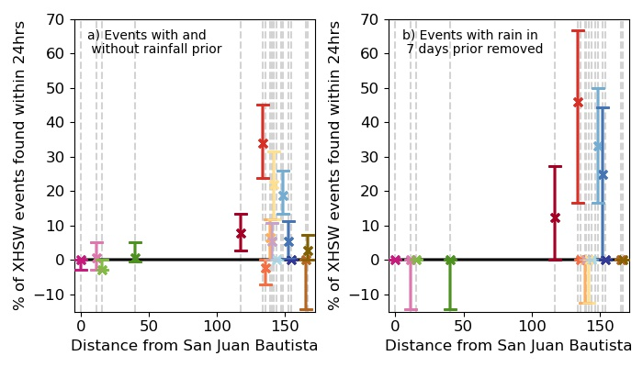
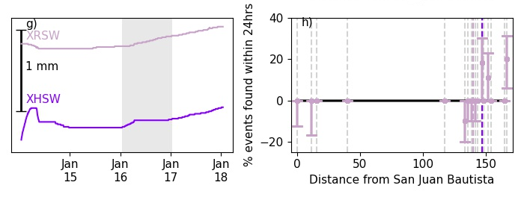
Human resources slide 3
Multi-strand Ruptures

Slide 15
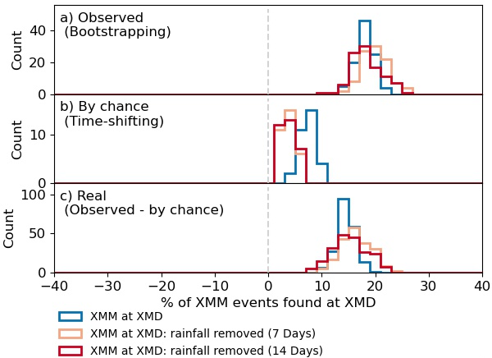
Human resources slide 3
Removing Short-term Rainfall Effects
Need to identify whether events are driven tectonically or are as a result of rainfall perturbations.
Repeat the analysis to account for short-term rainfall effects.
Remove creep events from the main creepmeter that have rainfall in the 3, 7, and 14 days prior.
Allows for the interpretation of the frequency of multi-creepmeter ruptures in the light of rainfall.
Notes:
Only look on short-timescales as seasonal variations are accounted for in our statistical analysis (shifting only by multiples of years)
Rain can drive creep events by providing a ‘kick’ to a shallow portion of the fault that has nominally stable rheology and low resistance to slip at near-surface low-stress condition.
The range of thresholds we used is longer than this to allow for varying timescales of rain infiltration as this is not a well-known quantity. Although fairly arbitrary, these timescales provide an ability to look at the broad overview of the effect of rainfall on the propagation of creep events within our statistical framework.

Slide 16
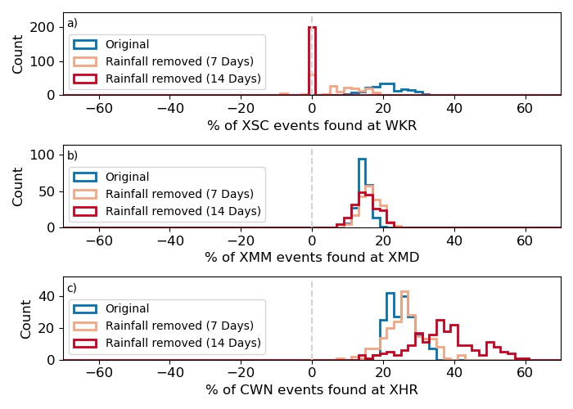
Human resources slide 3
Short-term Rainfall Influence on Creep Events
Affected by rainfall.
Unaffected by rainfall.
Percentage increase when rainfall removed.
Notes:
Affected by rainfall.
Expect closely timed events to coincide due to rainfall rather than a larger creep event connects the creepmeters.
Unaffected by rainfall.
Lack of change in closely spaced events implies that creep events respond minimally to rainfall.
Percentage increase when rainfall removed.
Small shallow events at XHR and CWN are triggered by rainfall.
Removing rainy intervals leaving only deeper large creep events that span both creepmeters.

Slide 17
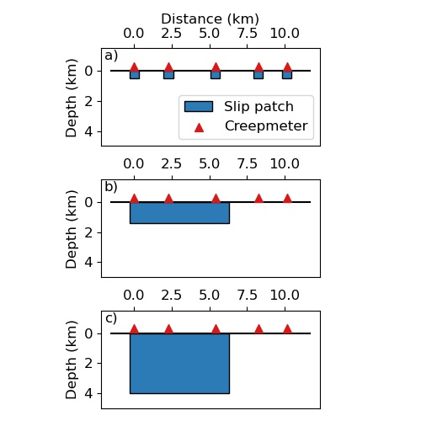


Conclusions
Daniel Gittins & Jessica Hawthorne| daniel.gittins@earth.ox.ac.uk|@Tees_Seis |EGU22-4107
Conclusions
Identified and correlated 2120 creep events recorded on creepmeters along the creeping section of the San Andreas Fault between 1985 and 2020.
Identified 306 potential multi-creepmeter events, spanning various along-strike lengths.
The vast majority of these events are not correlated with rainfall.
Lack of correlation of many creep events with rainfall would suggest that rainfall is not the driving force for all creep events.
Next steps are to determine the depth of these creep events using strainmeters as well as modelling the shape of creep events using different rheological laws.
Paper QR code
For more information, and to access the creep event catalogue check out our paper available here:

Slide 18
Human resources slide 3
Future work
18
Determine the depth of creep events.
Model slip patches at different depth to recover a synthetic strainmeter record.
Discriminate between different driving process for creep events.
Determine the duration and slip of creep events by modelling the shape of creep events using different rheological laws.
Notes:
Determine the depth of creep events:
Model slip patches at different depth to recover a synthetic strainmeter record.
Compare the synthetic strainmeter record to the observed strainmeter record in order to constrain the depth of the creep events observed in the Harris Ranch – Cienega Winery area.
Discriminate between different driving process for creep events:
Determine the duration and slip of creep events by modelling the shape of creep events using different rheological laws.
Identify scaling relationships for creep events to better understand the physical process that is causing them to occur.

