Slide 1




Spatial Structure of CIRs
Gergely Koban^{1,2},
Andrea Opitz¹, Zoltan Nemeth¹, Biro Nikolett¹, Akos Madar^{1,2}, Aniko Timar¹, Gabor Facsko¹
1 Wigner Research Centre for Physics, Budapest
koban.gergely@wigner.hu
2 Eötvös Loránd University, Doctoral School of Physics, Budapest
EGU22-4121

Slide 2
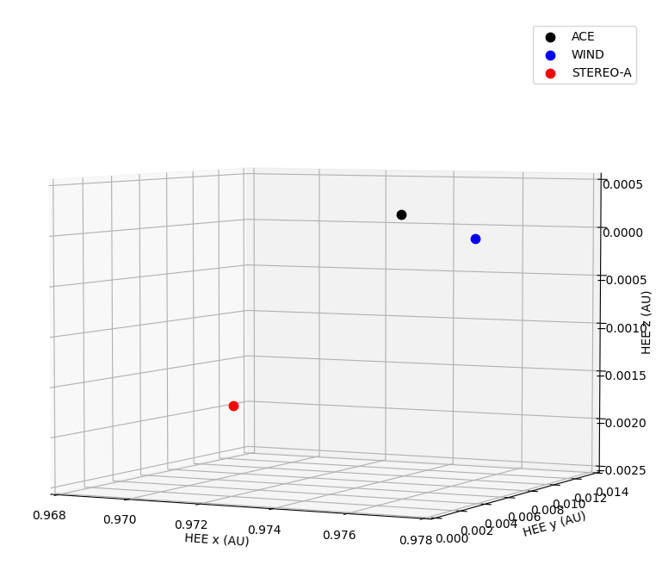
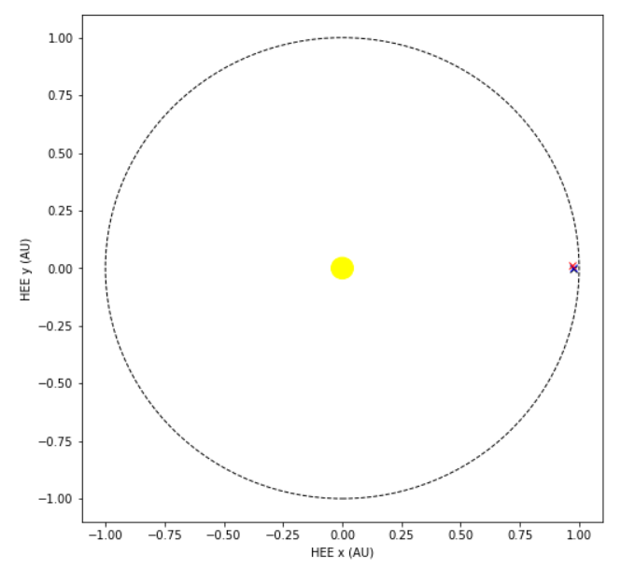

Motivation
Multispacecraft method → Spatial orientation of CIRs
SC at L1

Slide 3
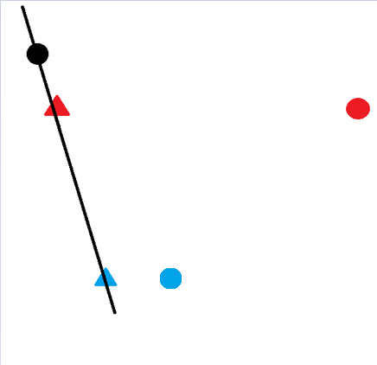
ACE, WIND, STEREO-A in 2007
Stream Interface
Correlation → Temporal delays
Shift positions
Calculate the plane

Slide 4
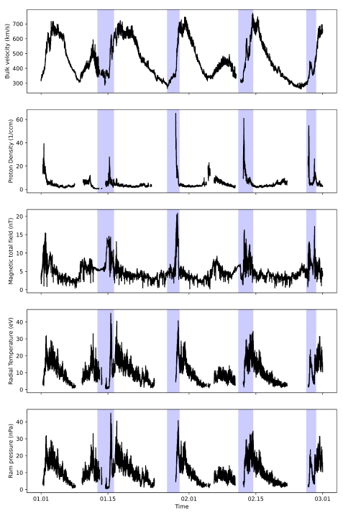
CIRs,
Stream Interfaces
V (km/s)
N (1/ccm)
B (nT)
T (eV)
P (nPa)
4 CIRs studied
in January-February of 2007

Slide 5
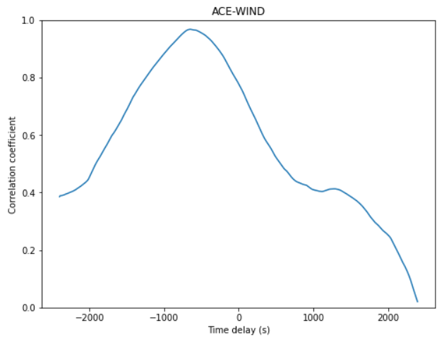
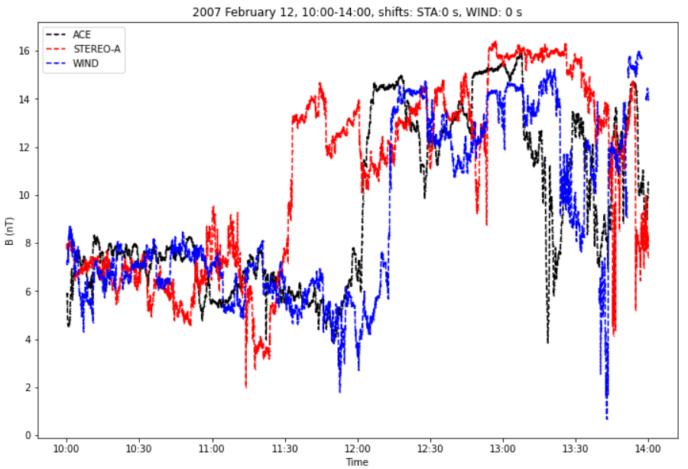
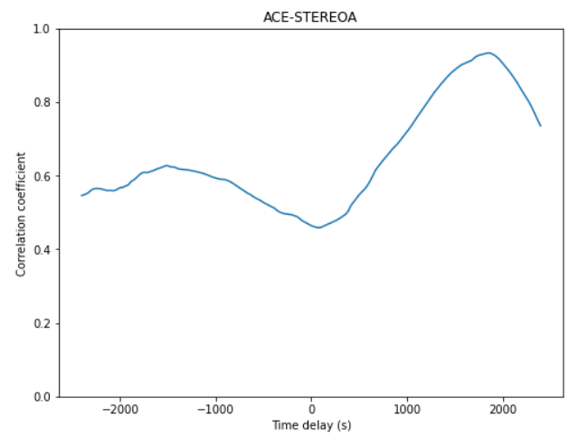
Correlation → Temporal delays

Slide 6
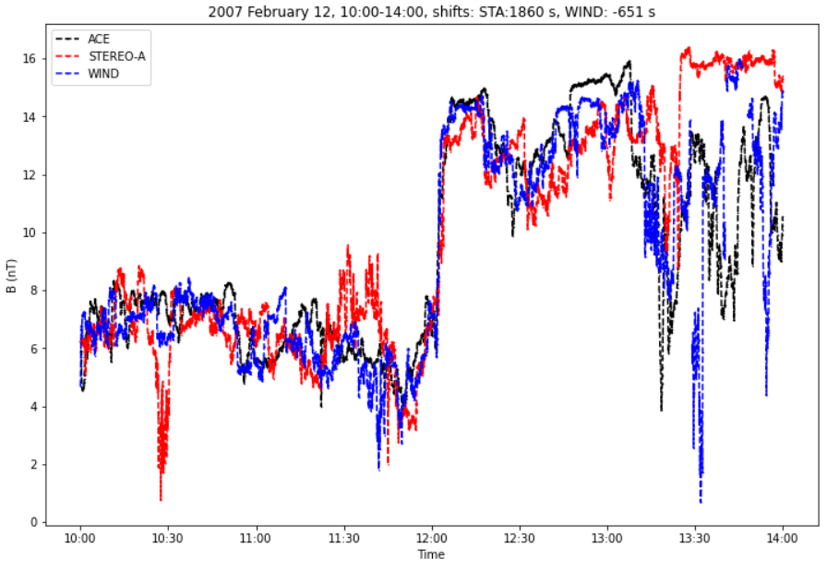
Time-shifted magnetic field observations

Slide 7
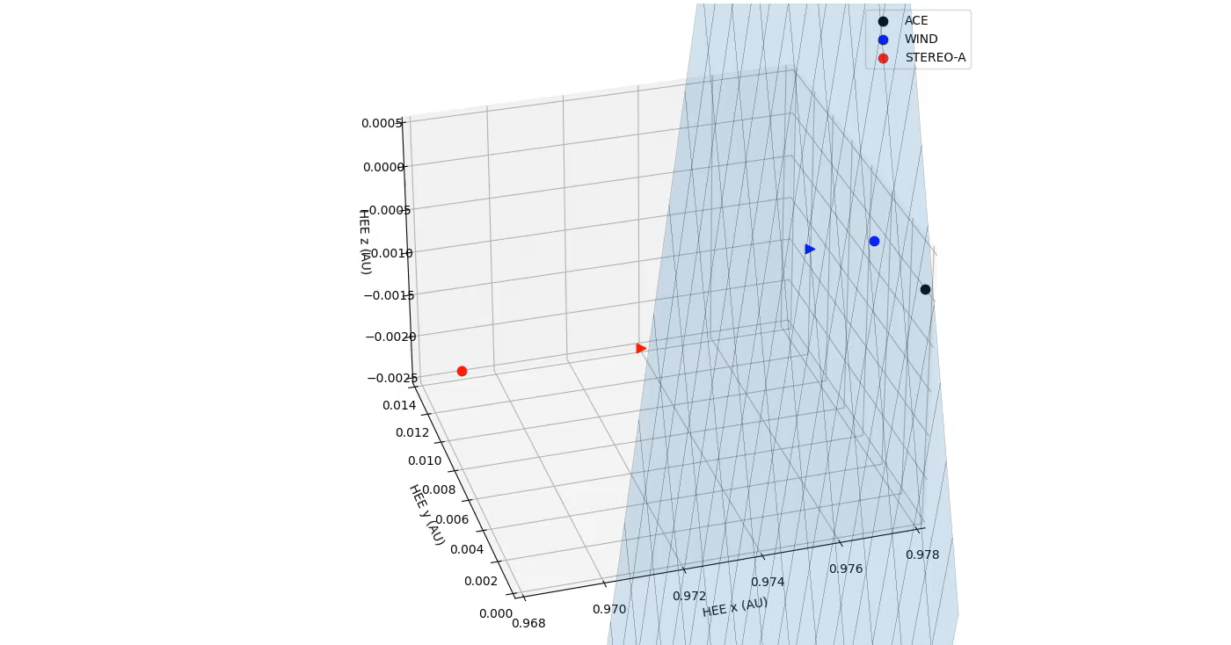
Stream Interface orientation of the CIR on 12 February 2007
[ 0.9188, 0.2555, -0.3005]

Slide 8


Thank you for your attention!
koban.gergely@wigner.hu
This work was supported by OTKA grant FK128548
EGU22-4121

