Slide 1

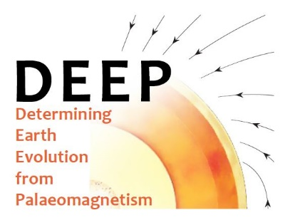


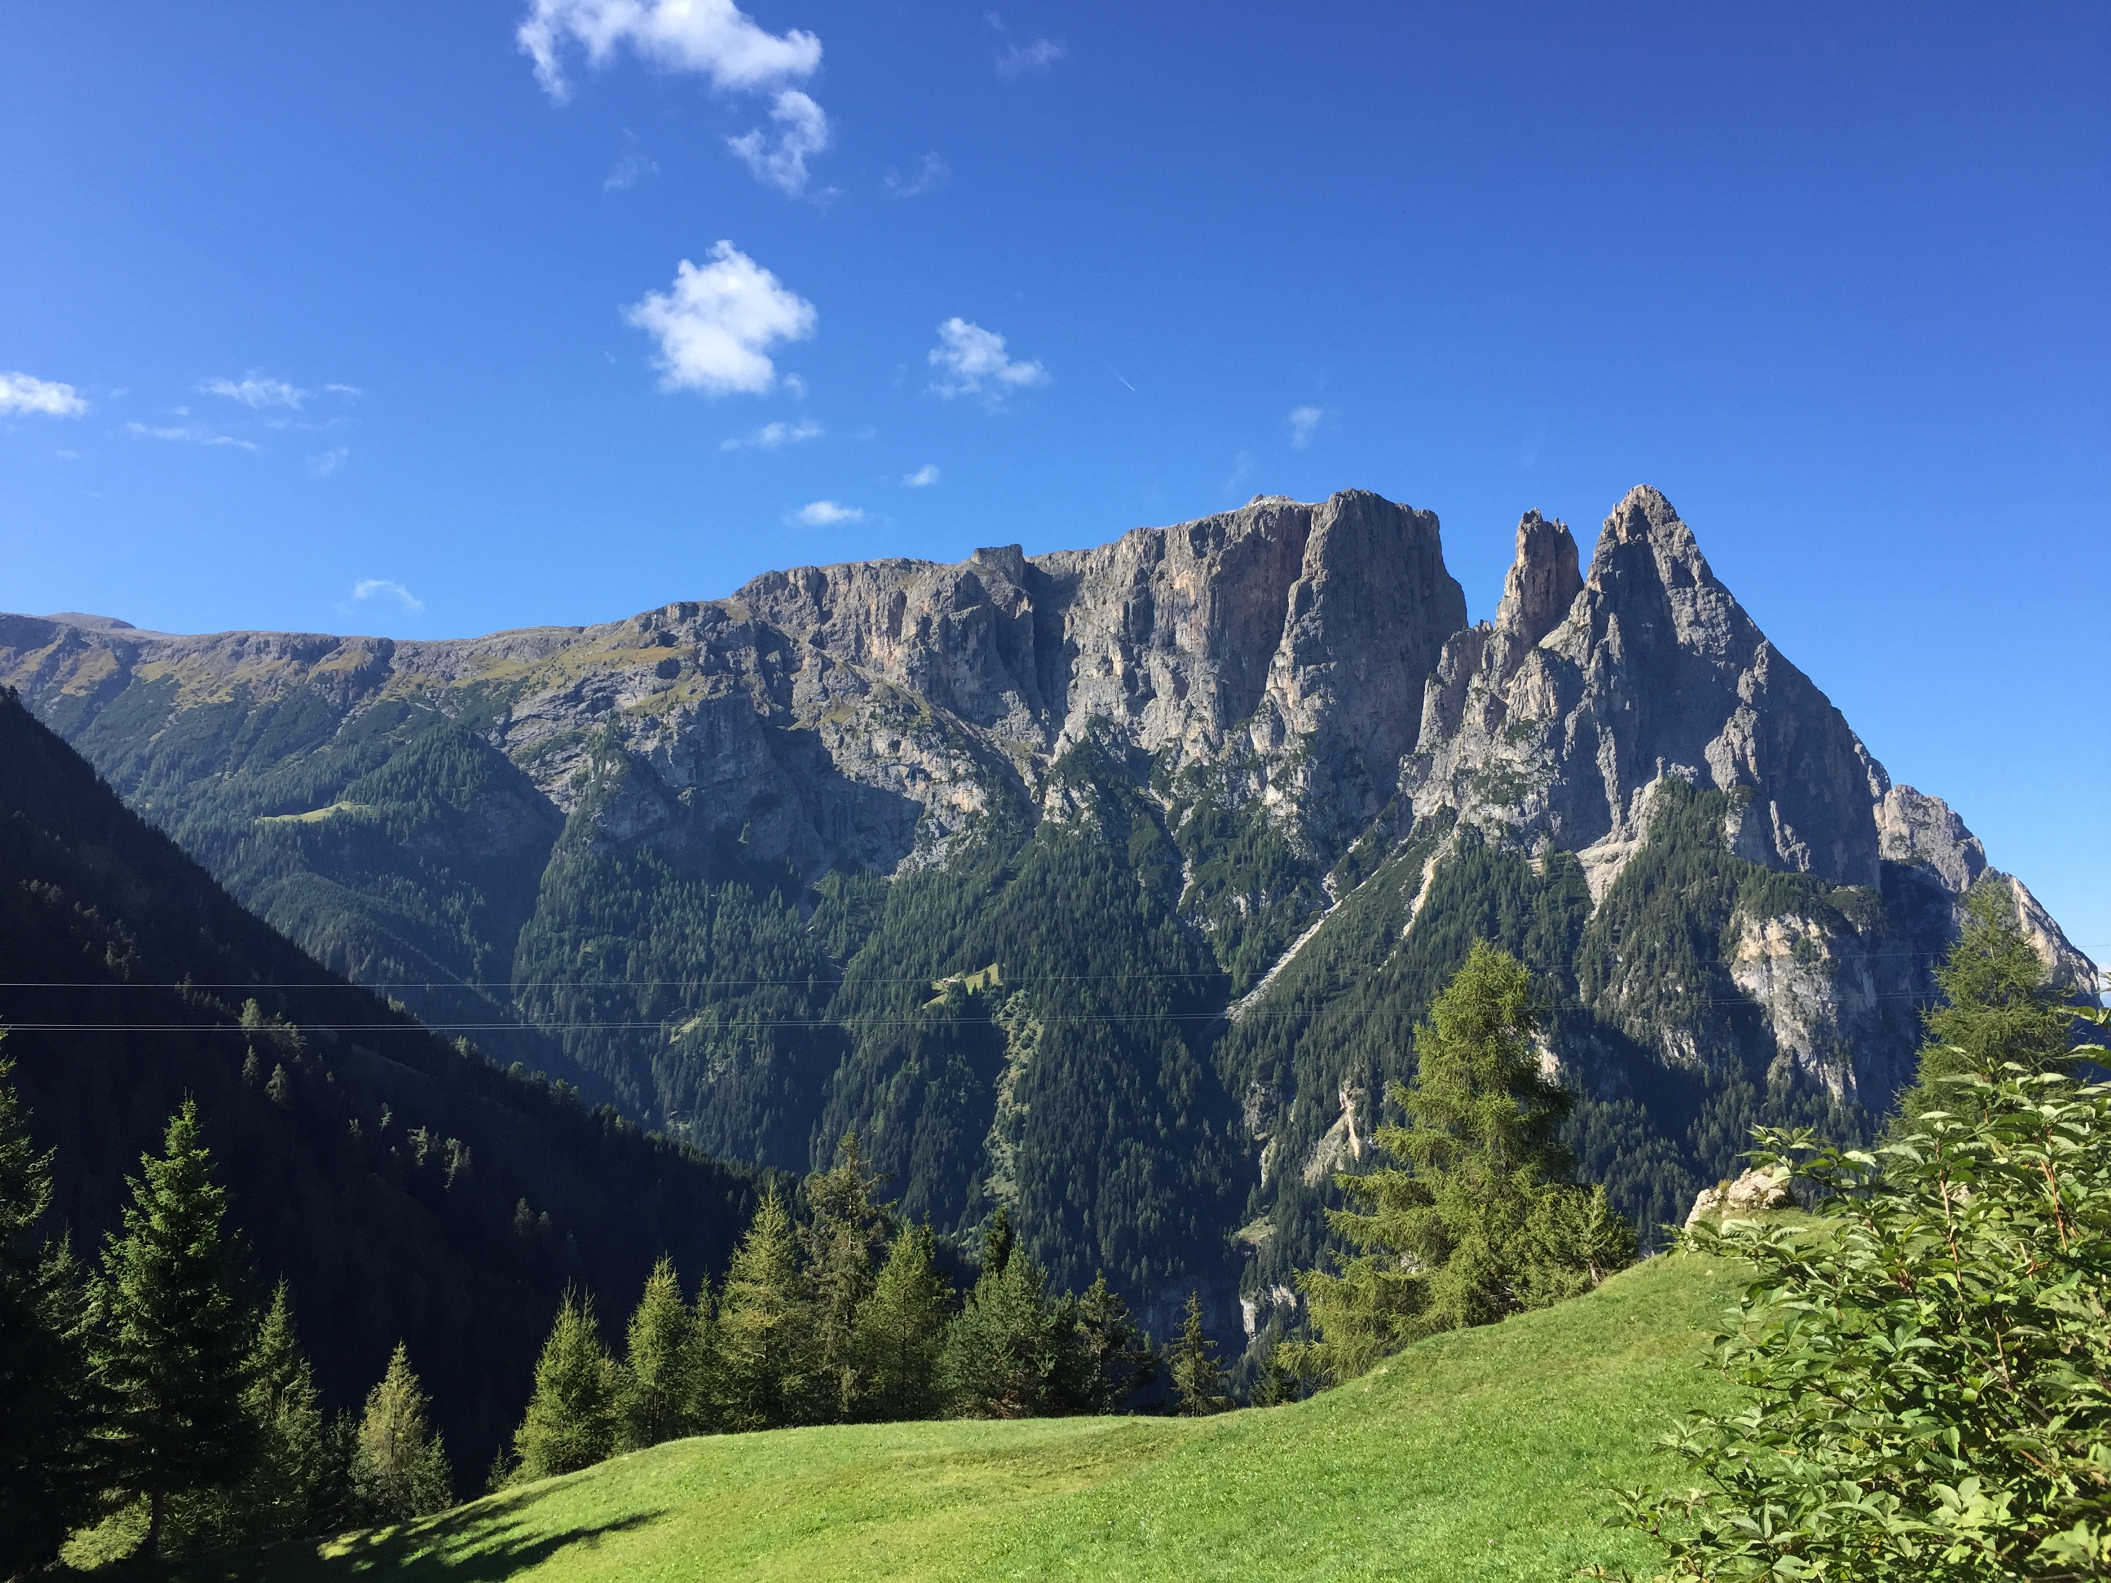
Characterising the Triassic Palaeomagnetic Field:
Palaeointensity estimates from the Dolomites, NE Italy
B.T. Handford, A.J. Biggin, A. van der Boon, B. Kugabalan
b.handford@liverpool.ac.uk

Slide 2
Background
Recent PSV studies:
Handford et al., (2021)
PCRS (318-265 Ma)
Post-PCRS (265-198 Ma)
Doubrovine et al., (2019)
Pre-CNS (198-126 Ma)
CNS (129-84 Ma)
Engbers et al., (submitted)
Miocene (23.0-5.3 Ma)
Cromwell et al., (2018)
Last 10 Ma
1
1
2
2
3
Average reversal frequency (Ma⁻¹)
PINT v8.0.0; Bono et al., (2021)
Average reversal frequency model; Handford et al., (2021)
Schwarz & Symons et al., (1968) Large age uncertainty (±30 Ma), & lack of modern palaeointensity methods
Eitel et al., (2014) Impact melt – potentially underestimated palaeointensity

Slide 3
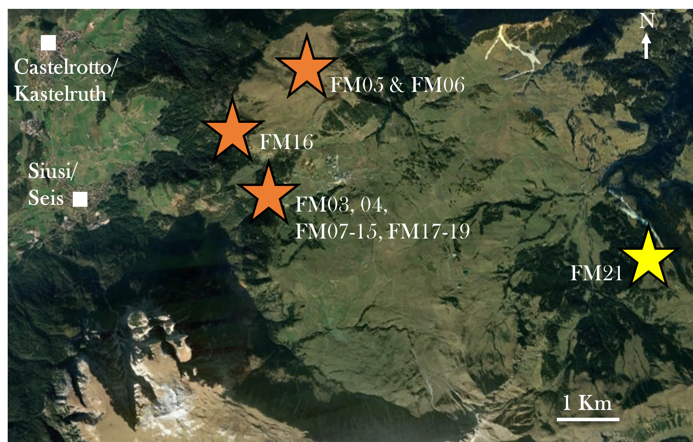
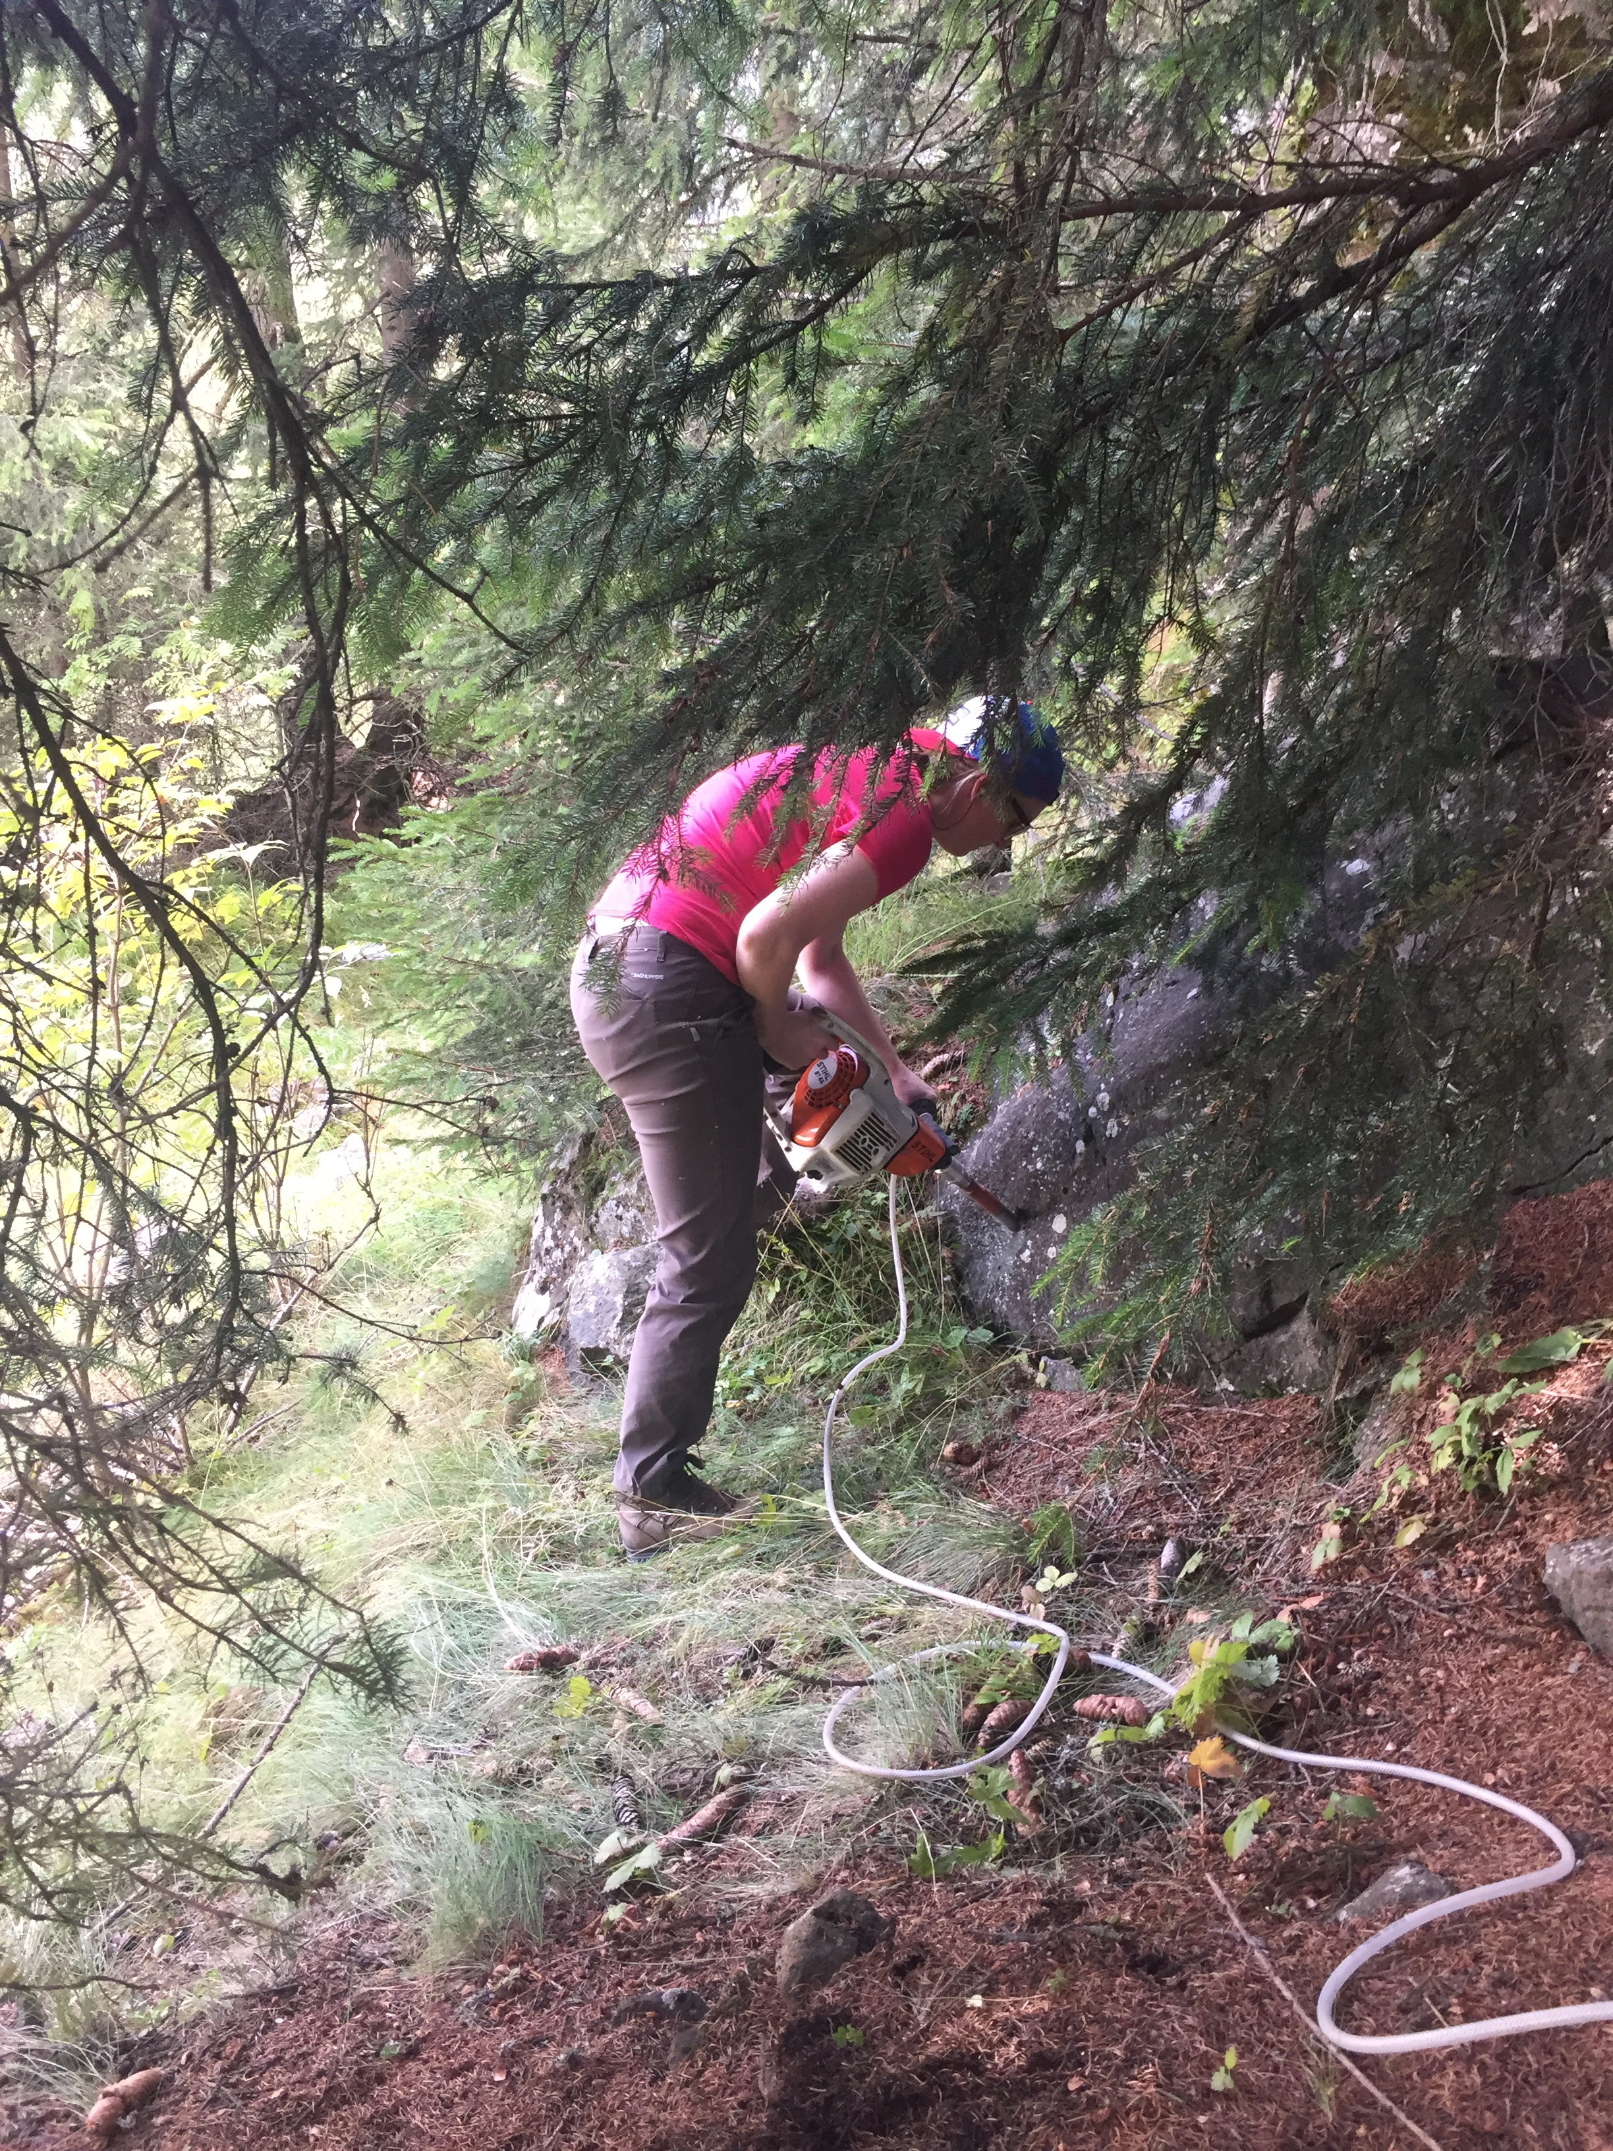
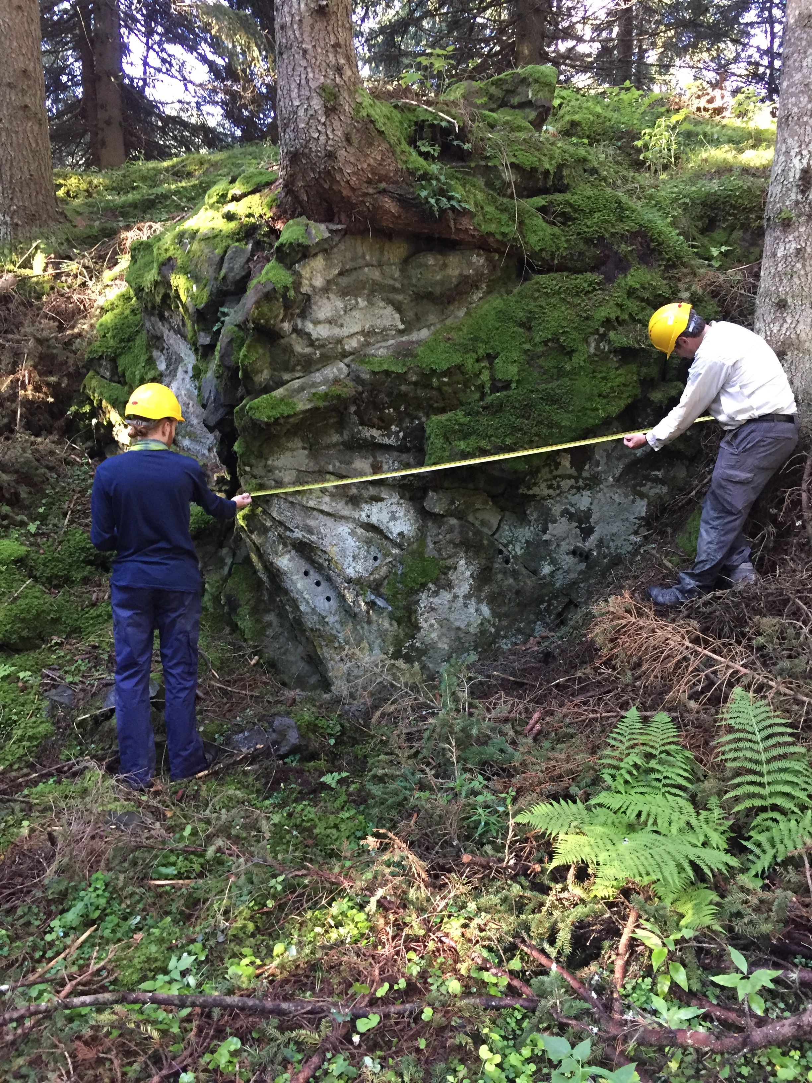
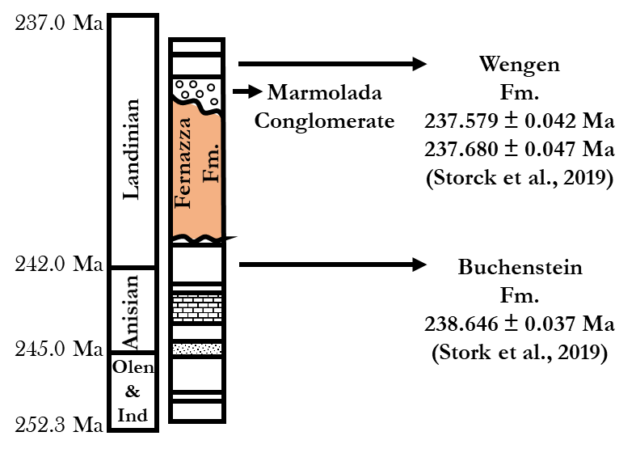
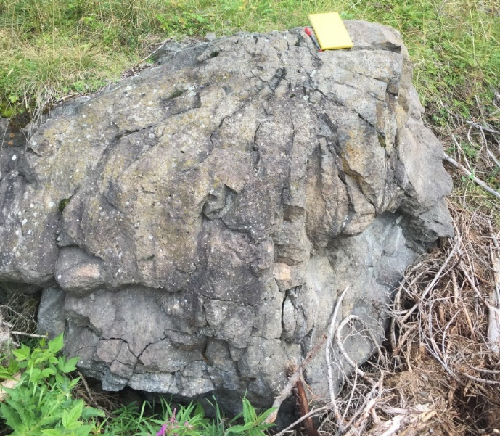
Background
Fernazza Fm pillow lavas
Max. eruption duration ~900 Kyr
Middle Triassic
Sedimentary basins dated either side
Conglomerate test
Google Earth
AUSTRIA
SWITZERLAND
SLOVENIA
Milan
CROATIA
ITALY

Slide 4


Suitability
Normal
Reversed
~350°C
Conglomerate test
Bayesian (Heslop & Roberts, 2018)
21 clasts
R = 6.39
Probability of uniformly random directions of 0.67
Ti-poor titanomagnetite
T_{C ~} 500°C
Petrological study - Casetta et al., (2021)
ca. Magnetite - χ_{usp} 0.52
Evidence of very-fine ilmenite lamellae
Incident light brightfield
Oxyexsolution at high-T
Likely a primary phase
Limited maghaematisation
Thermomagnetic curve inflection
Broadly reversible thermomagnetic curves
Non-pervasive cracking, limited to grain edges
Requirements for absolute palaeointensity
Primary magnetic phase
TRM

Slide 5
Results
Multi technique
Thermal Thellier - IZZI+
Pass
Fail
Fail
T_{c} 570-580°C, 250-300°C (Lattard et al., 2006)
ca. magnetite – χ_{usp} 0.52
(Casetta et al., 2021)
MD effects
2-slope
Zigzagging
Lower palaeointensity estimates

Slide 6
Results
Shaw- DHT
Pseudo-Thellier

Slide 7
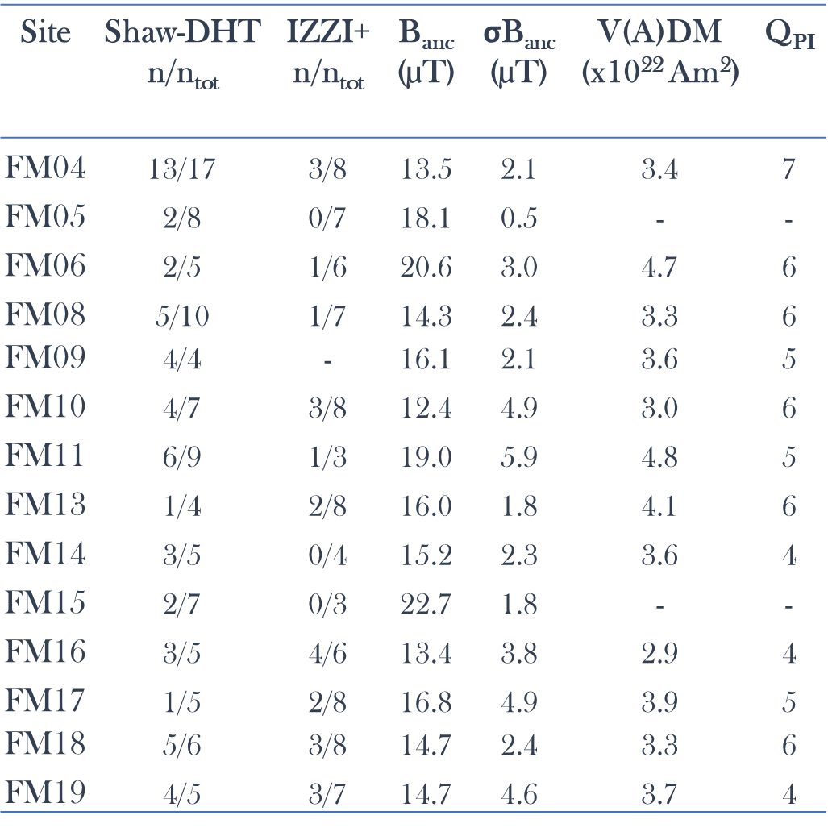
Results
*
Thermal Thellier (IZZI+), Shaw-DHT, pseudo-Thellier
14/17 sites
Shaw-DHT - 55/97
IZZI+ - 23/83
PTh - 72/93
Agreement between methods – including pT
3.0 to 4.8 x 10²² Am²
Q_{PI} 4 to 7
Median 5.5
*
Shaw-DHT: f_{N} ≥ 0.15, R² ≥ 0.99, Slope-T = 1.00 ± 0.05, k’ ≤ 0.20, MAD_{anc} ≤ 15, α ≤ 15 (Yamamoto et al., 2003; Lloyd et al., 2021)
IZZI+: n ≥ 5, β ≤ 0.100, f ≥ 0.35, q ≥ 1, MAD_{anc} ≤ 15, α ≤ 15, DRAT ≤ 10, CDRAT ≤ 15, k’ ≤ 0.35 (SPD+; Paterson et al., 2014)

Slide 8

TCRM Effects
4.0
FM04-10A
0.05 m
ARM0
(x10⁻⁰⁵ Am²)
7mT
Specimen | Distance from centre (m) | B_{ANC} (µT)
FM04-10A | 0.05 | 11.8
FM04-12A | 0.35 | 13.3
FM04-13A | 0.40 | 14.5
FM04-14A | 0.45 | 13.9
FM04-15A | 0.50 | 10.9
FM04-16A | 0.60 | 13.4
FM04-17A | 0.75 | 14.9
FM04-18A | 0.90 | 11.7
FM04-19A | 1.05 | 9.8
FM04-20A | 1.05 | 13.2
FM04-21A | 1.15 | 14.1
FM04-22A | 1.40 | 13.9
FM04-23A | 1.55 | 14.4
0.0
35mT
0.0
ARM1
(x10⁻⁰⁵ Am²)
4.0
Pillow circulation model
Increasing hydrothermal alteration pillow core to rim
Shaw ARM correction
ARM0/ARM1
Lab maghaemite inversion proxy
Increase core to rim?
Effects on palaeointensity estimates?
Corrects back to estimates from original TRM/TCRM signal
Greater TCRM would expect greater bias
3.0
FM04-20A
1.05 m
ARM0
(x10⁻⁰⁵ Am²)
9mT
0.0
40mT
0.0
ARM1
(x10⁻⁰⁵ Am²)
3.0
FM04-22A
3.0
1.40 m
9mT
Consistent estimates
σB/B_{ANC} = 0.18
ARM0
(x10⁻⁰⁵ Am²)
45mT
0.0
0.0
ARM1
(x10⁻⁰⁵ Am²)
3.0

Slide 9
Discussion
Time Interval | Median V(A)DM (x 10²² Am²) | AD/NAD_{median}
PCRS | 8.4 | 58.4 +6345.1/−47.3
Post-PCRS | 3.6 | 6.9 +9.2/-5.0
Pre-CNS | 4.6 | 8.8 +18.9/-6.0
CNS | 5.4 | 15.1 +29.9/-10.2
Miocene | 3.5 | 3.5 +8.9/-2.4
Last 5 Ma | 5.4 | 9.7 +19.2/-6.9
Long-term | 4.6 | -
In keeping with long-term median, and crucial in defining Post-PCRS
Most intervals in keeping with long-term median
PCRS exceptionally strong – due to high axial dipole dominance? (Handford et al., 2021)
AD/NAD_{median} (Biggin et al., 2020) – utilises PSV
Calculated for other intervals
Trend between axial dipole dominance and V(A)DM suggests relationship between PSV and palaeointensity
Areas highlighted in order to explore relationship
NB// Q_{PI} ≥ 3, Post-PCRS minus PTB
Thank you for listening. Any Questions?

