Slide 1






Prototype spectroscopic sensor for accurate, real time monitoring of personal exposure to NO₂
EGU22
Session: AS5.3
23 – 27 May 2022
Eibhlín F. Halpin, Dean S. Venables
ehalpin@ucc.ie

Slide 2

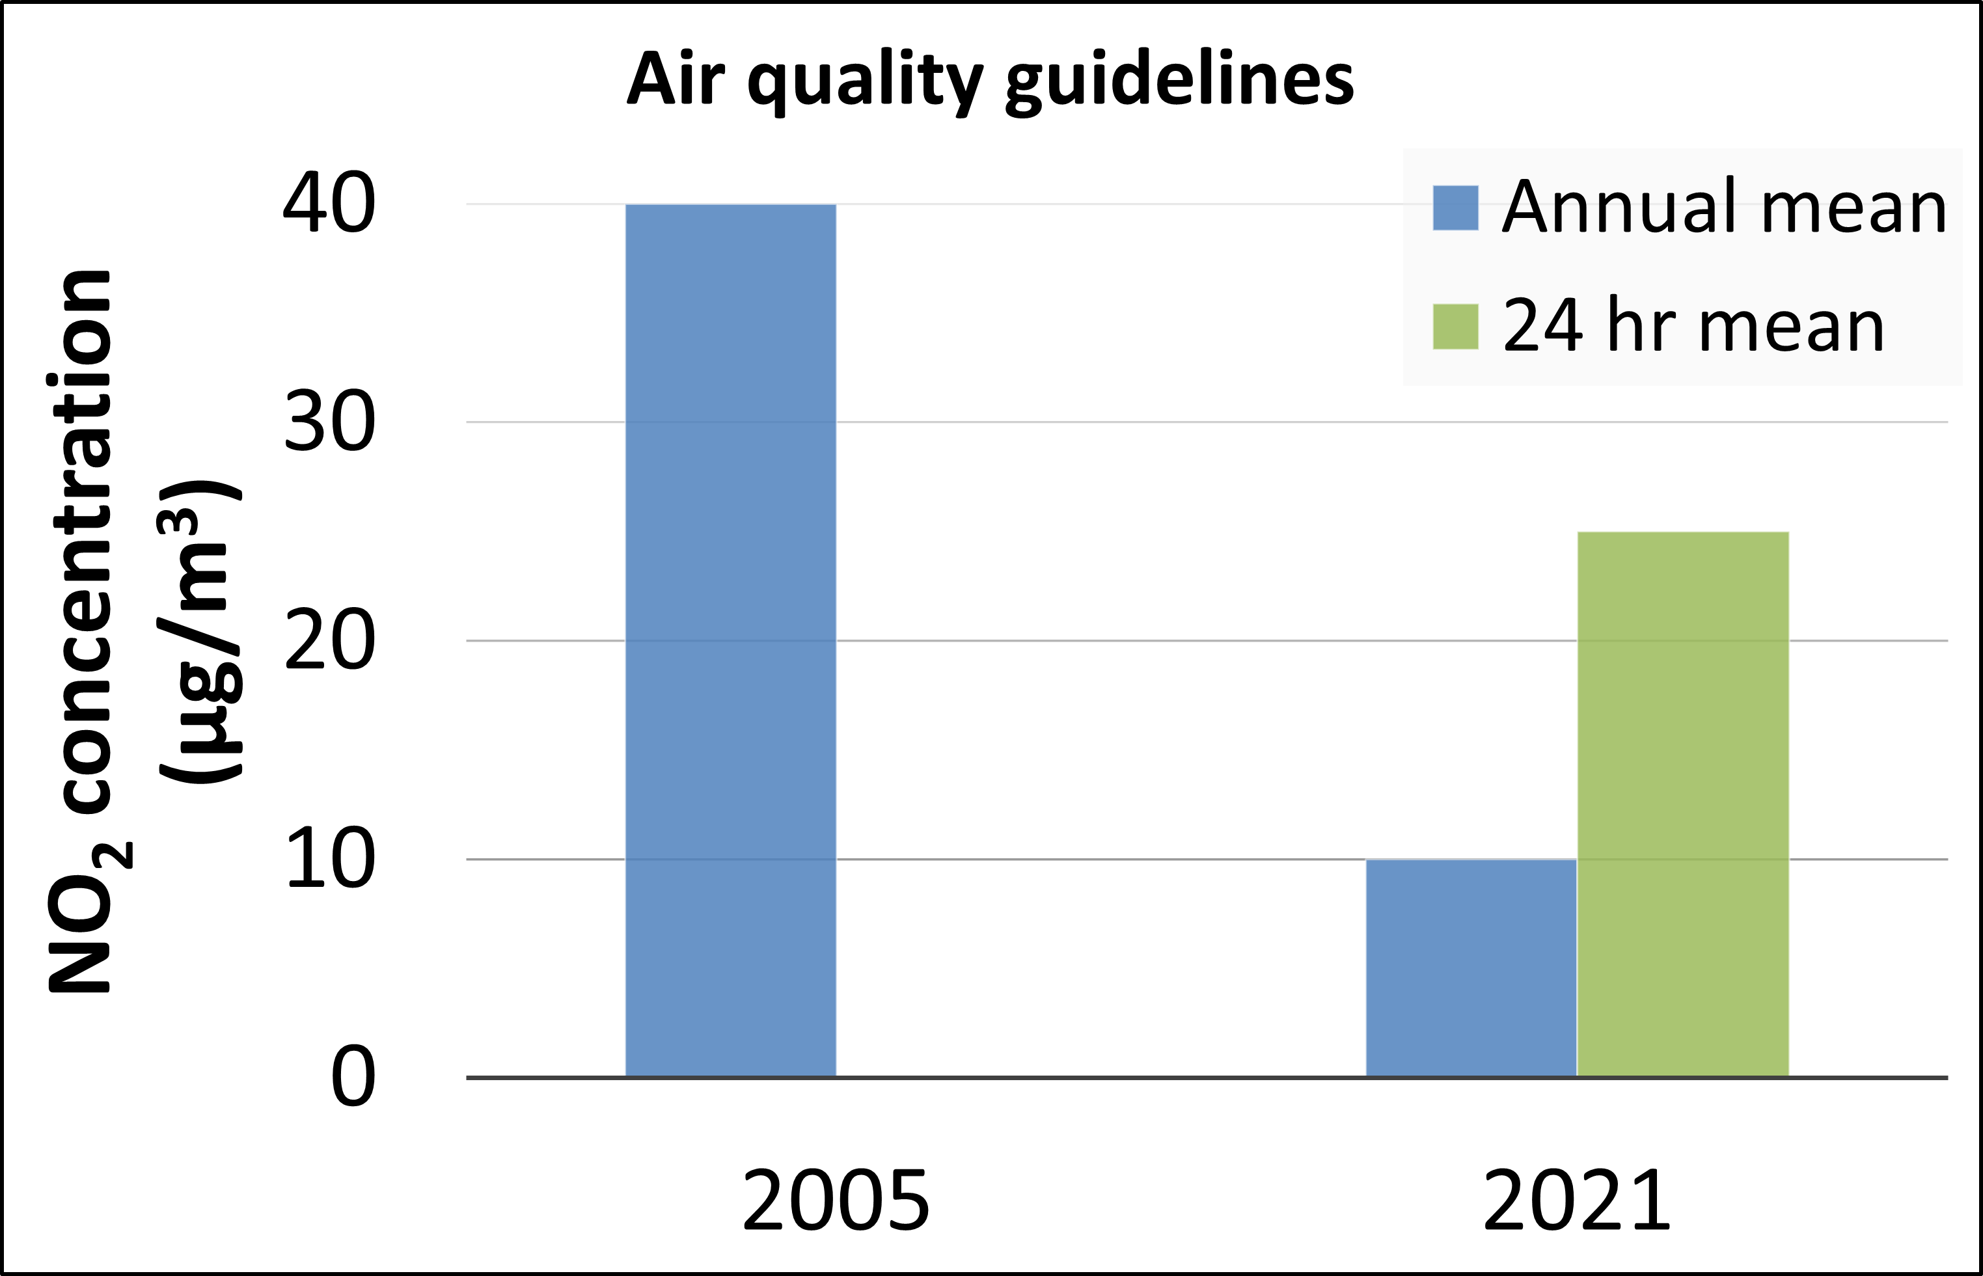

NO₂ and AQ regulations
Major source of NO₂: Burning fossil fuels – heavy traffic
Toxic – asthma, lung cancer, respiratory and cardiovascular illnesses
Need for a low-cost, portable, selective and sensitive NO₂ detector
Notes:
AQ guidelines: 2005 -2021 40 ug/m3
Bar graph showing difference in guidelines
non compliance with no2 limits will become more frequent
New limits based on epidemiological studies
Reference figures:
No2 https://www.hamworthy-heating.com/Knowledge/Articles/NOx-emissions-from-commercial-boilers
Traffic https://www.irishtimes.com/news/ireland/irish-news/three-car-crash-in-cork-causes-large-rush-hour-tailbacks-1.3473759
Headline https://www.irishtimes.com

Slide 3
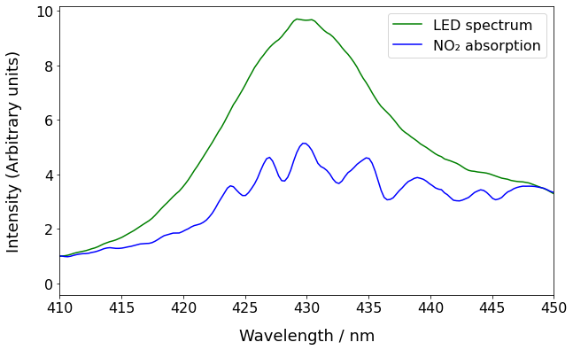
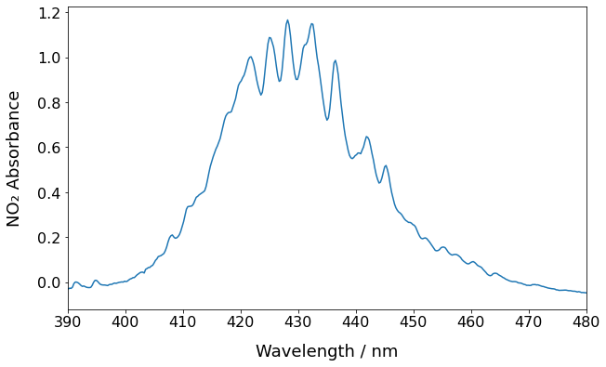
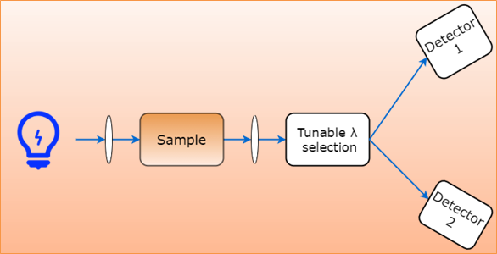
Principle of operation
438 nm
435 nm
Intensity spectra shows structured absorption features of NO₂
Notes:
Narrow bandpass filter fwhm 1.5 nm
NO2 has a uniquely structured spectrum within 250 – 650 nm. [click] Our spectroscopic method is based on 2-channel DOAS. Figure shows measured absorption spectrum using CCD spectrometer. [click]
Pick out strong and weak absorbing wavelengths – 435, 438 nm. [click] Each signal sent to detector. Look at change in ratio – eliminates common noise, selective to no2
Ref spectrum : Tian, Guoxun & Moosmuller, Hans & Arnott, William. (2013). Influence of photolysis on multispectral photoacoustic measurement of nitrogen dioxide concentration. Journal of the Air & Waste Management Association (1995). 63. 1091-7. 10.1080/10962247.2013.790323.

Slide 4

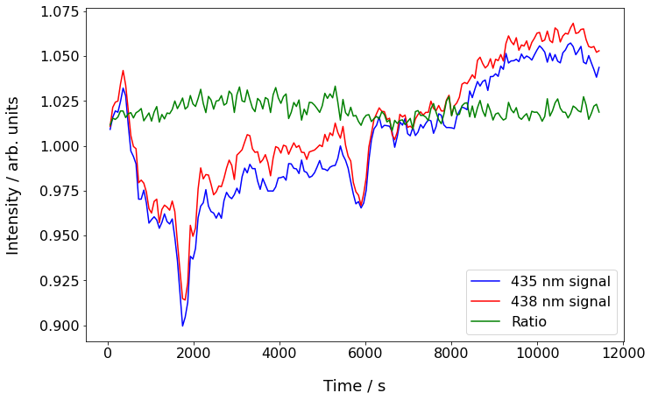
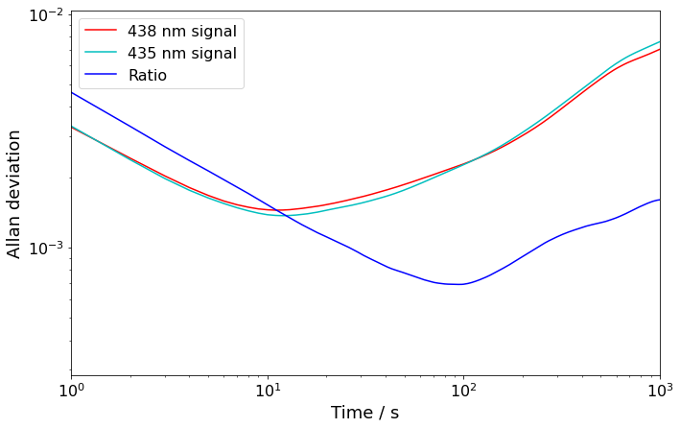
System stability
Minimum of ratio at 100s = 7x10⁻⁴
Improved long term stability
Common-mode noise rejection
σ_{ratio} = 0.3%
15% change
Notes:
Error bars showing 15% change v 3% change – critical for noise measurements
Allan deviation of signals and ratio shows more sensitivity in ratio
The ratio of the peaks reaches a minimum at 100s of approx 7e-4. This added precision comes from the common-mode noise rejection from taking the ratio of both signals. This also gives better selectivity to NO2.
minimum detectable concentration (1 sigma) is 1.84e10 molecules/cm3 which is 0.75 ppbv.
[click] Allow LED to run for approx. 3 hrs to monitor stability of individual channels. Large spikes in individual channels not seen in ratio – common-mode noise reduction. [click] Standard deviation improves from 0.01 in single channels to 0.003 in ratio trace.

Slide 5
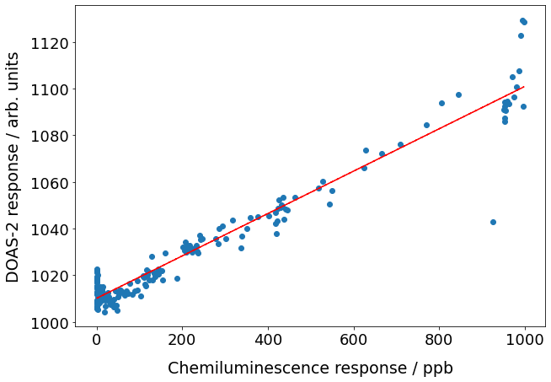
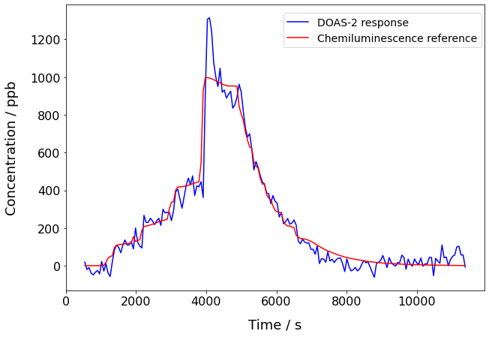
Chamber calibration
R² = 0.9404
4
NO₂ injected
Flushing
3
2
Data averaged over 60 s
1
σ = 35 ppb
Notes:
Chamber calibration where unknown amounts of NO2 were injected into atm sim chamber. The change in concentration was monitored by a reference chemiluminescence monitor and the DOAS2 system. Promising preliminary result however [click] still a lot of noise in system with standard deviation of 34.8 ppb when NO2 had been flushed out of system.
[click] Good correlation – r2 = 0.94

Slide 6


Going forward
Thank you
Increase input light - photon-limited noise
Narrower viewing angle
Light focused to centre of cavity (Fiedler et al.)
Lower reflectivity mirrors – allow more light through system
Development of photodiode system
ehalpin@ucc.ie
https://www.ucc.ie/en/eri/projects
Find us on Twitter:
@detectNO2
Notes:
Improve with diff mirrors and diff light sources

