Slide 1






Identification of flocculation during large-river estuarine mixing
Presented by: Ming Yue
Skate Key Laboratory of Estuarine and Coastal Research (East China Normal University)
Prepared for: EGU General Assembly 2022, Vienna, Austria, 23–27 May 2022, EGU22-4133

Slide 2
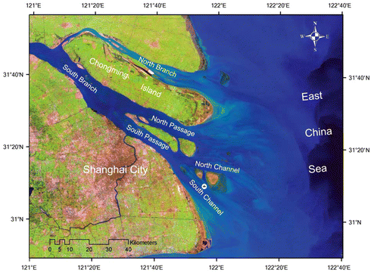
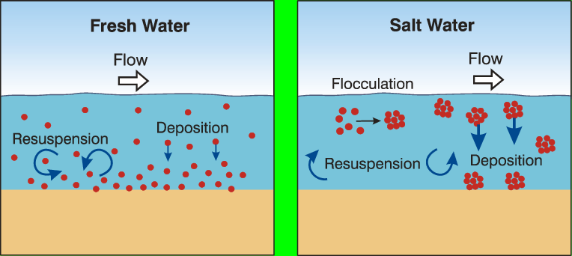
Differentiating various types of SPM & Identify flocculation products?
flocculation
Changjiang Estuary: land-to-sea inerations
Flocculation process
previous study
Jiang et al., (2011)
Webster et al., (2003)
This study
LISST parameters
( ≠ biological particles)
or
combined
Stable Carbon Isotopic Ratio
(seasonal or spatial factors)

Slide 3
LISST instrument and δ¹³C measurements combined
Three cruises conducted in March, May, and July 2016
different season
The ratio of Total volume to Turbidity size spectra
Stable Isotopic Carbon
Study area
(Changjiang estuary and the adjacent area)

Slide 4
LISST - derived parameters
the ratio of Total volume to Turbidity
group Ⅰ: terrestrial sediments; group Ⅱ: flocculation products; group Ⅲ: biological particles;
size spectrum changes before and after the flocculation process

Slide 5
LISST - derived parameters
Flocculation processes
ideal scenarios
March:
transported further out of the river mouth
AF = 2.0
AF = 2.6
actual scenarios
loosely organized
tightly packed
smaller particles aggergating into larger ones
May:
being deposited rapidly

Slide 6
LISST instrument and δ¹³C measurements combined
Three cruises conducted in March, May, and July 2016
different season
The ratio of Total volume to Turbidity size spectra
Stable Isotopic Carbon
Study area
(Changjiang estuary and the adjacent area)

Slide 7
Stable Isotopic Carbon measurements
seasonal or spatial
no consistent δ¹³C responses to the in situ flocculation and the different SPM compositions
quite different δ¹³C values among seasons

Slide 8
Identification of flocculation during large-river estuarine mixing
Presented by: Ming Yue
Skate Key Laboratory of Estuarine and Coastal Research (East China Normal University)
Prepared for: EGU General Assembly 2022, Vienna, Austria, 23–27 May 2022, EGU22-4133

