Slide 1






Temporal variability in central European climate reconstructions, 1501–2020 CE, and its attribution
Jiří Mikšovský^{1,2}, Rudolf Brázdil^{2,3}, Petr Dobrovolný^{2,3}, Petr Pišoft¹, Miroslav Trnka^{2,4}, Martin Možný⁵, and Jan Balek^{2,4}
¹ Charles University, Faculty of Mathematics and Physics, Dept. of Atmospheric Physics, Prague, Czech Republic
² Global Change Research Institute, Czech Academy of Sciences, Brno, Czech Republic
³ Institute of Geography, Masaryk University, Brno, Czech Republic
⁴ Department of Agrosystems and Bioclimatology, Mendel University in Brno, Brno, Czech Republic
⁵ Czech Hydrometeorological Institute, Prague, Czech Republic
jiri@miksovsky.info
http://www.miksovsky.info/EGU22.pptx

Slide 2

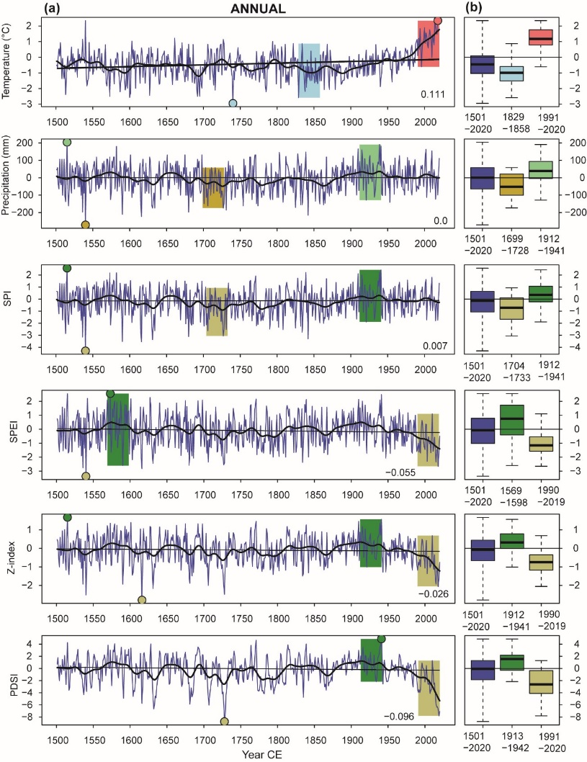
EGU General Assembly 2022; Mikšovský et al.: Temporal variability in central European climate …
Charles University Prague
Target data: Central European climate reconstructions, 1501-2020 CE
Annual and seasonal (DJF, MAM, JJA, SON) series constructed as combination of instrumental and documentary data:
Central European temperature (Dobrovolný et al. 2010)
Czech precipitation (Dobrovolný et al. 2015)
SPI: Standardized Precipitation Index
SPEI: Standardized Precipitation Evapotranspiration Index
Z-index
PDSI: Palmer Drought Severity Index
Alternative data: Phenological reconstructions of temperature and SPEI for MAMJ & AMJJA seasons (derived from documentary grain and grapes harvest dates)
⬅ Temporal variability in the reconstructed annual time series and their hottest/driest and coldest/wettest 30-year sub-periods

Slide 3
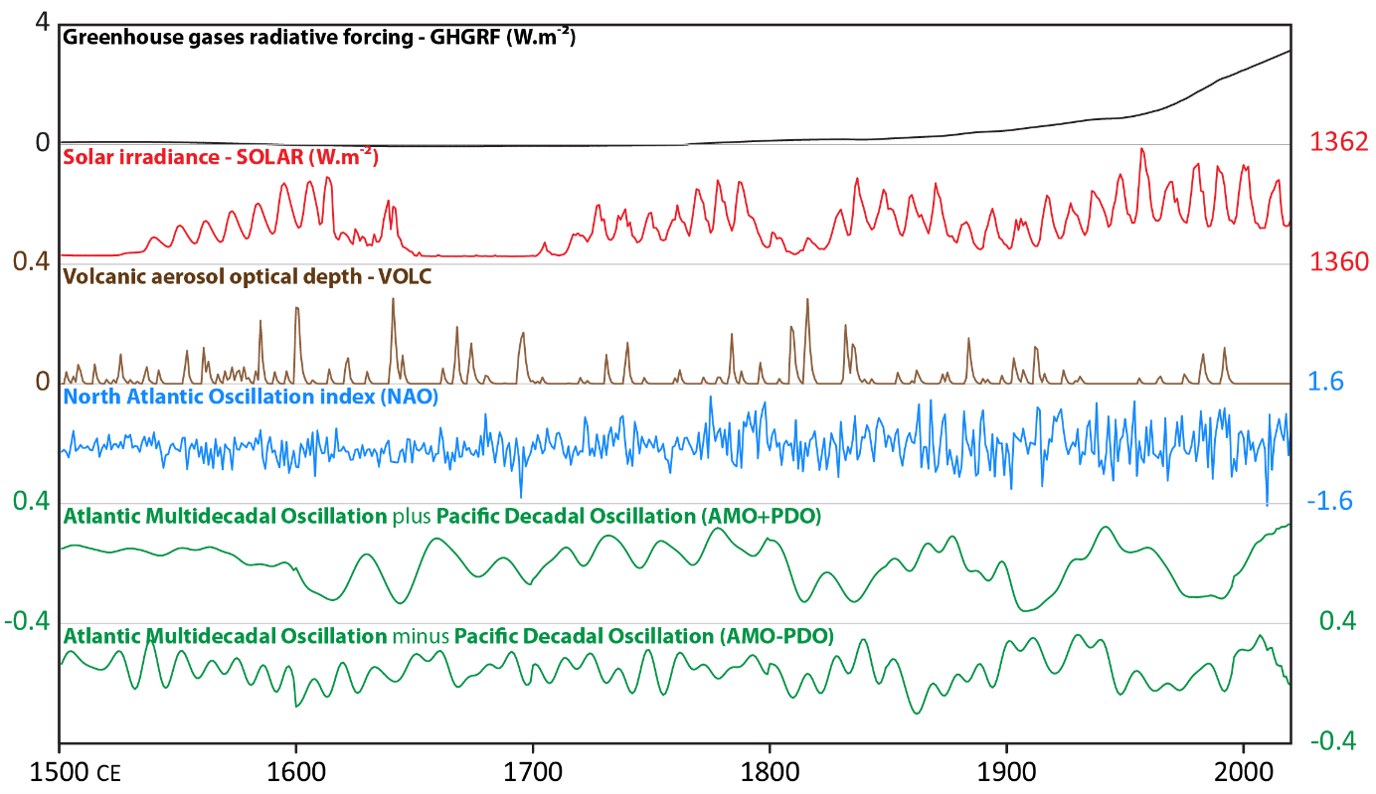
EGU General Assembly 2022; Mikšovský et al.: Temporal variability in central European climate …
Charles University Prague
Attribution analysis: Potential explanatory factors
Series capturing activity of potential explanatory factors, both anthropogenic and natural, including reconstructed indices of multiple large-scale internal climate oscillations (NAO, AMO, PDO)

Slide 4
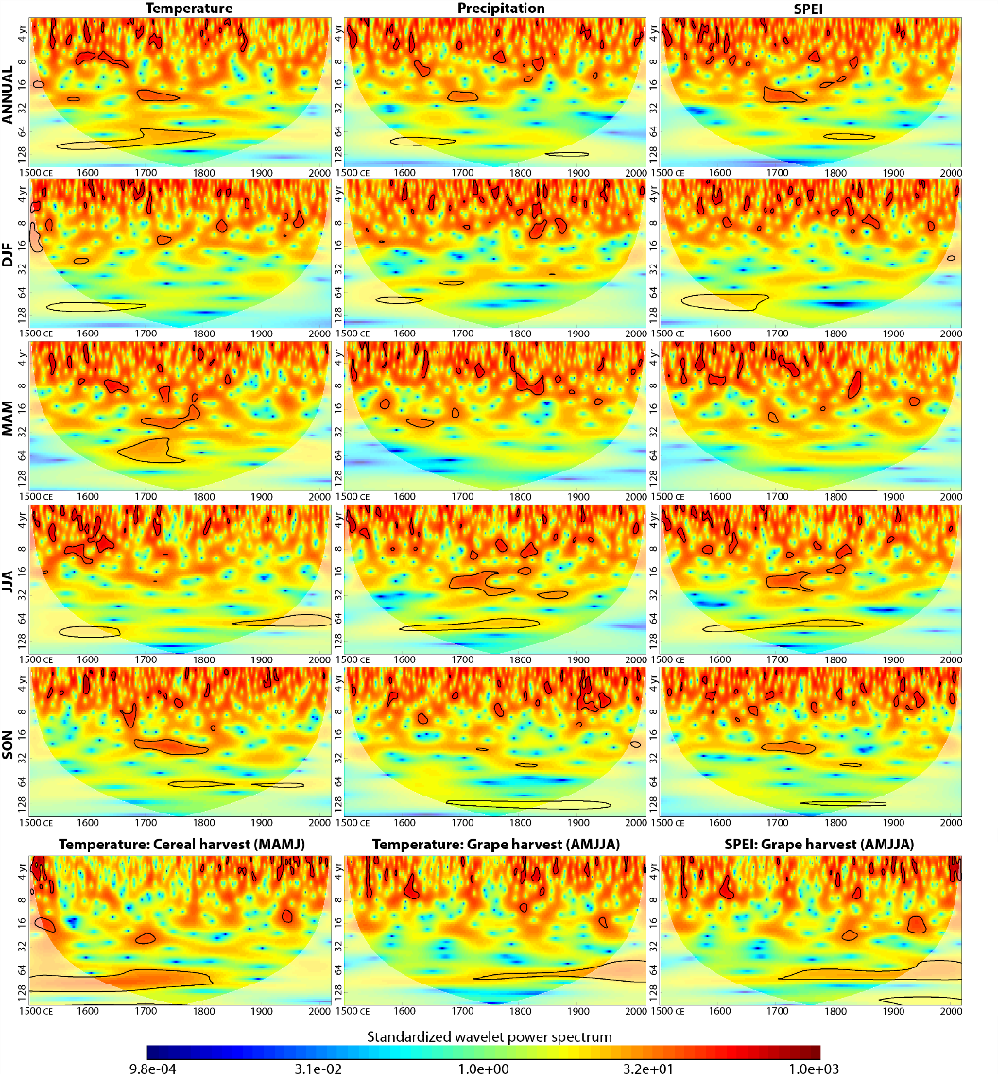
EGU General Assembly 2022; Mikšovský et al.: Temporal variability in central European climate …
Charles University Prague
Periodic components
Presence of periodic components investigated by continuous wavelet transform
Occurrence of notable oscillations detected especially in the period range of about 60-100 years
However, the periodicities exhibit substantial temporal instability and differences exist between different seasons of the year
Moreover, distinct contrast was found between features detected from various types of reconstructions, including phenoclimatic data
⬅ Standardized wavelet power spectra for temperature, precipitation and SPEI in the Czech Lands for the 1501–2020 period. Statistical significance highlighted at the 95% level (black line)

Slide 5
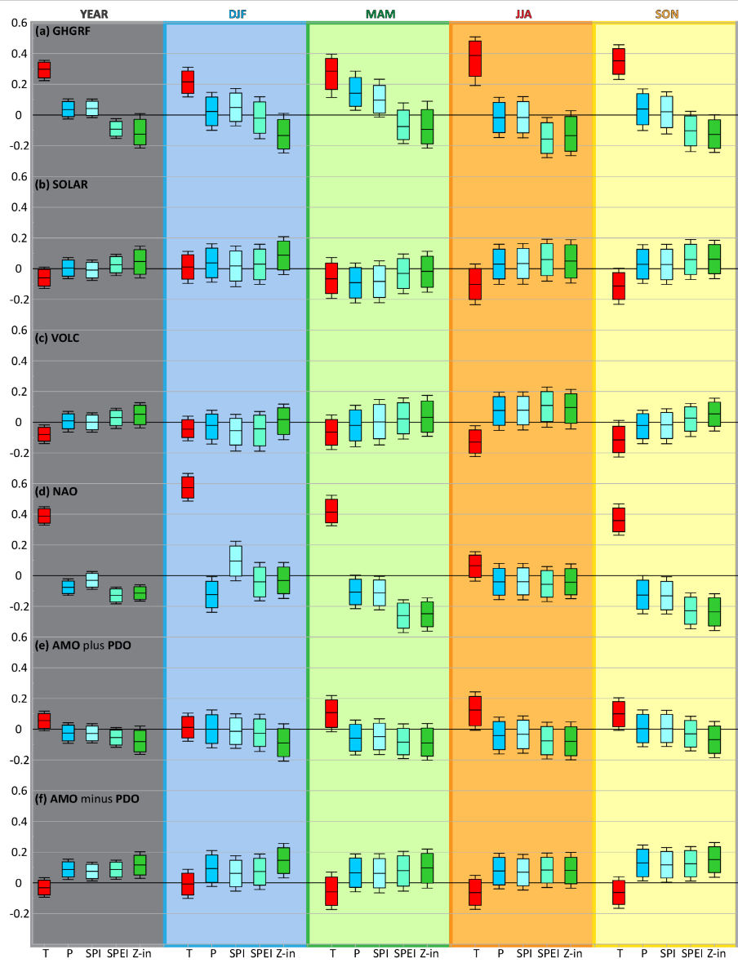
EGU General Assembly 2022; Mikšovský et al.: Temporal variability in central European climate …
Charles University Prague
Statistical attribution analysis
Primary tool: Multiple linear regression with bootstrap-based estimates of confidence intervals
Strong GHG-correlated trend found in temperature and temperature-sensitive drought indices
Distinct cooling effect related to volcanic activity identified especially in summer
Strong NAO effect found in most seasons, consistently present throughout the entire analysis period
AMO/PDO influence detected both for their common component (imprinted especially in the temperature reconstruction) and their difference (linked to precipitation and drought series)
⬅ Standardized regression coefficients between individual target and explanatory variables and their 95% (box) and 99% (whiskers) confidence intervals

Slide 6
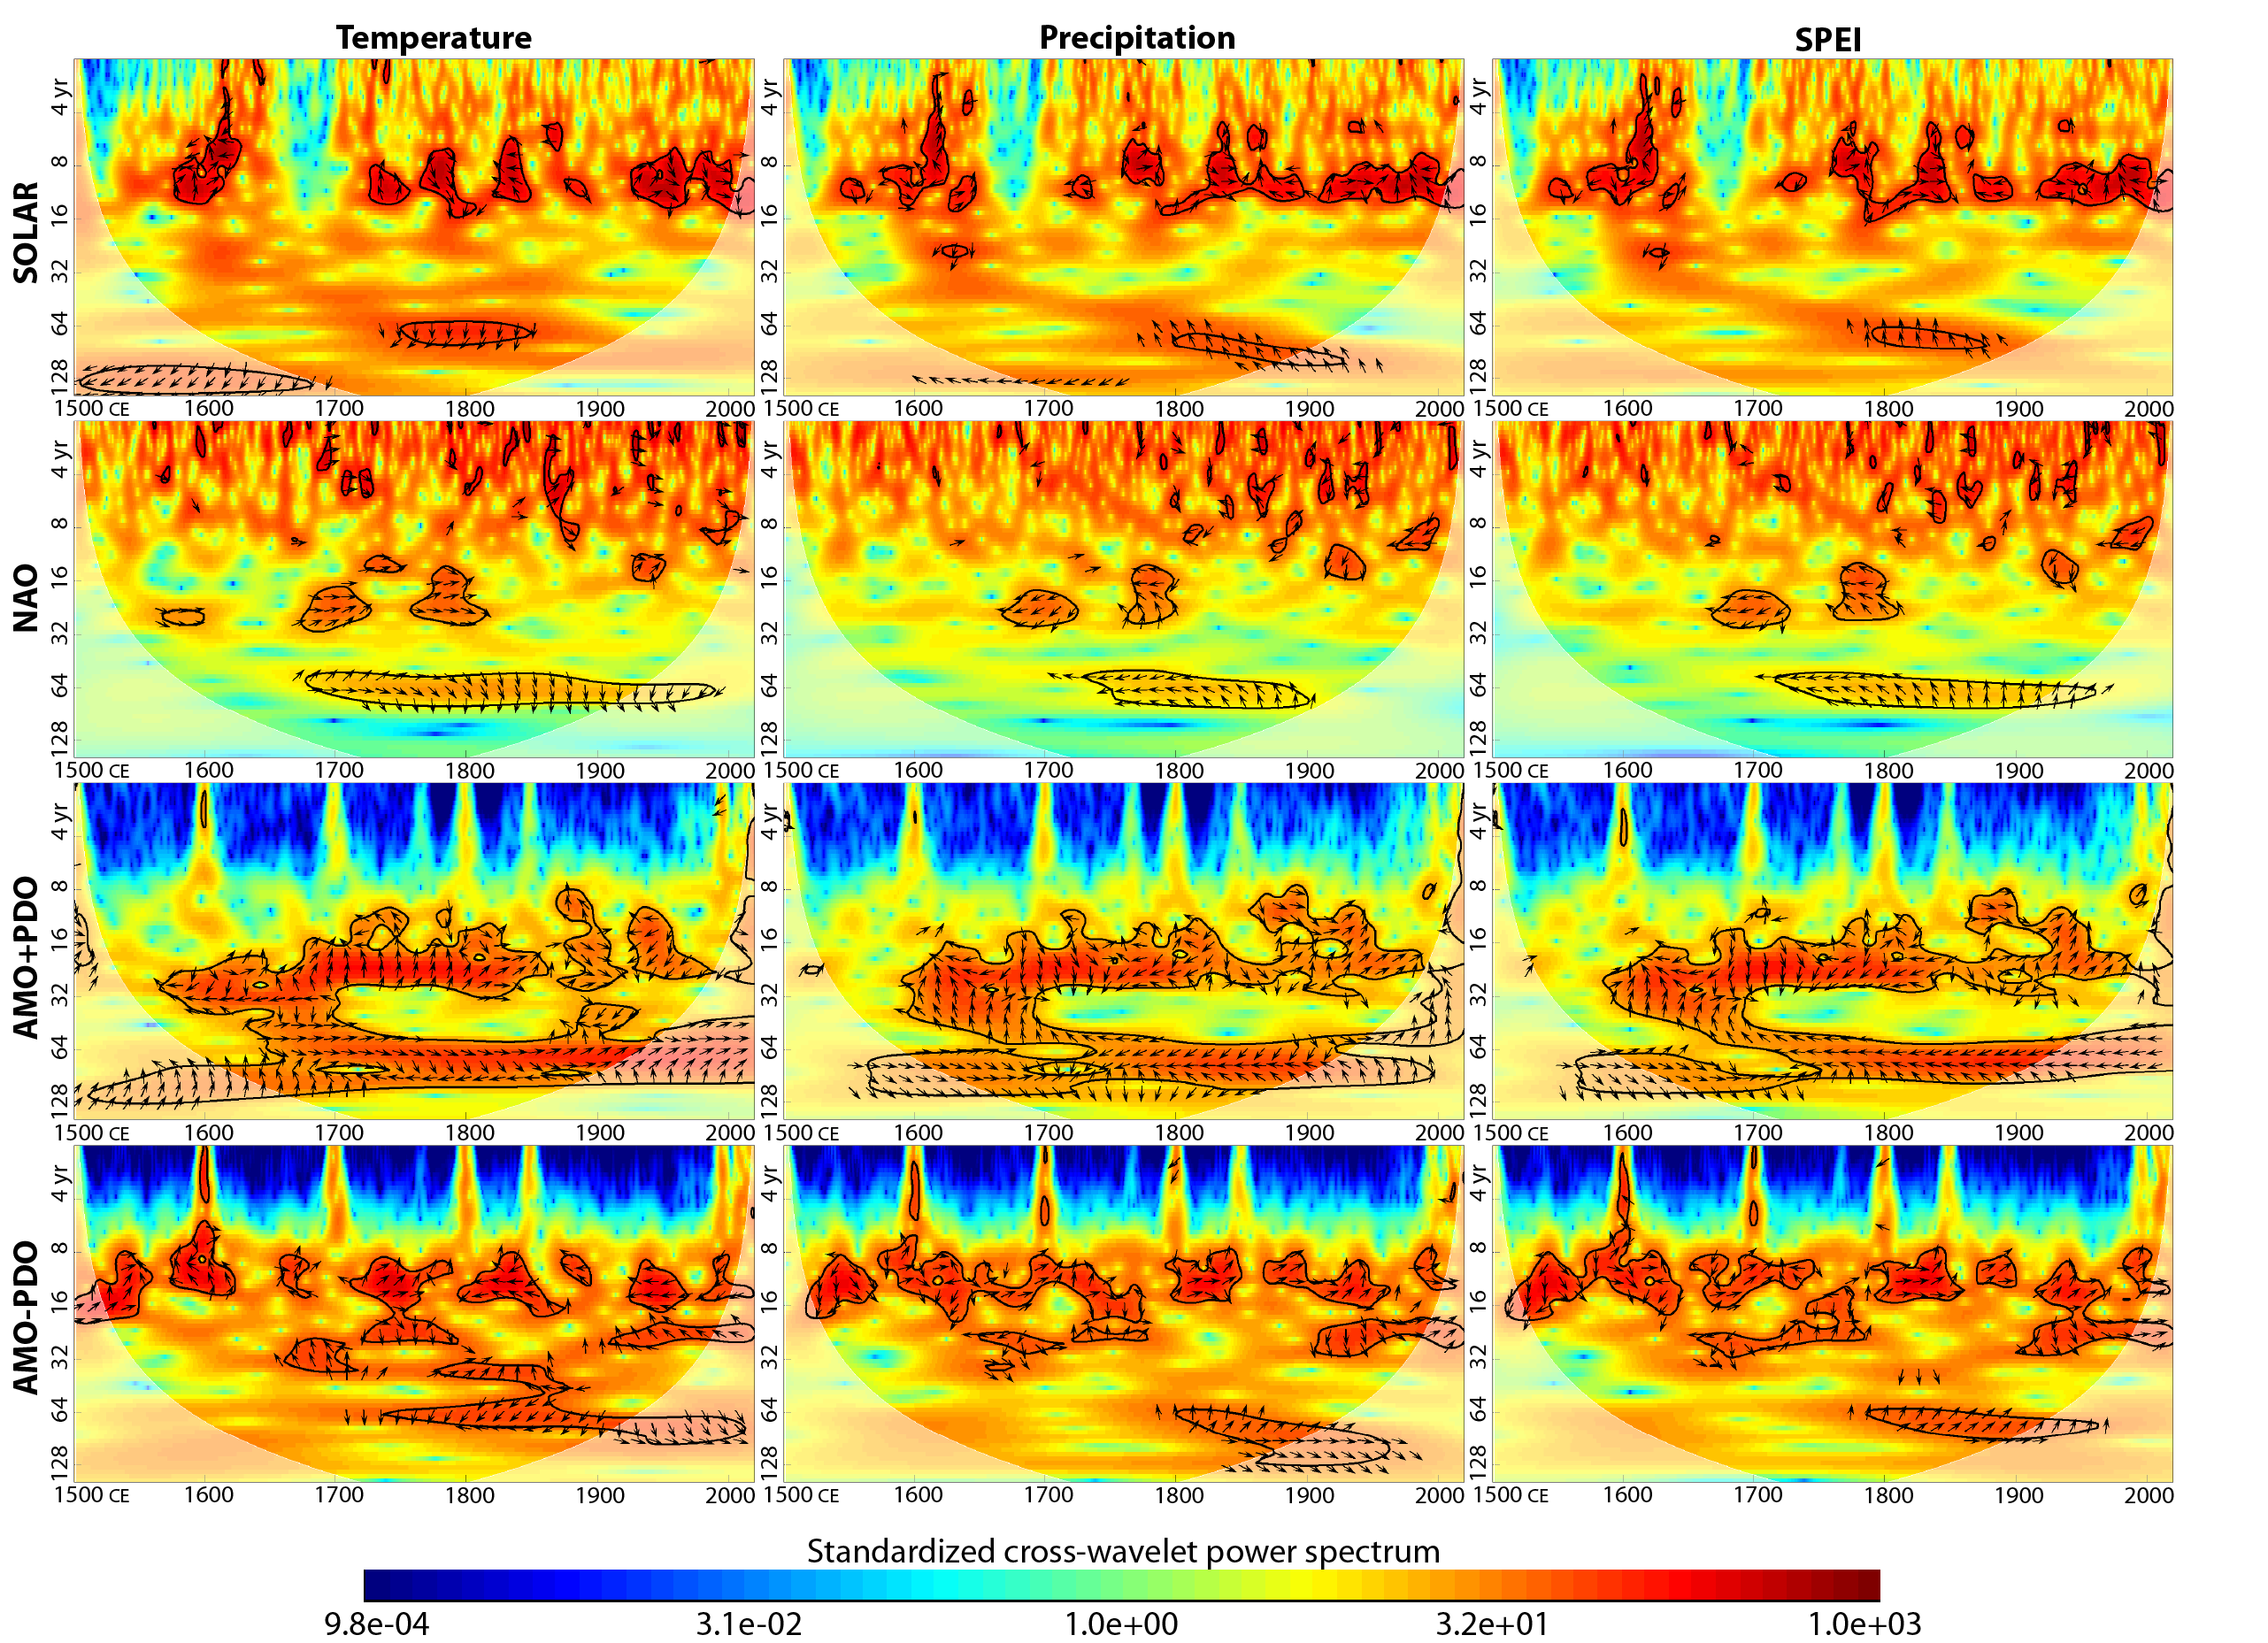
EGU General Assembly 2022; Mikšovský et al.: Temporal variability in central European climate …
Charles University Prague
Oscillatory components shared by target and explanatory variables
Primary tool: Cross-wavelet analysis & wavelet coherence
Significant shared oscillations detected especially in the 70-100 year period band, in particular between the AMO/PDO common component and temperature
Other spectral similarities also found, but with highly variable phase shift indicating lack of simple linear relationships
⬅ Standardized cross-wavelet spectra between series of temperature, precipita-tion or SPEI and explanatory variables with prominent oscillatory components (all seasons)

Slide 7
EGU General Assembly 2022; Mikšovský et al.: Temporal variability in central European climate …
Charles University Prague
Conclusions
Multi-centennial reconstructions allow for more sensitive detection of climate variability features, especially with regard to multidecadal variability and effects of rare episodic events
Specifically, for central Europe, the 520-year-long series reveal a distinct imprint of volcanic forcing (but no significant effect of variations in solar activity)
Additionally, influence of multidecadal variability in Atlantic Multidecadal Oscillation and Pacific Decadal Oscillation has been highlighted (both with regard to their common component as well as difference of their phases)
Open questions & future challenges
Further need for investigation of robustness of results obtained for different reconstructions of explanatory variables, derived from different proxy data
Development of methodology for coping with nonstationarity and inhomogeneity of the signals, both target and explanatory, as well as potential deviations from linearity of the relevant links

Slide 8
EGU General Assembly 2022; Mikšovský et al.: Temporal variability in central European climate …
Charles University Prague
References
Related analyses:
Brázdil, R., Dobrovolný, P., Mikšovský, J., Pišoft, P., Trnka, M., Možný, M., and Balek, J.: Documentary-based climate reconstructions in the Czech Lands 1501–2020 CE and their European context, Clim. Past, 18, 935–959, https://doi.org/10.5194/cp-18-935-2022, 2022
Mikšovský, J., Brázdil, R., Trnka, M., and Pišoft, P.: Long-term variability of drought indices in the Czech Lands and effects of external forcings and large-scale climate variability modes, Clim. Past, 15, 827–847, https://doi.org/10.5194/cp-15-827-2019, 2019
Data sources & description (central European climate reconstructions):
Dobrovolný, P., Brázdil, R., Trnka, M., Kotyza, O., and Valášek, H.: Precipitation reconstruction for the Czech Lands, AD 1501–2010, Int. J. Climatol., 35, 1–14, https://doi.org/10.1002/joc.3957, 2015
Dobrovolný, P., Moberg, A., Brázdil, R., Pfister, C., Glaser, R., Wilson, R., van Engelen, A., Limanówka, D., Kiss, A., Halíčková, M., Macková, J., Riemann, D., Luterbacher, J., and Böhm, R.: Monthly and seasonal temperature reconstructions for Central Europe derived from documentary evidence and instrumental records since AD 1500, Clim. Change, 101, 69–107, https://doi.org/10.1007/s10584-009-9724-x, 2010

Slide 9
Thank you for your attention
EGU General Assembly 2022; Mikšovský et al.: Temporal variability in central European climate …
Charles University Prague
jiri@miksovsky.info
http://www.miksovsky.info/EGU22.pptx

