Slide 1
Spectra of Tides and Planetary Waves from Ionosonde and MERRA-2 Data
Maksakova E. Yu., Gavrilov N. M., Koval A.V.
Saint-Petersburg State University, Atmospheric Physics Department, Saint Petersburg, Russia.

Slide 2
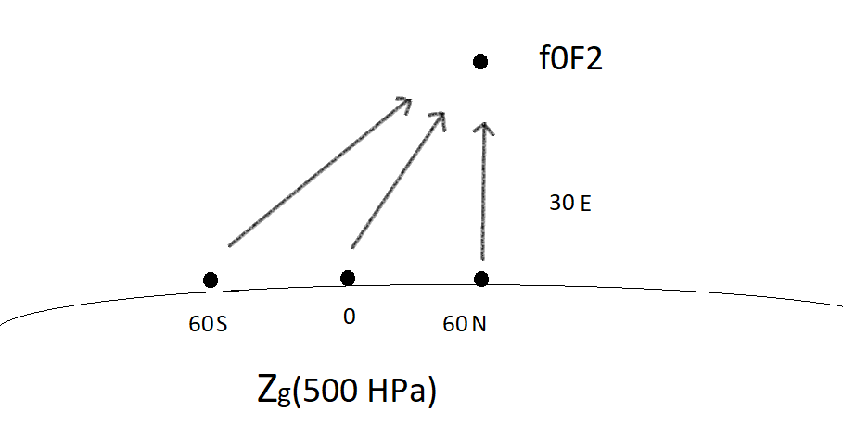

Slide 3
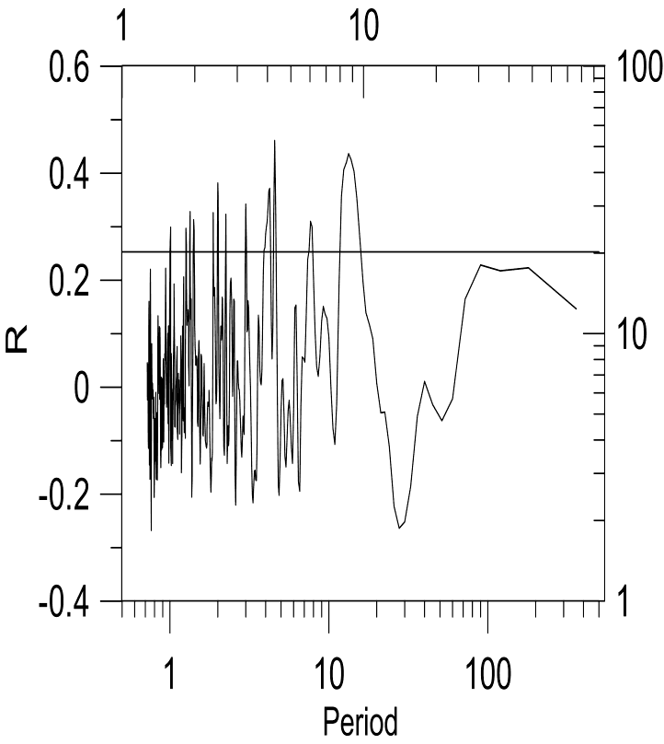
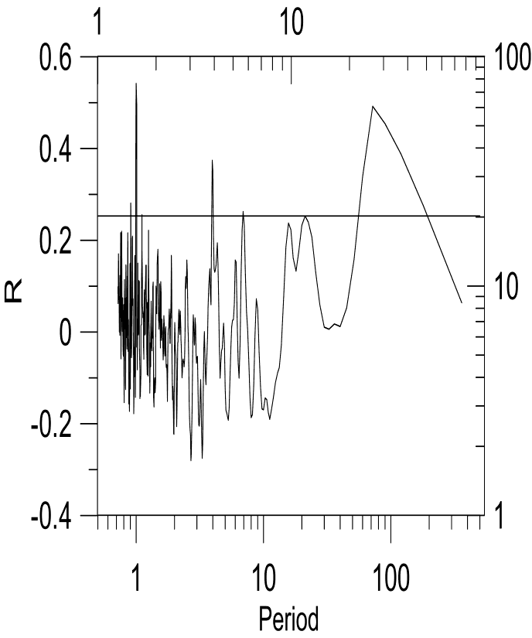
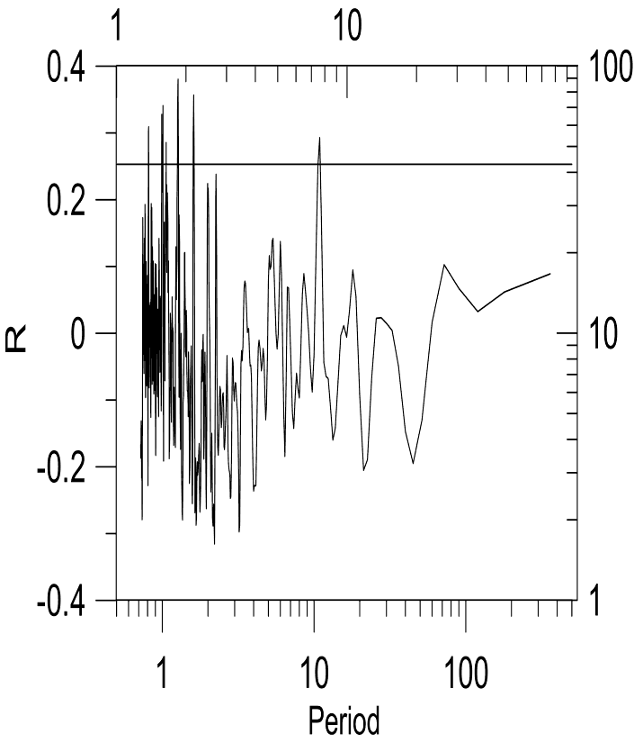
а) b) c)
Figure 1. Correlation dependence of geopotential height (60S (a), 0 (b), 60N (c), 30Е) and critical frequency f0F2 (60N and 30E)

Slide 4
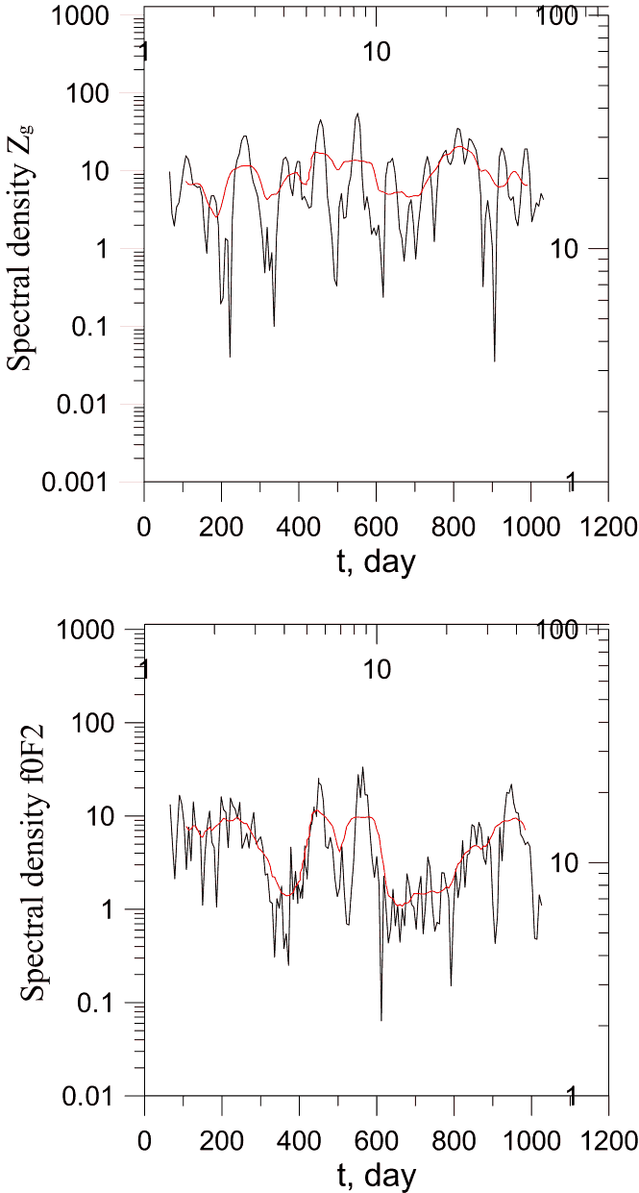
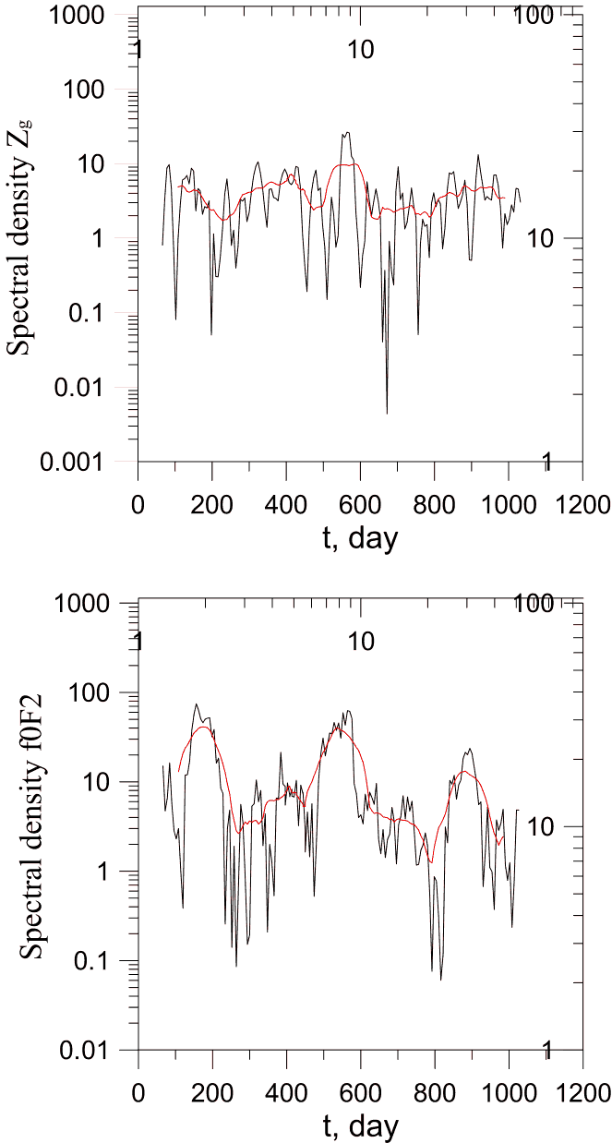
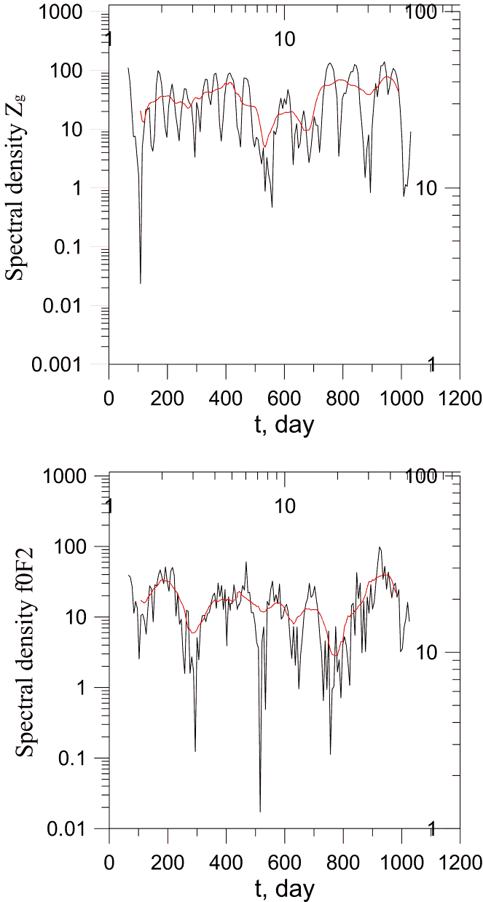
a) b) c)
Figure No. 2. Amplitudes of disturbances of geopotential height for 60 S(a), 0 (b), 60N(c), 30 E(upper panel) and critical frequency f0F2 at 60N and 30E (lower panel). With a period of PV: 3 (a), 3.96 (b) and 10.9 (c)

Slide 5
Conclusion
The correlation coefficient between the geopotential height and the critical frequency shows that there is a connection between the dynamic processes in the lower and upper atmosphere.

