Slide 1
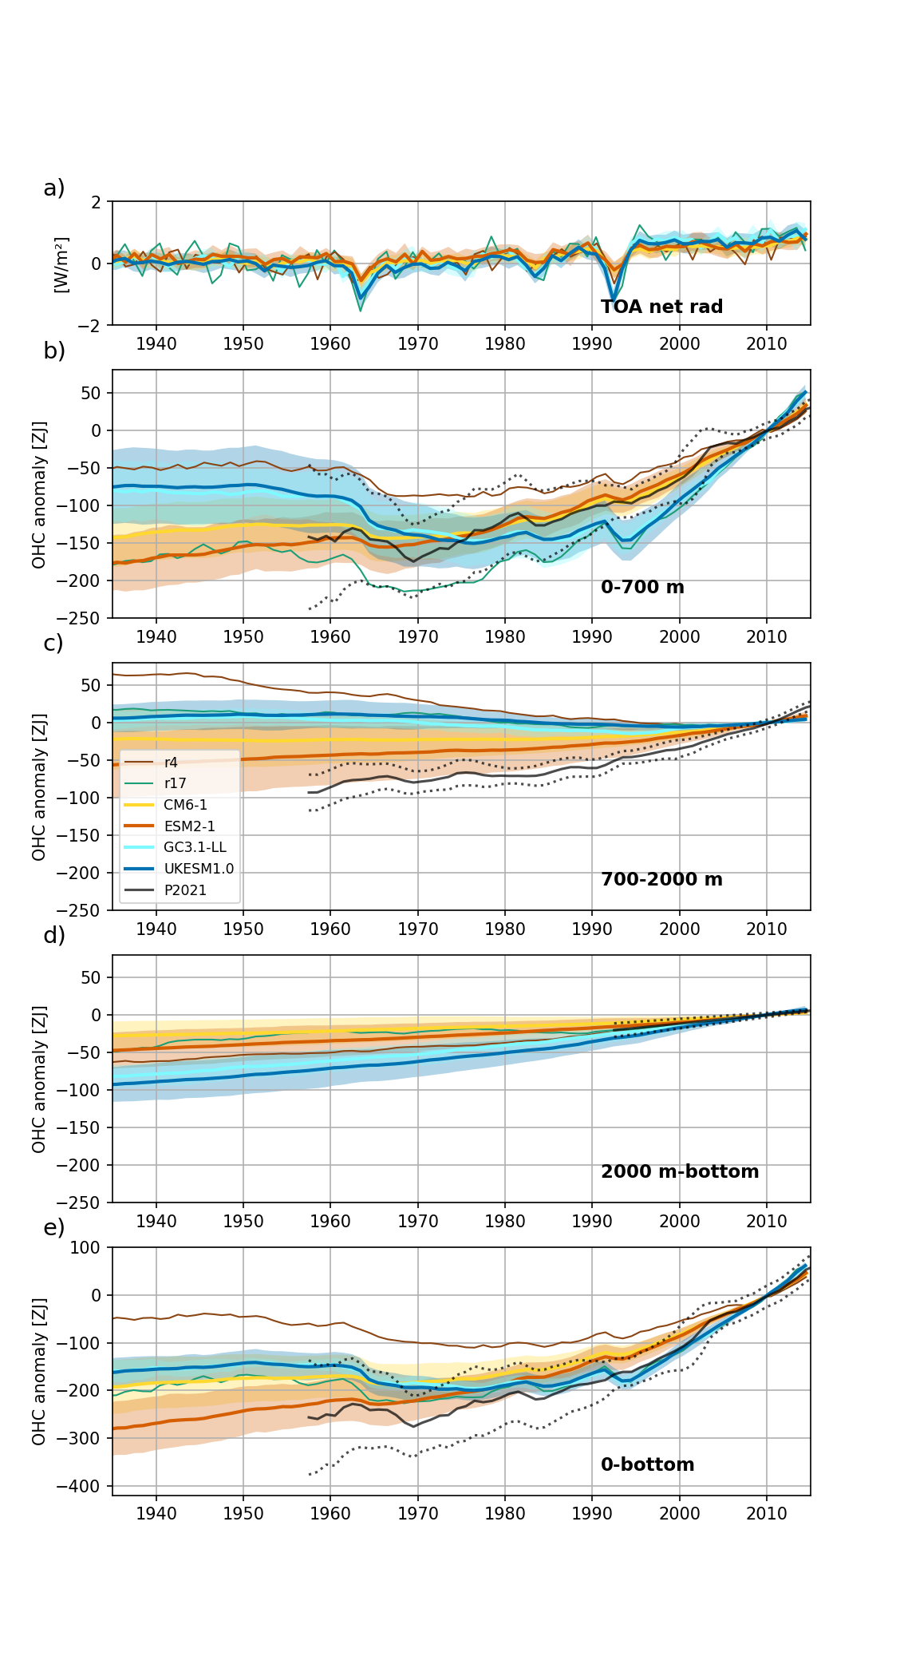




The global and regional structure of simulated historical ocean heat content change in CMIP6 models
Till Kuhlbrodt, Aurore Voldoire, Rachel Killick, Olivier Geoffroy and Matt Palmer
Evaluate four CMIP6 models: UKESM1.0, HadGEM3-GC3.1-LL, CNRM-CM6-1, CNRM-ESM2-1.
All 4 models use the NEMO3.6 ORCA1 configuration, with a few different settings.
0-700 m: UK models have near zero OHU 1965-1991; after that OHU too strong.
CNRM models very close to observations.
700-2000 m: all models showing too small OHU throughout
2000 m – bottom: UK models warm too strongly; CNRM models close to observations
0-bottom: UK models looking realistic after 1980; CNMR-ESM2-1 within the envelope throughout, but warming rate after 1991 too small
Net radiation balance (a) and global ocean heat content (b-e) for the four models of this study. The historical ensembles (light blue, dark blue, yellow and red) are compared with an ensemble of the observational datasets available for each layer (black). Thick lines for the ensemble means. Shading indicates ±one standard deviation of the individual model ensembles. For the Palmer et al (2021) observations ensemble the total error is dotted. Ensemble member r17 from UKESM1.0 in teal, and ensemble member r4 from CNRM-CM6-1 in brown. All OHC time series are normalised to the 2005-2014 average. The TOA time series are normalised to the 1850-1900 average.

Slide 2
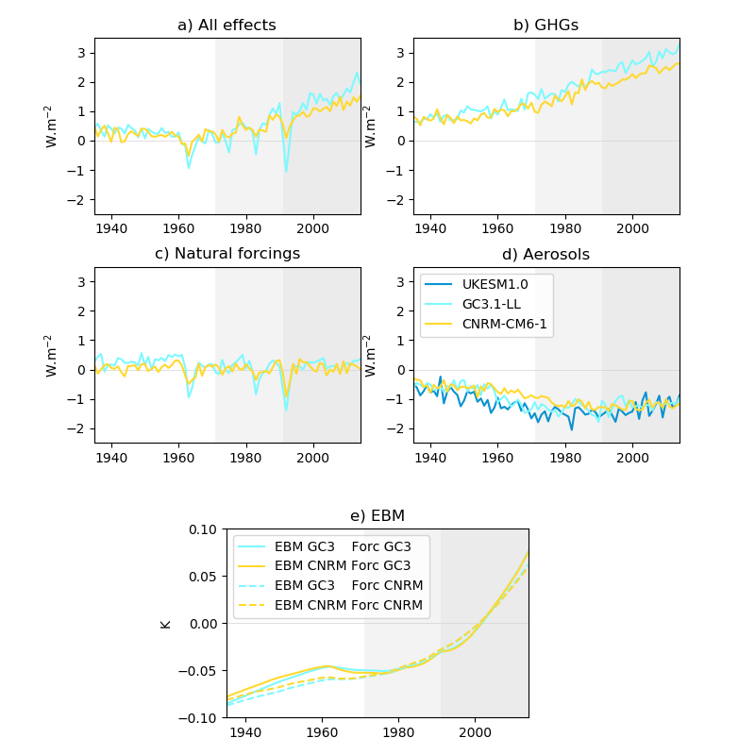
Radiative forcing and its components
GC3.1-LL has a smaller total ERF than CM6-1 between 1960 and 1991, but larger afterwards
  The GHG forcing is stronger than CM6-1 throughout
  Aerosol ERF is more negative than in CM6-1 between about 1955 and 1990
The impact of a given total ERF is very similar when applied to a simple two-layer EBM fitted to either CNRM-CM6-1 or HadGEM3 GC3.1-LL
Timeseries of the total effective radiative forcing (ERF) (a) and its components: greenhouse gases (GHGs)s (b), natural forcings (c) and aerosols (d) for two of the four models, plus UKESM1.0 in panel (d). (e) Timeseries of deep ocean temperature (in K) simulated by a simple two-layer Energy Balance Model (EBM) as described in Geoffroy et al. (2013) Temperature are anomalies to the reference period average 1985-2014. Solid lines indicate the deep ocean temperature simulated by the EBM of each model forced by the GC3.1-LL total ERF, while dotted lines stand for the same EBM forced by the CNRM-CM6-1 total ERF (the total ERF are shown in panel a). The light grey shading indicates the focus periods of the analysis, 1971-1991 and 1991-2014 (darker).

Slide 3
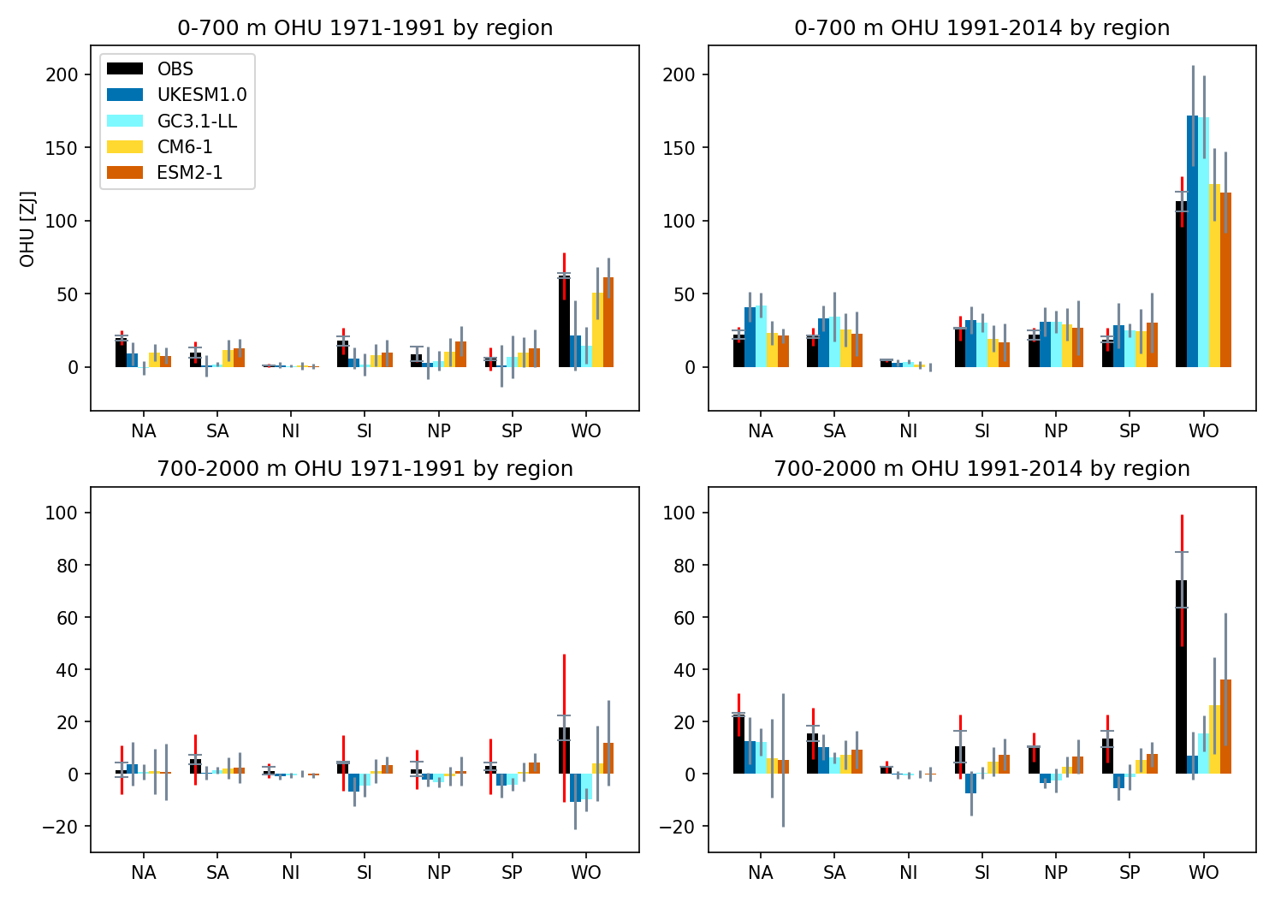
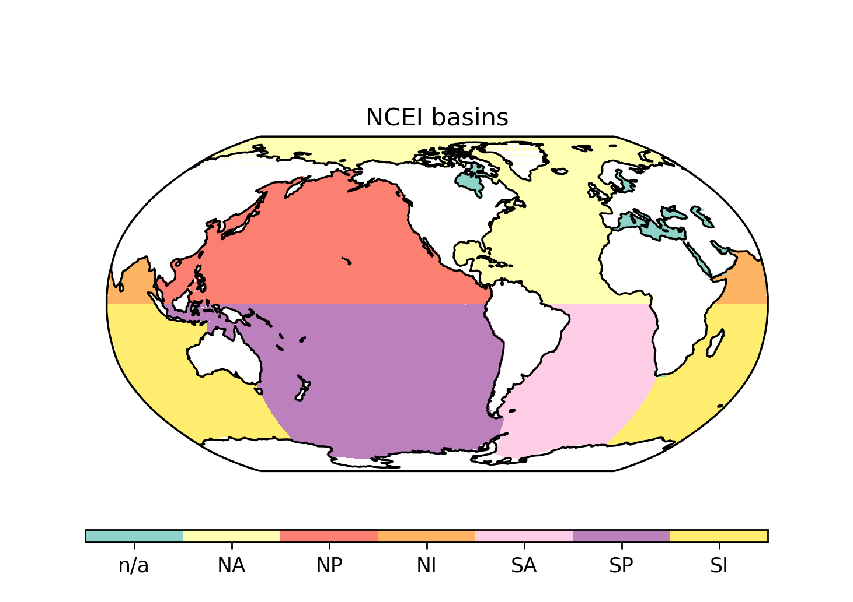
Regional ocean content change
We use an ensemble of two observational data sets (black): the pentadal NCEI data set and the CHG data set. Displayed are the structural error (in grey) and the total error (red).
For models, the column represents the ensemble mean and the grey bar one standard deviation of the ensemble.
0-700 m: UK models underestimate OHU in all basins before 1971, but the overestimate after 1991 comes mostly from the Atlantic
700-2000 m: Obs suggest significant OHU only after 1991. CNRM models capture this better for the global total, but UK models capture the dominance of the Atlantic OHU in this layer.
Ocean heat uptake from 1971 to 1991 (left) and from 1991 to 2014 (right) in the 0-700 m layer (top) and the 700-2000 m layer (bottom) by NCEI ocean basin (with WO for global ocean). Note the different scales on the y-axes in the upper and lower row of panels. The four models are UKESM1 in dark blue, GC3.1-LL in light blue, CNRM-CM6-1 in yellow and CNRM-ESM2-1 in red. The column represents the ensemble mean and the grey bar one standard deviation of the ensemble. For WO, the columns represent the entire global ocean as simulated in models, including those marginal seas that are disregarded in the NCEI basin definitions.
J. Clim., in review
t.kuhlbrodt@reading.ac.uk

