Slide 1




Spatial variation of the background solar
wind in the Inner Heliosphere
Nikolett Biro^{1,2}
biro.nikolett@wigner.hu
¹Wigner Research Centre for Physics
²Eötvös Loránd University
Andrea Opitz¹, Zoltan Nemeth¹, Aniko Timar¹, Akos Madar^{1,2}, Zsuzsa Dalya¹, Gergely Koban^{1,2}
EGU22-4155
This work was supported by OTKA grant FK128548.

Slide 2

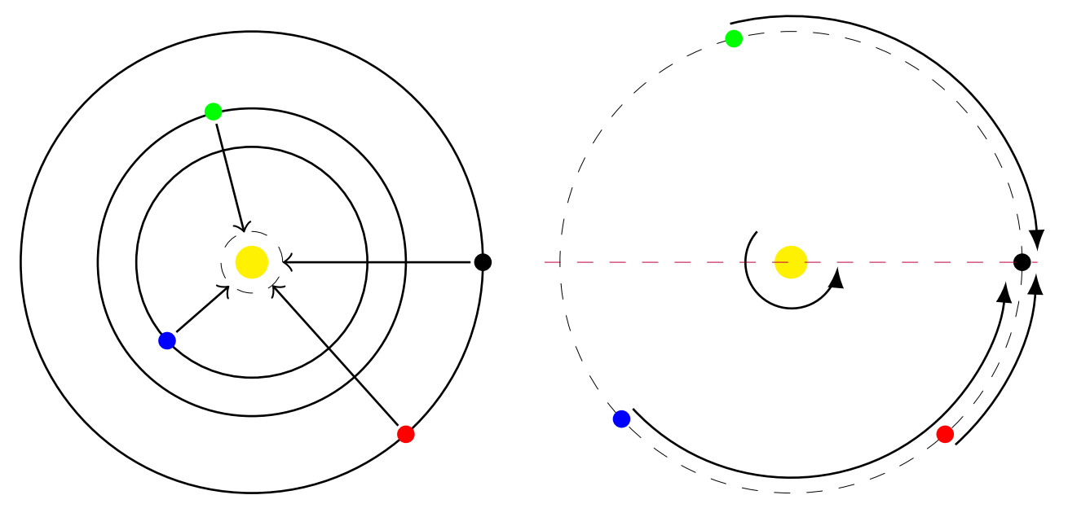
Motivation, data and method
Heliospheric space weather forecast
ACE
Parker Solar Probe
STEREO A
Solar Orbiter
Ballistic propagation
with differential rotation

Slide 3
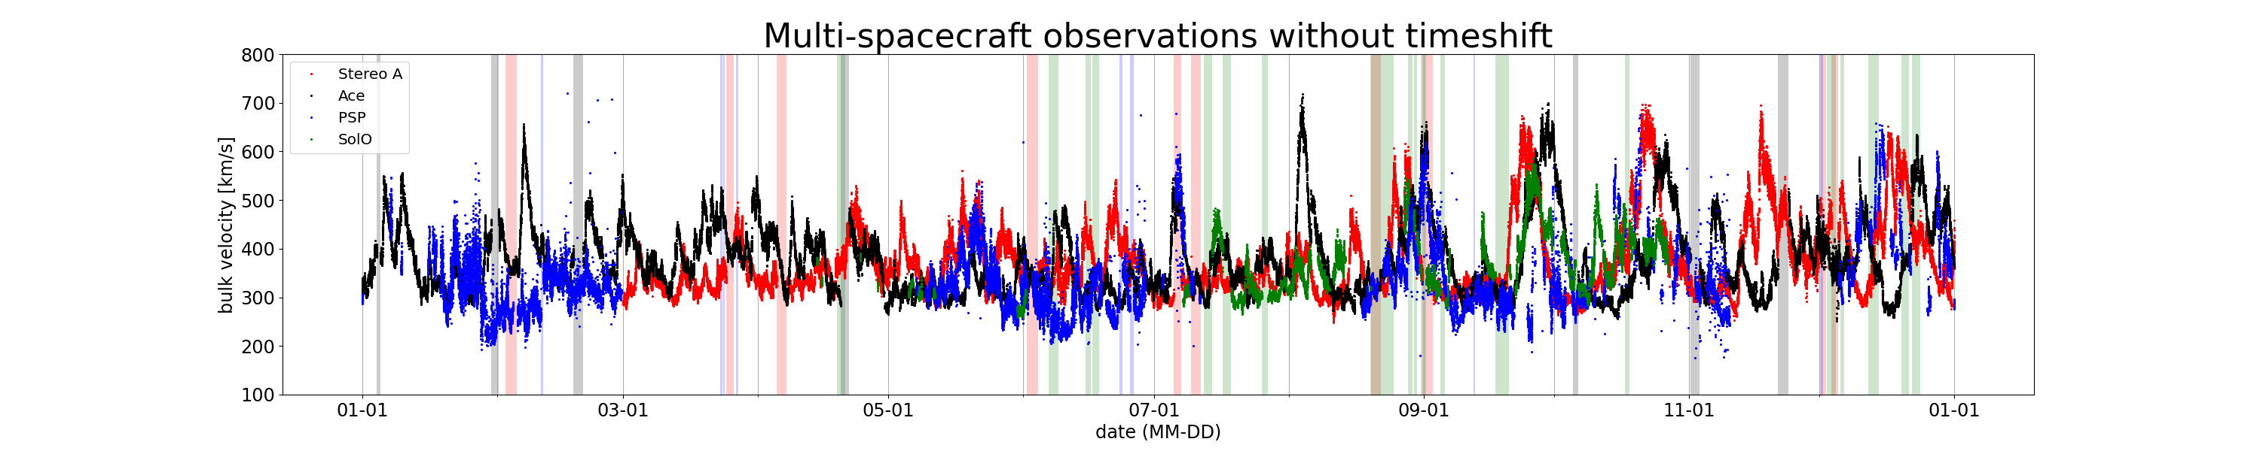
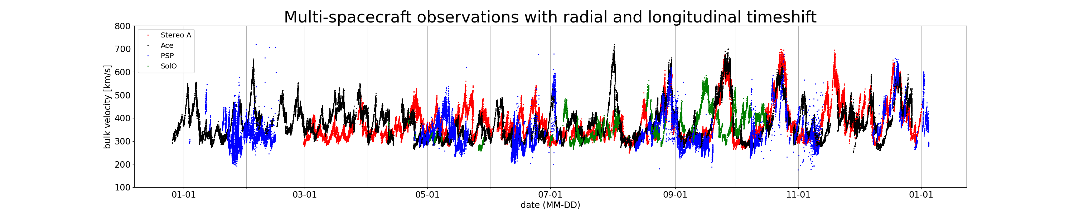
Results
2020
PSP
STEREO A
ACE
SolO

Slide 4

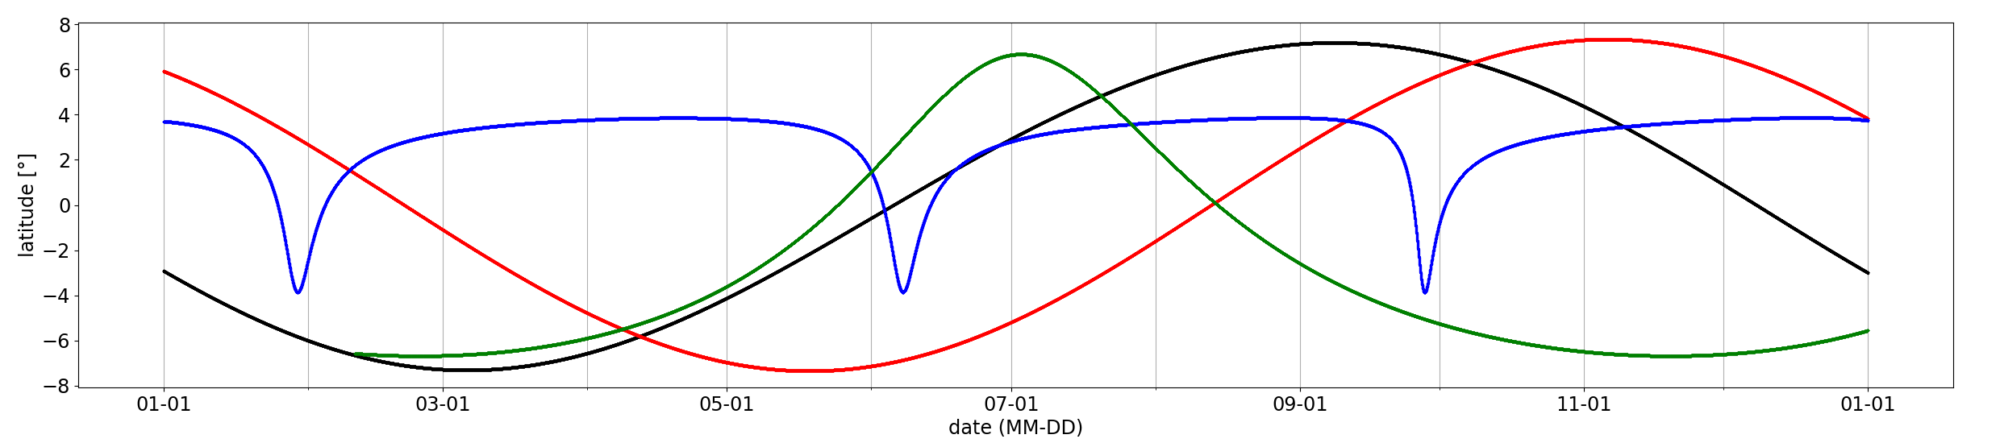
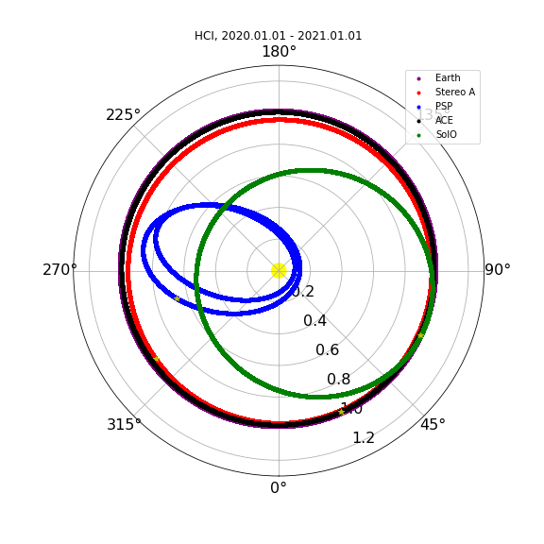
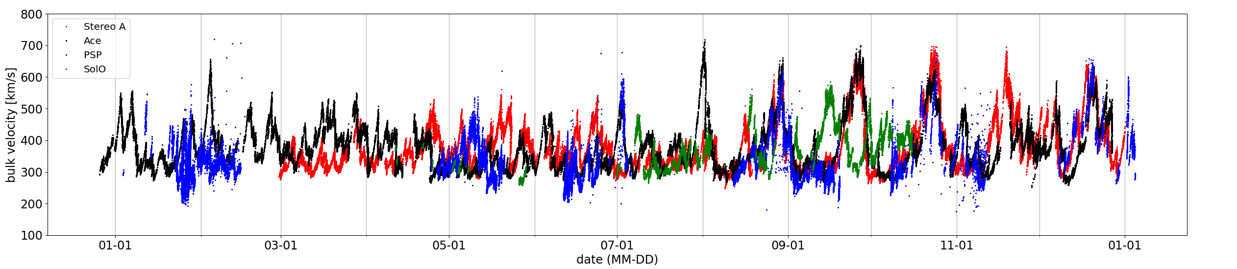
2020
without timeshift
PSP
ACE
STEREO A
SolO
timeshifted

Slide 5
2020
without timeshift
PSP
ACE
STEREO A
SolO
timeshifted

Slide 6
2020
without timeshift
PSP
ACE
STEREO A
SolO
timeshifted

Slide 7
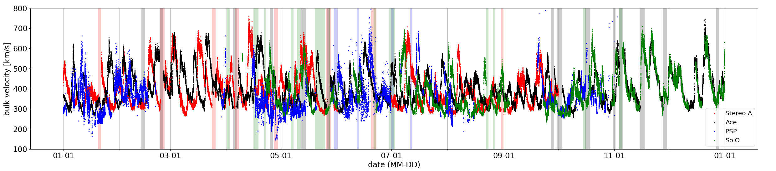
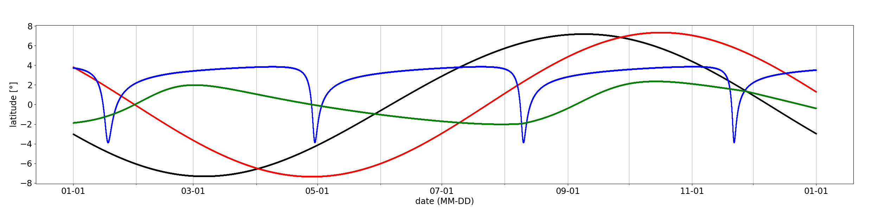
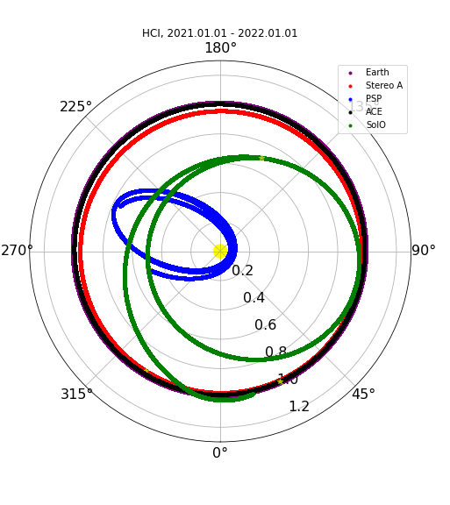
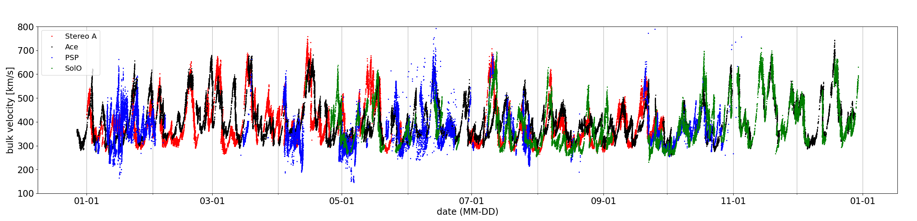
2021
without timeshift
PSP
SolO
STEREO A
ACE
timeshifted

Slide 8
2021
without timeshift
PSP
SolO
STEREO A
ACE
timeshifted

Slide 9
2021
without timeshift
PSP
SolO
STEREO A
ACE
timeshifted

Slide 10
Spatial variation of the background solar
wind in the Inner Heliosphere
Nikolett Biro^{1,2}
biro.nikolett@wigner.hu
¹Wigner Research Centre for Physics
²Eötvös Loránd University
Andrea Opitz¹, Zoltan Nemeth¹, Aniko Timar¹, Akos Madar^{1,2}, Zsuzsa Dalya¹, Gergely Koban^{1,2}
EGU22-4155
Acknowledgments
This research used version 3.1.3. (Mumford et al., 2022) of the SunPy open source software package (The SunPy Community et al., 2020).
Data analysis was performed with the AMDA science analysis system provided by the Centre de Données de la
Physique des Plasmas (CDPP) supported by CNRS, CNES, Observatoire de Paris and Université Paul Sabatier, Toulouse.
I would like to further acknowledge the respective spacecraft and instrument teams for ACE SWEPAM, PSP SPC,
SolO PAS, and STEREO A PLASTIC.
This work was supported by OTKA grant FK128548.

