Slide 1
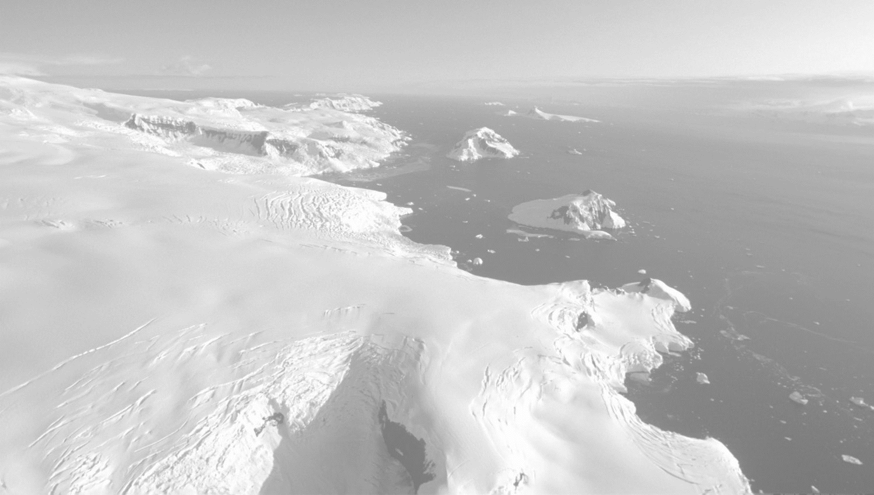


Dynamics of East Antarctic glaciers from 1937-2021 analyzed using historical aerial expedition images
Mads Dømgaard – mld@ign.ku.dk
Department of Geoscience & Natural Resource Management
Geography

Slide 2
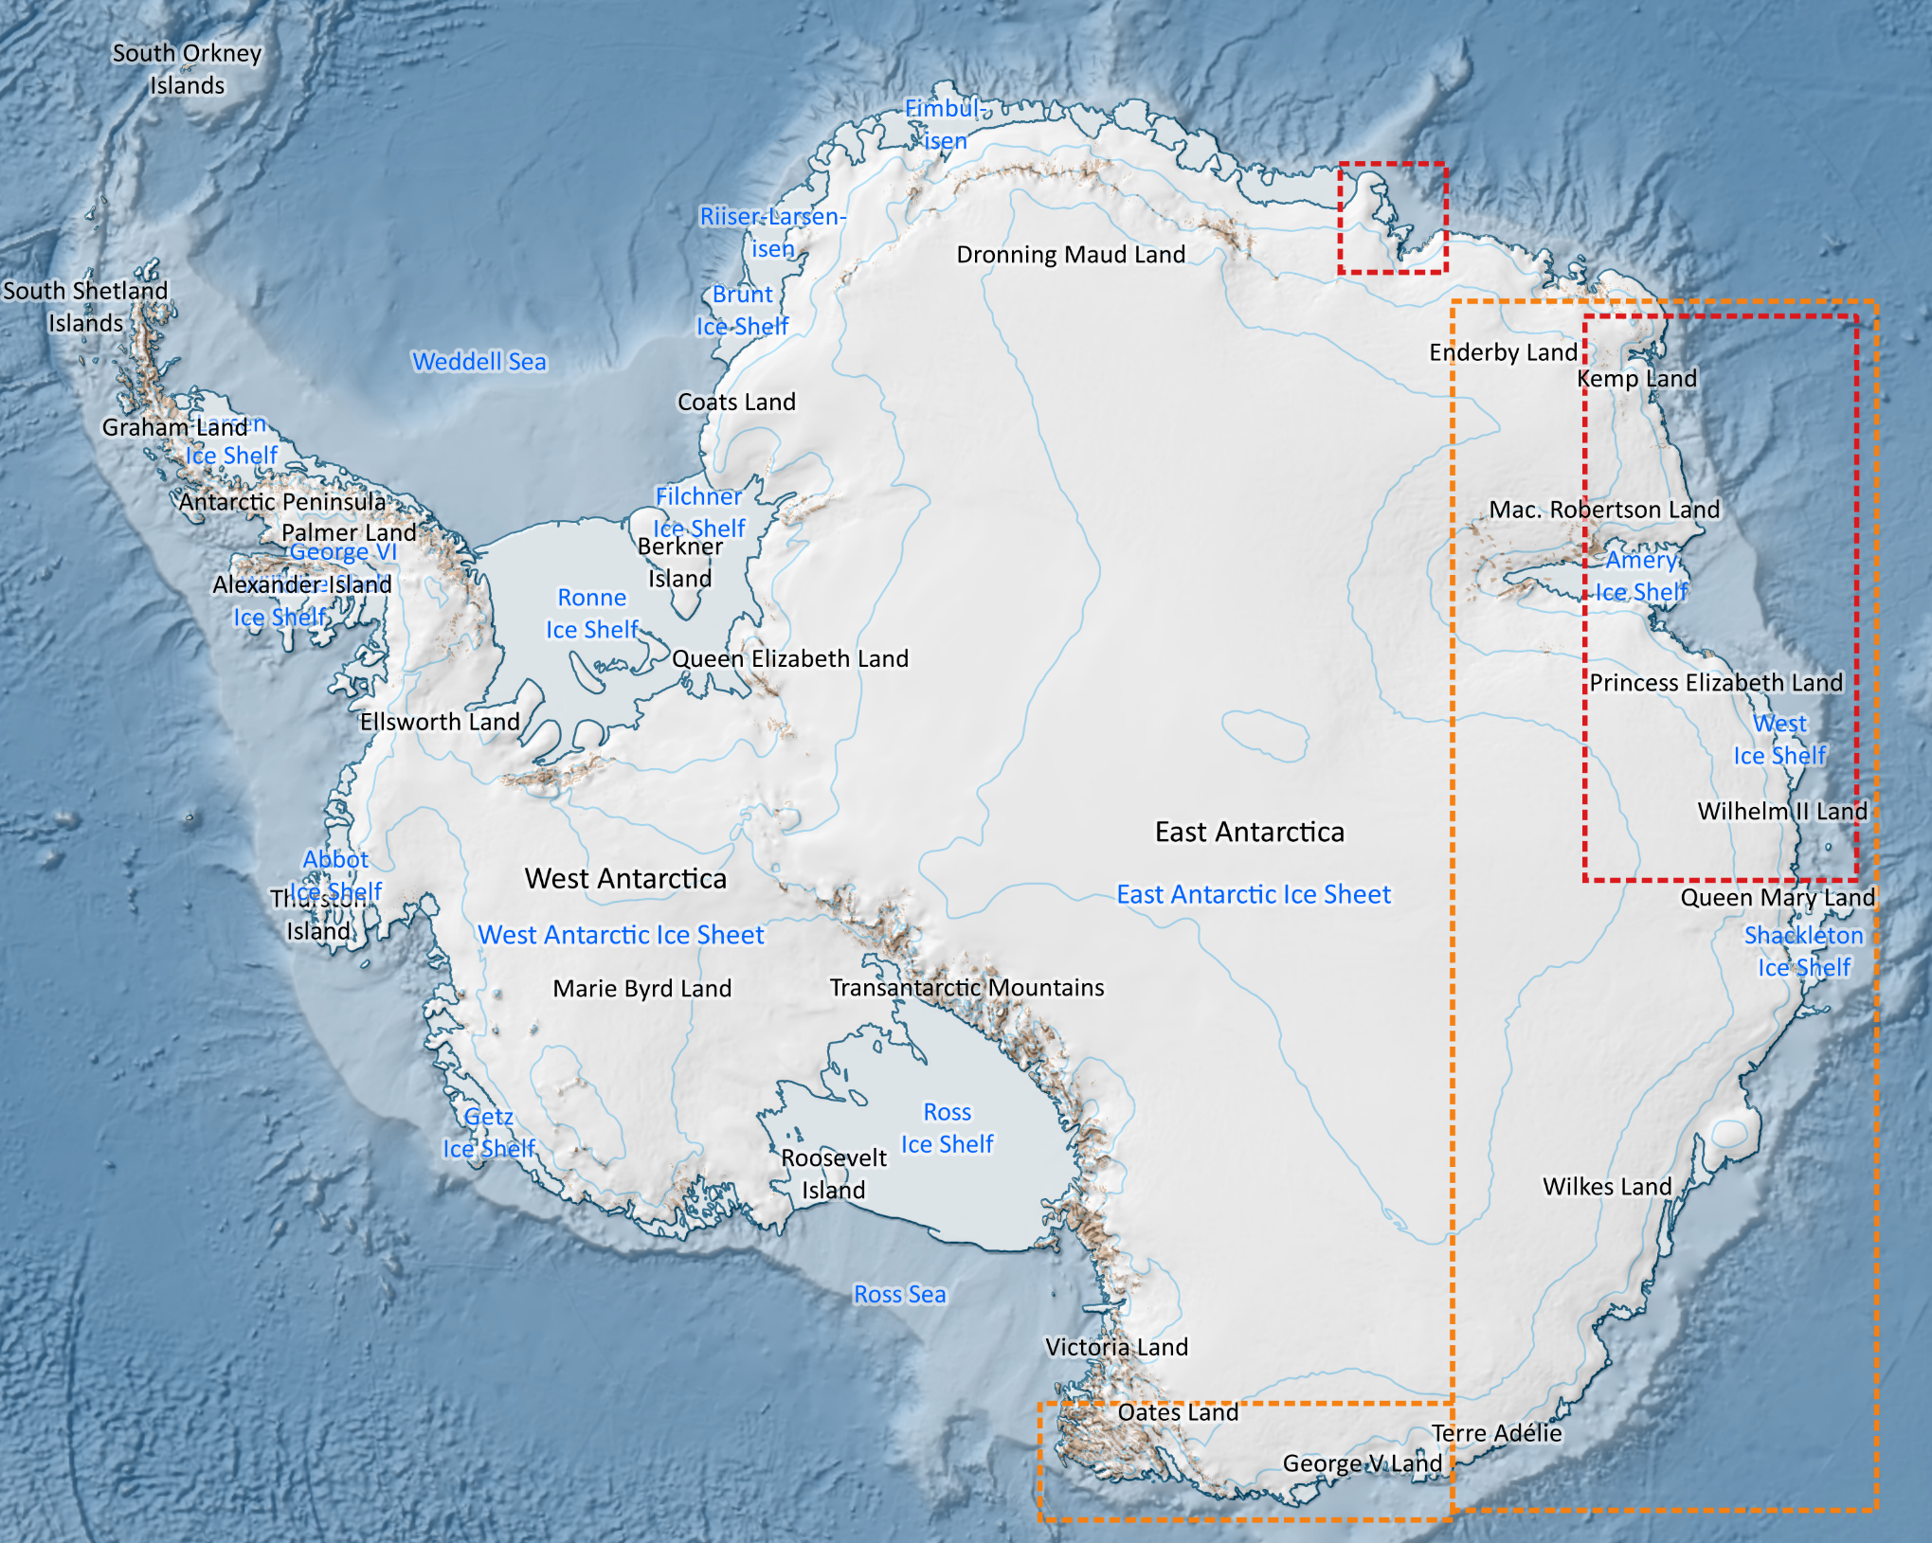
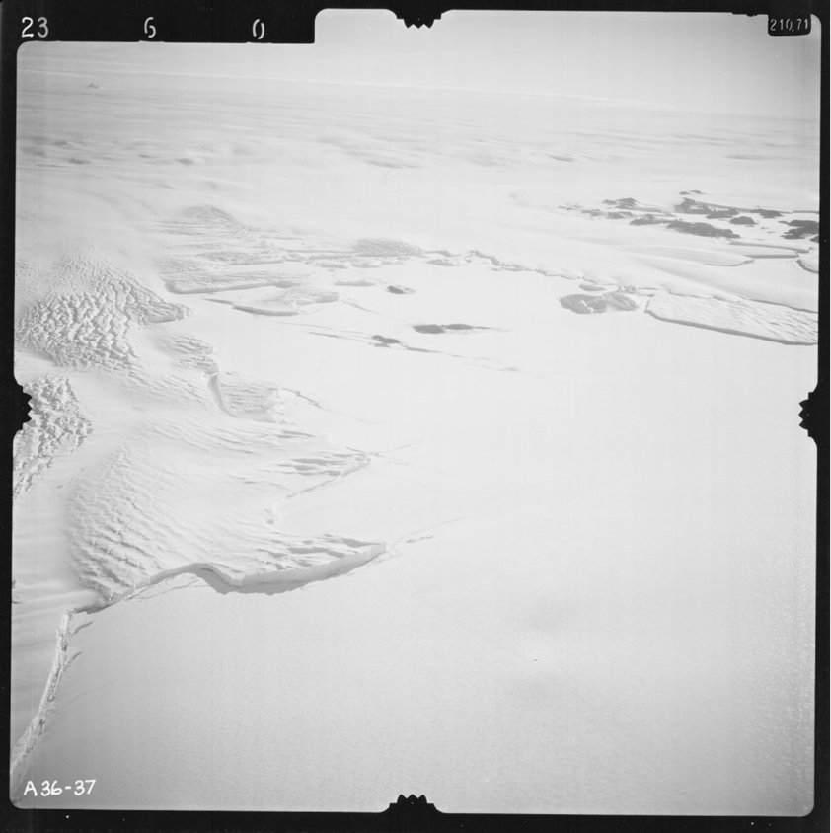
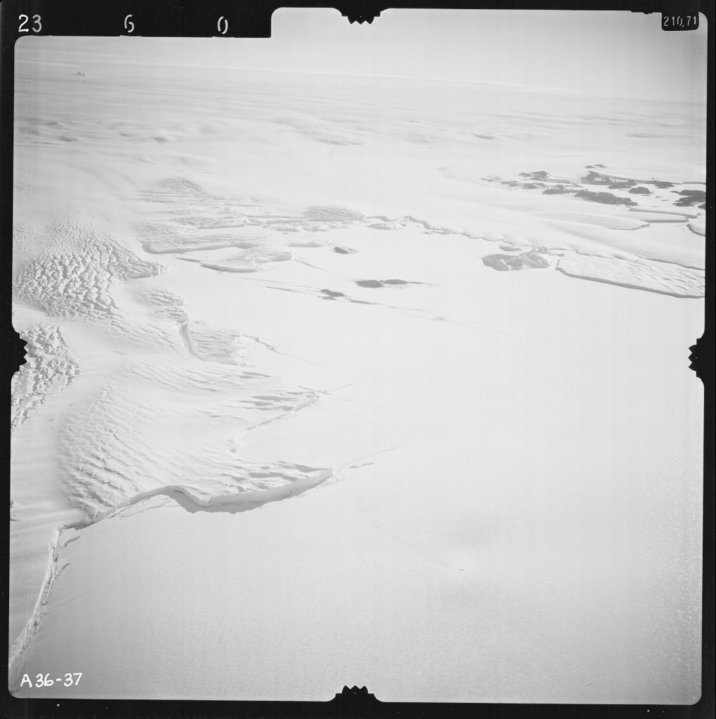
Data
Norwegian image coverage
Australian image coverage

Slide 3
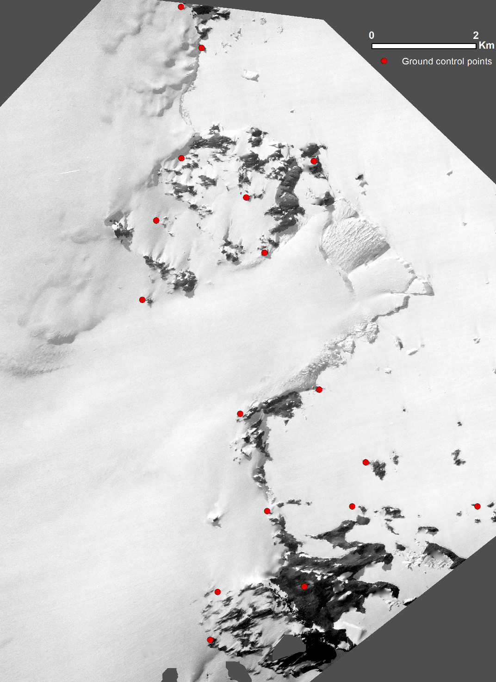
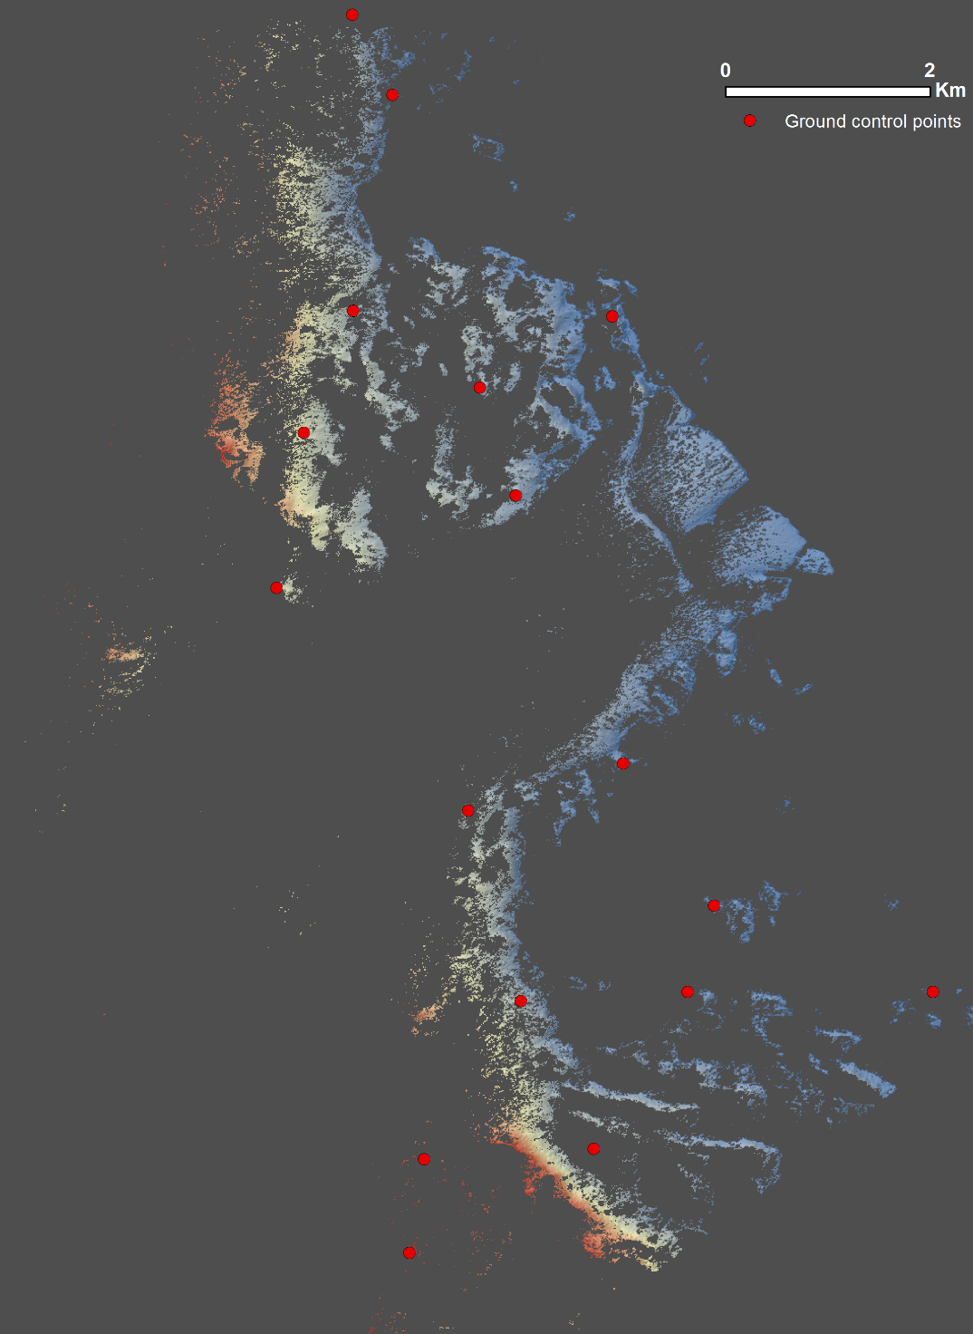
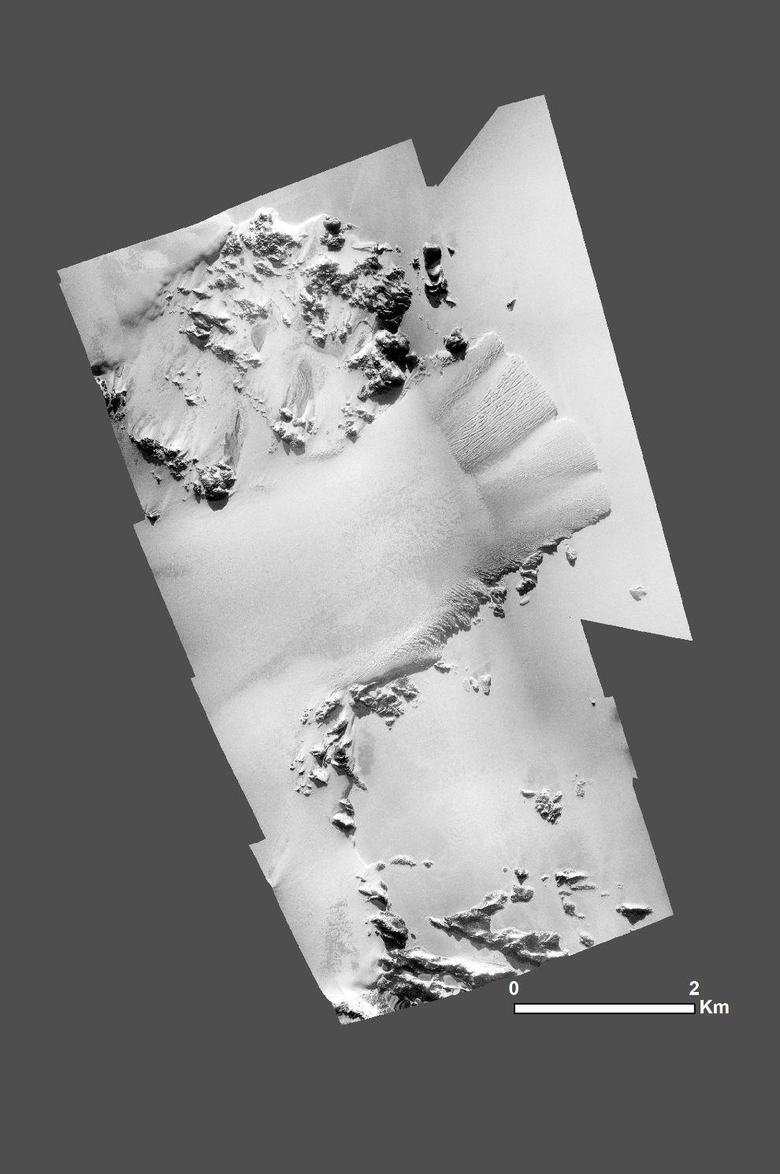
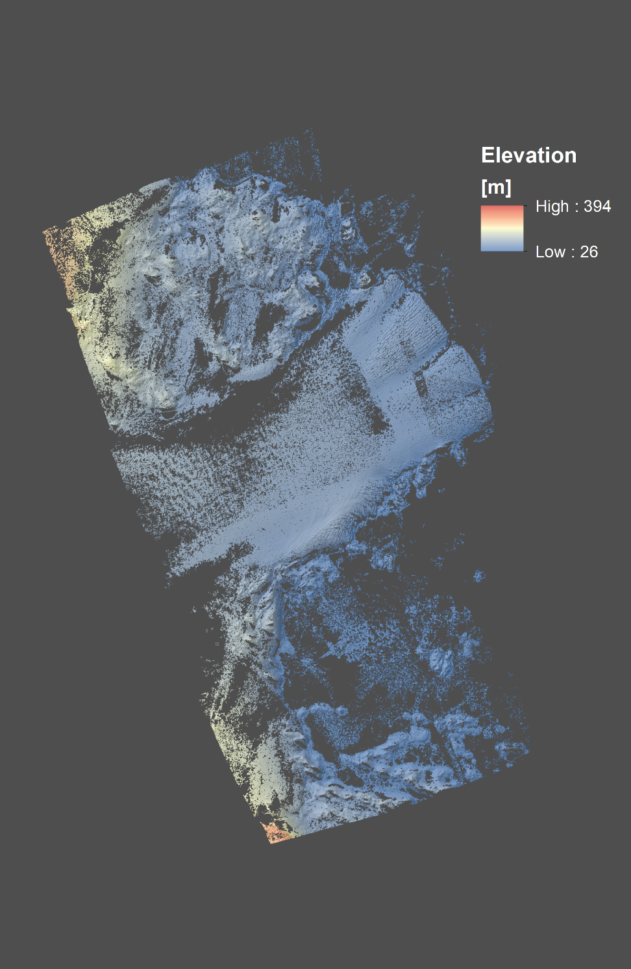
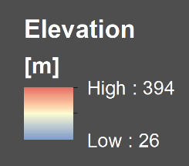
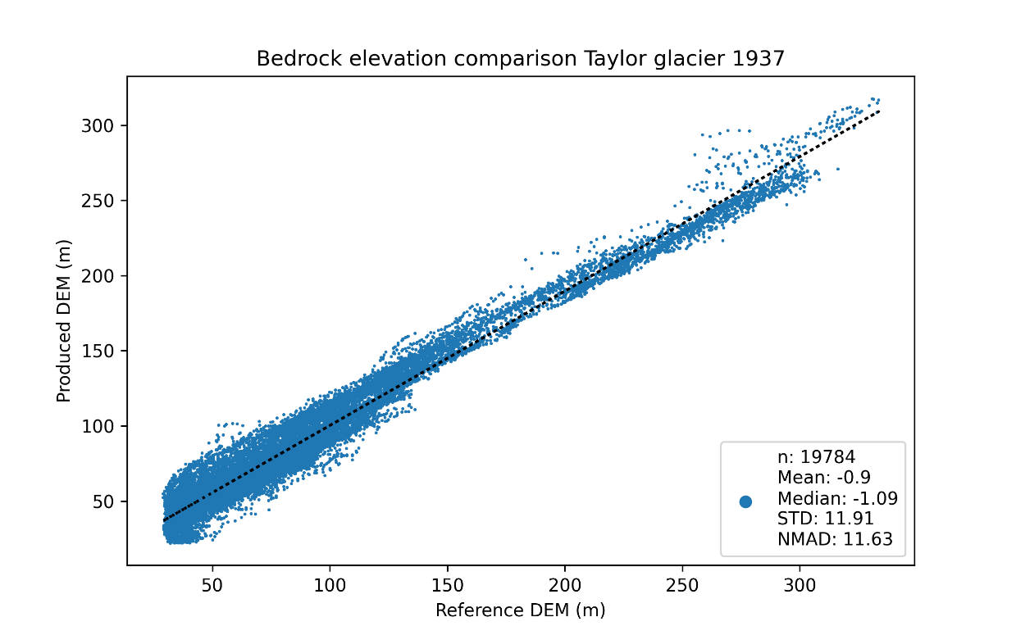
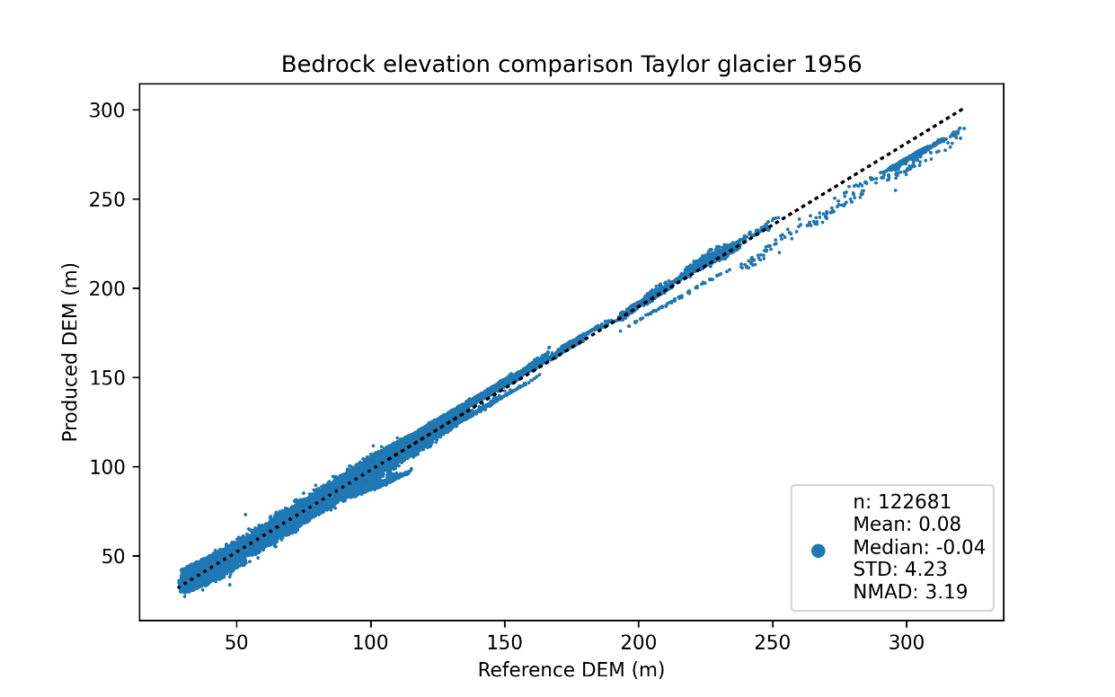
Orthophotos and elevation models
Taylor glacier 1937
Taylor glacier 1956
Orthophoto
DEM
Orthophoto
DEM
Accuracy: 11.6m
Accuracy: 3.2m

Slide 4
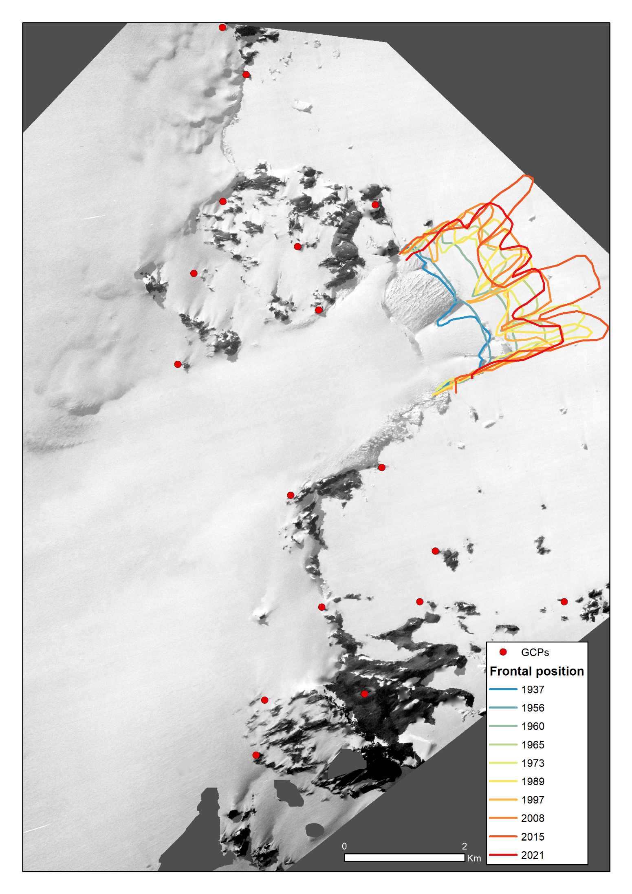
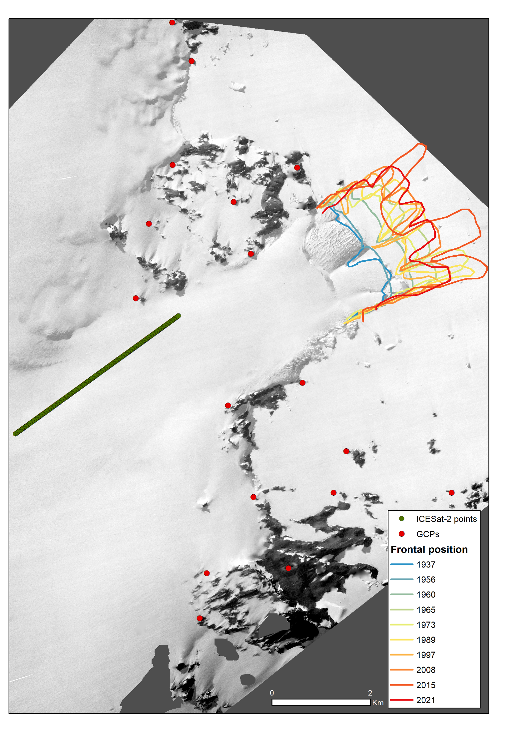
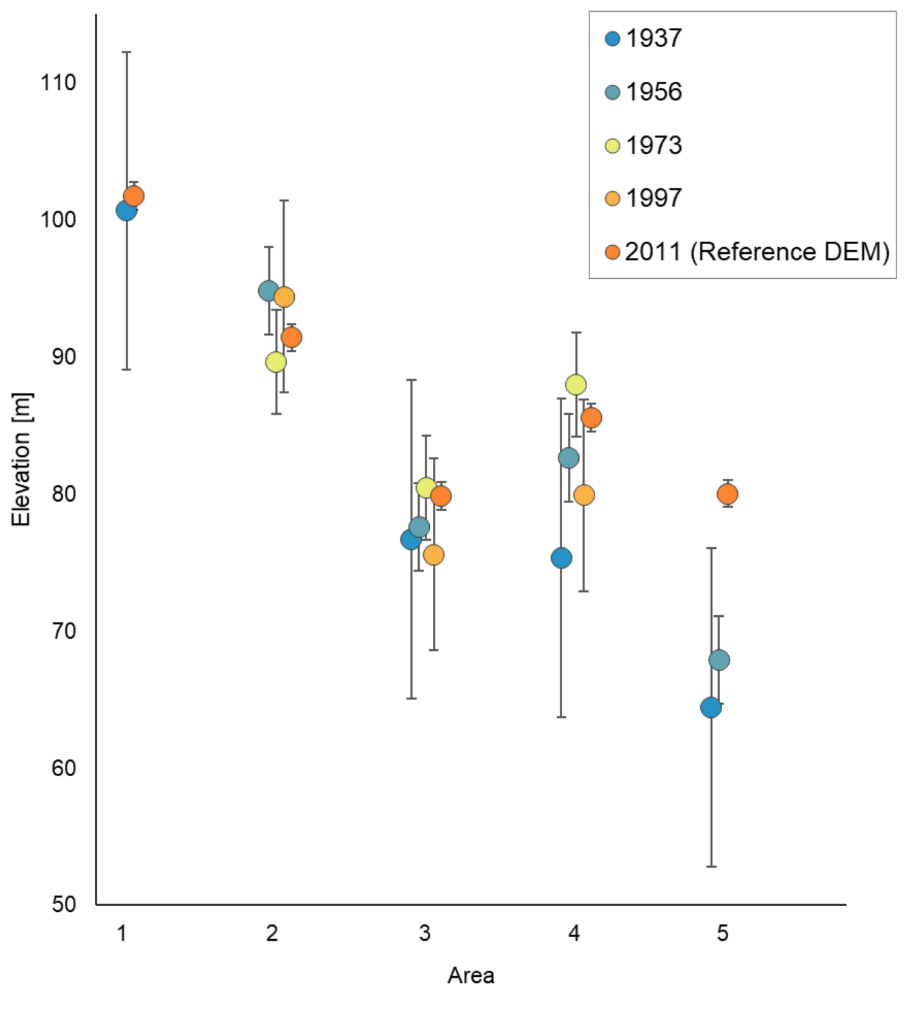
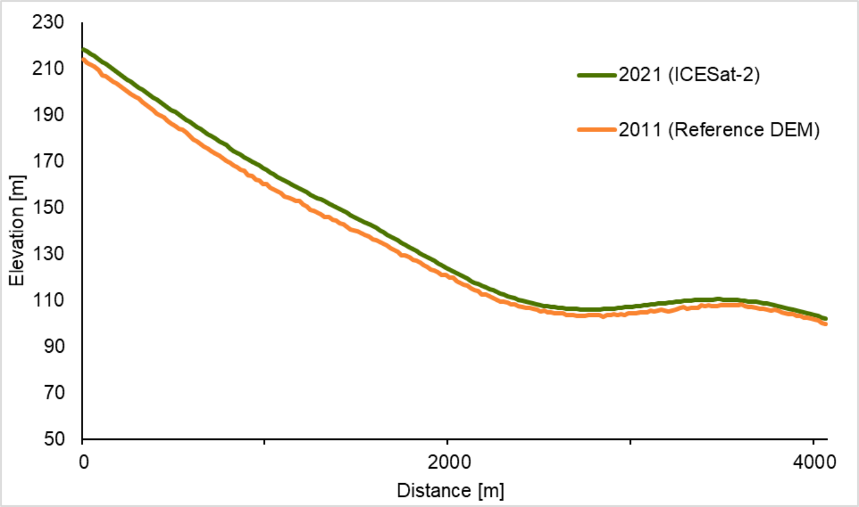
Taylor Glacier 1937-2021
5
4
2
3
1

