Slide 1

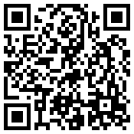


Quantifying the impact of soil erosion on soil security by using
alternative fallout radionuclides
V. García-Gamero, A. Peñuela, JL. Mas, A. Peña, S. Hurtado-Bermúdez, and T. Vanwalleghem

Slide 2

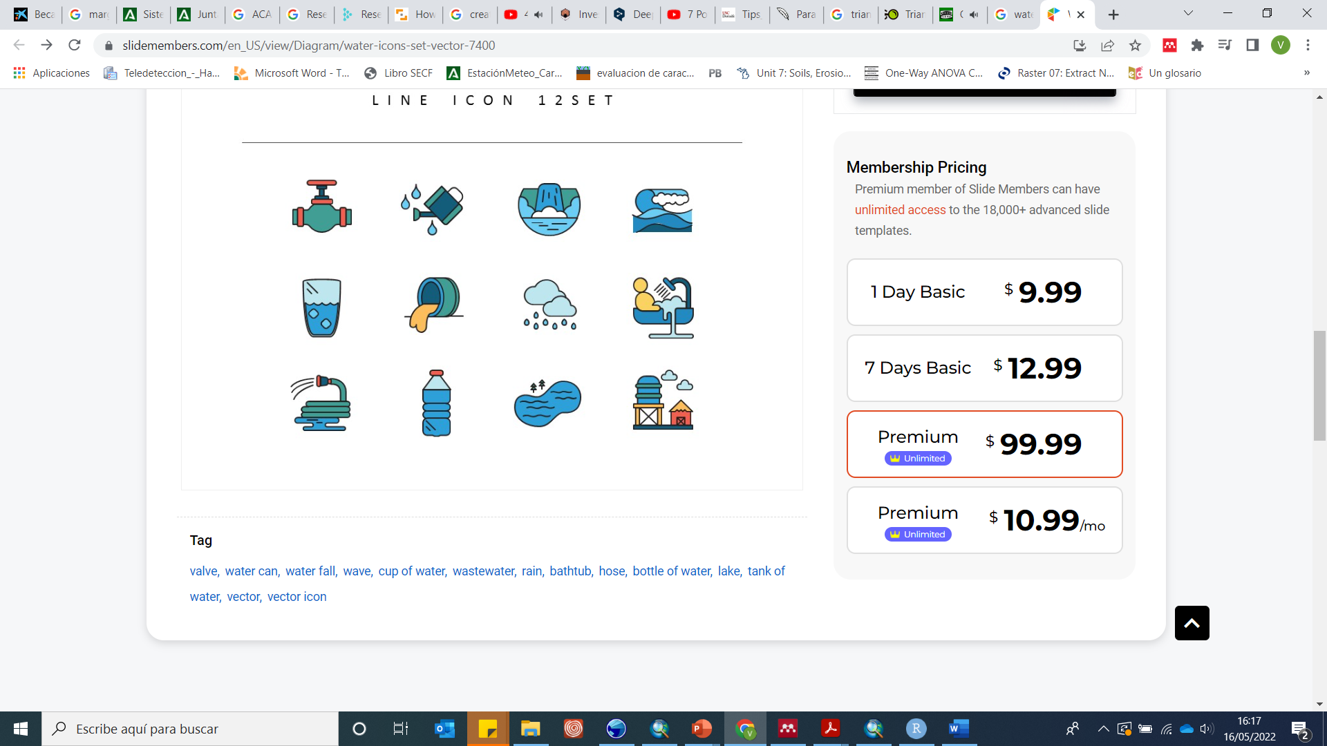
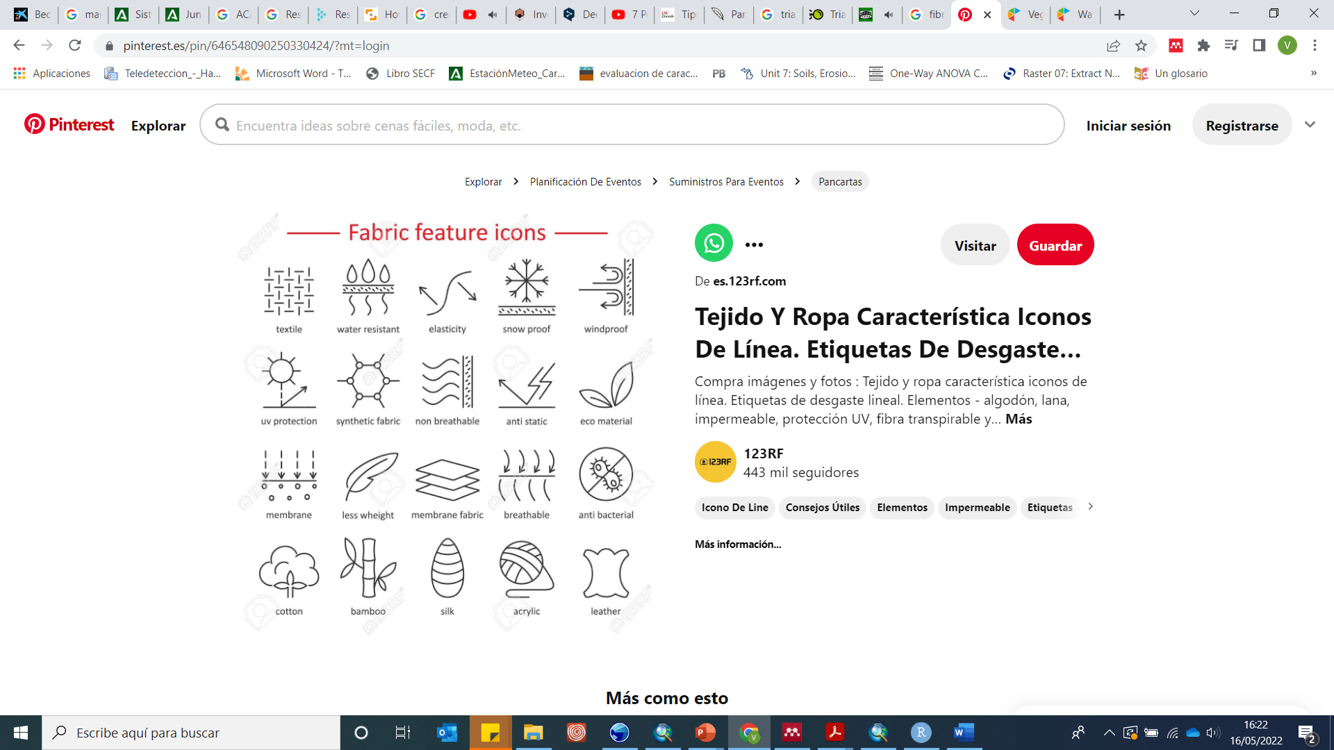
01
Food
ECOSYSTEM SERVICES
SOIL
SECURITY
FIBRE
03
02
Notes:
© Copyright PresentationGO.com – The free PowerPoint template library

Slide 3

Objectives
What is the current status and future evolution of soil security in the Guadalquivir basin (Spain)?
To calculate the soil erosion rates using fallout radionuclides tracers (FRN)

Slide 4
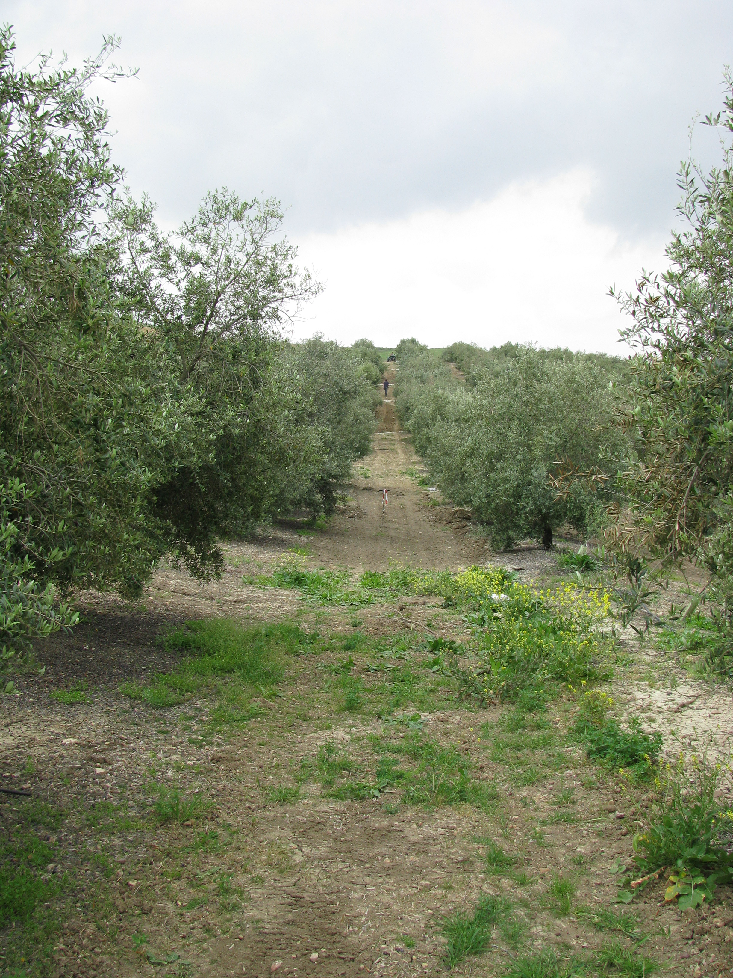
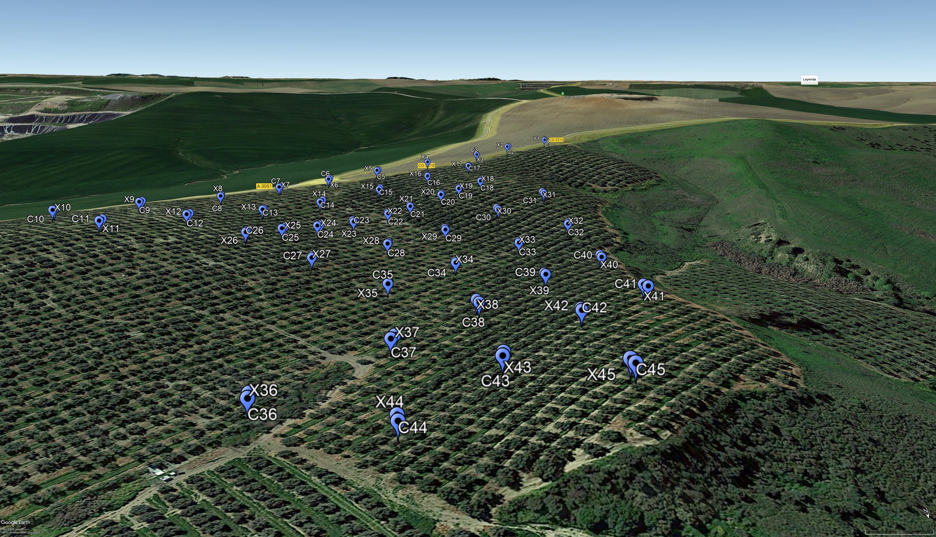

The Study Site: La Conchuela farm (southern Spain)
C
X
Below-canopy
Inter-row

Slide 5
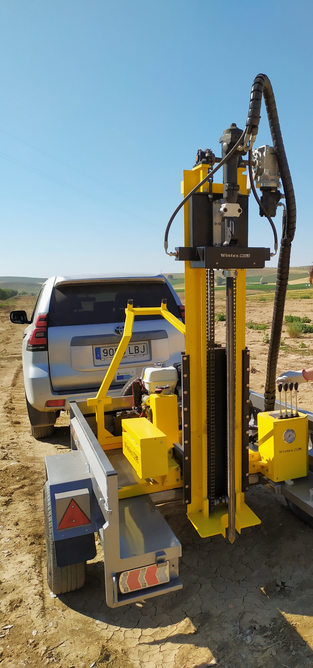
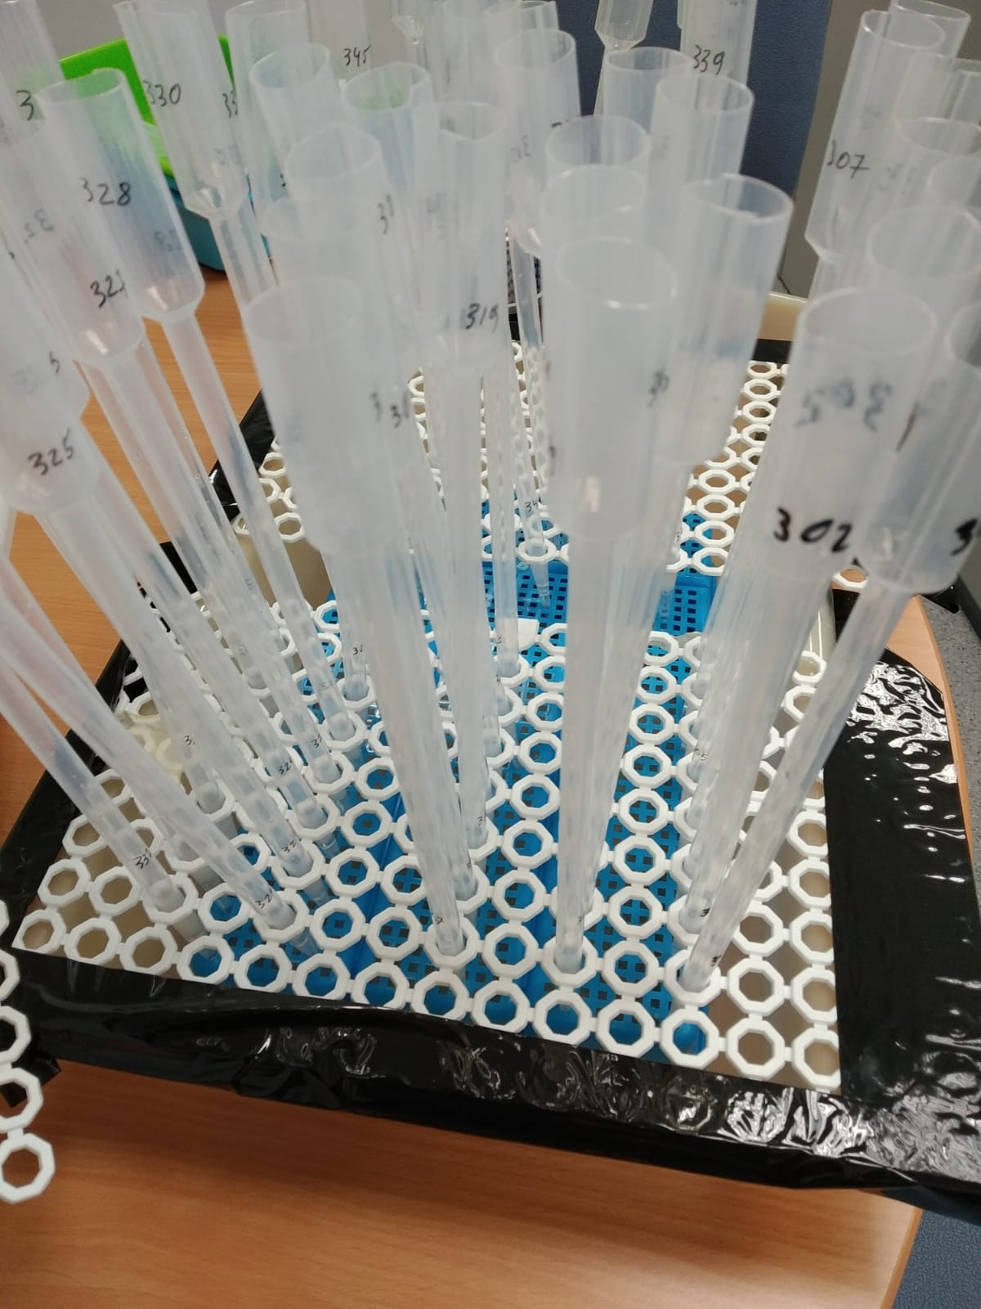
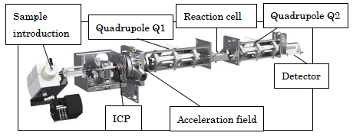
Determination of soil erosion rates by FRN tracers
Sampling
Separation of Pu
Analysis of Pu isotopes
Inventory (Bqm⁻²)
a(²³⁹⁺²⁴⁰Pu) (mBq kg⁻¹)

Slide 6

Determination of soil erosion rates by FRN tracers
Inventory (Bqm⁻²)
L. Arata et al. / Journal of Environmental Radioactivity 162-163 (2016) 45-55
MODERN (Modelling Deposition and Erosion Rates with Radionuclides)
Erosion and deposition rates:
$$E \left(t {ha}^{−1}y^{−1}\right)=\frac{0.1∆z(cm)ρ_{bulk}(kgm^{−3})}{2010−1963(y)}$$

Slide 7
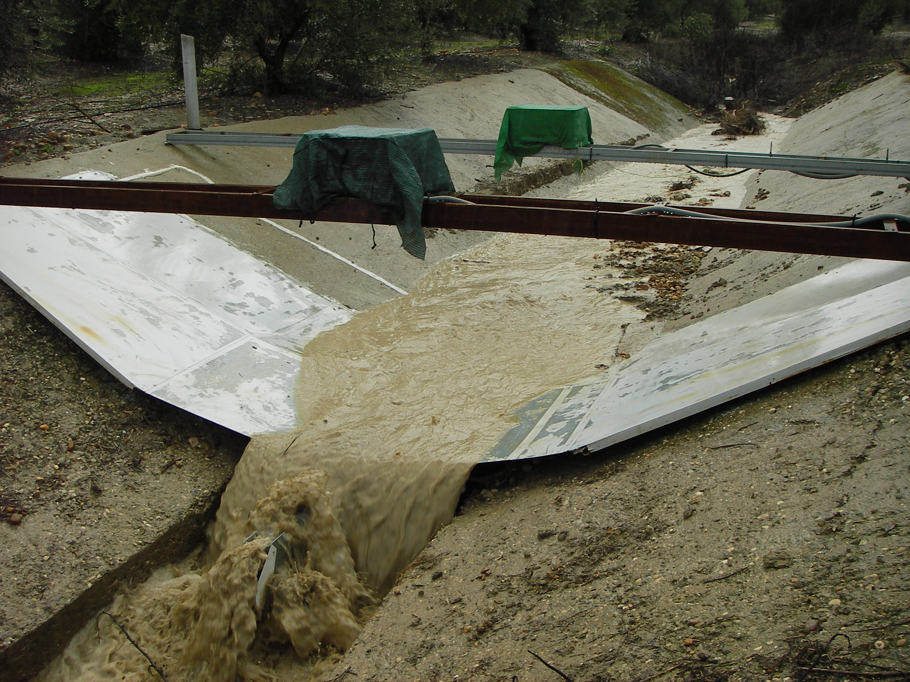
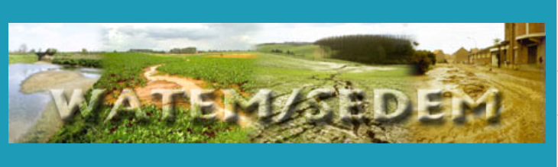
Validating soil erosion rates: field data + modelling
Calibration Factor: Transport capacity coefficient (ktc)
Optimum values maximizing the NSE values

Slide 8
²³⁹⁺²⁴⁰Pu redistribution rates: Inter-row
t ha⁻¹ y⁻¹ | Mean | SD
Erosion rates | -89.5 | 56.9
Depositon rates | 19.6 | 11.2

Slide 9
²³⁹⁺²⁴⁰Pu redistribution rates: Below-canopy
t ha⁻¹ y⁻¹ | Mean | SD
Erosion rates | -59.3 | 23.6
Depositon rates | 9.25 | NA

Slide 10
WaTEM/SEDEM redistribution rates
t ha⁻¹ y⁻¹ | Mean | SD
Erosion rates | -37.7 | 27.4
Depositon rates | 25.2 | 128.4

Slide 11
Comparison ²³⁹⁺²⁴⁰Pu derived rates to WATEM/SEDEM modelled rates

Slide 12
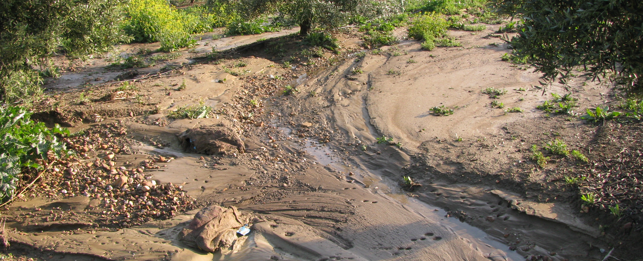
Conclusions
WaTEM/SEDEM rates are in the same range as ²³⁹⁺²⁴⁰ Pu rates
Difficulties for a correct identification of deposition rates
Acknowledgment
This work is supported by the project “Quantifying the impact of SOil erosion and cLImaTe chAnge on soIl secuRity by using alternativE fallout radionuclides” (SOLITAIRE) funded by MINECO.

Slide 13
Quantifying the impact of soil erosion on soil security by using
alternative fallout radionuclides
V. García-Gamero, A. Peñuela, JL. Mas, A. Peña, S. Hurtado-Bermúdez, and T. Vanwalleghem
e-mail: g02gagav@uco.es

