Slide 1





New insights into the non-conservative behaviors of nutrients triggering phytoplankton blooms in the Changjiang (Yangtze) River Estuary
Wang mengyu
East China Normal University
52203904022@stu.ecnu.edu.cn
2022.05.23
EGU22-4174

Slide 2

CONTENTS
01
02
03
04
Background
Methodology
Results
Conclusion

Slide 3
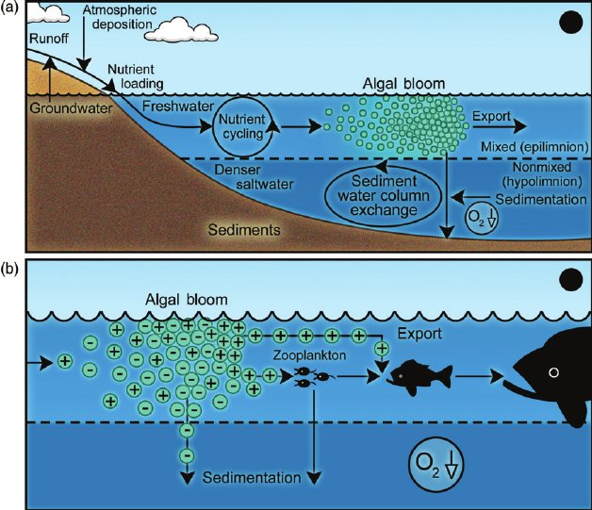
Background
high nutrient uptake rate
the mechanisms responsible for the occurrence of algal blooms?
high chlorophyll-a content
studying non-conservative behaviors of nutrients
box budget calculations (Gao et al., 2008a)
partial correlation analysis (Gao et al., 2008b)
stable isotopes (Wang et al., 2018)
analysis of water age of seawater masses (Gao & Zong, 2021)
in situ seawater incubation
Figure 1. (a) Linkage between external nutrient loading, internal nutrient cycling, nutrient-enhanced algal bloom formation, and hypoxia under salinity-stratified conditions. (b) Differential impact on hypoxia of phytoplankton species.
(Paerl H W and Justić D, 2011)

Slide 4
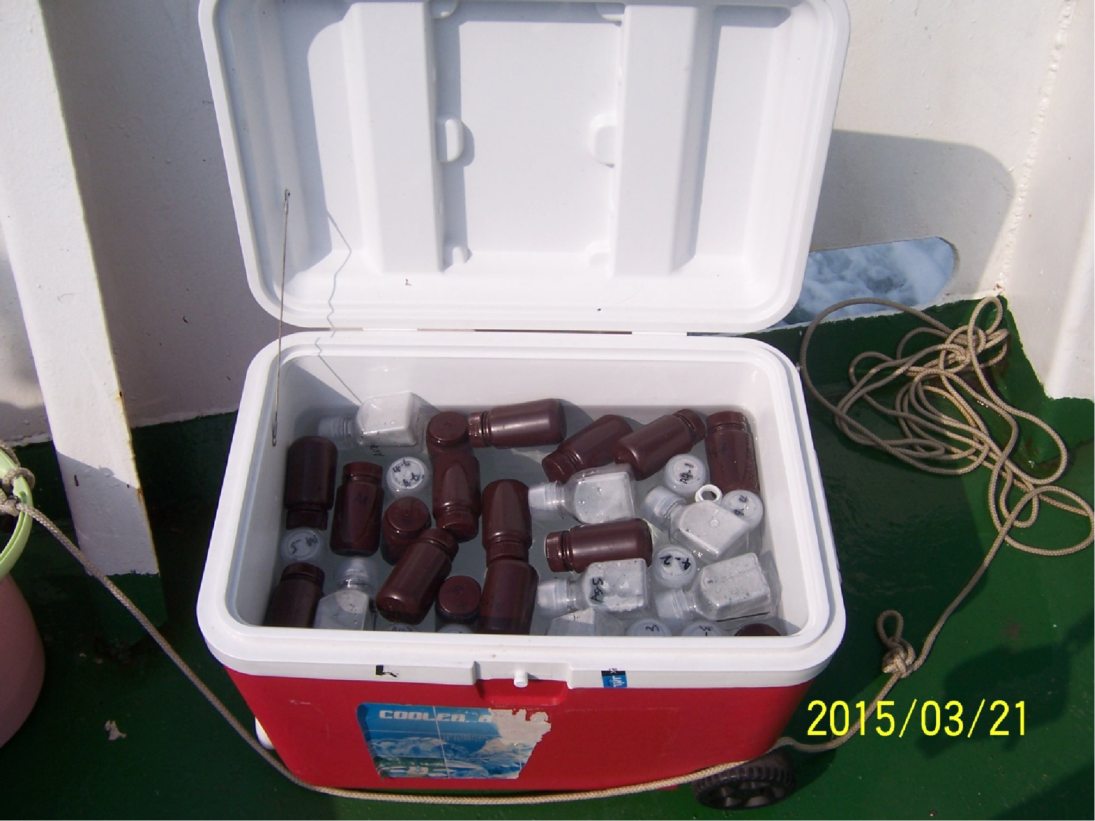
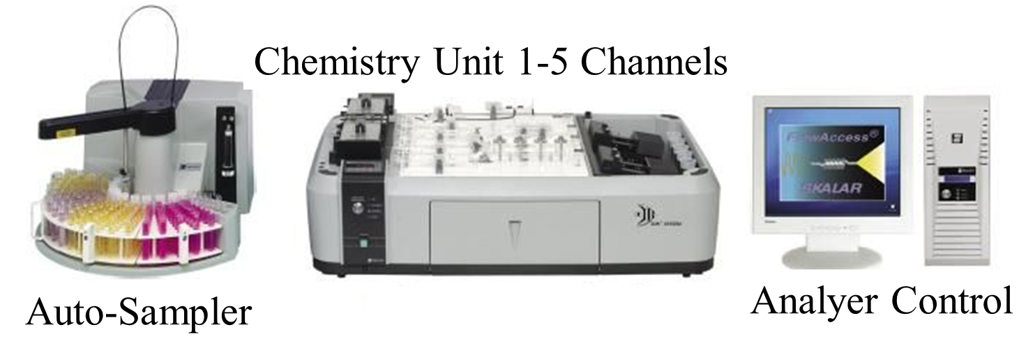
Methodology
Figure 2. In-situ incubation
Figure 3. Nutrient measurements

Slide 5
Results
winter : NO₃⁻ near conservative
summer : larger NO₃⁻ sinks
the intermediate salinity regions
Figure 5. Average values (± standard deviation) of the variation rate of NO3– over the eight salinity ranges from 0–1 to 30–35 during the four cruises.
Figure 4. Distributions of salinity and variation rates of NO₃– (μM/h) at the surface during the four cruises

Slide 6
Results
Nutrient dynamics
phytoplankton activities
the metabolism of the microbial (non-phytoplankton) community.
Diatom
high nutrient uptake rates the outer edge of the TMZ
higher chlorophyll-a concentrations a time lag existed!
the outer edge of the high nutrient uptake rate zone
Figure 6. Relationships between the variation rates of NO₃– and those of the other four nutrients (SiO₃^{2–}, PO₄^{3–}, NH₄⁺, and NO₂–)
Figure 7. Positions of stations with high nutrient uptake rates (red points) and high chlorophyll-a concentrations (green points)

Slide 7
Conclusion
nutrient concentration ＋ nutrient variation rates
understanding the mechanism of in situ bloom events
In summer and in the direction from land to sea :
1) TMZ : the physical filter
2) high net nutrient uptake rates but low chlorophyll-a concentrations : the biogeochemical filter
3) high chlorophyll-a concentrations but low net nutrient uptake rates
Figure 8. Estuaries as a biogeochemical filter

Slide 8
Thank you!
EGU22-4174

