Slide 1
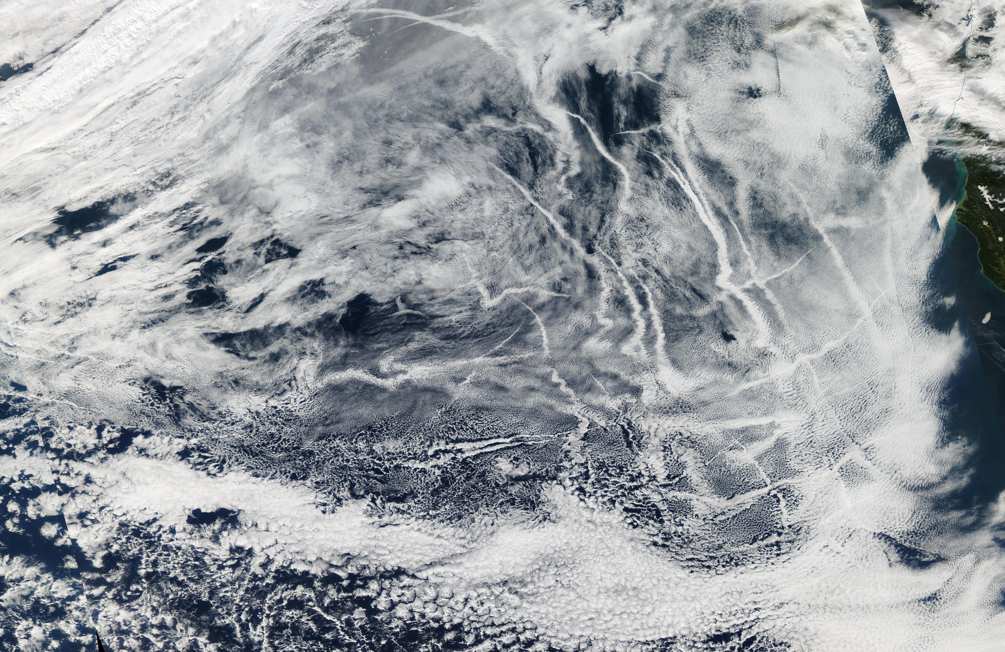



Invisible Ship Tracks
Peter Manshausen
EGU, Clouds, Aerosols,
Radiation and Precipitation
26/5/2022
with: Duncan Watson-Parris¹, Matthew Christensen², Jukka-Pekka Jalkanen³, and Philip Stier¹
¹University of Oxford, ²PNNL, ³Finnish Meteorological Institute
This research receives funding from the European Union’s Horizon 2020 research and innovation programme under Marie Skłodowska-Curie grant agreement No 860100 (iMIRACLI).

Slide 2
Background
ship tracks studied since 60s (Conover, 1966)
one of many opportunistic experiments (Christensen et al., 2021)
allow for direct comparison of polluted and unpolluted cloud
can be time-resolved with knowledge of emissions (Gryspeerdt et al. 2021)

Slide 3
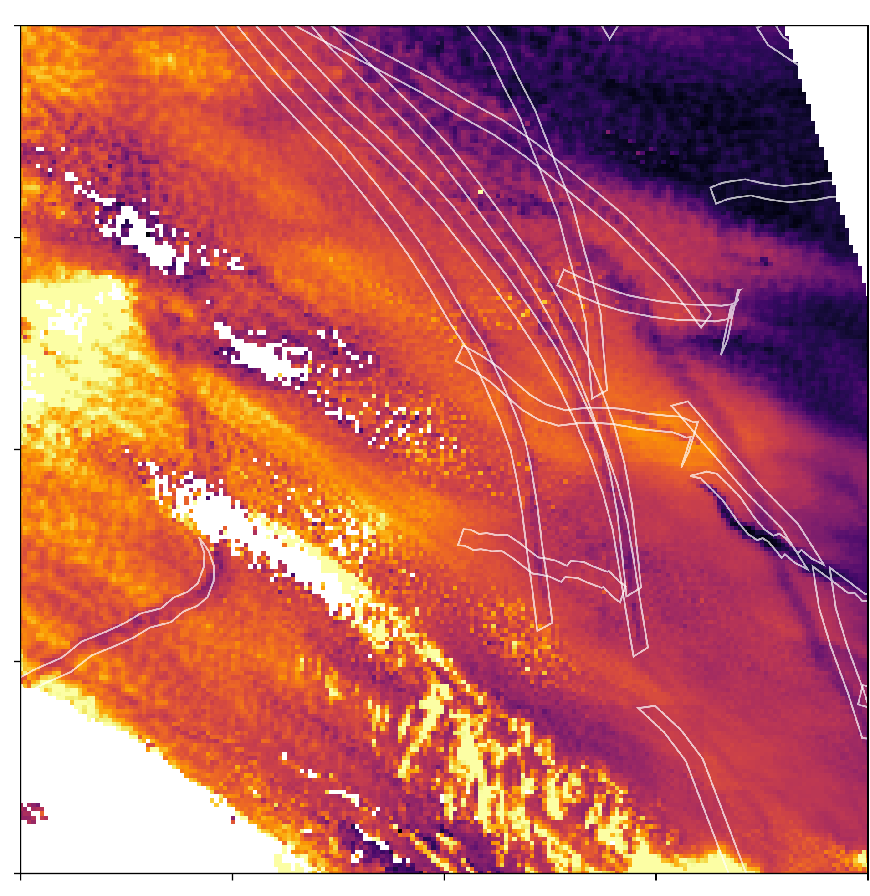
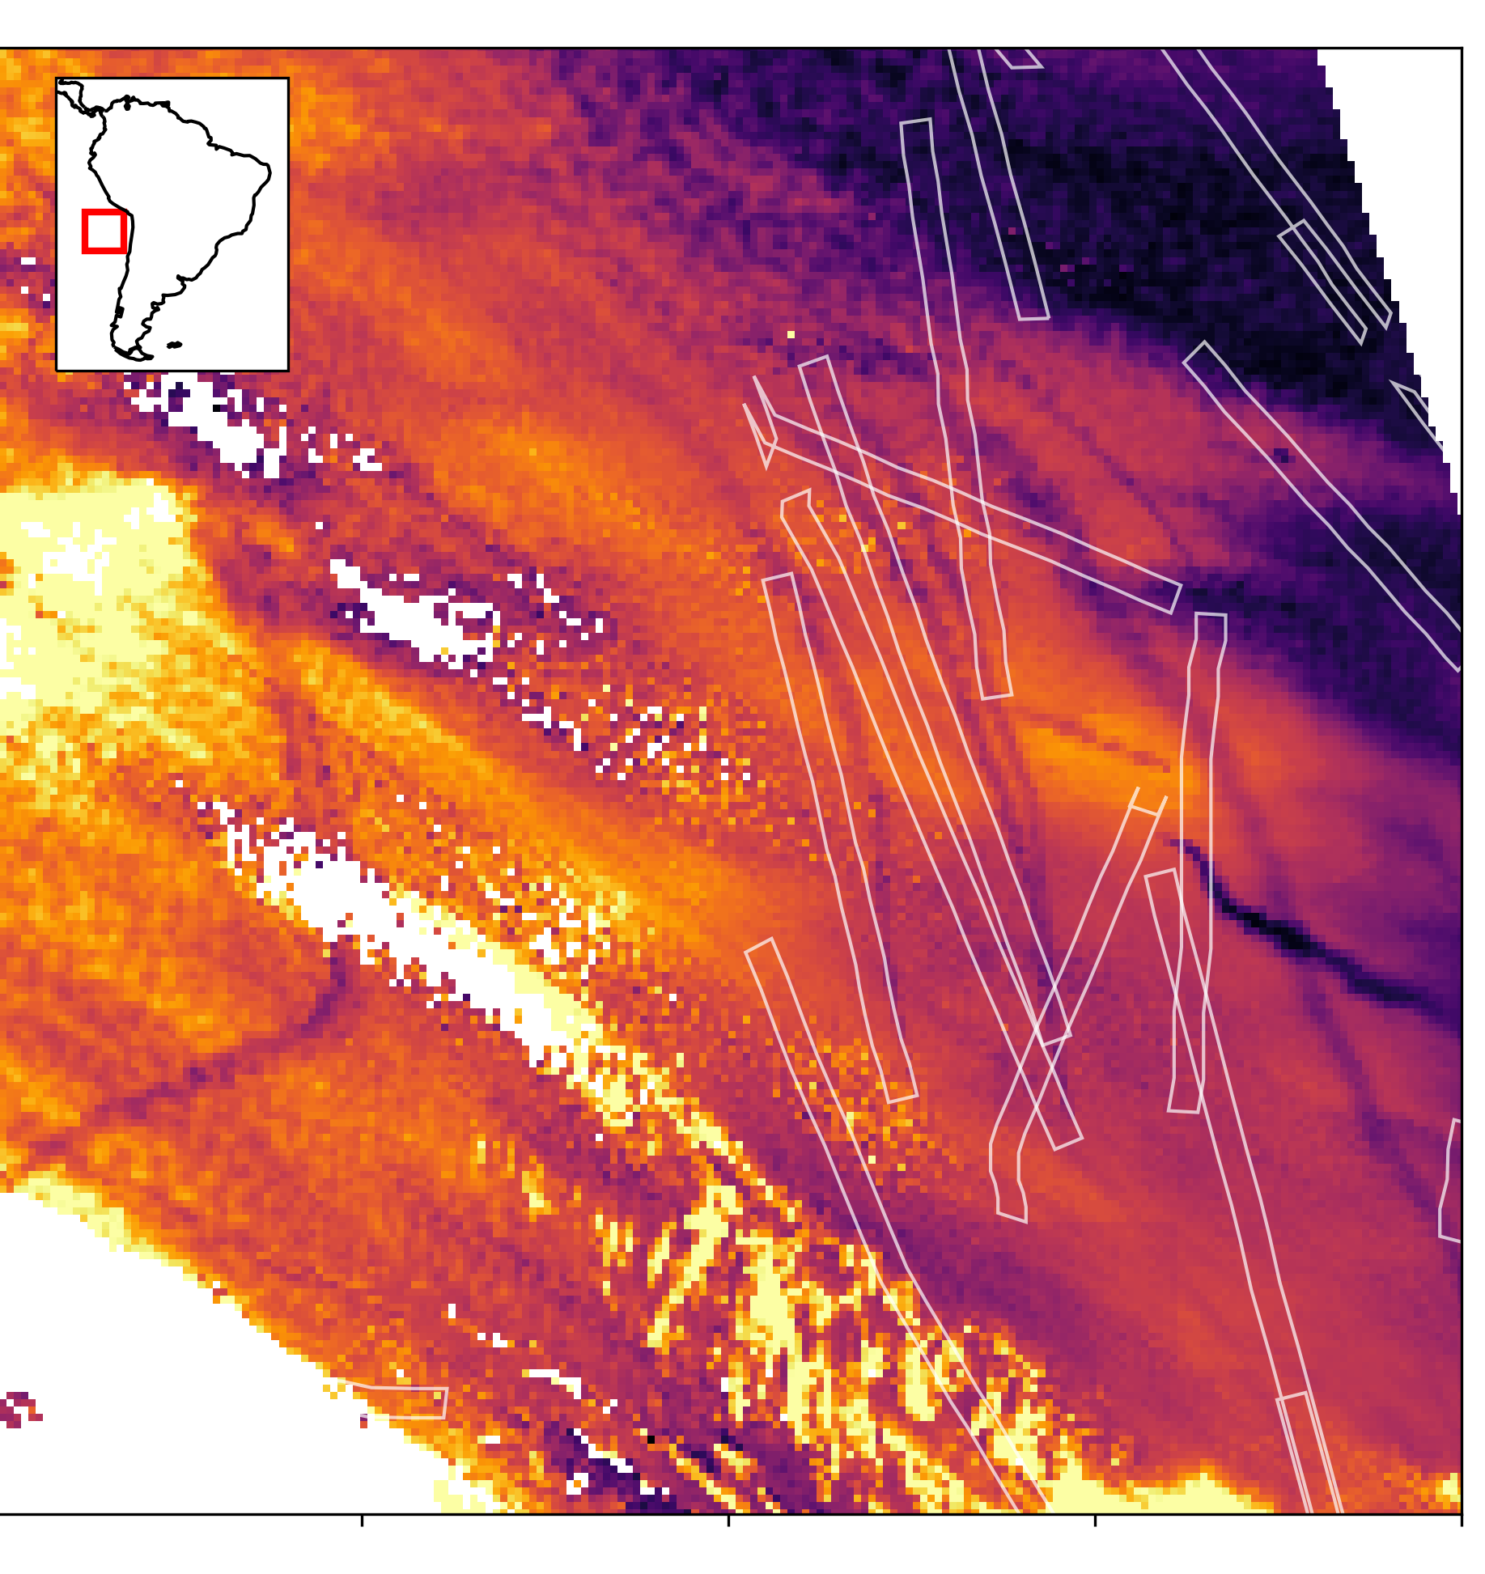
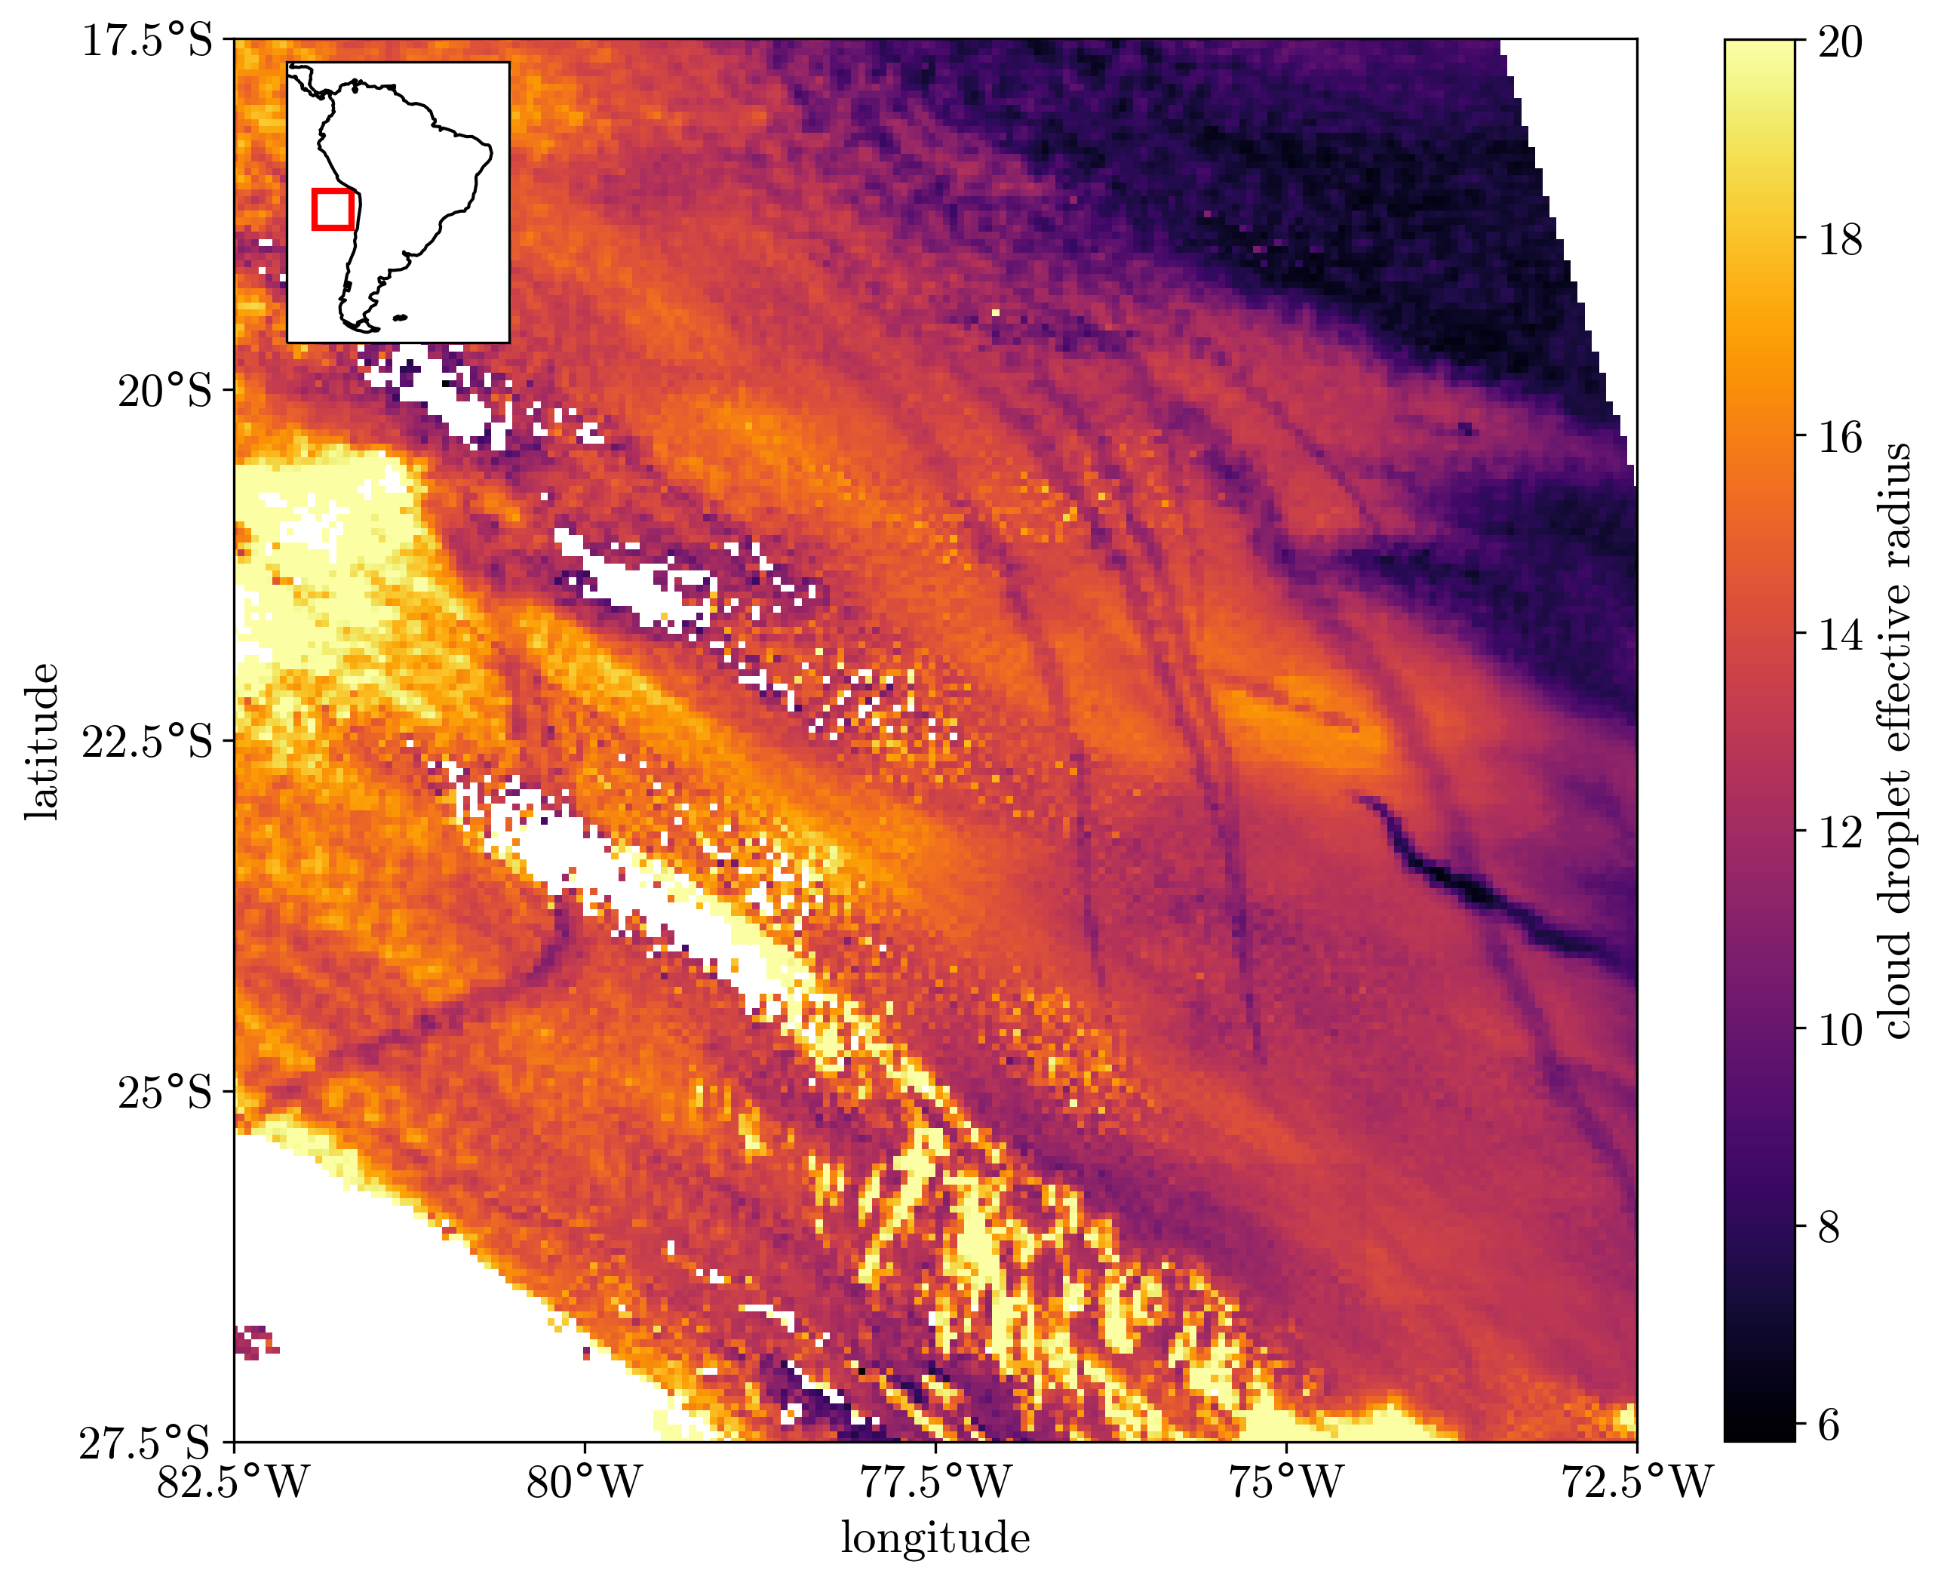
What is different here?
not logging ship tracks by hand
instead: using ship emissions
use reanalysis data and HYSPLIT model to advect emissions with wind
collocate with MODIS retrievals
compare with region to the side (~30 km)
analyse equivalent of 4 Million ship tracks
Notes:
usually, tracks logged visually from satellite images of clouds
method relying on shipping emissions
dataset of hourly emissions
advected with HYSPLIT winds until time of satellite retrieval
collocate with MODIS
also retrieve properties on either side of tracks
see that this mostly works

Slide 4
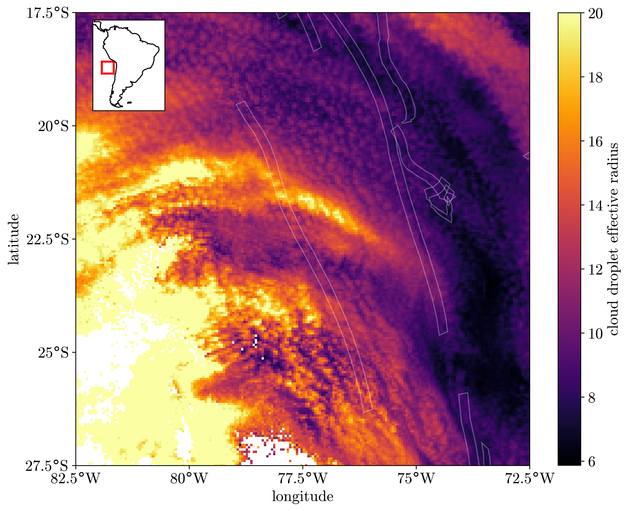
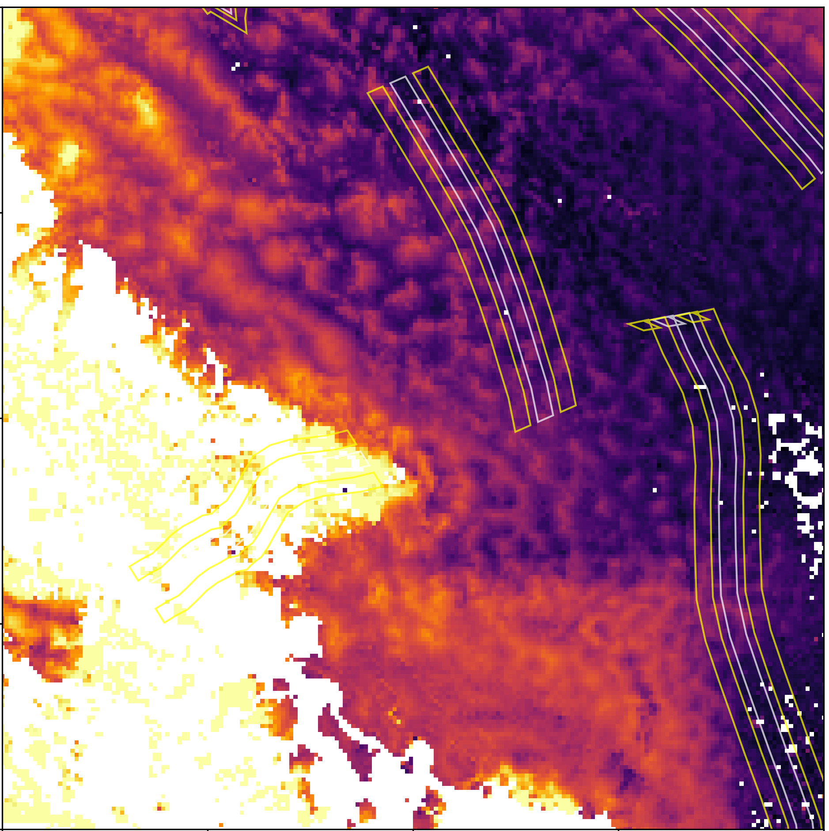
Can we detect invisible tracks?
Yes! Signal in droplet number on days without visible tracks
only clear when averaging over several ship tracks/days
Notes:
can detect tracks even on days when none visible by eye in the image
need O(10) days/200 ships to find this

Slide 5
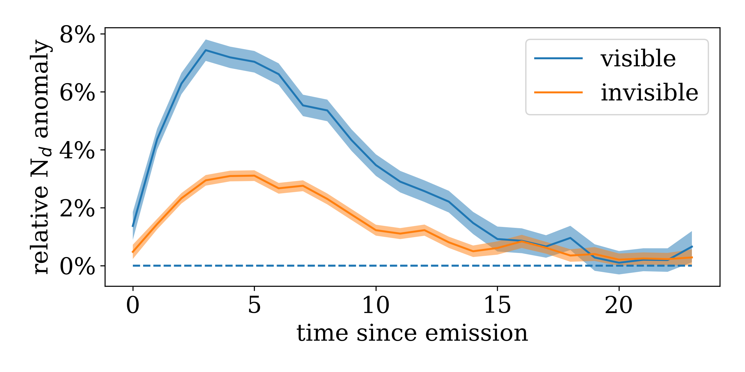
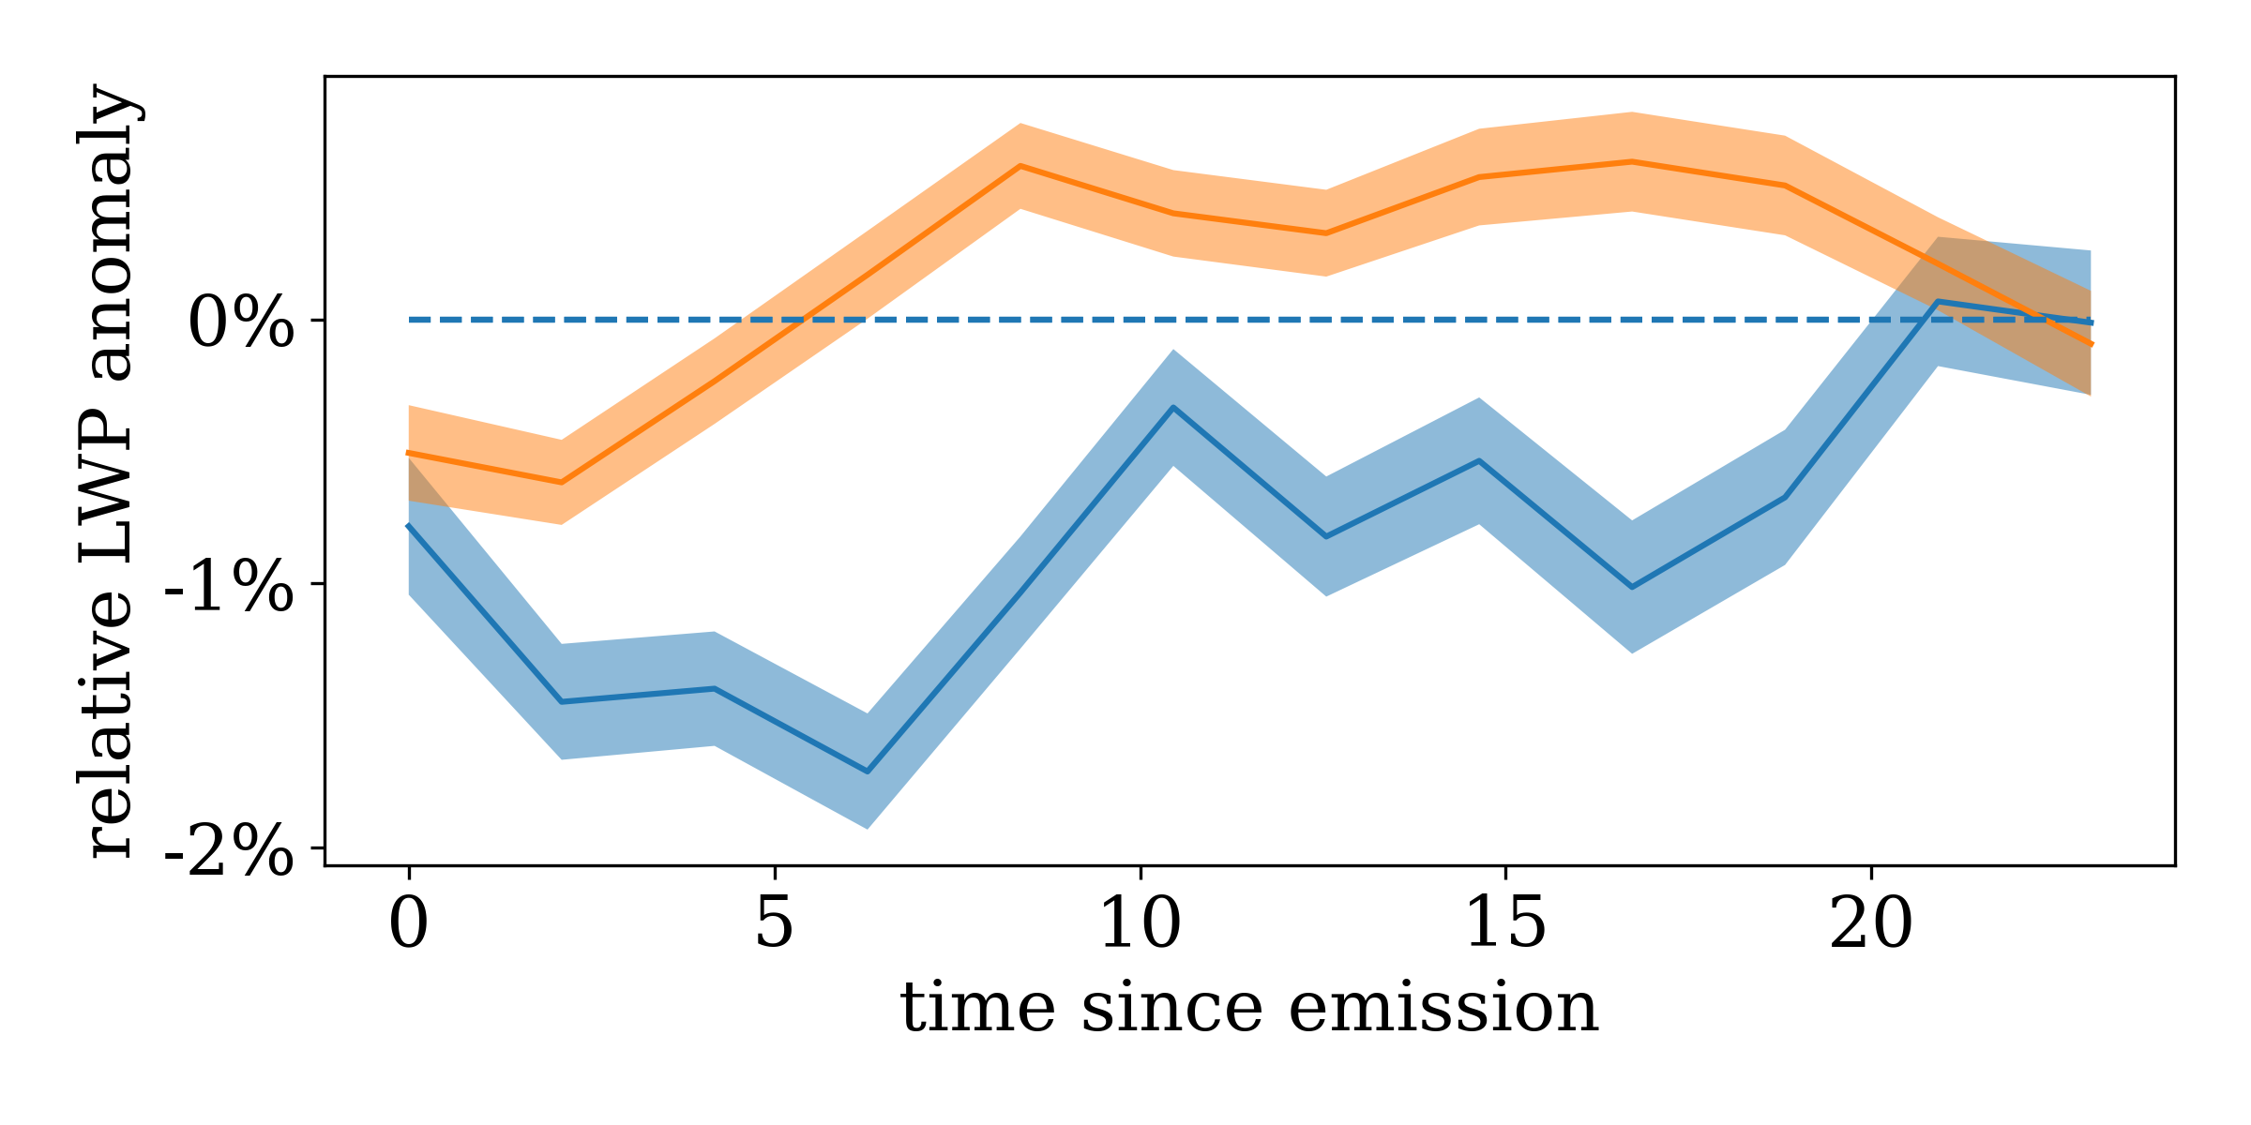

Are invisible tracks different?
Chilean Sc 2014-2019
cf. Gryspeerdt et al, 2021
divide days into ‘with any visible tracks’ and ‘without’
droplet number (Nd) increase even on days without visible tracks
Liquid Water Path (LWP) increase
visible
invisible
Notes:
split data in ‘visible shiptracks days’ and ’no vis shiptracks days’
plot relative anomaly in droplet number
= average of in-track Nd in the position where aerosol was emitted t hours before / average out-of track
surprisingly, find Nd increase on days without tracks
also find different LWP response in non-precipitating clouds, increase rather than decrease

Slide 6
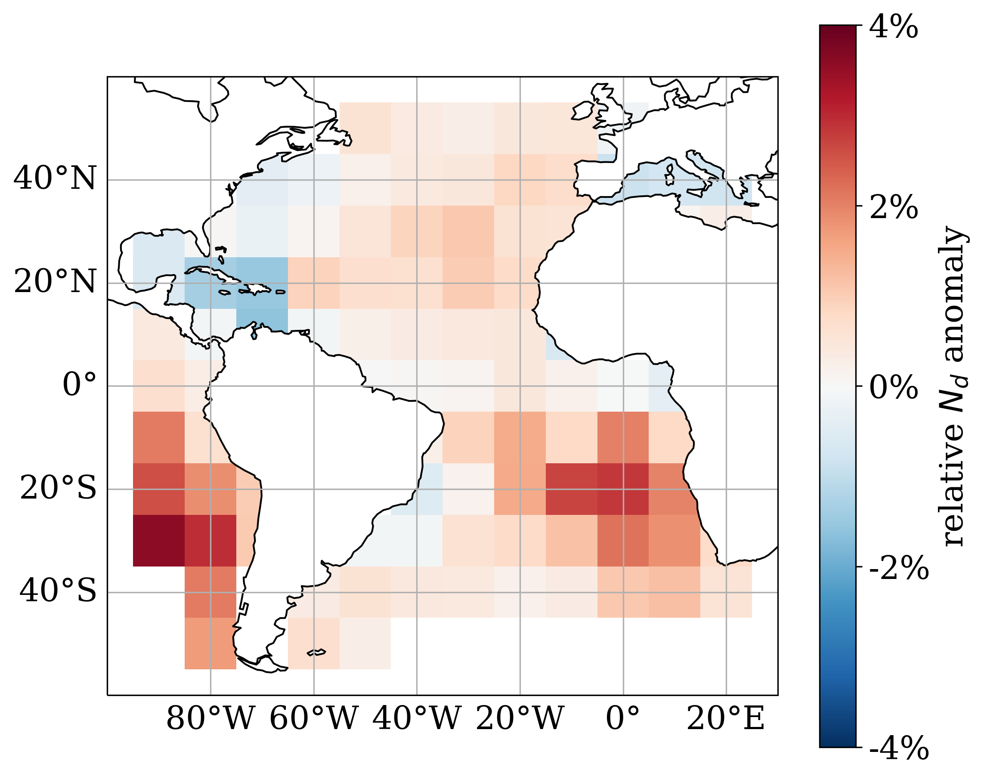
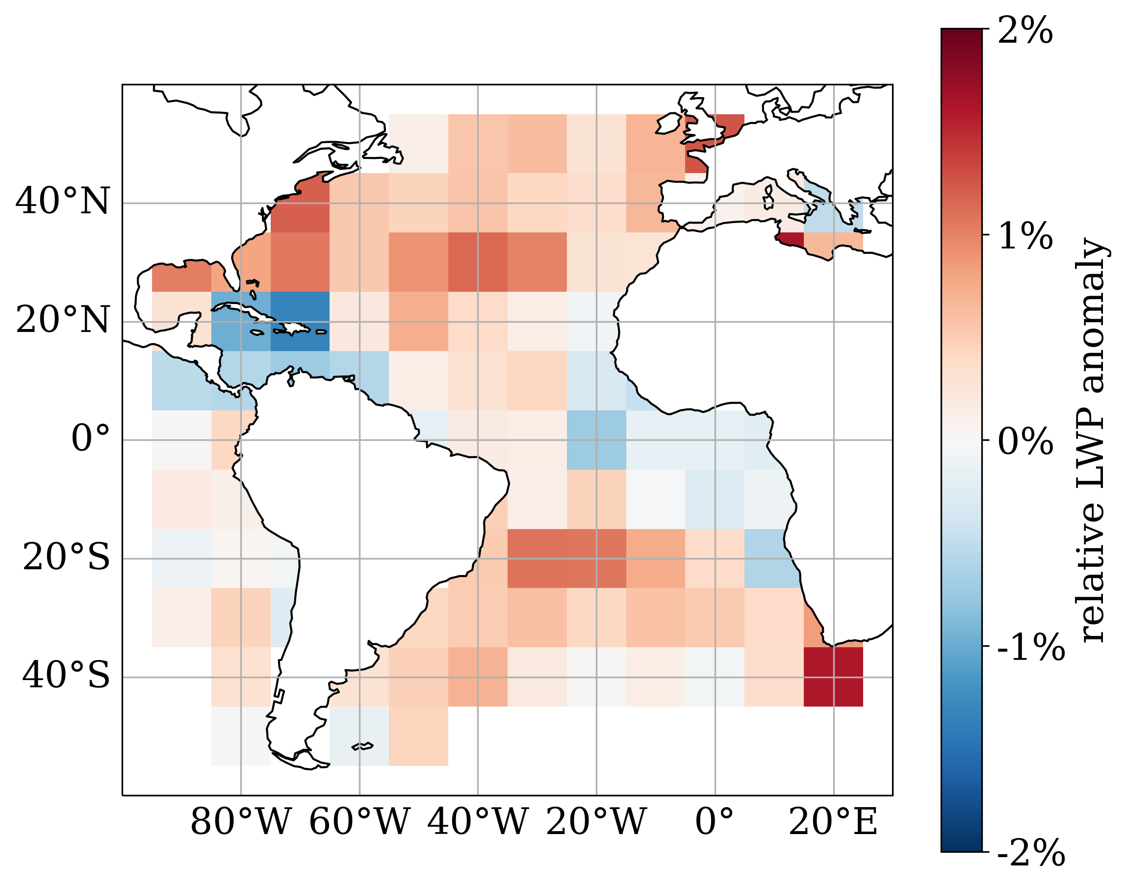
Is the response regionally different?
strong Nd response in Sc, strong LWP response in Cu
Notes:
digging a bit deeper plot heatmaps:
ratio of local in-track mean over out-of-track mean, all times included
uniform, so for Nd there seems to be no difference
for LWP, weak response in the traditionally studied Sc regions,
strong positive response in trade regions

Slide 7
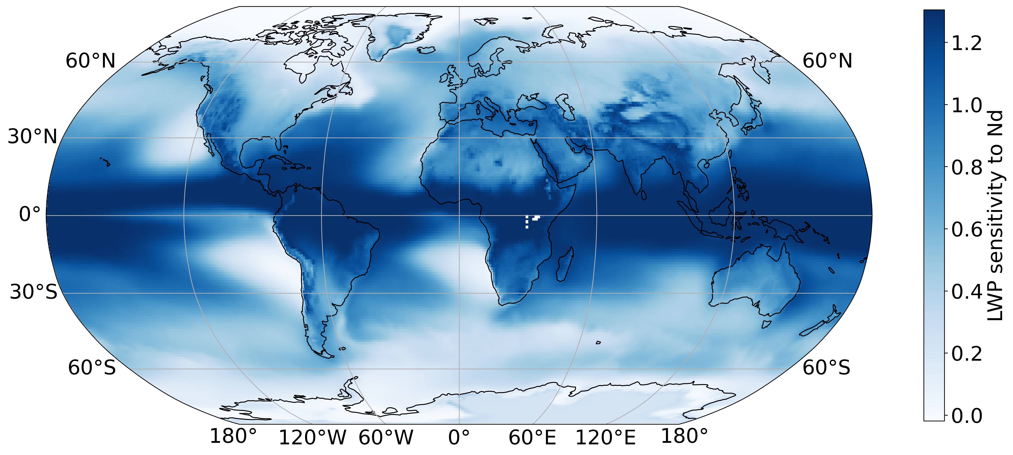
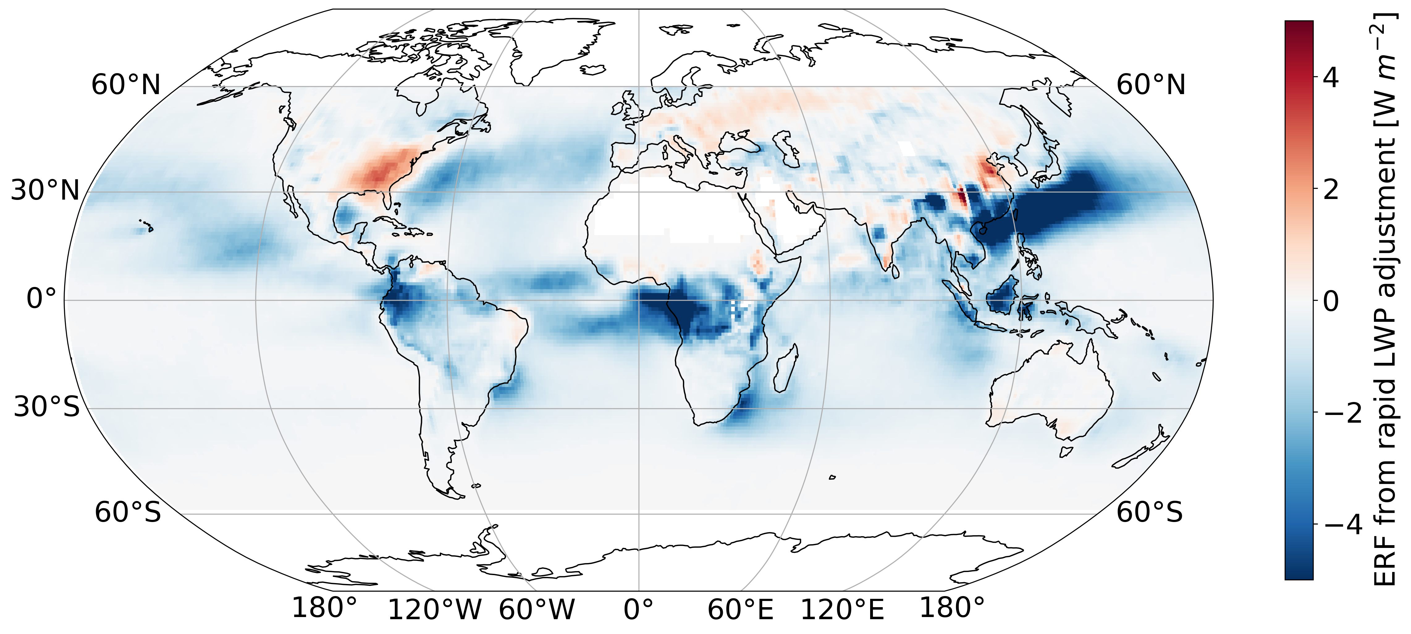
What is the resulting forcing?
extrapolate sensitivity globally as a function of EIS β(EIS)
multiply anthropogenic Nd, cloud fraction
strong cooling of (-1.03, -0.49) Wm-2, compare IPCC estimate of (0.0, +0.4) Wm-2…

Slide 8


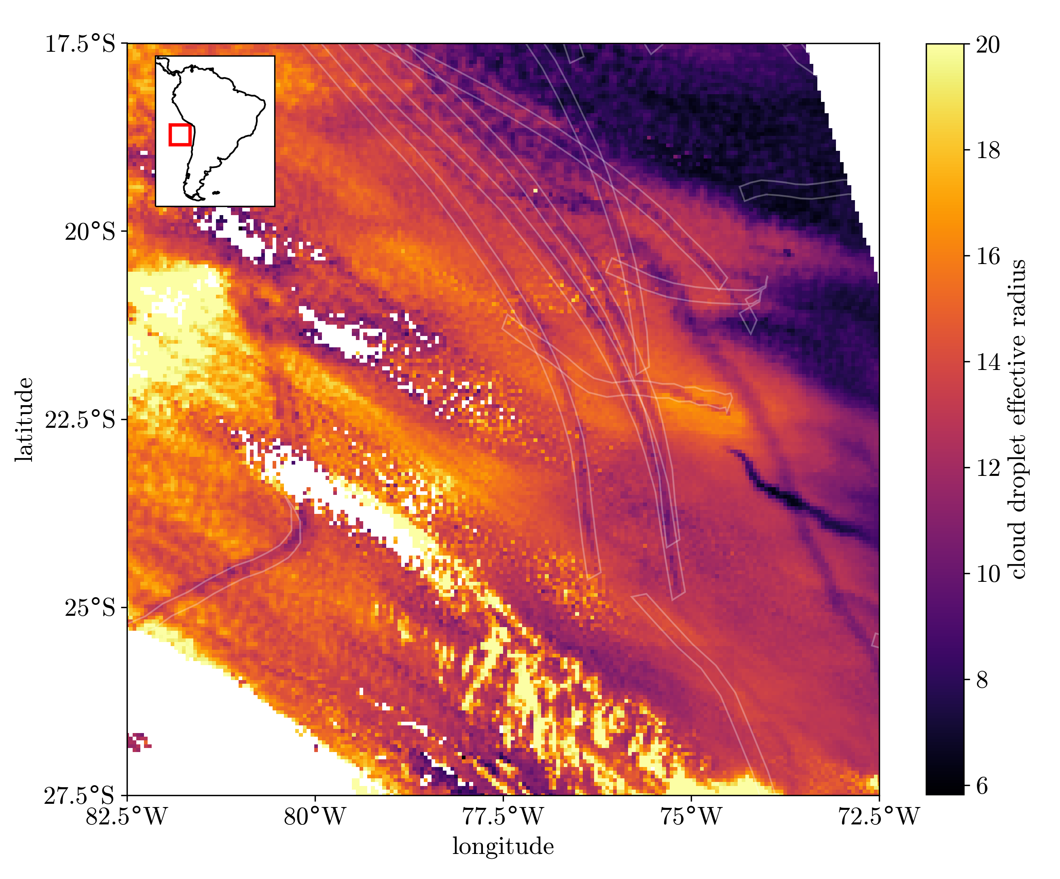
Summary
rely on emission locations + winds rather than visually identifying ship tracks → study all regions/cloud types
‘invisible tracks’ detected, LWP response different
detection in trade wind Cu, LWP response different
strong forcing from rapid LWP adjustment?
paper out soon: Manshausen et al., Invisible Ship Tracks Show Large Cloud Sensitivity to Aerosol, Nature (accepted)
Notes:
study new regions and cloud regimes
detect shipping effects in these: ’invisible tracks’
could mean that ship track studies, which were limited to visible tracks suffer from strong selection bias
systematically underestimating LWP response

Slide 10
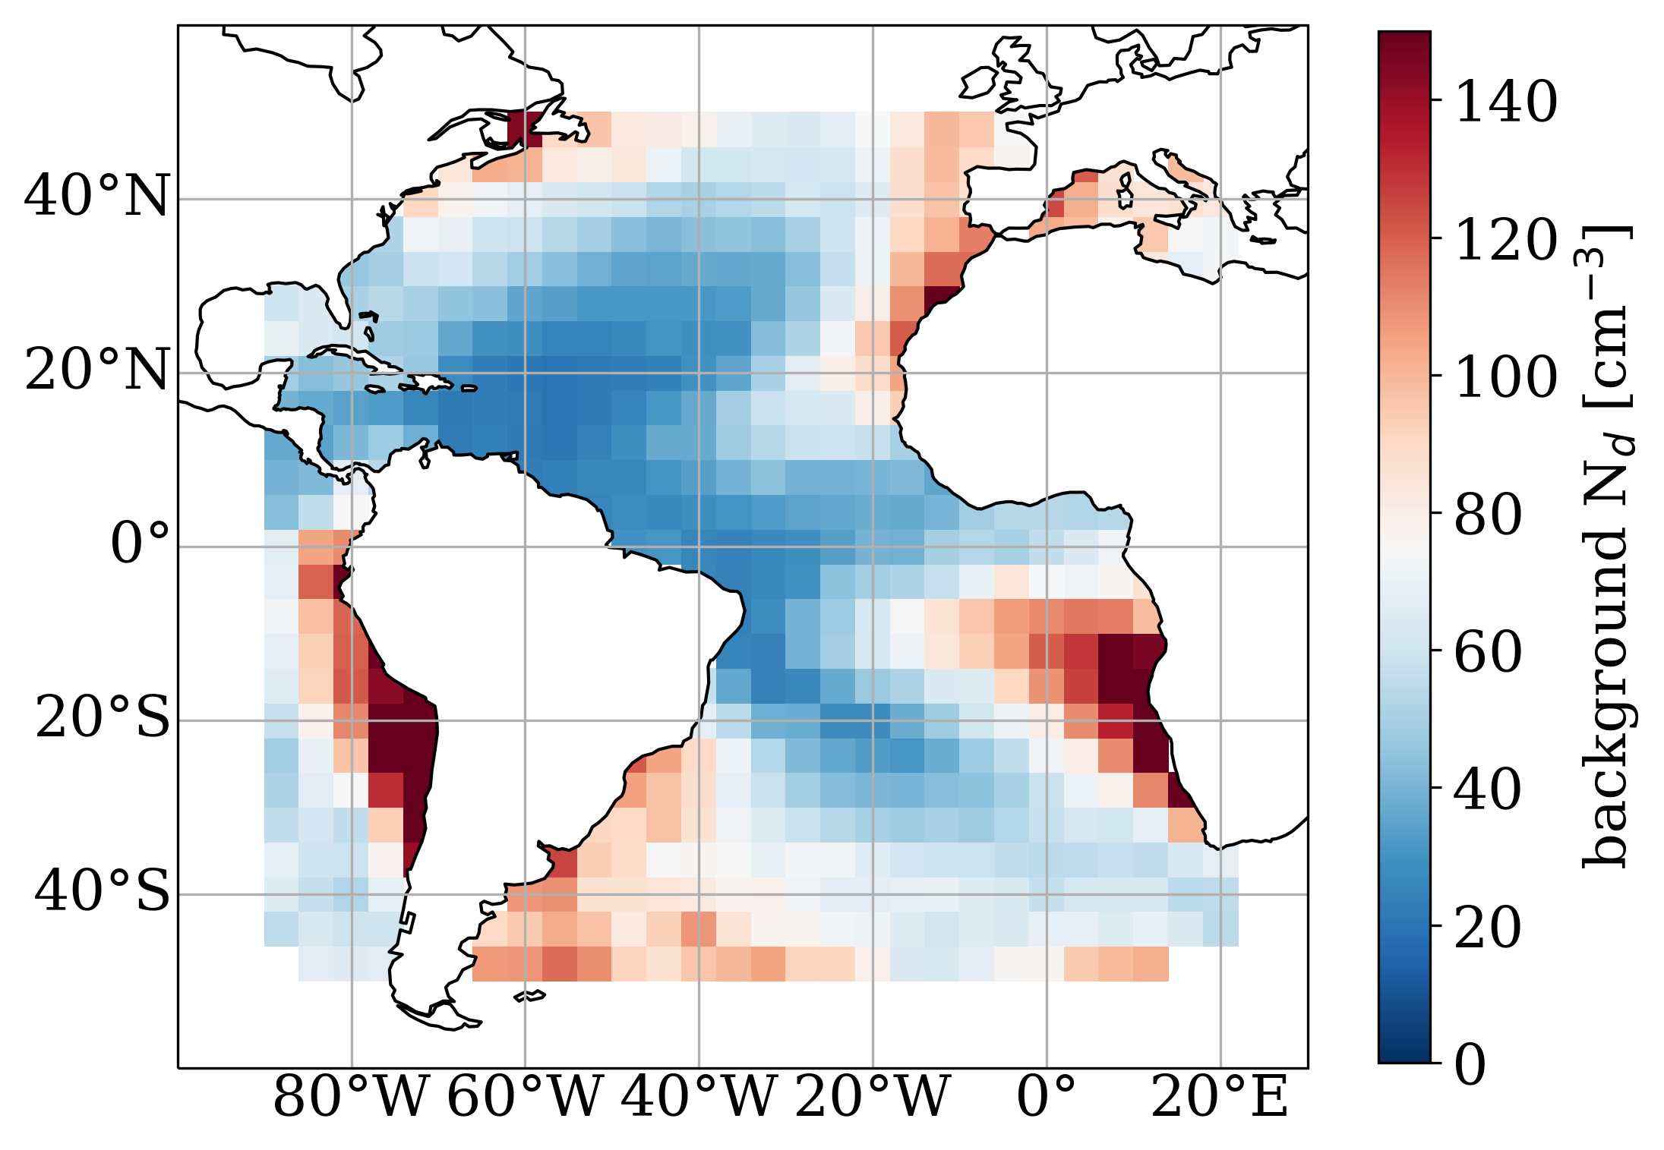


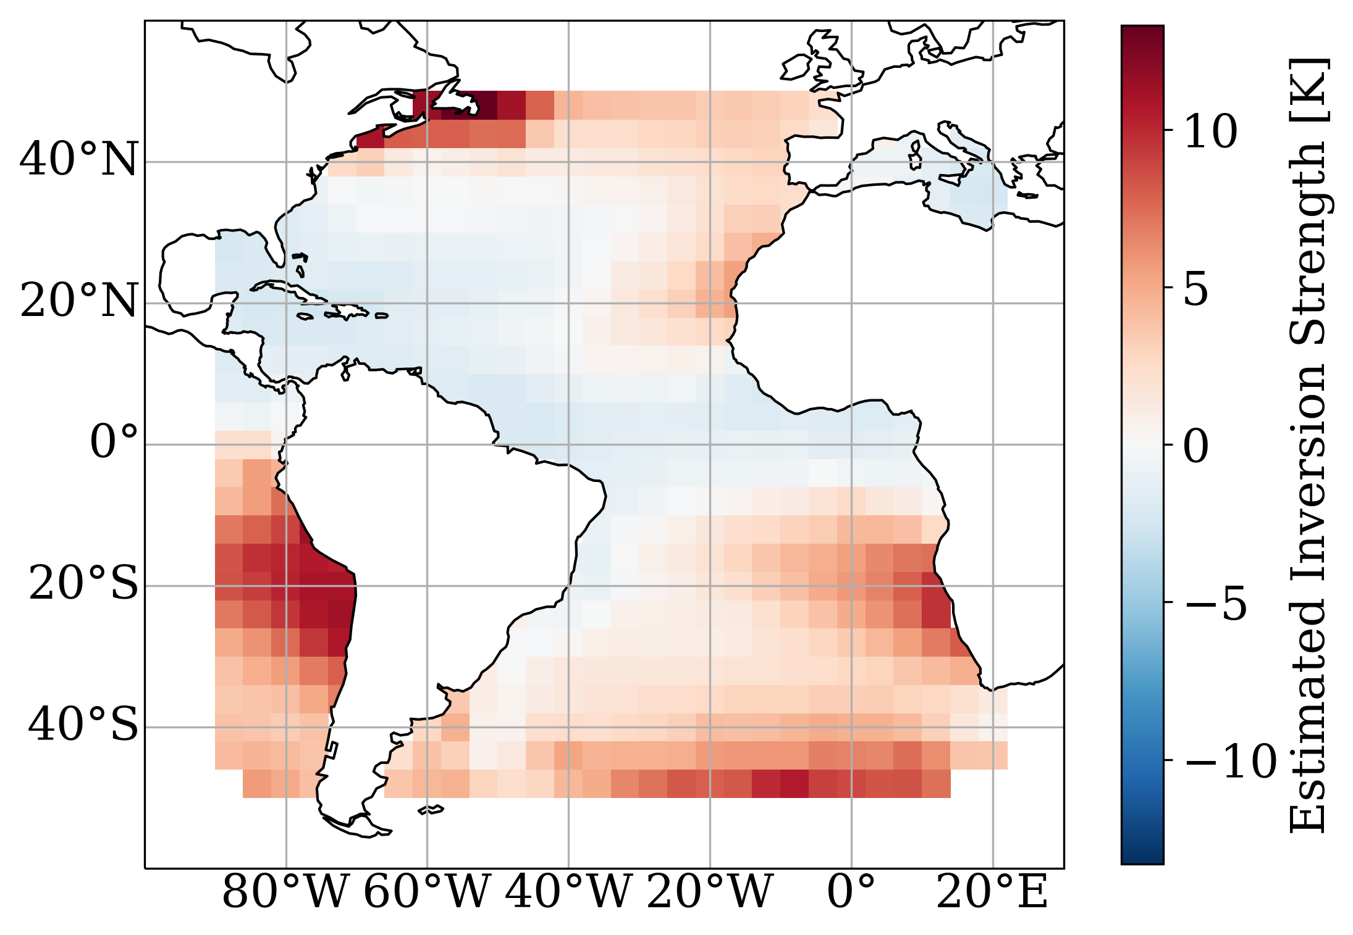
Why the large LWP response?
low droplet number, unstable conditions
LWP
LWP

Slide 11
Invisible Ship Tracks

