Slide 1


Influence of environmental factors on the accuracy of the Sentinel-3A altimetry over Polish rivers
Michał Halicki and Tomasz Niedzielski
Department of Geoinformatics and Cartography, Faculty of Earth Sciences and Environmental Management, University of Wrocław, pl. Uniwersytecki 1, 50-137 Wrocław, Poland
European Geosciences Union General Assembly 2022, 23-27 May 2022

Slide 2
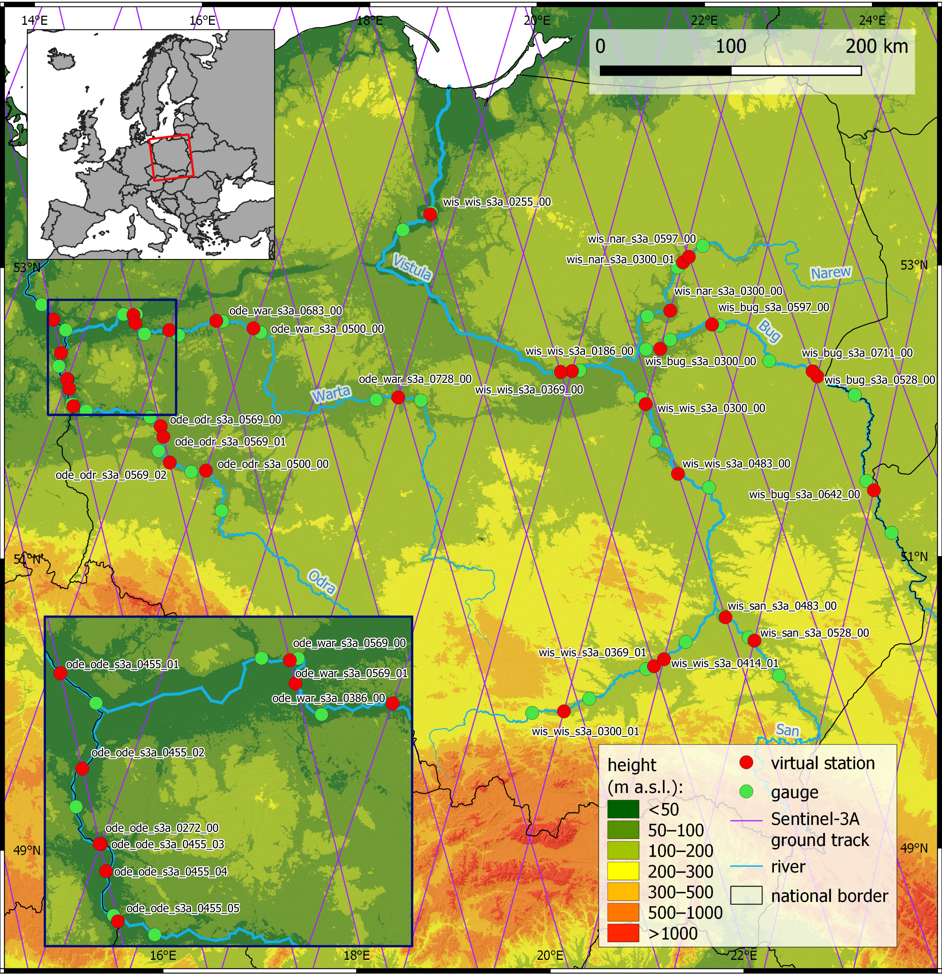
Objective of research
Examination of the accuracy of water levels from 34 virtual sites (VS) of the Sentinel-3A (S-3A) satellite, located on Polish rivers and processed by Hydroweb.
Study of the influence of environmental factors (river width, channel morphology and VS geometry) on the accuracy of altimetric measurements.
Influence of environmental factors on the accuracy of the Sentinel-3A altimetry over Polish rivers 1/5

Slide 3
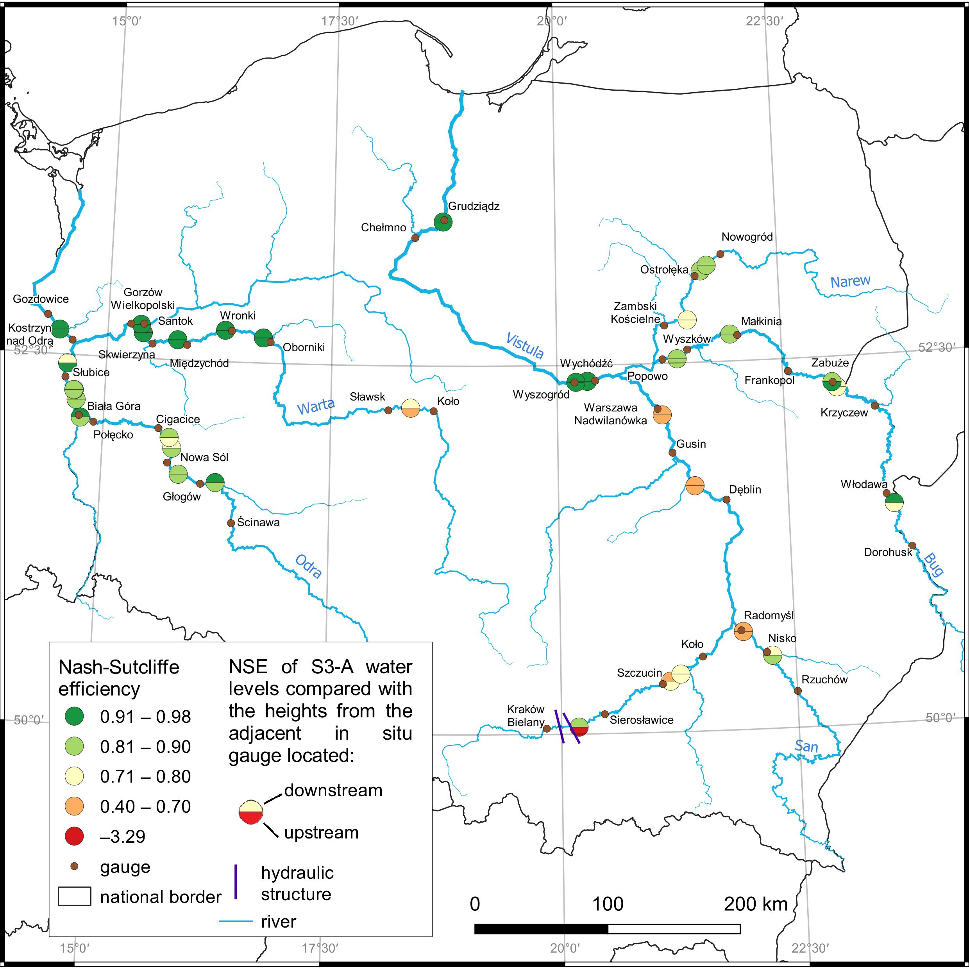
Accuracy of S-3A water levels
RMSE range from 0.12 to 0.44 m, with mean of 0.22 m
NSE range from 0.40 to 0.98 with mean of 0.84 for 67 pairs of time series, out of 68 considered
Influence of environmental factors on the accuracy of the Sentinel-3A altimetry over Polish rivers 2/5

Slide 4
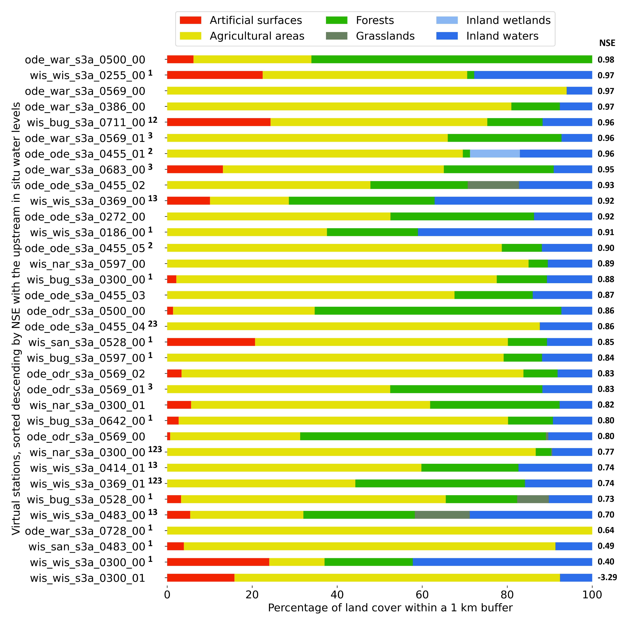
Land cover within the 1 km buffer of each VS
High accuracy
Low accuracy
¹ sandbars in the VS vicinity
² river channel parallel to satellite ground track
³ multiple river crossing
Influence of environmental factors on the accuracy of the Sentinel-3A altimetry over Polish rivers 3/5

Slide 5
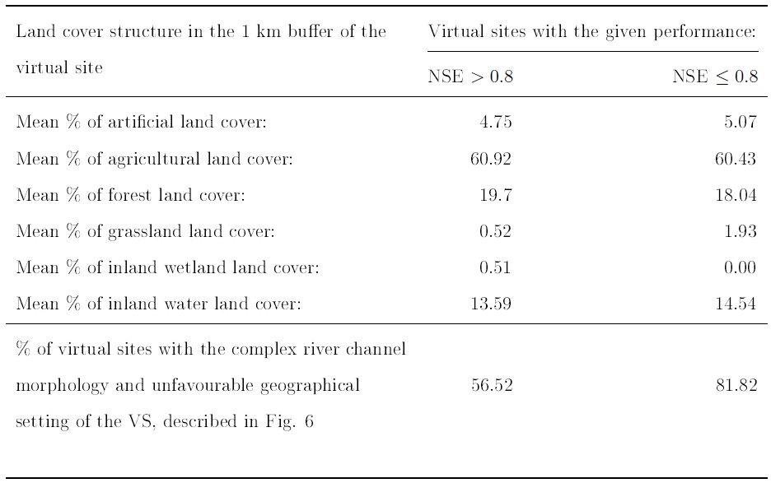
Land cover within the 1 km buffer around each VS
Almost identical
<
Influence of environmental factors on the accuracy of the Sentinel-3A altimetry over Polish rivers 4/5

Slide 6
Conclusions
Water levels at virtual sites of the Sentinel-3A satellite located on Polish rivers and processed by Hydroweb are characterized by high accuracy (RMSE: 0.12-0.44 m)
Neither the river width, nor the land topography reveal any impact on the accuracy of altimetric measurements
Sandbars and unfavourable geometry of the VS occurred more often on VS characterized by lower accuracy (NSE ≤ 0.8)
Influence of environmental factors on the accuracy of the Sentinel-3A altimetry over Polish rivers 5/5

Slide 7
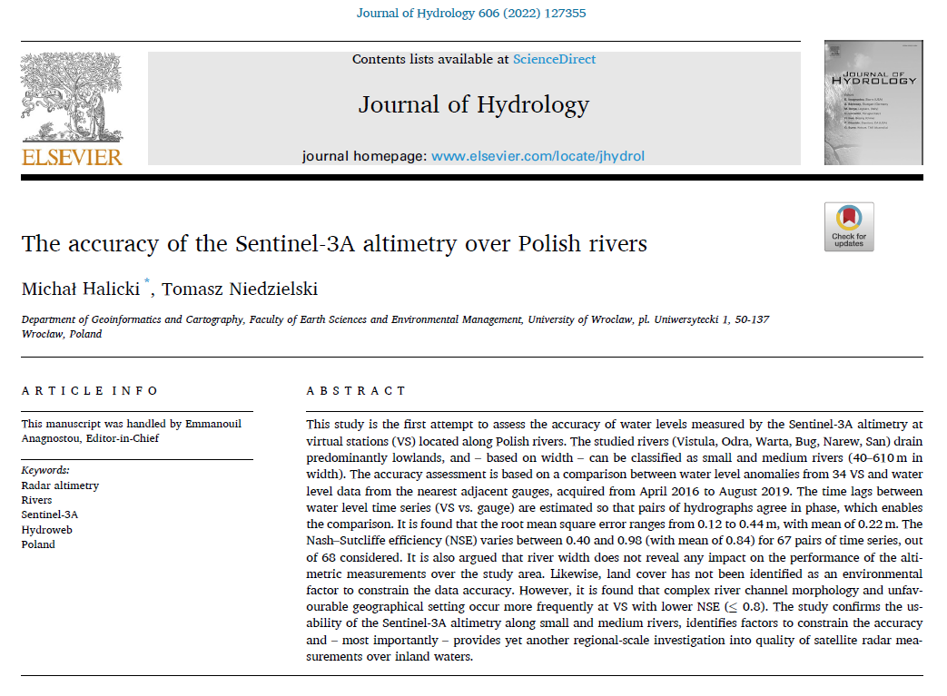


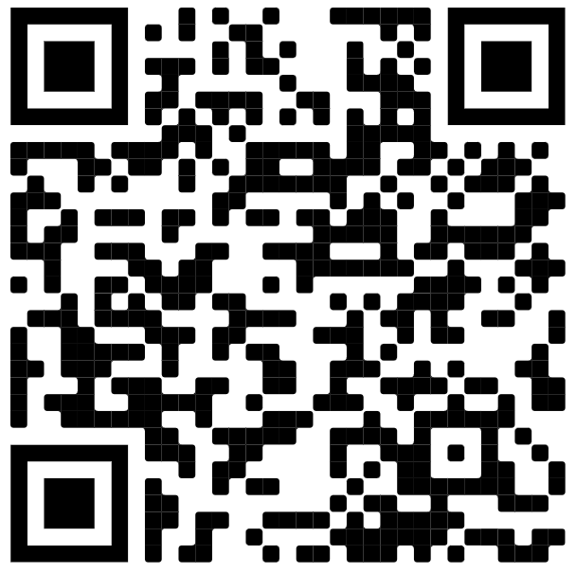

Thank you for your attention!
Feel free to contact me:
michal.halicki2@uwr.edu.pl
The research is supported by the National Science Centre, Poland, through the project no. 2020/38/E/ST10/00295

