Slide 1



Biopolymer soil stabilization as protection from slope erosion and shallow sliding
EGU22-4236
Josif Josifovski ¹ and Aleksandra Nikolovska Atanasovska ²
¹ Dr., Professor at Faculty of Civil Engineering, University “Ss. Cyril and Methodius” of Skopje
jjosifovski@gf.ukim.edu.mk
² MSc, Research fellow at Faculty of Civil Engineering, University “Ss. Cyril and Methodius” of Skopje
nikolovskaaleksandra189@gmail.com

Slide 2
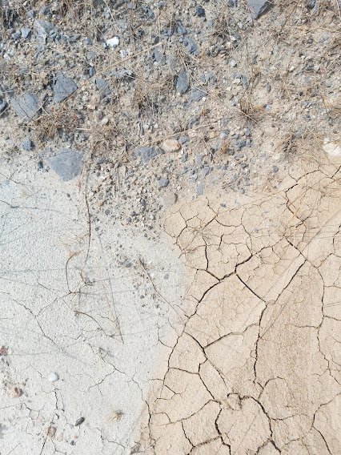
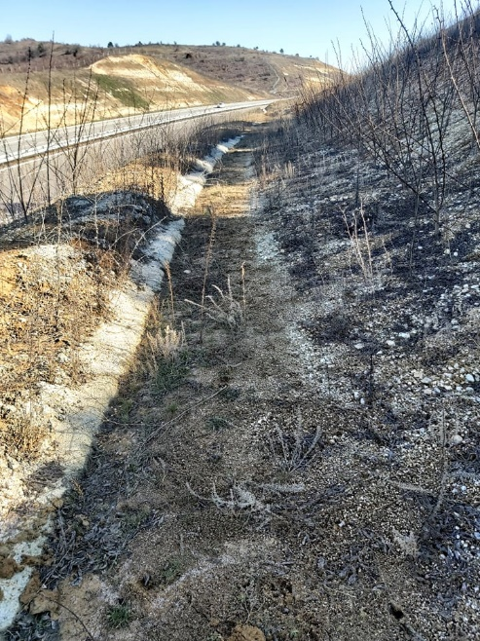
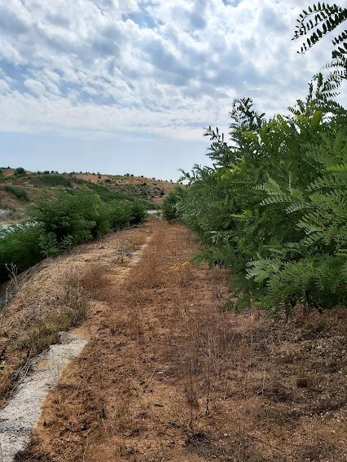
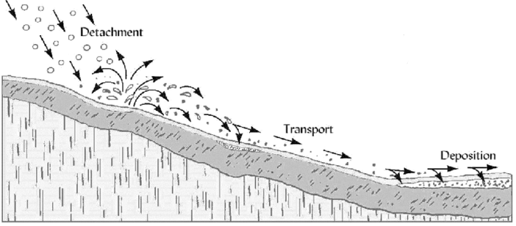
Process of creation soil erodibility

Slide 3
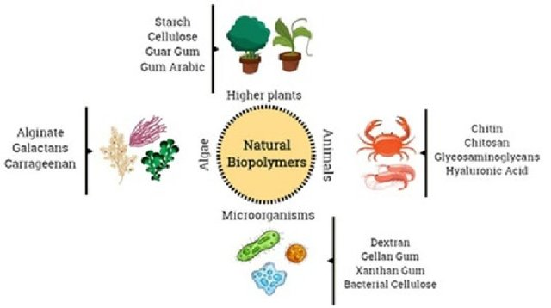
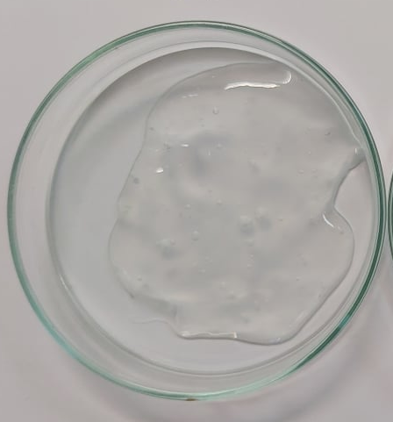
Biopolymer solution – Xanthan gum
Concentration 1.0 %
Art.-Nr. 3557.1
CAS: 11138-66-2
EG-Nr: 2343942

Slide 4
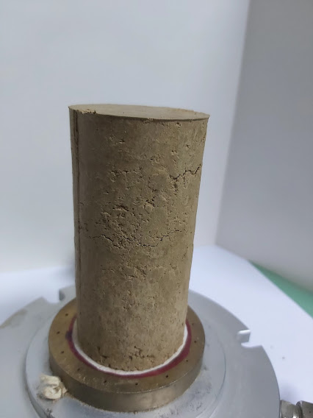
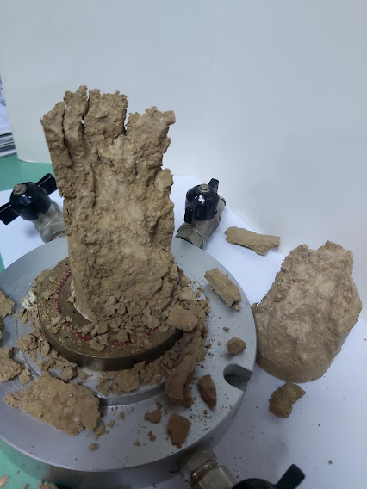
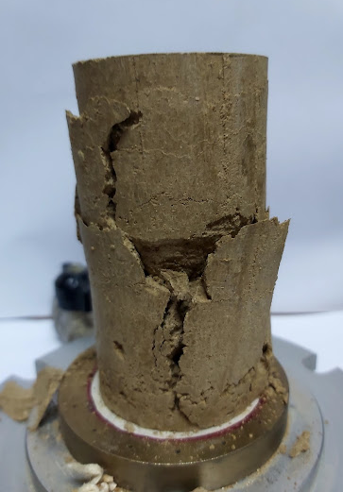
Laboratory tests on
natural and biopolymer treated soil
Characterization parameters
Uniaxial compressive strength (UCS)
Silty sand soil
Moisture [%] | 23.62
Natural Unit weight [kN/m³] | 18. 82
Specific weight [/] | 2.57
Optimal water content [%] | 17.60
Unit dry weight [kN/m³] | 15.20
Strength & deformation parameters
 | Biopolymer treated soil |  |  | Natural soil
 | Curing period [days]
 | 1 | 14 | 28 | 0
Strength [kN/m³] | 435.29 | 1132.43 | 1601.68 | 257.09
Deformation [%] | 4.00 | 2.59 | 2.92 | 3.52
Moisture [%] | 13.70 | 7.10 | 6.24 | 14.93

Slide 5
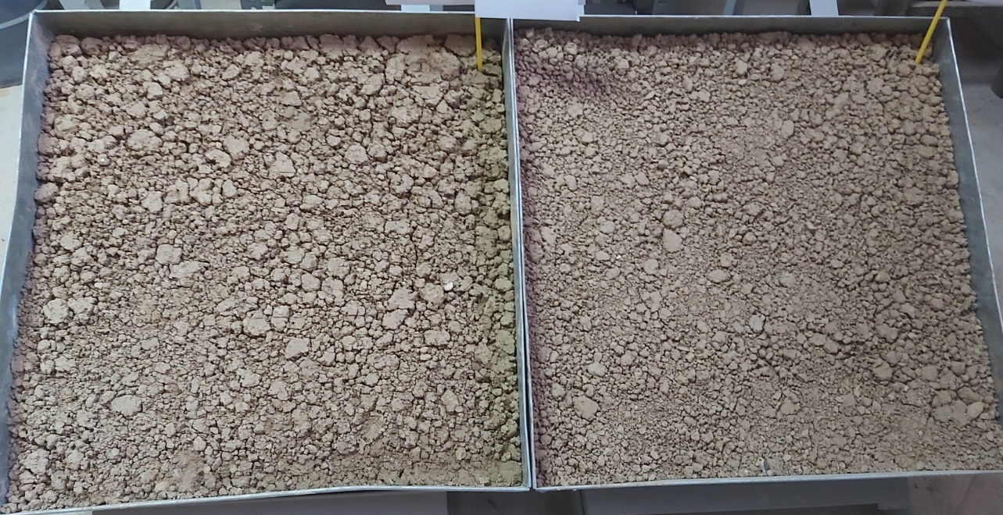
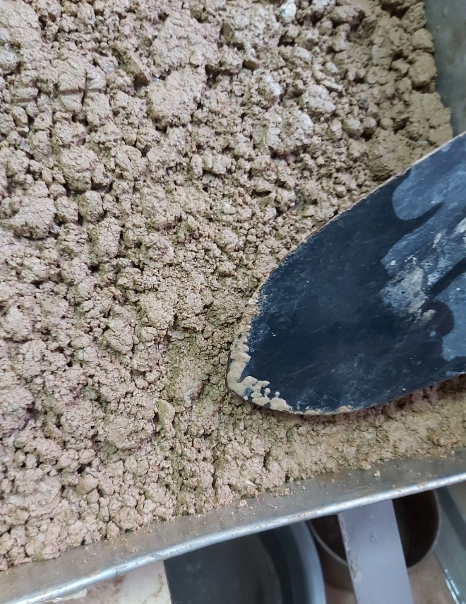
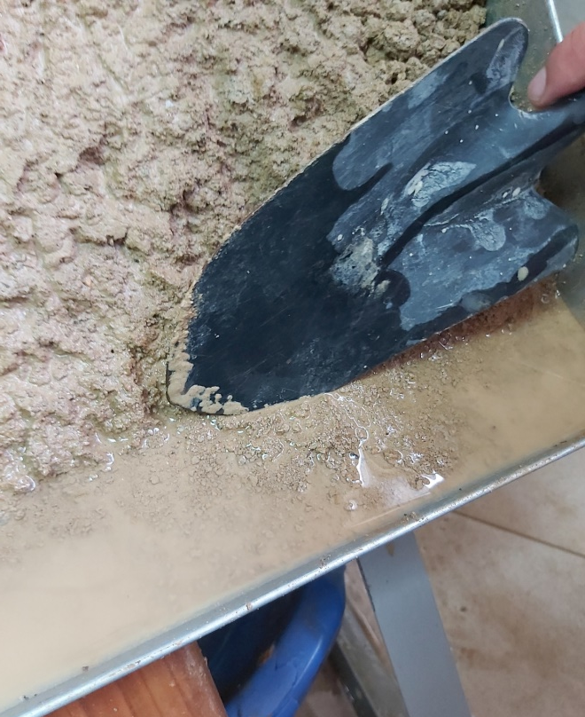
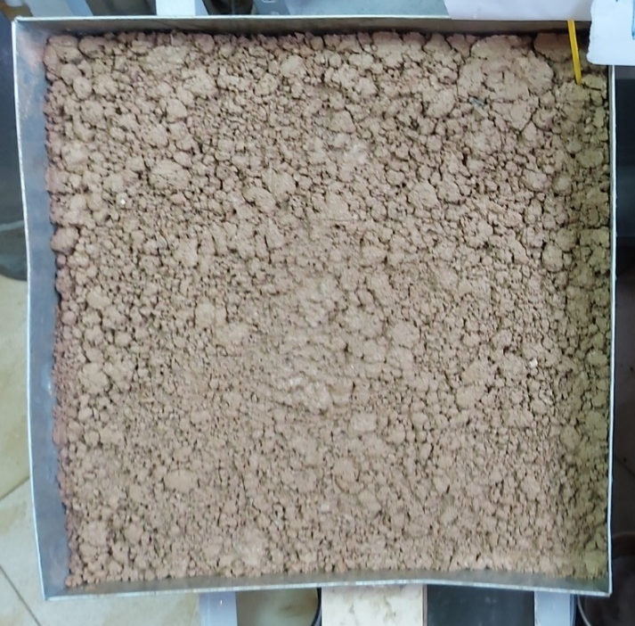

II. Experimental testing of natural and biopolymer treated soil
Treated slope
Natural slope
0 "
Eroded soil on untreated slope with an area of 1.0m² was about 1900gr or soil erosion of 9.5%.
Rainfall 10 liters per hour
1 : 1,5 slope
Test period 3 hours
180 "

Slide 6
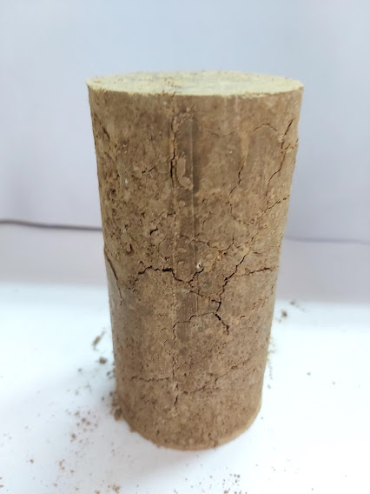
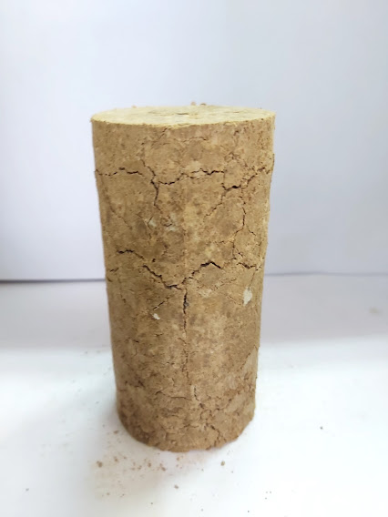
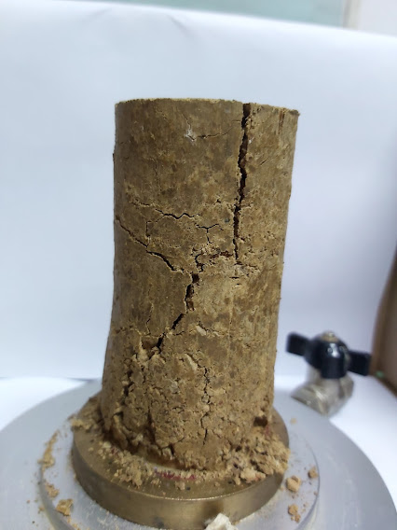
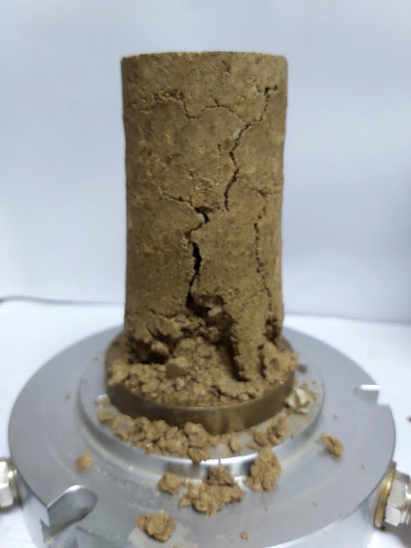
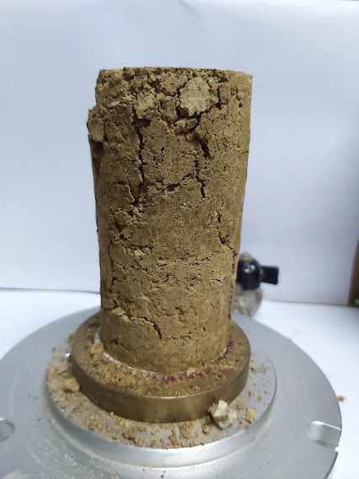
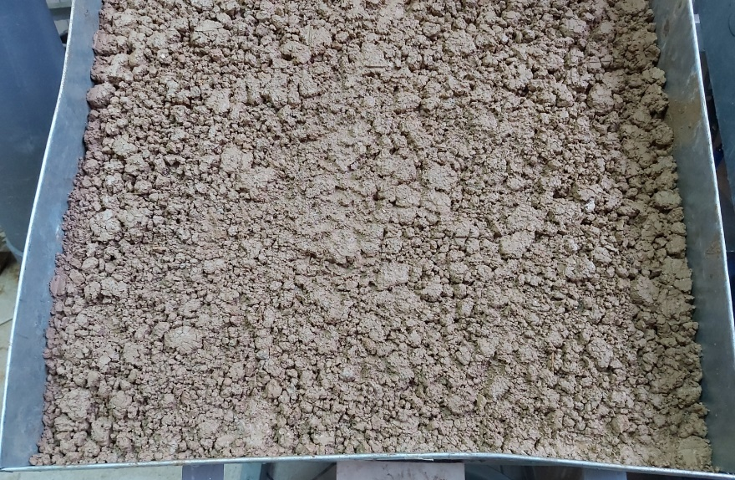
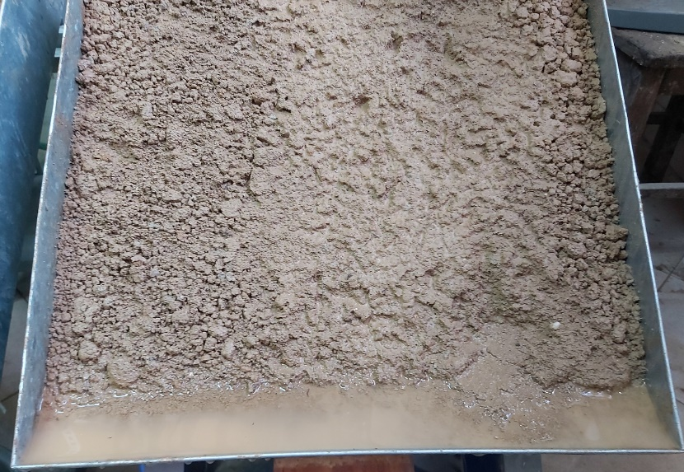
Conclusion
before testing
The biopolymer solution can:
Improves strengthening parameters of the soil;
Fills the pores in the soil;
Reduces water infiltration into the soil;
Improves interparticle cohesion;
Increases erosion resistance.
after testing
Treated soil
Non-treated soil
Thank you for your
Attention !

