Slide 1
Discerning TGF and leader current pulse in ASIM observation
A. Mezentsev¹⁾, N. Østgaard¹⁾, M. Marisaldi¹⁾, T. Neubert²⁾, O. Chanrion²⁾, V. Reglero³⁾
1) Birkeland Centre for Space Science, University of Bergen, Norway
2) National Space Institute, Technical University of Denmark, Denmark
3) University of Valencia, Spain

Slide 2

Instrumentation
TGFs being the bursts of high energy photons shot from Earth’s atmosphere to space, are known to be produced during the initial upward propagation of the +IC lightning leader. VLF and LF radio sferics can often be found in association with the short duration TGFs.
The Atmosphere-Space Interactions Monitor (ASIM) instrument provides synchronous X- and gamma-ray measurements with optical recordings in 180-240 nm, 337 nm and 777.4 nm wavelength. This allows for simultaneous detection of TGFs and lightning processes associated with them.

Slide 3

Instrumentation
TGFs being the bursts of high energy photons shot from Earth’s atmosphere to space, are known to be produced during the initial upward propagation of the +IC lightning leader. VLF and LF radio sferics can often be found in association with the short duration TGFs.
The Atmosphere-Space Interactions Monitor (ASIM) instrument provides synchronous X- and gamma-ray measurements (MXGS module) with optical recordings in 180-240 nm, 337 nm and 777.4 nm wavelength (MMIA module). This allows for simultaneous detection of TGFs and lightning processes associated with them.
337 nm captures light from streamers while 777.4 nm records optical emission from lightning leaders.

Slide 4
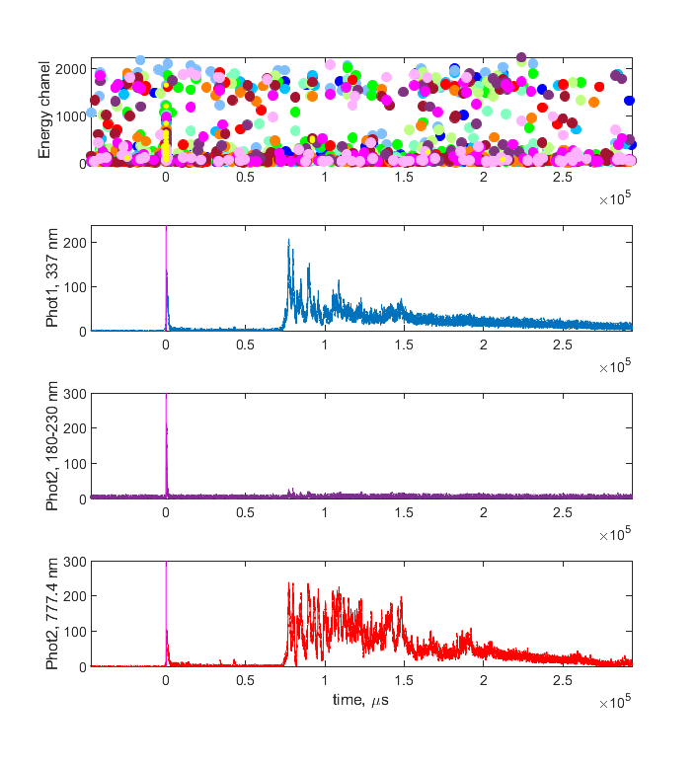
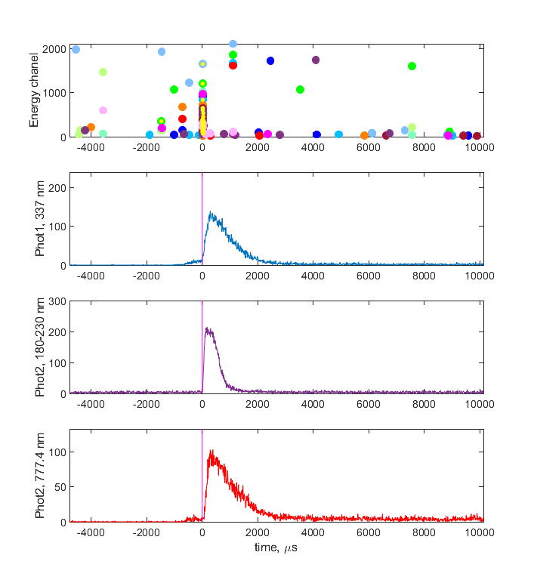
TGFs are accompanied by the optical pulse
ASIM observations has shown that TGFs within the FOV of the optical instruments are always accompanied by the prominent optical pulse which starts the lightning flash (Lindanger et al., 2022, https://doi.org/10.1029/2021JD036305).

Slide 5
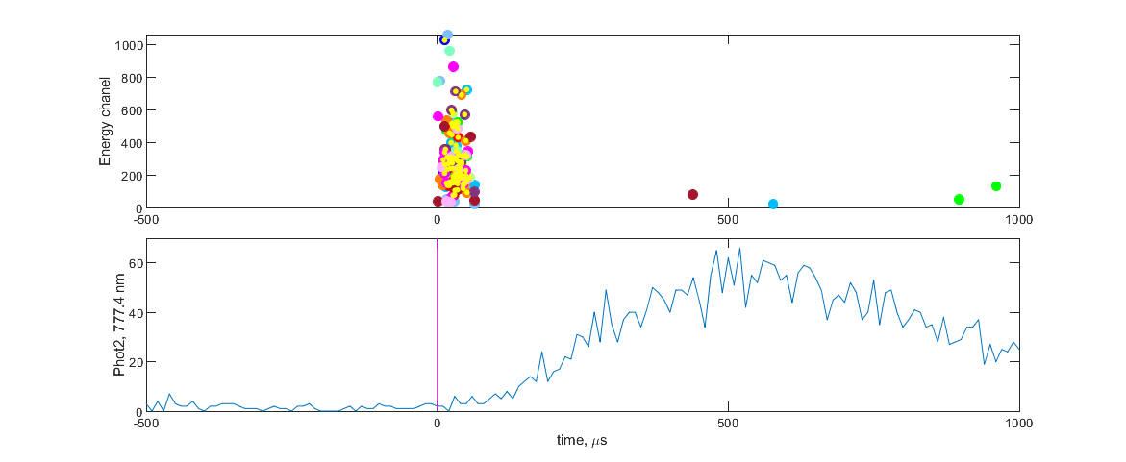
TGFs tend to precede optical pulse
TGFs have a clear tendency to slightly precede the optical pulse (Østgaard et al., 2019 http://dx.doi.org/10.1029/2019JD031214; Skeie et al., submitted to JGR), but the short duration of TGFs together with the optical delay of the lightning light propagating through the cloud do not allow to confidently resolve the true sequence of these events (Østgaard et al., 2021 https://doi.org/10.1029/2020JD033921).
The same problem is present in radio measurements as well: TGF current is usually mixed with the lightning current in the recordings, due to temporal proximity of the processes involved.

Slide 6
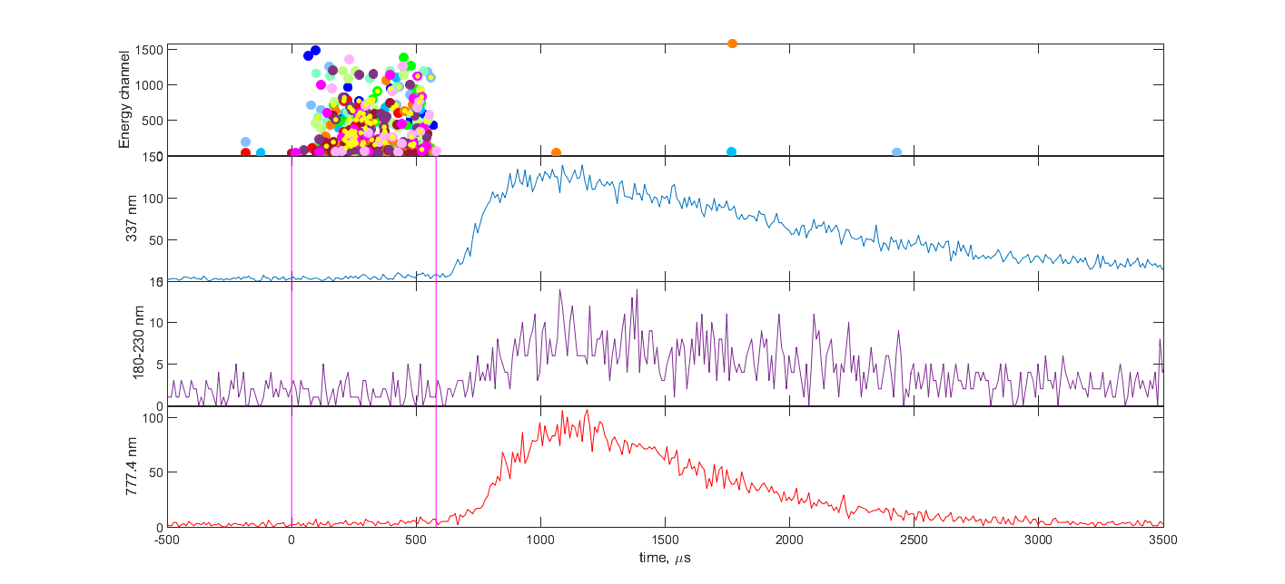
TGF 2021-12-03 21:15:39
Here we report a remarkable TGF, with high fluence (360 HED counts) and long duration (580 µs), together with its associated optical recordings which show clear distinction between the TGF and the optical pulse.

Slide 7
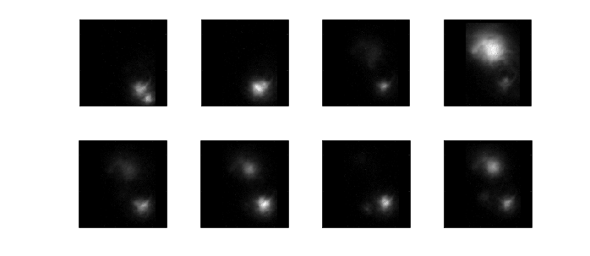
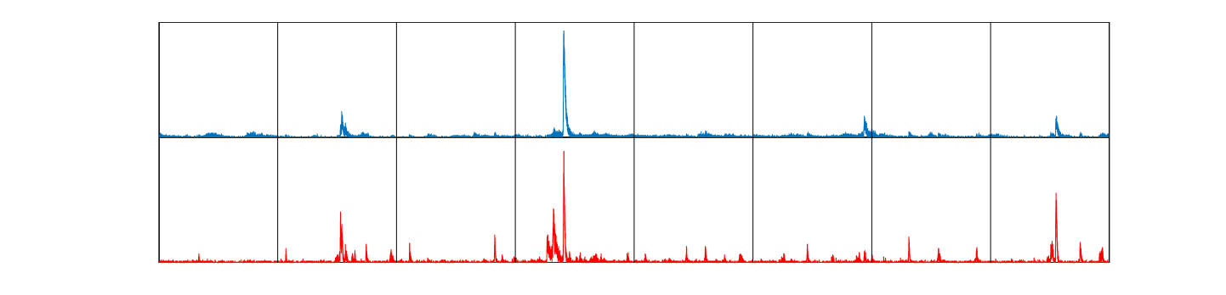
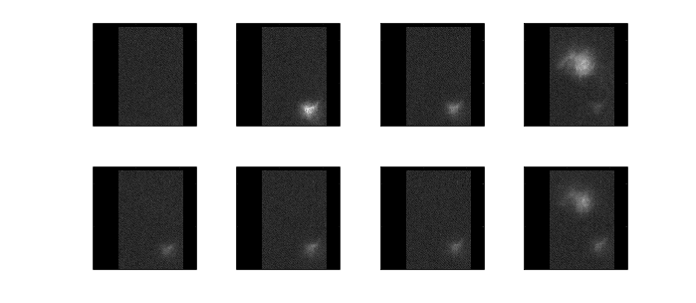
Source location
337 nm (blue) camera images
Light emission from streamers
Optical pulse associated with TGF
337 nm and 777 nm photometers
Each frame is 83 ms
777 nm (red) camera images
Light emission from leader channel

Slide 8
Discussion
From previous observations we know that TGFs are accompanied with strong optical pulse in 777 nm, which attributes it to a current surge in the leader channel.
This TGF allows to test several possible scenarios that usually could not be addressed.
TGF is produced by the current surge in the leader channel, such that the current surge creates conditions for TGF generation
TGF evolves together with the current surge in the leader channel, such that the TGF conditions coexist with the current through the leader channel
TGF is terminated by the current surge in the leader channel, such that the current surge destroys conditions for TGF generation

Slide 9
Discussion
From previous observations we know that TGFs are accompanied with strong optical pulse in 777 nm, which attributes it to a current surge in the leader channel.
This TGF allows to test several possible scenarios that usually could not be addressed.
TGF is produced by the current surge in the leader channel, such that the current surge creates conditions for TGF generation
TGF evolves together with the current surge in the leader channel, such that the TGF conditions coexist with the current through the leader channel
TGF is terminated by the current surge in the leader channel, such that the current surge destroys conditions for TGF generation
TGF is generated and evolves through its lifecycle before the current surge in the leader channel
TGF termination is pretty close in time to the inception of the current surge in the leader channel

Slide 10
Conclusions
This observation clearly shows that the optical pulse is subsequent to the TGF, as it starts after the TGF is gone. Long TGF duration allows to exclude possible optical delays while scattering through the cloud.
We can rule out the current surge in the leader channel from possible mechanisms responsible for conditioning the TGF generation. We can confidently say that it is not the current surge that leads to a TGF generation.
Conditions for TGF generation do not coexist with the current surge in the leader channel.
TGF can be the process that conditions the subsequent current surge in the leader channel.
In turn, the current surge in the leader channel can be responsible for TGF termination, or be just a manifestation of the conditions leading to TGF termination. This moment still remains unclear.

Slide 11
Questions
Questions?

