Slide 1
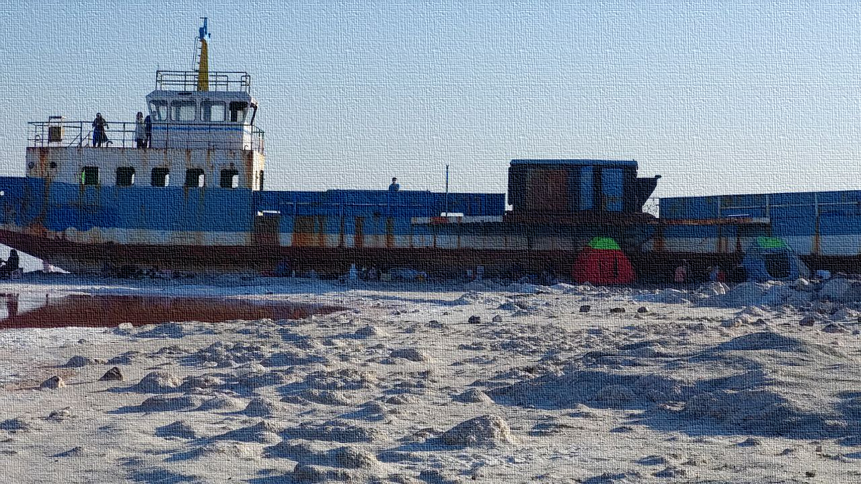





Fri, 27 May, 08:52–08:59 (CEST) Room 2.15
EGU22-4242 | ECS
Water Governing Systems:
addressing conflicts between hydrological and institutional scales
Peyman Arjomandi A.^{1,2}, Seyedalireza Seyedi^{3,4}, and Nadejda Komendantova²
¹Department of Civil, Chemical, Environmental and Materials Engineering (DICAM), University of Bologna, Bologna, Italy
²Advancing Systems Analysis Program, International Institute for Applied Systems Analysis (IIASA), Laxenburg, Austria
³Department of Mathematical Sciences, Yazd University, Yazd, Iran
⁴Mathematical Modelling Centre, Yazd University, Yazd, Iran
Notes:
1

Slide 2

System Fit
Selecting the focused spatiotemporal levels in the study case
Formulating the interaction structure by an appropriate device (i.e. statistical mechanics models)
Tuning the interaction set up with demand/supply rates
Natural system
Temporal
Scale
Human-made system
Desk reviews/field evaluations and capturing the structure of the water governing system
Setting the interactions based on political/institutional (interaction) rules and regulations
Measuring the system cost and handling capacity interlinked to those interactions
Political
Scale
Water governing system
Spatial
Scale
Institutional
Scale
Spatial-Temporal
Political-Institutional
Clustering the major and minor players in respect to their institutional/administrative level
Mapping out the players at spatial scale
Comparing the results with alternative system structures

Slide 3
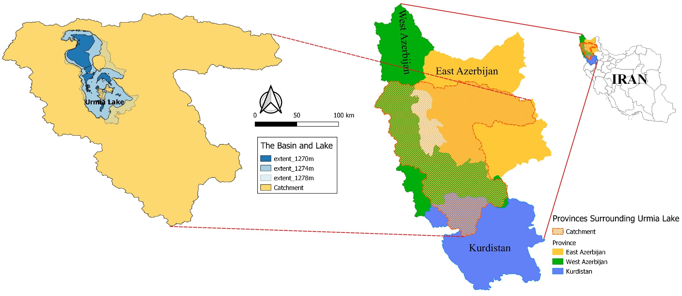
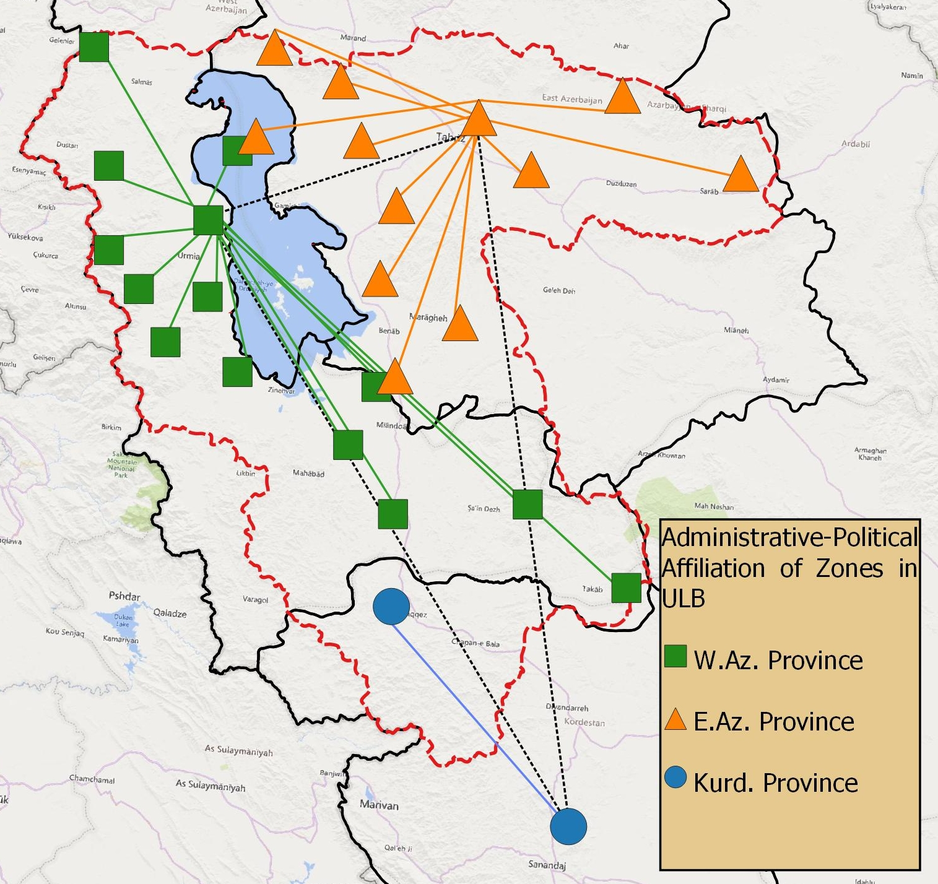
Example case

Slide 4
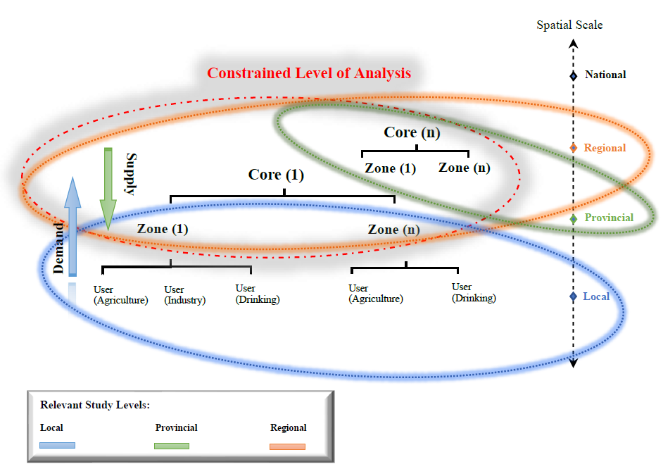
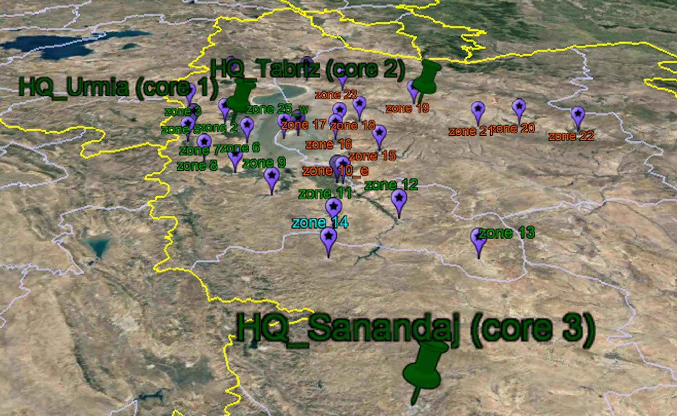
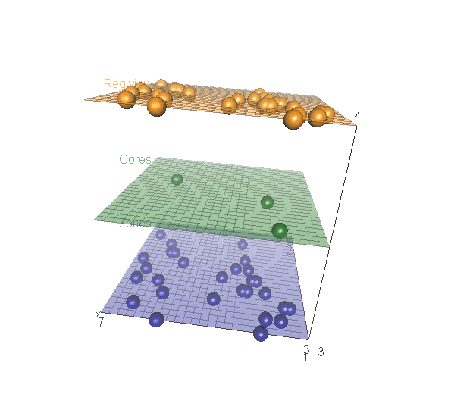
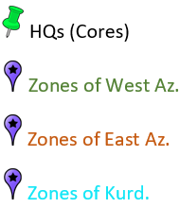
Layers and Players

Slide 5
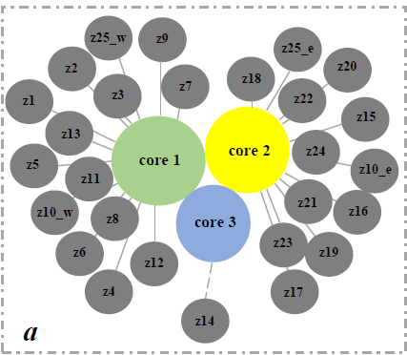
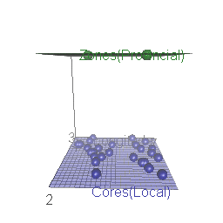
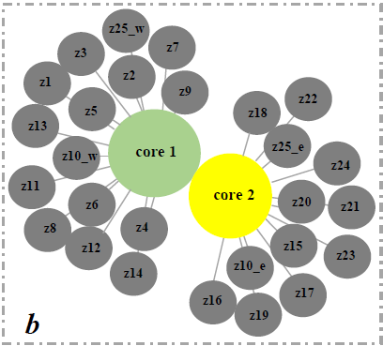
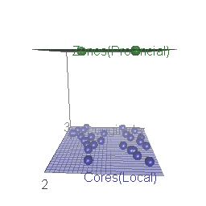
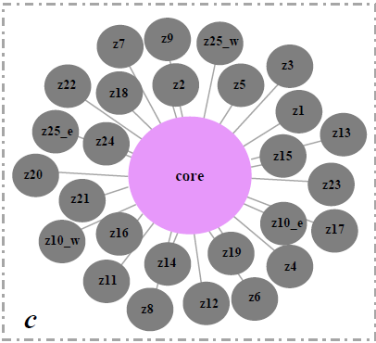
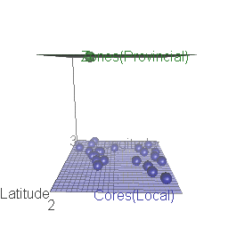
Governing system state
The existing system
The number of handled zones
Assumed system (2-Cores)
Assumed system (1-Core)
All zones in the basin
The least the system cost the better the system fit

Slide 6
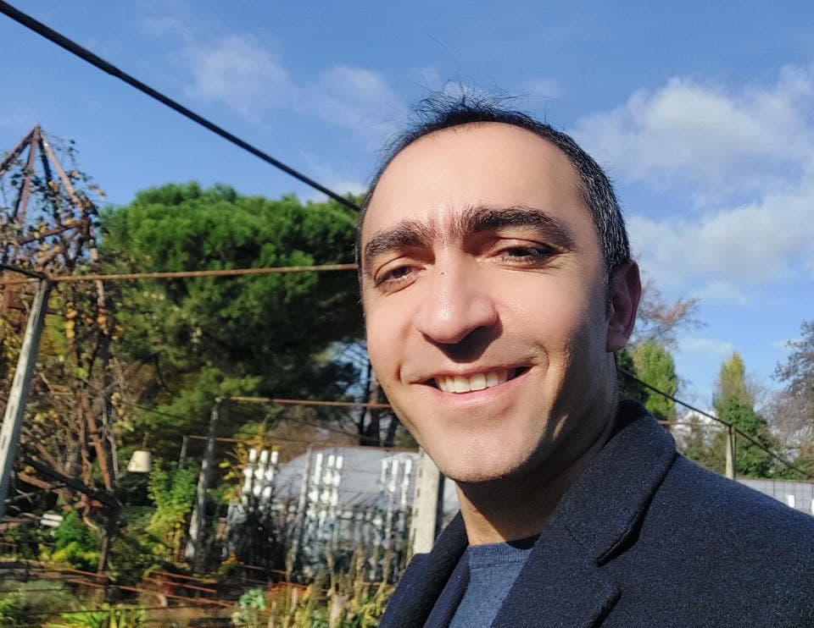
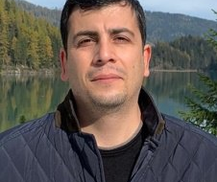
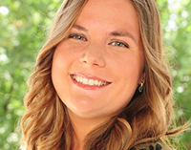
Peyman Arjomandi: a PhD scholar at University of Bologna, also a visiting scholar at IIASA, conducting a multidisciplinary research on water governance analysis associated with interfering factors at macro/meso as well as micro scales.
Seyedalireza Seyedi: an honorary scholar at Mathematical Modelling Centre of Yazd University, with extensive expertise on applied stochastic differential equations, optimization techniques and numerical analysis
Nadejda Komendantova: a senior research scholar in the Advancing Systems Analysis Program at The International Institute for Applied Systems Analysis (IIASA), leading the Cooperation and Transformative Governance Research Group

Slide 7

Thank for your attention
Corresponding author’s email:
peyman.arjomandi2@unibo.it
arjomandi@iiasa.ac.at

