Slide 1






Piergiorgio Moschini
piergiorgio.moschini@uniroma1.it
Modeling clinopyroxene and plagioclase growth kinetics at Mt. Etna and Stromboli
Modeling clinopyroxene and plagioclase growth kinetics
at Mt. Etna and Stromboli
Piergiorgio Moschini ª, Silvio Mollo ^{a,b}, Alessio Pontesilli ^{b}, Mario Gaeta ª, Manuela Nazzari ^{b}, Piergiorgio Scarlato ^{b}
piergiorgio.moschini@uniroma1.it
ª
^{b}
© Moschini et al. All rights reserved

Slide 2
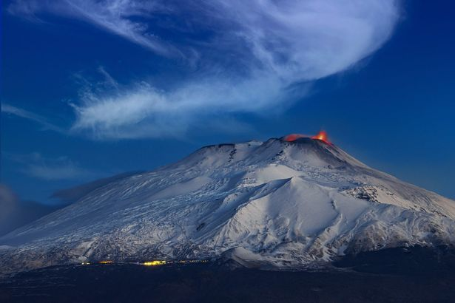
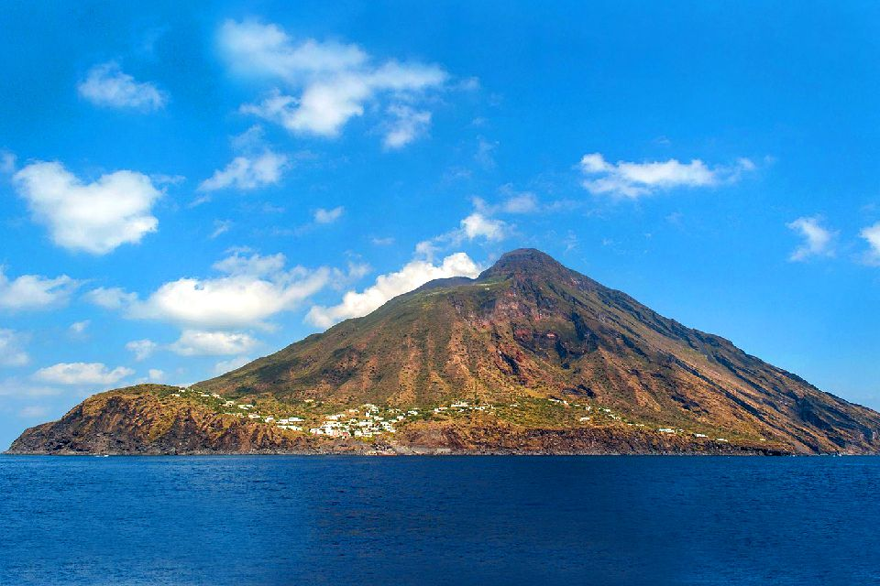
Piergiorgio Moschini
piergiorgio.moschini@uniroma1.it
Modeling clinopyroxene and plagioclase growth kinetics at Mt. Etna and Stromboli
Overview
Mt. Etna
Control of supersaturation and relaxation phenomena on clinopyroxene and plagioclase crystallization;
Crystallization time of clinopyroxene and plagioclase parameterized as function of growth rate;
Cooling-decompression paths of Etnean and Strombolian magmas.
Photograph:Angela Platania/REX/Shutterstock
Stromboli
Photograph:Francesco Pantusa/123RF
© Moschini et al. All rights reserved

Slide 3
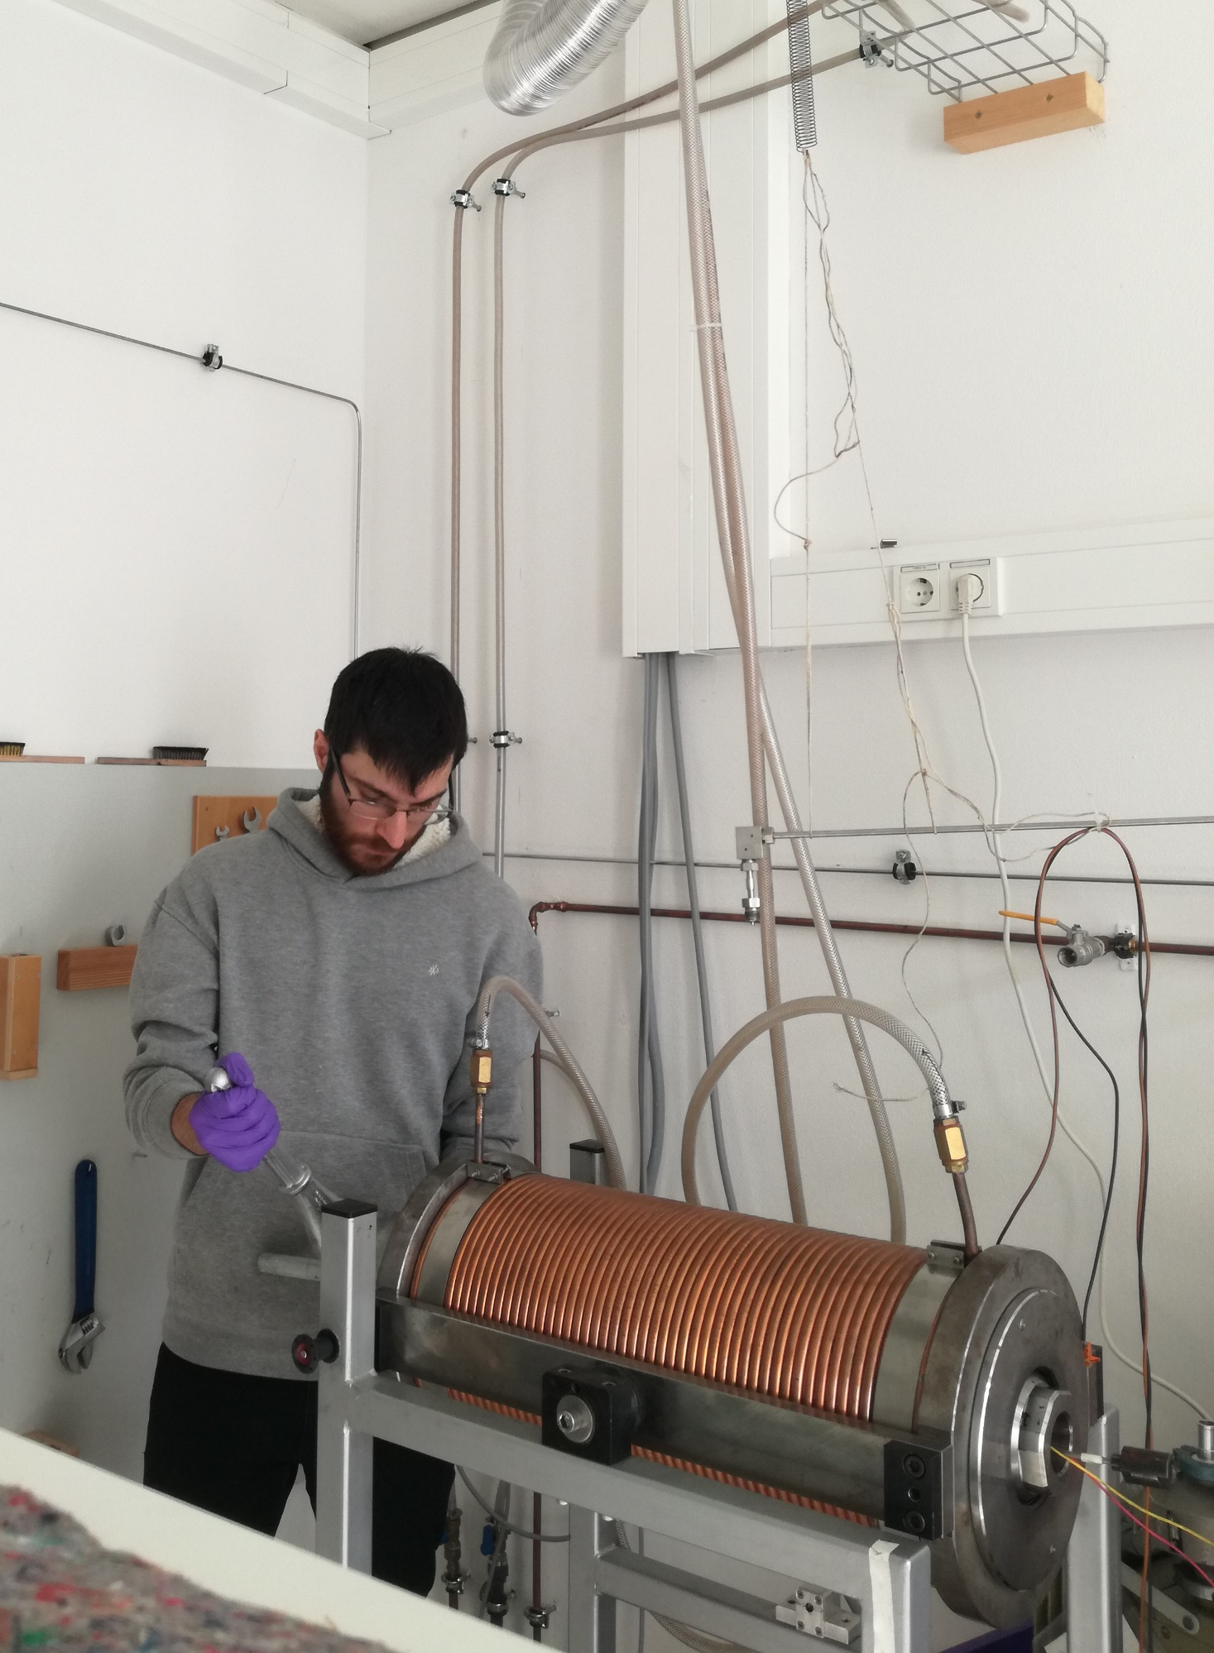
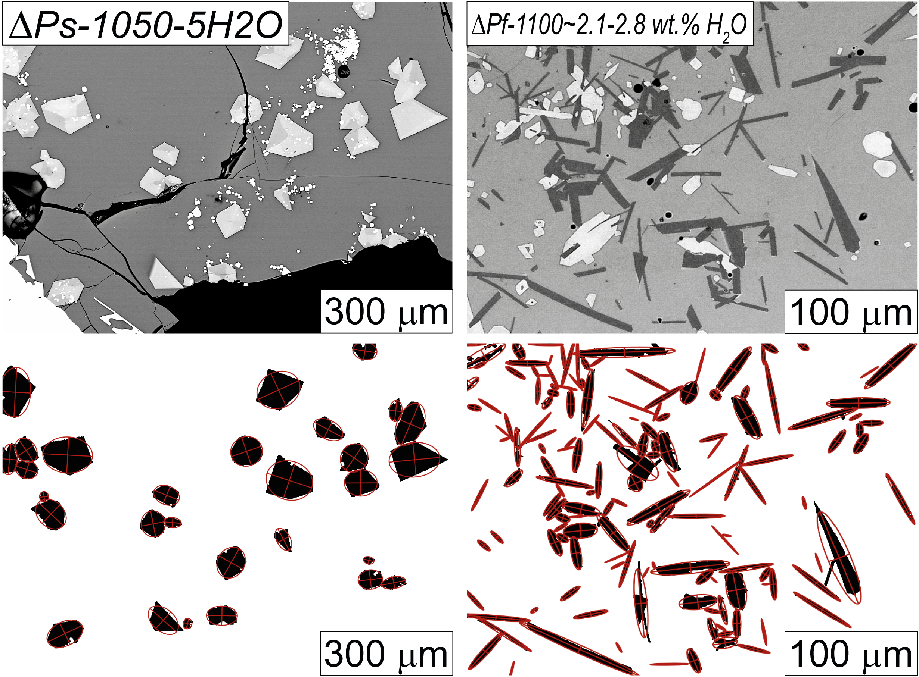
Piergiorgio Moschini
piergiorgio.moschini@uniroma1.it
Modeling clinopyroxene and plagioclase growth kinetics at Mt. Etna and Stromboli
Experimental approach and data collection
Starting material: two basalts erupted at Mt. Etna and Stromboli volcanoes
Fast decompression experiments
(ΔPf = 0.98 MPa s⁻¹)
Cooling rate experiments
(CR = 80 °C min⁻¹)
Slow decompression experiments
(ΔPs = 0.018 MPa s⁻¹)
Isothermal-isobaric experiments
(1050 < T < 1150 °C ; 30 < P < 300 MPa ; 0 < H₂O < 5 wt.% ; 0.25 < t < 72 h)
Clinopyroxene
Plagioclase
Data collection
Acquisition of BSE photomicrographs with FE-SEM;
Reduction of the greyscale images to binary type images by grey level tresholding (i.e., image segmentation);
Retrieving textural parameters by using a Matlab© code (Moschini et al., 2021) in conjunction with NIH Image J software.
© Moschini et al. All rights reserved

Slide 4
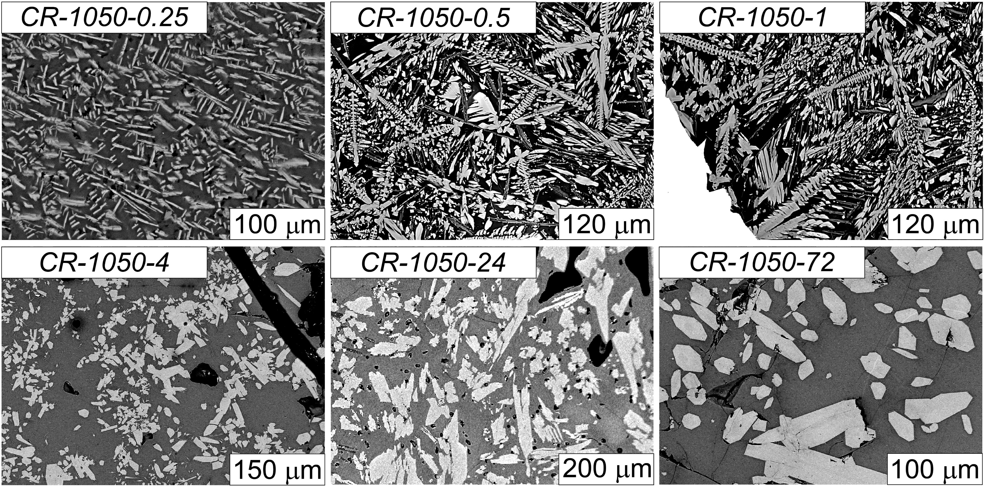
Piergiorgio Moschini
piergiorgio.moschini@uniroma1.it
Modeling clinopyroxene and plagioclase growth kinetics at Mt. Etna and Stromboli
For a constant cooling rate of 80 °C min⁻¹, the textural maturation of clinopyroxene evolves from tiny, anhedral crystals to large, euhedral crystals as the experimental time increases from 0.25 to 72 hours.
This textural evolution is governed by relaxation phenomena operating at the crystal-melt interface and changing the crystallization regime from diffusion-controlled to interface-controlled (Moschini et al., 2021).
Moschini et al., 2021, Lithos
© Moschini et al. All rights reserved

Slide 5
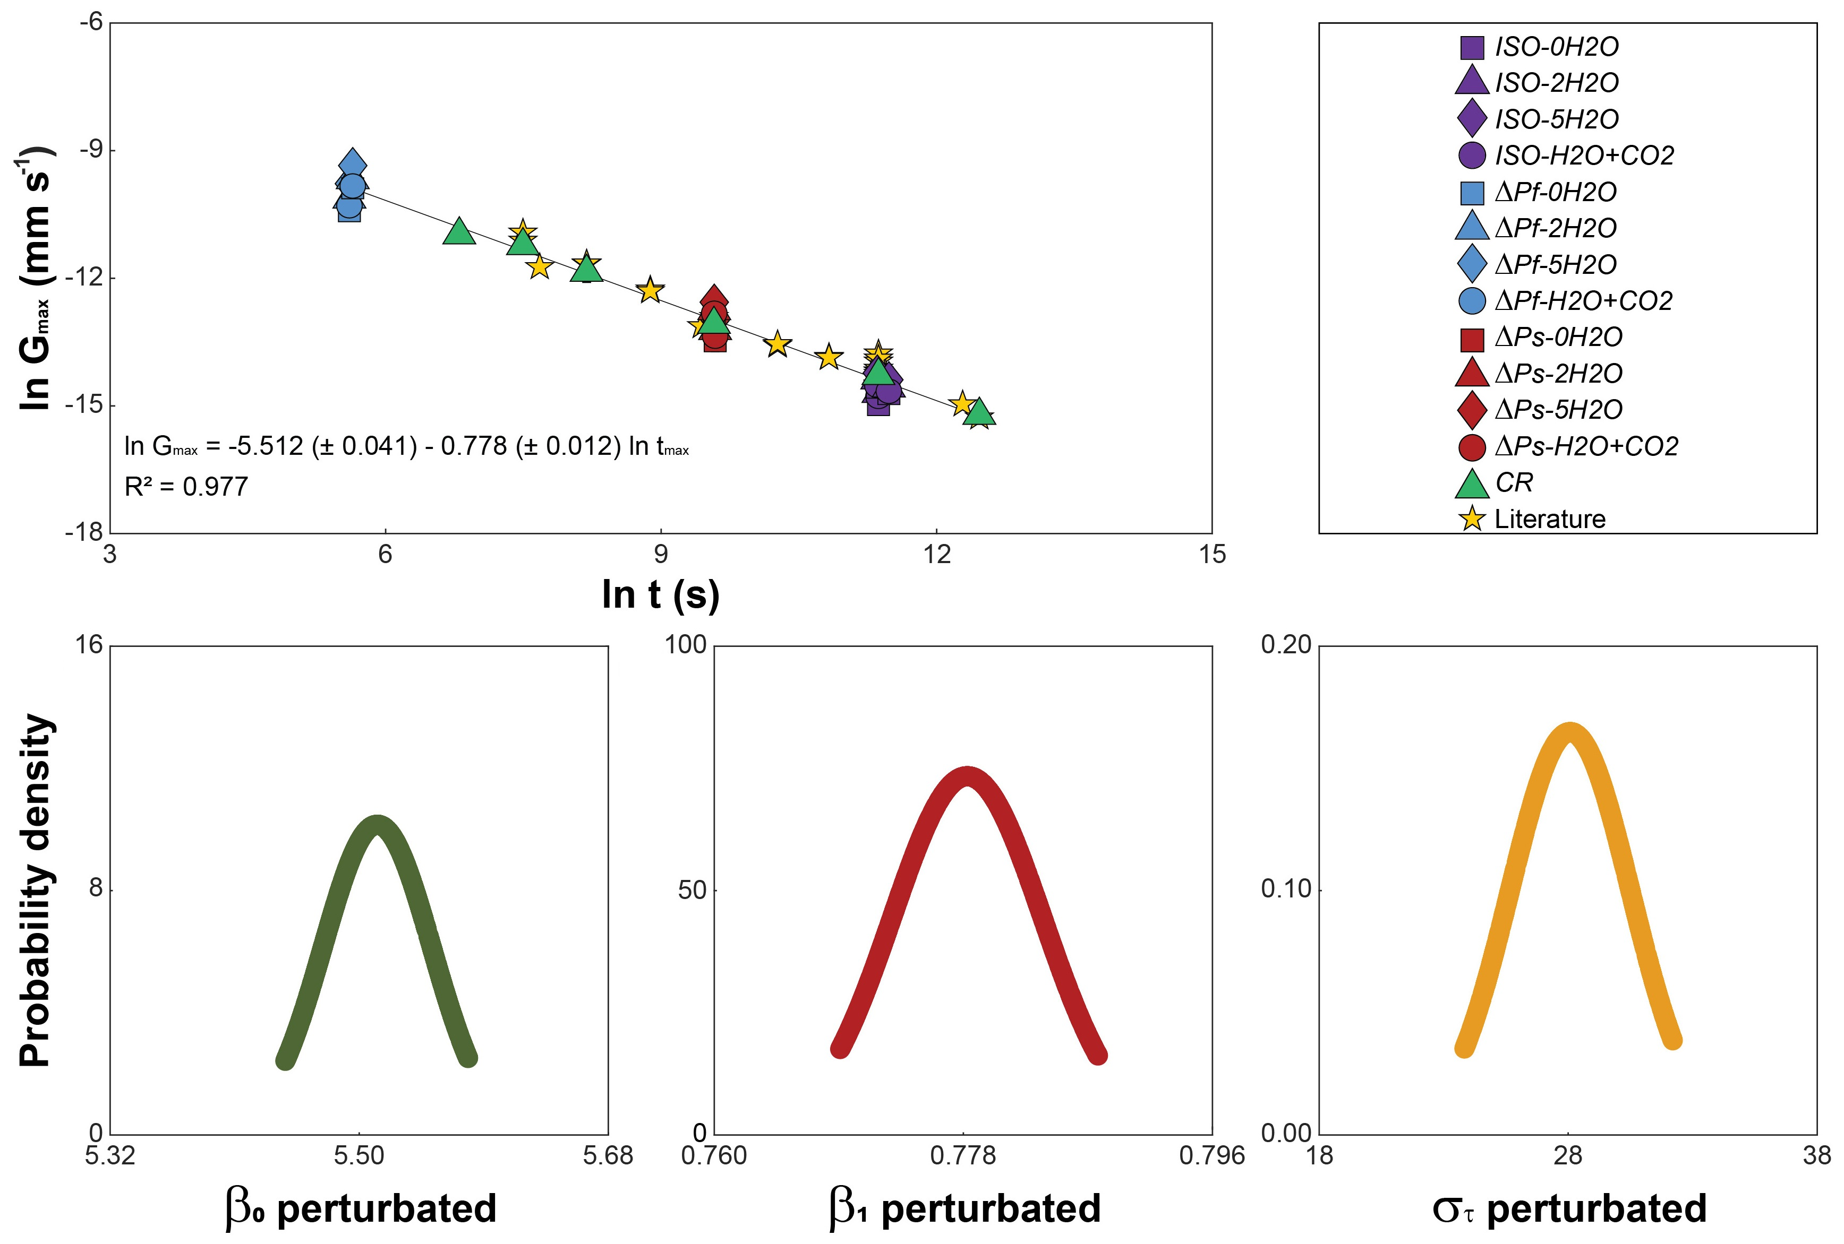
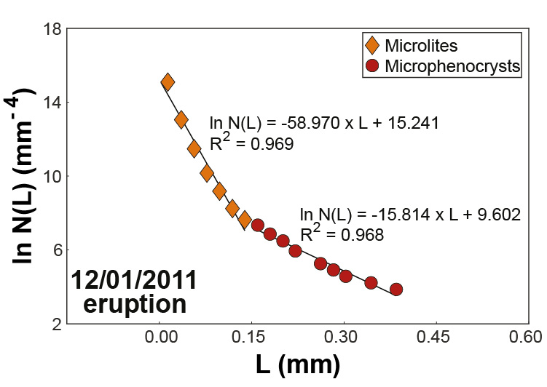
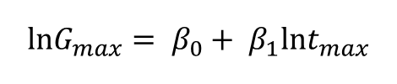
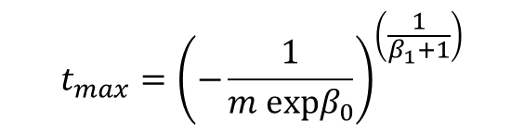
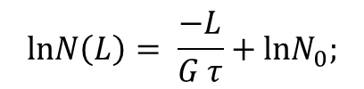
Piergiorgio Moschini
piergiorgio.moschini@uniroma1.it
Modeling clinopyroxene and plagioclase growth kinetics at Mt. Etna and Stromboli
A new model to estimate crystallization time
decay of clinopyroxene growth rate with increasing crystallization time
Crystal Size Distribution analysis
$$lnG_{max}= β_{0}+ β_{1}lnt_{max}$$
$$lnN\left(L\right)= \frac{−L}{G τ}+lnN_{0};$$
1
2
m = 1 / (G × τ)
$$t_{max}={\left(−\frac{1}{m expβ_{0}}\right)}^{\left(\frac{1}{β_{1}+1}\right)}$$
Moschini et al., 2021, Lithos
© Moschini et al. All rights reserved

Slide 6
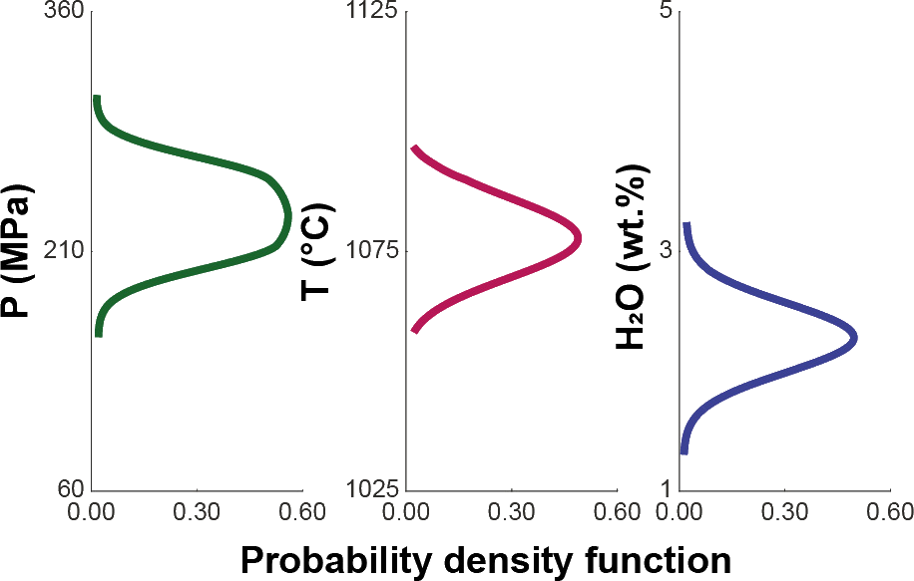
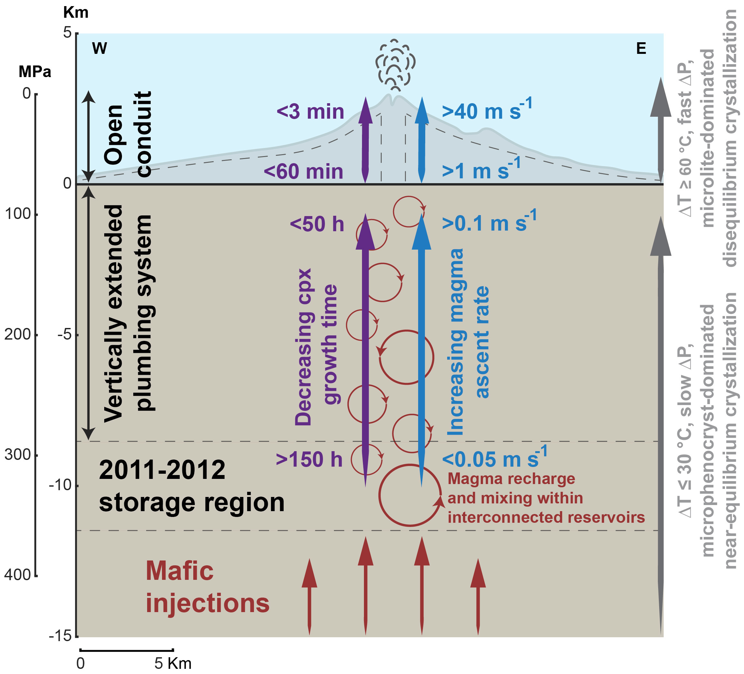
Piergiorgio Moschini
piergiorgio.moschini@uniroma1.it
Modeling clinopyroxene and plagioclase growth kinetics at Mt. Etna and Stromboli
Conceptual model of magma dynamics at Mt. Etna volcano
The crystallization time model has been used in concert with thermobarometric and hygrometric evidence to build a conceptual model for Mt. Etna volcano.
Near equilibrium condition for clinopyroxene saturation:
~ 210-260 MPa;
~ 1070-1080 °C;
~ 2.2-2.4 wt.% H₂O.
Moschini et al., 2021, Lithos
© Moschini et al. All rights reserved

Slide 7
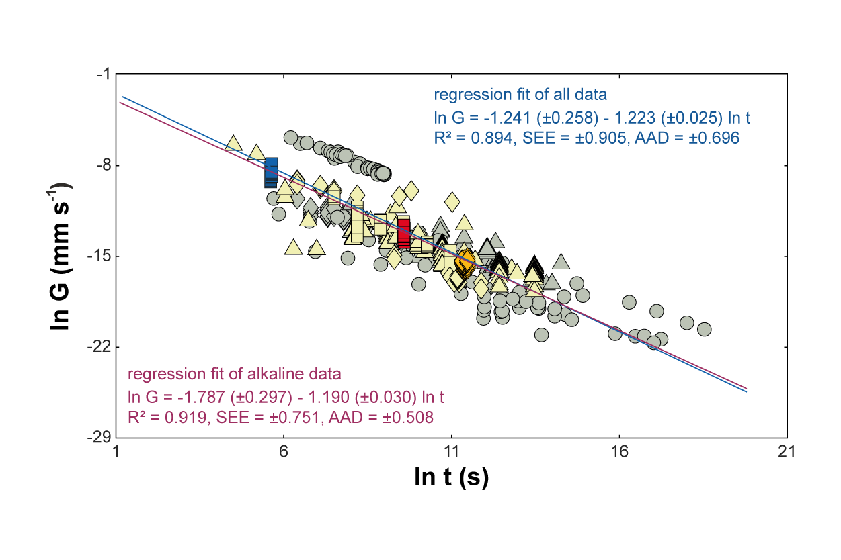
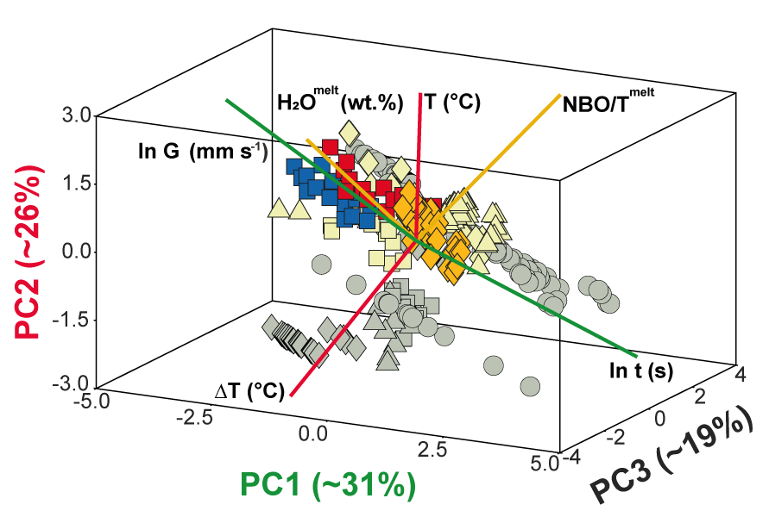
Piergiorgio Moschini
piergiorgio.moschini@uniroma1.it
Modeling clinopyroxene and plagioclase growth kinetics at Mt. Etna and Stromboli
Results
decay of plagioclase growth rate
with increasing crystallization time
Principal Component analysis
Moschini et al., in preparation
© Moschini et al. All rights reserved

Slide 8
Piergiorgio Moschini
piergiorgio.moschini@uniroma1.it
Modeling clinopyroxene and plagioclase growth kinetics at Mt. Etna and Stromboli
Conclusions
The texture of clinopyroxene and plagioclase crystals is greatly controlled by relaxation phenomena and melt supersaturation;
Crystallization time of clinopyroxene and plagioclase crystals can be parameterized as a function of growth rate by integrating experimental textural data and the algebraic expression of crystal size distribution;
The temporal information could be used to better elucidate the magma dynamics within mafic alkaline systems.
More information can be found here:
Moschini et al., 2021, Lithos, doi: 10.1016/j.lithos.2021.106225
Thanks for your attention
© Moschini et al. All rights reserved

