Slide 1



EGU22-4245
Towards a global monitoring system for terrestrial primary production (TerrA-P)
Colin Prentice, Keith Bloomfield (Imperial College London)
Roel van Hoolst (VITO)
Manuela Balzarolo, Sara Vicca (University of Antwerp)
Darren Ghent (University of Leicester)

Slide 2
Productivity model (the ‘P model’)
A parsimonious Light Use Efficiency (LUE) model for Gross Primary Production (GPP):
  GPP = LUE x IPAR x fAPAR
There are many LUE models…
…but in the P model, LUE is derived from the FvCB photosynthesis model.
Optimal acclimation => no PFT distinctions (except C₃/C₄) required.
All parameters estimated independently => no calibration, no guesswork!
Wang et al. (2017) Nature Plants
Stocker et al. (2020) GMD

Slide 3
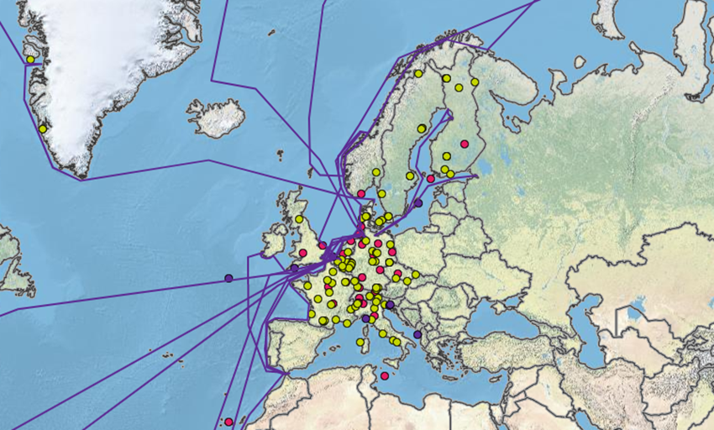
TerrA-P project (ESA, led by VITO), Phase II
Prototype of a new global GPP monitoring system, based on the P model
fAPAR input from Sentinel-3 (2018, 2019)
Evaluation with flux-tower GPP from ICOS
ICOS - Integrated Carbon Observation System (icos-cp.eu)

Slide 4
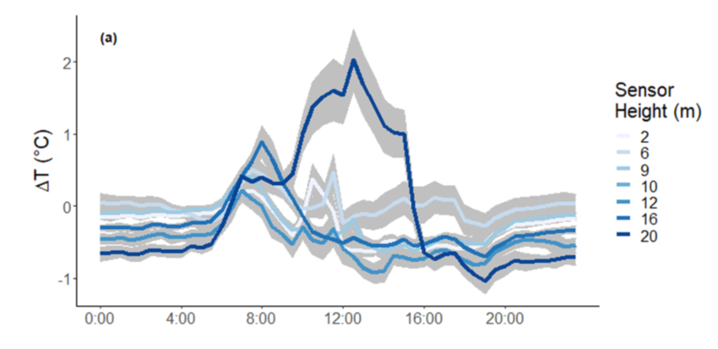
Land Surface Temperature (LST) as input
Could LST – rather than air temperature – be a more appropriate measure of physiological temperature, and account for drought effects?
2018 European drought as a natural experiment
P-model inputs:
IPAR, fAPAR, CO₂, elevation;
temperature, vpd
ΔT = T_{leaf} – T_{air}
Miller et al. (2021) Agric. For. Meteorol.

Slide 5
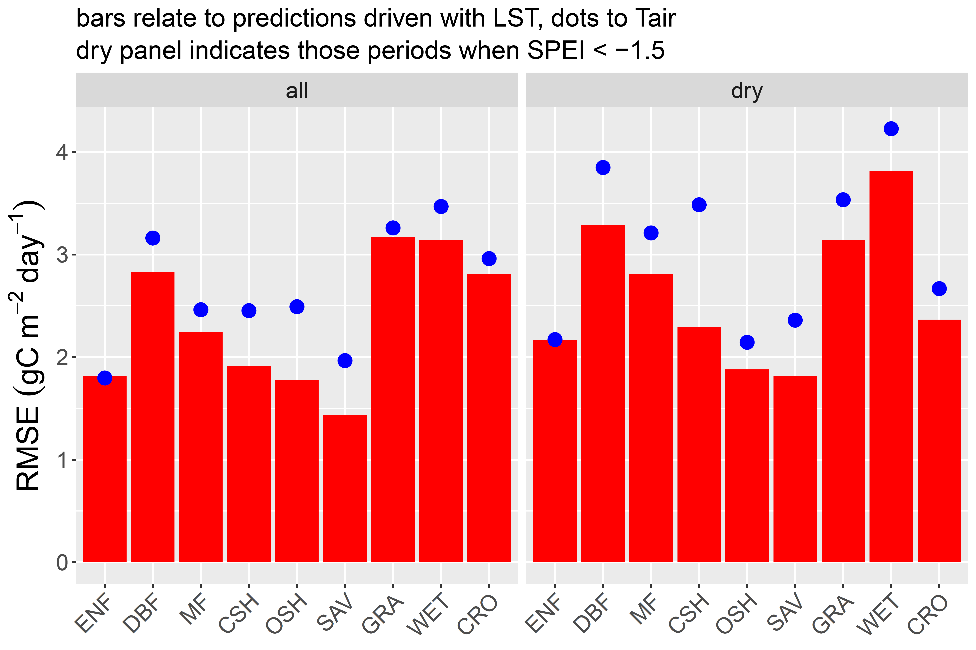
Evaluation: comparing predictions using S3_LST versus gridded Tair
Relative performance varies with biome and moisture availability

Slide 6
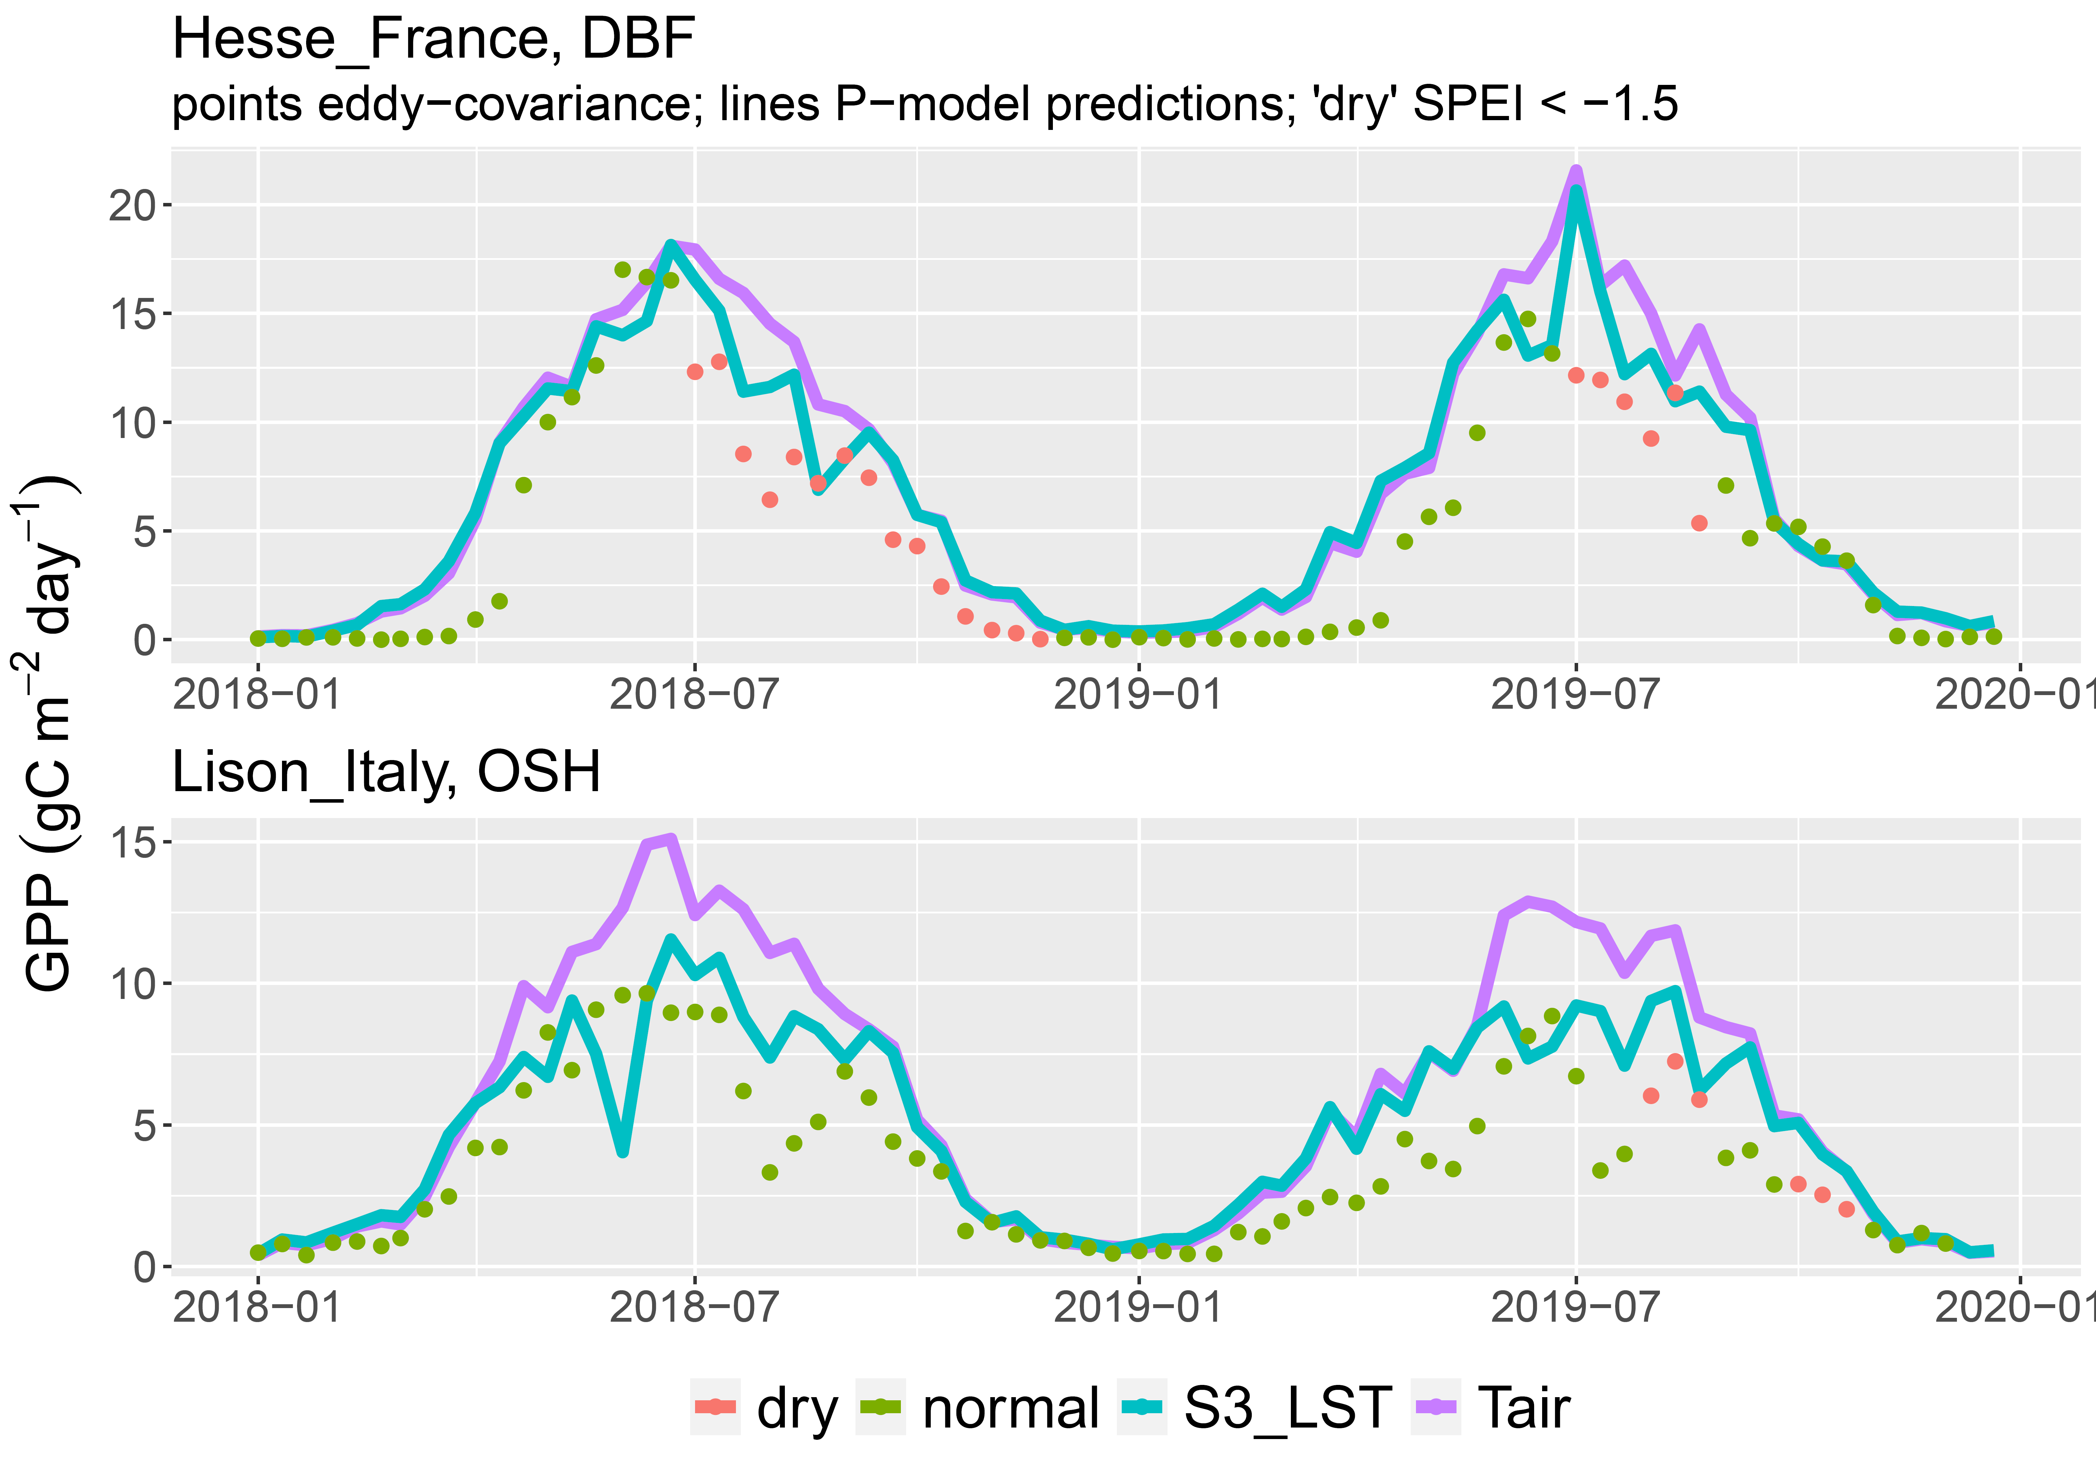
Seasonal cycles at two contrasting sites
Summer 2018 unusually dry at Hesse, not Lison
Early-season bias (prediction > observation)
LST better than T_{air} especially in sparse vegetation….
…but does not fully represent drought effect on GPP.

Slide 7
Next steps
A daytime average of LST versus a single (mid-day) snapshot?
Sparsely vegetated pixels: correct LST with a vegetation index?
  Likely to be more important in arid regions…
The P-model is under development:
  The P-Model — pyrealm: Ecosystem Models in Python 0.5.6 documentation

