Slide 1

Microplastic pollution of the surface of the Kara Sea in different years
Igor Zhdanov, Svetlana Pakhomova, Olga Mekhova, Maria Pogojeva, Anfisa Berezina, Matvey Novikov, Nelli Gettikh, Tatiana Evenkova, Alexander Osadchiev, Natalia Stepanova, Igor Semiletov, and Evgeniy Yakushev

Slide 2
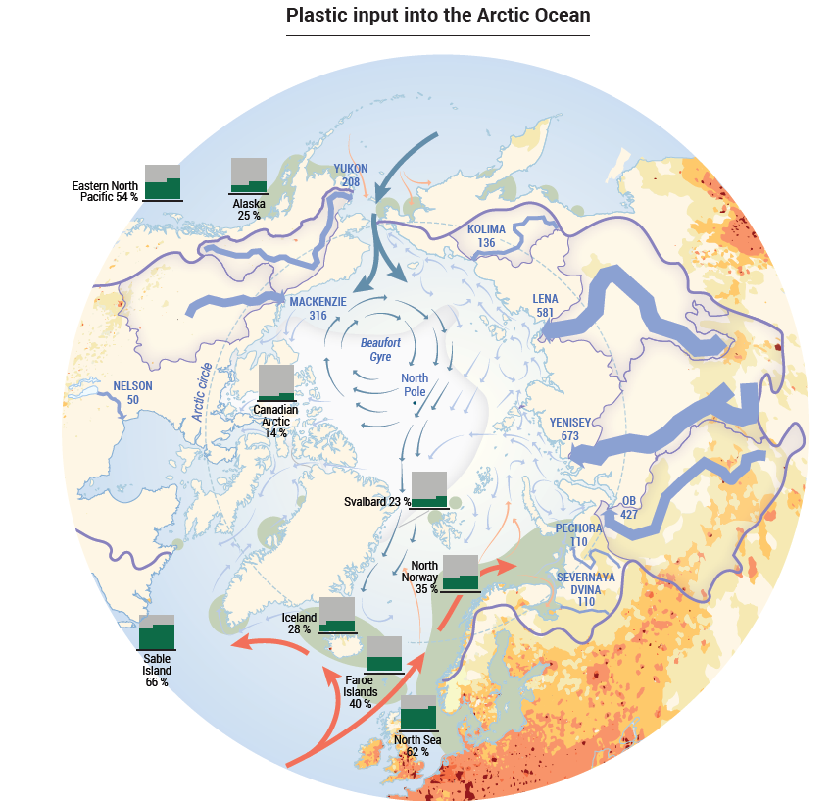
Sources of plastic in the Arctic
Coastal runoff (rivers)
Atlantic waters
Maritime traffic
Atmospheric transport
Melting ice (second source)

Slide 3
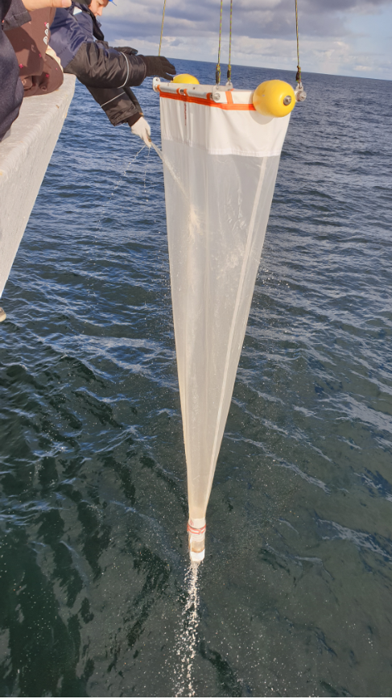
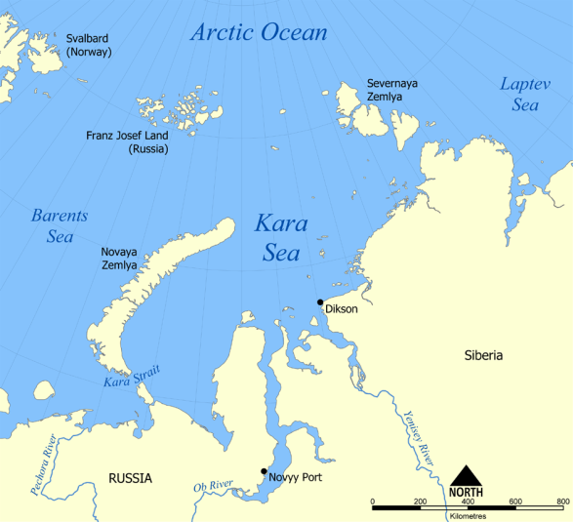
Brief information
Research question:
Is there interannual variability of microplastic in the Arctic and how is it determined?
The measurements were carried out in the Kara Sea in 2019-2021 September-October
Sampling of floating MPs with a neuston net (0,35-5mm)
Identification of all potential plastic particles on FT-IR

Slide 4
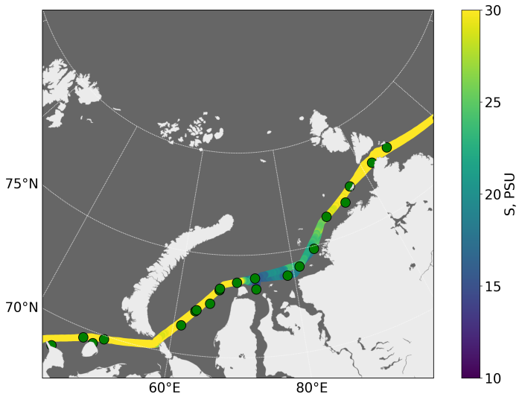
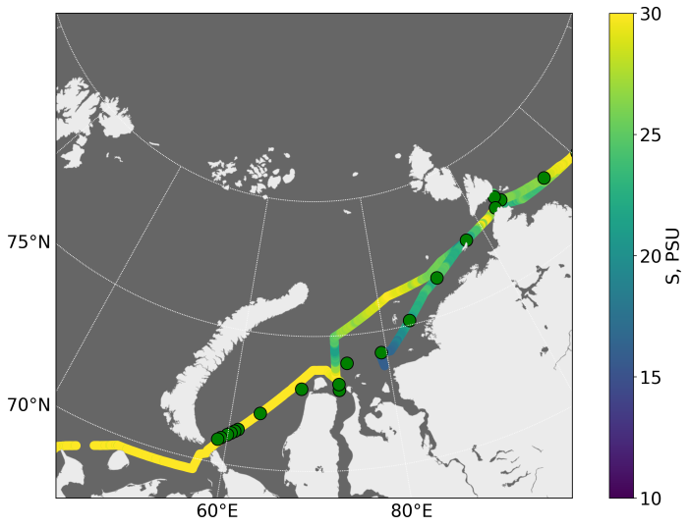
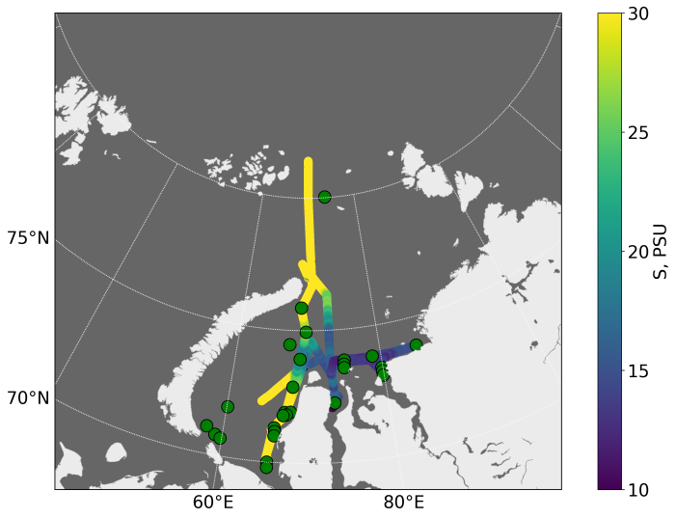
Map of stations and surface salinity
2019
2020
2021
Different hydrophysical conditions:
2019 – inflow of Polar waters in the area of ​​the Vilkitsky Strait, plumes of the Yenisei and Lena are separated
2020 – almost continuous external plume east of the Ob, saline water inflow eastern than in 2019
2021 - ice in the Vilkitsky Strait almost all summer - there was no water transfer from Kara to Laptev Sea

Slide 5
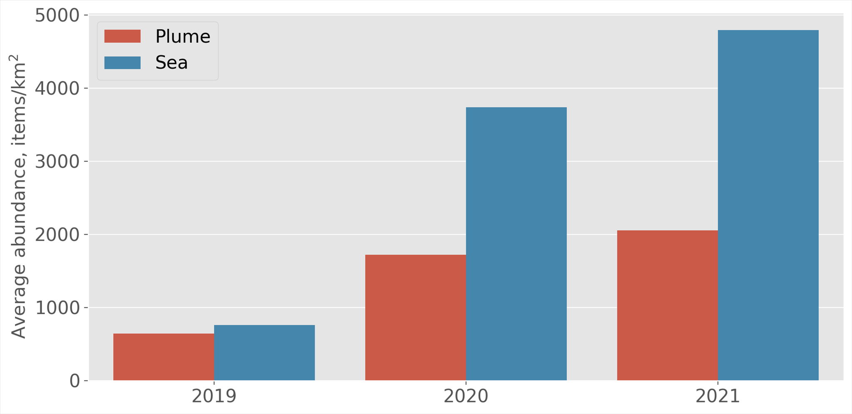
Abundance of MPs in the Kara Sea in accordance with water masses
Highly saline Atlantic/Barents Sea waters (S>28)
Plume of the Ob’ and Yenisei (S<28)

Slide 6
What caused the increase of MPs in the Kara Sea?
Is the increase true (greater release to the ocean) or is it caused by the hydrophysical features of the transfer of plastic to the Arctic?
Need to compare:
River discharge
Ice conditions
Inflow of waters from the North Atlantic/Barents Sea
Shipping activity

Slide 7
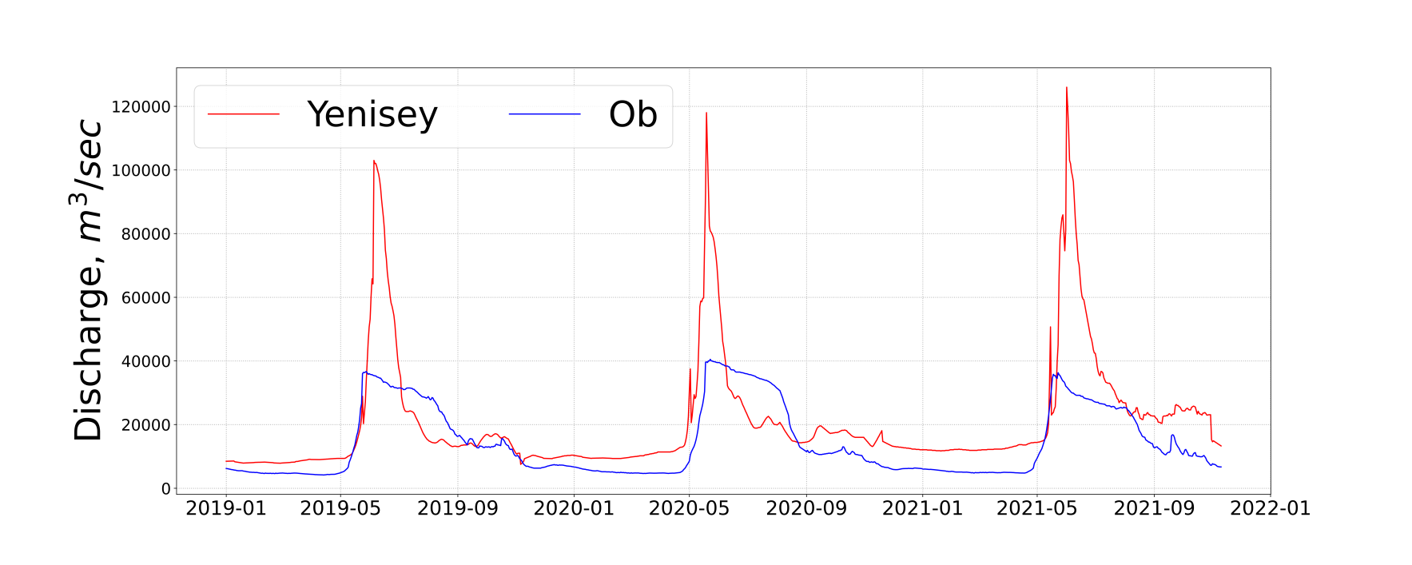
River discharge
River discharge in Arctic is increasing year by year
This may explain the growth of microplastics in plume waters, but does not explain the increase in concentrations in saltier water
MPs abundance in the river plumes is lower than in high saline water
1000 km³/2019
1100 km³/2020
1200 km³/2021

Slide 8
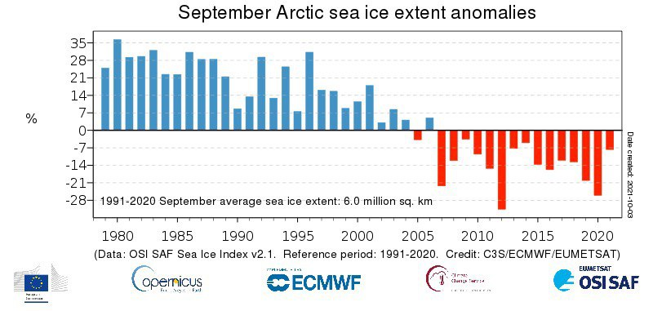
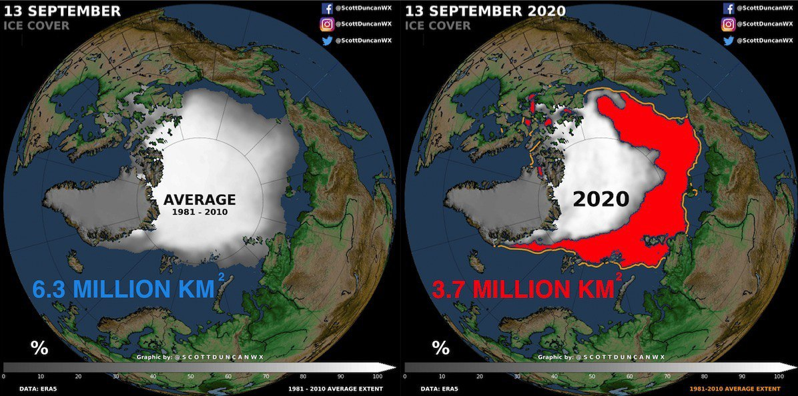
Ice conditions
Plastic debris can cling to the edge of the ice, freeze and transfer to the other Arctic areas
Due to the difference in the density of sea water and sea ice, large fragments can be crushed to the size of microplastics
In recent years, there has been an active melting of multi-year ice (2020 anomaly that coincides with sharp increase in MPs)
Plastic that has accumulated over the years could released to the seas of the Arctic Basin

Slide 9
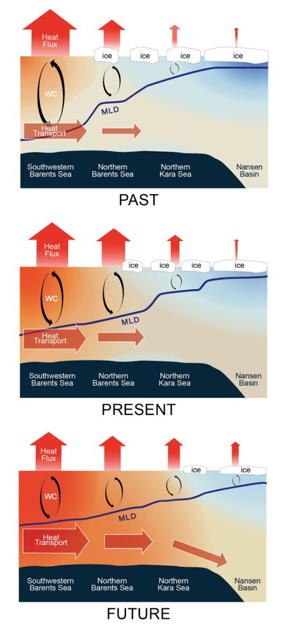
Atlantification of the Arctic
Reducing ice cover leads to a decrease in heat loss from warm Atlantic waters
Warm Atlantic waters can get further into the Arctic Ocean
The waters of the Atlantic Ocean are on average more polluted with microplastics and are capable of transporting plastic particles to the Arctic waters

Slide 10
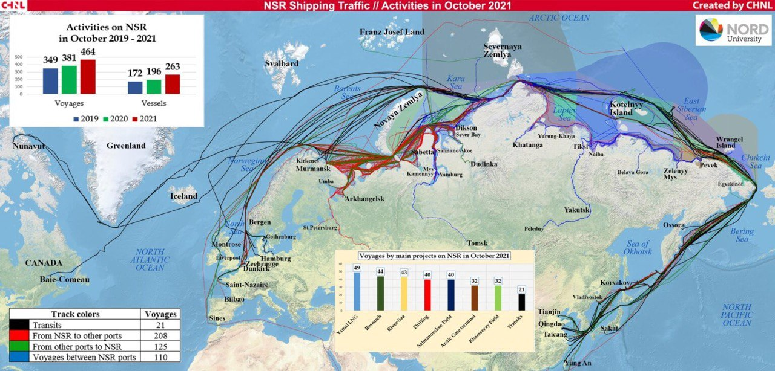
Maritime traffic
  Shipping has been identified as one of the main sources of plastic pollution in the Arctic
  The Northern Sea Route (NSR) is one of the main transport arteries of the Arctic
  The number of voyages and ships increased from 2019 to 2021
  With the growth of shipping activity in the Arctic, the flow of plastic waste from ships is increasing

Slide 11
Conclusions
The amount of microplastics in the Kara Sea is increasing year by year
Siberian rivers bring less microplastics to the Arctic than is found in the surrounding high-saline water
Melting of ice could result in release of microplastics into the Arctic seas
Atlantification of Arctic facilitates the transport of MPs from heavily polluted Atlantic waters to the Arctic
The growth of shipping along the Northern Sea Route leads to an increase in the local supply of microplastics
It is impossible to isolate the main factor that determines the increase in MPs pollution of the Kara Sea, since all potential sources of MPs and the processes that affect its transfer to the Kara Sea became more active during the studied period

Slide 12
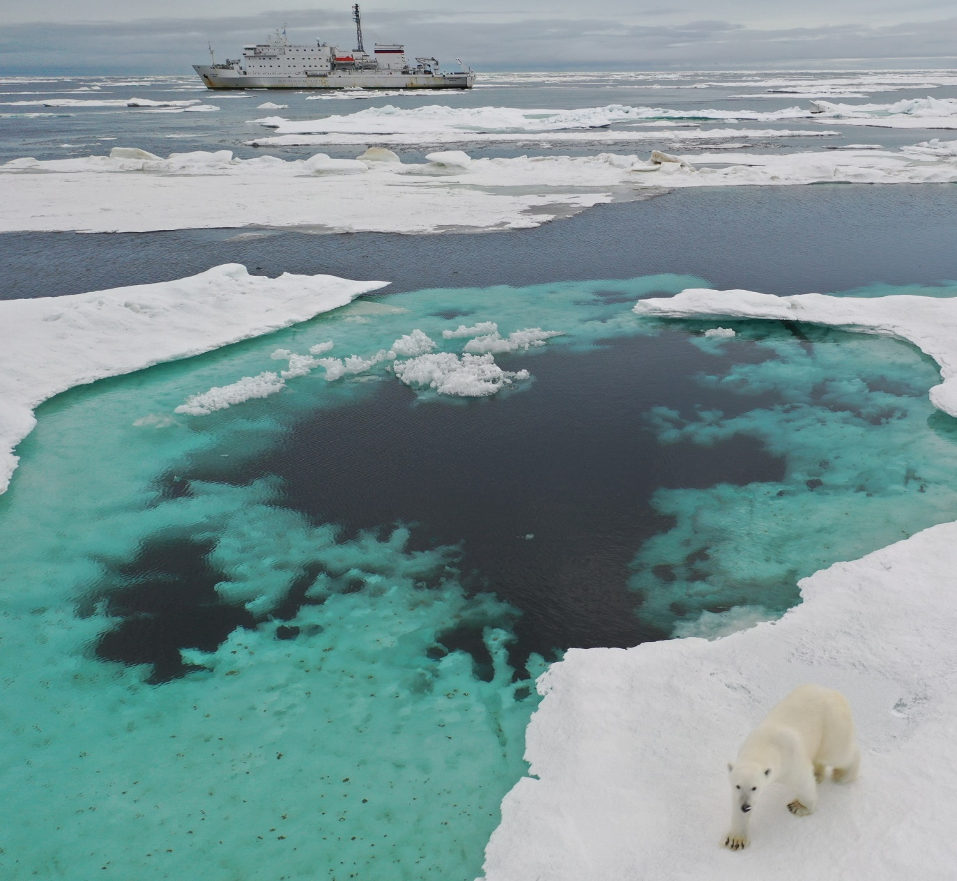
Contacts
zhdanovaeroplast@gmail.com

