Slide 1
The Feasibility of Implementing Minewater Heat on the Durham University Estate
Michael MacKenzie
Supervisors: Prof. Jeroen van Hunen & Prof. Jon Gluyas

Slide 2
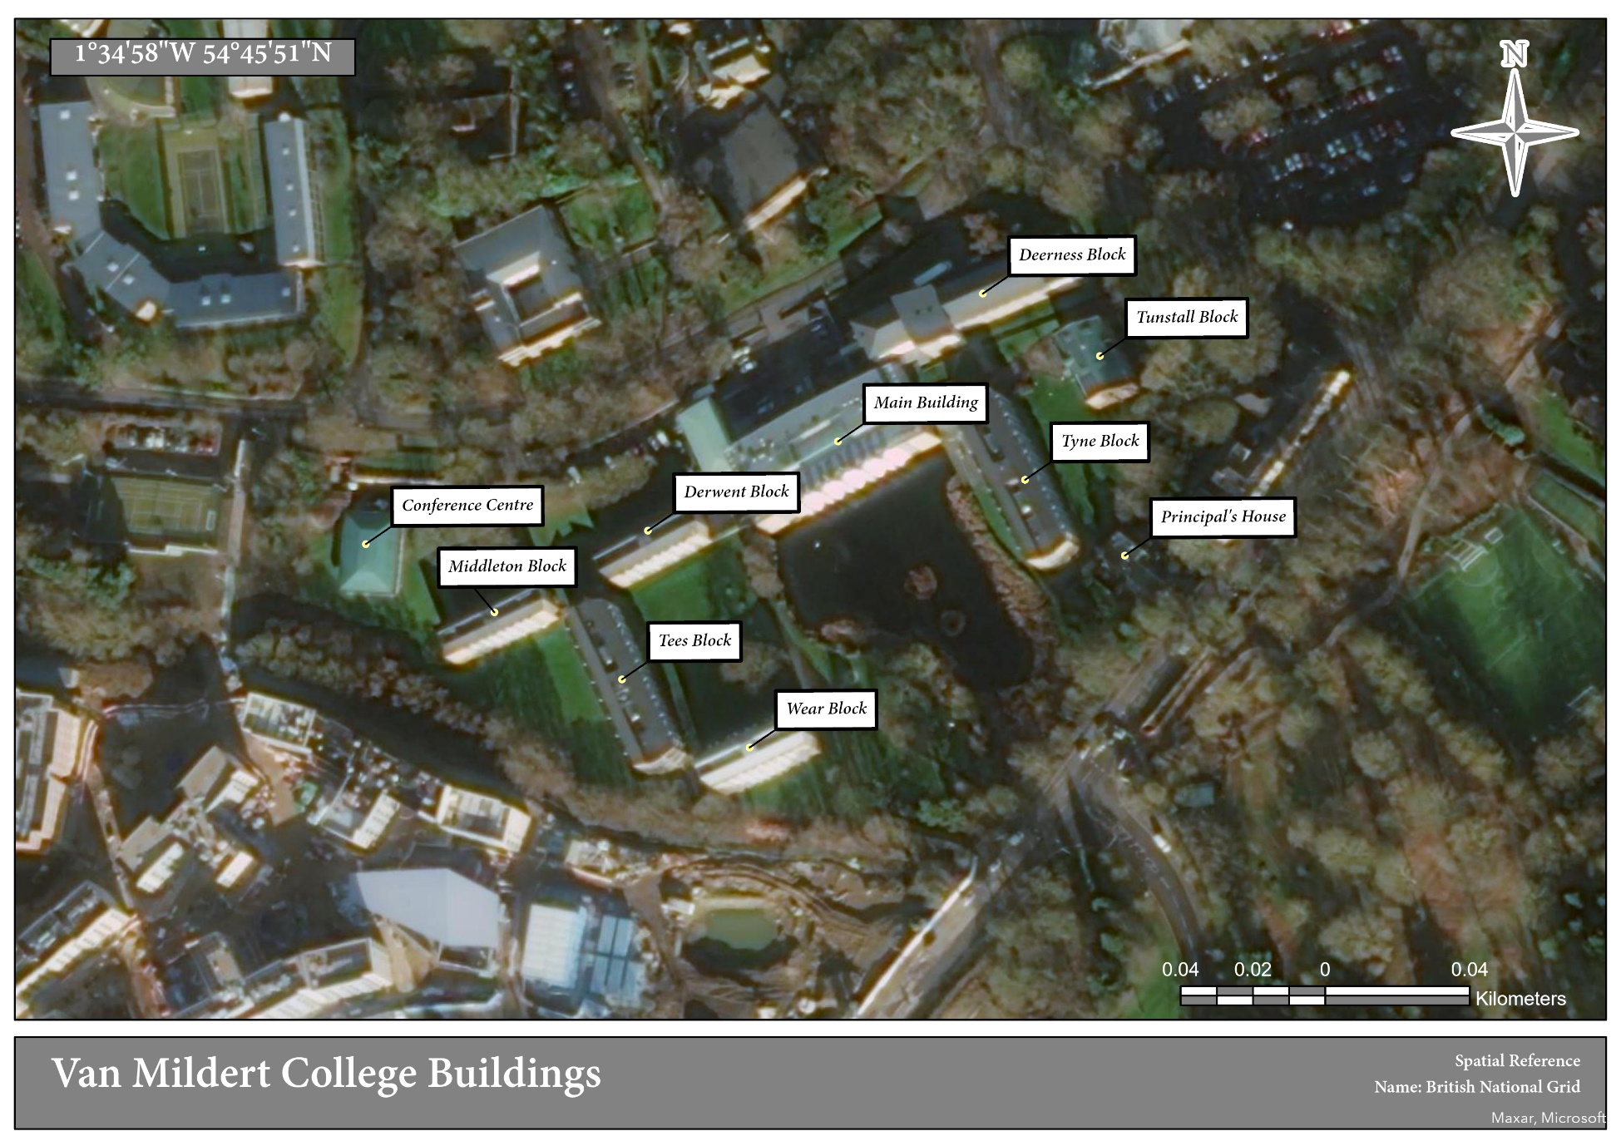
Background
Durham University was founded in 1832, in the North-East of England, where there is a strong legacy of coal mining.
With 17 colleges, much of the Durham City campus overlies abandoned room and pillar workings of the Elvet and Littleburn Collieries
Extensively worked seams at 60 and 145m depths.
Van Mildert College- Target Case Study
8 Residential Buildings
521 Bedrooms
1,127 Rooms in Total
Built in the 1960s

Slide 3
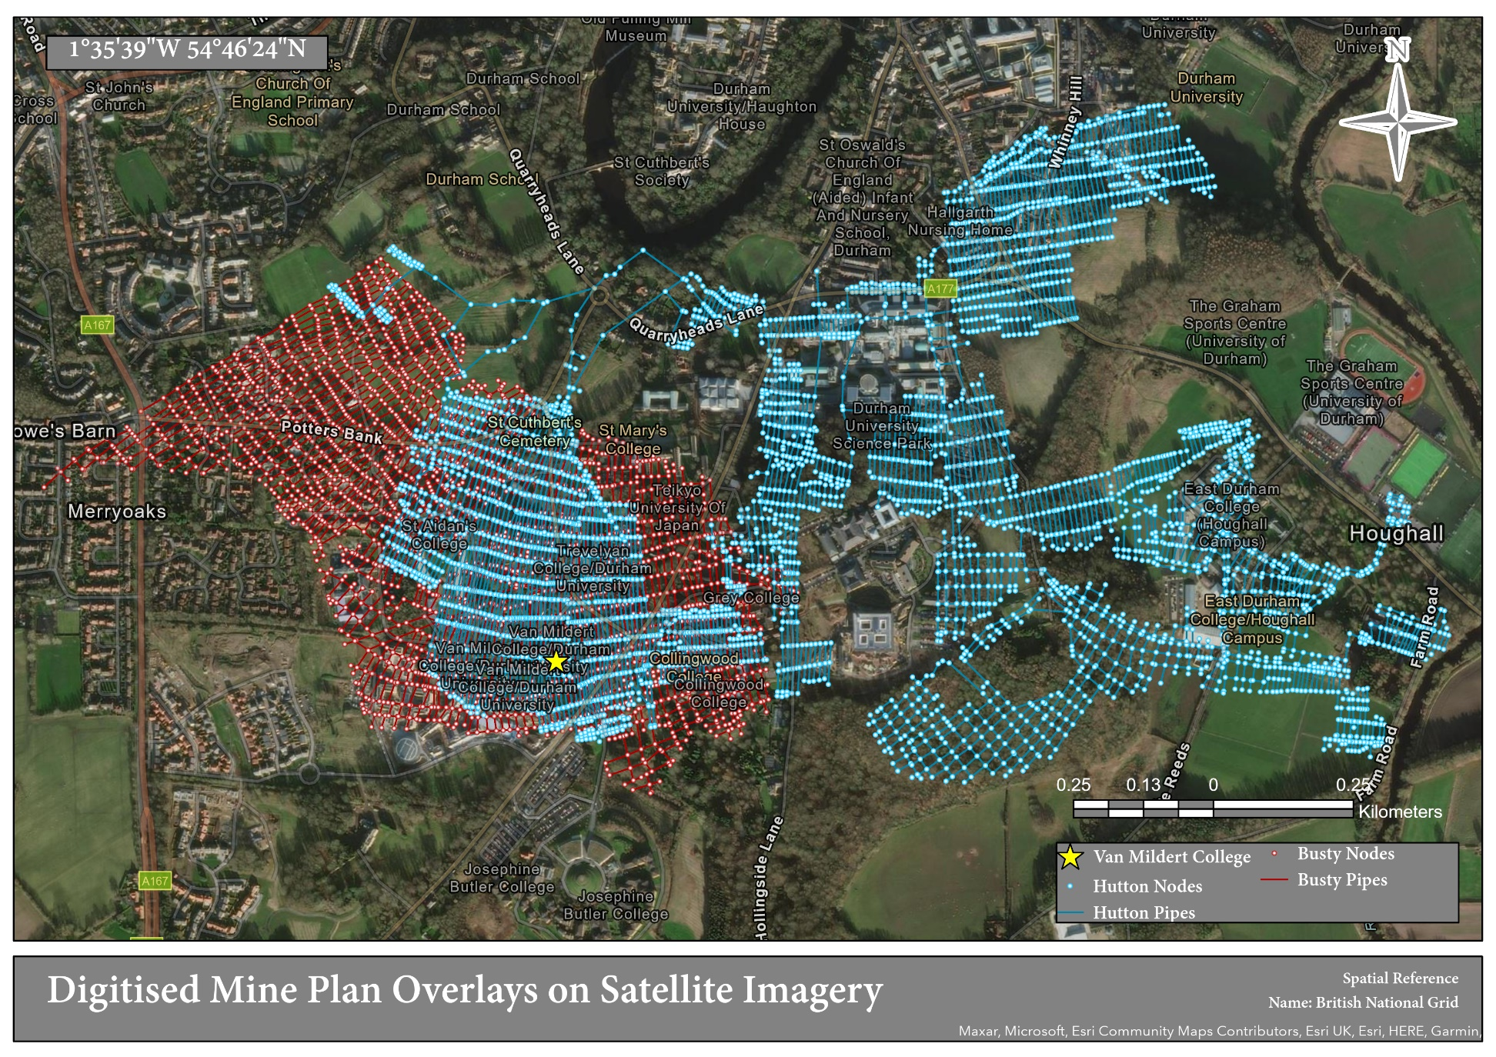
Methodology
Digitisation process designed in ArcGIS Pro, using a ‘Point Feature’ Class to denote ‘Nodes’ and a ‘Line Feature’ Class to denote the ‘Pipes’ or roadways
Allows the user to trace over the georeferenced mine plan to recreate the geometry of mineworkings
Added a Conditional Formula in the MATLAB Script which allowed for the model to auto-assign flow directions between Pipes and Nodes
Scaled the geometries that could be modelled from a few hundred data points, to over 10,000

Slide 4
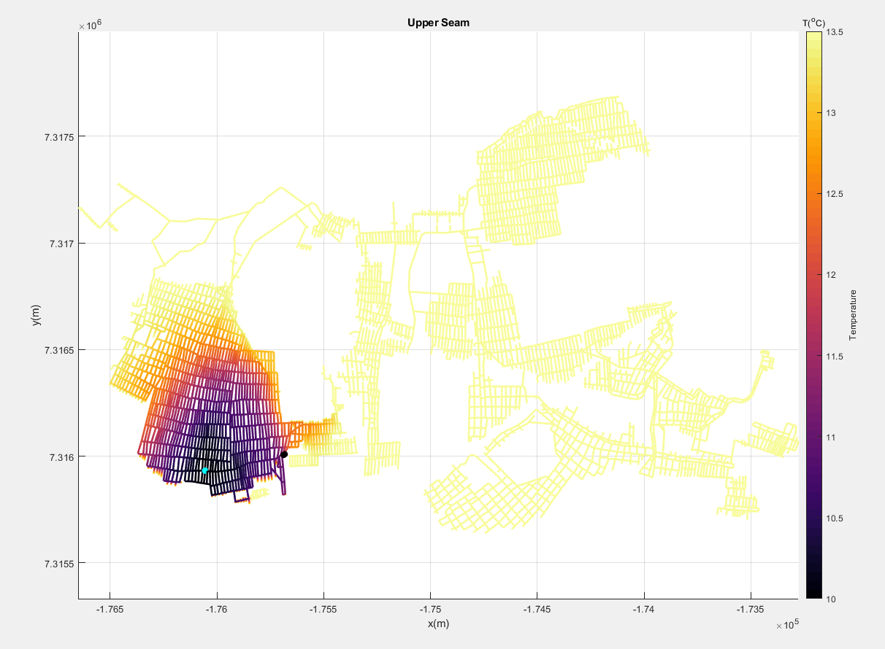
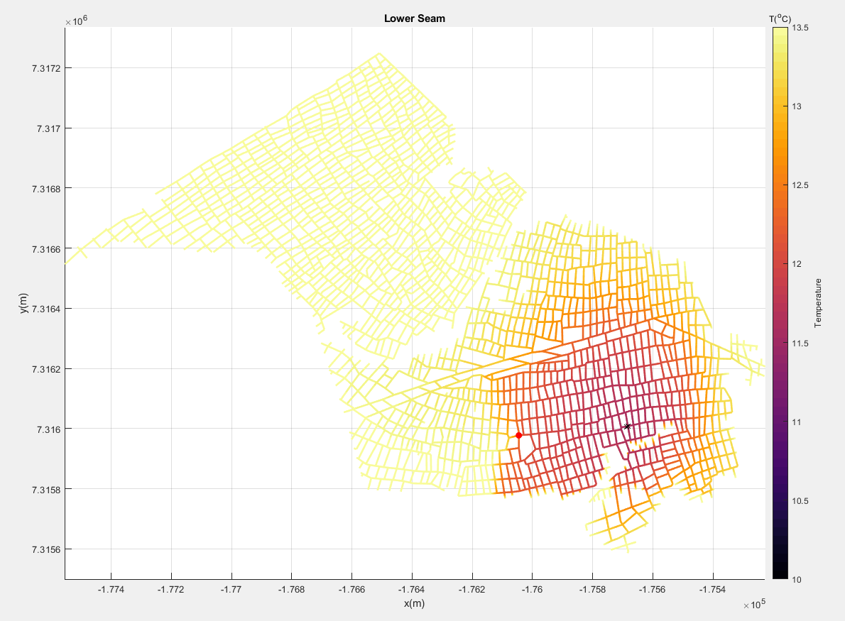
Results
Van Mildert College

Slide 5
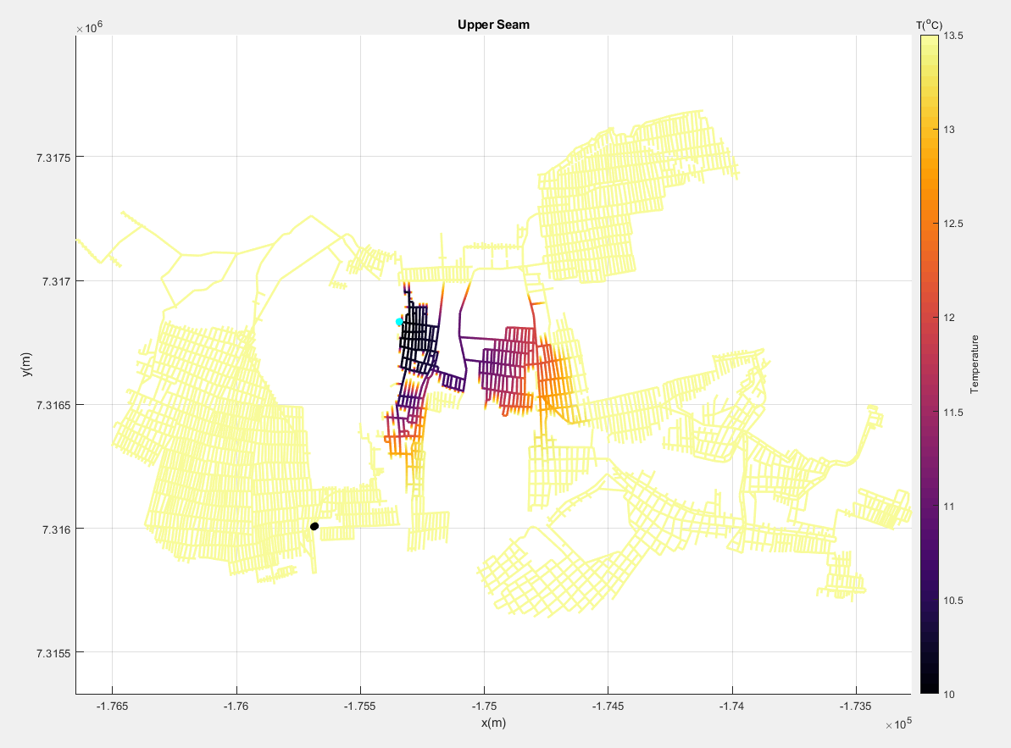
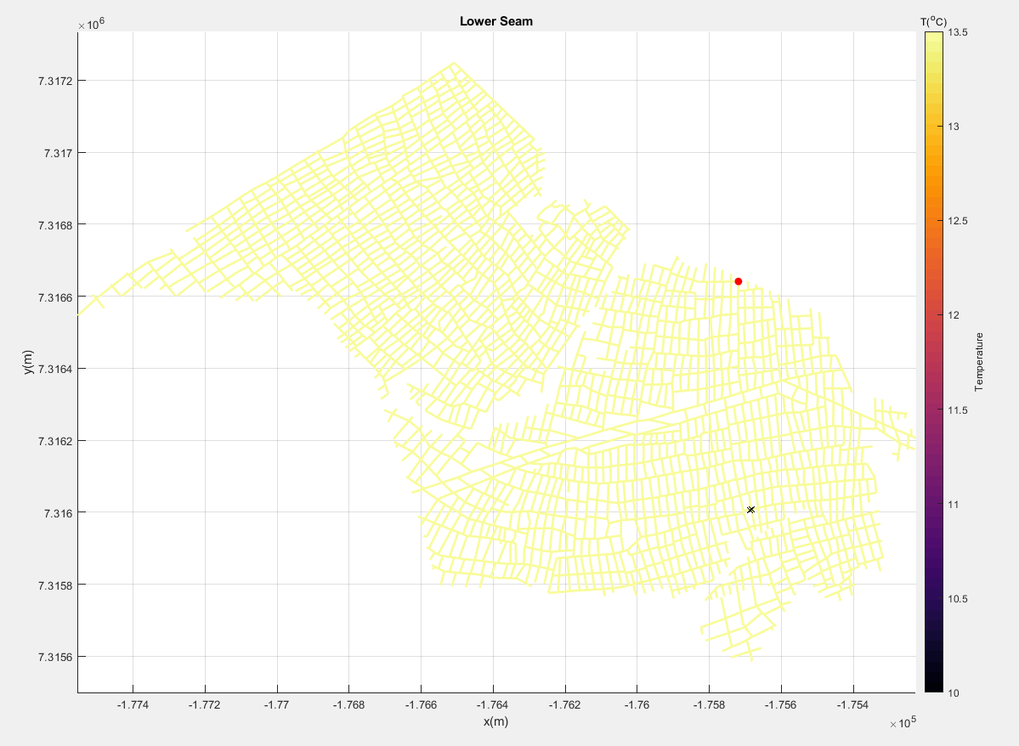
Results
Teaching and Learning Centre

Slide 6
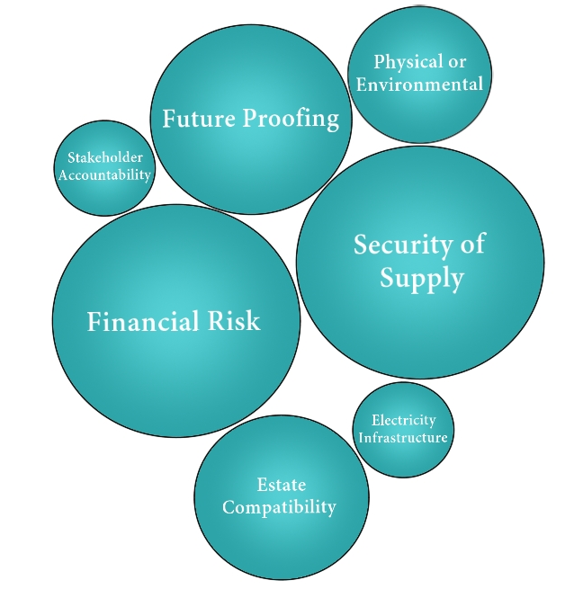
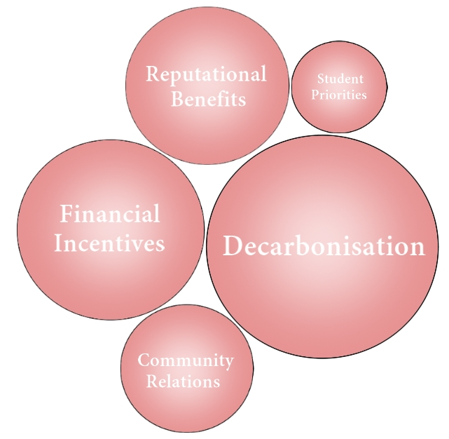
Results
Concerns and Opportunities as Identified by Key “Decision-Makers” within the University

Slide 7


Results
$$1,725,429 kWh ×\left(392 g ÷1000\right)=567,666.14 k$$
$$\text{2,008,38}6 kWh ×\left(277 g ÷1000\right)=455,904 kg$$
$$\frac{2,008,386}{3.89}=516,295 kWh$$
$$516,295 kWh ×\left(256 g ÷1000\right)=132,172 kg$$
$$455,904 kg−132,172 kg=323,732 kg$$
Estimated CO₂ produced from heating TLC at present
Required electrical input for equivalent heat provision, assuming COP of 3.89
Estimated CO₂ production from proposed heat pump system
Estimated annual CO₂ reduction
Worth noting that this research has been based upon a one end-user, two well system.
Expanding proposed works to build a heat network supplying the nearby Science Site could achieve better economic and system efficiencies.

Slide 8
Thank You
michael.r.mackenzie@durham.ac.uk

