Slide 1
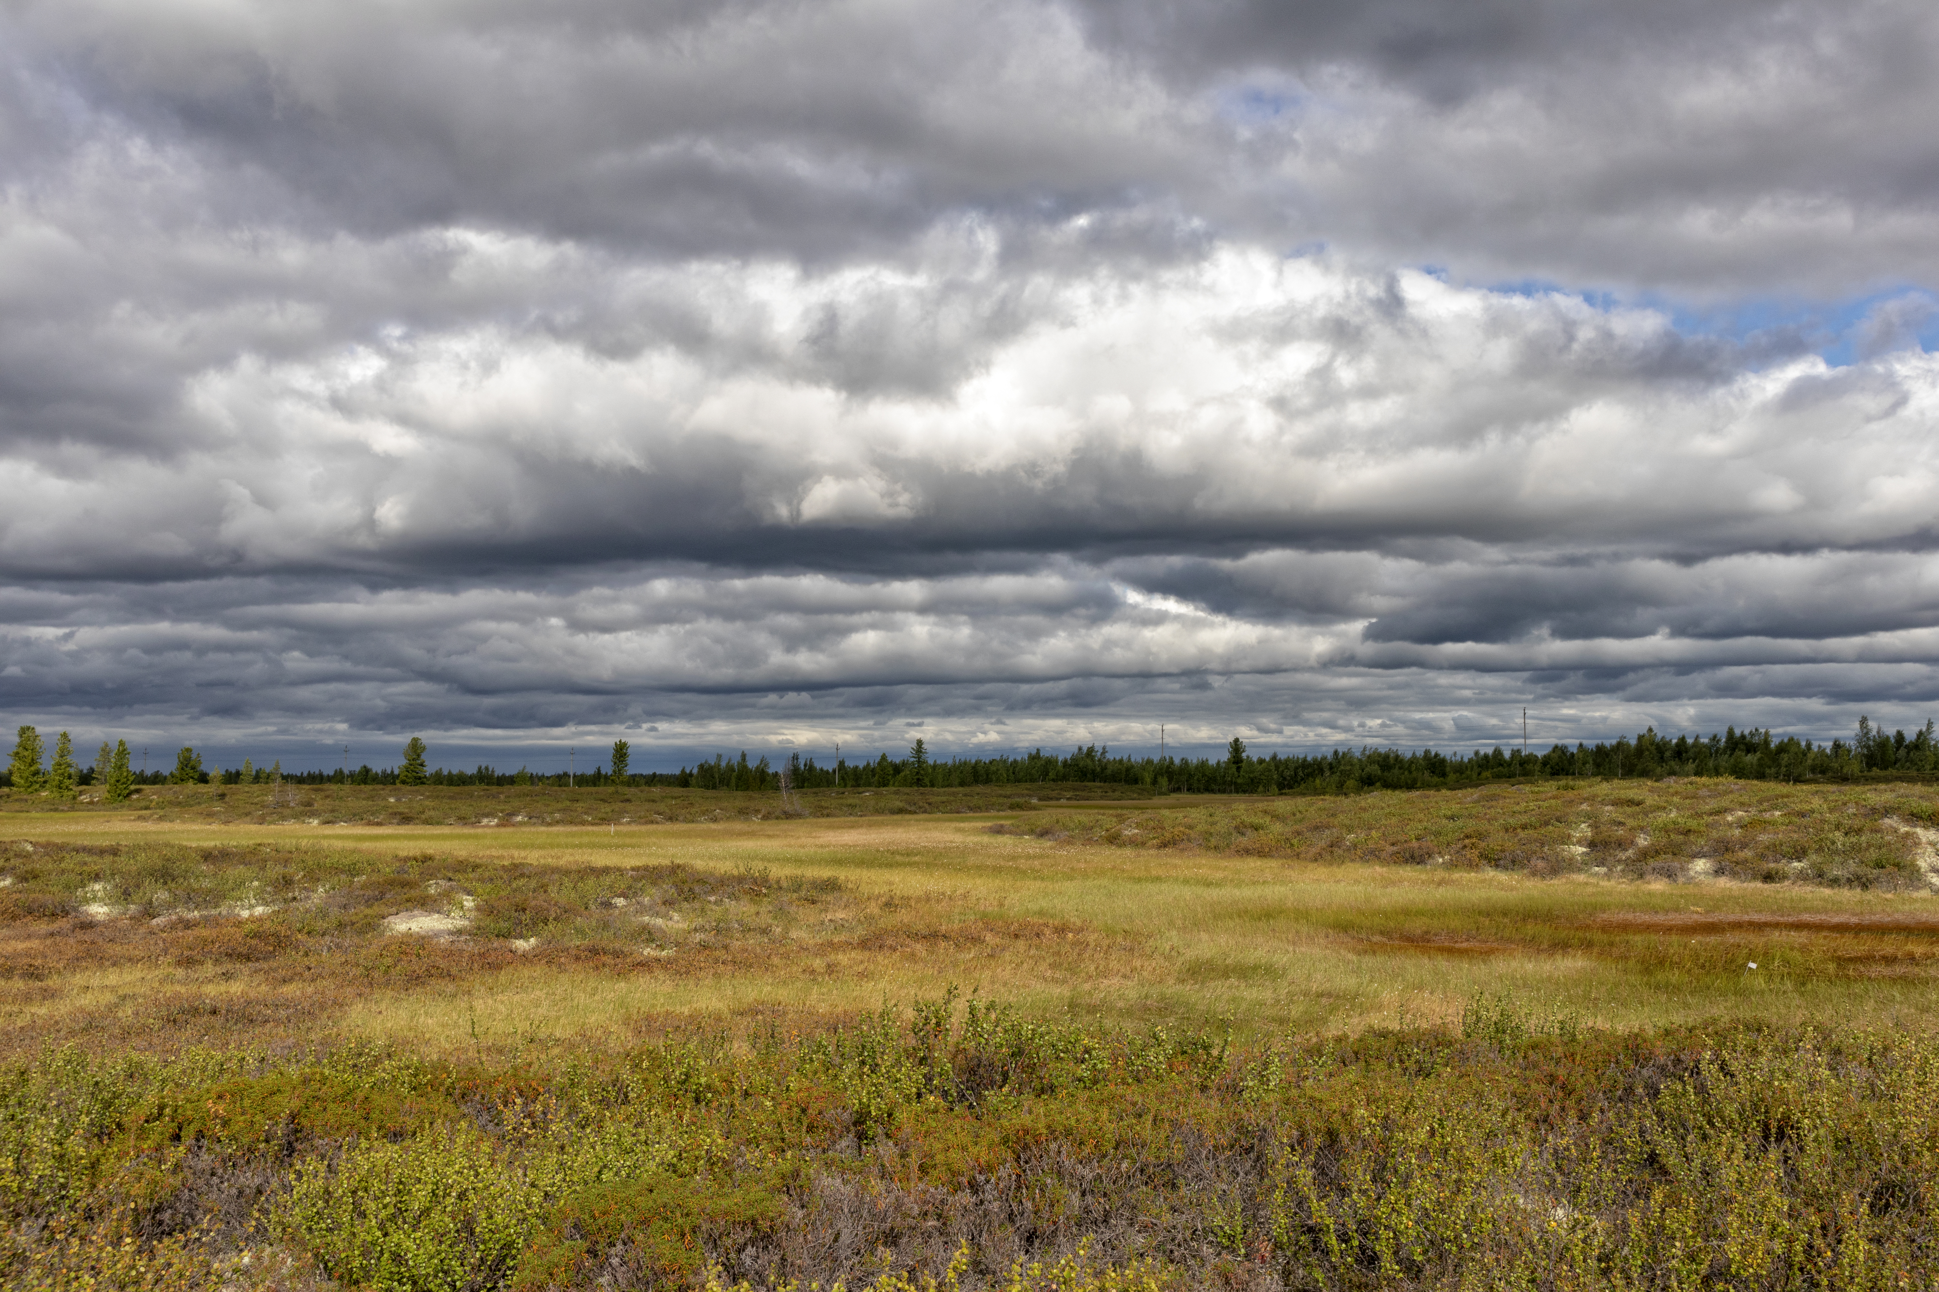
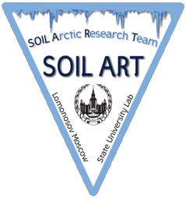




Permafrost thawing and changes of peat biological activity of palsa mire in Western Siberia
Dokuchaev Soil Science Institute
Lomonosov Moscow State University
Stanislav Chuvanov
stas.chuvanov@gmail.com

Slide 2
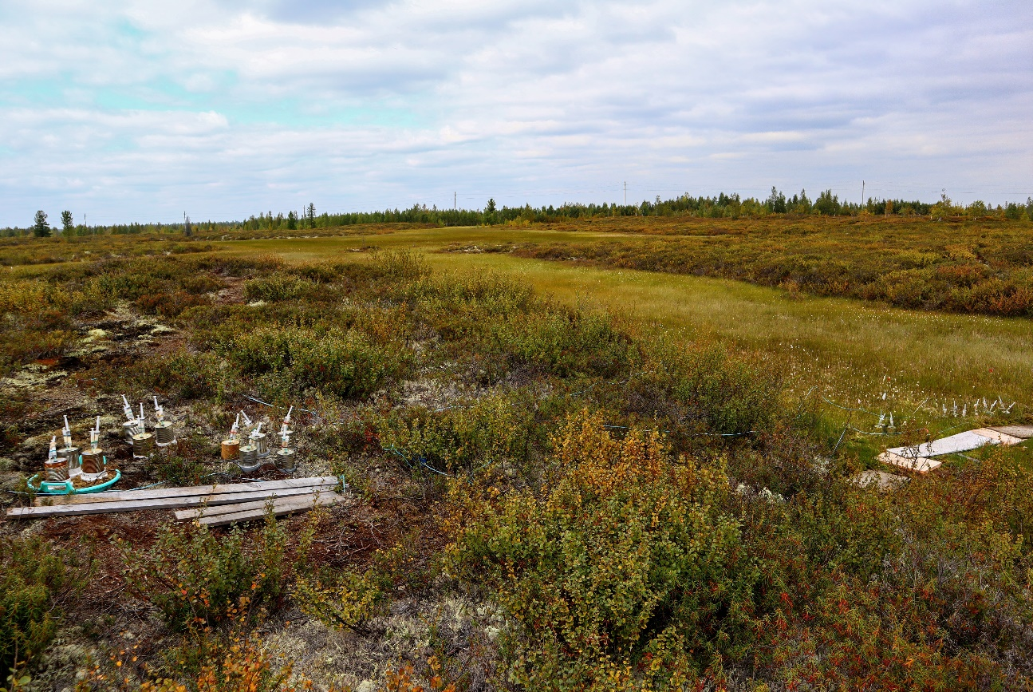
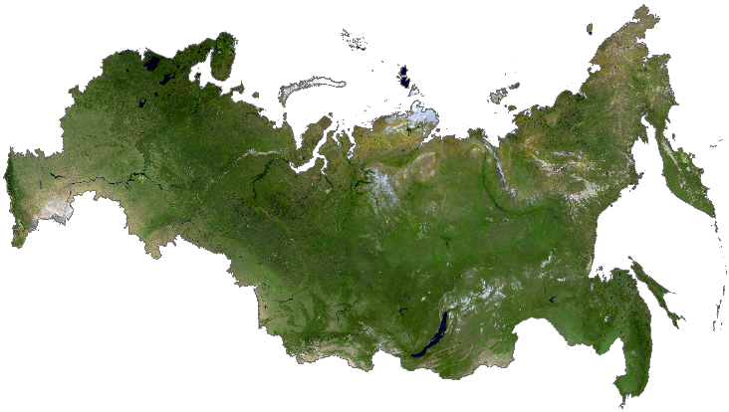
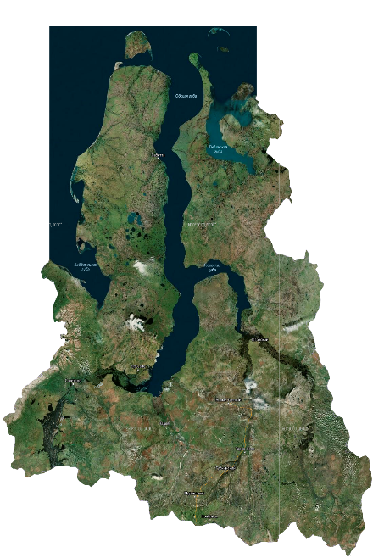
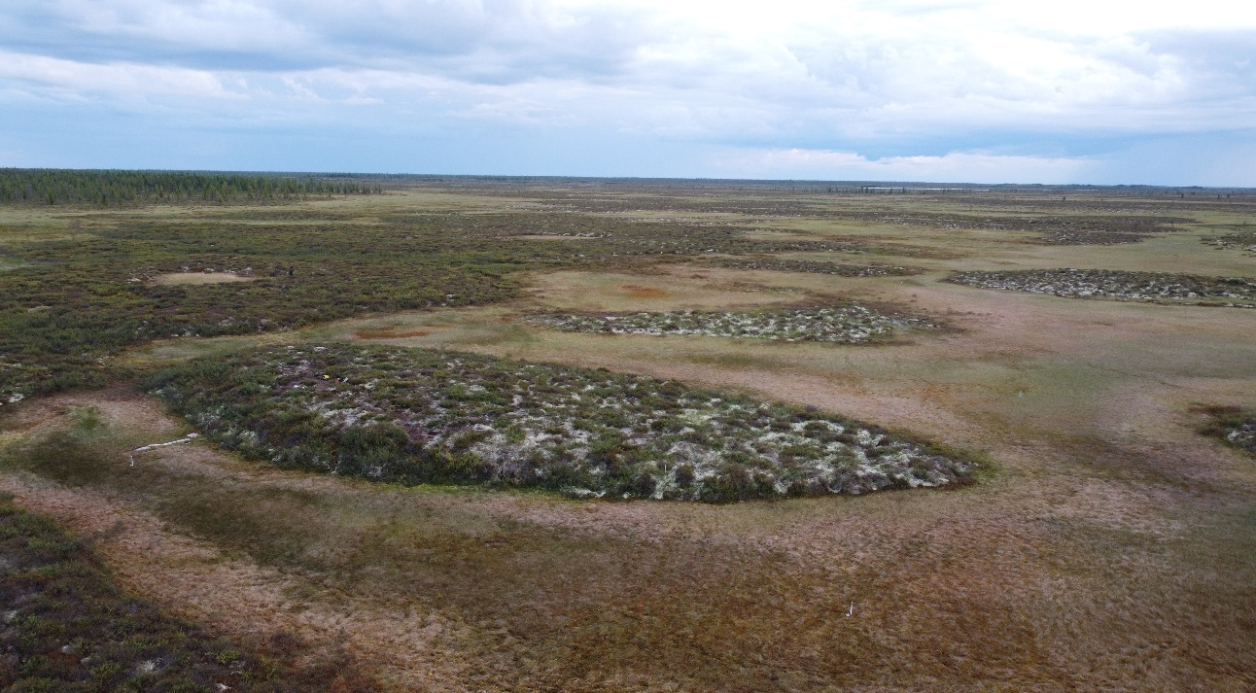
Russia, north of Western Siberia, Nadym region
Northern taiga
Discontinuous permafrost
Palsa mire: Bog (fibric histosols) and palsa (cryic histosols)
gisgeography.com
Bog
Palsa
Arctic Circle
Nadym

Slide 3

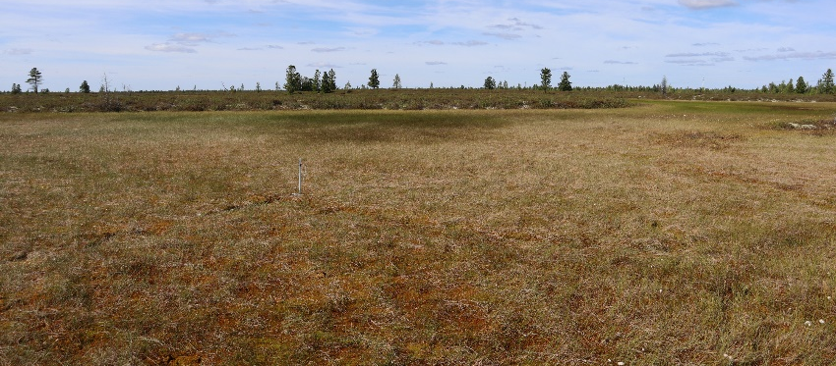
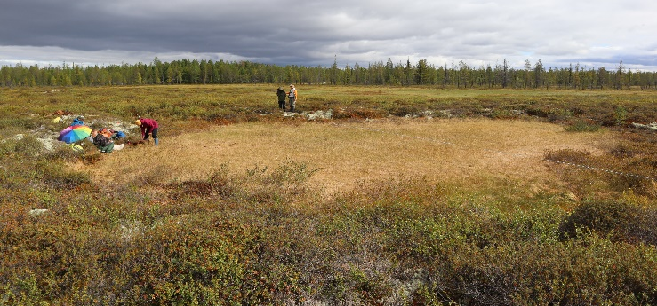
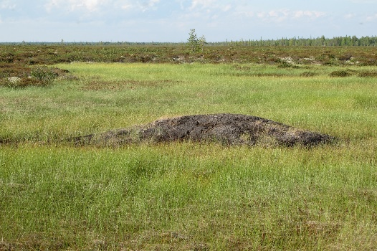
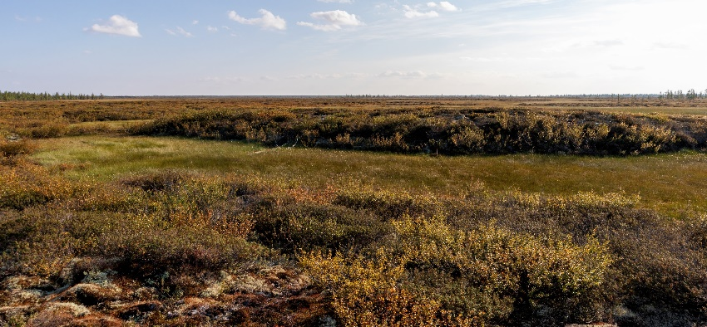

Impact of climate change on ecosystems of the permafrost zone
Bog
Permafrost formation
CO₂ flux?
or
Thermokarst
Raising the palsa from the bog
Permafrost thawing
Palsa

Slide 4
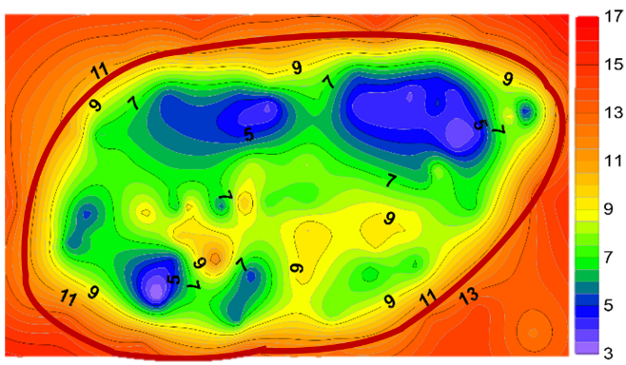
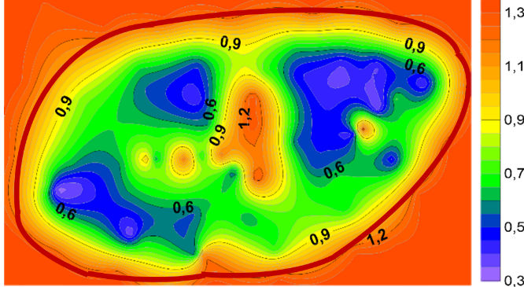
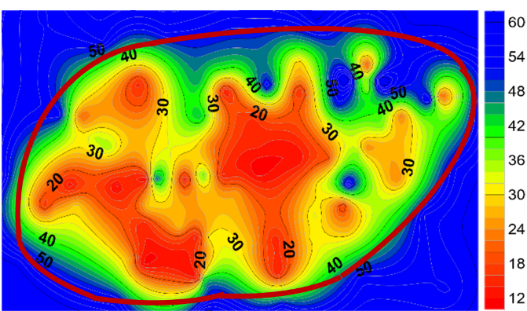
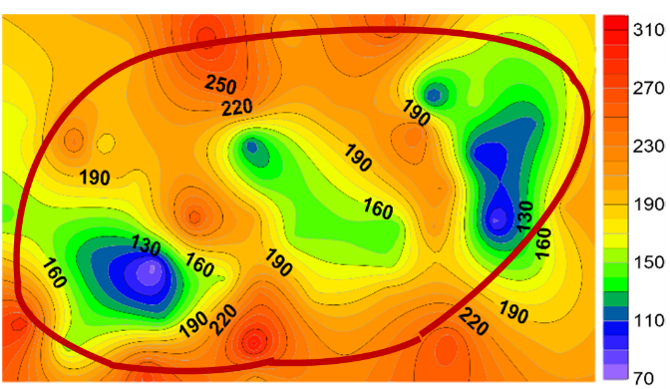
Field experiment (2018-2021)
1. Spatial heterogeneity parameters of ecosystems
Palsa
Bog
Soil temperature, ℃
Thawing depth, m
Parameters | Palsa | Bog
Thawing depth, m | 0.66±0.25* | >2.0
Soil temperature, ℃ | 8.35±2.72 | 14.64±2.44
Soil moisture, % | 32.23±13.16 | 56.24±2.13
CO₂ flux, mg CO₂ m⁻² h⁻¹ | 177.55±79.38 | 199.06±90.05
Soil moisture, %
CO₂ flux, mg CO₂ m⁻² h⁻¹
*Average ± standard deviation

Slide 5
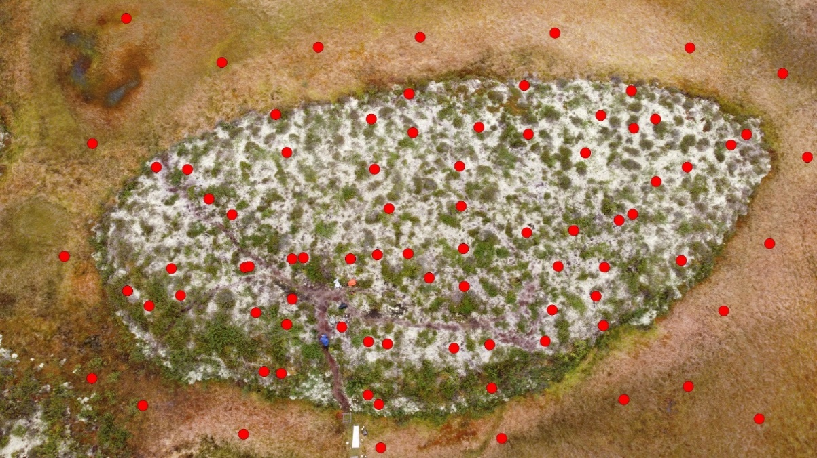
2. CO₂ flux from three sites: «Dry» (22.72±6.92%), «Wet» (38.92±3.11%), «Moist» (51.03±4.37%) on the palsa with similar temperature, vegetation, soil, but with different moisture.
CO₂ flux from soils in different palsa sites by years
Palsa
Moist
Wet
Dry
Grid measurement points
- Standard deviation
5

Slide 6
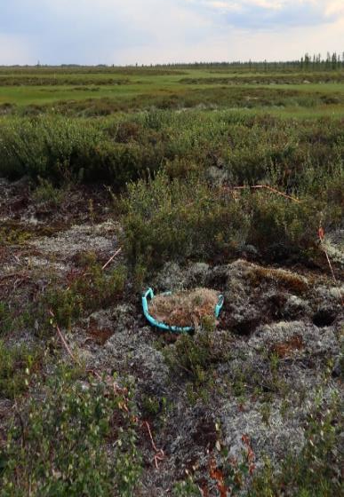
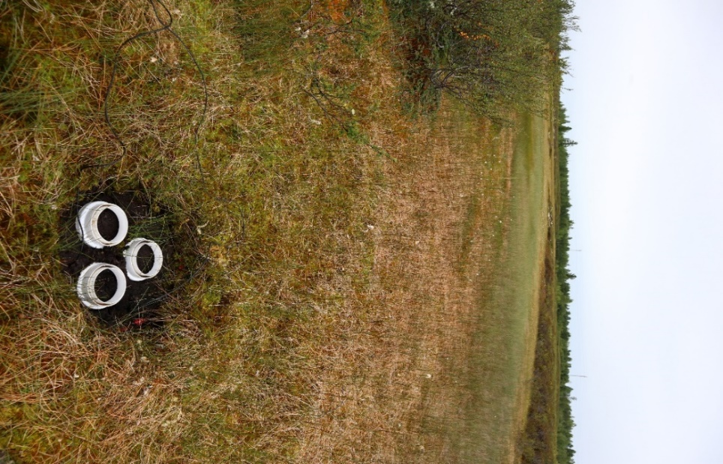



3. Transplantation - measurement of CO₂ flux from undisturbed peat soil of a large volume transferred from dry palsa to a wet bog. And vice versa. Selected plots had the same temperature.
Palsa
Bog
CO₂ flux on transplanted soils for different wet condition
Variant 1. Drying
Variant 2. Wetting
6

Slide 7
SUMMARY
The CO₂ flux in the areas of the bog did not differ from that of palsa.
High values of CO₂ flux in wet areas may not be caused by the biological activity of these ecosystems, but by additional factors such as the methane oxidation value and the transport of dissolved CO₂ with liquid over the permafrost surface of the palsa.
A field transplantation experiment demonstrated a wide range of optimal moisture content for the biological activity of soils.
Bog
Palsa
No differ
but
Soil moisture
CO₂ flux
Permafrost thawing

Slide 8
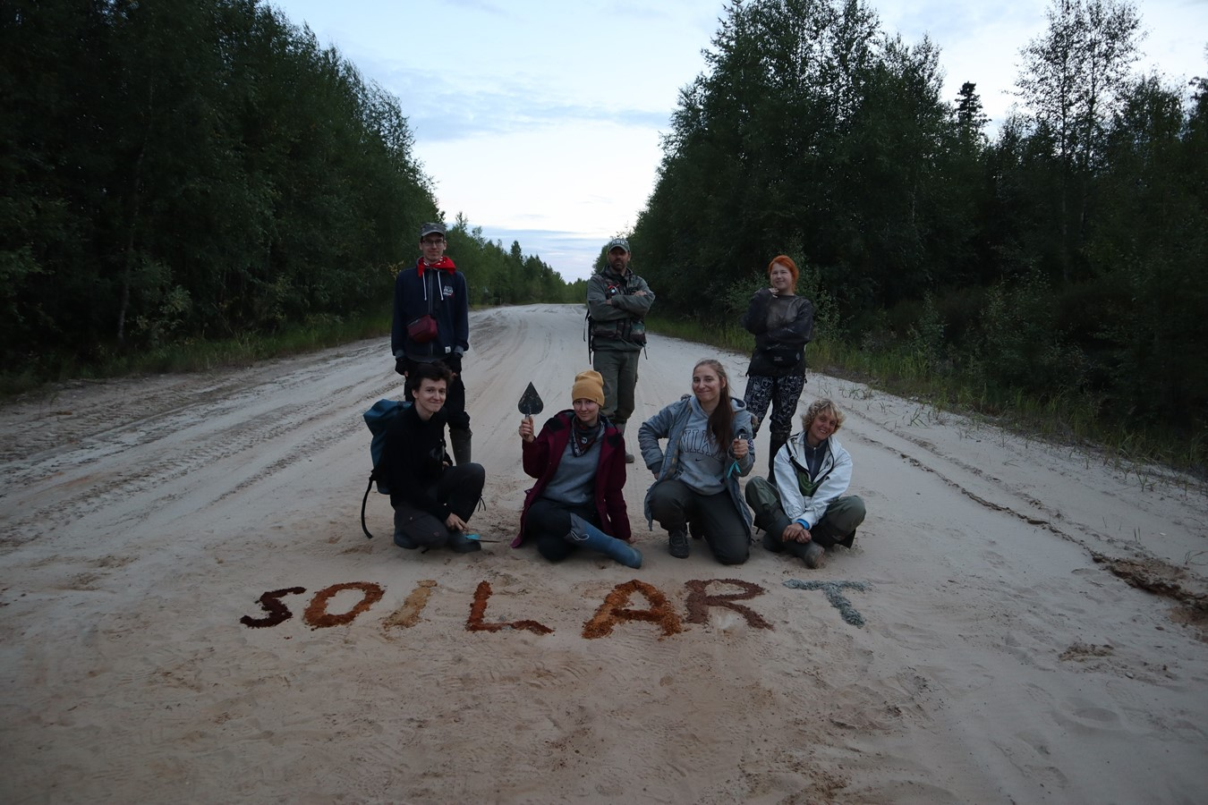
Thank you for your attention!
stas.chuvanov@gmail.com
https://www.researchgate.net/profile/Chuvanov-Stanislav

