Slide 1






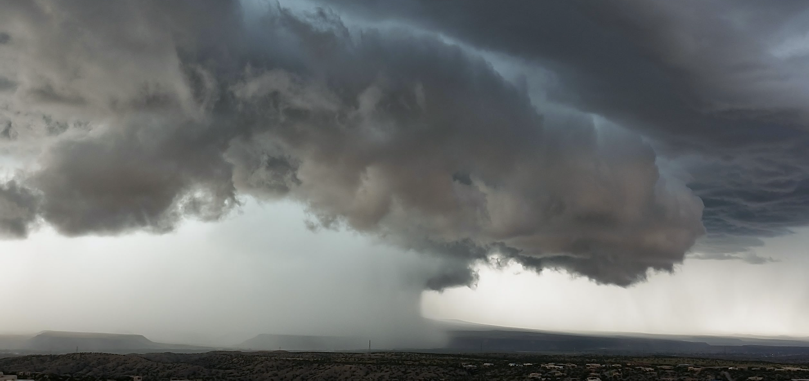
Landslide events in Portugal under climate change scenarios
(PTDC/GES-AMB/30052/2017)
Joana R. Araújo (1), Alexandre M. Ramos (1), Pedro M.M. Soares (1), Raquel Melo (2),(3), Sérgio C. Oliveira (2), and Ricardo M. Trigo (1)
(1) Instituto Dom Luiz, Faculdade de Ciências da Universidade de Lisboa, 1749-016 Lisbon, Portugal
(2) Centre for Geographical Studies and Associated Laboratory TERRA, Institute of Geography and Spatial Planning, Universidade de Lisboa, Lisboa, Portugal
(3) Departamento de Geociências, Escola de Ciências e Tecnologia, Universidade de Évora, Évora, Portugal

Slide 2
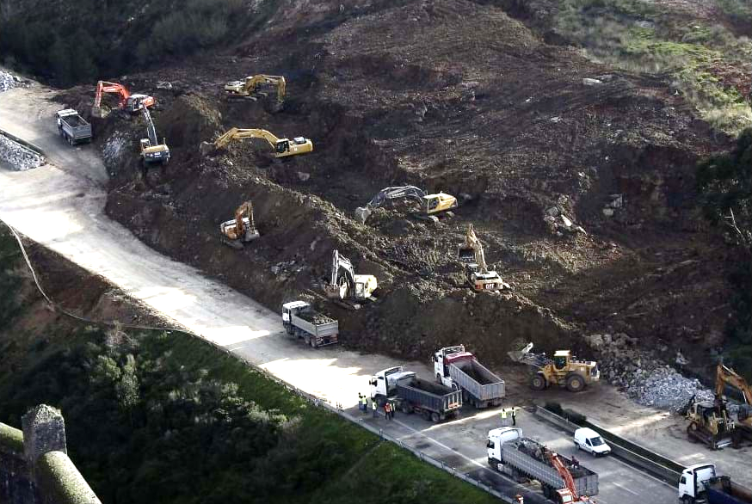
Iberia02 (IB02)
DATA & STUDY AREA
METHODS
MODELS’ PERFORMANCE
PRECIPITATION ASSESSMENT
CONCLUSIONS
Landslides
Extreme Precipitation
Triggering mechanism:
Relationship between Landslide events and Extreme Precipitation:
Rainfall Triggering Thresholds
Zêzere et al. (2005)
 | SMA |  | SMP
 | Low linear | Higher linear | Low linear | Higher linear
1 day | 38.4 | 173.8 | 65.4 | 352.2
10 days | 80.0 | 234.5 | 146.7 | 455.9
30 days | 172.5 | 369.5 | 327.2 | 686.2
60 days | 311.3 | 572.0 | 598.1 | 1031.6
EURO-CORDEX simulations
Shallow landslides – 1 to 15 days
Deep landslides – 30 to 90 days
1950-2008
0.2º ~ 20km
0.11º (~12.5km)
1971-2000; 2071-2100
RCP4.5 and RCP8.5
IB02 – grid points located closest to the stations
EURO-CORDEX models’ runs – nearest point from each location

Slide 3
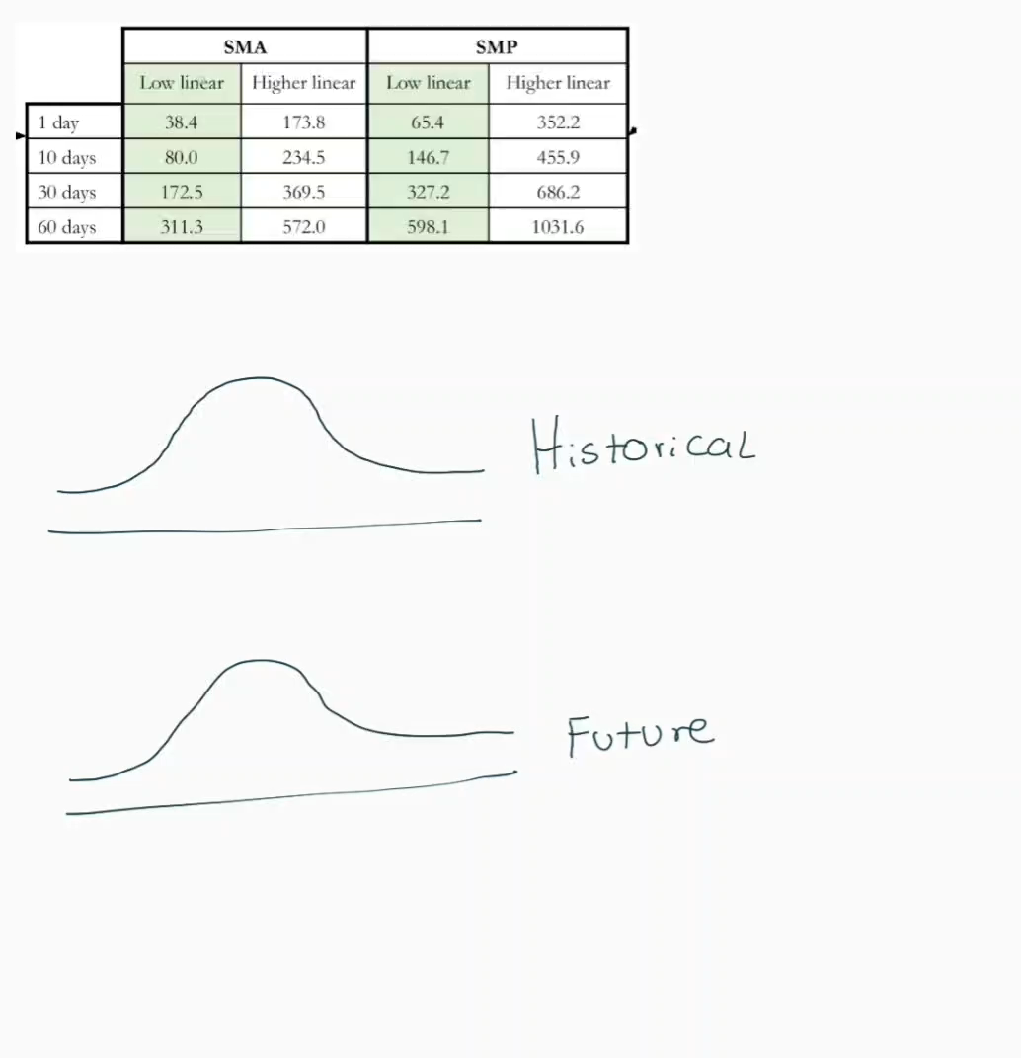
Extreme Precipitation
DATA & STUDY AREA
METHODS
MODELS’ PERFORMANCE
PRECIPITATION ASSESSMENT
CONCLUSIONS
Models’ Performance
Rainfall Triggering Thresholds’ percentiles assessment
Historical IB02
vs.
Historical models’ simulations

Slide 4
DATA & STUDY AREA
METHODS
MODELS’ PERFORMANCE
PRECIPITATION ASSESSMENT
CONCLUSIONS
Models’ performance
SMA

Slide 5
DATA & STUDY AREA
METHODS
MODELS’ PERFORMANCE
PRECIPITATION ASSESSMENT
CONCLUSIONS
Rainfall Triggering Thresholds’ Percentiles
future evaluation
60D
RCP4.5
RCP8.5

Slide 6
Multimodel ensemble mean
DATA & STUDY AREA
METHODS
MODELS’ PERFORMANCE
PRECIPITATION ASSESSMENT
CONCLUSIONS
RCP4.5
1D
10D
30D
60D
SMA
SMP
RCP8.5
1D
10D
30D
60D
SMA
SMP

Slide 7



DATA & STUDY AREA
METHODS
MODELS’ PERFORMANCE
PRECIPITATION ASSESSMENT
CONCLUSIONS
Extreme precipitation
Good Performing Model: Multimodel ensemble mean
RCP4.5: Rainfall triggering thresholds of 1D, 10D, 30D and 60D will become more likely events
RCP8.5: Rainfall triggering thresholds of 1D will become a more likely event, whereas the rainfall triggering thresholds of 10D, 30D and 60D will become more unlikely, over SMA.

Slide 8
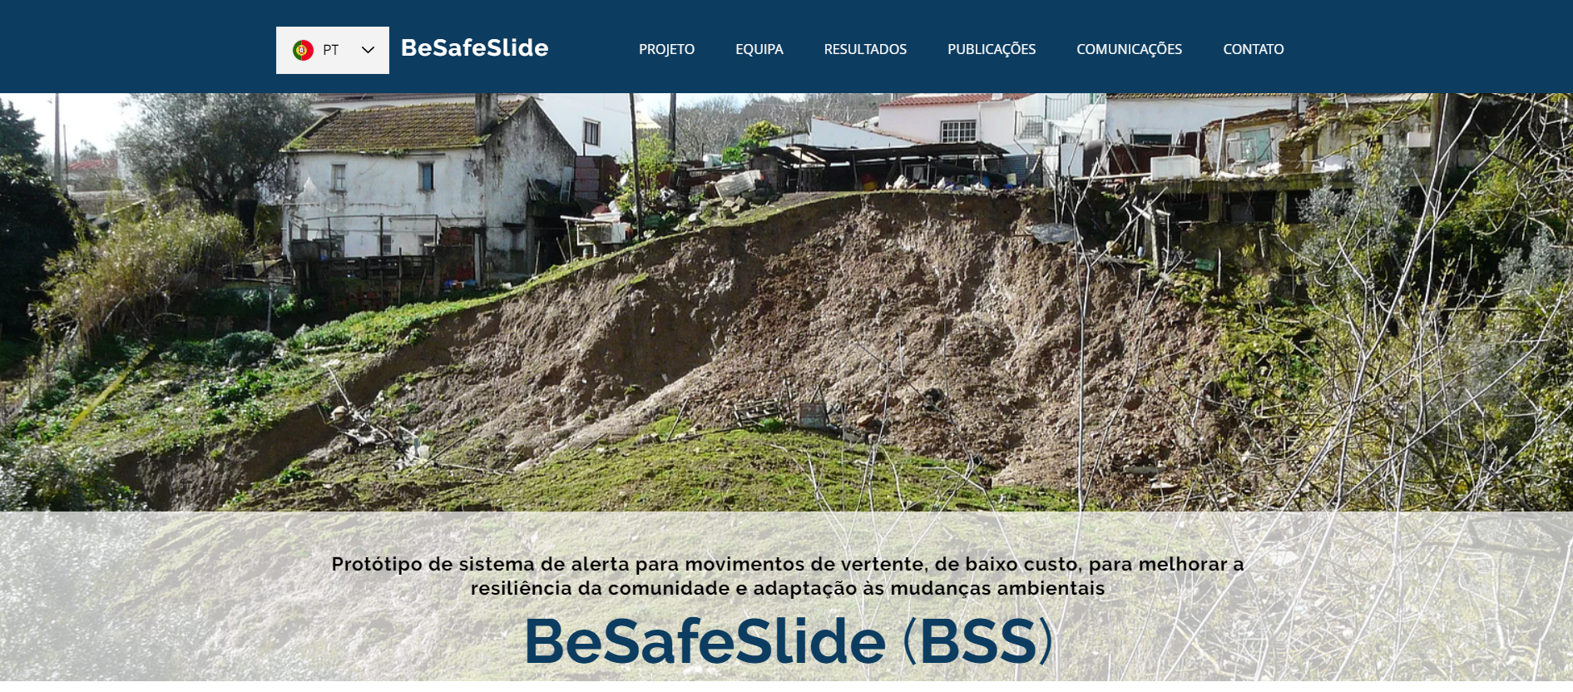

(PTDC/GES-AMB/30052/2017)
Thank you!
https://cruzdeoliveira.wixsite.com/besafeslide

Slide 9
