Slide 1
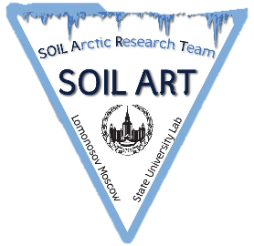




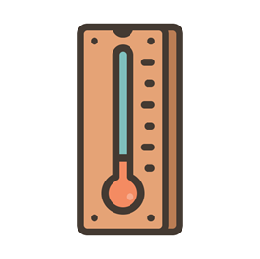

Effects of temperature and moisture manipulation on biological activity in Northern and Southern taiga peat soils
Viktoriia Trifonova¹, Irina Ryzhova¹, George Matyshak¹, Stanislav Chuvanov², and Matvey Tarkhov¹
¹Lomonosov Moscow State University, Moscow, Russian Federation
²Dokuchaev Soil Science Institute, Moscow, Russian Federation
e-mail: victoriatrifonova04@gmail.com
https://www.researchgate.net/profile/Viktoriia-Trifonova
+
vs

Slide 2

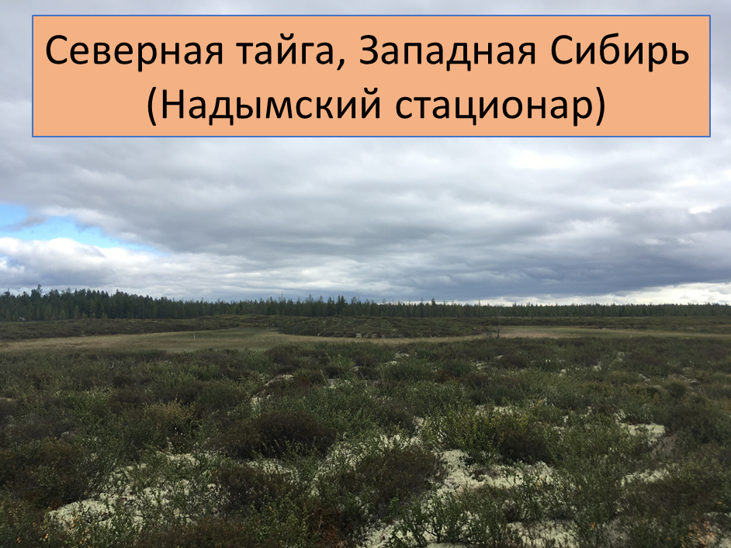
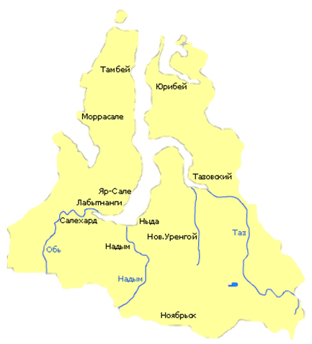
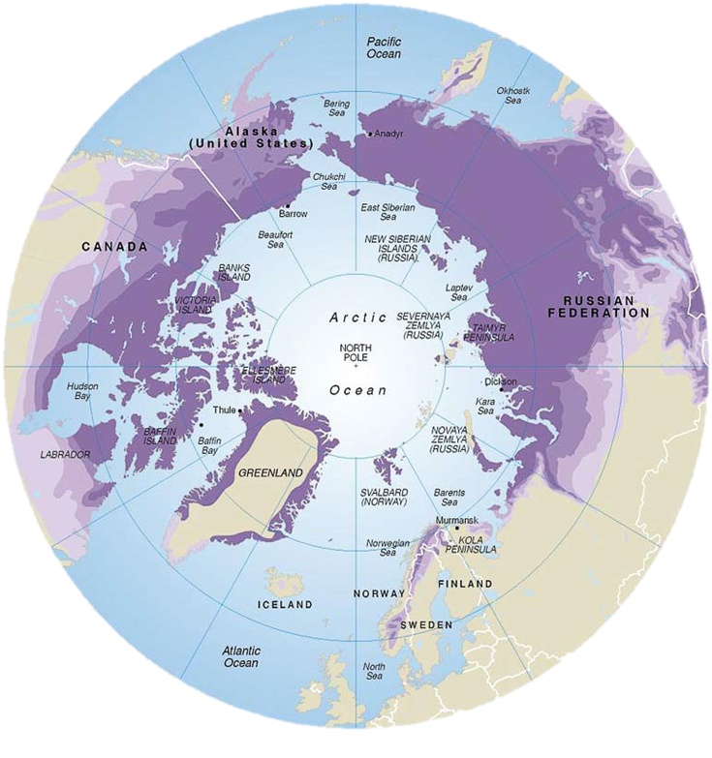
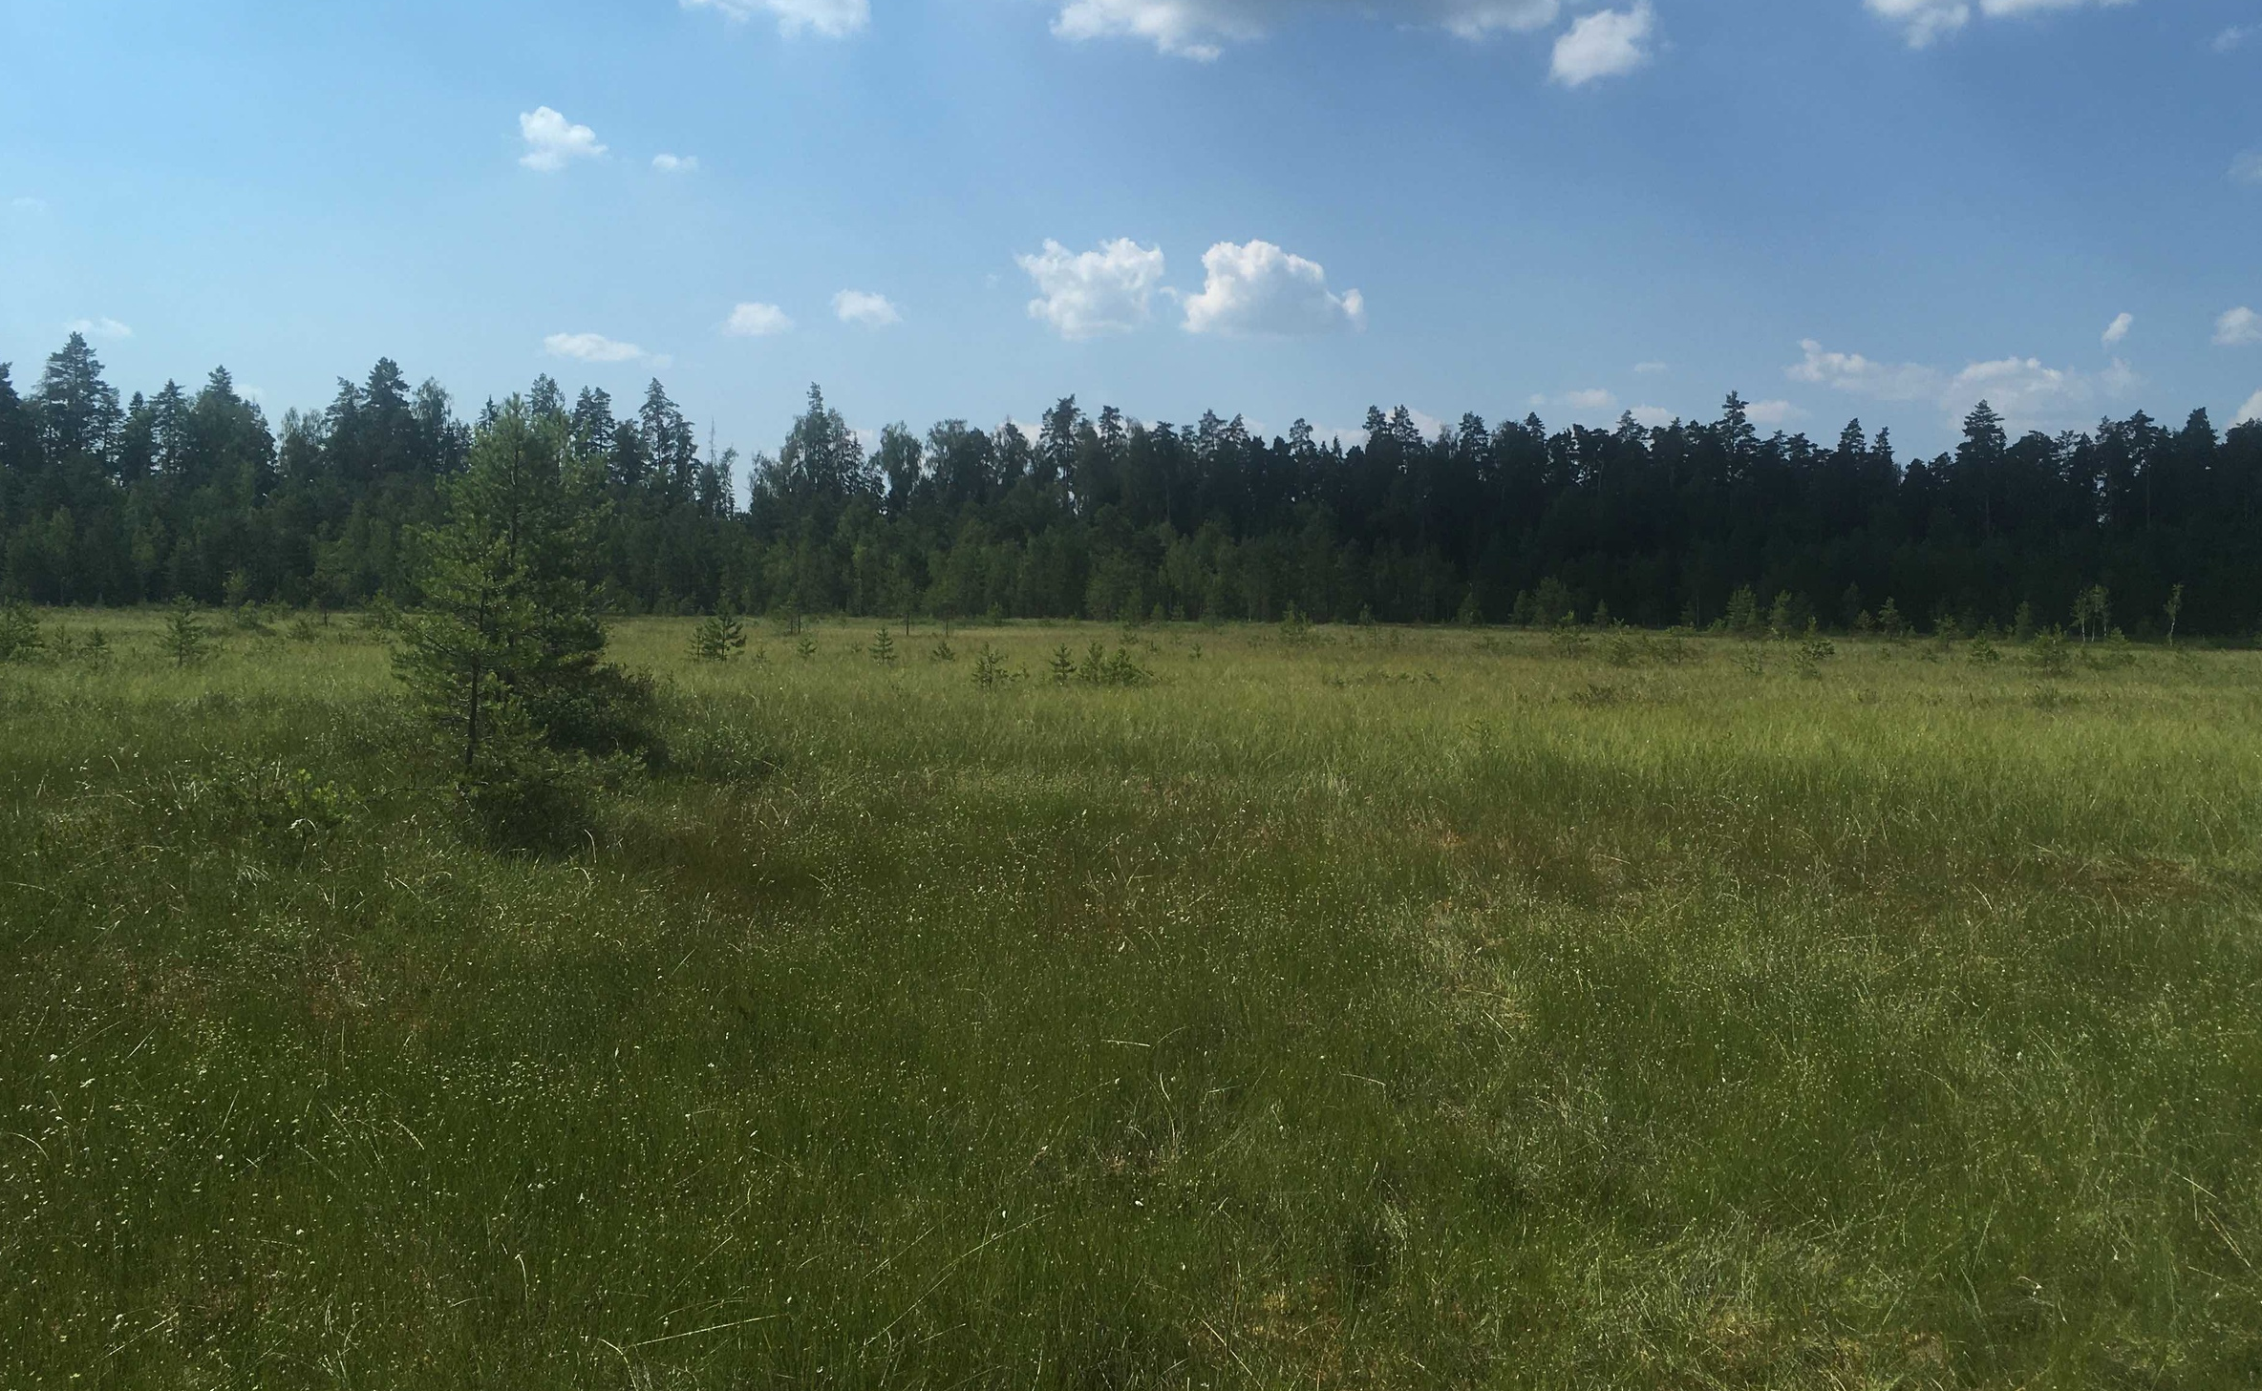
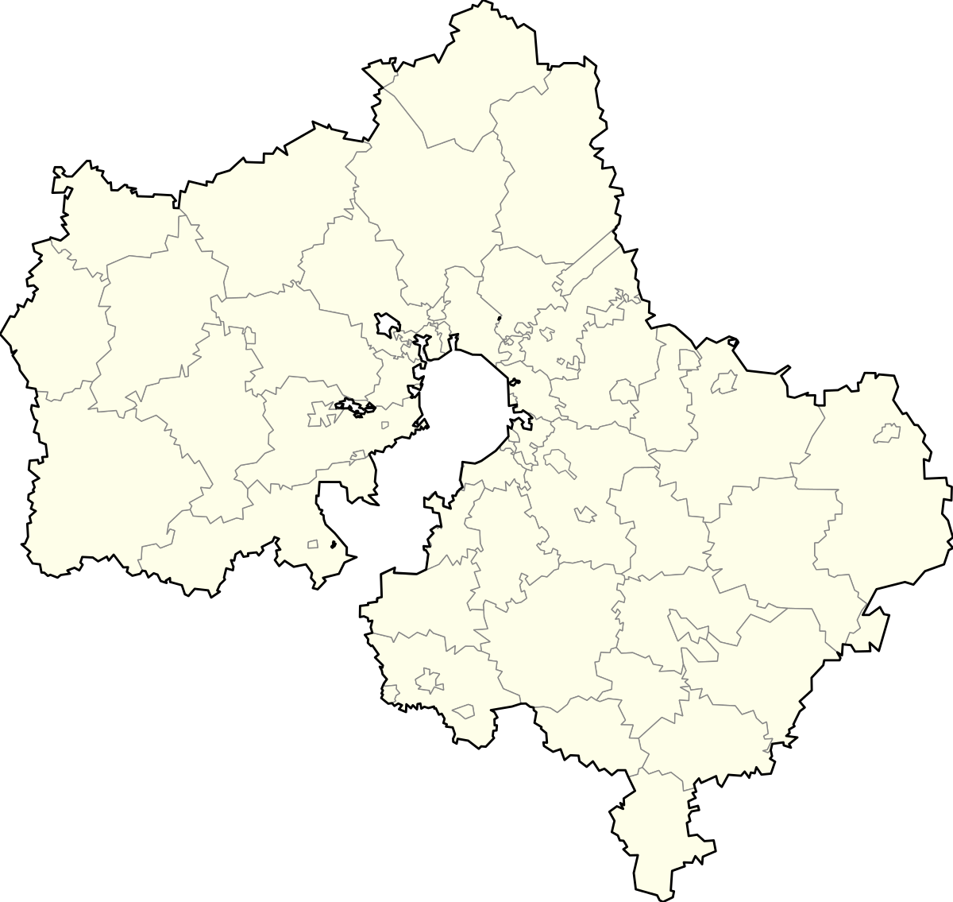
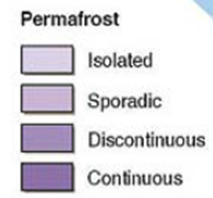

Study area
Northern taiga, Western Siberia, Nadym region, Russia
Yamalo-Nenets Autonomic Region
Nadym
Taz
Ob
Nadym
Southern taiga, East European Plain, Moscow region, Russia
Moscow
Moscow Region
Maps: https://ru.wikipedia.org/wiki/
https://www.eea.europa.eu/data-and-maps/figures/permafrost-in-the-northern-hemisphere

Slide 3
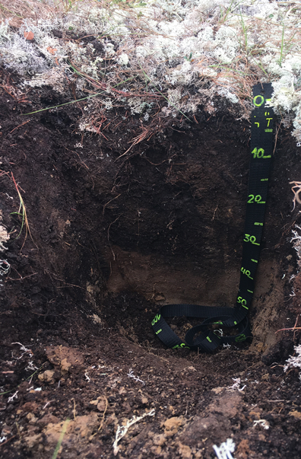
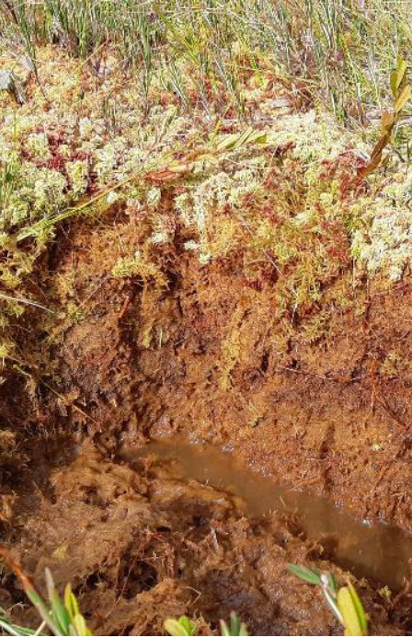
Objects of study
Sample | Bulk density, g/cm³ | pH | Row ash, % | Ash without contaminants, %
Cryic histosol | 0,11 | 4,11 | 8,09 | 1,42
Fibric Histosol | 0,25 | 3,14 | 3,56 | 1,06
Cryic histosol (WRB, 2014)
Fibric Histosol (WRB, 2014)

Slide 4

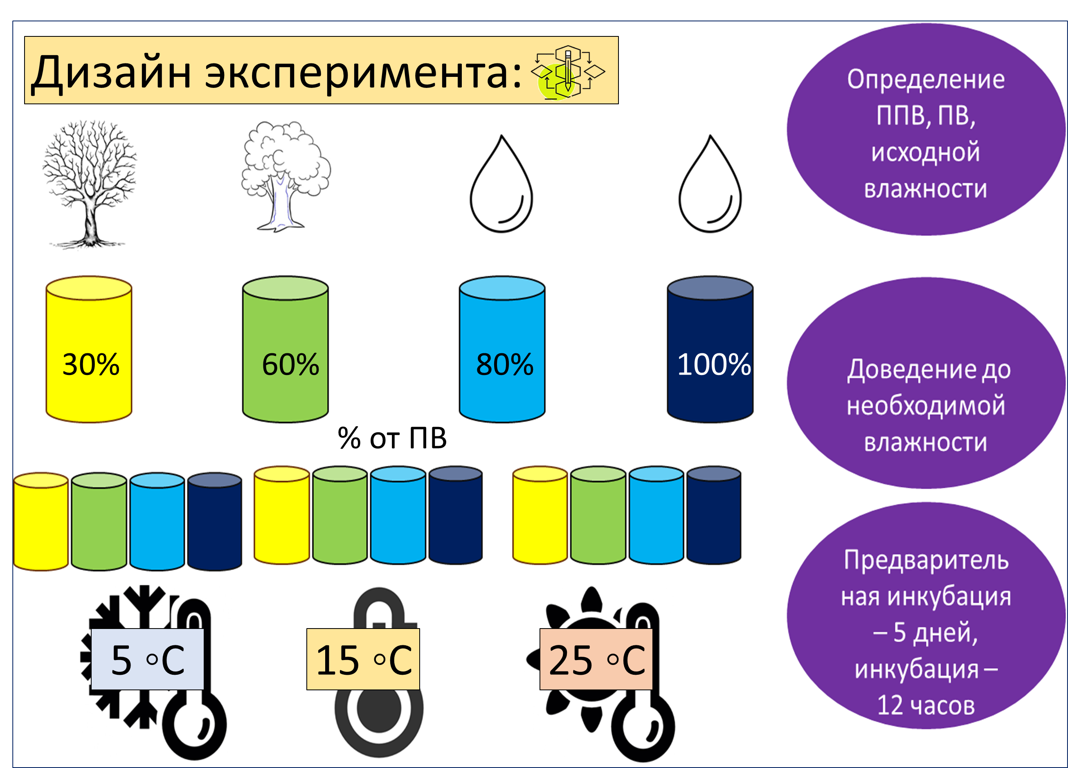
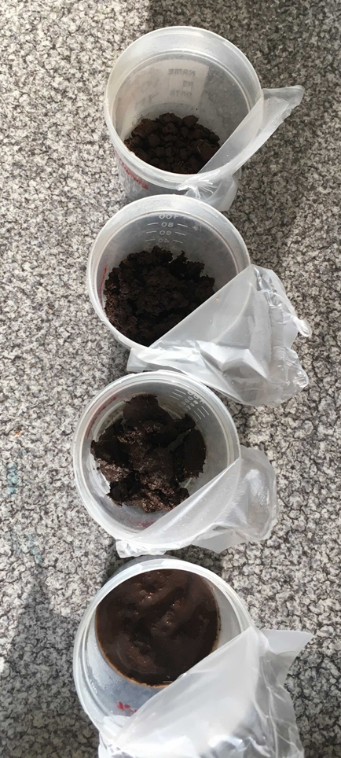
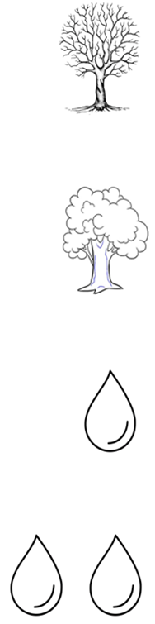


Experimental design
Saturation/drying - 1.5 weeks at 5 ◦С
% of water holding capacity (WHC)
Pre-incubation at different temperatures - 5 days, incubation - 12 hours

Slide 5
Results (1) Microbial Respiration (MR)
% from WFPS
% of WHC
% of WHC
Microbial Respiration
R
- Standard deviation
30% WHC
100% WHC

Slide 6
Results (2) Temperature sensitivity Q10
The temperature coefficient Q10 characterizes the change in the rate of heterotrophic soil respiration relative to temperature.

Slide 7
Summary:
e-mail: victoriatrifonova04@gmail.com
https://www.researchgate.net/profile/Viktoriia-Trifonova
The influence of soil moisture on the temperature dependence of heterotrophic respiration is mostly recognized at a low temperature (5 ^{о} С).
For the studied samples, the intensity of heterotrophic respiration is not observed with an increase above 60-70% of the WHC, which is considered optimal.
Soils in Northern region are more sensitive to temperature increasing.
Microbial respiration
>
Southern taiga
Northern taiga
Q10
Northern taiga
>
Southern taiga

