Slide 1
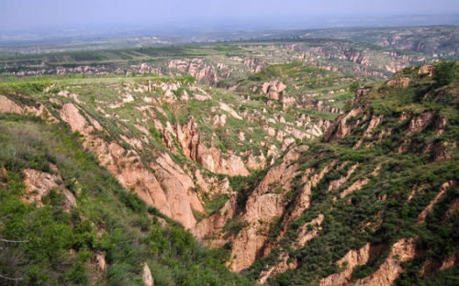
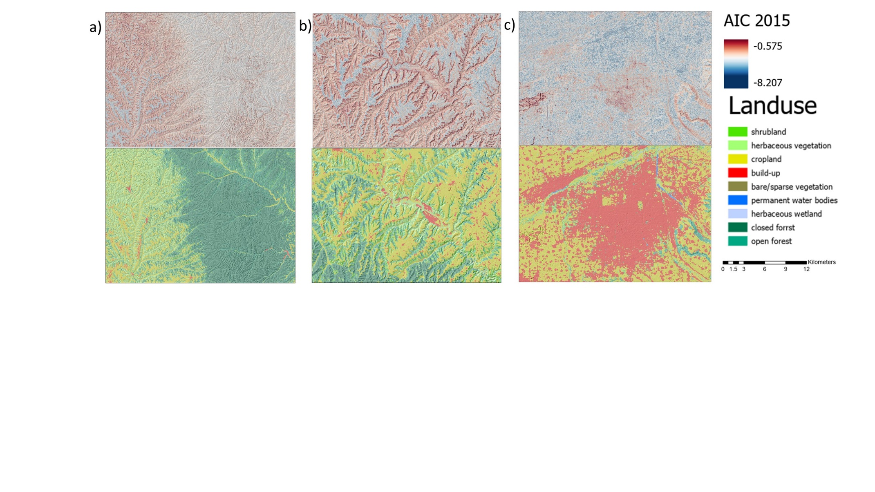
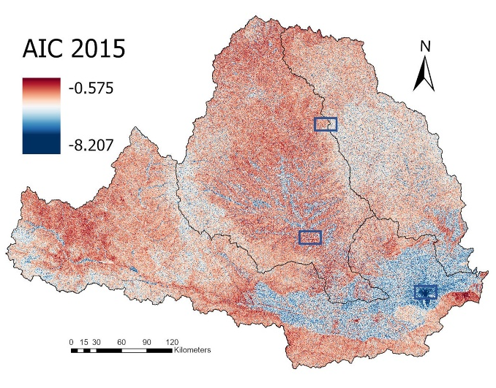
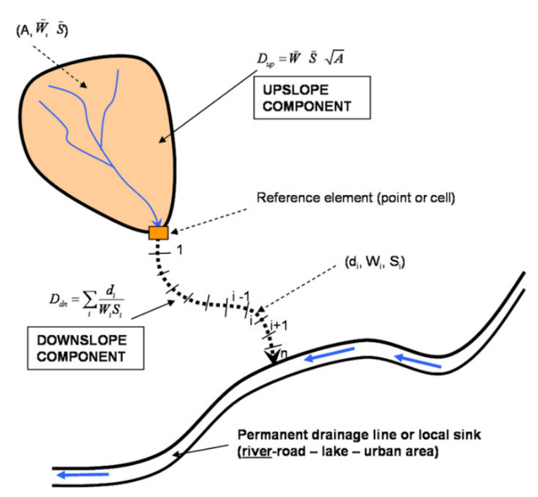


Intra-annual sediment dynamic assessment in the Wei River Basin, China, using the AIC functional-structural connectivity index
Zhenni Wuª, Jantiene E.M. Baartmanª, João Pedro Nunes ^{a,b}, Manuel López-Vicente^{c}
zhenni.wu@wur.nl
a Wageningen University, The Netherlands
b Evolução e Alterações Climáticas, Faculdade de Ciências, Universidade de Lisboa, Portugal
c University of A Coruña, Spain.
Introduction
2. Objectives
to exam the possibility of using the aggregated index of sediment connectivity to map and characterize functional and structural sediment connectivity at the large regional scale
to identify the spatial patterns and intra-annual variation of sediment transfer in a representative catchment of the Loess Plateau.
Wei River Basin (134,800 km2)located in the Chinese Loess Plateau, one of the most eroded area in the world.
During the last three decades, there have been a large number of soil and water conservation measures taken.
3. Methodology
${AIC}_{k}=\log_{10}\left(\frac{D_{UP,K}}{D_{dn,k}}\right)=\log_{10}\left(\frac{\overline{R_{t}} ∙\overline{RT} ∙\overline{C_{t} } ∙\overline{K_{P}} ∙\overline{S} ∙\sqrt{A_{K}}}{\sum_{k=i}^{n}{\frac{d_{i}}{{AWC}_{i}}}}\right)$
4. Results
Including rainfall, landcover, soil available water content, topographic factors in the index
High connectivity areas were found in the west part of the Wei sub-basin and the Jing sub-basin, and low connectivity areas were located in the east part of the Wei sub-basin and the Beiluo sub-basin.
Sediment connectivity is a promising concept in erosion research, explaining the sediment transfer from source to sink within a system.
Not many studies have investigated connectivity on large basin scale.
Forest would generally have lower connectivity due to their higher cover, if they are located in steep slopes and gullies, they will still have higher connectivity than cropland on local plateaus (tableland)
Croplands on the tableland have lower sediment connectivity than shrubland and forest on the hillslope
The build-up area mostly has a higher connectivity than the cropland area in the plain in the Wei sub-basin
The three sub-basins showed significant differences due to the different ecological restoration conditions.
5. Conclusions
Within the different land uses, bare land had the highest connectivity, while build-up area had the lowest
Cropland on the tableland had lower connectivity than shrubland and forest on the hill slope, indicating that location (transport) and topographic conditions has greater impact than land cover (detachment) on sediment connectivity.
The rainfall factor showed the highest correlation with AIC, and in agricultural and vegetation dominated area like the Loess Plateau, C-RUSLE factor is of great important to reflect the land-cover change within the year. Thus, functional connectivity showed better details than structural connectivity.

