Slide 1









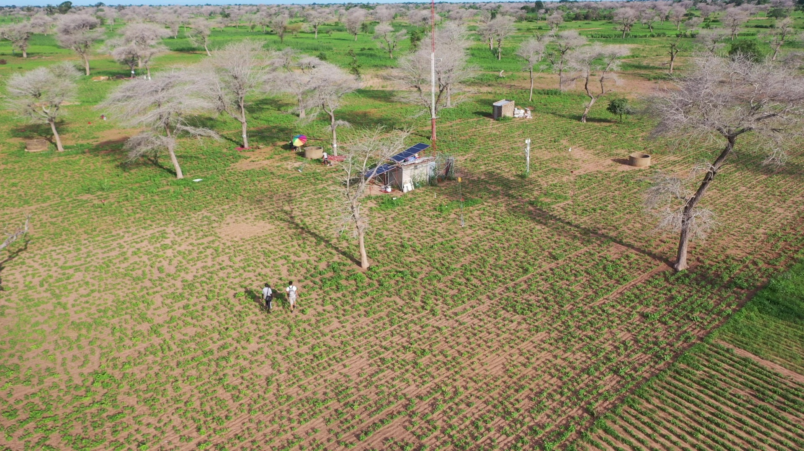


Monitoring soil greenhouse gas (GHG) emissions in a Sahelian agrosilvopastoral parkland
Seydina Mohamad Ba, Olivier Roupsard, Lydie Chapuis-Lardy, Frédéric Bouvery,
Djim Mouhamadou Lamine Diongue, Yélognissè Frédi Agbohessou,
Håkan Torbern Tagesson, Bienvenu Sambou, and Dominique Serça
https://doi.org/10.5194/egusphere-egu22-4337
© Author(s) 2022. This work is distributed under
the Creative Commons Attribution 4.0 License.
seydina1988@gmail.com
https://lped.info/wikiObsSN/?Faidherbia-Flux
24 may 2022

Slide 2

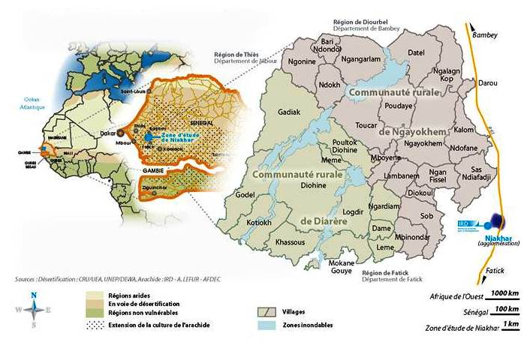
MOTIVATION AND AIMS
The impact of agrosilvopastoral systems in the Sahel on the carbon cycle and greenhouse gas (GHG) fluxes is very poorly documented
Growing need to produce baseline data on GHG emissions
Study of the temporal and spatial variability of GHG fluxes (between soil and atmosphere)
Where?
NIAKHAR (Sob) – Groundnut Bassin (SENEGAL)
Agrosilvopastoral area dominated by the Faidherbia albida
Cropped area ( millet, groundnut in an annual rotation)
Instrumented site (Faidherbia flux)
“Faidherbia-Flux” Web site : https://lped.info/wikiObsSN/?Faidherbia-Flux
Notes:
Produire des données de références sur les facteurs d’émissions de

Slide 3
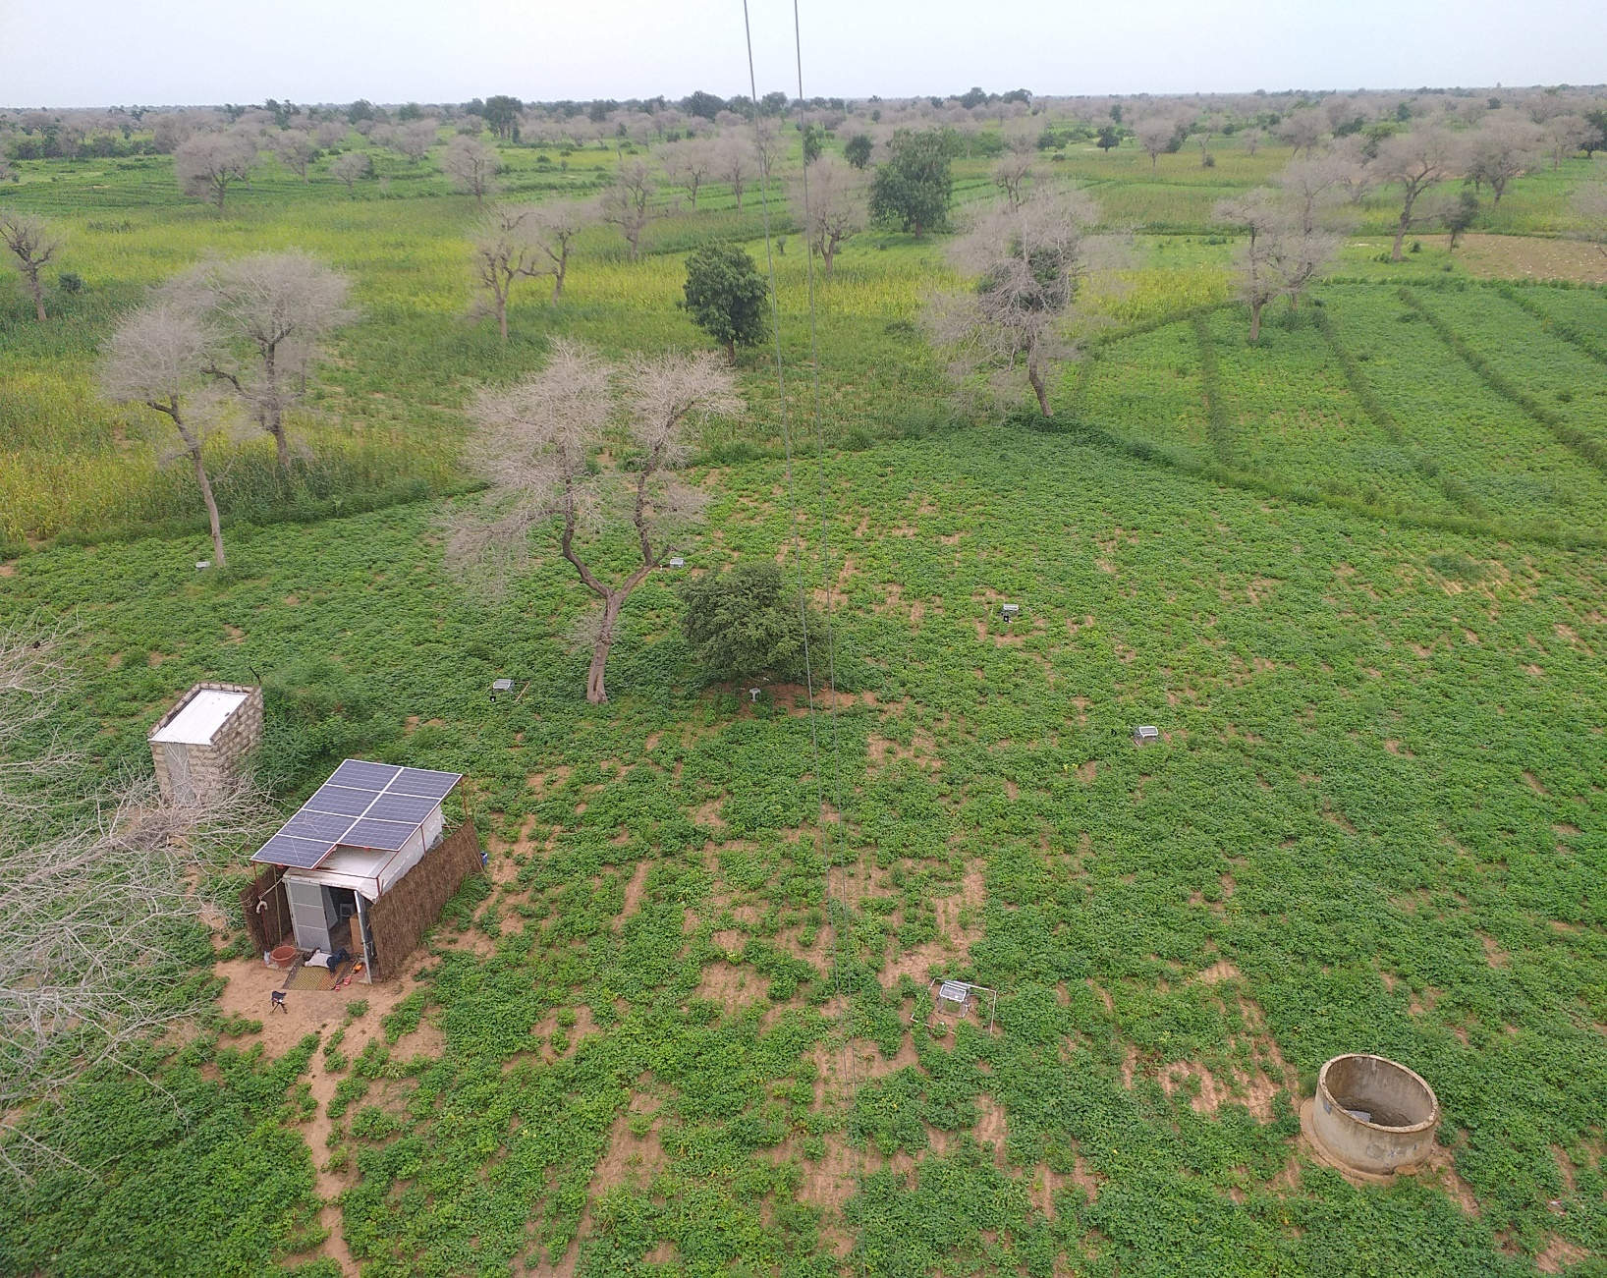
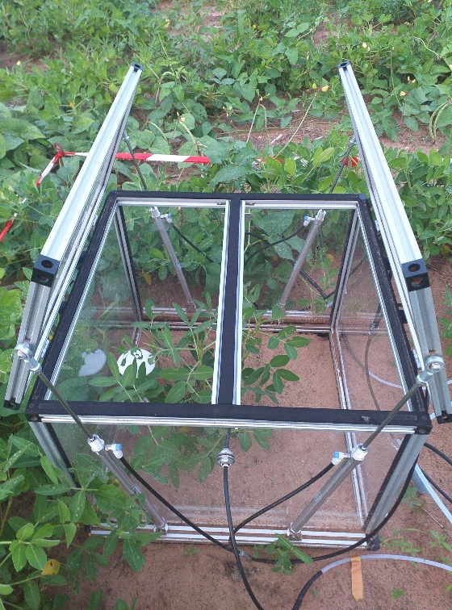
Experimental design
METHODS :
8 automatic chambers used (04 under trees -Faidherbia albida- and 04 far from trees)
With a groundnut plant during the rainy season and without a groundnut plant during the dry season
The whole is coupled to a Picarro 5 gas analyser
© Design: F. Bouvéry
SN, Niakhar/Sob: Wet season
soil GHG analyser
shelter
Photo credit: O. Roupsard
Shaded chambers
Full sun chambers
Photo credit: O. Roupsard

Slide 4



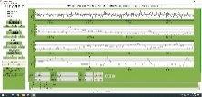
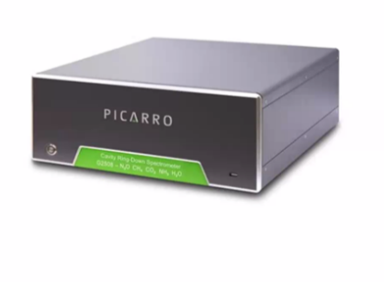
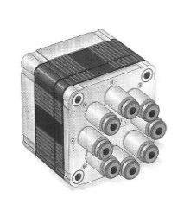
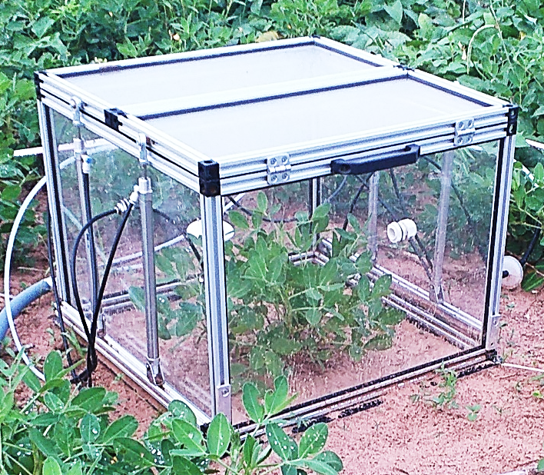


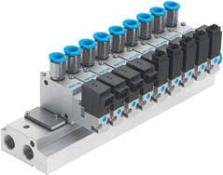
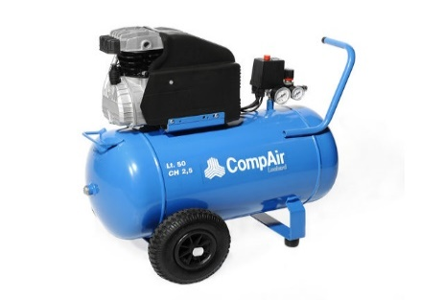
in situ gas monitoring system (CO₂, CH₄, N₂O, H₂O and NH₃)
METHODS :
SDM-CD16AC relay
https://www.youtube.com/watch?v=32VfIJF4wug
Autopilot control
From chamber to
analyser
Running program
Picarro G2508
Automatic chamber
Matrix
(9 ways)
Water trap
Chamber number sending
Autopilot control
filter
Pump
Matrix
(9 ways)
Campbell datalogger (CR1000X)
With automation program
Air compressor
From pump to chamber
Solenoid valve (9 ways)
to solenoid valve
From solenoid valve
To pneumatic cylinders

Slide 5
Results :
8 months GHG fluxes (soil, plant and atmosphere)
CO2 fluxes (measured from June 21 to January 22)
DS
RS
DS
Shaded
soil
chambers_Avg
Full
sun
soil
chambers_Avg
DS = Dry season with
bare soil
Rain (
mmsemih
)
CO2Flux (micmolCO2m-2s-1)
RS = Rainy season with
cropped soil (groundnut)
Soil respiration was highest after the first rainfall (high release of CO2 trapped in the soil pore spaces) and throughout the wet season.
During the wet season, the maximum soil respiration at night was about 5 μmolCO2m-2s-1 and the maximum net CO2 uptake during the day was about -6μmolCO2m-2s-1
Soil CO2 respiration was very low at the end of the dry season, with an average of about 0.6 μmolCO2m-2s-1.
daily soil respiration is highest under trees (p< 0,0001), but the patterns remain similar

Slide 6
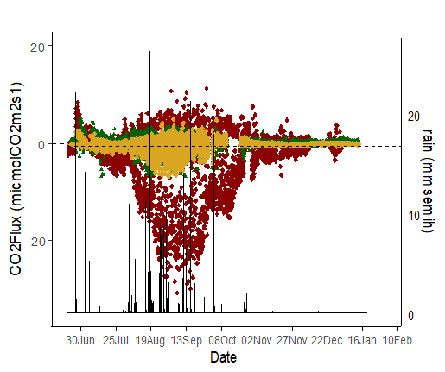
Results :
GHG fluxes exchange trends (soil, plant and atmosphere)
Comparing soil fluxes to Eddy covariance (EC) measurements at 4.5 m above the crop
DS
RS
DS
DS = Dry season with
bare soil
CO2Flux (micmolCO2m-2s-1)
RS = Rainy season with
cropped soil (groundnut)
NEE_micmolm2s_4.5m
Shaded
soil
chambers_Avg
Full
sun
soil
chambers_Avg
Rain (
mmsemih
)
The CO2 fluxes from the automatic chambers show similar patterns to those from the EC tower.
During the dry season, the CO2 fluxes obtained by automatic gas chambers were close to the EC fluxes. However, during the rainy season, with crop growth, a large difference was observed (i.e. a factor of 3.74 and 7 respectively for soil respiration and photosynthesis)
This gap could be due to higher leaf cover in the field (as sensed by EC) as compared to leaf cover inside chambers.
Therefore, we will soon apply correction per unit leaf area.

Slide 7
Results :
GHG fluxes exchange trends (soil, plant and atmosphere)
H2O, CH4, N2O and NH3 fluxes trends
H2Oflux (mmolH2Om-2s-1_Av)
CH4flux (micmolCH4m-2s-1_Av)
N2Oflux (micmolN2Om-2s-1_ Av)
H2OFlux (mmolH2Om-2s-1)
CH4Flux (micmolCH4m-2s-1)
N2OFlux (micmolN2Om-2s-1)
NH3flux (nanomolNH3m-2s-1_ Av)
No clear trend for the CH4, N2O, and NH3 was found during the rainy season. The fluxes recorded look more like noise which decreases considerably in the dry season.
Another reason might be the low soil fertility, the lack of nitrogen
supply, and the low moisture content in these sandy soils which are
not suitable for trace gases production processes like N2O and CH4.
H2O fluxes seem to be more perceptible during the rainy season, possibly due to soil evaporation and plant transpiration, but with low intensity, as compared to EC fluxes (data not shown), probably due to vapor condensing in the pipes.
NH3flux (nanomolNH3m-2s-1)
Shaded
soil
chambers_Avg
LEGEND
Full
sun
soil
chambers_Avg
Rain (
mmsemih
)

Slide 8



Thank you
Looking forward to receiving any questions or comments
© Seydina Mohamad BA
https://lped.info/wikiObsSN/?Faidherbia-Flux
https://www.youtube.com/watch?v=32VfIJF4wug
seydina1988@gmail.com
olivier.roupsard@cirad.fr
https://www.cassecs.org/

