Slide 1




Towards urban flood susceptibility mapping using data-driven models: Case study Berlin, Germany.
Omar Seleem, Georgy Ayzel, Arthur Costa, Axel Bronstert & Maik Heistermann
Chair of Hydrology
Institute of Environmental Science and Geography
University of Potsdam
EGU 23-27 May 2022

Slide 2
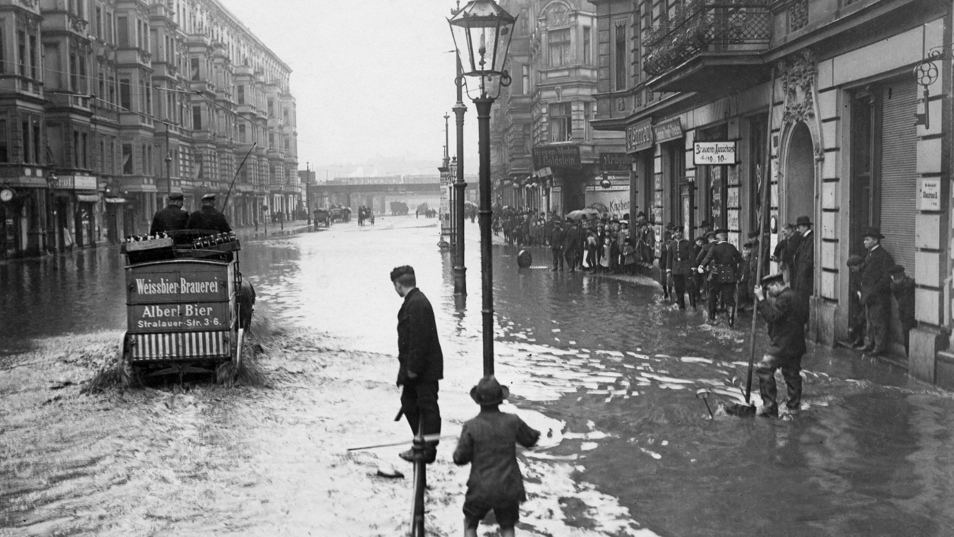

Introduction
Fig. Urban pluvial flooding in Berlin in Summer 1902.
seleem@uni-potsdam.de
2
https://www.bz-berlin.de/berlin/wenns-richtig-regnet-kann-es-auch-in-berlin-hochwasser-geben

Slide 3
Research Questions
Does deep learning (CNN & ANN) outperforms traditional machine learning algorithms (RF & SVM) in flood susceptibility mapping?
How does the spatial resolution of input data (i.e., 30, 10, 5, and 2 m) impact the performance of the image-based models (CNN) and point-based models (RF, SVM and ANN)?
How transferable are the trained models (in space) ?
Can we explain the model prediction and which predictors are most useful for flood susceptibility mapping ?
CNN: Convolutional neural network
_{RF: Random forest}
_{SVM: Support vector machine}
_{ANN: Artificial neural network}
seleem@uni-potsdam.de
3

Slide 4
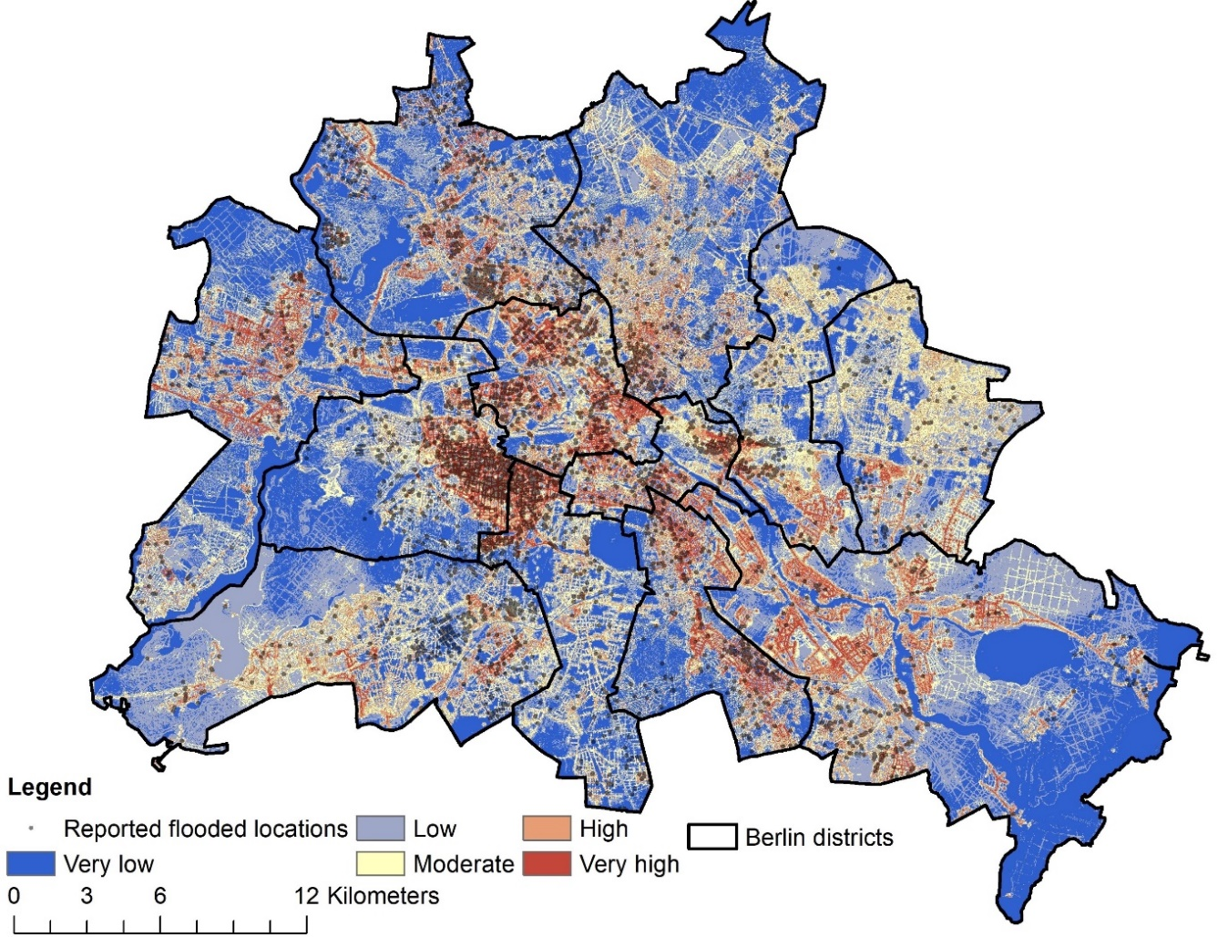
Outlook
RF models outperformed deep learning models (AUC =0.97)
Spatial resolution impacts on the model performance.
Models are transferable in space (Minimum AUC =0.8)
Model predictions can be explained using SHAP (SHapley Additive exPlanations) python package (Lundberg and Lee, 2017).
Aspect and Altitude were the most important predictors for image and point based models respectively.
AUC: Area Under the Curve (AUC) of _{the} Receiver Characteristic Operator (ROC)
_{RF: Random forest}
Fig. Flood susceptibility map for Berlin from RF - 2 m model (best performance model) and the reported flooded locations.
seleem@uni-potsdam.de
4

Slide 5
Further Research
Testing transferability in environments with different characteristics.
Aspect is the most important predictor by the CNN models ???
Reference:
Seleem O, Ayzel G, Costa A, Bronstert A, Heistermann M. Towards urban flood susceptibility mapping using data-driven models in Berlin, Germany. Geomatics, Nat. Hazards Risk (under review)
CNN: Convolutional neural network
seleem@uni-potsdam.de
5

Slide 6
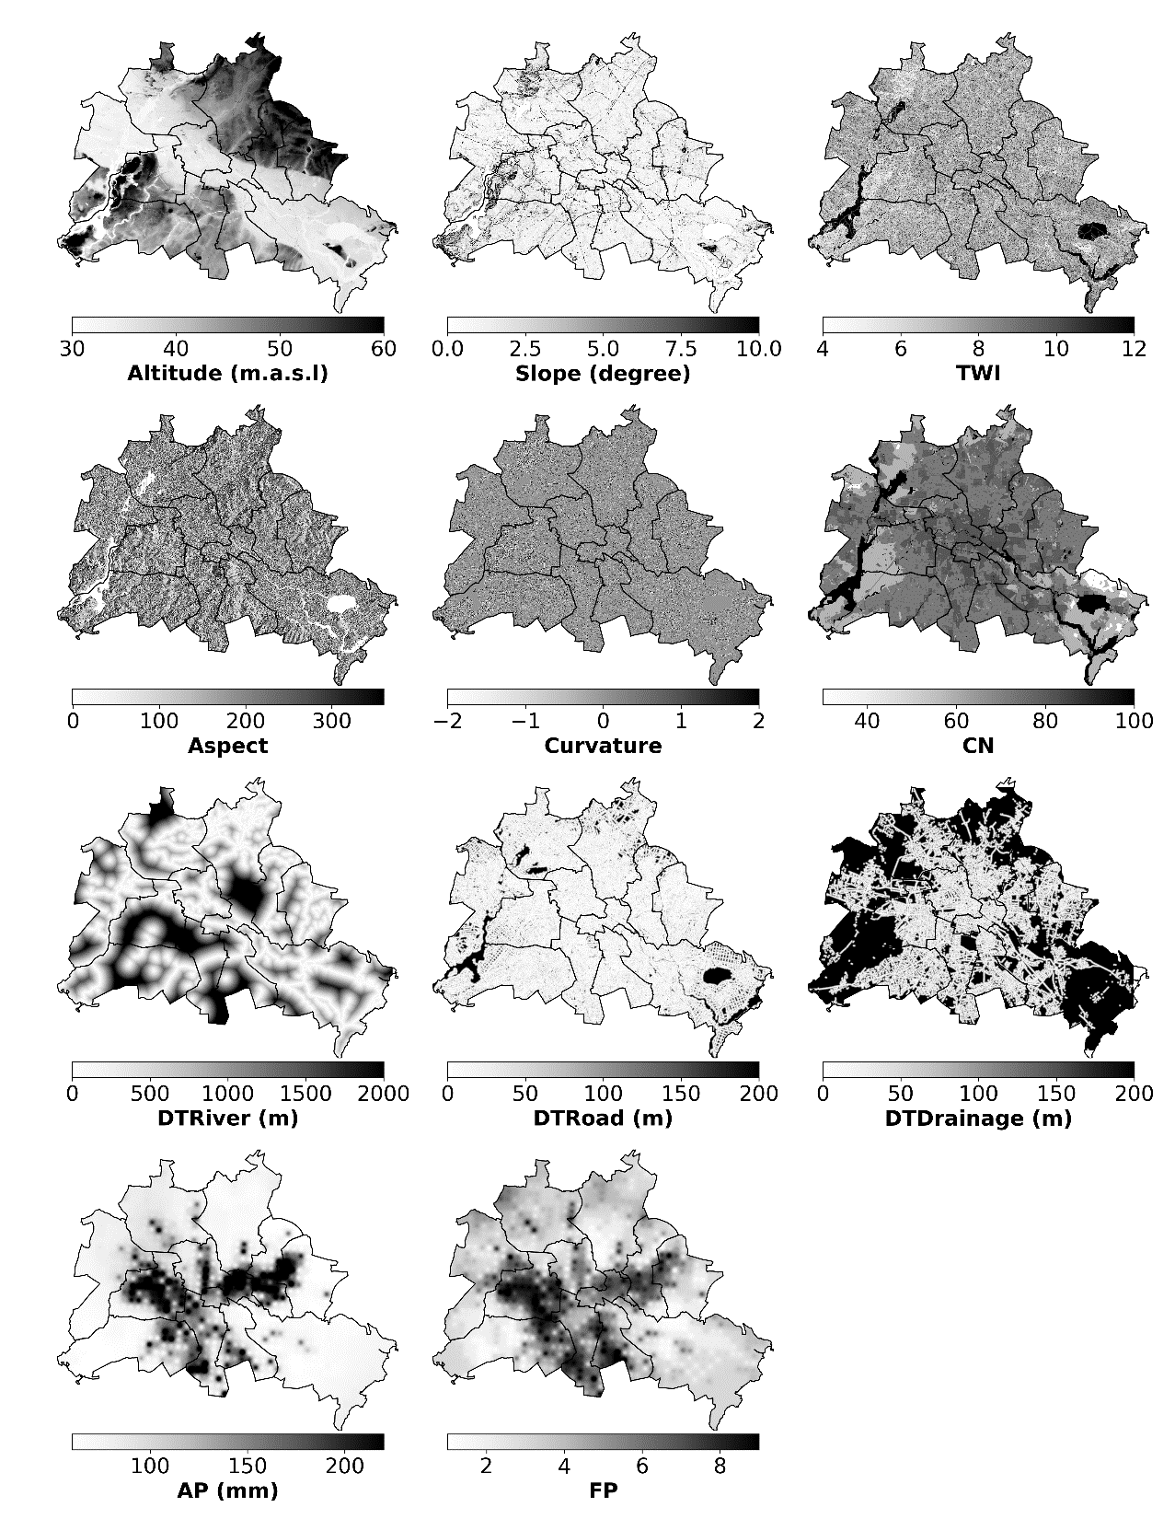
Predictors
Topographic:
Altitude
Slope
Topographic wetness index
Aspect
Curvature
Infrastructural:
Curve number (CN)
Distance to rivers (DTRiver)
Distance to roads (DTRoad)
Distance to drainage system (DTDrainage)
Meteorological:
Maximum annual daily precipitation (AP)
Frequency of heavy precipitation (FP)
Fig. Spatial distribution of flood influencing factors used to develop the models.
seleem@uni-potsdam.de
6

Slide 7
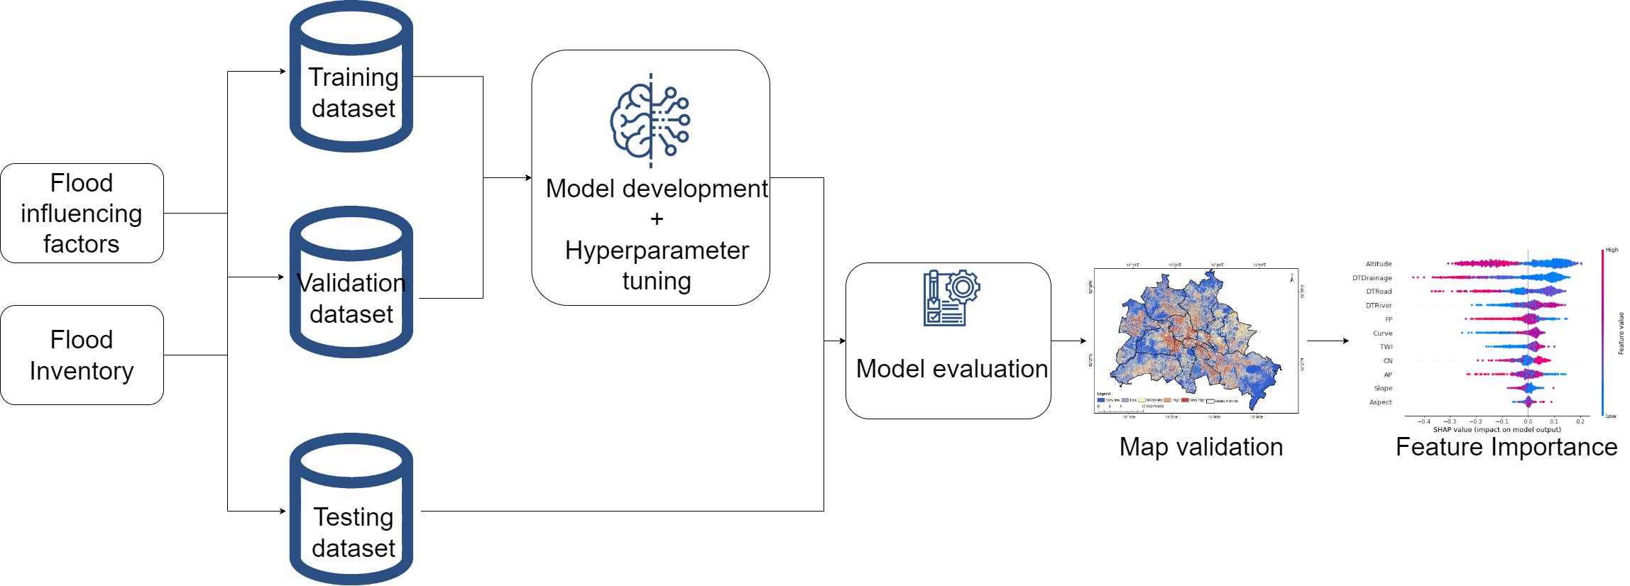
Methodology
seleem@uni-potsdam.de
Introduction – Data & Methods – Results – Outlook
7

Slide 8
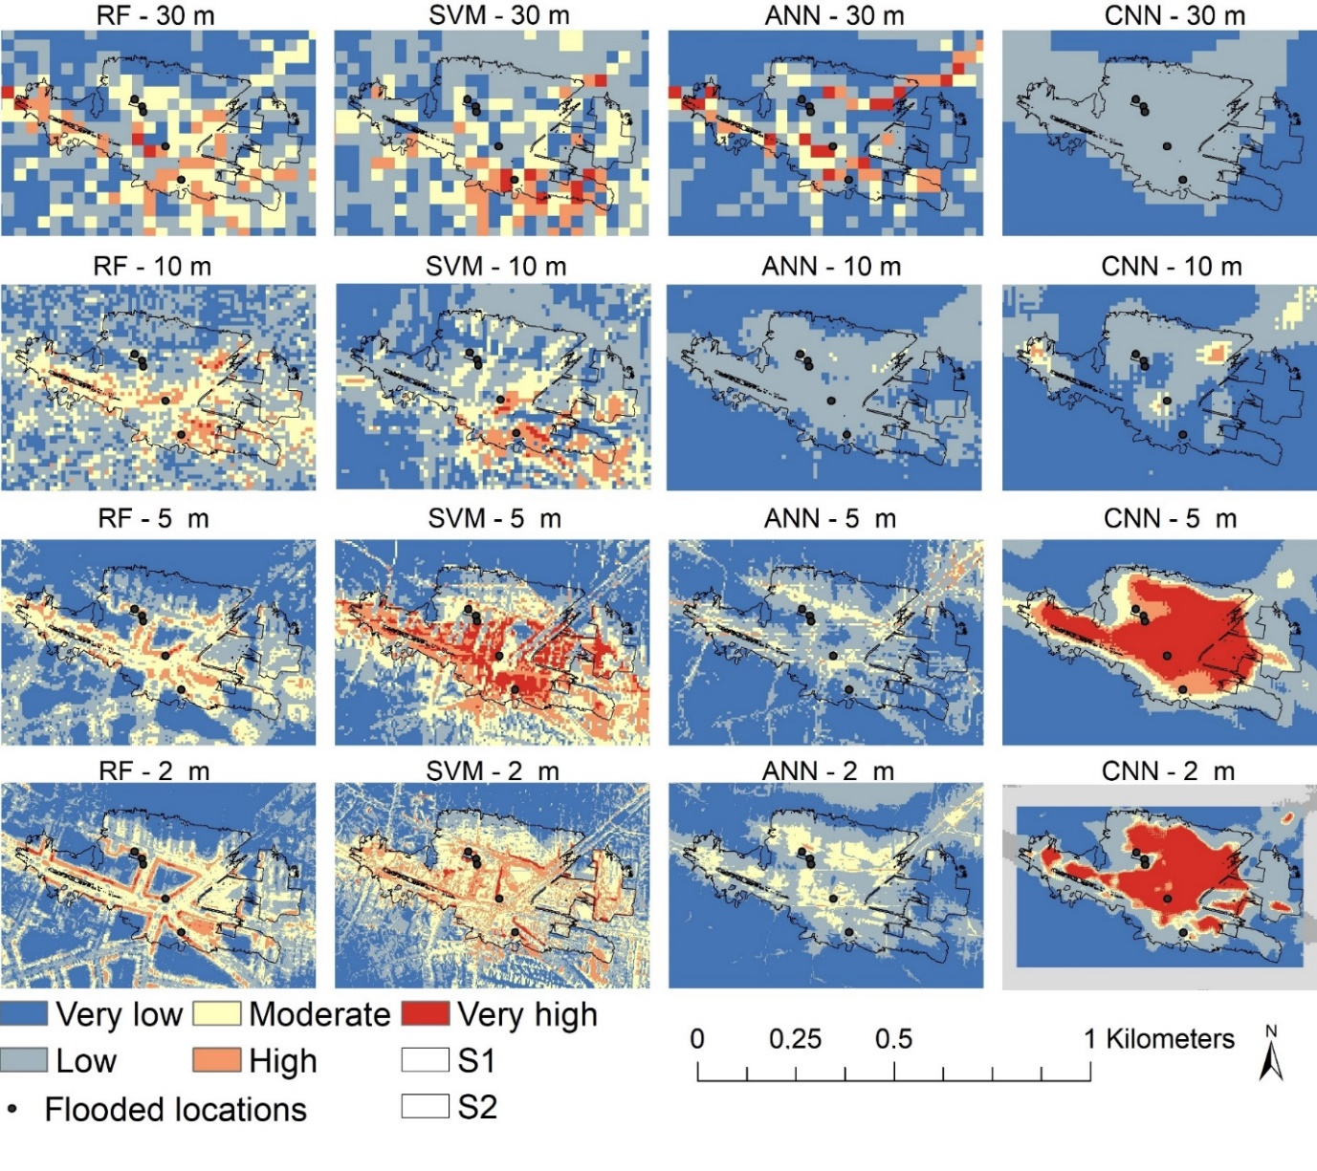
Impact of the spatial resolution of input data on image and point based models
Minimum AUC = 0.87
RF models outperformed the other models at all spatial resolutions.
RF – 2m was superior for the used flood inventory and predictors (AUC = 0.97).
AUC: Area Under the Curve (AUC) of _{the} Receiver Characteristic Operator (ROC)
CNN: Convolutional neural network
_{RF: Random forest}
_{SVM: Support vector machine}
_{ANN: Artificial neural network}
Fig. Flood susceptibility maps from all models at different spatial resolution for a selected topographic depression (S1).
seleem@uni-potsdam.de
8

Slide 9
How transferable are the trained models (in space)?
Minimum AUC = 0.8
The RF - 2 m had the best performance (AUC = 0.92).
Areas with high flood susceptibility coincide with the reported flooded locations.
AUC: Area Under the Curve (AUC) of _{the} Receiver Characteristic Operator (ROC)
_{RF: Random forest}
Fig. Flood susceptibility map for Berlin from RF - 2 m model (best performance model) and the reported flooded locations.
seleem@uni-potsdam.de
9

Slide 10
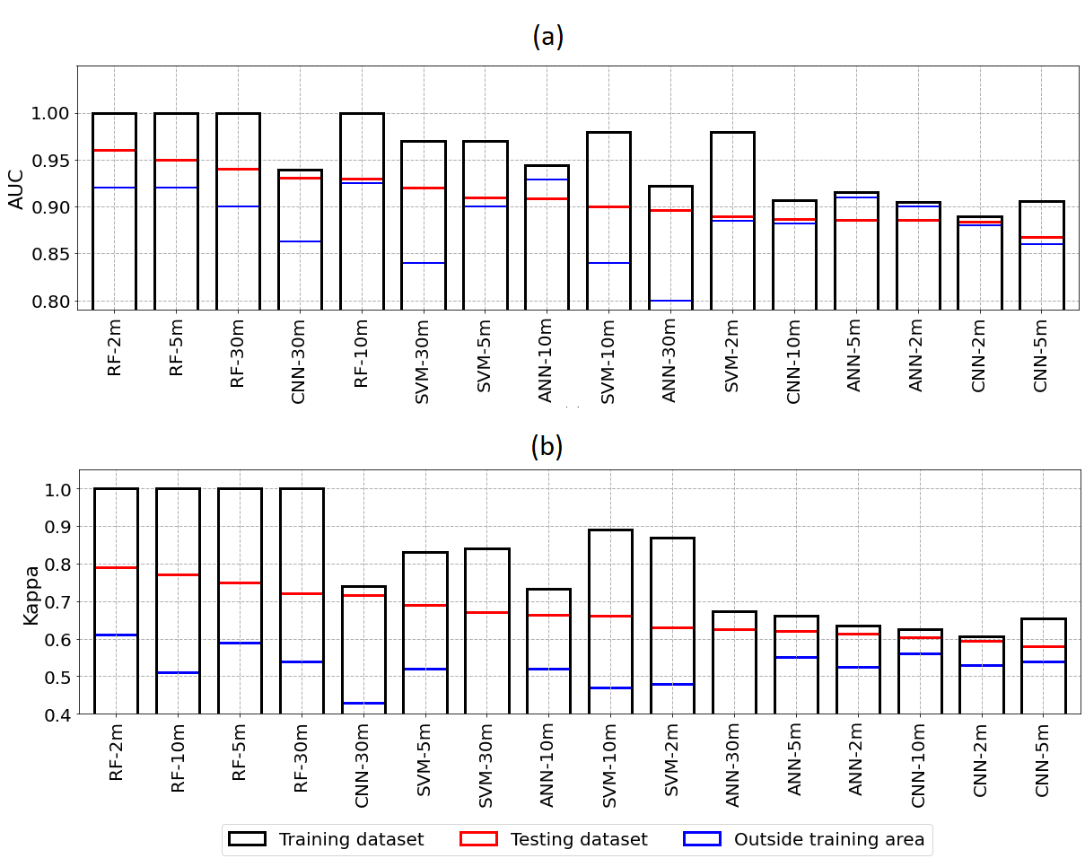

Model Validation
$$Kappa=\frac{P_{o}−P_{e}}{1−P_{e}}$$
Where observed agreement (Po) and hypothetical probability of chance agreement (Pe) (Viera et al., 2005)
Index | Range
AUC | 0 < AUC < 1
Kappa | -1 < Kappa <1
Fig. Calculated performance indices for the training dataset, testing dataset and the locations located outside training area, models are arranged horizontally in descending order according to their score for the testing dataset: (a) AUC, (b) Kappa.
seleem@uni-potsdam.de
10

Slide 11
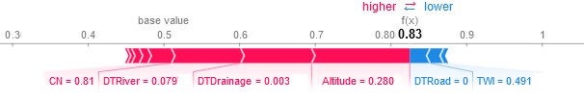
Can we explain the model prediction and which factors are most useful for flood susceptibility mapping ?
SHAP (SHapley Additive exPlanations) python package (Lundberg and Lee, 2017).
Altitude and Aspect were the most important predictors for point and image based models respectively.
Fig. SHAP values of each feature and their impact on the model prediction for a certain location by the RF model at 2 m resolution
_{RF: Random forest}
seleem@uni-potsdam.de
11

Slide 12
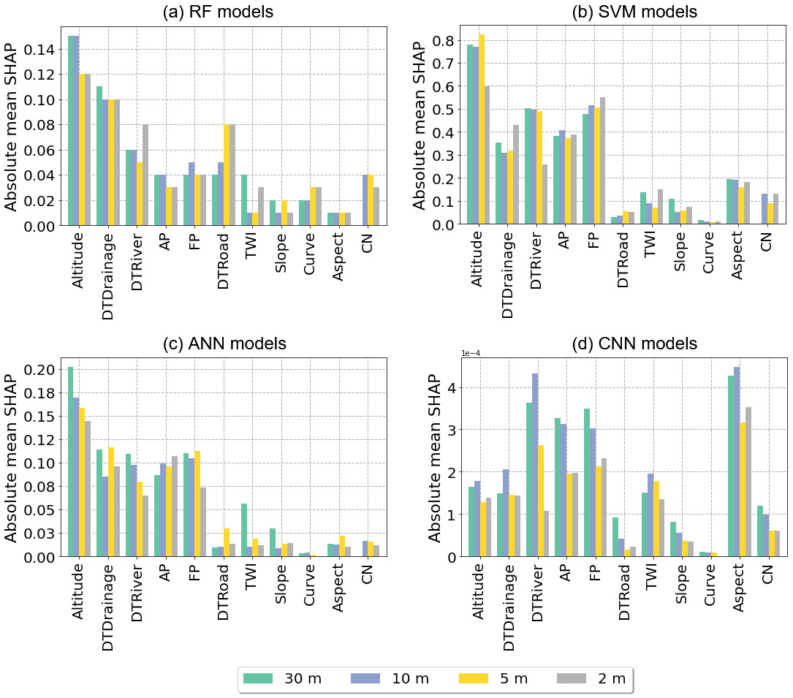
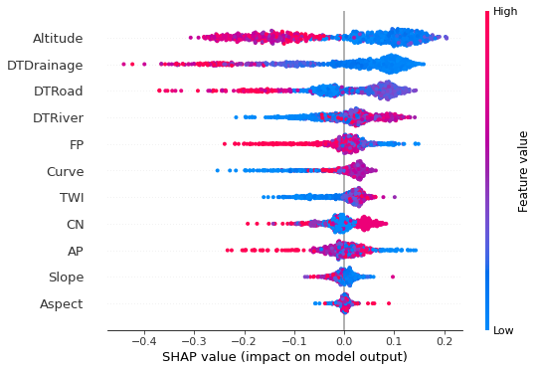
Can we explain the model prediction and which factors are most useful for flood susceptibility mapping ?
Fig. SHAP values for the testing dataset using RF - 2 m model.
Fig. Feature importance for all models based on the calculated absolute mean SHAP values.
seleem@uni-potsdam.de
12

