Slide 1



How does the rise of atmospheric evaporative
demand affect flash drought development in Spain?
Iván Noguera, Fernando Domínguez-Castro, and Sergio M. Vicente-Serrano
Pyrenean Institute of Ecology (IPE–CSIC), Zaragoza, Spain.
Email: i.noguera@ipe.csic.es

Slide 2
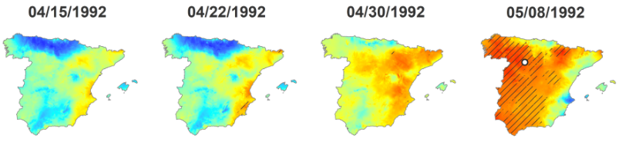
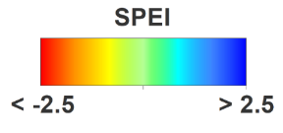
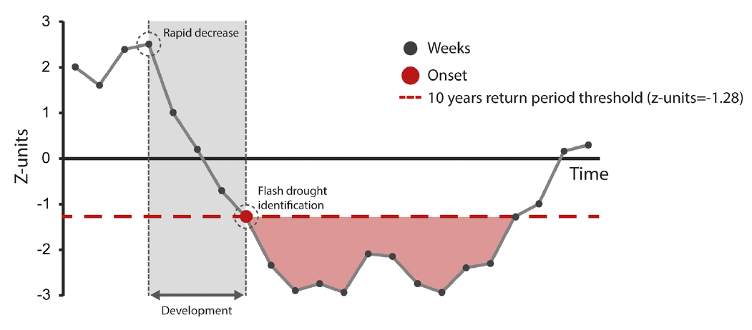
Flash drought: definition and identification
Generally driven by severe precipitation deficits and/or anomalous increase in atmospheric evaporative demand (AED).
Drought episodes characterized by a rapid development and intensification (a few weeks), incresing potential drought impacts.
Usually, flash droughts are identified based on standardized drought indices at short times scales to capture the rapid onset (i.e., development phase).
We proposed a method based on Standardised Precipitation Evapotranspiration Index (SPEI) at 1-month and weekly frequency: define as a decline of 2 in SPEI that results in a final value ≤ -1.28 (10-year return period) over 4 weeks.
Time
Noguera et al. (2020) Annals of the New York Academy of Sciences

Slide 3
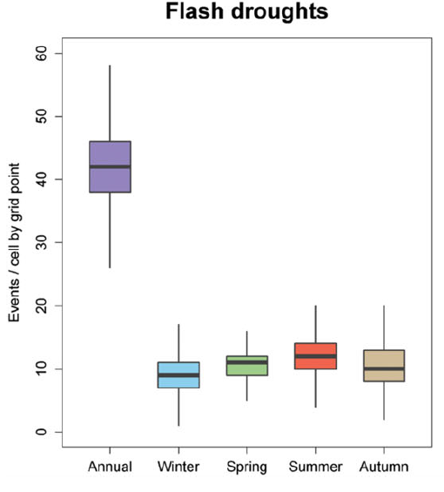
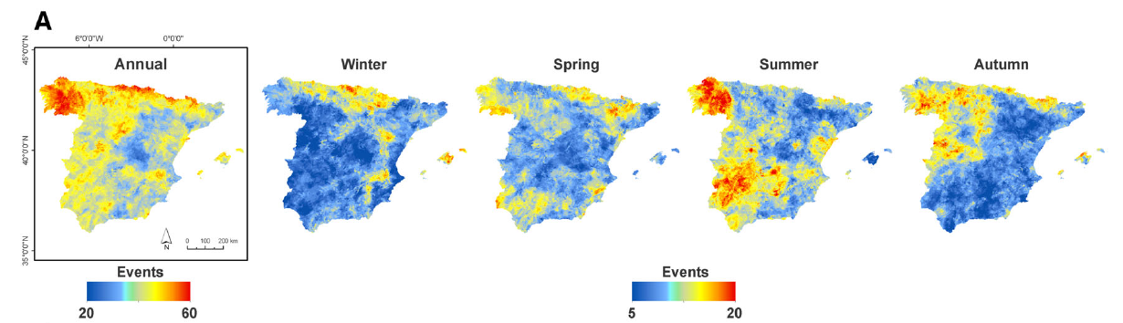
Flash drought in Spain: characteristics (1961-2018)
In Spain, 40% of all droughts events develop as flash drought.
There are important spatial and seasonal variations in flash drought frequency.
The north and northwest regions are the most affected by flash droughts.
Flash droughts are more frequent in spring and summer.
Noguera et al. (2020) Annals of the New York Academy of Sciences

Slide 4
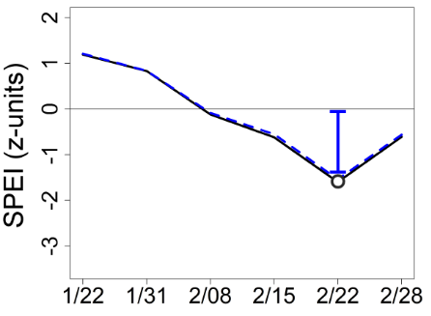
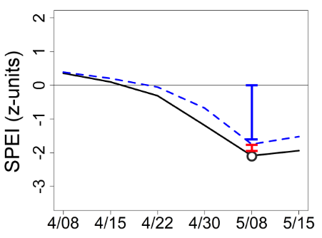
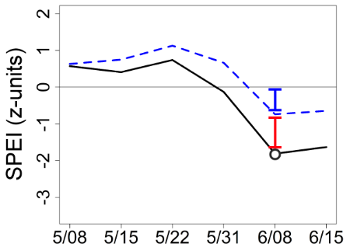
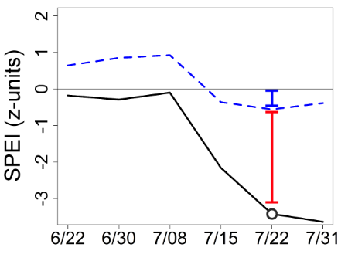
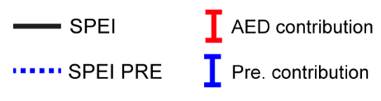
Precipitation and AED role in flash drought development
We compared SPEI with a “new version” of SPEI (SPEI PRE) in which precipitation vary according to the observed climate evolution, while the AED remained at its mean value (averaged for each week of the year over the period 1961–2018).
The difference between zero and SPEI PRE was due to precipitation variability, while the difference between SPEI PRE and SPEI was due to AED contribution
Method used in several studies:
Cook et al., 2014; Scheff & Frierson, 2014; Williams et al., 2015 etc.

Slide 5
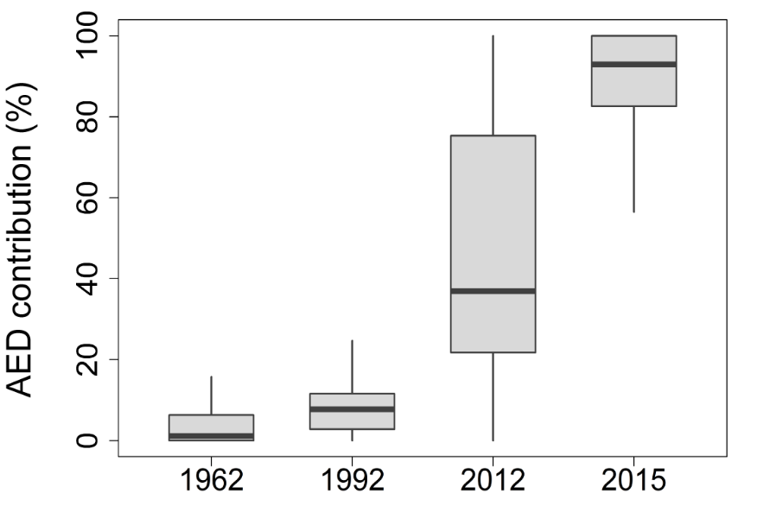
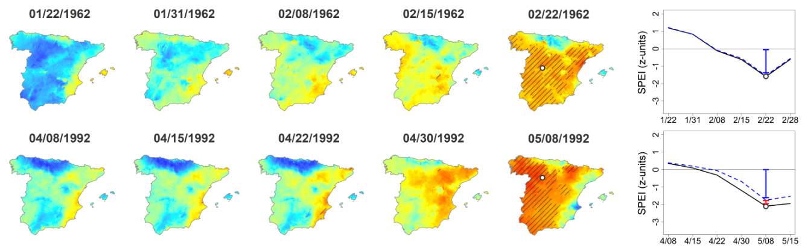
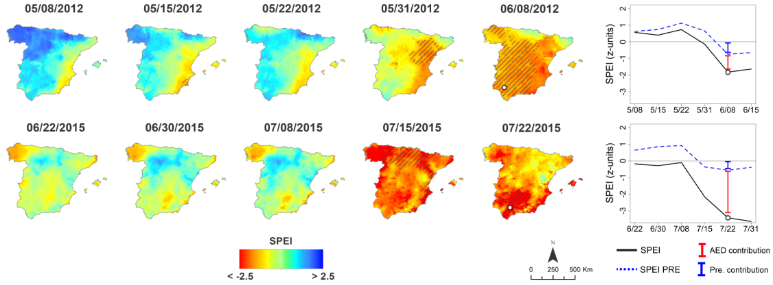
Normally, low AED contribution:
In winter, spring and autumn.
Cold and very dry periods.

Slide 6
Normally, high AED contribution:
In summer.
Dry and very warm periods

Slide 7
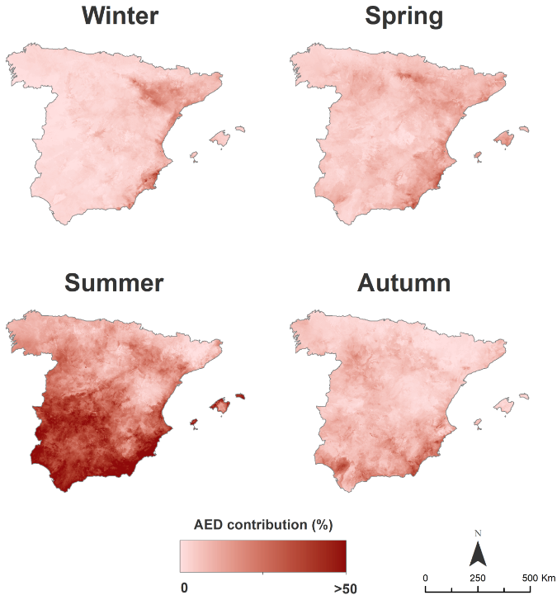
Precipitation and AED role in flash drought development (1961-2018)
In Spain, precipitation defitis are the main driver of flash drought development while AED plays a key role in the water-limited regions of central and southern Spain during the summer.
There is a close relationship between average AED contribution and seasonal average precipitation.
Noguera et al. (2022) Geophysical Research Letters

Slide 8
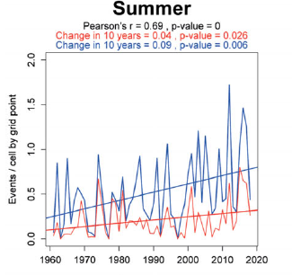
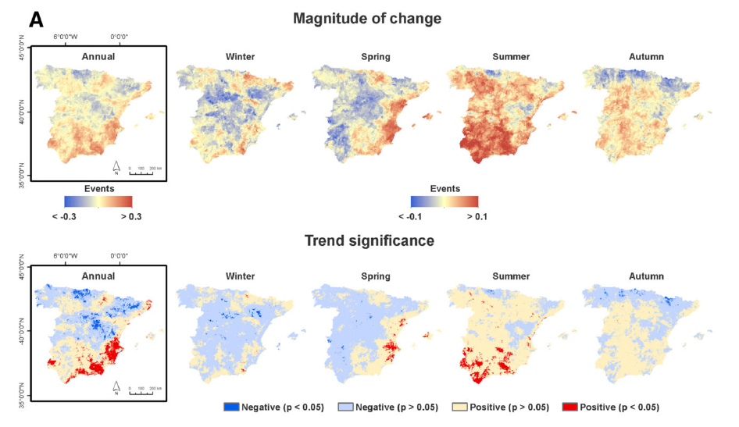
Flash drought in Spain: trends (1961-2018)
The trends show remarkable contrasts between the northern and central regions of Spain and the southern and southeastern regions.
Flash drought episodes increased significantly in summer during the last years.
Noguera et al. (2020) Annals of the New York Academy of Sciences

Slide 9
Implications of the rise in AED on the flash drought development
General increase in the contribution of AED to flash drought development.
The trends in flash droughts cannot be explained without the role of the AED.
The increase in AED contribution is notable in summer, but also in spring and autumn.
AED contribution to the development of flash drought has almost doubled in the last two decades in spring, summer and autumn.
Noguera et al. (2022) Geophysical Research Letters

Slide 10
Thank you very much
Questions and comments:
i.noguera@ipe.csic.es

