Slide 1
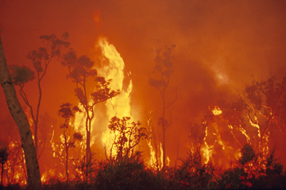
BG1.2，EGU22-4394, May 25, 2022
Fire aerosols slow down the global water cycle
Fang Li
Institute of Atmospheric Physics, Chinese Academy of Sciences (IAP/CAS)
E-mail: lifang@mail.iap.ac.cn
David M. Lawrence (NCAR) , Yiquan Jiang (NJU) , Xiaohong. Liu (TAMU) Zhongda Lin (IAP/CAS)
Notes:
1

Slide 2
Backgrounds
Fire is the largest source of global primary carbonaceous aerosols
Earlier studies quantified the impact of fire aerosols on:
Radiative effect Raditaion forcing T Prec. Atm. cir. & comp.
C cycle Air quality Human health Energy budget
But it remains unknown how much and by which mechanisms fire aerosols affect the whole picture of the global water cycle

Slide 3
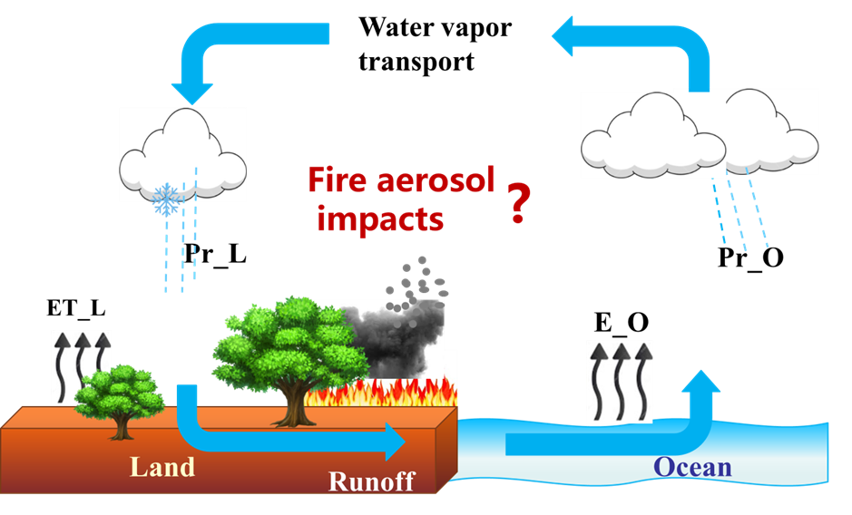
Aim
Quantify the influence of fire aerosols on the global water cycle and identify the main influence pathway

Slide 4
Methods and data
Model platform: Fully coupled Earth system model CESM1.2, replace MAM3 with MAM4
Exp. Design: FIRE & NOFIRE
(with & without fire aerosol emis.)
Fire aerosol emis: 2003-2011 daily GFED3.1
AeroCom vert. dis.
Run for 99 years, the last 27 years analyzed

Slide 5
Evaluation
Can simulate global amounts and spatial pattern of present-day water cycle reasonably well

Slide 6
Results
Fire aerosols and induced increase in AOD: peak in the tropics, also Artic-boreal zone
Globally, fire contributed
46±4 % (BC)
74±3 % (POM)
2±1 % (Sulfate)
and increased AOD by 6±2%

Slide 7
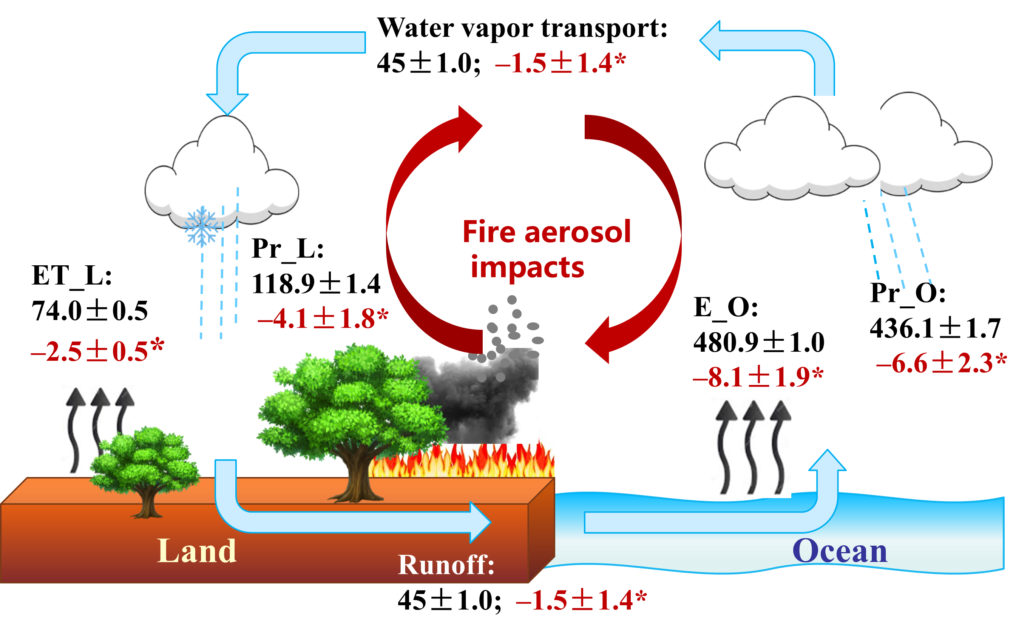
Fire aerosols sig. slow down the global water cycle
FIRE
Fire effect
* P<0.05

Slide 8
decrease ET and evaporation over most regions
reduce Pr, but sig. increase Pr in some SH tropical oceans
Spatially similar to the influence on land Pr

Slide 9
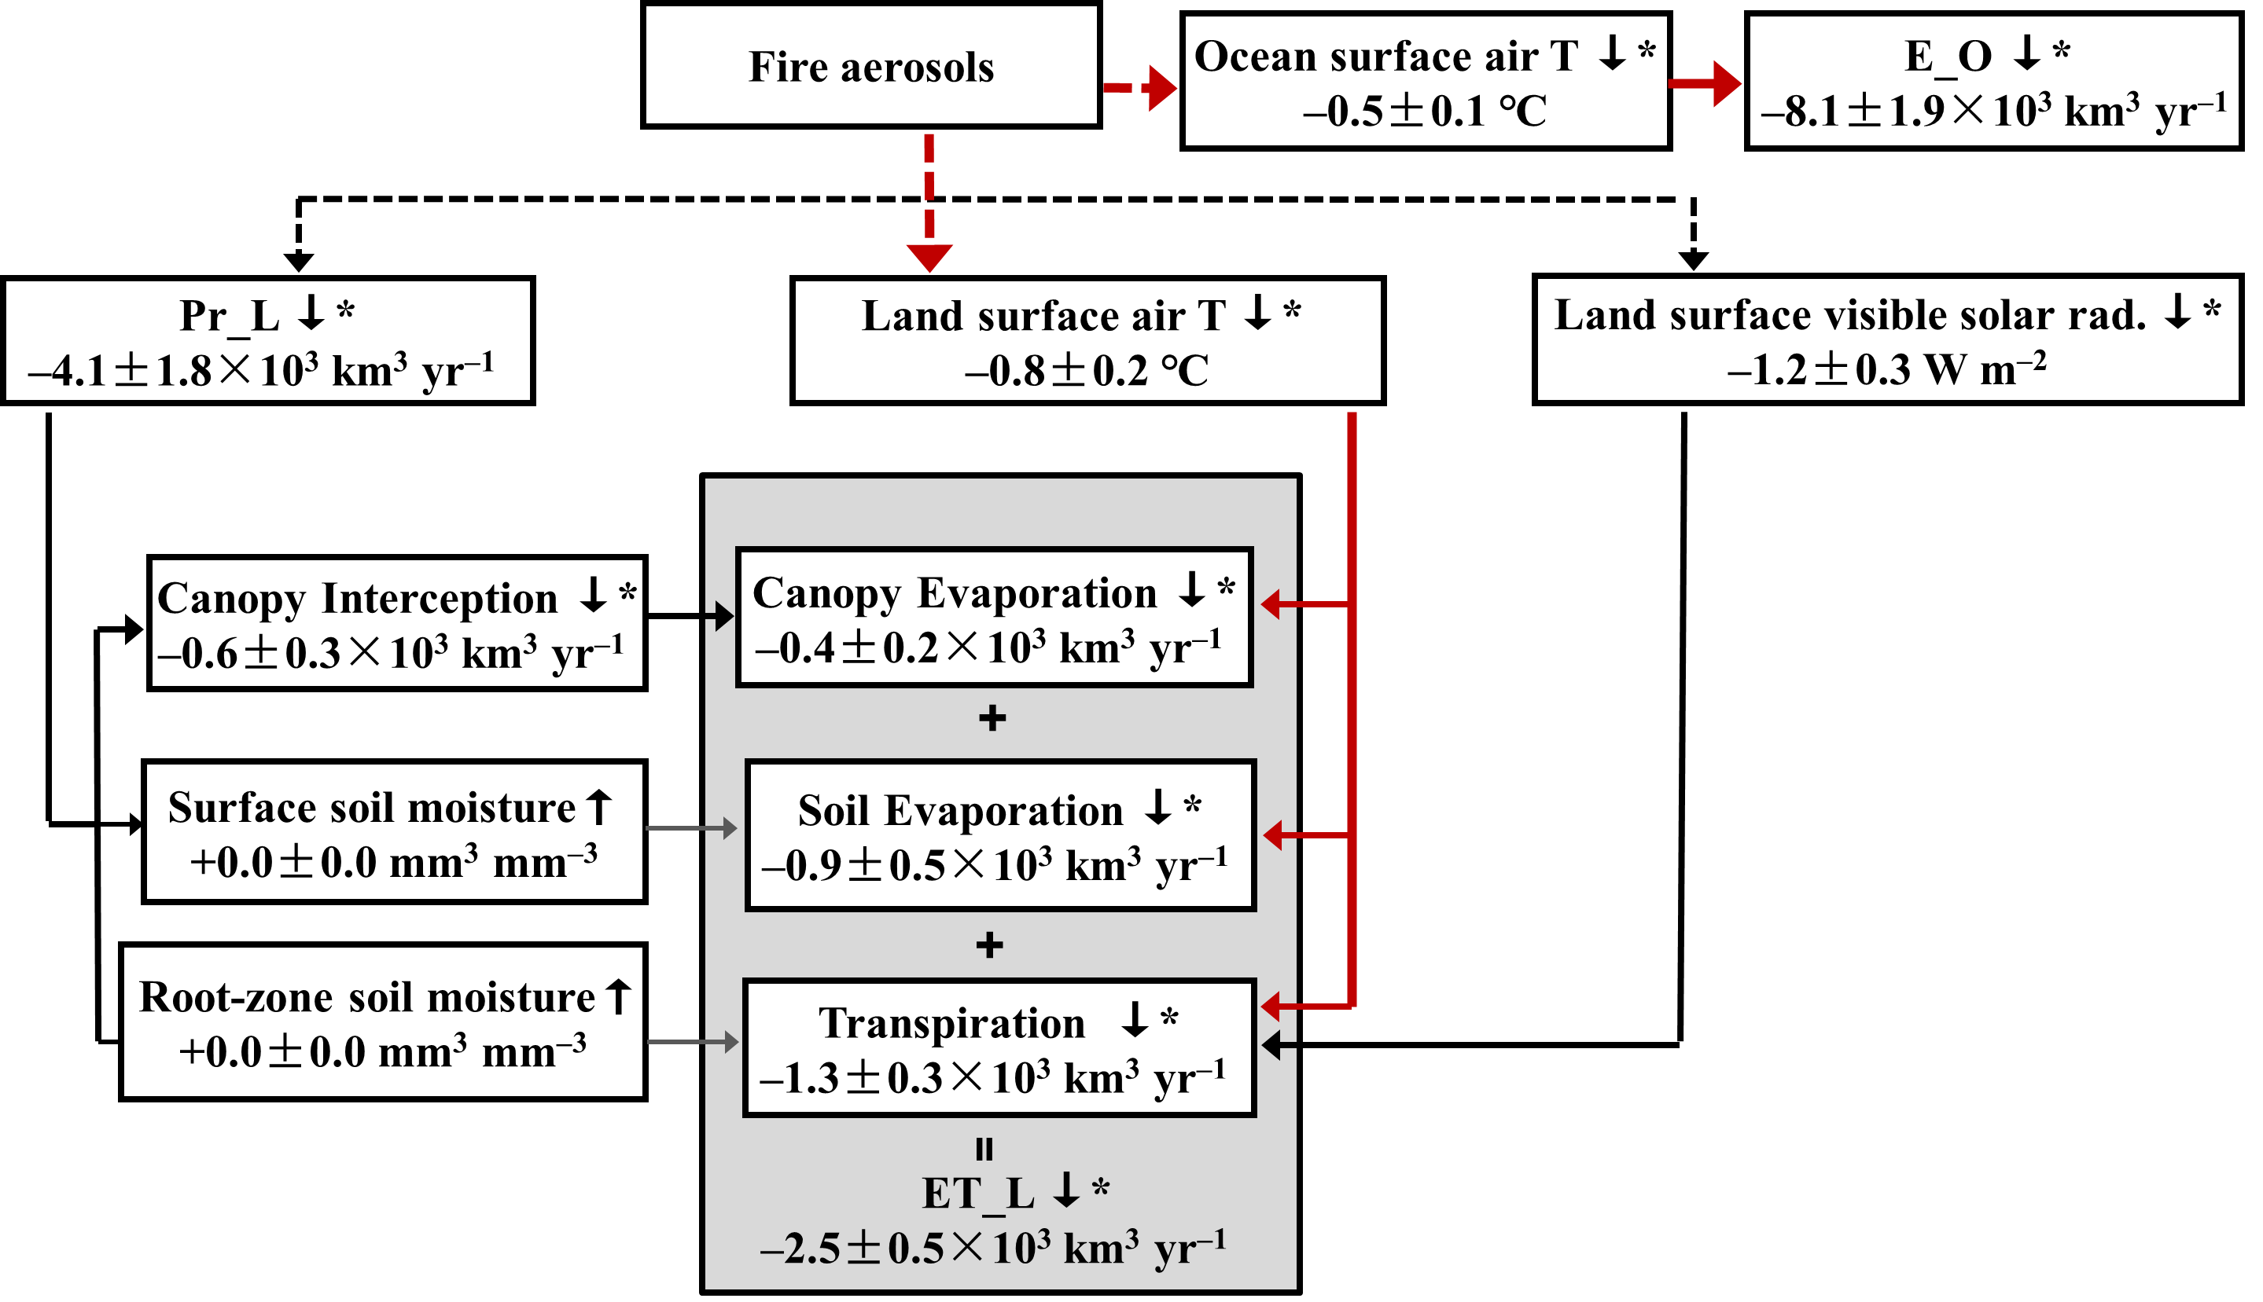
Mechanism 1:
surface cooling is the main pathway by which fire aerosols affect the global land ET and ocean E
Solid: +
Dash: ─

Slide 10
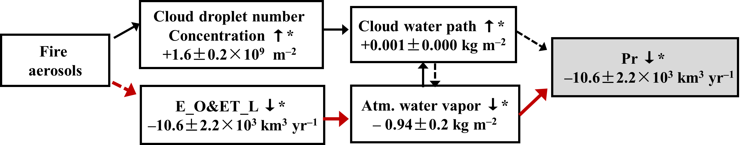
Mechanism 2: decreased ocean E and land ET is the primary pathway for global precipitation decrease.
More fire aerosols in NH mid. & high lat. → Inter-hemispheric energy asymmetry → Southward shift of ITCZ → Increased Pr in tropical SH oceans

Slide 11
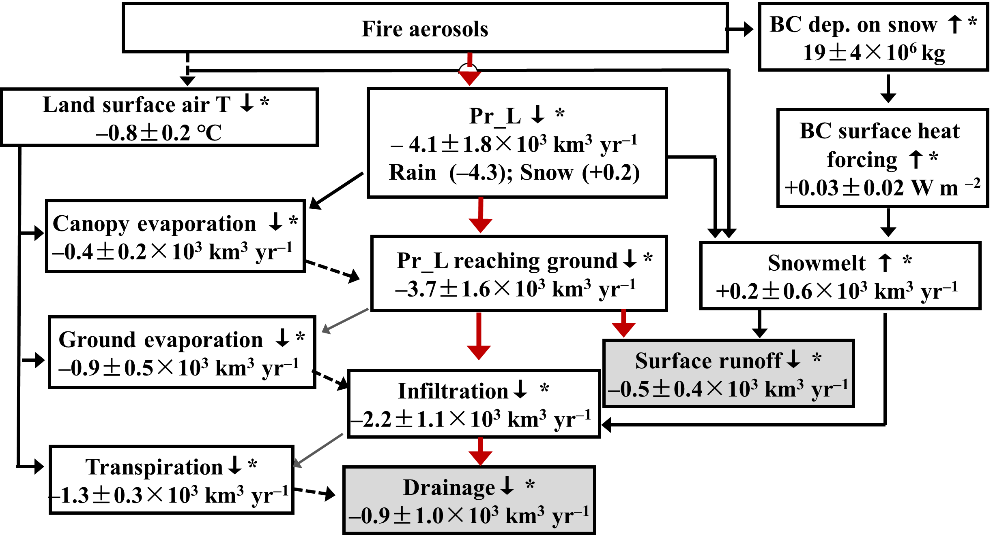
Mechanism 3: Fire-aerosol-induced decrease in surface runoff and drainage mainly correspond with the changes in land Pr
+ High spatial correlation among Pr_L, Pr_L reaching ground, Infiltration, Drainage and surface runoff

Slide 12
Conclusions
Fire aerosols weaken the global water cycle significantly (decrease ~3%). The impacts are most clearly seen in the tropics and the Arctic-boreal zone
Main pathway: Fire aerosols→ Surface cooling → Decrease in land ET and E → Decrease in atm. water vapor → Pr decrease → Decrease in surface runoff and drainage
Thanks!

