Slide 1




Weak effectiveness on vegetation greenness, cover and productivity at the edges of protected areas on the Tibetan Plateau, China
Ting Hua, Wenwu Zhao, Francesco Cherubini,
Xiangping Hu, Paulo Pereira
25 May 2022
Contact for questions: Ting Hua (email: huatingcn@126.com)
Reference:
Hua, T., Zhao, W., Cherubini, F., Hu, X., & Pereira, P. (2022). Effectiveness of protected areas edges on vegetation greenness, cover and productivity on the Tibetan Plateau, China. Landscape and Urban Planning, 224, 104421. https://doi.org/10.1016/j.landurbplan.2022.104421
.

Slide 2
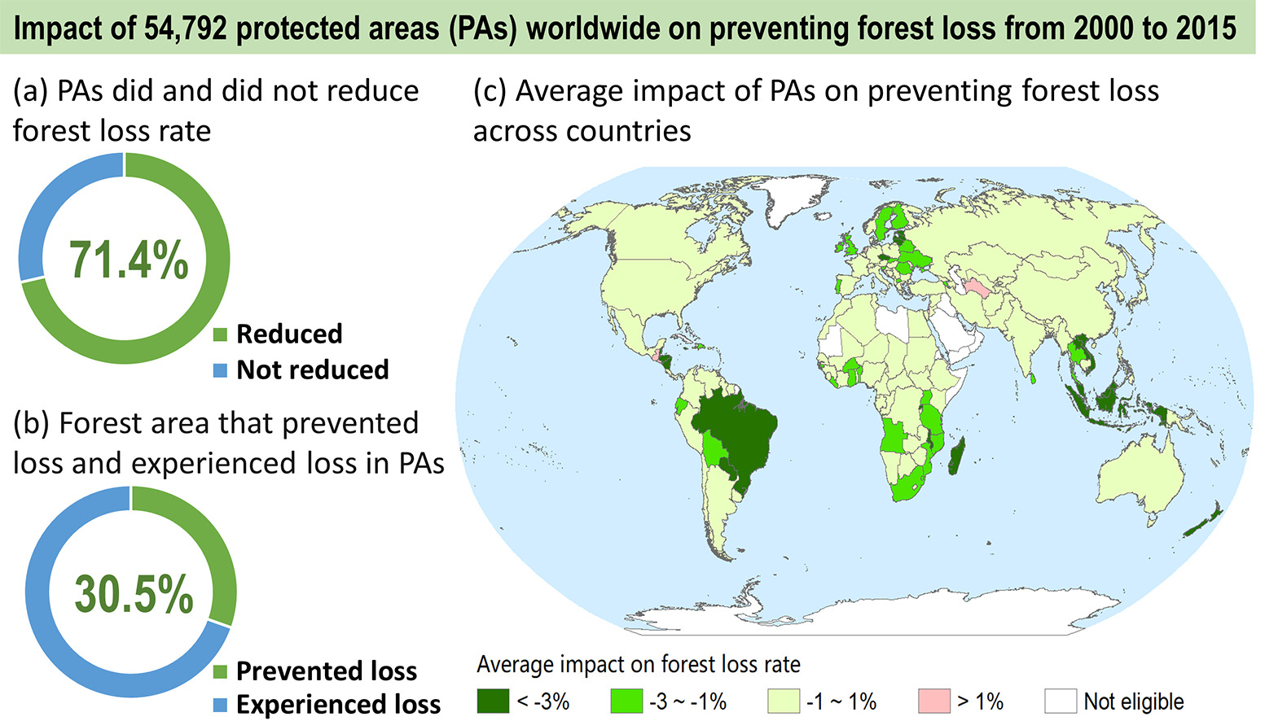
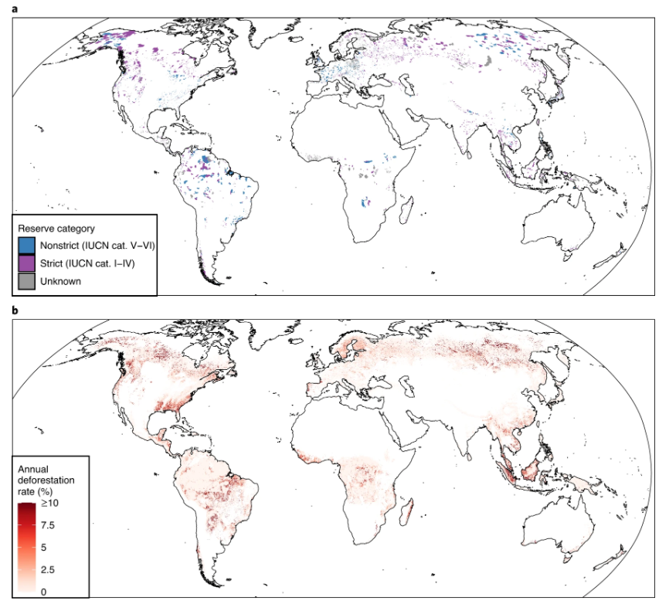
Background
(Wolf et al., Nat. Ecol. Evol, 2021;Yang et al., STOTEN, 2021)
Protected areas (PAs) are the critical societal tool to preserve global vegetation growth
71.4% global PAs have contributed to reducing forest loss, reducing deforestation rates by 41%

Slide 3
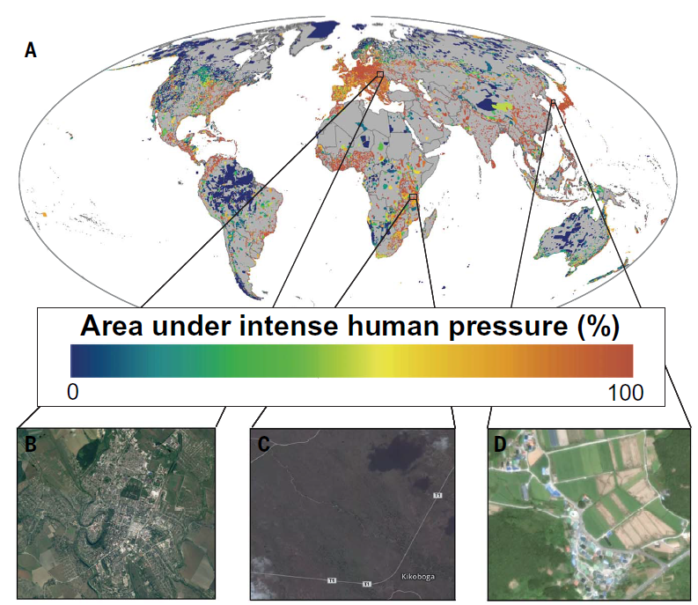
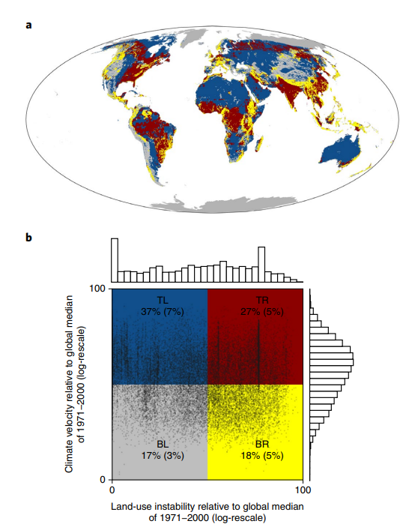
Background
Climate change, intensified human activities are challenging the effectiveness of PAs
About a third of the global PAs are under intense human pressure
About 27% of global PAs are expected to experience rapid climate change and land use change by 2050

Slide 4
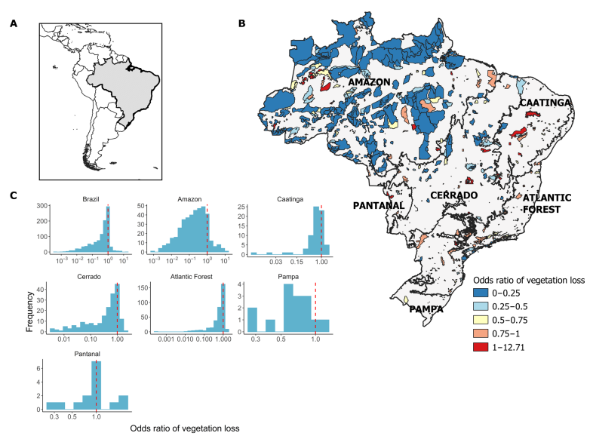
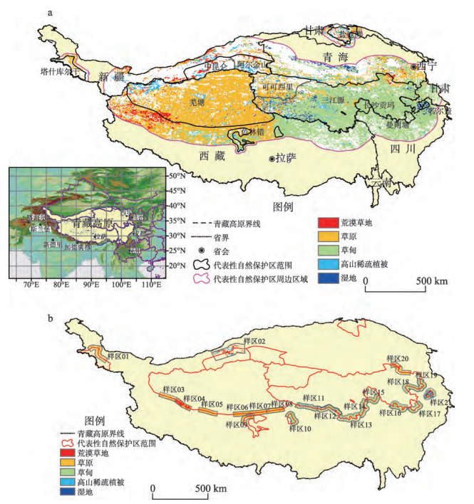
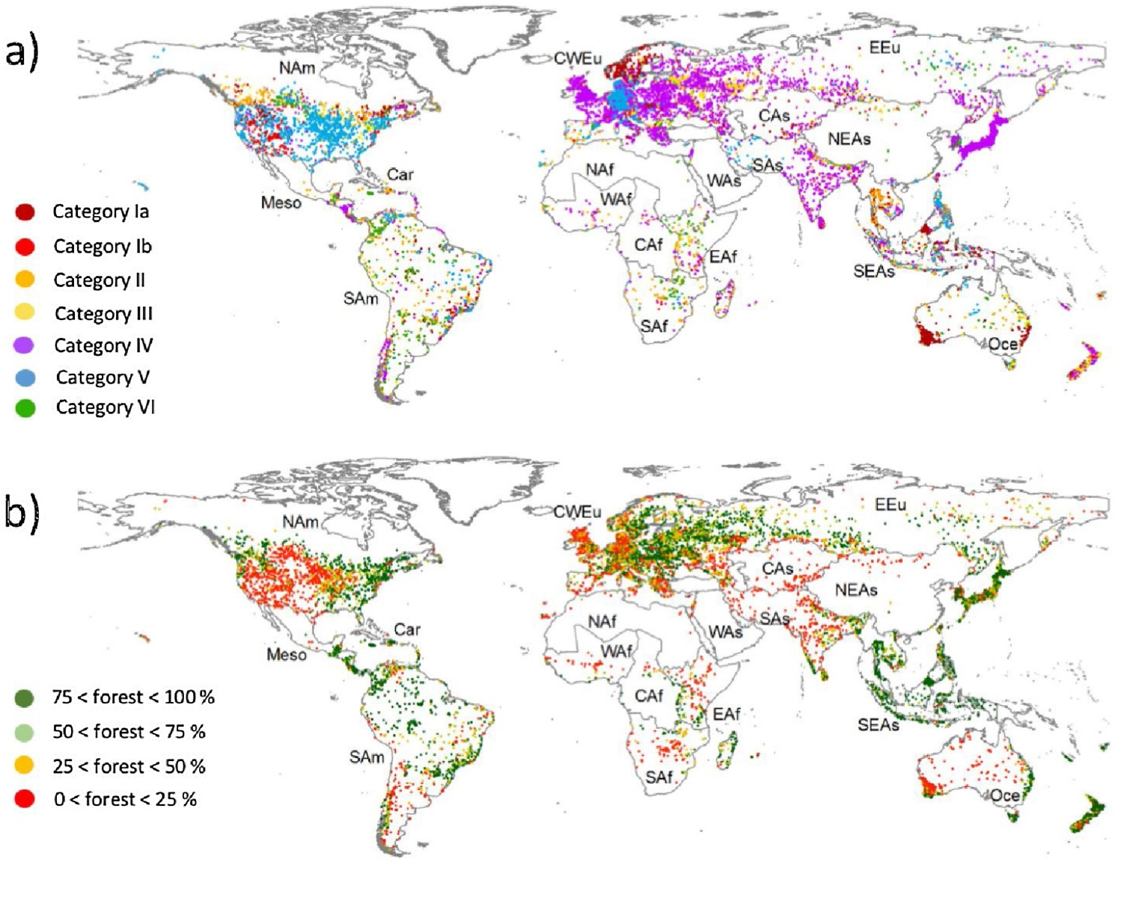
Knowledge gaps
(Gonçalves-Souza et al., Sci. Adv., 2021)
(张镱锂等, 地理学报, 2015)
(Leberger et al., BC, 2020)
Previous studies mainly used a single indicator such as NDVI or vegetation coverage to evaluate PAs’ effectiveness, however, they are only part of vegetation’s characteristics.
Notes:
previous studies mainly used a single indicator such as normalized difference vegetation index (NDVI) or vegetation coverage to evaluate PAs’ effectiveness
These indicators are only part of vegetation’s characteristics, such as greenness or coverage, and other important parameters such as vegetation productivity are rarely considered.

Slide 5
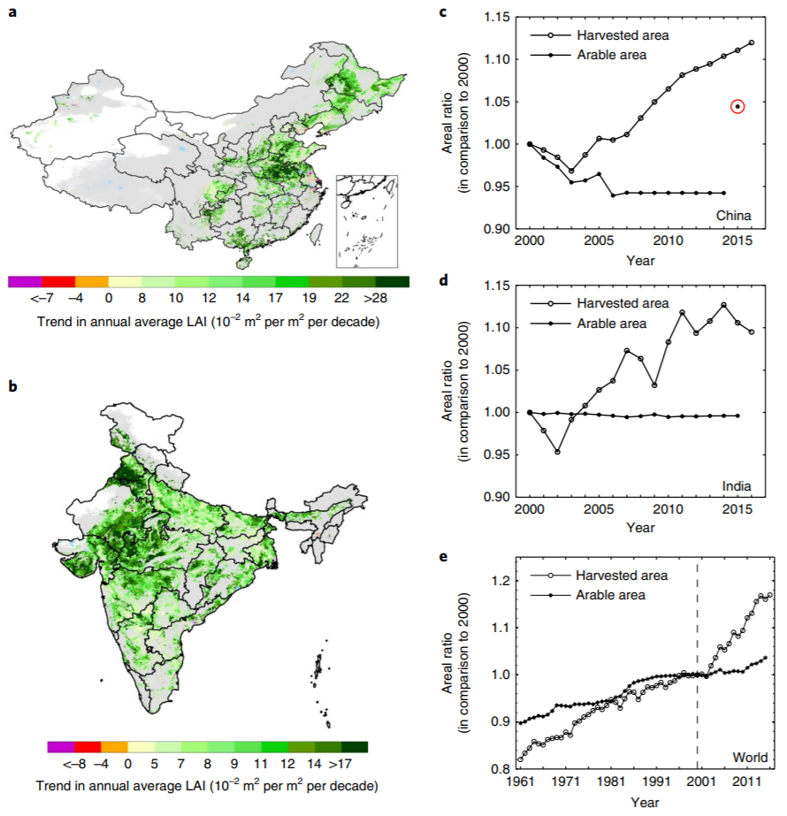
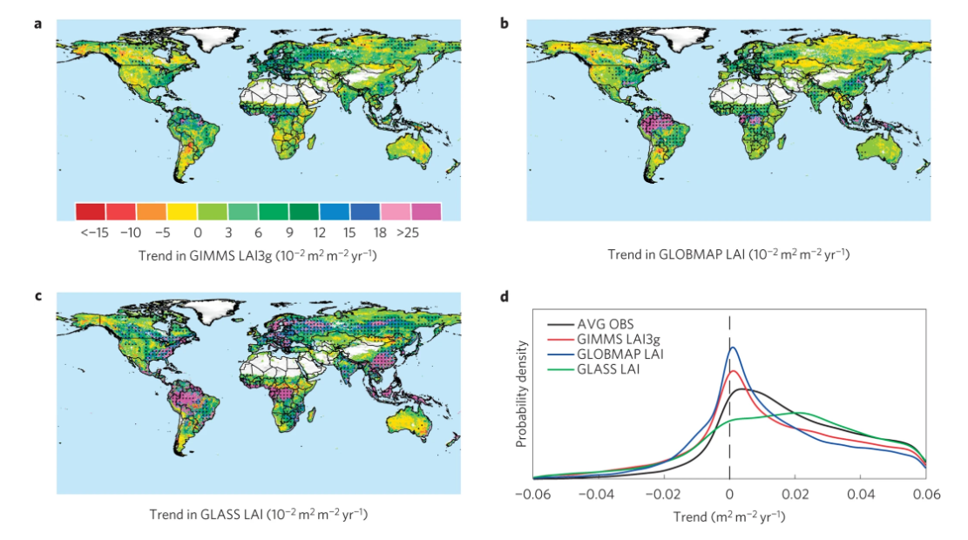
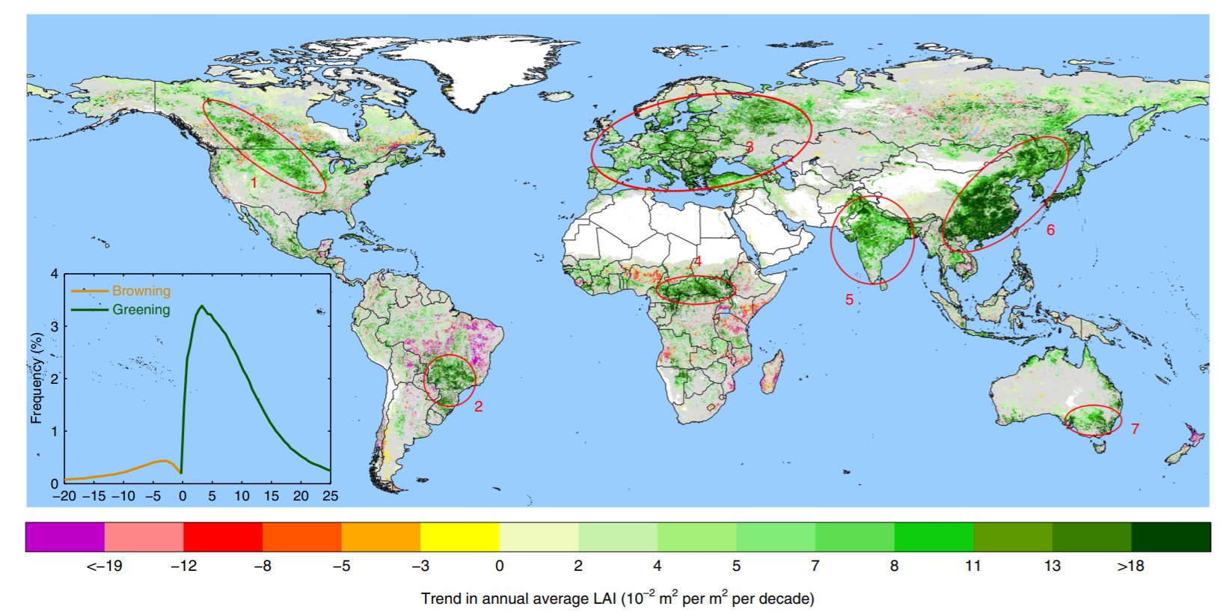
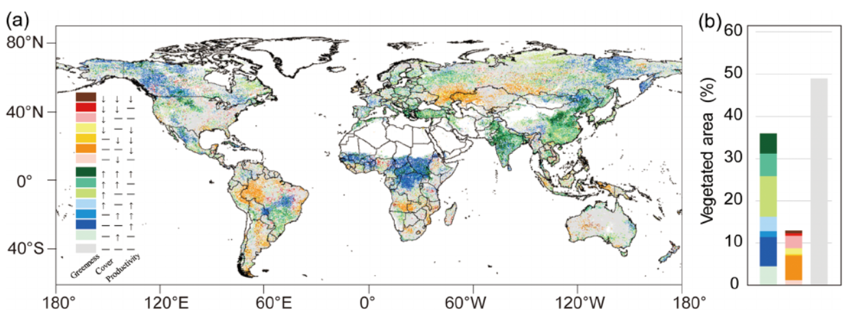
Knowledge gaps
(Chen et al., Nature Sust, 2018)
LAI
NDVI
NPP
?
(Zhu et al., Nature climate change, 2016)
An increase in NDVI does not necessarily lead to an increase in NPP
2000-2015, only 5.4% of global vegetated area exhibited consistant trends in greenness, cover and productivity

Slide 6
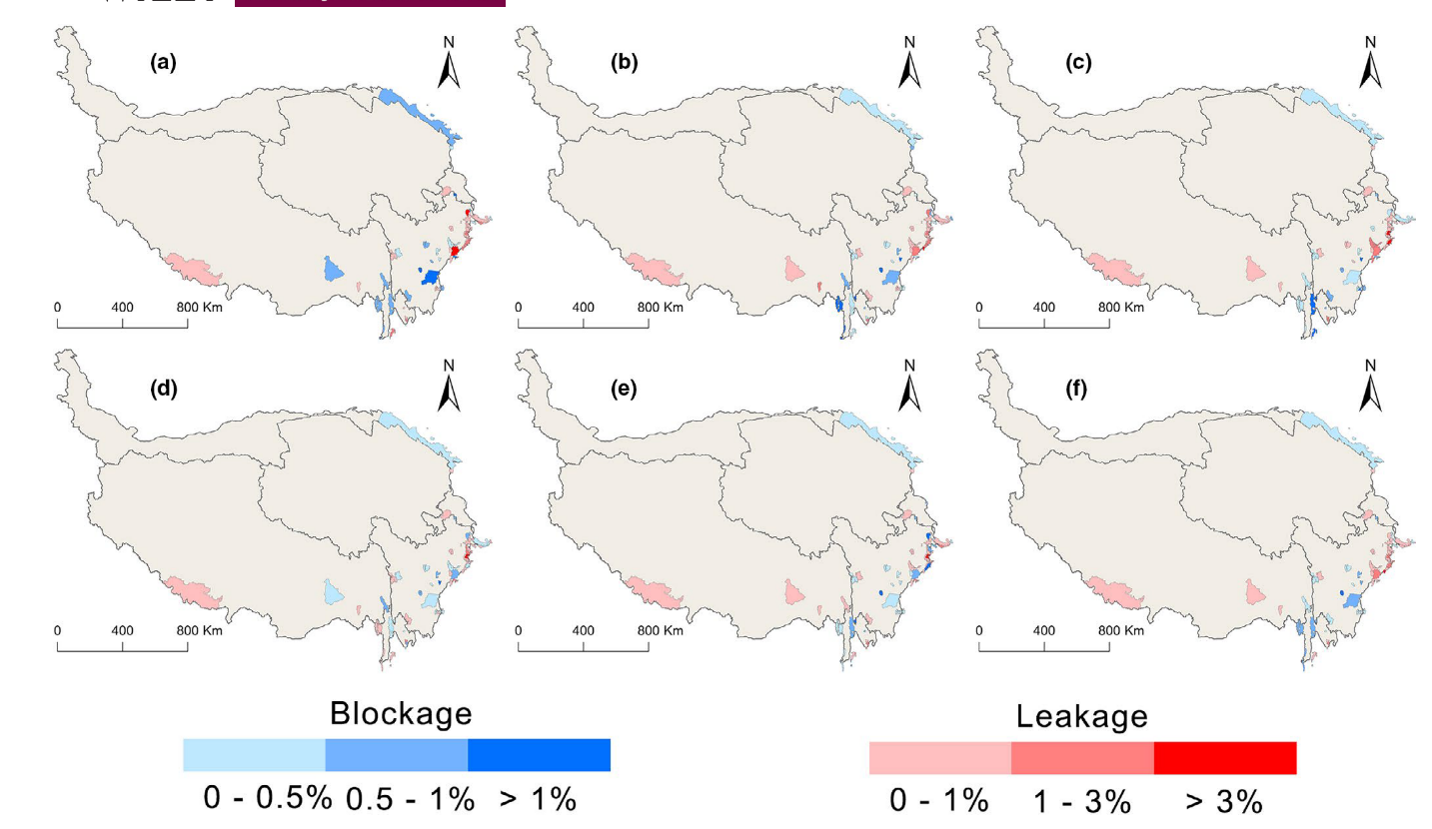
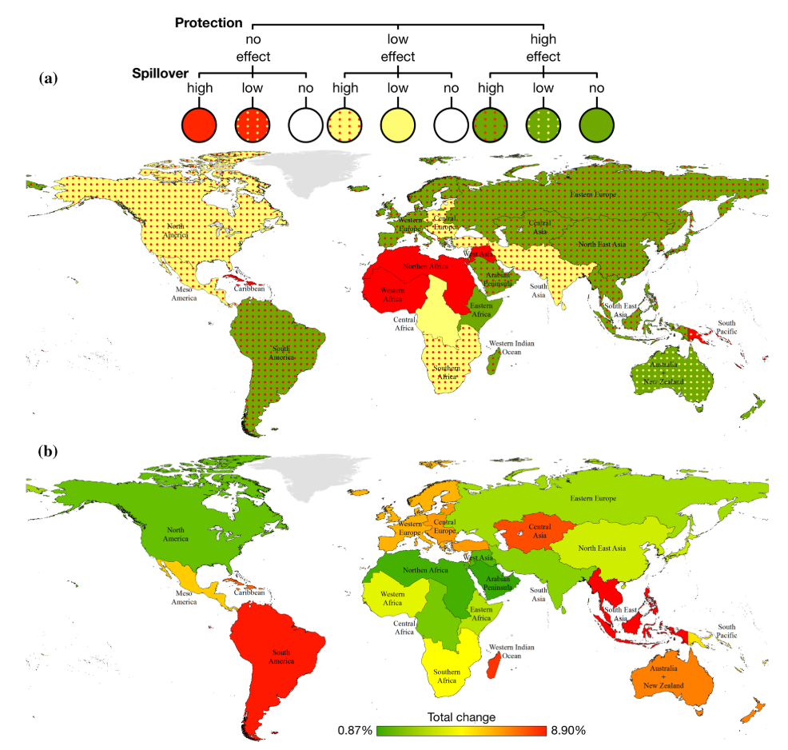
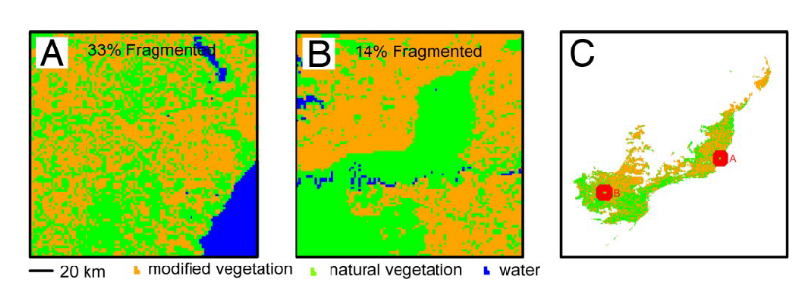
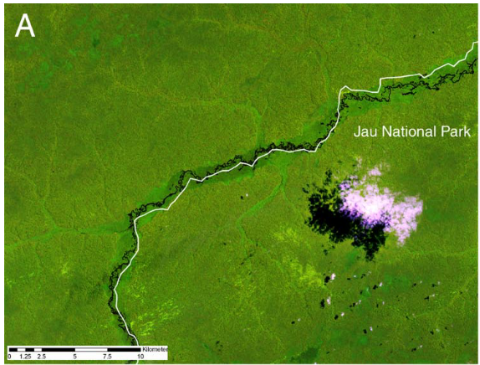
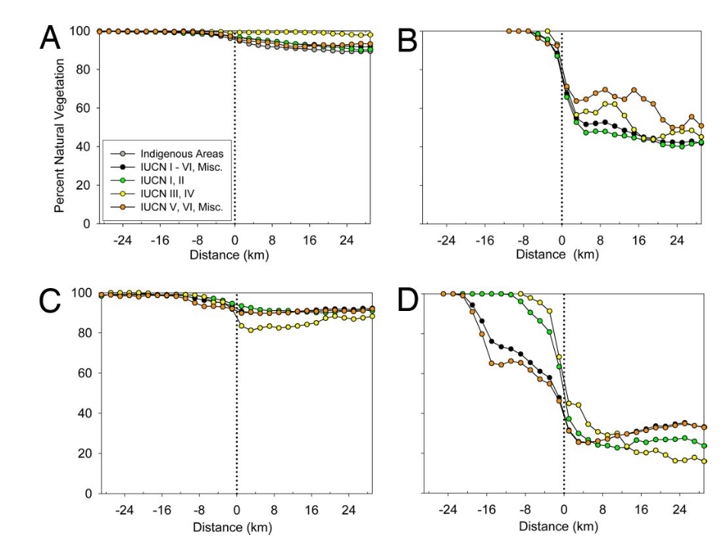
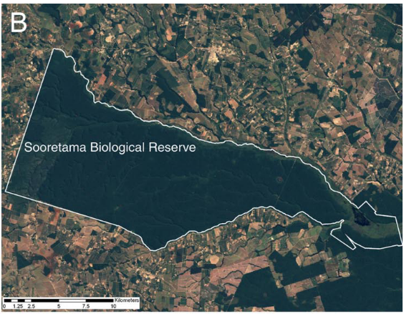
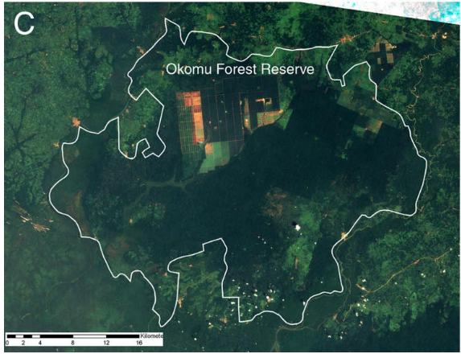
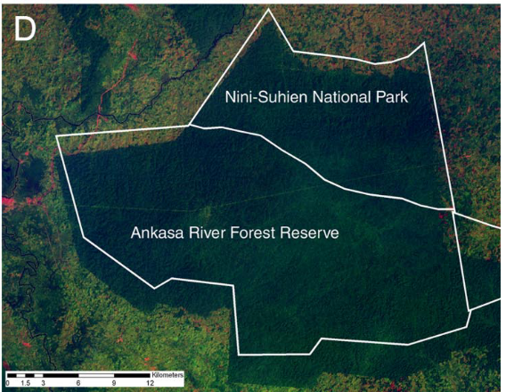
Knowledge gaps
(Shen et al., 2021)
(Guerra et al., 2019)
(Joppa et al., PNAS, 2008)
Notes:
Guerra, C. A., Rosa, I. M. D., & Pereira, H. M. (2019). Change versus stability: are protected areas particularly pressured by global land cover change? Landscape Ecology, 34(12), 2779–2790. https://doi.org/10.1007/s10980-019-00918-4

Slide 7
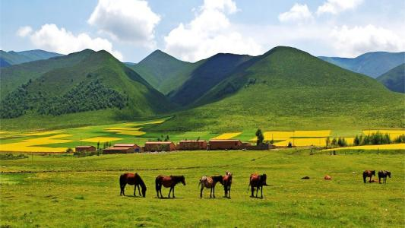
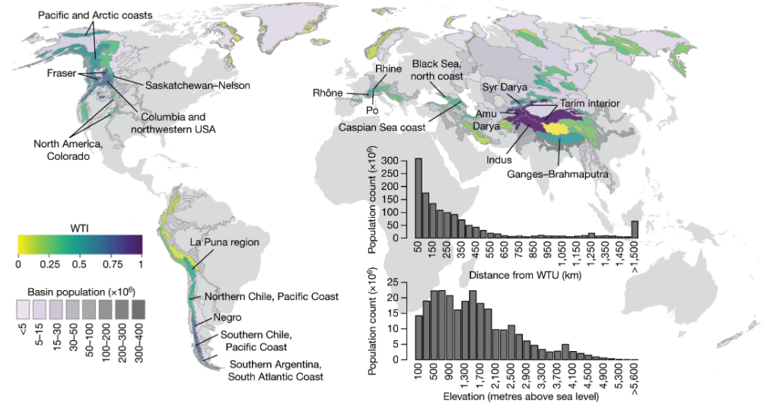
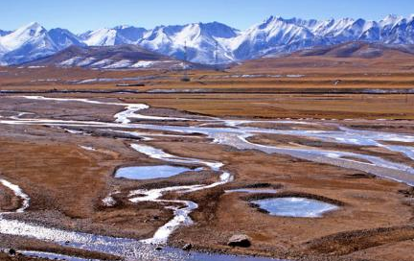

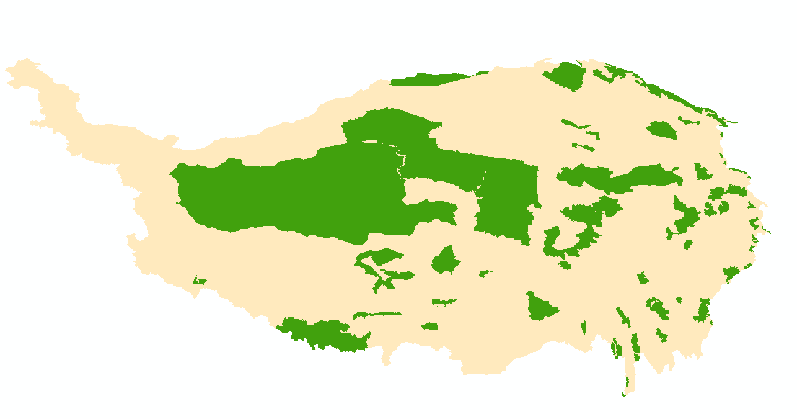
Study area
Source for several major Asian rivers such as the Yellow River, the Yangtze River to supply water for more than a billion people downstream
The Roof of the World
Ecological barrier
Asia water tower

Slide 8
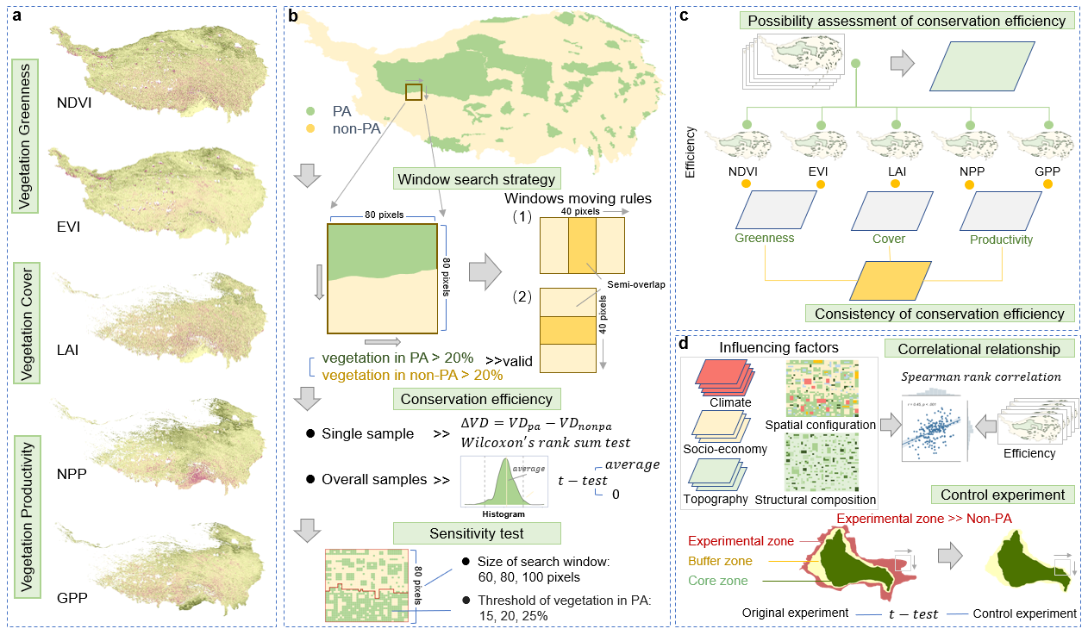
Methods
Notes:
We adopted a window search strategy (Fig. 2b) to find all available samples following Li et al., 2015, Yang et al., 2020. This method’s core idea is to reflect the conservation efficiency by comparing vegetation growth inside and outside the edges of NRs. This strategy can ensure that each pair of comparison samples is close in the distance and shares a similar climate or social-economic background.

Slide 9
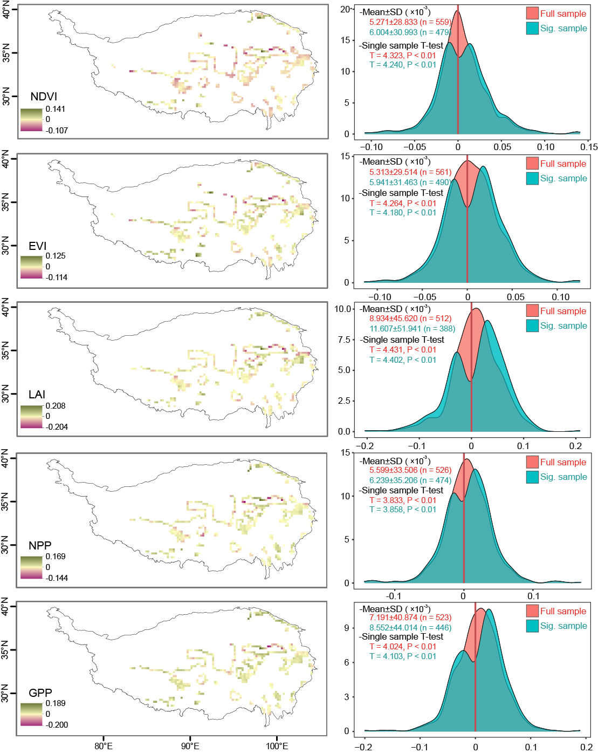
Results and Discussions
 |  | NDVI | EVI | LAI | NPP | GPP
 | 15% | 5.076** | 5.435** | 11.361** | 5.697** | 7.982**
30km | 20% | 5.267** | 5.632** | 11.598** | 5.783** | 8.018**
 | 25% | 5.693** | 5.938** | 12.034** | 5.947** | 8.310**
 | 15% | 6.024** | 5.988** | 11.953** | 5.873** | 8.241**
40km | 20% | 6.166** | 6.147** | 12.081** | 6.508** | 8.531**
 | 25% | 6.252** | 6.321** | 12.595** | 6.994** | 8.862**
 | 15% | 7.014** | 5.988** | 11.791** | 6.013** | 8.034**
50km | 20% | 6.551** | 6.301** | 11.956** | 6.218** | 8.249**
 | 25% | 7.208** | 6.575** | 12.081** | 6.547** | 8.918**
Approximately 58% of the samples have a positive effect for various vegetation indices, showing that the positive effect at the edges of PAs is evident but not prevalent
With different parameters, sensitivity tests showed a weak but significant positive effect on the five vegetation indices

Slide 10
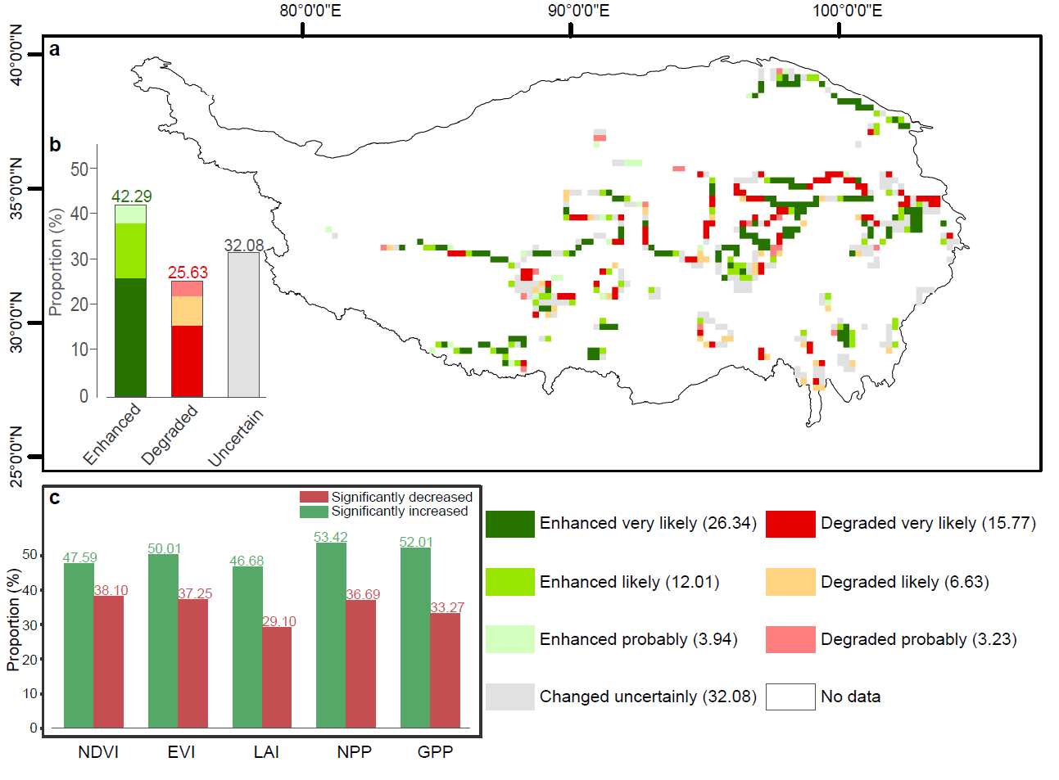
Results and Discussions
Possibility assessment of conservation efficiency
5↑
5↓
3/ 4↑
3/4↓
2↑
2↓
42.29% of the areas performed a different degree of enhancement from PAs.
As for less than 10% of the areas, PAs had the likely degraded (6.63%) or probably degraded effect (3.23%).
There was no obvious cluster pattern for the areas with different conservation possibilities

Slide 11
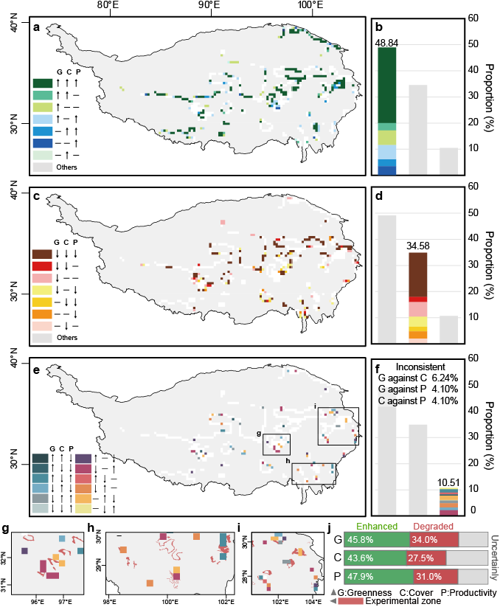
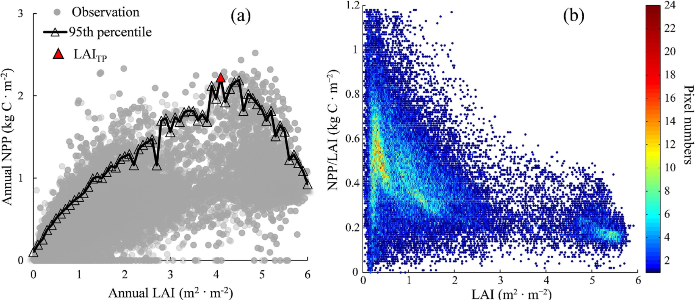
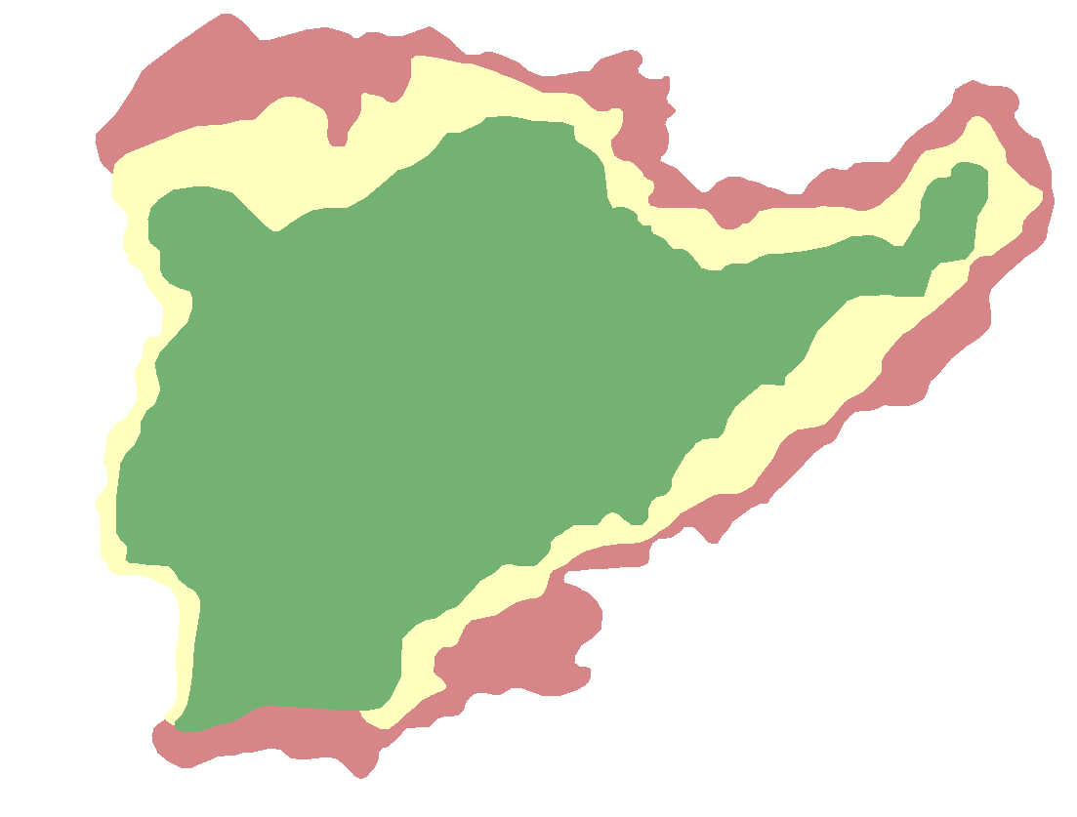
Results and Discussions
Approximately 30% (20%) of the areas exhibited a positive (negative) pattern in all aspects.
10.51% of the samples the opposite effect on vegetation greenness, cover, and productivity, partly overlapping with PAs’ experiment zones
Reasons for inconsistent efficiency in vegetation greenness, cover, and productivity
1) Vegetation growth biophysical process
self-shadowing and nutrient limitation
plant light-use efficiency and carbon-use efficiency
2) PAs’ structure
Experimental zone
Buffer zone
restorations
Core zone
Notes:
can rapidly increase the vegetation greenness or cover, while productivity might not increase simultaneously

Slide 12
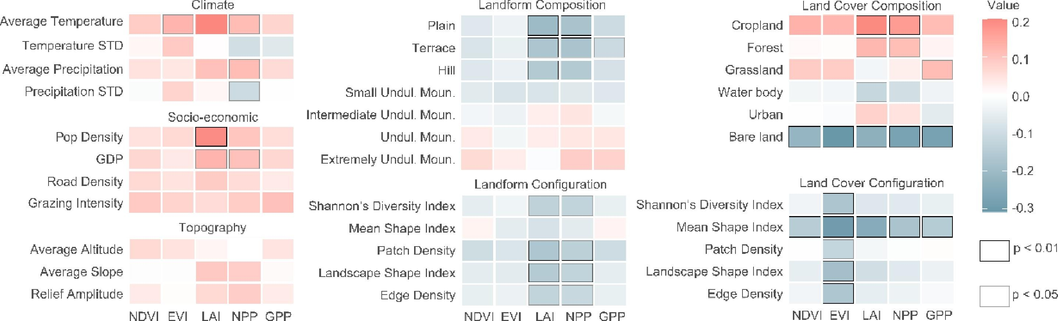
Results and Discussions
Compared to geographic background factors, the correlation between structural composition and spatial configuration of landforms and land cover, and conservation efficiency were stronger
A non-significant correlation was observed between conservation efficiency and grazing intensity. Grazing exclusion using fences also declines soil fertility, negatively affecting vegetation.

Slide 13
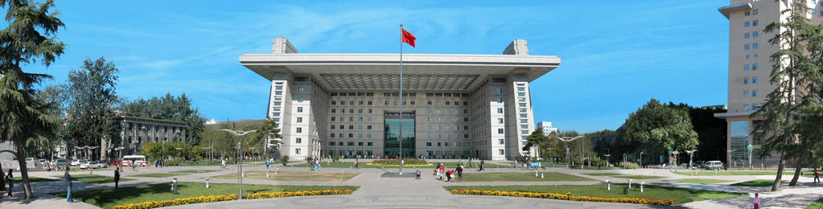
Thank you for your attention

