Slide 1


Impact of wildfires on streamflow: A case Study of Simlipal National Park, Odisha, India.
B. L. V. Prasad ⁽¹⁾ Srinivas V. V. ^{(1,2)}
1 Department of Civil Engineering, Indian institute of Science, Bangalore, India
2 Interdisciplinary Centre for Water Research (ICWaR) Indian institute of Science, Bangalore, India
Session : NH7.1 – Spatial and temporal patterns of wildfires: models, theory, and reality
Abstract : EGU22-441

Slide 2
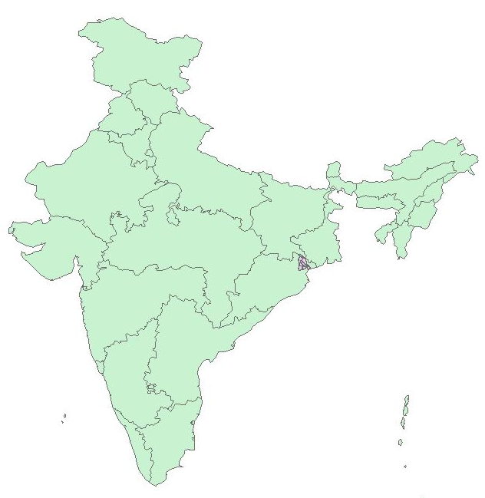
Contents:
Part-1: Forest fire risk map generation using Analytical Hierarchical Process (AHP)
Part-2: Hydrological Modelling- Calibration and validation of SWAT Model
Part-3: Simulating the model for two post wildfire scenarios (Optimistic and Non-optimistic) to analyze the change in streamflow
Study area: Similipal National Park (Budhabalanga River Basin)
Location: Mayurbhanj District of Odisha
Mean elevation 900m, Area 4500 km2,
Home to Bengal tigers and Asian elephants
Contains Similipal National Park, which experienced prolonged dry spell and below average monsoon in recent years
Forest fire has started in the last week of February 2021 and continued for around 2-3 weeks

Slide 3




Part-1: Forest fire risk map generation using Analytical Hierarchical Process (AHP)
Major causes of wildfire: Vegetation/Fuel (NDVI), Slope, Elevation, Aspect and Distance to roads
Pairwise comparison matrix
Data | Source
Elevation (24m) Distance to roads NDVI (Feb-2021) (30m) Fire point data (Feb-2021) (375m) | Cartosat-1 Diva-GIS Landsat-8 VIIRS
 | NDVI | Slope | Elevation | Distance to Roads | Aspect
NDVI | 1 | 5 | 5 | 7 | 8
Slope | 1/5 | 1 | 1 | 3 | 3
Elevation | 1/5 | 1 | 1 | 3 | 4
Distance to Roads | 1/7 | 1/3 | 1/3 | 1 | 2
Aspect | 1/8 | 1/3 | 1/4 | 1/2 | 1
Weights | 0.5677 | 0.1512 | 0.1623 | 0.0706 | 0.0483
Weights are assigned to each covariate using AHP to generate fire risk map
Relative importance of each covariate with respect to each other, is chosen by the user and a pairwise comparison matrix is generated.
Consistency of the assigned weights is checked by Consistency Index (C.I) and Consistency ratio (C.R) defined by Saaty (1990).
C.I.$=\frac{\text{λ}\text{max}\text{−1}}{n−1}$
$\text{, }\text{λ}\text{max}$ is the maximum eigen value
$C.R.=$C.I./R.I.
$\text{, }R.I$is a constant (for n=5, RI=1.12)
CI | 5.12% | <10%
CR | 5.74% | <10%

Slide 4
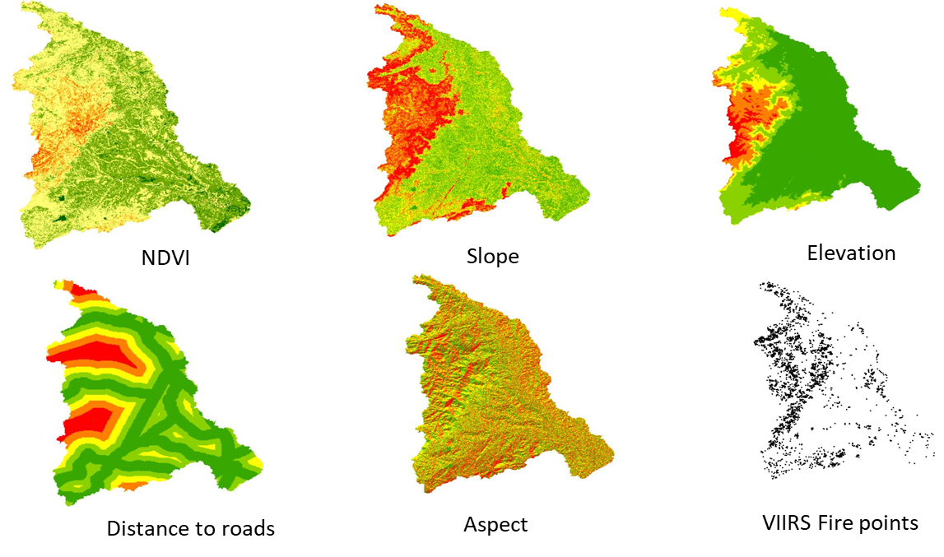
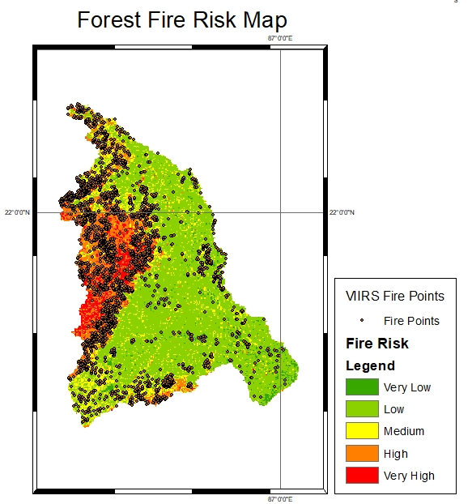

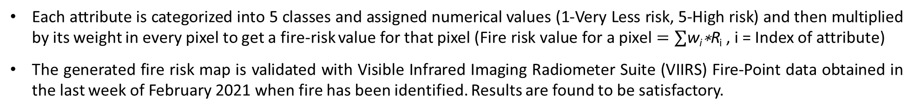
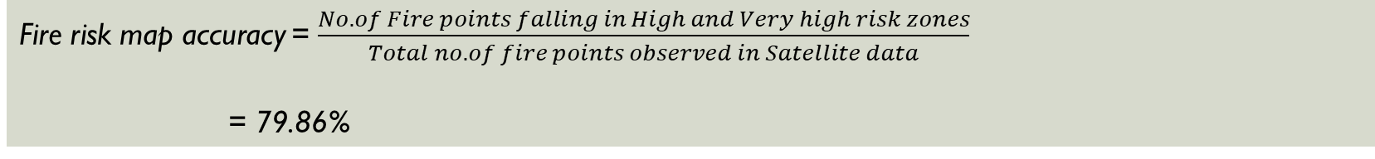
Each attribute is categorized into 5 classes and assigned numerical values (1-Very Less risk, 5-High risk) and then multiplied by its weight in every pixel to get a fire-risk value for that pixel ($\text{Fire} \text{r}\text{isk} \text{value} \text{for} \text{a} \text{pixel}=∑\text{w}\text{i}\text{∗}\text{R}$_{i} , i = Index of attribute)
The generated fire risk map is validated with Visible Infrared Imaging Radiometer Suite (VIIRS) Fire-Point data obtained in the last week of February 2021 when fire has been identified. Results are found to be satisfactory.
Fire risk (R_{i})
Individual Fire risk maps
Fire risk map accuracy = $\frac{No. of Fire points falling in High and Very high risk zones}{Total no. of fire points observed in Satellite data}$
= 79.86%

Slide 5
Part-II: Hydrological Model - Soil Water Assessment Tool (SWAT)
Physically based, semi distributed hydrologic model
SWAT Model Workflow chart
Data | Source
Digital Elevation Model (24m) Land use maps (30m) Soil data (30 arc second) Meteorological data 2000-2014 (~38km) Gauge-discharge data (@Govindpur NH-5 Station) | Cartosat-1, Bhuvan, ISRO National Remote Sensing Centre HWSD (Harmonized World Soil Data) CFSR (Climate Forecast System Reanalysis ) Indian-Water Resources Information System (IWRIS)
Land use + Soil + Slope
Input weather
Simulation, Calibration and Validation
Sensitivity Analysis
HRU creation
Model is simulated at monthly scale from 2000-2013
Important parameters are identified during Calibration
Calibration (2002-2009) and Validation (2010-2013) are performed using SWAT-CUP tool and the results are found to be satisfactory

Slide 6
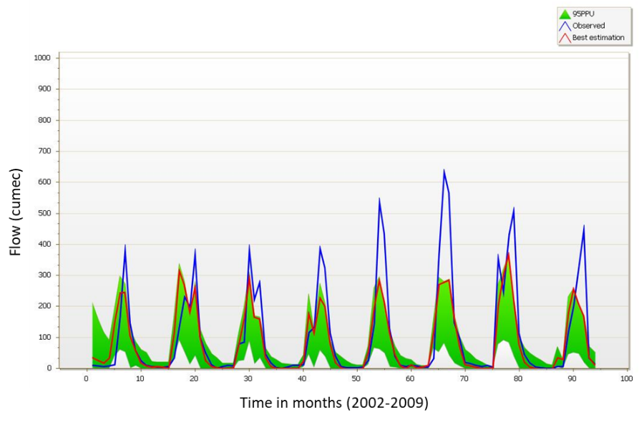
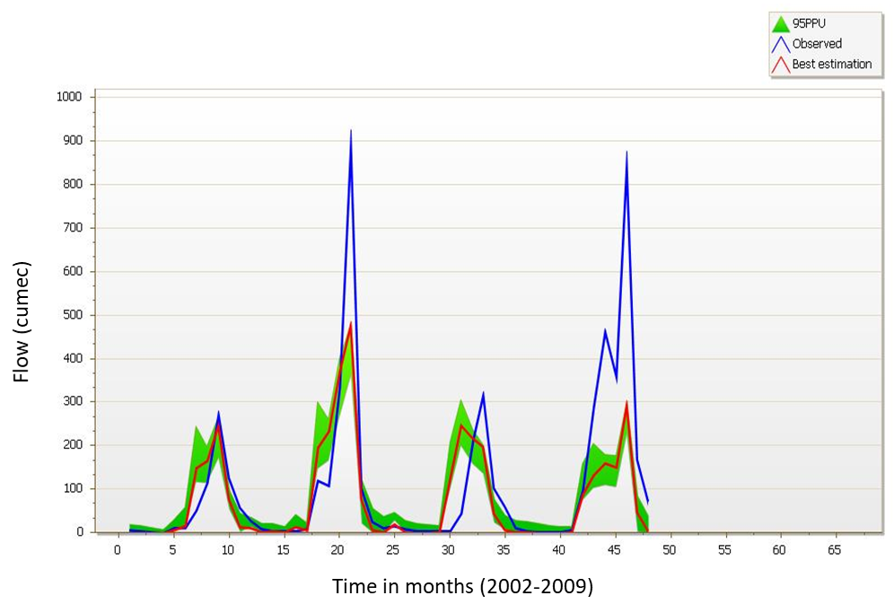
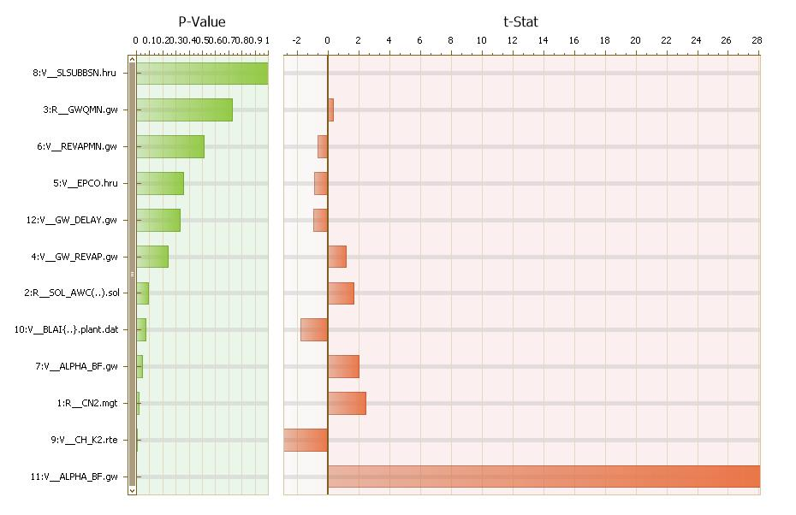
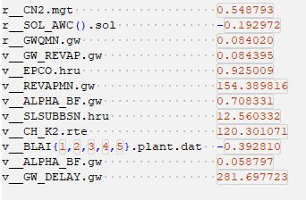
Calibration
Validation
Sensitivity Analysis
R² | 0.61
NS | 0.76
R² | 0.59
NS | 0.54
(2010-2013)
Parameters

Slide 7
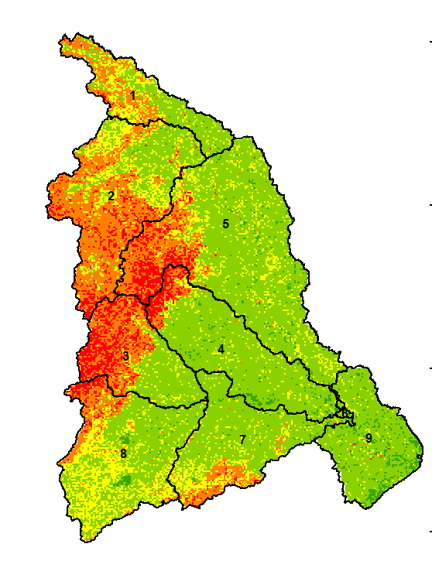
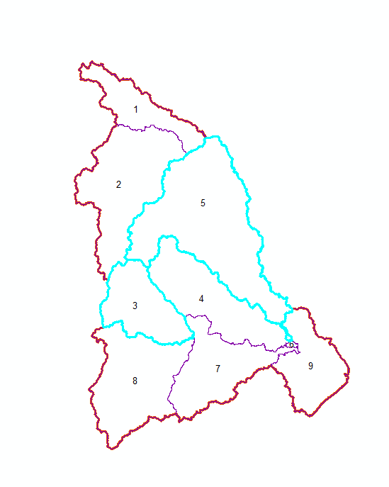
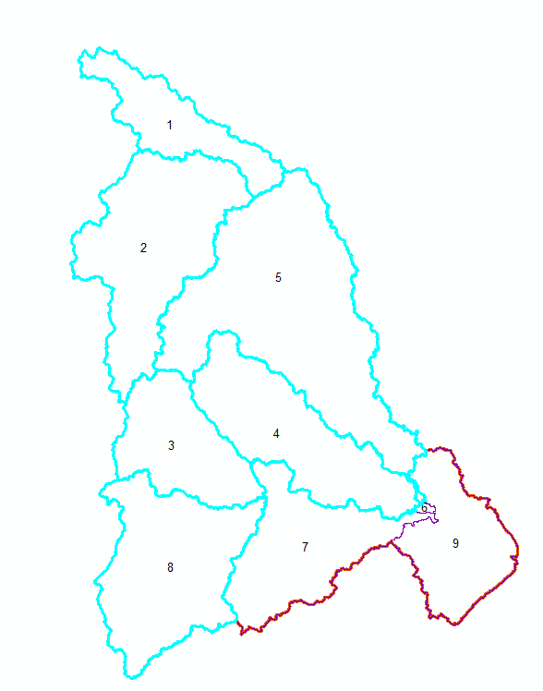
Part-III: Streamflow in post wildfire scenarios (Optimistic and Non-optimistic)
Parameter values are adjusted to represent the post wildfire conditions (eg: increasing CN2, decreasing Sol_AWC
Two post wildfire scenarios are considered
Optimistic (Parameters are changed only in subbasins with high fire risk- 3, 5)
Non-optimistic (Parameters are changed in subbasins with moderate to high fire risk- 1, 2, 3, 4, 5 and 8)
Subbasins
Optimistic
Non-optimistic
11.9%
40.5%
Increase in Mean-Annual streamflow

Slide 8
References:
Abbaspour KC. 2007. User Manual for SWAT-CUP, SWAT Calibration and Uncertainty Analysis Programs. Swiss Federal Institute of Aquatic Science and Technology, Eawag: D¨ubendorf, Switzerland
Jaiswal, Rajeev Kumar, Mukherjee, Saumitra, Raju, Kumaran D., Saxena, Rajesh, 2002. Forest Fire risk zone mapping from satellite imagery and GIS. Int. J. Appl. Earth Obs. Geoinf. 4 (1), 1–10.
K. Venkatesh, K. Preethi, H. Ramesh, Evaluating the effects of forest fire on water balance using fire susceptibility maps, Ecological Indicators, Volume 110, 2020, 105856.
Prasad, B. L. V., and Srinivas, V. V. (2021) Development of Forest Fire Risk Map for Budhabalanga River basin in India using Analytical Hierarchical Process. AGU 2021 Fall 30 meeting (Online/Virtual), 13-17 December 2021, New Orleans, LA, NH25A-0529, (https://doi.org/10.1002/essoar.10510264.1)
Saaty TL. Multicriteria decision making: the analytic hierarchy process. Pittsburgh (US): RWS Publications; 1990
Soulis, K. X. (2018). Estimation of SCS Curve Number variation following forest fires. Hydrological Sciences Journal, 63(9), 1332-1346.

Slide 9


