Slide 1






Long-term soil warming alters fine root dynamics and morphology, and their ectomycorrhizal fungal community in a temperate forest soil
Steve Kwatcho Kengdo, Derek Peršoh, Andreas Schindlbacher, Jakob Heinzle, Ye Tian, Wolfgang Wanek, Werner Borken
Contact: steve.kwatcho-kengdo@uni-bayreuth.de

Slide 2
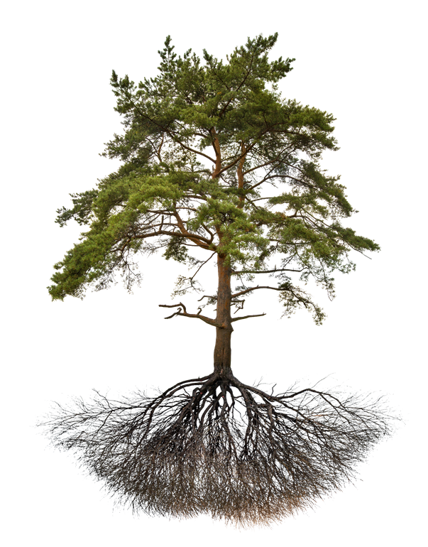
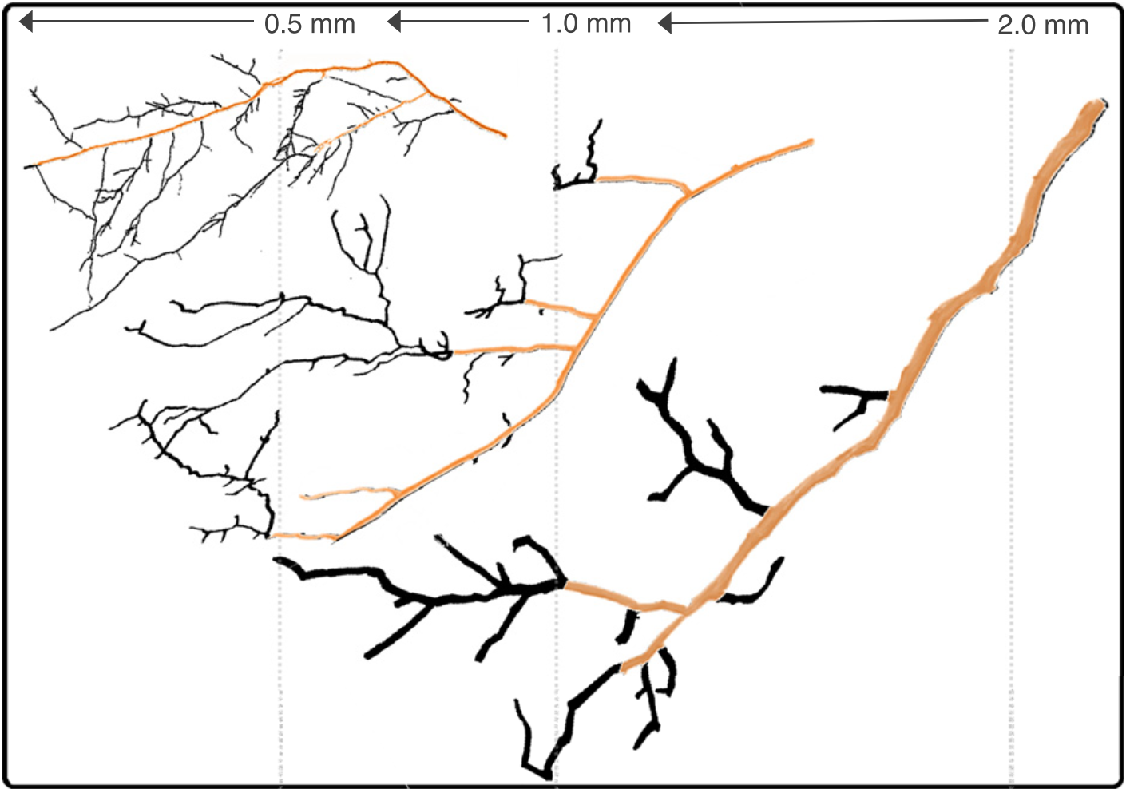
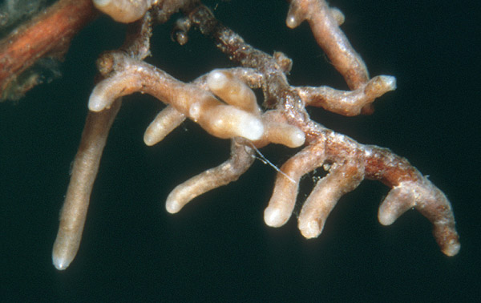
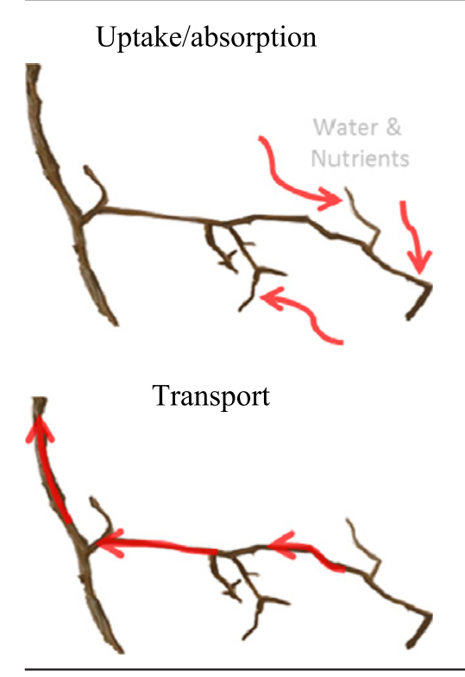
Motivation
Fine roots: Ø < 2 mm
Mc Cormack et al. 2015
© pngfuel.com
Weiss M. (1988)
Does soil warming affect the fine root system of forest trees?
Water and nutrients uptake
Mc Cormack et al. 2015

Slide 3
Hypotheses
Soil warming:
H1: increases fine root biomass
H2: increases the absorptive capacity of fine roots
H3: changes the ectomycorrhizal fungal community

Slide 4
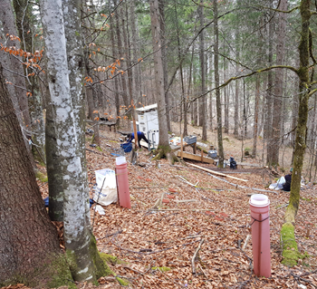
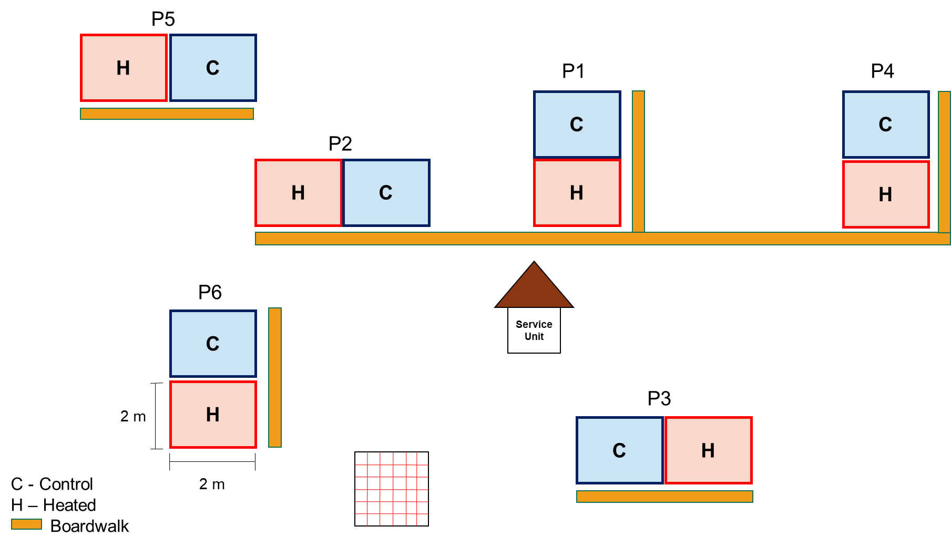
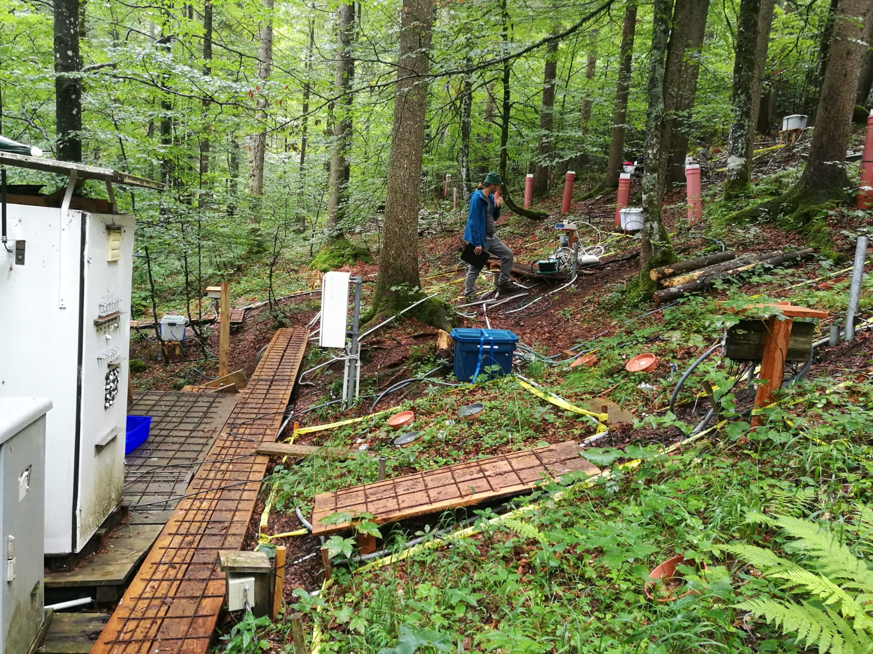
Soil warming experiment at Achenkirch, Tyrol, Austria (2004 - present)
Mixed forest stand
Rendzic Leptosol on dolomitic bedrock; 20 cm thickness
+ 4°C at 5cm soil depth during the snow-free season

Slide 5
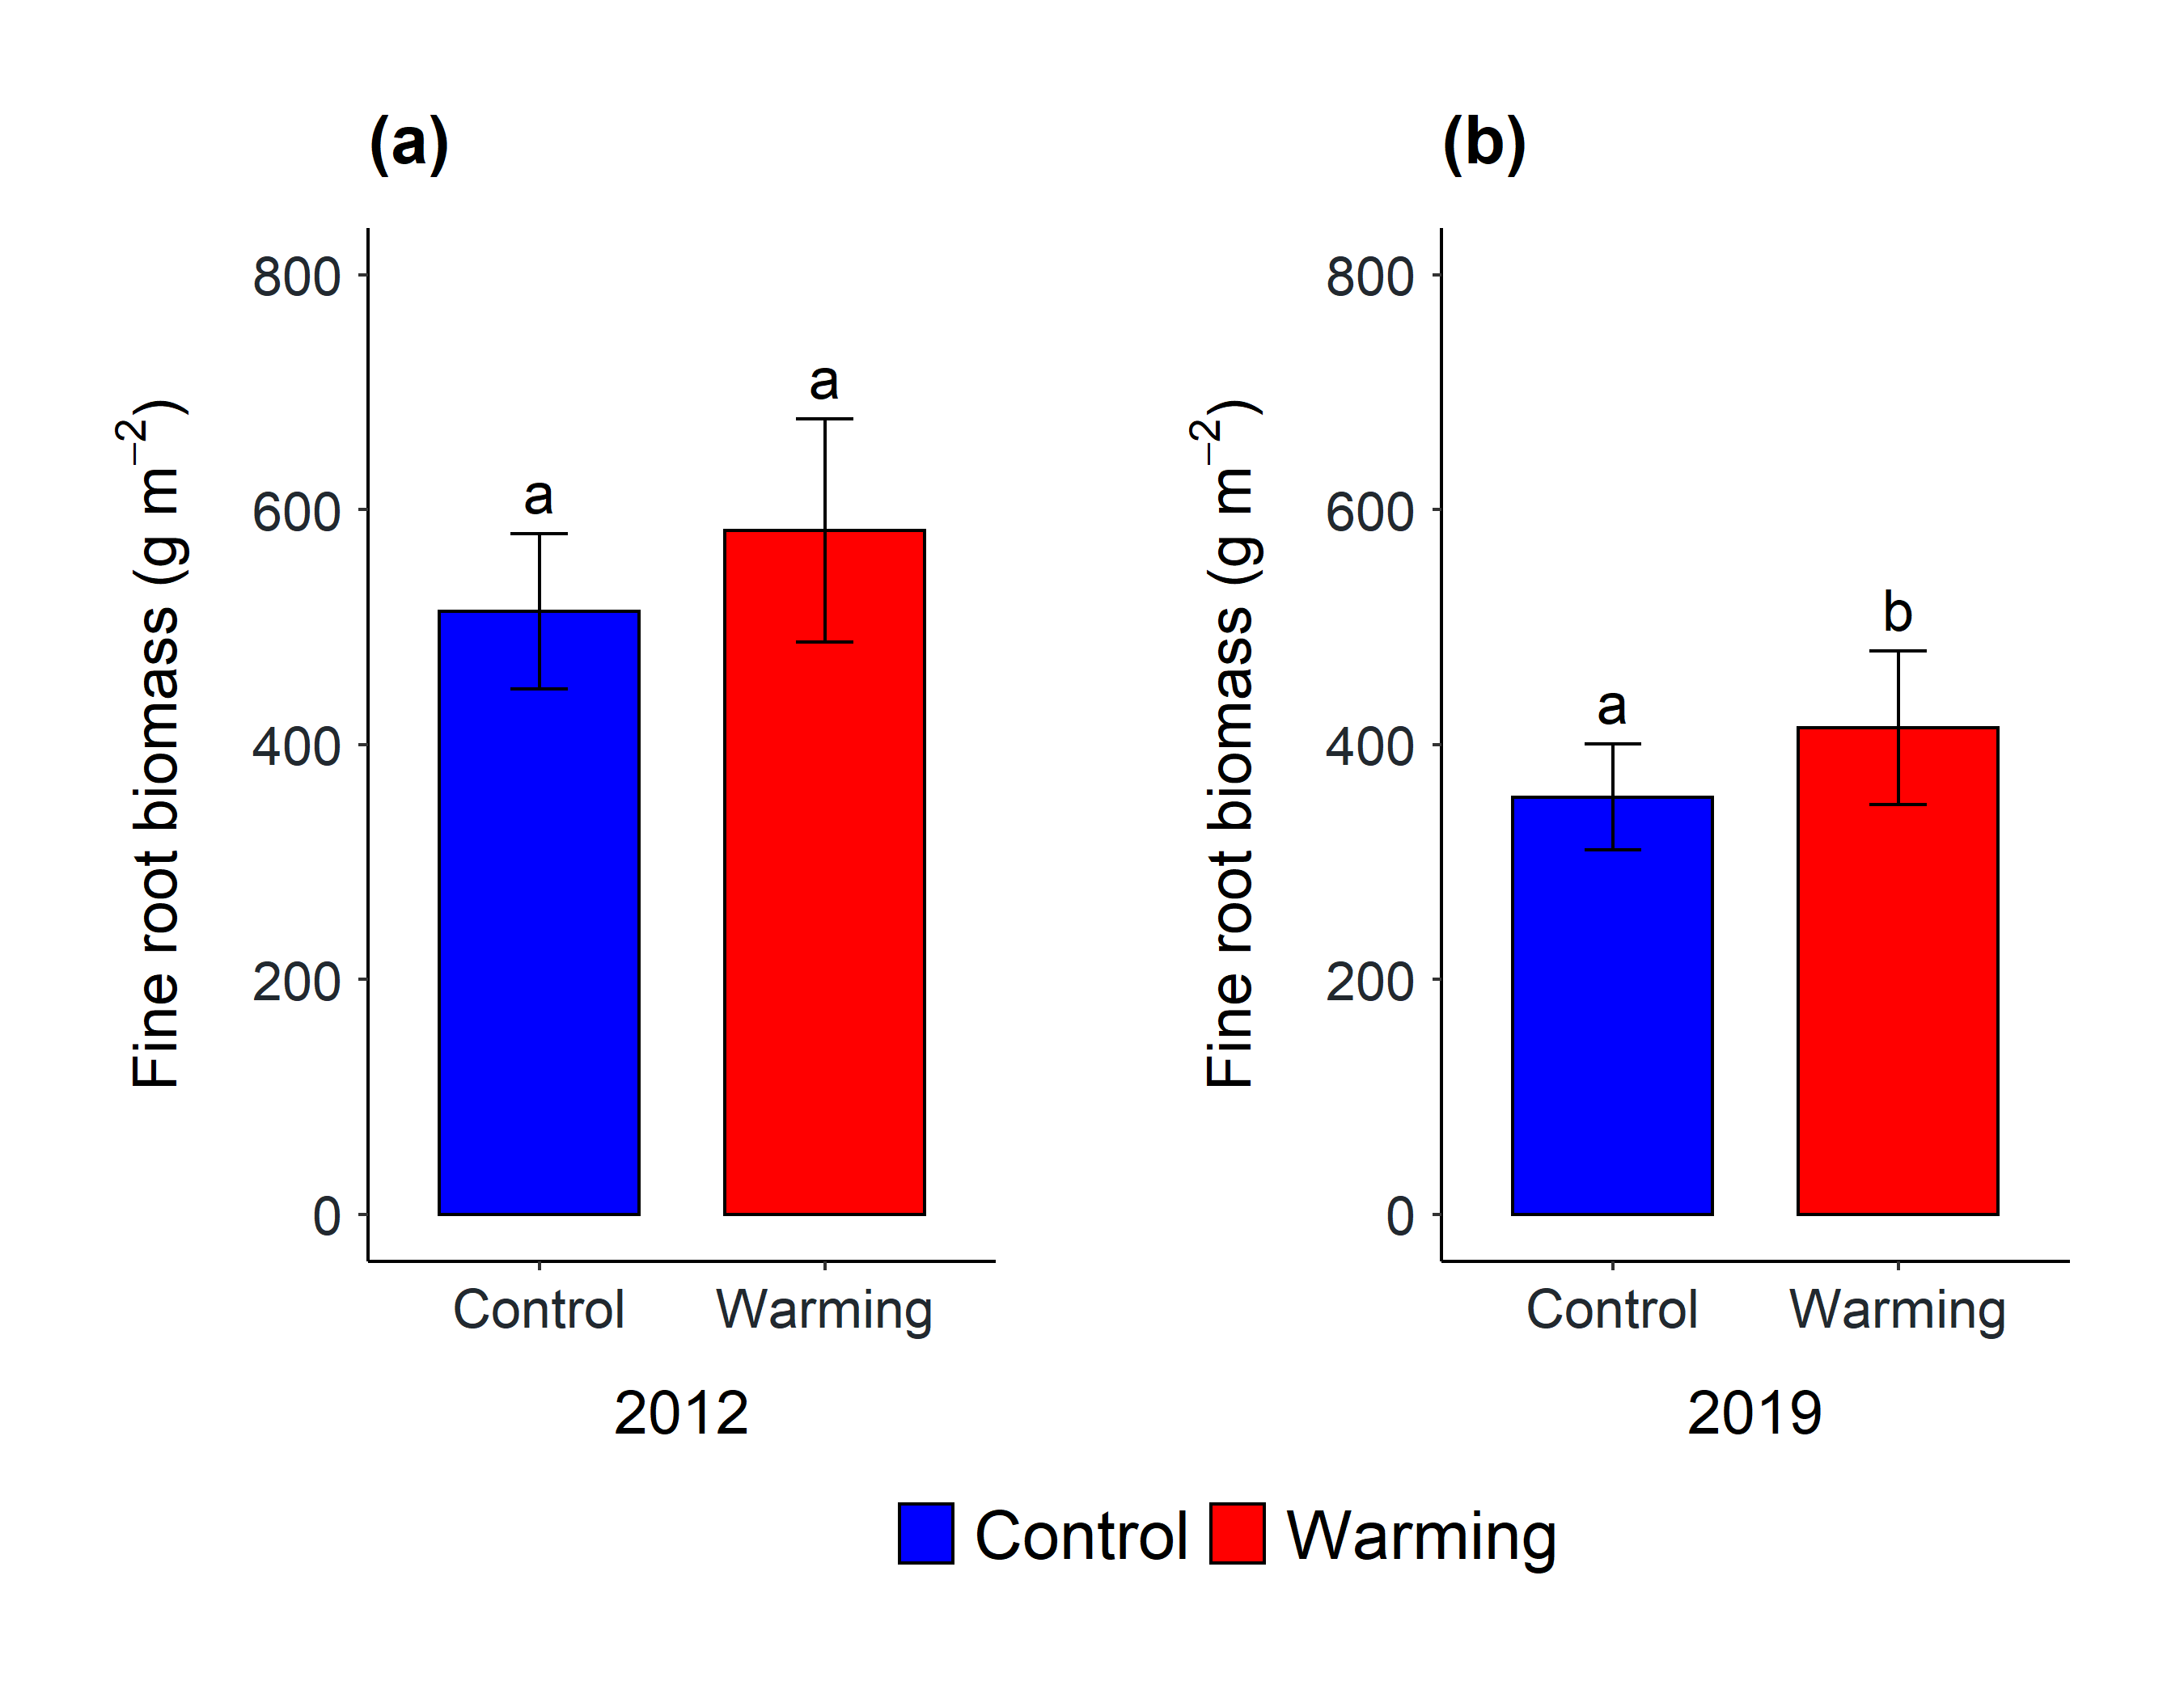
Results
1) Fine root biomass at 0 – 20 cm soil depth
+ 13%
+ 17%
Increasing fine root biomass indicates greater plant below-ground C allocation

Slide 6
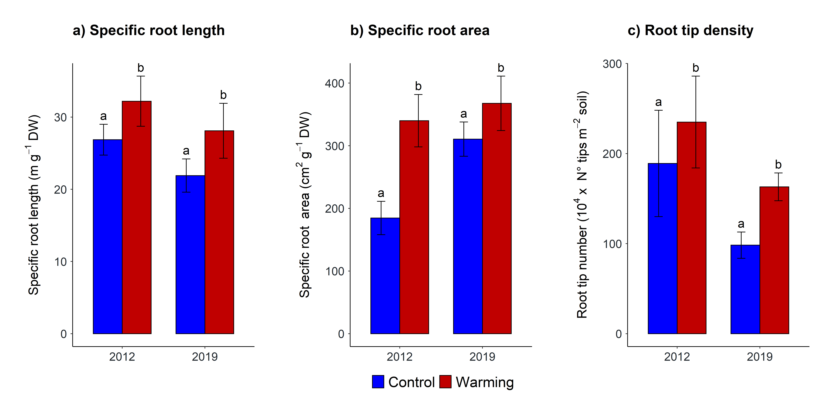
2) Fine root morphological traits at 0 – 20 cm soil depth
Increase in absorptive surface of root systems

Slide 7
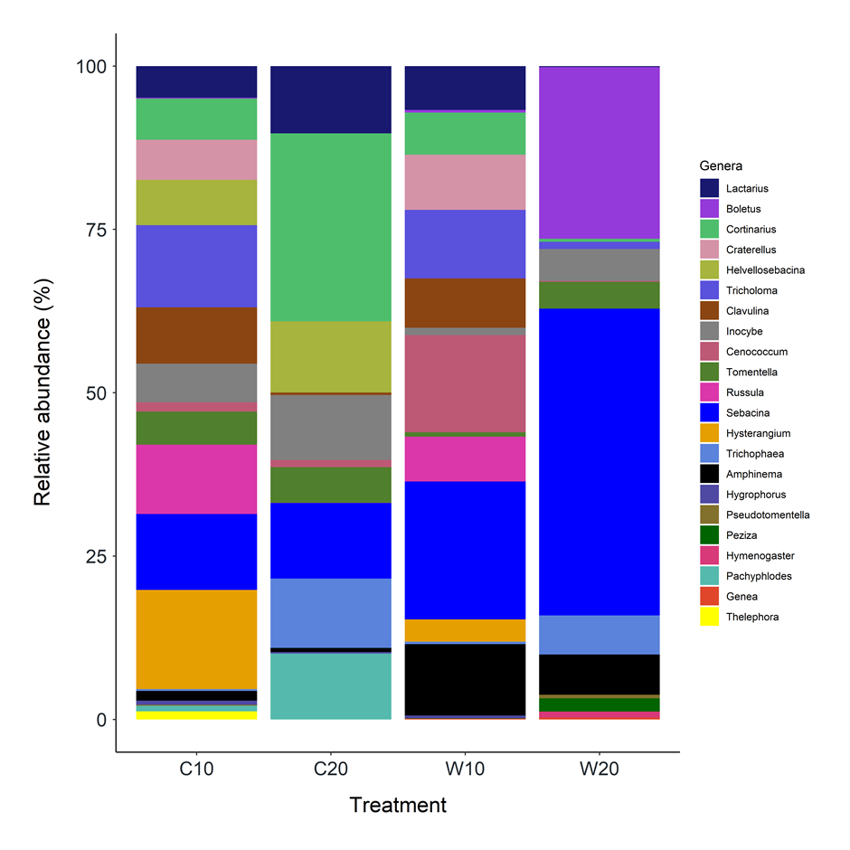
3) EcM community at 0 – 10 and 10 – 20 cm soil depth
Soil warming changed the EcM community composition
No effects on EcM exploration types and diversity
Control
0 – 10 cm
Control
10 – 2 0 cm
Warming
0 – 10 cm
Warming
10 – 20 cm

Slide 8
Conclusion
Global warming:
increases soil carbon input due to increased fine root production
improves nutrient foraging through changes in fine root morphology

Slide 9
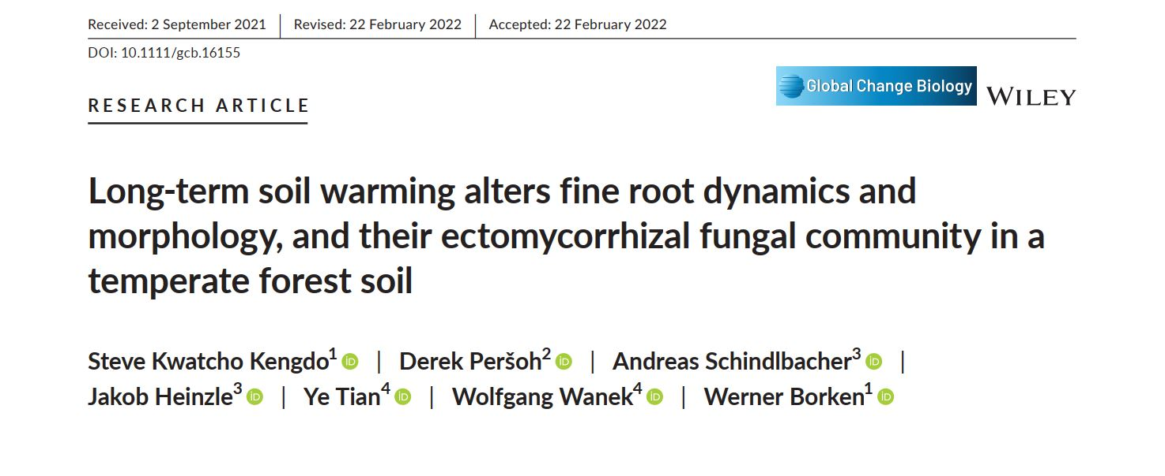
More details…
Contact: steve.kwatcho-kengdo@uni-bayreuth.de

