Slide 1
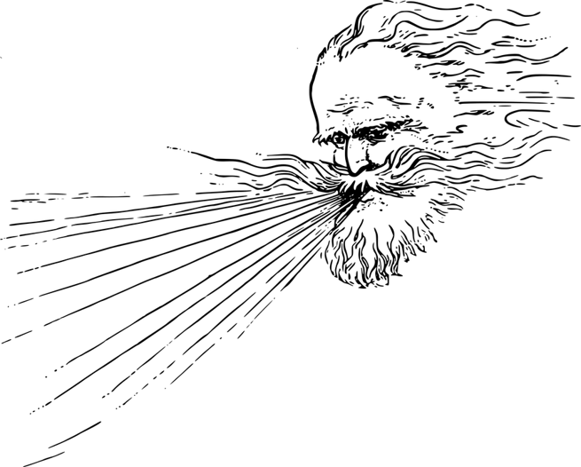



Wind Generates Seismic Noise at Sos Enattos
Josiah Ensing
Notes:
Good morning/afternoon.
My name is Josiah Ensing.
I work at AstroCeNT in Poland
I recently completed a work exchange at GSSI, l'Aquila looking into wind and seismic noise at Sos Enattos

Slide 2
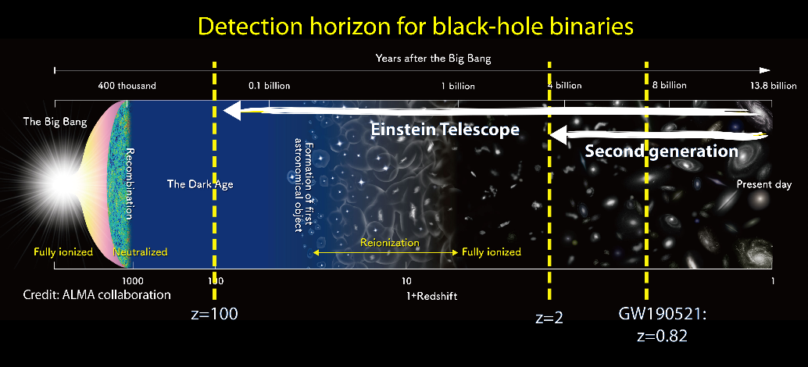
Einstein Telescope
A proposed underground 3rd-generation, gravitational-wave observatory.
Notes:
Wind can move buildings and trees
Door slamming
Wind can excite structures at their resonant frequencies
Wind can couple with the ground
With trees and buildings of different heights and geometries, wind can generate vibrations at a range of frequencies.

Slide 3
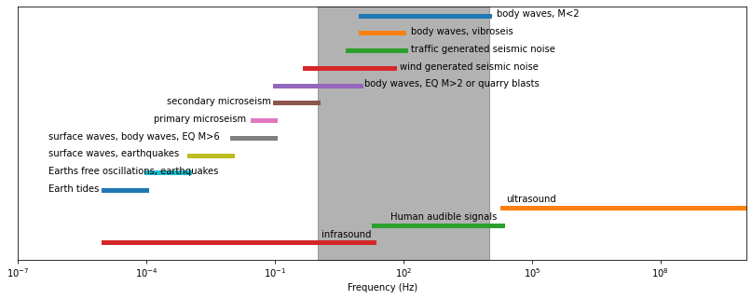
Seismic Noise
Increasing sensitivity will require the suppression of various noise sources.
Seismic waves will be one of these noise sources.
Notes:
Wind can move buildings and trees
Door slamming
Wind can excite structures at their resonant frequencies
Wind can couple with the ground
With trees and buildings of different heights and geometries, wind can generate vibrations at a range of frequencies.

Slide 4
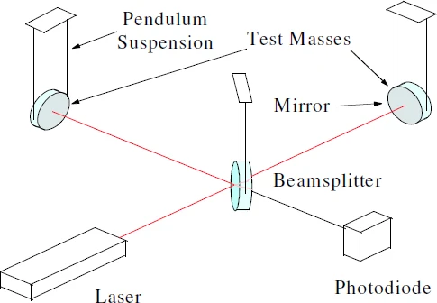
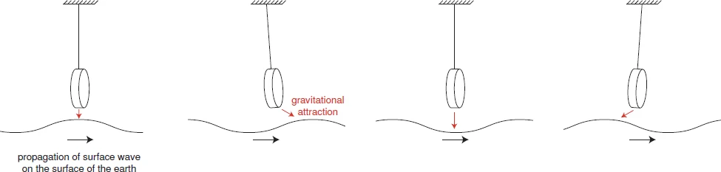
Newtonian Noise
Result of density fluctuations of the surrounding geology.
Density fluctuations occur when the ground is displaced by seismic waves
Unaffected by seismic isolation
Figures from Pitkin et al. (2011)
Notes:
Wind can move buildings and trees
Door slamming
Wind can excite structures at their resonant frequencies
Wind can couple with the ground
With trees and buildings of different heights and geometries, wind can generate vibrations at a range of frequencies.

Slide 5



Data
WInd and Seismic Noise
June 2020 - March 2021
Wind speed and direction recorded every 30 minutes
Three trilliums SOE0 (240s, at the surface), SOE1 (120 Horizon, 86~m below surface), and SOE2 (240s, 111~m below surface).
324 days for the surface seismometer
Wind can generate seismic noise by moving
Water
Trees
Buildings
Bridges
The ground itself.
Etc.

Slide 6
Sos Enattos, Sardinia

Slide 7
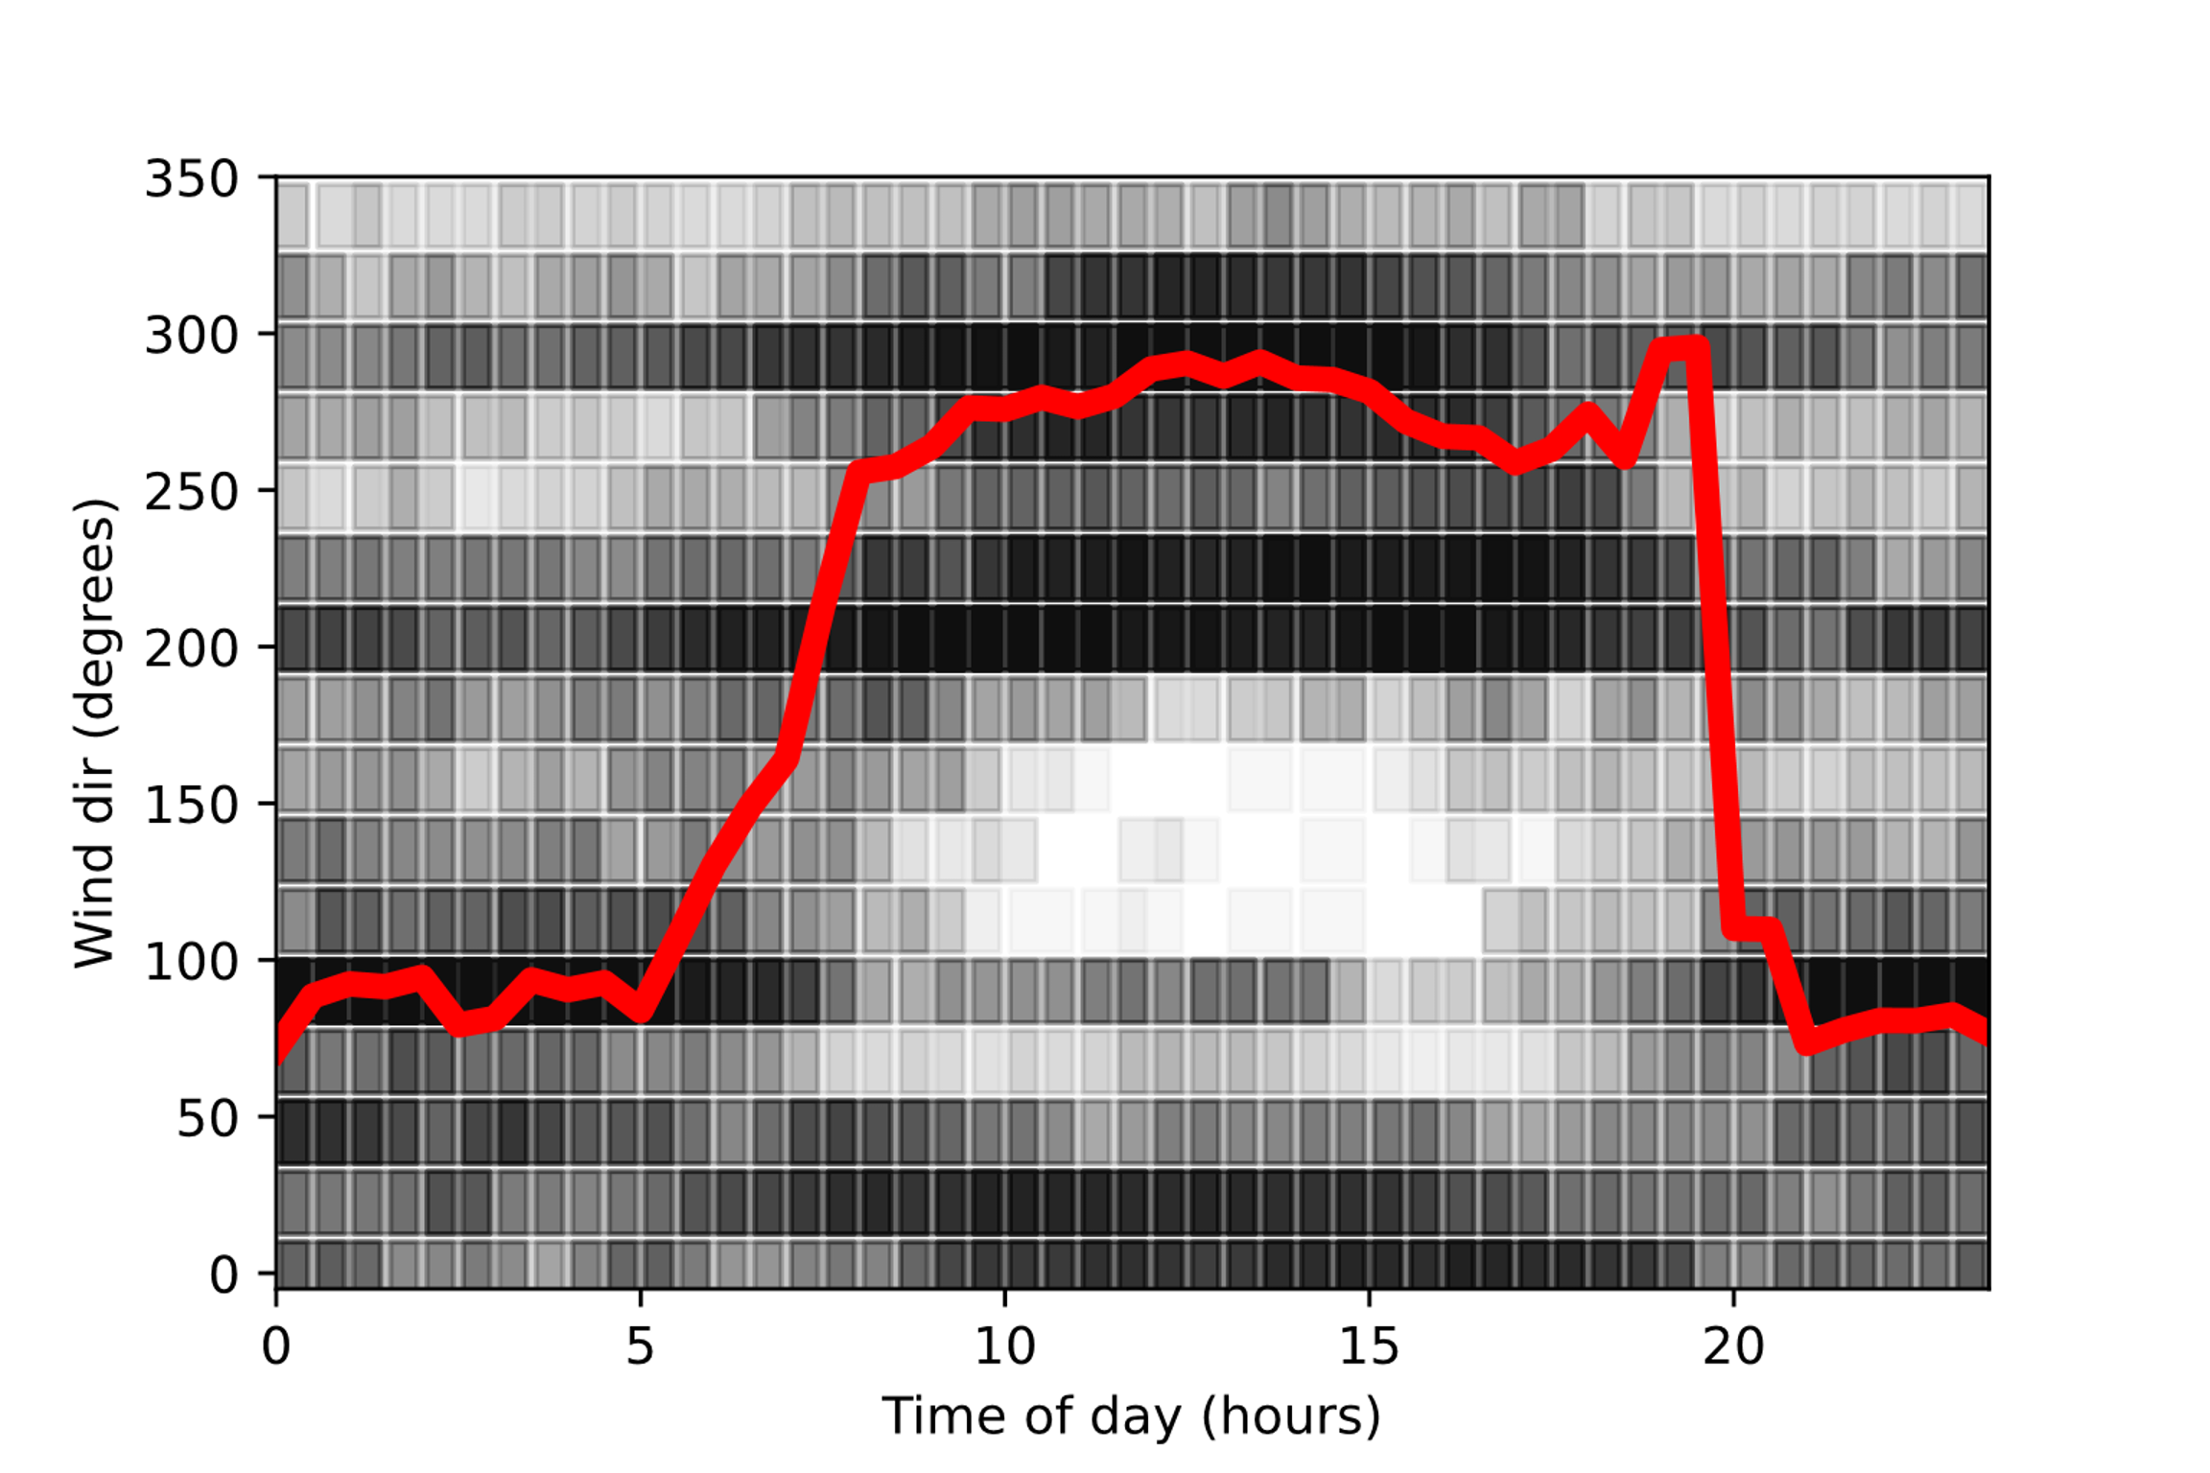
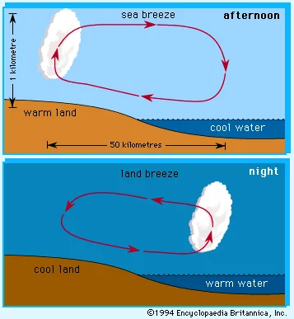
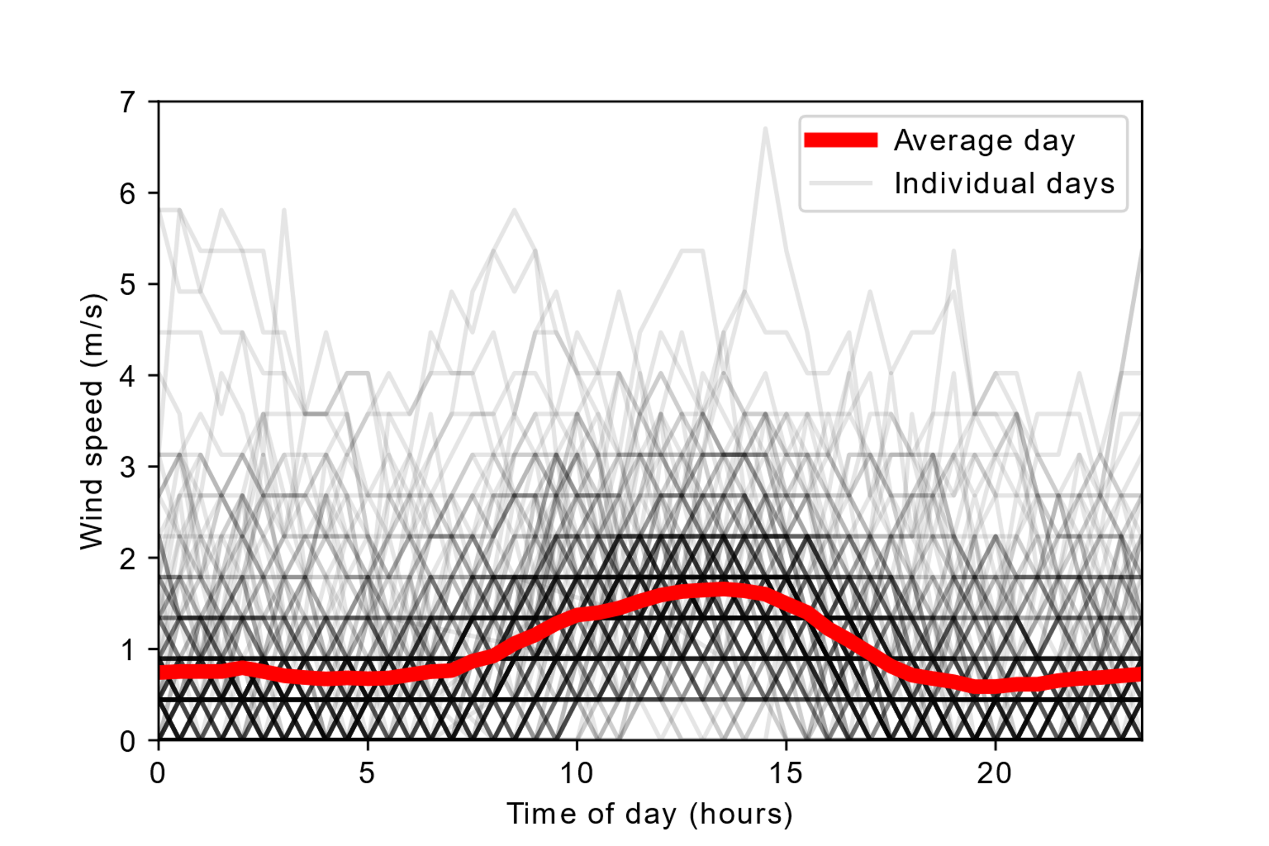
Diurnal WInd

Slide 8
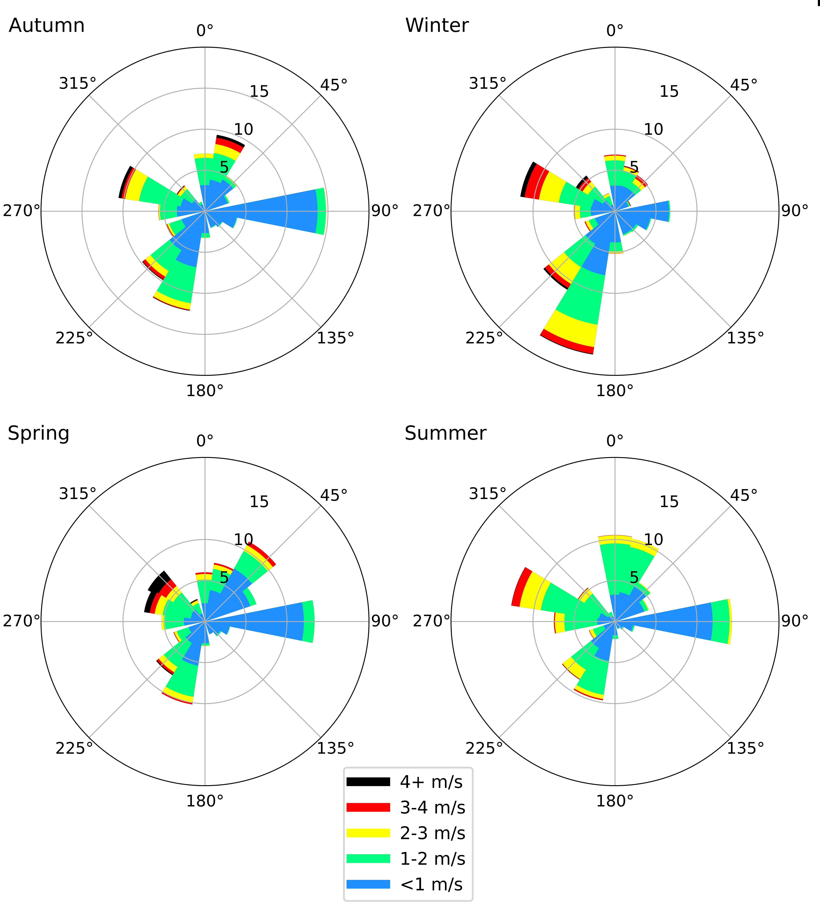
Seasonal WInd
The strongest winds occurred most often in spring or winter.
No wind speeds above 4m/s occurred during Summer.
Gentle night land-breezes occur least frequently and weakest in winter.
Notes:
Higher wind speeds tend to occur between

Slide 9
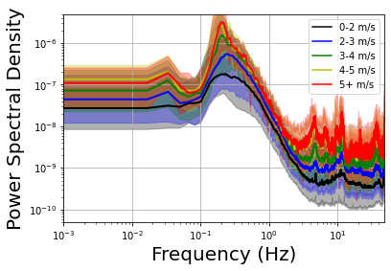
Probablistic Power Spectral Density
SOE0 (surface)
Higher wind speeds increase seismic noise across a broad range of frequencies
m²s⁻²/Hz

Slide 10
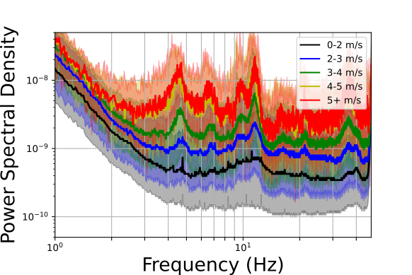
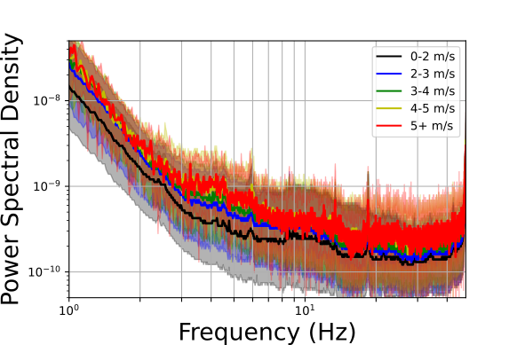
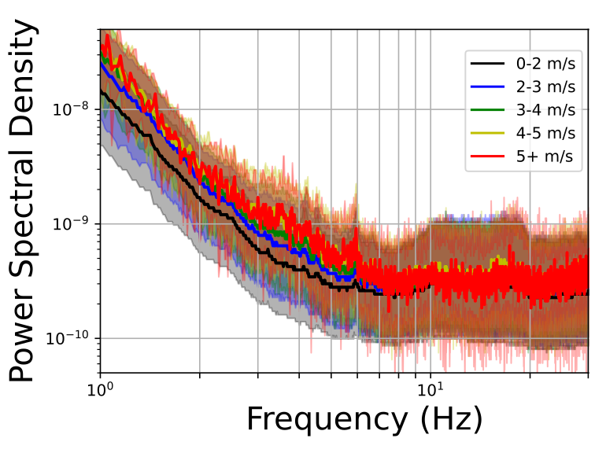
Probablistic Power Spectral Density
Amplitude decreases with depth (esp. at high-f)
ET will be built 100-200m underground
Local wind generated seismic noise will be low
SOE0 (surface)
SOE1 (86m below surface)
SOE2 (111m below surface)

Slide 11

Thank you for listening
Josiah Ensing

