Slide 1






Identifying the influence of reservoirs on the flow regime across Great Britain
Saskia Salwey ¹
G. Coxon ^{1,3}, F. Pianosi ^{2,3}, M. Singer ⁴, C. Hutton ⁵
¹ School of Geographical Sciences, University of Bristol, Bristol, United Kingdom
² Department of Civil Engineering, University of Bristol, Bristol United Kingdom
³ Cabot Institute, University of Bristol, Bristol, United Kingdom
⁴ School of Earth and Environmental Sciences, Cardiff University, Cardiff, United Kingdom
⁵ Wessex Water Services Ltd, Bath, United Kingdom
saskia.salwey@bristol.ac.uk

Slide 2
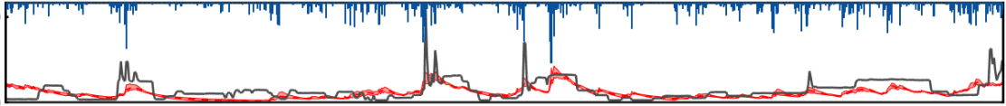
Reservoirs are key drivers of flow alteration
Indicators of Hydrologic Alteration (IHA)
Many metrics and techniques have been used to quantify and characterize the influence of reservoirs on the flow regime
Paired Catchment Analysis
Model Based Studies
Most pre-existing research has high data requirements and is usually applied on small scales
We seek to understand the influence of reservoirs on the flow regime at a large-scale across Great Britain
Coxon et al. (2019)
30
0
Discharge (mm/day)
Precipitation (mm/day)
Observed Flow
Simulated Flow
60
0
saskia.salwey@bristol.ac.uk
Notes:
In reservoir catchments, simulated flow is often unable to recreate observed timeseries where models miss vital aspects of streamflow behaviour
To overcome this, in this study… such that we can inform the development of hydrological models contribute to advancing national-scale water resource management

Slide 3
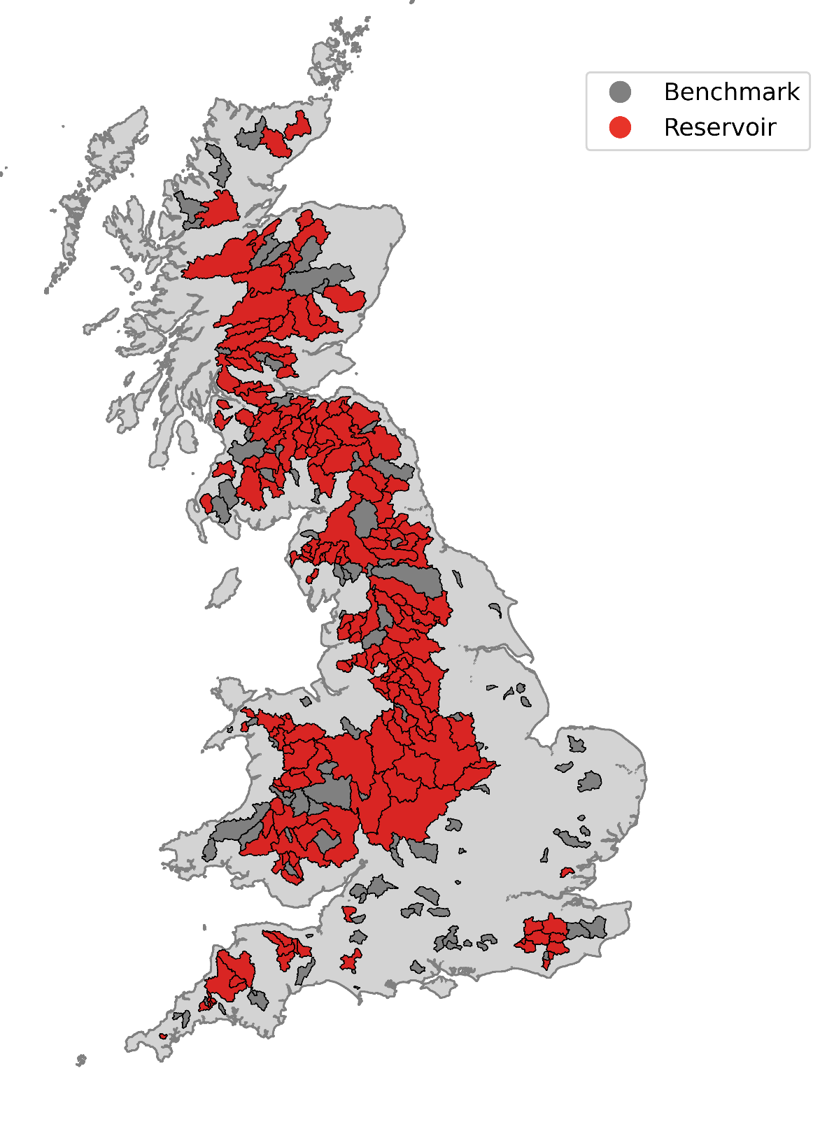
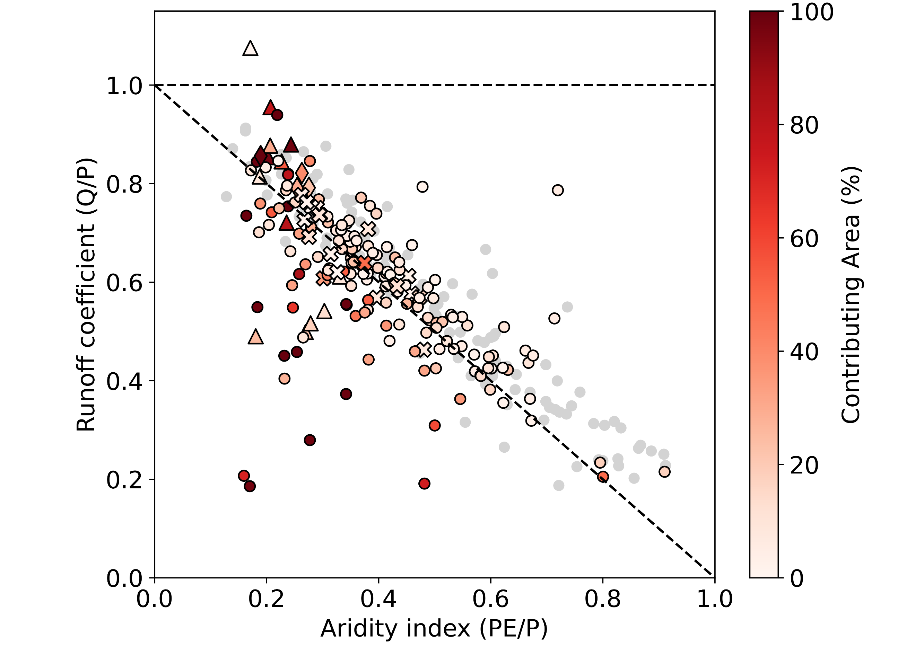
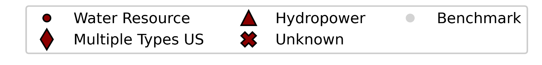
Hydrological signatures can infer upstream reservoir operation from downstream flow
Benchmark (111)
Reservoir (186)
Water Balance Surplus
Water Balance Deficit
saskia.salwey@bristol.ac.uk
Notes:
Signatures are designed to capture the full range of reservoir impacts, and have the capability to diagnose upstream operational rules
To demonstrate this, on the right you see a plot detailed the water balance signature. Here we link US abstraction to deficits in the WB

Slide 4
Hydrological signatures can infer upstream reservoir operation from downstream flow
Benchmark (111)
Reservoir (186)
Water Balance Surplus
0.5
-0.6
Water Balance Deficit
saskia.salwey@bristol.ac.uk
Notes:
Quantifying the signature by calculating the deviation in the runoff coefficient from a closed water balance

Slide 5
Hydrological signatures can infer upstream reservoir operation from downstream flow
Benchmark (111)
Reservoir (186)
Water Balance Surplus
Threshold
Water Balance Deficit
saskia.salwey@bristol.ac.uk
Notes:
For each signature we define thresholds based on benchmark variability which help to identify which catchments are experiencing significant flow alteration

Slide 6
Hydrological signatures can infer upstream reservoir operation from downstream flow
Benchmark (111)
Reservoir (186)
Water Balance Surplus
Threshold
Water Balance Deficit
saskia.salwey@bristol.ac.uk
Notes:
Throughout the study we also use 2 catchment descriptors to describe reservoir catchments
You can see here that abstractions are leading to large deficits in the WB, particularly in catchments with high contributing area.

Slide 7
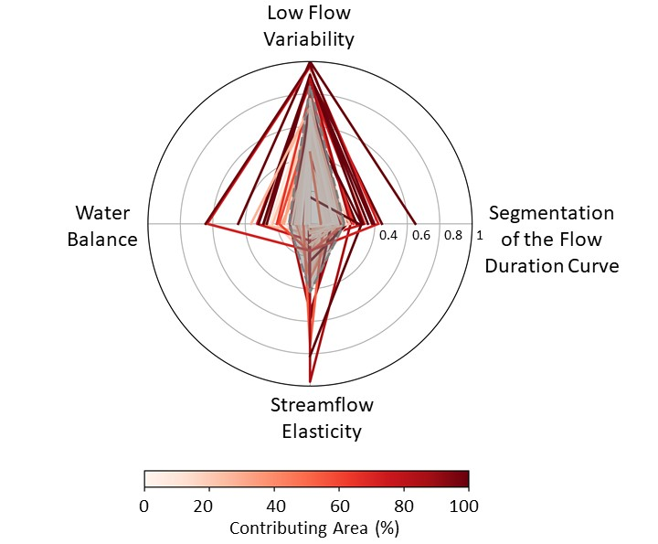
A large-scale assessment highlights where and how reservoirs are impacting the flow regime in Great Britain
Catchment descriptors can be used to explain and predict the magnitude of flow alteration
The diagnostic component of signatures can help define and evaluate reservoir functions
By application in Great Britain we have demonstrated the feasibility of using hydrological signatures for evaluating reservoir impact at a large scale
Thank you for listening ☺
saskia.salwey@bristol.ac.uk
Notes:
For all 4 signatures, we find higher values associated with those catchments with higher contributing area, suggesting that the descriptor can be used to explain and predict the magnitude of flow alteration.
As well as the impacts of abstractions on the WB, we also see the significant influence of compensation flow and pre-defined releases on the low flow regime and flow duration curve
We hope that the diagnostic component of these signatures can help define and evaluate reservoir functions

