Slide 1

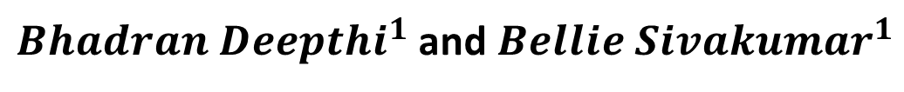
Complexity of rainfall dynamics in India in the context of climate change
${Bhadran Deepthi}^{1}$ and${ Bellie Sivakumar}^{1}$
$$1_{\text{Department} \text{of} \text{Civil} \text{Engineering}\text{, }\text{Indian} \text{Institute} \text{of} \text{Technology} \text{Bombay}\text{, }\text{India} }$$

Slide 2
Objectives
Overall Objective
  To determine the temporal dynamic complexity of monthly historical and future rainfall in India at a spatial resolution of 1º × 1º.
Specific Objectives
  To use the false nearest neighbor (FNN) algorithm to determine the complexity of historical and future rainfall in India
  To determine how the complexity varies across different shared socio-economic pathway scenarios (SSPs)
  To determine how the complexity varies across two different time frames (near future (2022–2060) and far future (2061–2099))

Slide 3
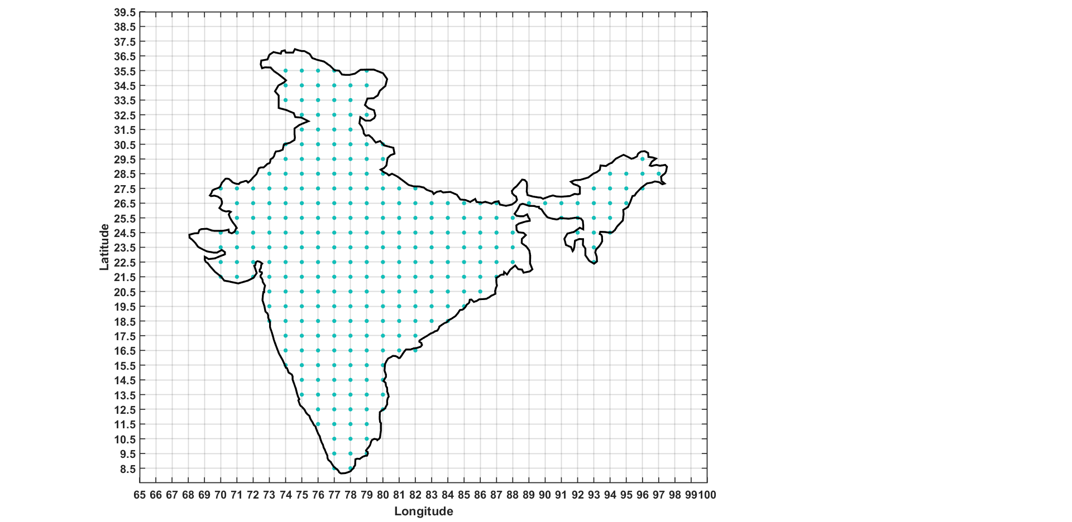
Study Area and Data Used
India
Latitude - 8°4’ North to 37°6’ North
Longitude - 68°7’ East to 97°25’ East
27 CMIP6 GCMs
Monthly simulated historical rainfall data (1961-2014)
Future rainfall data under SSP126, SSP245, SSP370, and SSP585 (2022-2099)
Bilinear interpolation technique
Resolution- 1° × 1°
288 grid points
Figure 1: Study area showing grid points

Slide 4
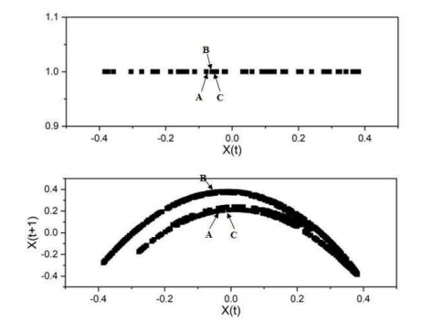
False Nearest Neighbor Method (FNN)
False Nearest Neighbor Method (FNN)
Algorithm introduced by Kennel et al. in 1992
Principle - Two vectors which are near to each other (neighbors) in a phase space of optimum dimension should remain neighbors even when the dimension is increased
Optimum dimension - percentage of FNN falls to zero
Figure 2: Phase space of Henon data for dimensions 1 and 2

Slide 5
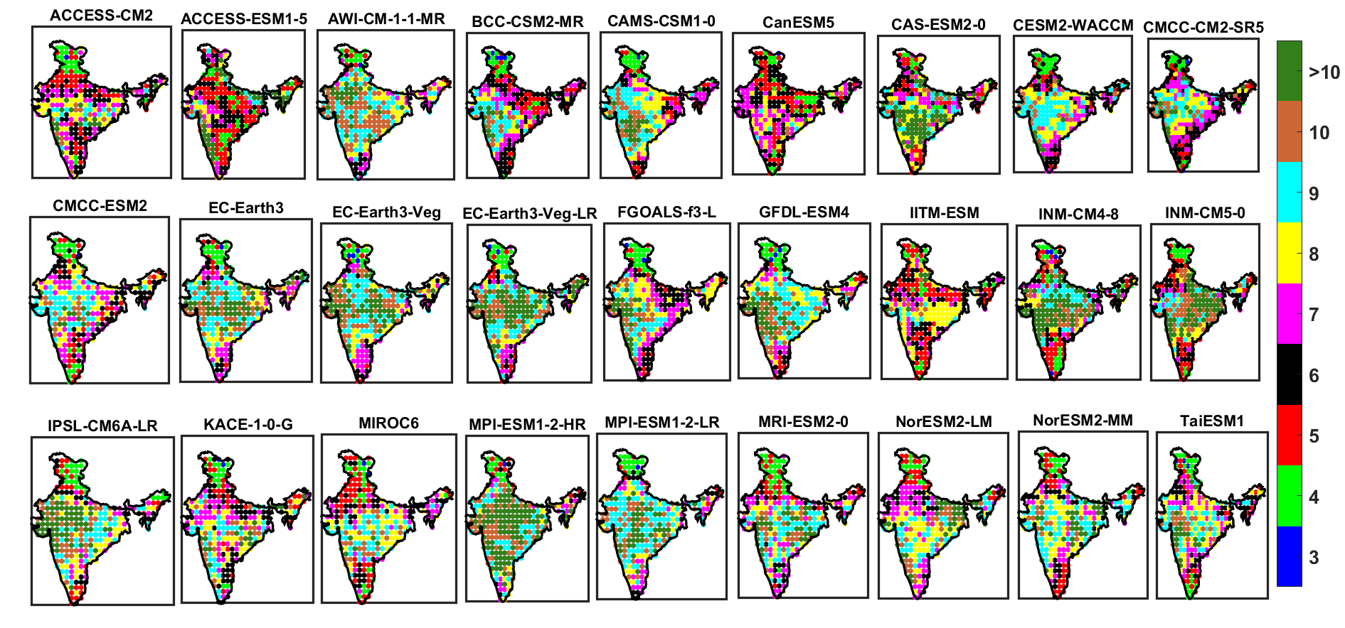
Results
Figure 3: FNN dimension of historical Rainfall simulated from 27 GCMs (1961-2014)

Slide 6
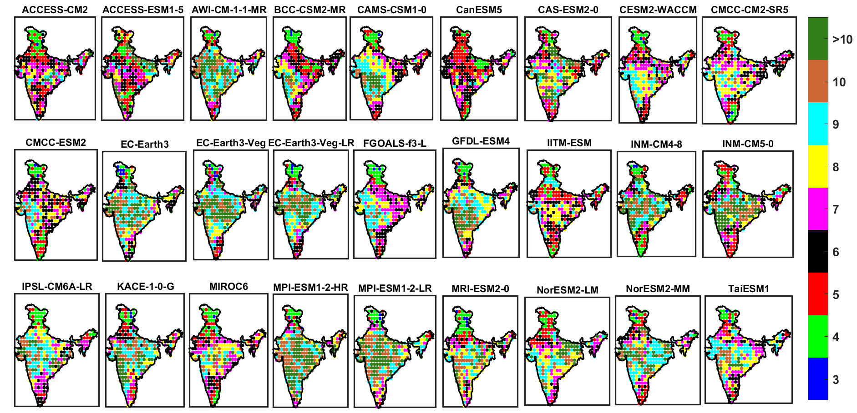
Results for different SSP scenarios
Figure 4: FNN dimension of future rainfall from 27 GCMS under SSP 126 scenario (2022-2060)

Slide 7
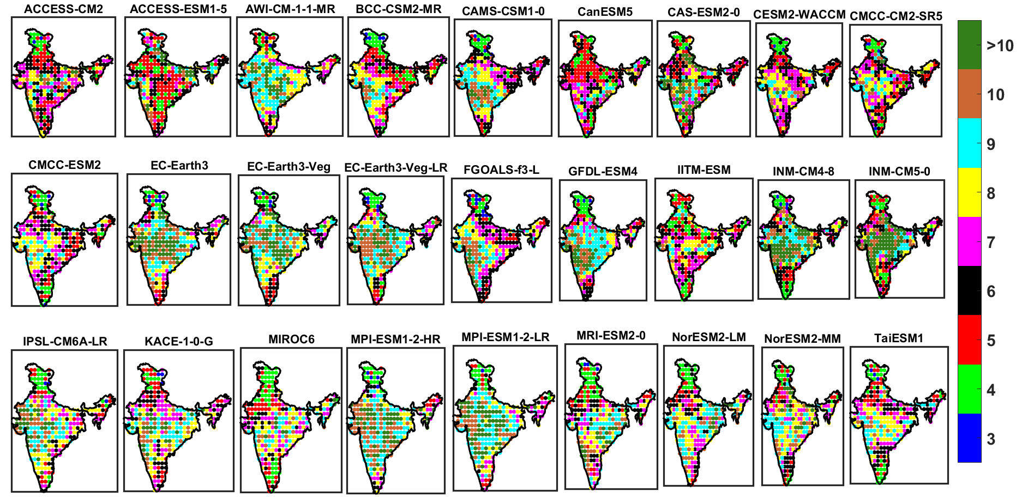
Results for different time frames
Figure 5: FNN dimension of future rainfall from 27 GCMs under SSP 126 scenario (2061-2099)

Slide 8
Table 1: Number of grids in which GCMs have a particular FNN dimension
Time Frame | 2022-2060 |  |  |  |  |  |  |  | 2061-2099
SSP Scenarios | SSP 126 |  | SSP 245 |  | SSP 370 |  | SSP 585 |  | SSP 126 |  | SSP 245 |  | SSP 370 |  | SSP 585
FNN Dimension | <= 10 | > 10 | <= 10 | > 10 | <= 10 | > 10 | <= 10 | > 10 | <= 10 | > 10 | <= 10 | > 10 | <= 10 | > 10 | <= 10 | > 10
ACCESS-CM2 | 274 | 14 | 279 | 9 | 270 | 18 | 274 | 14 | 274 | 14 | 273 | 15 | 281 | 7 | 284 | 4
ACCESS-ESM1-5 | 257 | 31 | 254 | 34 | 262 | 26 | 257 | 31 | 257 | 31 | 256 | 32 | 257 | 31 | 267 | 21
AWI-CM-1-1-MR | 230 | 58 | 243 | 45 | 226 | 62 | 229 | 59 | 244 | 44 | 227 | 61 | 223 | 65 | 213 | 75
BCC-CSM2-MR | 278 | 10 | 286 | 2 | 276 | 12 | 281 | 7 | 284 | 4 | 288 | 0 | 286 | 2 | 285 | 3
CAMS-CSM1-0 | 260 | 28 | 271 | 17 | 274 | 14 | 270 | 18 | 275 | 13 | 264 | 24 | 269 | 19 | 280 | 8
CanESM5 | 287 | 1 | 283 | 5 | 278 | 10 | 283 | 5 | 284 | 4 | 286 | 2 | 287 | 1 | 268 | 20
CAS-ESM2-0 | 236 | 52 | 233 | 55 | 243 | 45 | 245 | 43 | 233 | 55 | 220 | 68 | 212 | 76 | 243 | 45
CESM2-WACCM | 284 | 4 | 276 | 12 | 284 | 4 | 283 | 5 | 284 | 4 | 286 | 2 | 279 | 9 | 287 | 1
CMCC-CM2-SR5 | 284 | 4 | 277 | 11 | 278 | 10 | 284 | 4 | 283 | 5 | 281 | 7 | 280 | 8 | 286 | 2
CMCC-ESM2 | 285 | 3 | 282 | 6 | 288 | 0 | 283 | 5 | 285 | 3 | 280 | 8 | 281 | 7 | 282 | 6
EC-Earth3 | 230 | 58 | 224 | 64 | 230 | 58 | 233 | 55 | 227 | 61 | 246 | 42 | 254 | 34 | 245 | 43
EC-Earth3-Veg | 225 | 63 | 217 | 71 | 230 | 58 | 241 | 47 | 224 | 64 | 239 | 49 | 264 | 24 | 274 | 14
EC-Earth3-Veg-LR | 229 | 59 | 227 | 61 | 247 | 41 | 224 | 64 | 248 | 40 | 248 | 40 | 261 | 27 | 263 | 25
FGOALS-f3-L | 281 | 7 | 273 | 15 | 273 | 15 | 278 | 10 | 275 | 13 | 270 | 18 | 263 | 25 | 280 | 8
GFDL-ESM4 | 250 | 38 | 258 | 30 | 242 | 46 | 253 | 35 | 251 | 37 | 253 | 35 | 254 | 34 | 271 | 17
IITM-ESM | 287 | 1 | 284 | 4 | 283 | 5 | 288 | 0 | 285 | 3 | 284 | 4 | 287 | 1 | 278 | 10
INM-CM4-8 | 225 | 63 | 204 | 84 | 216 | 72 | 227 | 61 | 223 | 65 | 225 | 63 | 213 | 75 | 199 | 89
INM-CM5-0 | 211 | 77 | 207 | 81 | 221 | 67 | 206 | 82 | 208 | 80 | 225 | 63 | 223 | 65 | 250 | 38
IPSL-CM6A-LR | 255 | 33 | 233 | 55 | 245 | 43 | 256 | 32 | 252 | 36 | 257 | 31 | 256 | 32 | 251 | 37
KACE-1-0-G | 234 | 54 | 227 | 61 | 215 | 73 | 233 | 55 | 261 | 27 | 230 | 58 | 256 | 32 | 251 | 37
MIROC6 | 278 | 10 | 280 | 8 | 279 | 9 | 279 | 9 | 280 | 8 | 279 | 9 | 282 | 6 | 283 | 5
MPI-ESM1-2-HR | 204 | 84 | 191 | 97 | 207 | 81 | 203 | 85 | 227 | 61 | 215 | 73 | 219 | 69 | 204 | 84
MPI-ESM1-2-LR | 213 | 75 | 218 | 70 | 211 | 77 | 232 | 56 | 218 | 70 | 225 | 63 | 227 | 61 | 208 | 80
MRI-ESM2-0 | 264 | 24 | 270 | 18 | 253 | 35 | 250 | 38 | 267 | 21 | 240 | 48 | 276 | 12 | 279 | 9
NorESM2-LM | 252 | 36 | 277 | 11 | 260 | 28 | 269 | 19 | 277 | 11 | 274 | 14 | 281 | 7 | 276 | 12
NorESM2-MM | 237 | 51 | 275 | 13 | 258 | 30 | 268 | 20 | 266 | 22 | 249 | 39 | 285 | 3 | 279 | 9
TaiESM1 | 275 | 13 | 277 | 11 | 280 | 8 | 279 | 9 | 285 | 3 | 281 | 7 | 283 | 5 | 278 | 10

Slide 9
Conclusions
Both the FNN dimension of historical rainfall and future rainfall simulated by the 27 GCMs across India under all scenarios range from 3 to 20
Low to high-level complexity of the rainfall dynamics
Only less than 1% of the study area shows high-level complexity in historical and future rainfall dynamics
20 GCMs exhibit low to medium-level complexity of rainfall dynamics in 80% of the study area, with the dimensionality in the range from 3 to 10
The number of GCMs simulating rainfall that exhibits dimensionality in the range 11 to 20 are few
The complexity of rainfall dynamics in India in the future will be low-to-medium dimensional

Slide 10


Slide 11
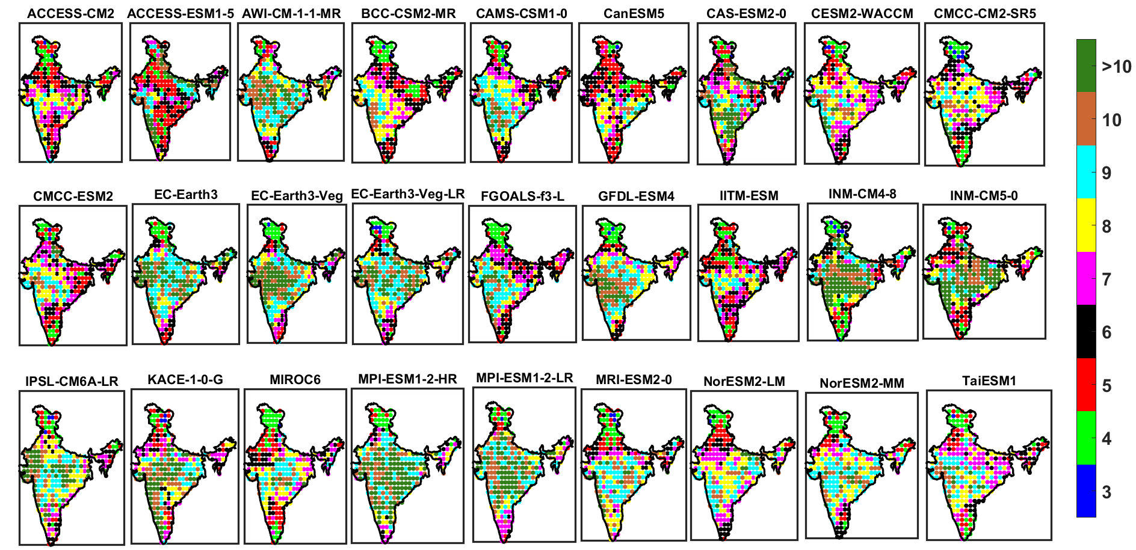
SSP 245
Figure 6: FNN dimension of future rainfall from 27 GCMs under SSP 245 scenario (2022-2060)

Slide 12
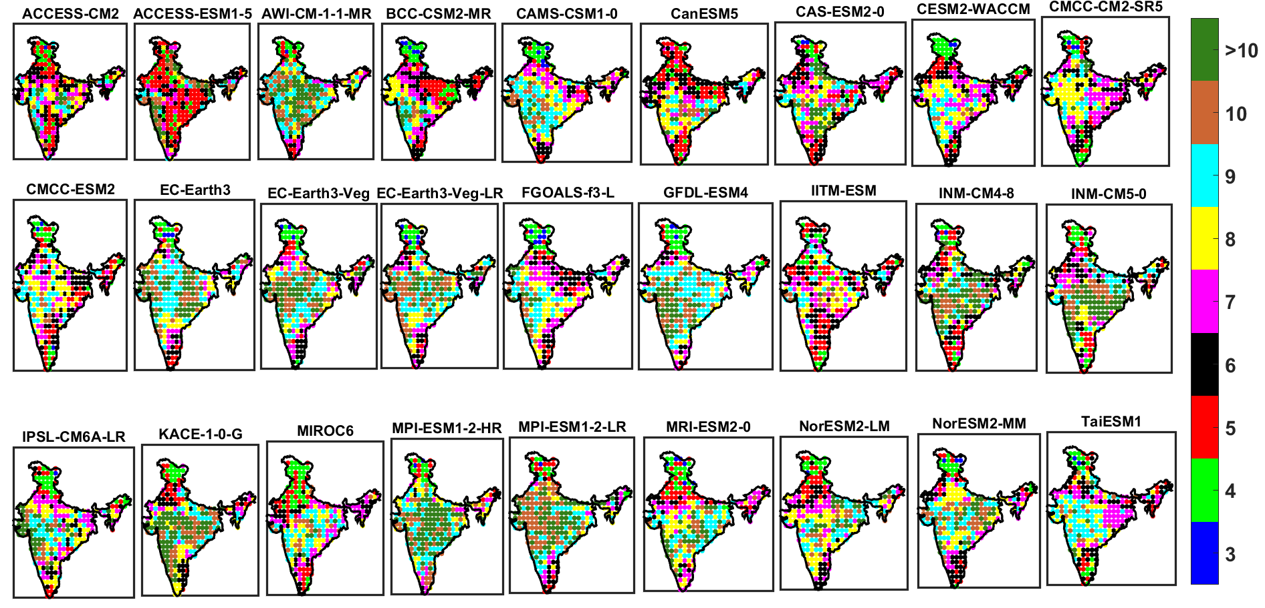
SSP 370
Figure 7: FNN dimension of future rainfall under SSP 370 scenario (2022-2060)

Slide 13
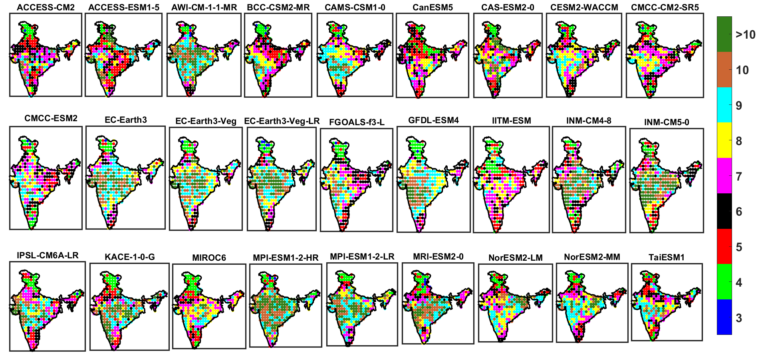
SSP 585
Figure 8: FNN dimension of future rainfall from 27 GCMs under SSP 585 scenario (2022-2060)

Slide 14
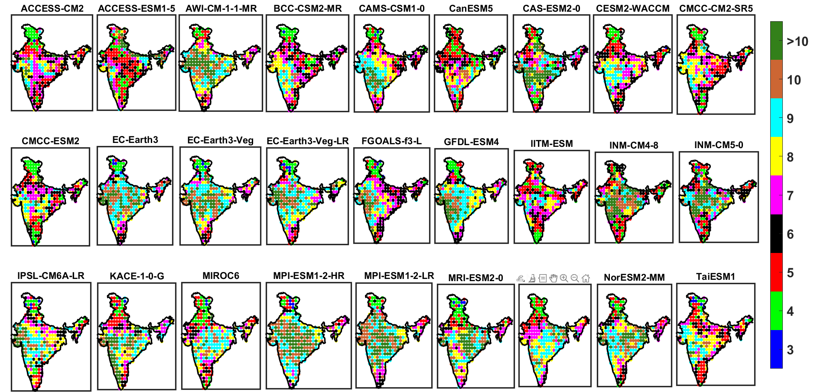
SSP 245
Figure 9: FNN dimension of future rainfall from 27 GCMs under SSP 245 scenario (2061-2099)

Slide 15
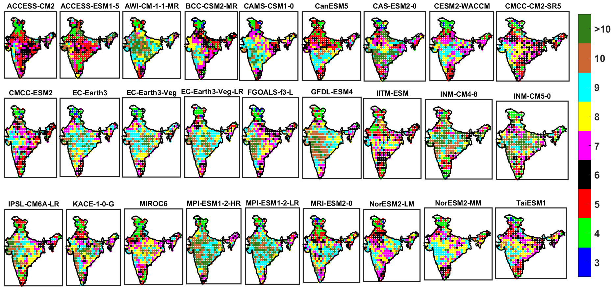
SSP 370
Figure 10: FNN dimension of future rainfall from 27 GCMs under SSP 370 scenario (2061-2099)

Slide 16
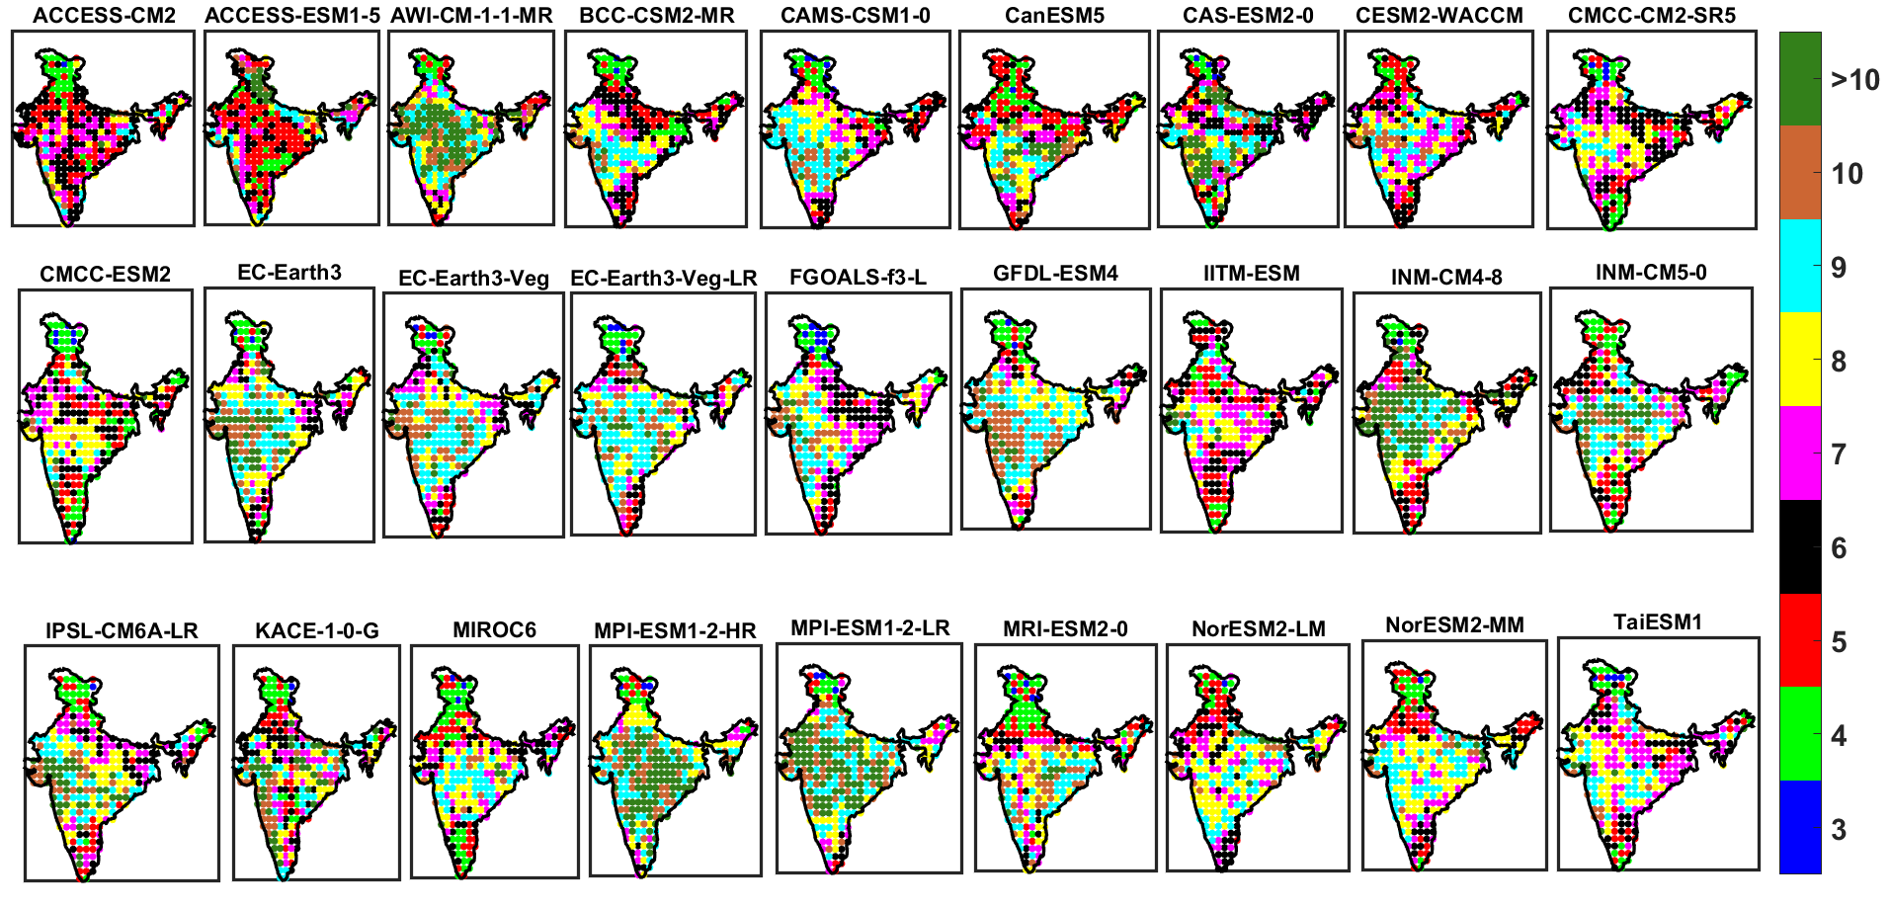
SSP 585
Figure 11: FNN dimension of future rainfall from 27 GCMs under SSP 585 scenario (2061-2099)

