Slide 1
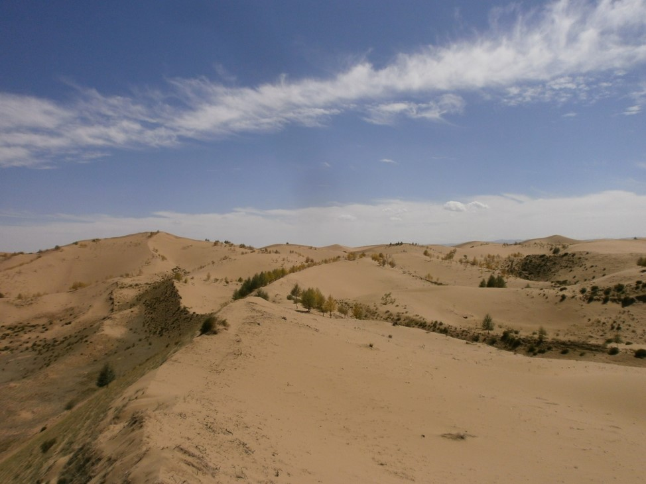


Remotely sensed dune movement rates in desert margins of Central Asia over five decades using satellite imagery
Lukas Dörwald, Janek Walk, Frank Lehmkuhl, Georg Stauch
EGU – General Assembly 2022
Funded by:
EGU22-4460
Notes:
Hello and welcome/ Lukas from aachen and I am…
- Remotly sensed dunes in desert margins of CA
- Last five decades

Slide 2
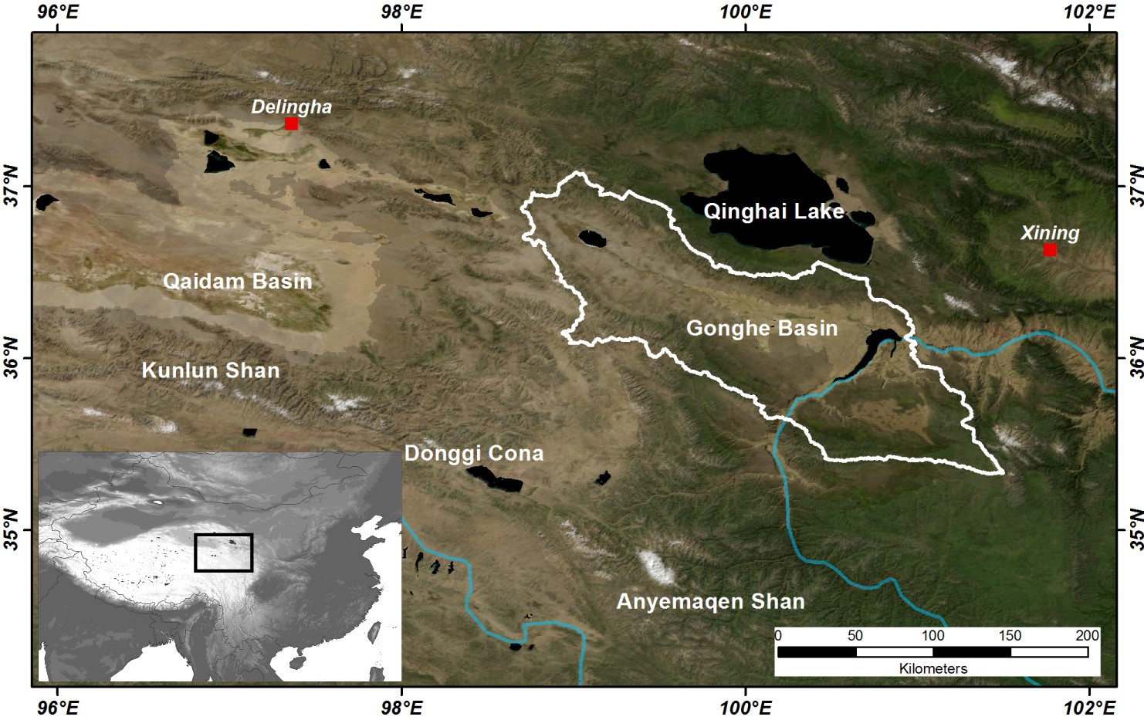
Study area
Westerlies
Area especially sensitive to climatic changes.
Dunes show quick responses to changes in wind direction and strength.
Abundance of sand and dust in the study area.
Area: ~ 20.000 km²
Mean altitude: 3000 m asl
Mean precipitation: 310 mm/a
Mean air temperature: 3.7 °C/a
ASM
EGU22-4460
Notes:
Study area
- Very sensitiv to climate changes on the tibetan plateau
- Transition edge between westerlie trade winds and asian summer monsoon
- Can be classified as semi-arid according to climatic parameters

Slide 3
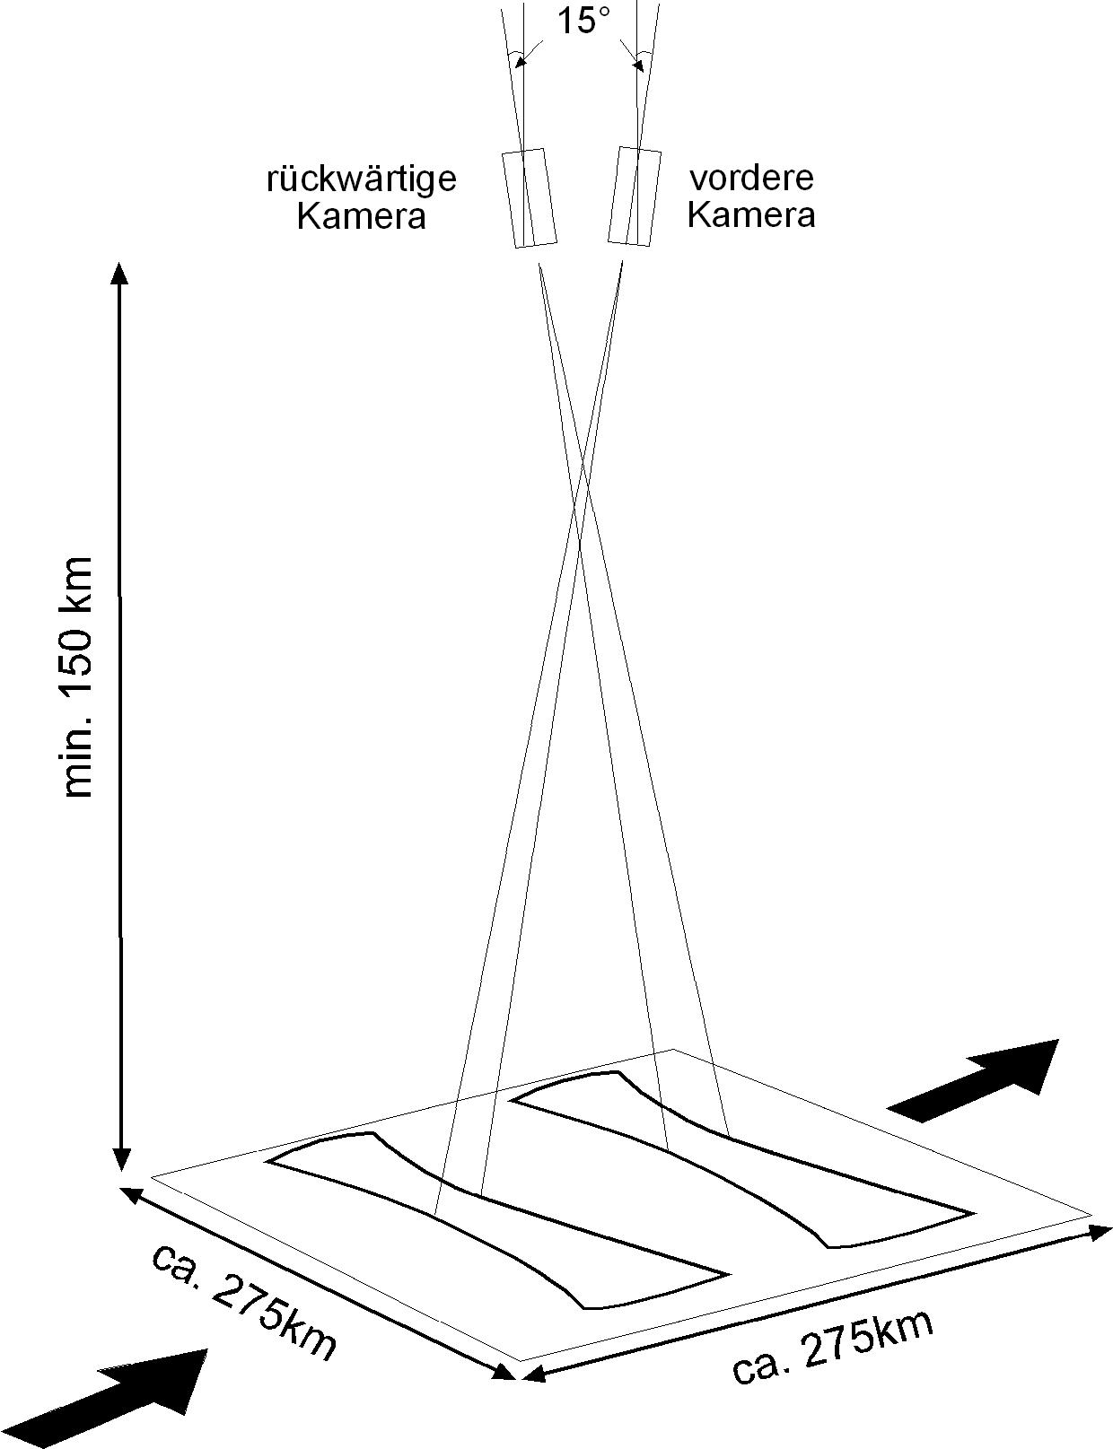
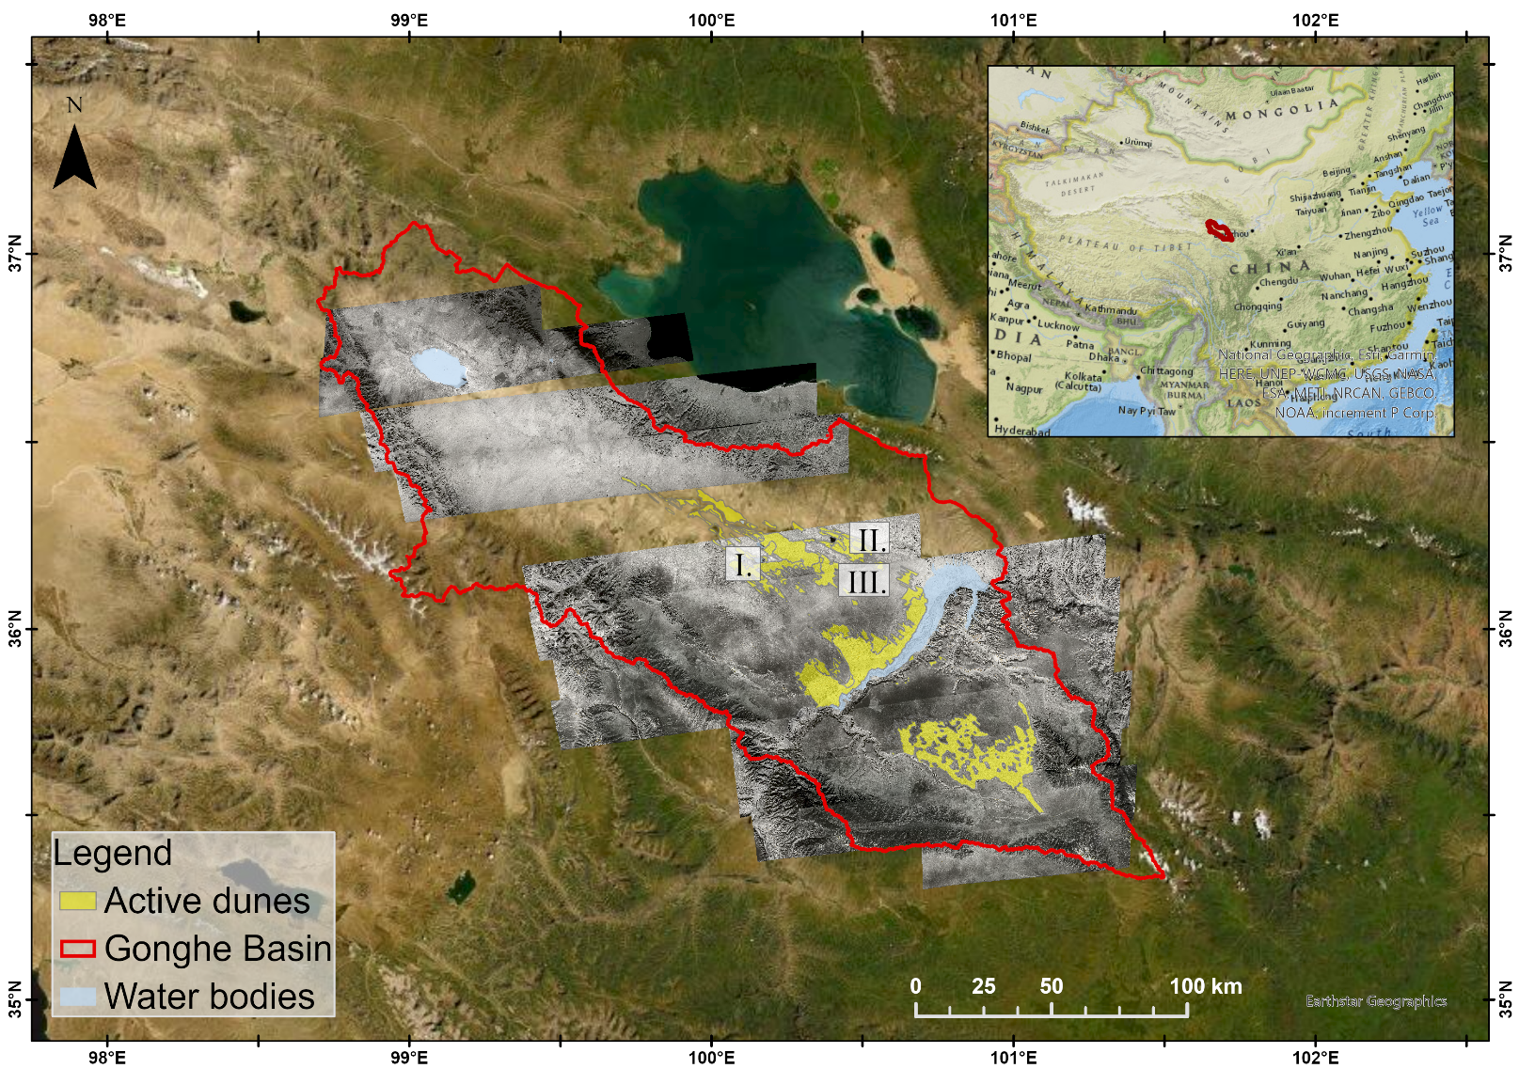
Approach and data base
4 time slices per dune
(1) 1968 (KH-4B Corona Satellite)
(2) 1987 (Landsat 5 TM Mosaic)
(3) 2001 (Landsat 7 ETM)
(4) „now“ (ESRI Basemap Mosaic from
WorldView and GeoEye satellites 2017-2020)
Afterward facing camera
Forward facing camera
Stauch 2006
EGU22-4460
Notes:
Approach utalizes old analog satellite images : Corona (USA/ SPY/ 1.8m resolution)
4 time slices
Georeferencing → mosaic
Mapping of crestlines – midpoint - connecting

Slide 4
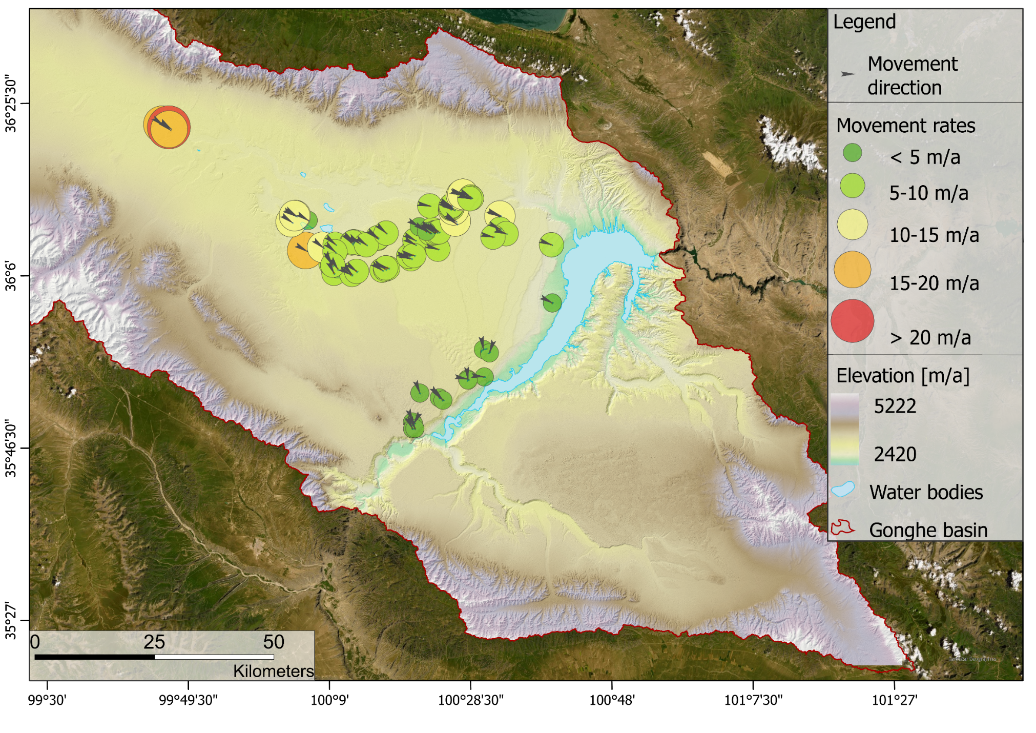

Dune movement rates in the Gonghe Basin ^{n = 76}
Prevailing wind direction
[m]
EGU22-4460
Notes:
76 dunes mapped
Topography
Slow rates in field
Rates from sub 5 m to above 20m/a
Good fit to prevailing wind direction, calculated from ERA-5

Slide 5
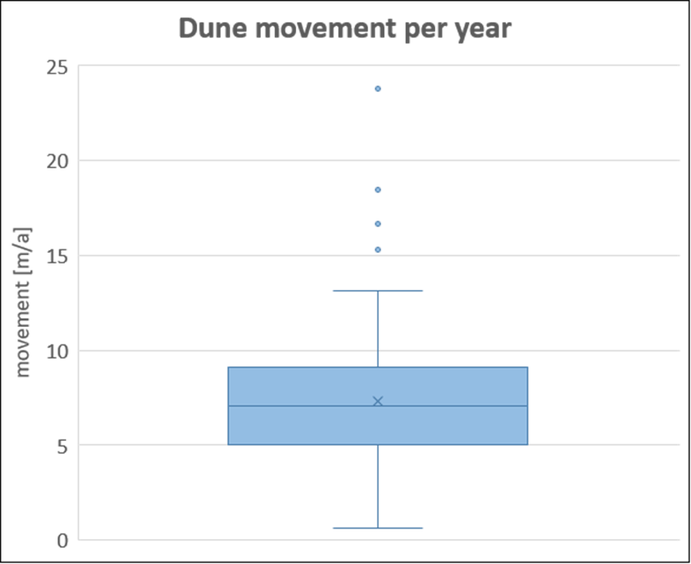
Results of 76 measured dune movement rates: 1968 – 1987 – 2001 – 2020
Dune movement rate [m/a]
Slowing trend
19 a
14 a
19 a
Average rate: 7.3 m/a
EGU22-4460
Notes:
Average length 379
Range length 1212
Shortest 26
Longest 1238
-s slowing trend when time slices used

Slide 6
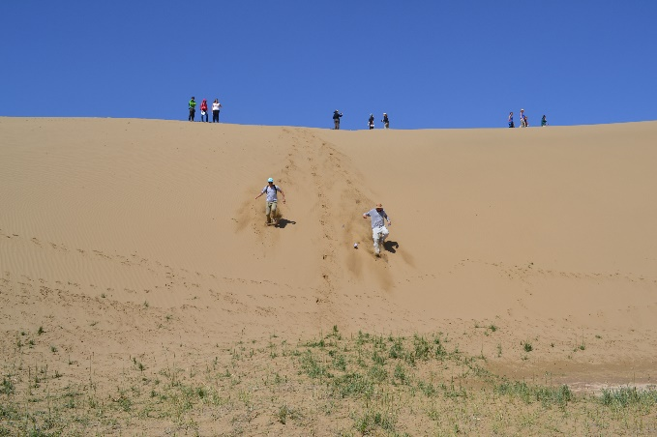
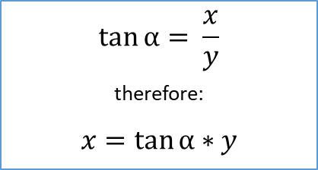
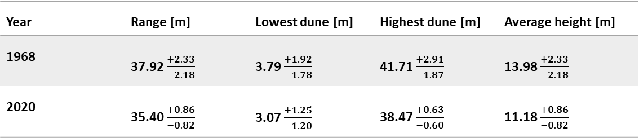
Dune height estimations ^{n = 76}
Height (x)
α = 31 ± 1°
.
$$\tan{α}= \frac{x}{y}$$
therefore:
$$x=\tan{α}∗y$$
α
Base length (y)
Year | Range [m] | Lowest dune [m] | Highest dune [m] | Average height [m]
1968 | 37.92 $\frac{+2.33}{−2.18}$ | 3.79 $\frac{+1.92}{−1.78}$ | 41.71 $\frac{+2.91}{−1.87}$ | 13.98 $\frac{+2.33}{−2.18}$
2020 | 35.40 $\frac{+0.86}{−0.82}$ | 3.07 $\frac{+1.25}{−1.20}$ | 38.47 $\frac{+0.63}{−0.60}$ | 11.18 $\frac{+0.86}{−0.82}$
Average dune
height change = - 17 %
EGU22-4460
Notes:
Additional morphology paramter height
Simple approach of idealized dune cross section
Angle of repose = 31° plus minus 1
Height change 68-2020 of -17%

Slide 7
ERA-5 dataset – Google Earth Engine analysis: Rain & Temperature ^{(30 km grid resolution)}
Dune movement rates
1968
9.50 m/a
1987
8.86 m/a
2001
7.69 m/a
2020
1980
1990
2000
2010
2020
EGU22-4460

Slide 8
Precipitation & NDVI analysis
Google Earth Engine analysis of NDVI values. ^{(2-5 days/ month)}
0.25
0.20
0.15
0.10
0.05
0.00
EGU22-4460

Slide 9
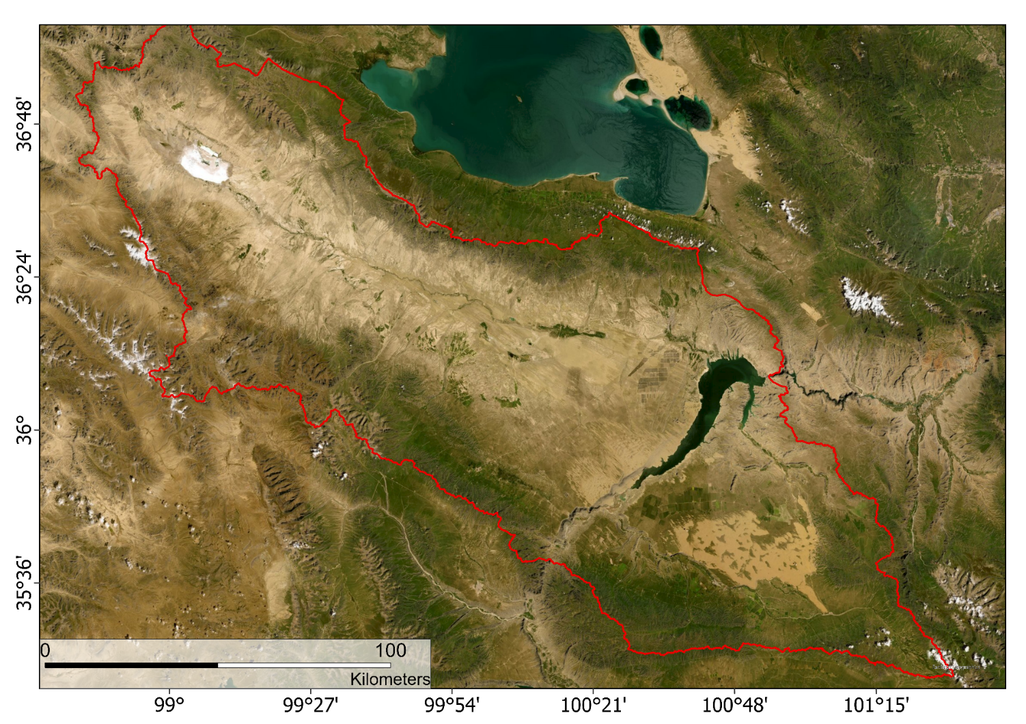
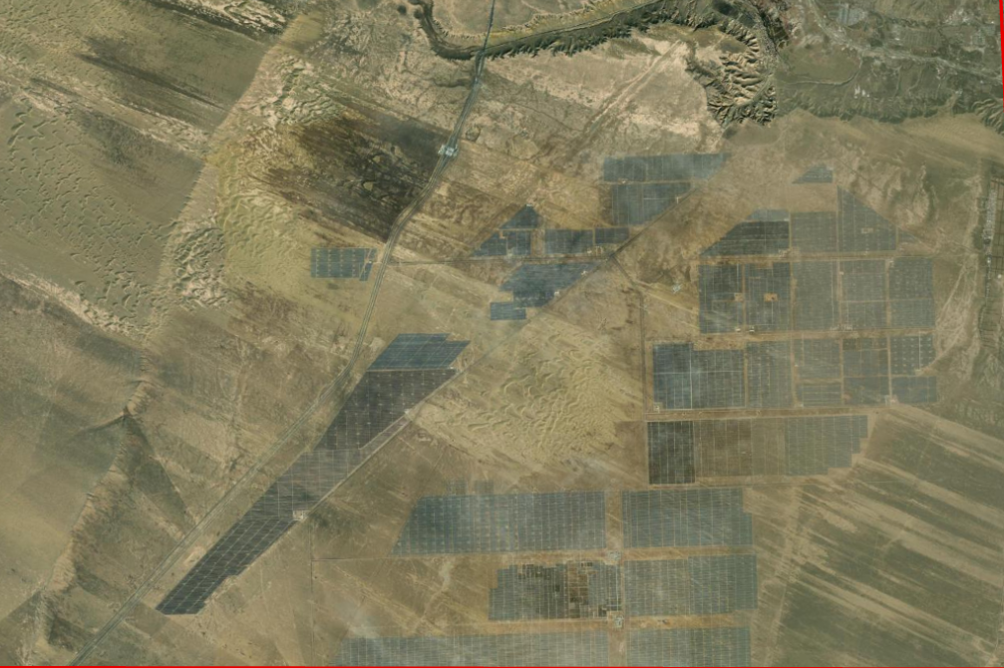
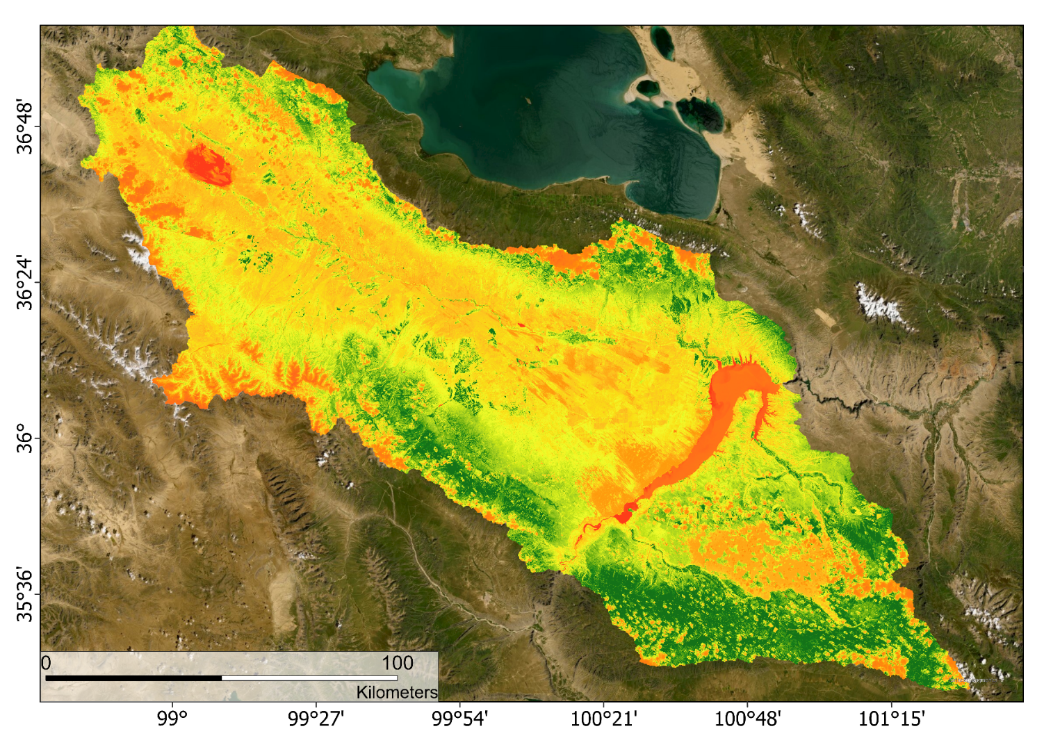
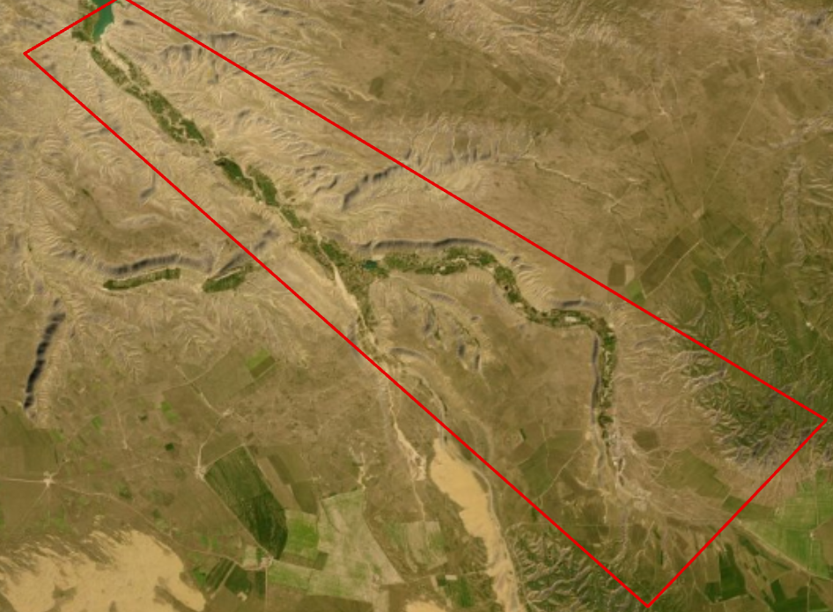
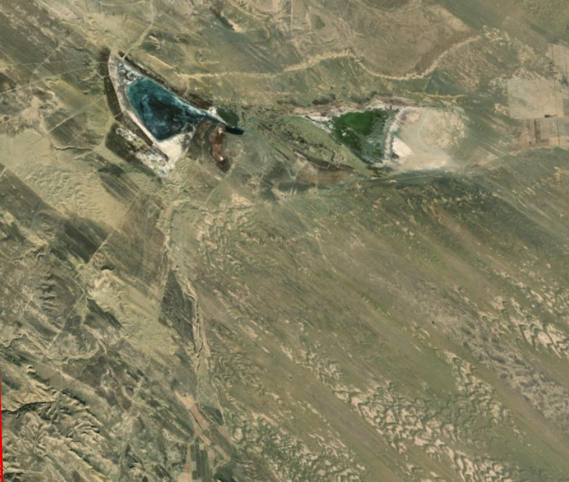
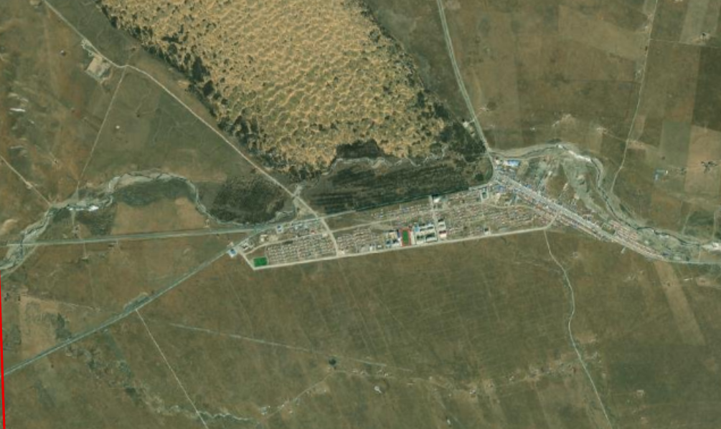
NDVI analysis
0. 50
0.40
0.30
0.20
0.10
0.00
1986 2019
1986 2019
0.25
0.20
0.15
0.10
0.05
0.00
0.80
0.70
0.60
0.50
0.40
0.30
0.20
0.10
0.00
1986 2019
1986 2019
EGU22-4460

Slide 10
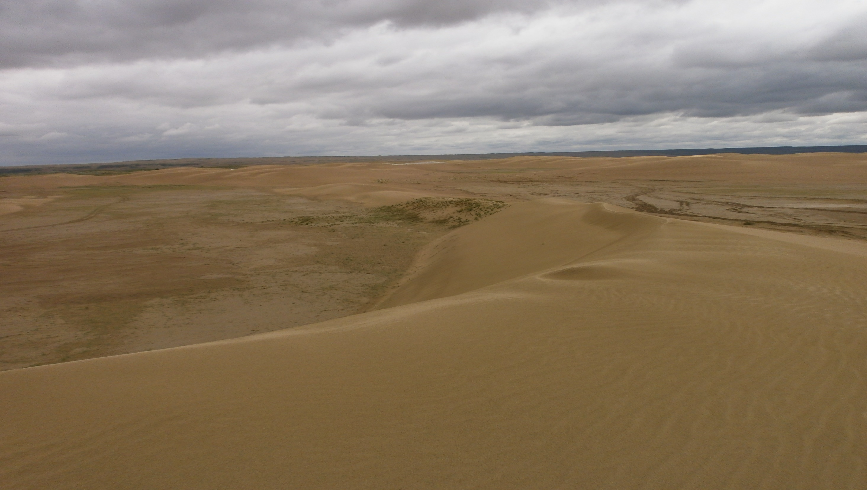

Thank you for your attention!
Contact me:
Funded by:

