Slide 1




Application of Electrical Resistivity Tomography (ERT) to study to soil water and salt movement under drip irrigation in a saline soil cultivated with melon
Agnese Innocenti¹, Veronica Pazzi^{1,2}, Marco Napoli³, Riccardo Fanti¹, and Simone Orlandini³
¹University of Florence, Department of Earth Sciences, Italy
²University of Trieste, Department of Mathematics and Geosciences, Italy
³University of Florence, Department of Agriculture, Food, Environment and Forestry, Italy
https://doi.org/10.5194/egusphere-egu22-4469, 2022

Slide 2
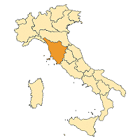
Research question
Site: Barbaruta (42.804113, 11.023221) in the municipality of Braccagni (GR)
Problem: the investigation site is characterised by soils rich in sodium
Goal: Study the movement of salt during irrigation in soils with a high salt content and used for melon cultivation
Study area

Slide 3
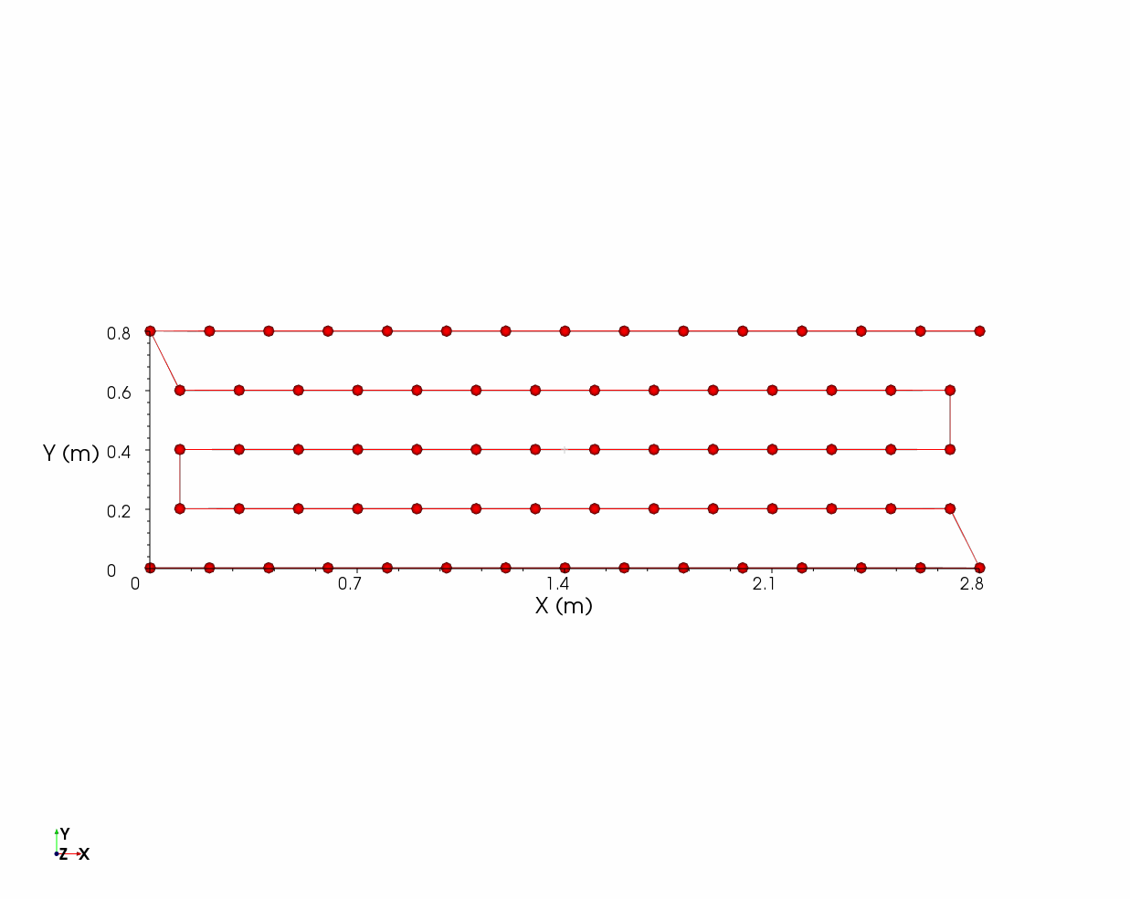
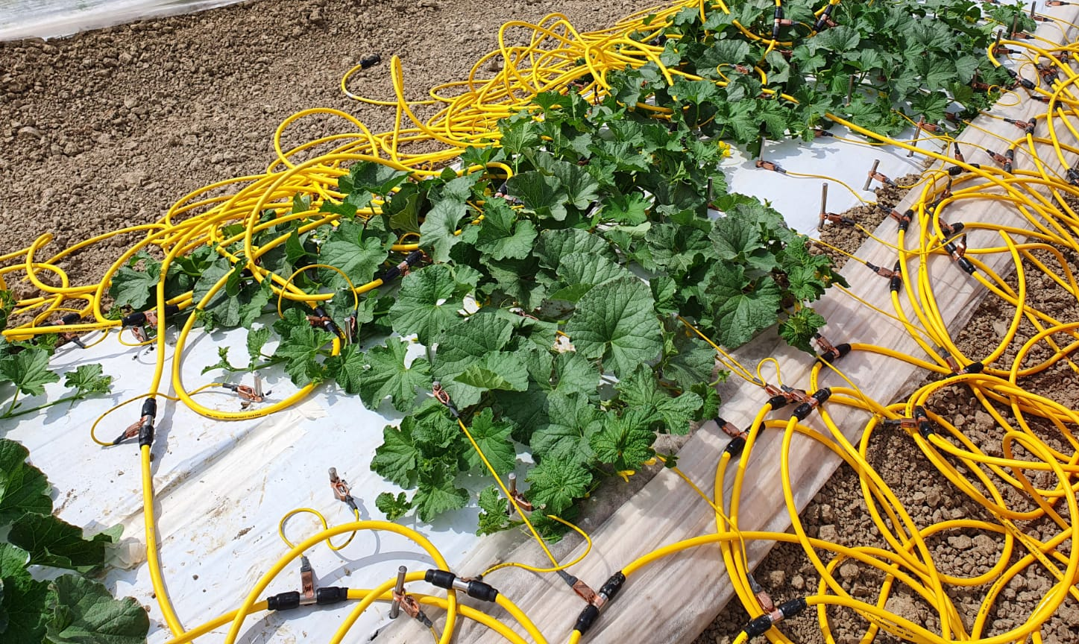
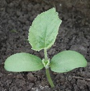
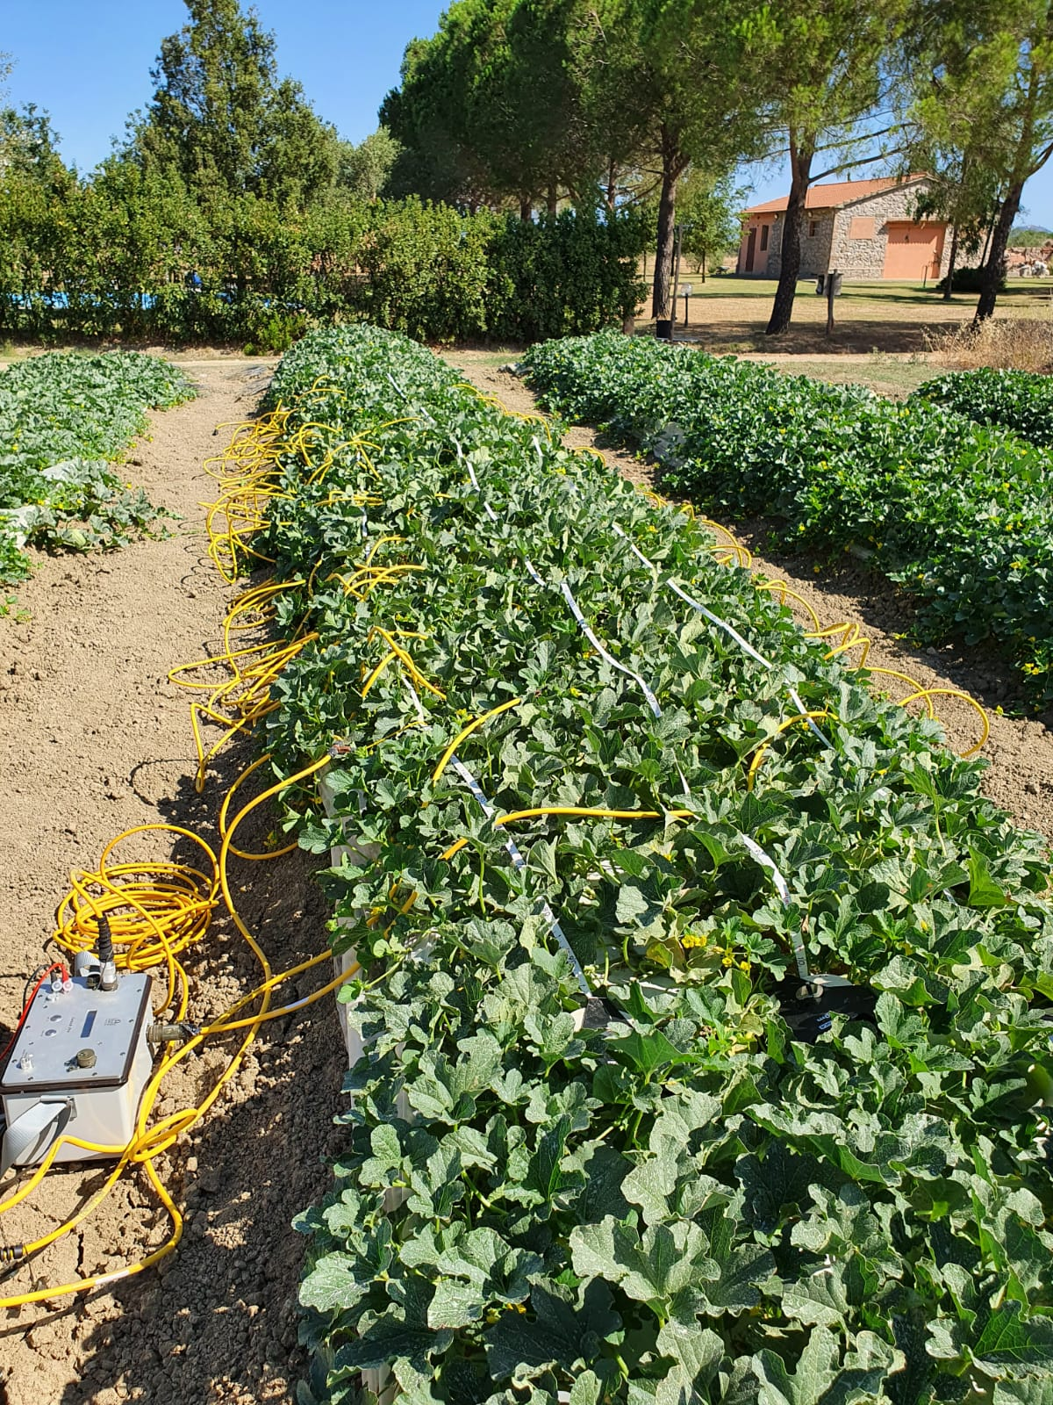
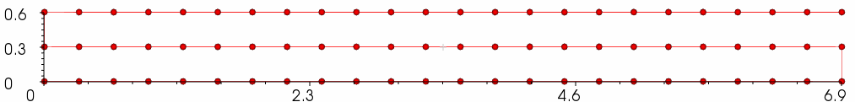

Planned methodology
Experimental set up - First campaign 08/07/2021
5
4
Y (m)
3
2
1
X (m)
Experimental set up - Second campaign 03/08/2021
3
Y (m)
2
1
X (m)

Slide 4
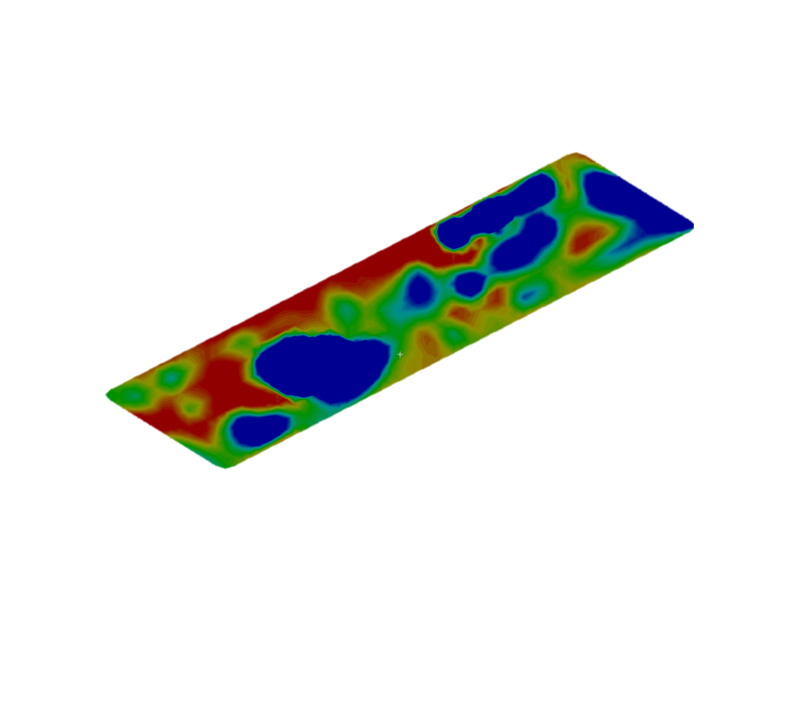
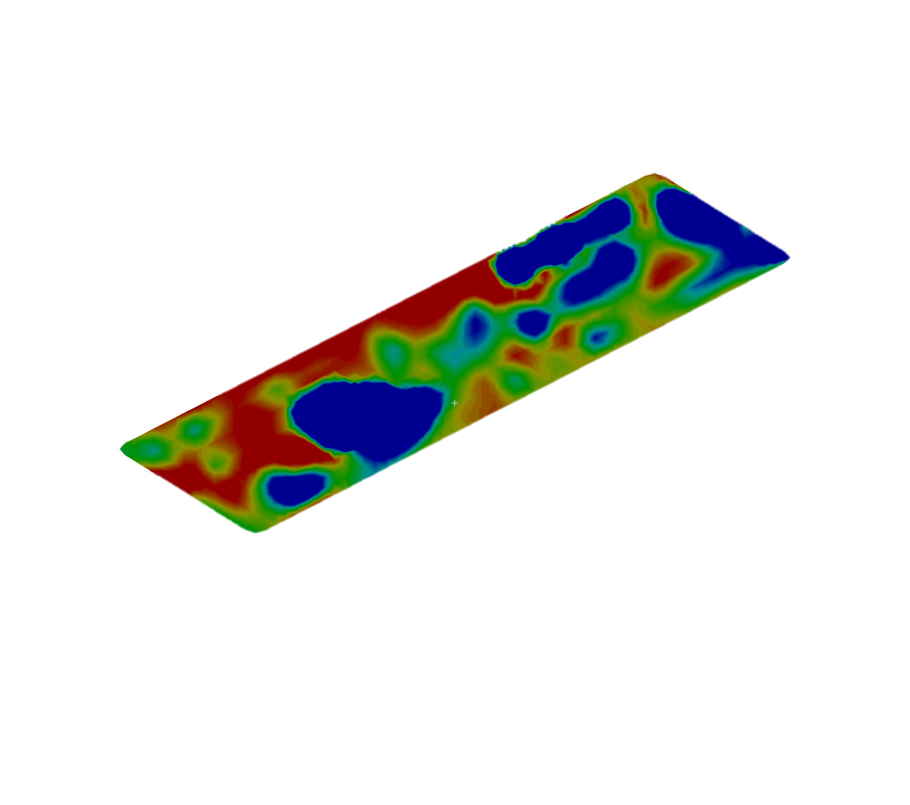
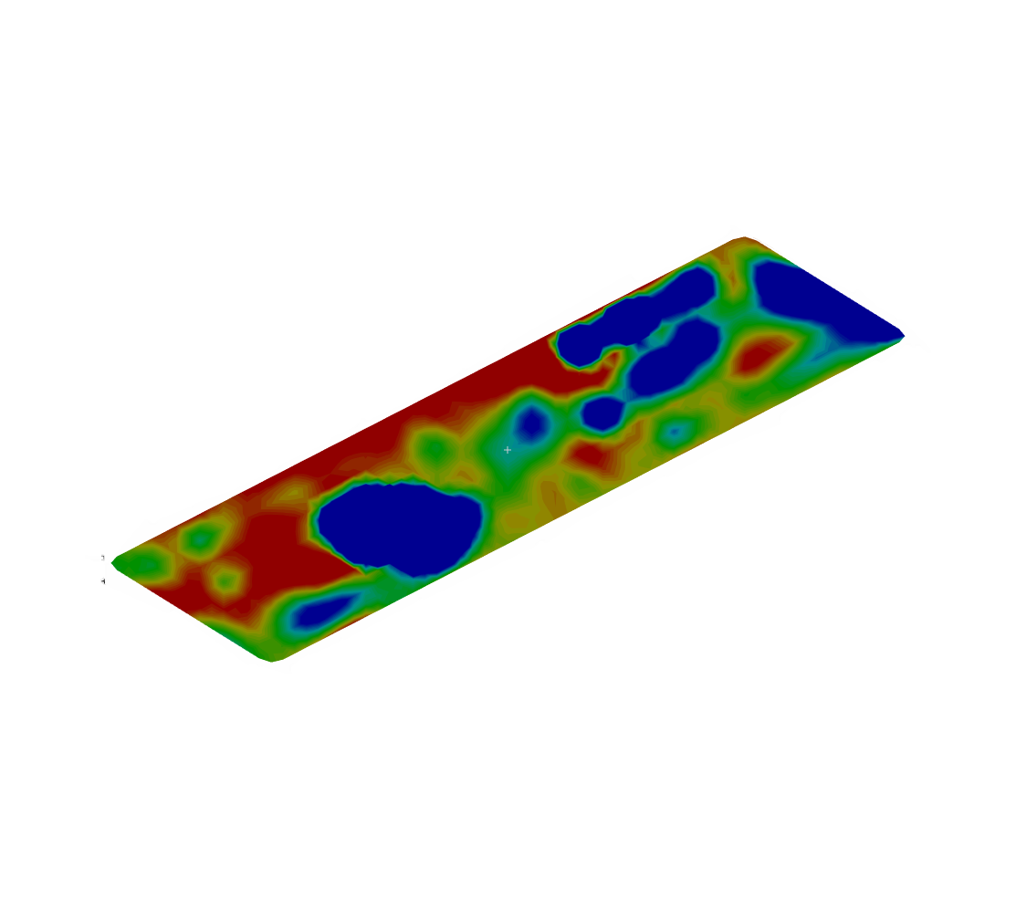
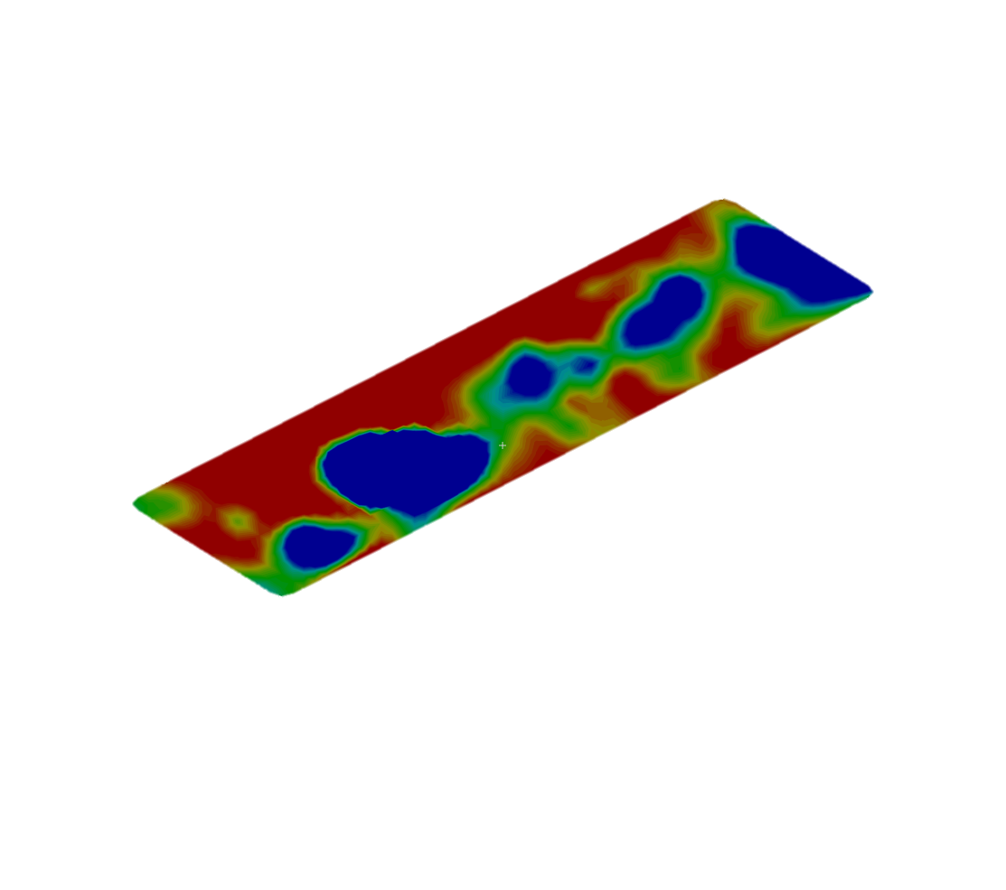
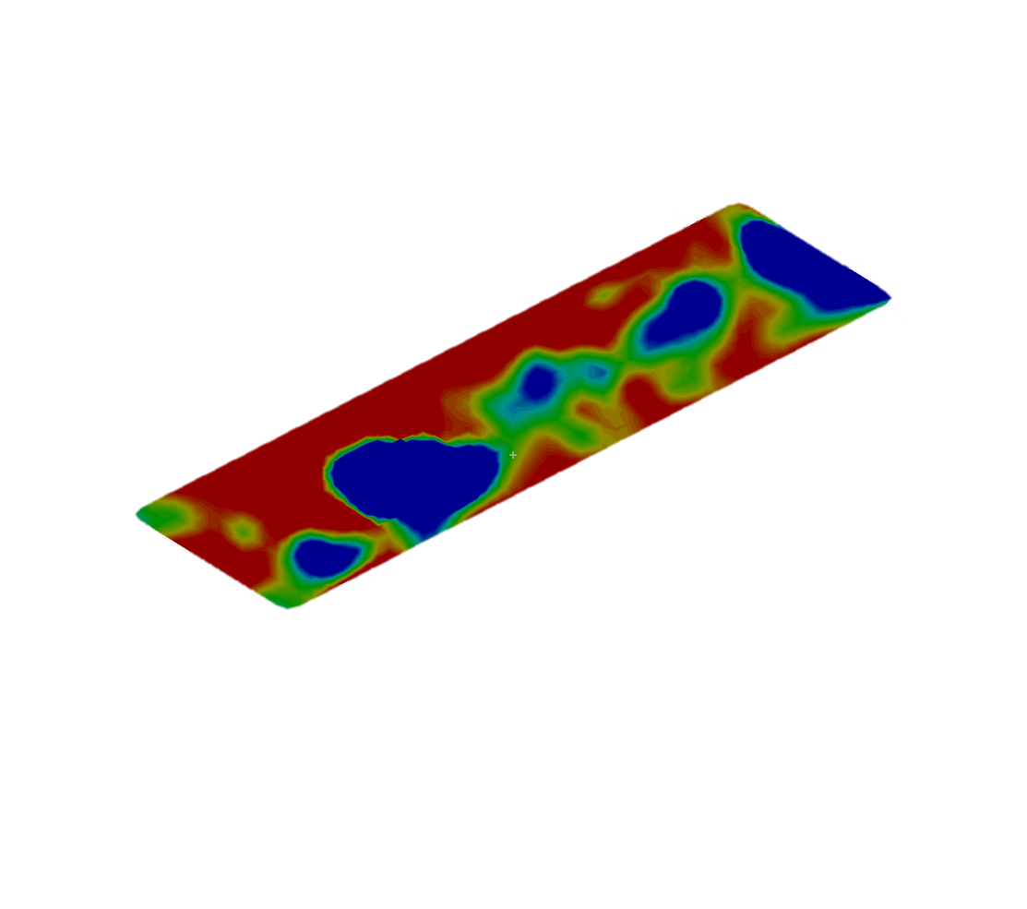
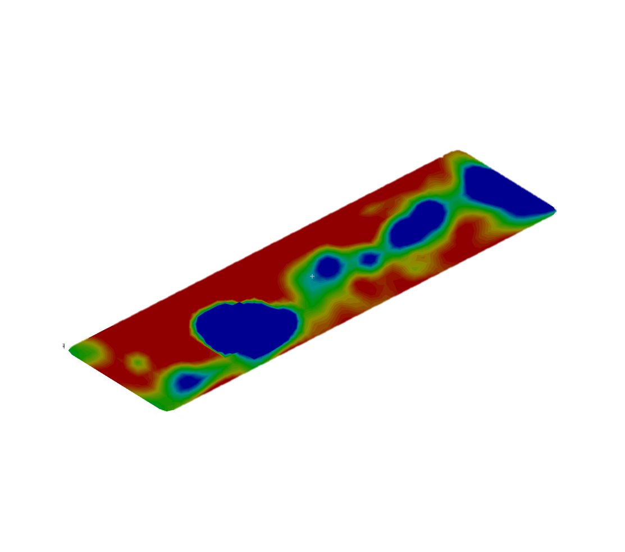
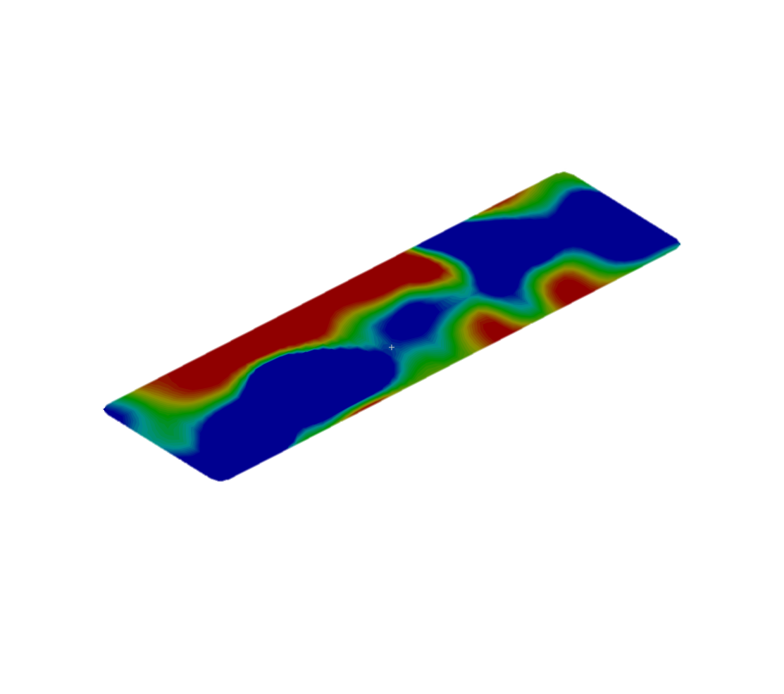
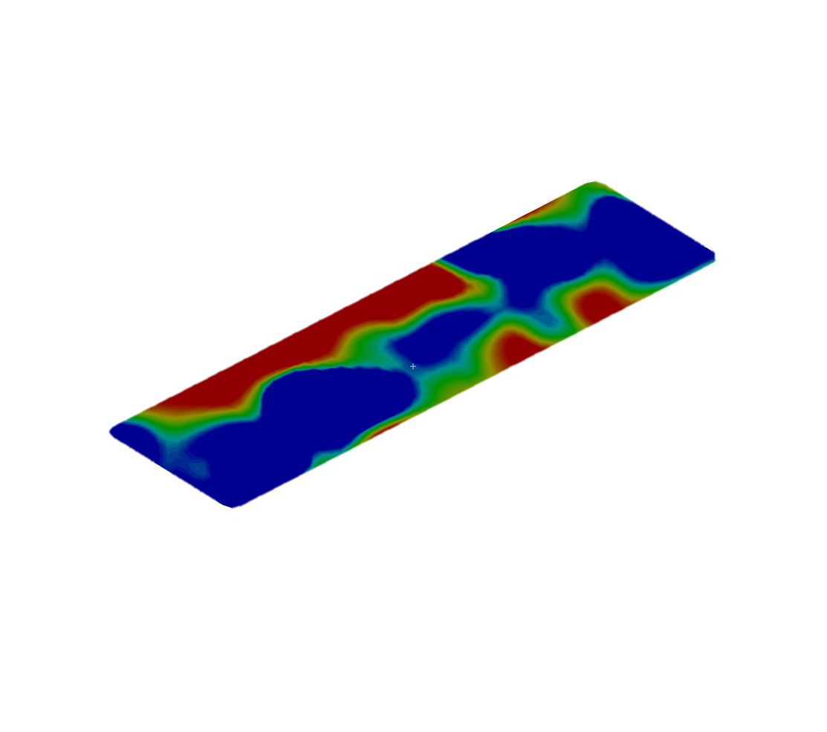
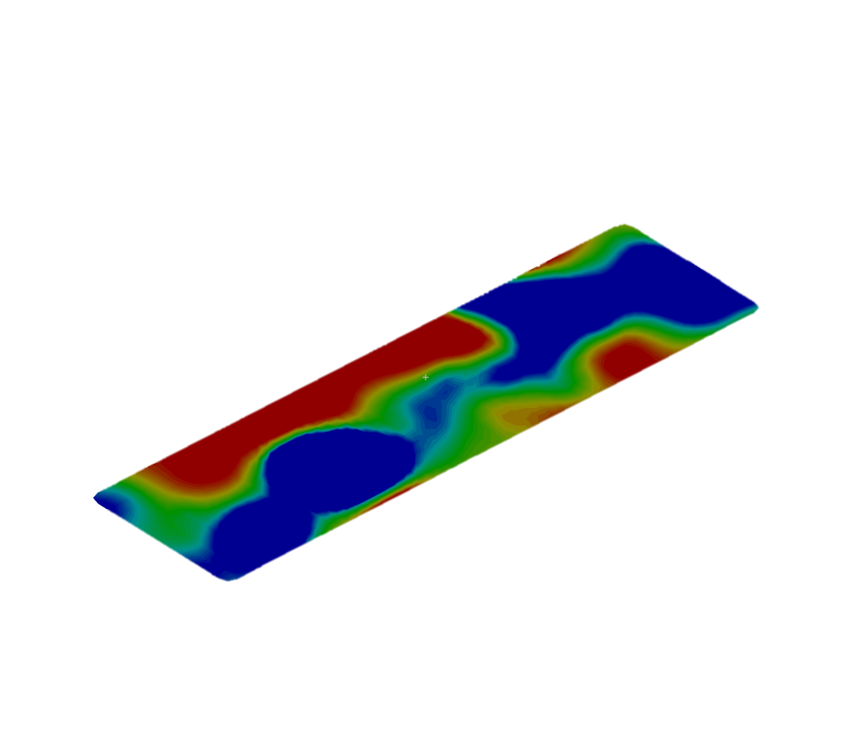
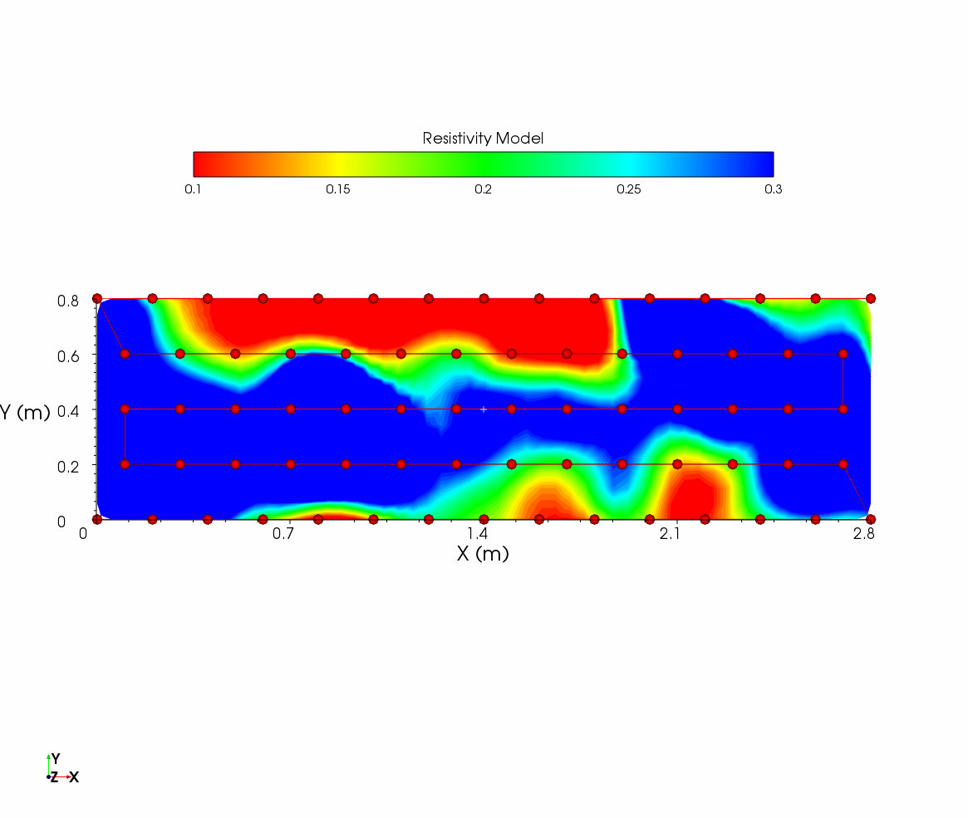
Preliminary results
T1_dry_pre irrigation
T6_28 min irrigation
T8_dry_post irrigation
Irrigators
Z (m)
Z (m)
Z (m)
- 0.08
- 0.08
- 0.08
- 0.11
2.8
- 0.11
2.8
- 0.11
2.8
2.1
2.1
2.1
1.4
X (m)
- 0.20
1.4
X (m)
- 0.20
- 0.20
1.4
X (m)
0.8
0.8
0.7
0.8
0.7
0.4
0.7
0.4
Y (m)
0.0
0.4
Y (m)
0.0
Y (m)
0.0
Conductivity Model [S/m]

Slide 5
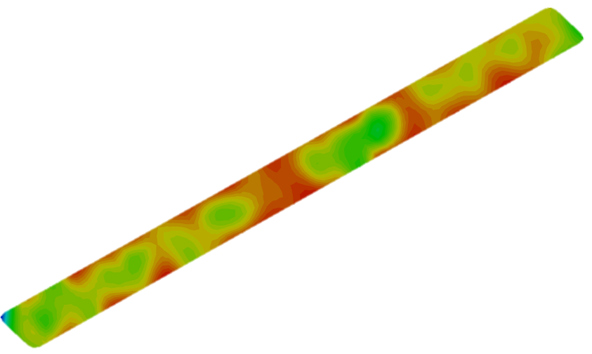
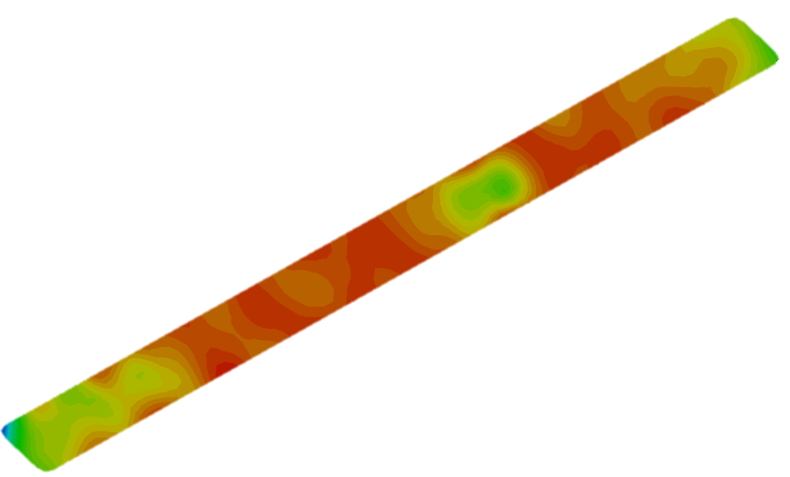
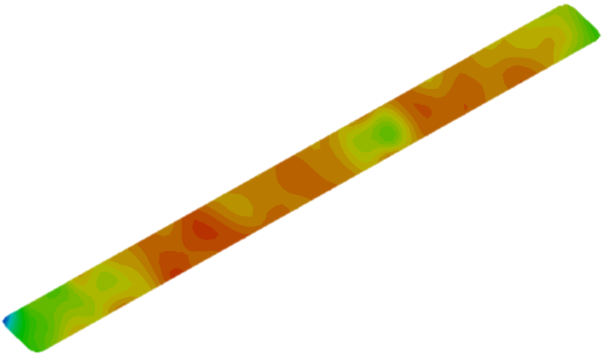
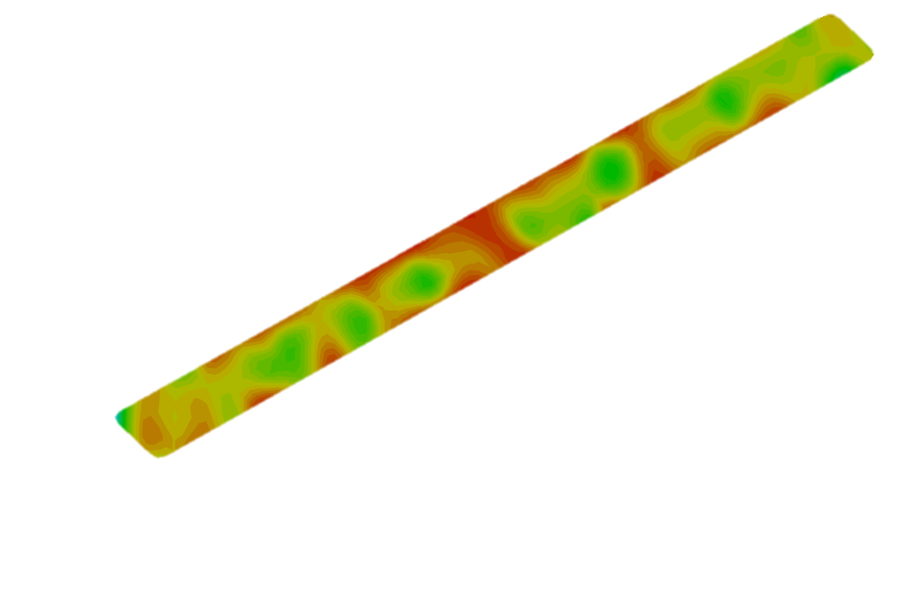
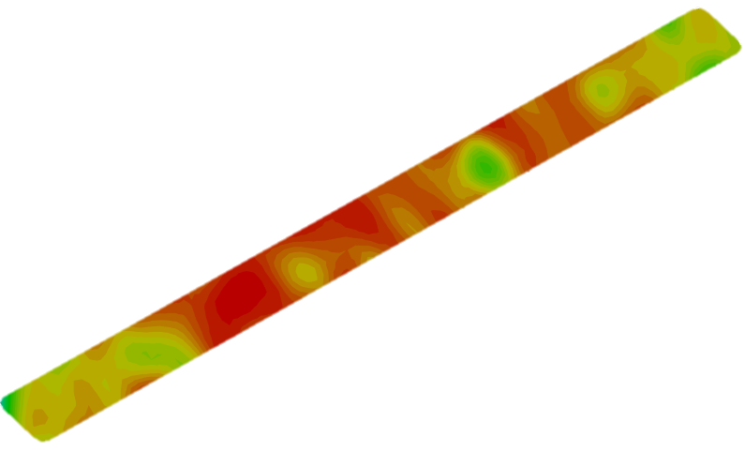
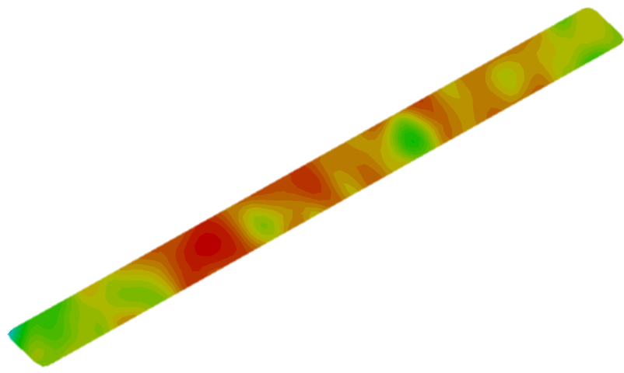
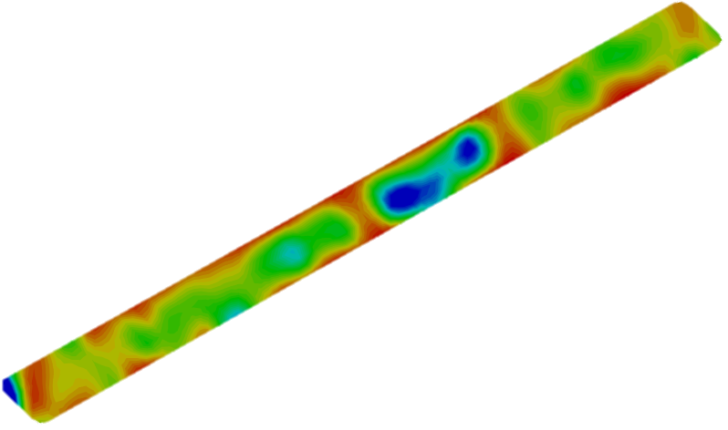
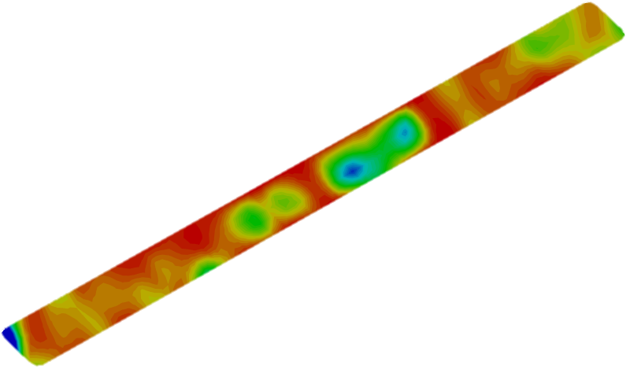
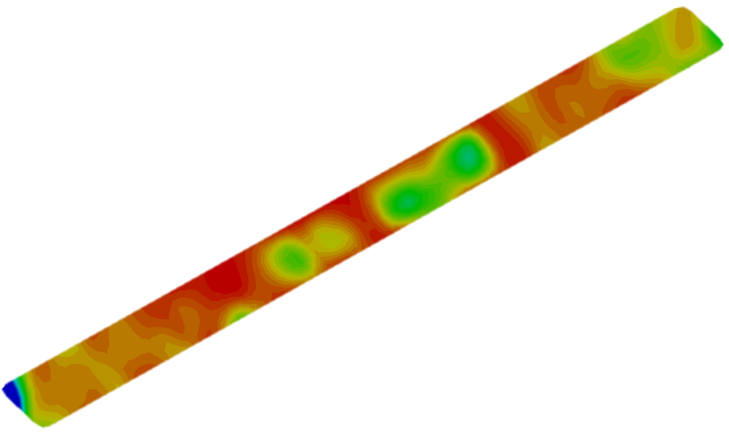
Preliminary results
T1_dry_pre irrigation
Irrigators
T5_28 min irrigation
6.9
T6_dry_post irrigation
Z (m)
4.6
- 0.10
X (m)
6.9
- 0.15
2.3
- 0.20
Z (m)
0.6
4.6
6.9
- 0.10
Y (m)
0.0
X (m)
- 0.15
2.3
Z (m)
4.6
- 0.20
- 0.10
0.6
X (m)
Y (m)
0.0
- 0.15
2.3
Conductivity Model [S/m]
- 0.20
0.6
Y (m)
0.0

Slide 6
Conclusions
Preliminary considerations on the experimental design:
conductivity generally increases with depth and over time;
the range of conductivity values ​​increases from dry to wet conditions;
concordance of data between the campaigns of July 2021 and August 2021;
a general increase in conductivity with depth is observed, however at the depth between -0.11 m and -0.15 m there is a decrease conductivity during both the July 2021 and August 2021 campaigns;
3-line configuration was better as it allowed more plants to be included within the survey than the 5-line configuration.
Future activities:
creation of smaller electrodes that could be left in the field to avoid disturbance of the measurement to the plants;
induced polarization (IP), a small stratigraphic sounding, and permeability measurements.

Slide 7

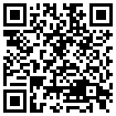
Thanks for your attention
agnese.innocenti@unifi.it
https://doi.org/10.5194/egusphere-egu22-4469, 2022
Innocenti, A., Pazzi, V., Napoli, M., Fanti, R., and Orlandini, S.: Application of Electrical Resistivity Tomography (ERT) to study to soil water and salt movement under drip irrigation in a saline soil cultivated with melon, EGU General Assembly 2022, Vienna, Austria, 23–27 May 2022, EGU22-4469

