Slide 1
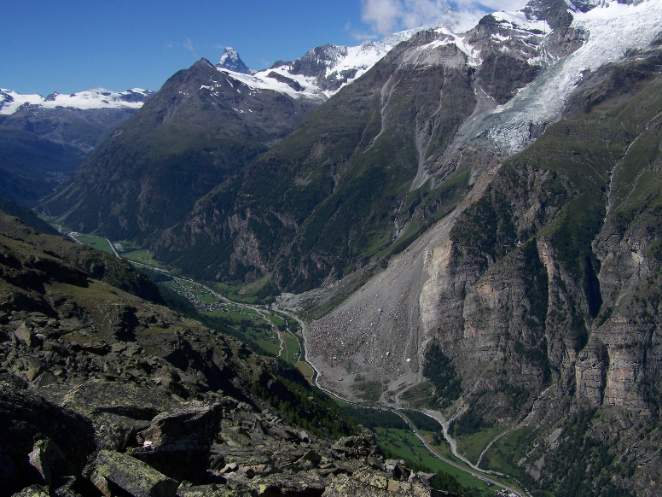
Relative tropospheric delay fields by GNSS, InSAR and NWP models in an Alpine Region
Institute of Geodesy and Photogrammetry
Endrit Shehaj¹, Othmar Frey^{2,3}, Gregor Moeller¹, Matthias Aichinger-Rosenberger¹, Alain Geiger¹, Markus Rothacher¹
¹ ETH Zürich, Institute of Geodesy and Photogrammetry
² ETH Zürich, Institute of Environmental Engineering
³ Gamma Remote Sensing
EGU2022, Session G5.2, May 23, 2022

Slide 2
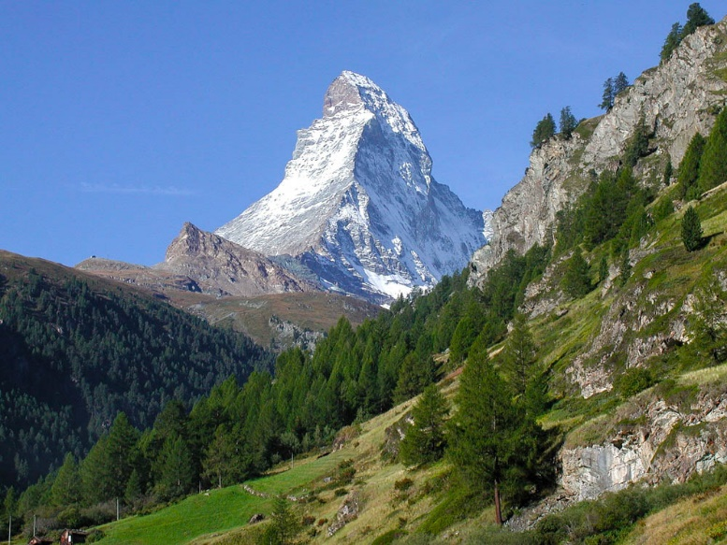
Motivation
Cross-validation of retrieved delays, for NWP assimilation
The assimilation of InSAR products is not yet standardized. A better understanding of these products and validation with GNSS and NWP data is an important starting point for their consideration by meteorologists
GNSS atmospheric products for InSAR processing
Can GNSS-derived tropospheric path delays be used as a first correction for tropospheric effects in InSAR images?
'Robust' combination of GNSS and InSAR meteo products
To benefit from the complementary spatio-temporal characteristics of InSAR and GNSS measurements
source: Wikipedia
source: www.artisansofleisure.com/luxury-travel-blog

Slide 3
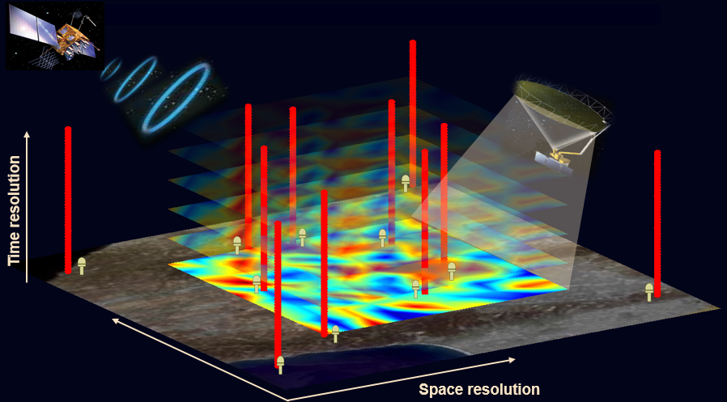
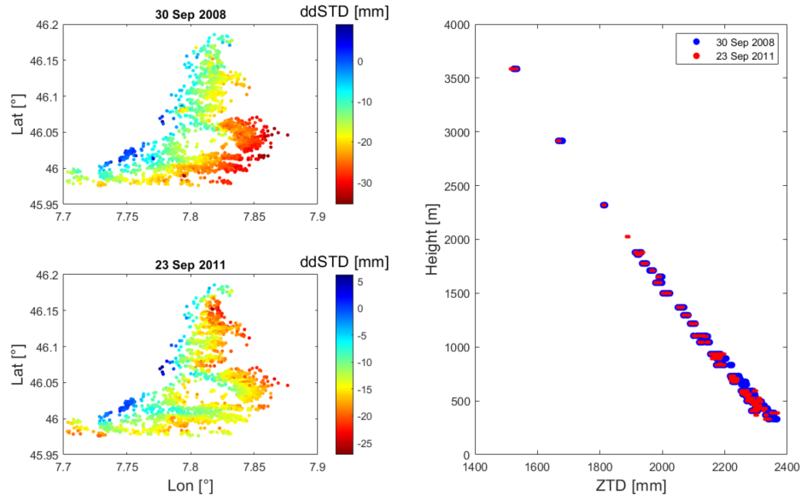
GNSS/InSAR spatio-temporal characteristics
InSAR - ddSTDs
Relative measurements
Low temporal resolution but high spatial density
GNSS - ZTDs
Absolute measurements
High temporal resolution but low spatial density
Steps for cross-validation:
Conversion of GNSS ZTDs into ddSTDs
Spatio-temporal interpolation of GNSS delays to InSAR grid (-> see example plot of InSAR retrievals)

Slide 4
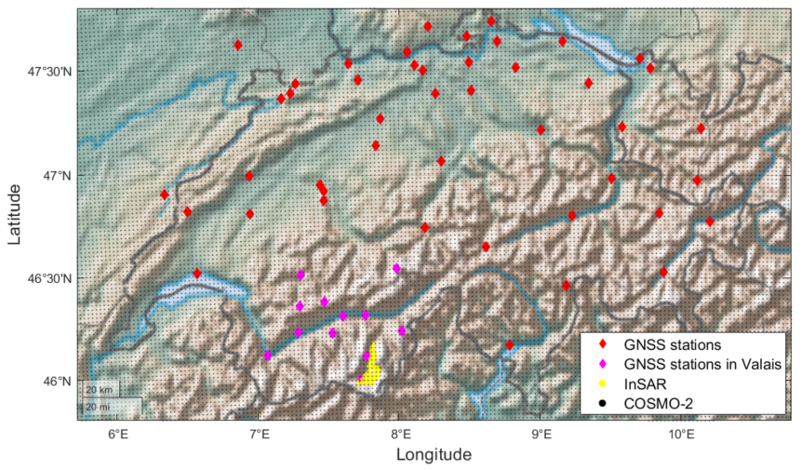
Datasets: GNSS, InSAR and NWP
InSAR
29 COSMO-SkyMed images provided by Gamma Remote Sensing, period: 2008-2013 (Jun – Oct)
ddSTDs for 300`000 identified InSAR points
GNSS (AGNES/COGEAR)
Dense GNSS network in Alpine region
Height variability: 1200 – 4100 m
Hourly ZTDs
NWM dataset (for additional validation)
COSMO-2 data from MeteoSwiss
Parameters: Pressure, temperature and water vapor pressure on 51 pressure levels
Study area: Valais (Matter valley)
Observing network in Switzerland

Slide 5
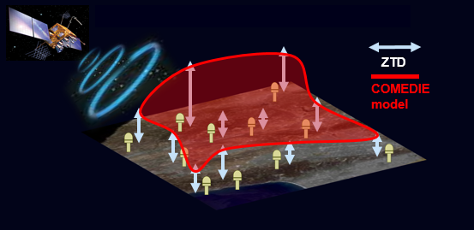
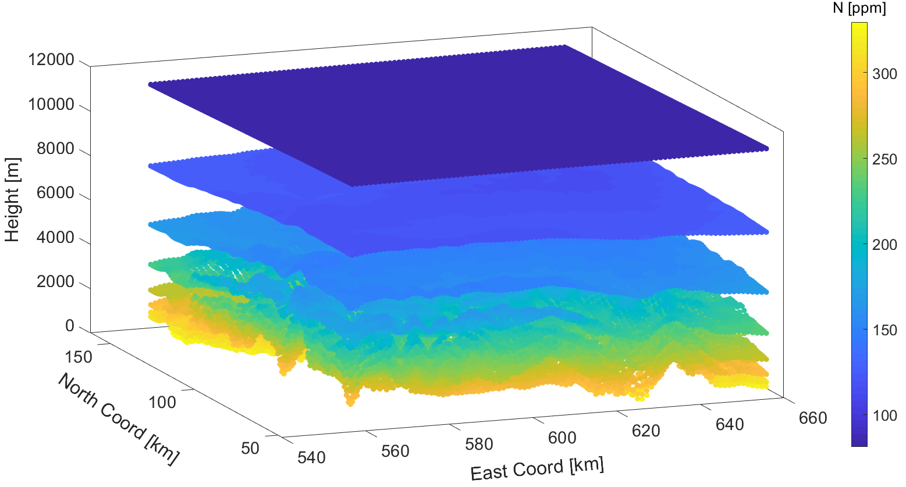
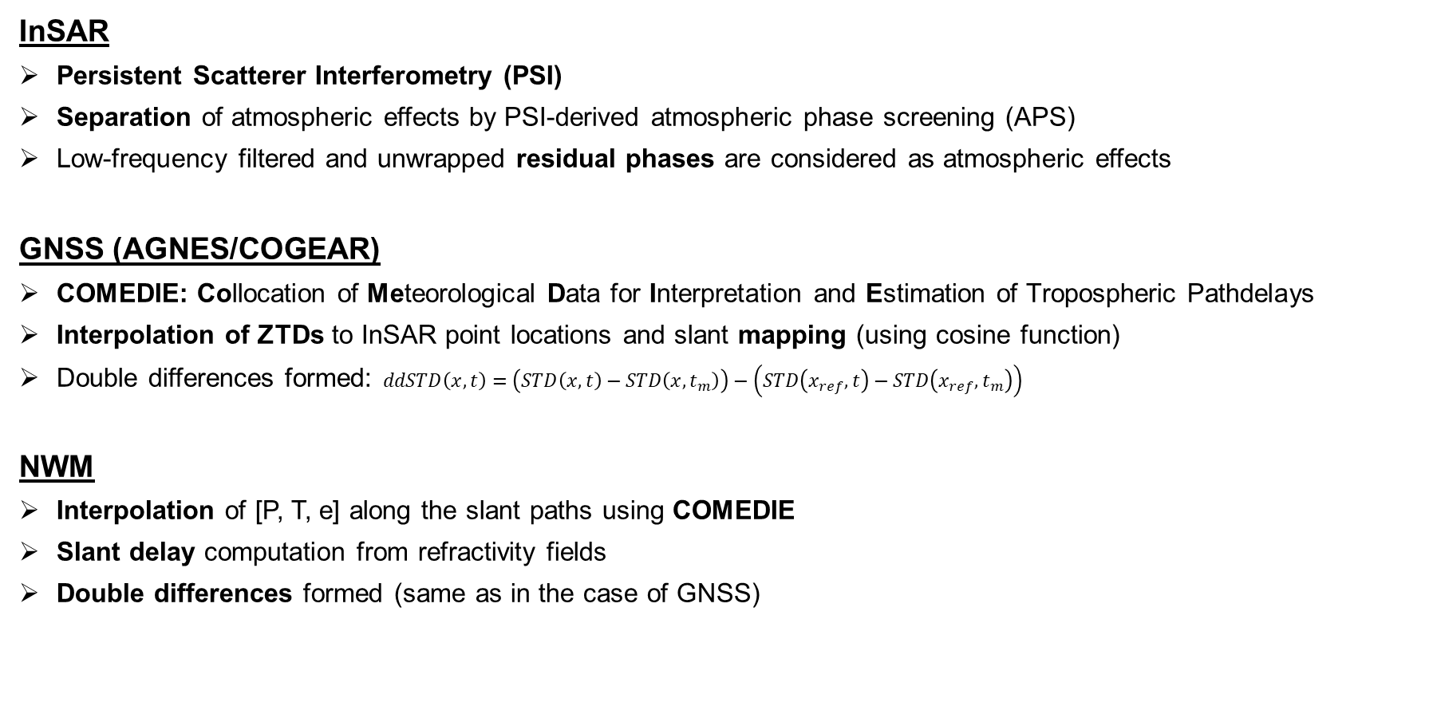
Methods for tropospheric delays retrieval
InSAR
Persistent Scatterer Interferometry (PSI)
Separation of atmospheric effects by PSI-derived atmospheric phase screening (APS)
Low-frequency filtered and unwrapped residual phases are considered as atmospheric effects
GNSS (AGNES/COGEAR)
COMEDIE: Collocation of Meteorological Data for Interpretation and Estimation of Tropospheric Pathdelays
Interpolation of ZTDs to InSAR point locations and slant mapping (using cosine function)
Double differences formed: $ddSTD\left(x,t\right)=\left(STD\left(x,t\right)−STD\left(x,t_{m}\right)\right)−\left(STD\left(x_{ref},t\right)−STD\left(x_{ref}, t_{m}\right)\right)$
NWM
Interpolation of [P, T, e] along the slant paths using COMEDIE
Slant delay computation from refractivity fields
Double differences formed (same as in the case of GNSS)
Measurement model
𝑙=𝑓+𝑠+𝜖
Example refractivity field from NWP data

Slide 6
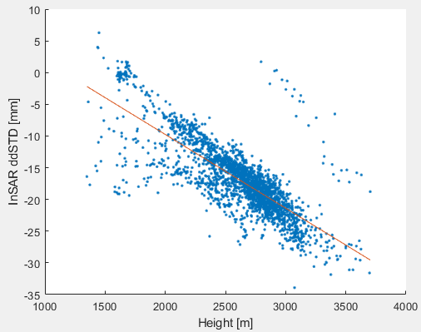
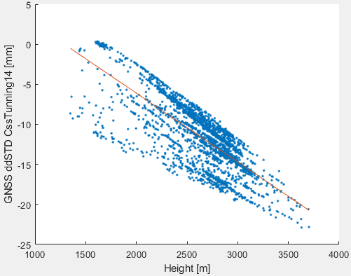
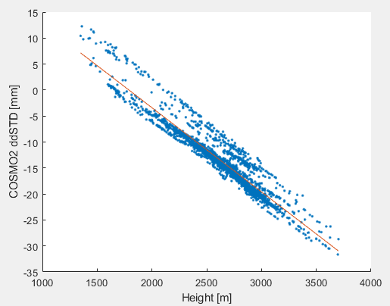
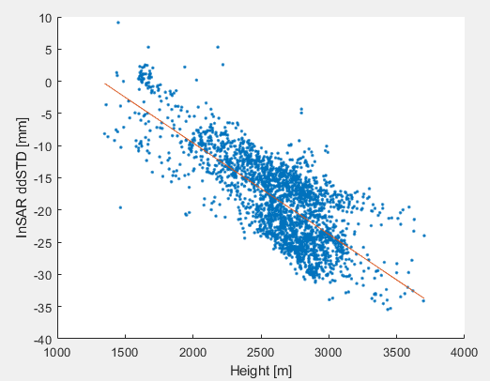
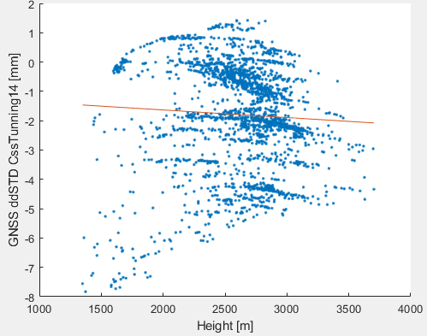
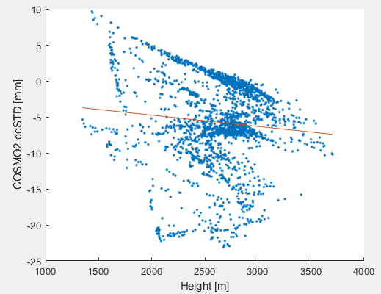
Relative pathdelays (ddSTDs) from GNSS, InSAR and NWP data
Example of good agreement:
Example of low agreement:
InSAR
GNSS
NWP
InSAR
GNSS
NWP

Slide 7
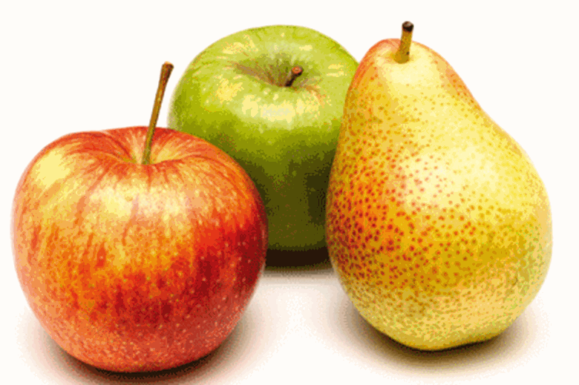
Relative pathdelays (ddSTDs) from GNSS, InSAR and NWP data
Analysis of 28 interferometric images:
For all methods there is a correlation of the ddSTDs with height
InSAR and NWP have a tendency to correlate better
Retrieval of relative delays by collocation of GNSS ZTDs:
Correlation lengths: Good results with Δh=5 km and ΔE,N = 30 km. Highest agreement by individual parameter tuning for each image
Size of the GNSS network used in the collocation: Using only a sub-network closeby to the InSAR image can produce comparable results to using all stations of the AGNES/COGEAR network. 10-20% improvement by increasing the GNSS network density from 10km to 2km mean station distance (from simulations)
Weather conditions: Local pressure variations have the largest impact on the ddSTD agreement
GNSS
InSAR
NWP

Slide 8
Future works
Setup of an Alpine laboratory in the Matter valley, including
a dense GNSS network,
radar reflectors,
close-up / long-range laser scanning
Possible refinement of collocation models for the operation on local scales
Cross-validation of the individual techniques
Development of processing strategies for the monitoring of small-scale mass movement in the Alpine domain
Example GNSS/reflector station
Mass movements @ Breithorn (Matter valley)

Slide 9
Endrit Shehaj
PhD student
eshehaj@ethz.ch
ETH Zürich
Institute of Geodesy and Photogrammetry
HPV F 51
Robert-​Gnehm-Weg 15
8093 Zurich
www.mpg.igp.ethz.ch

