Slide 1



Characterising volatile organic compound (VOC) emission changes in native black poplar under elevated carbon-dioxide (CO₂), elevated ozone (O₃) and herbivory
Laura James¹, Christian Pfrang¹, Robbie Girling², Scott Hayward¹, Rob MacKenzie¹
1. University of Birmingham, Geography, Earth and Environmental Sciences, 2. University of Reading
@lauradjames
lxb973@student.bham.ac.uk

Slide 2
How and why am I ‘characterising’ changes to VOC emissions?
What even is a VOC?
Why does this matter?
Notes:
(collecting VOCs from head space, looking at using GC-MS, identifying molecules [particularly those that are ‘induced’ by herbivory])Q is there a difference between control plants, and ones grown under pollution

Slide 3
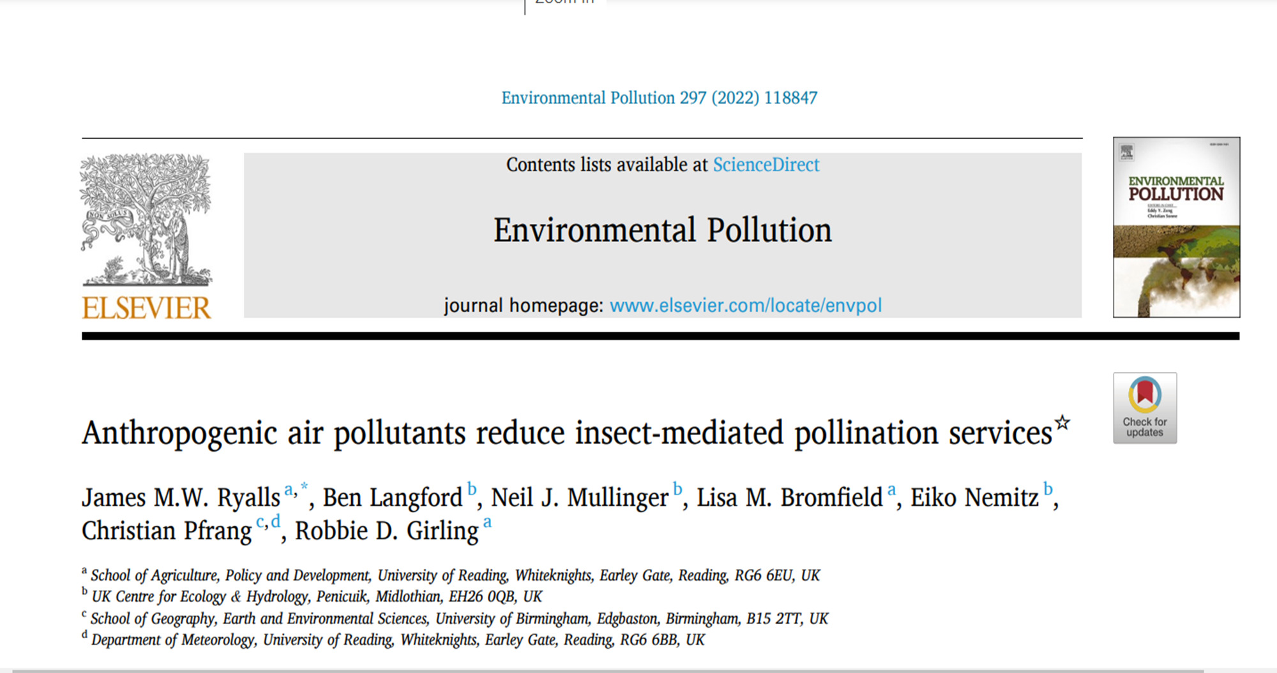

Slide 4
“elevating diesel exhaust and O3, individually and in combination, to levels lower than is considered safe under current air quality standards*, significantly reduced counts of locally-occurring wild and managed insect pollinators by 62–70% and their flower visits by 83–90%. These reductions ( . . .) coincided with significant reductions (14–31%) in three different metrics of pollination and yield of a self-fertile test plant”

Slide 5
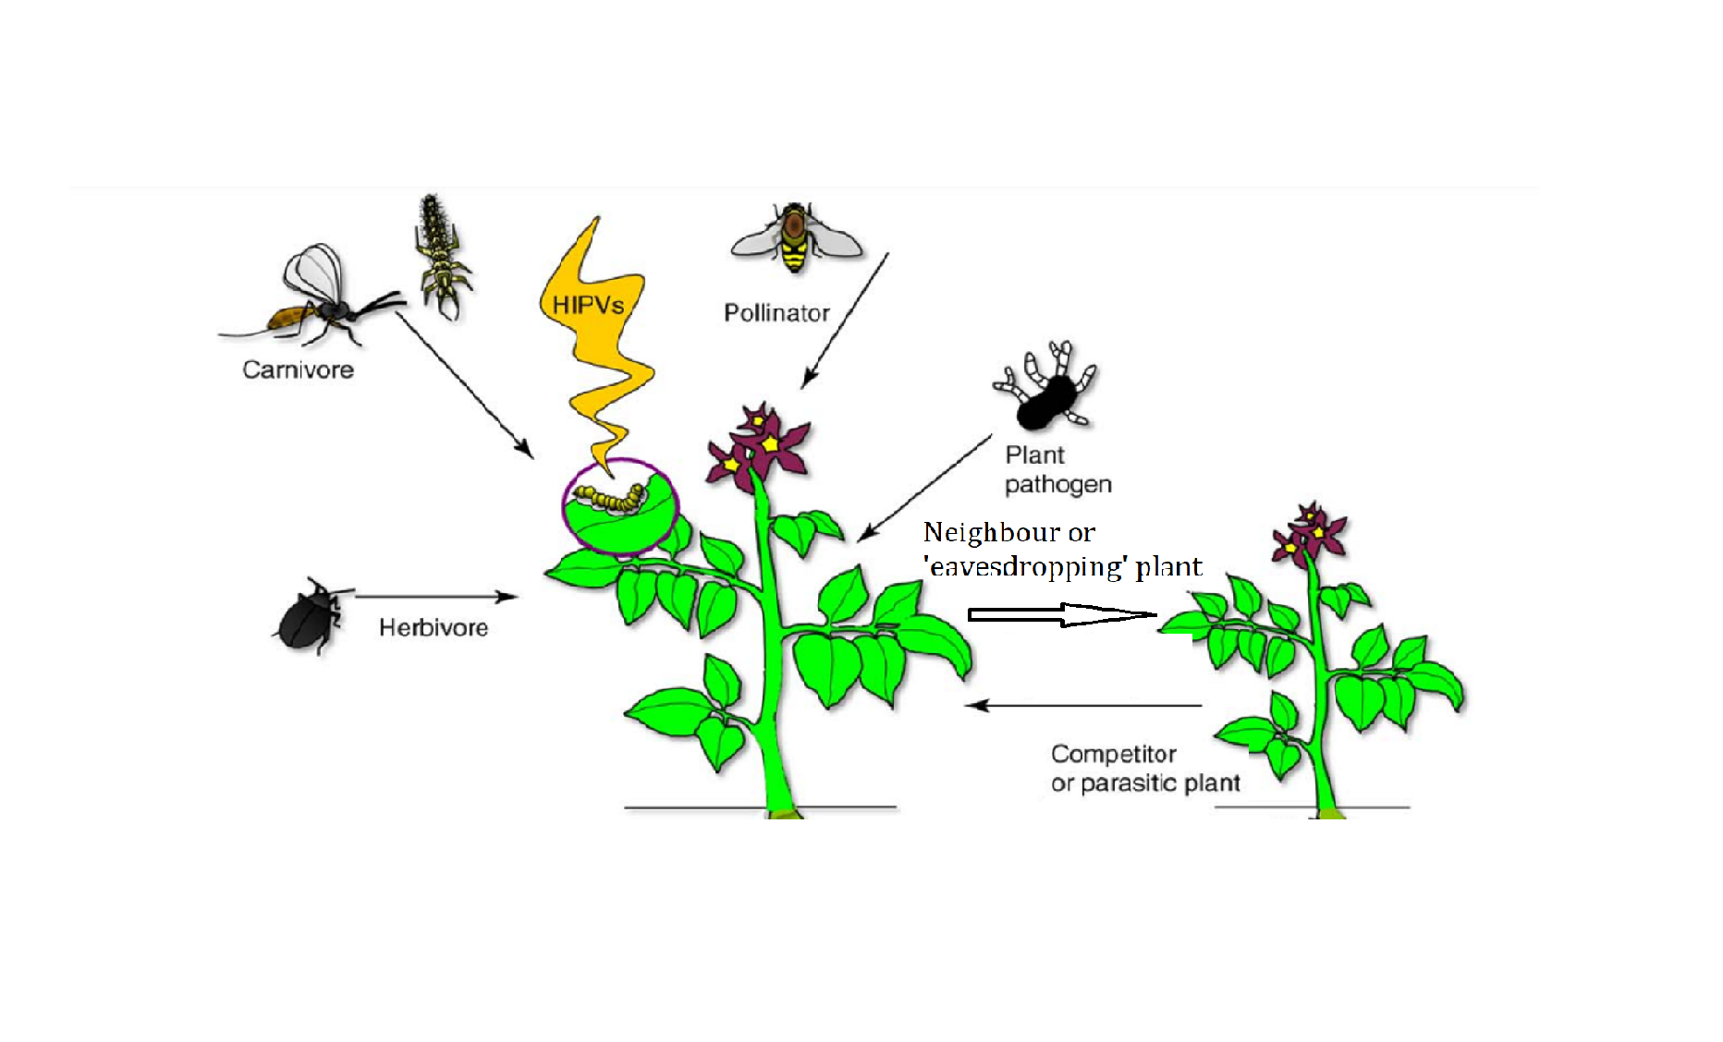
Adapted from Dicke and Baldwin 2010 (beyond the cry for help)

Slide 6
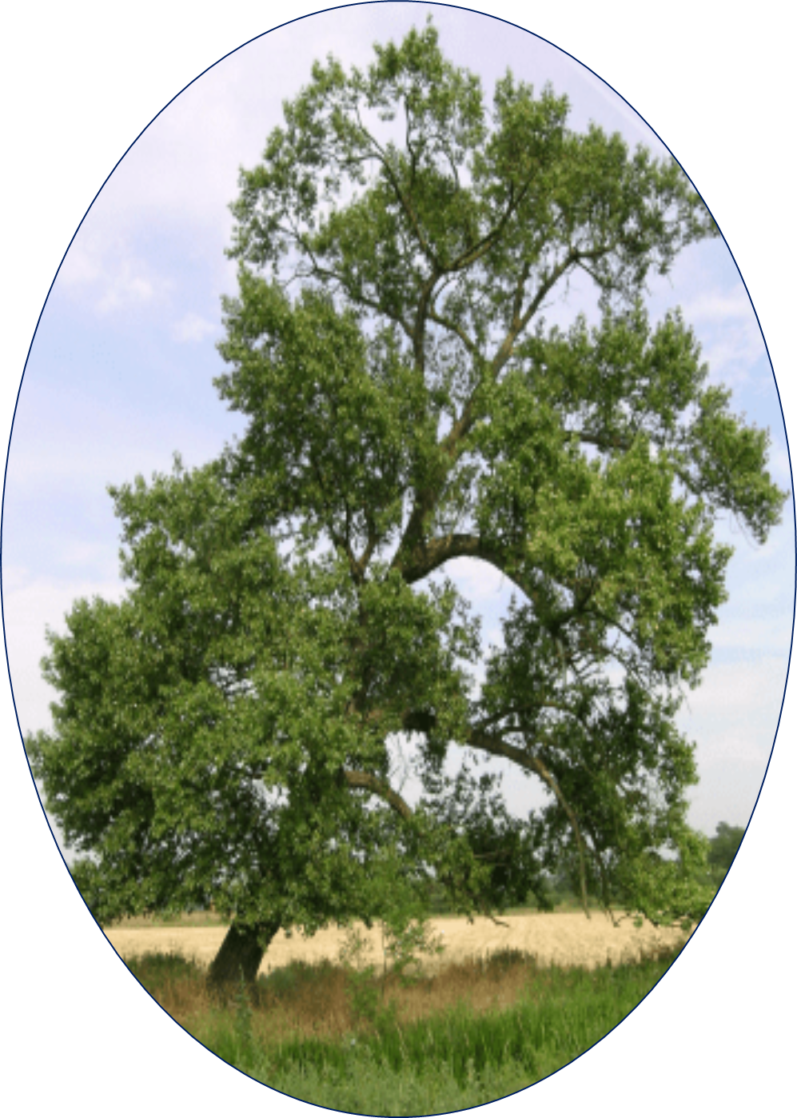
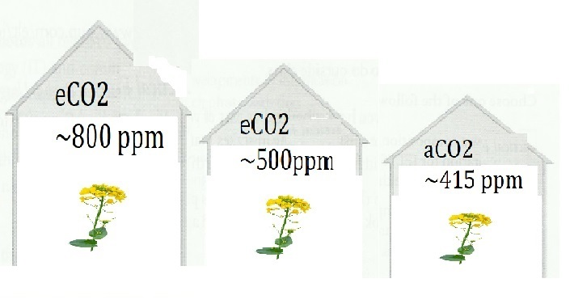
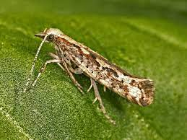
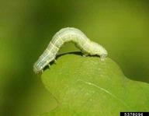
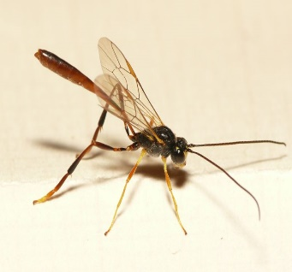
Model system 1
Model system 2
Black poplar (Populus nigra)
Diamond back moth (plutella xylostella)
Winter moth (Operophtera brumata)
Oil seed rape
(Brassica napus)
Parasitoid wasp of winter moth (Agrypon flaveolatum)

Slide 7
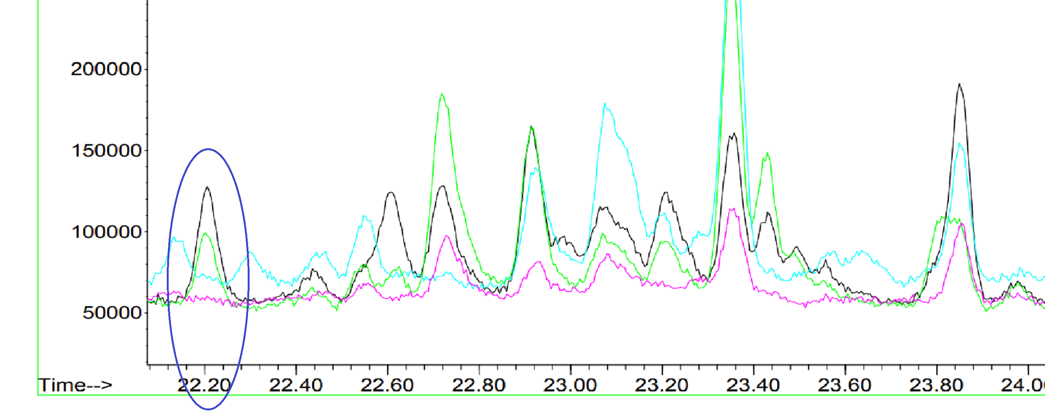
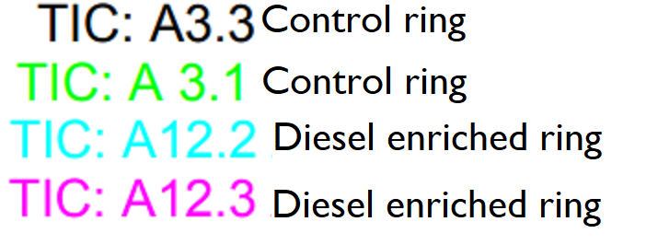

Slide 8
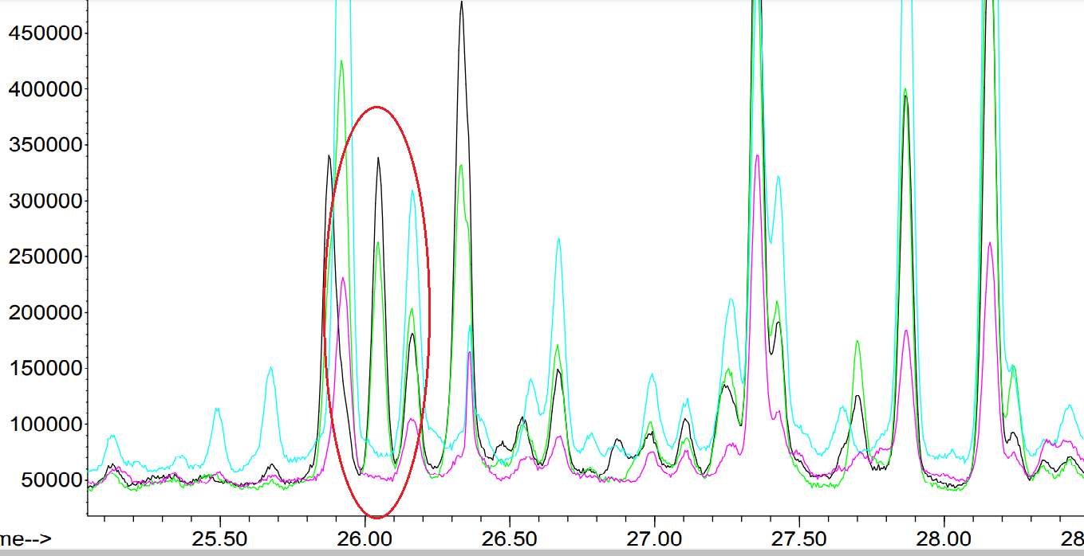

Slide 9
In conclusion, we hope that larger data sets can elucidate the specific plant volatile compounds that are most impacted by these key pollutants, and will add something to the conversation around anthropogenically altered chemical communication

