Slide 1
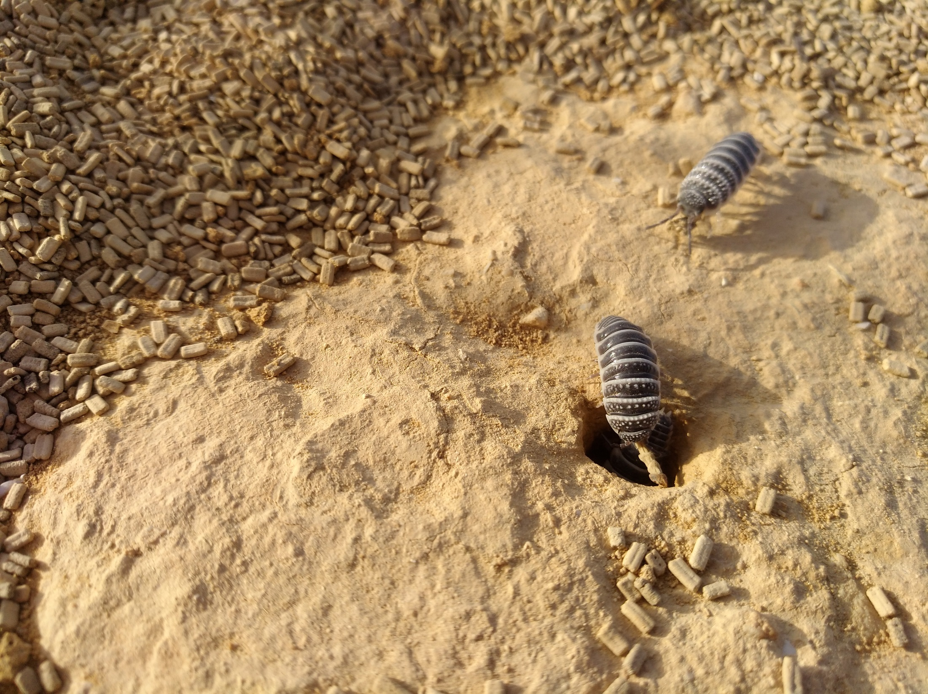


Ecosystem engineering by desert macro-detritivores facilitates microbial litter decomposition
Nevo Sagi, Moshe Zaguri & Dror Hawlena
Embracing the role of soil fauna in biogeochemical cycling
EGU 2022, Vienna
Notes:
Hello everyone. My name is Nevo Sagi and I will talk about how ecosystem engineering by desert macro-detritivores facilitates microbial litter decomposition.

Slide 2
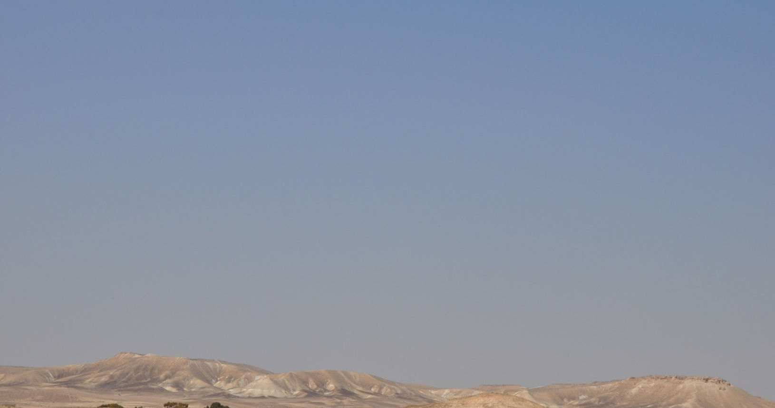
Litter decomposition in terrestrial ecosystems
Regulated by moisture-dependent activity of microorganisms
In deserts:
Very low and infrequent moisture availability
Expected - slow decomposition, mainly after rain events
In fact:
Decomposition decoupled from climate conditions:
Faster than predicted by climate-based models
Independent on precipitation
Notes:
Plant-litter decomposition in most terrestrial ecosystems is regulated by moisture-dependent activity of microorganisms.
Deserts are characterized by low and infrequent precipitation
Therefore, litter decomposition is expected to be slow and happen mainly during sporadic rain events.
Instead, we see that litter disappears faster than expected, independent on precipitation.

Slide 3
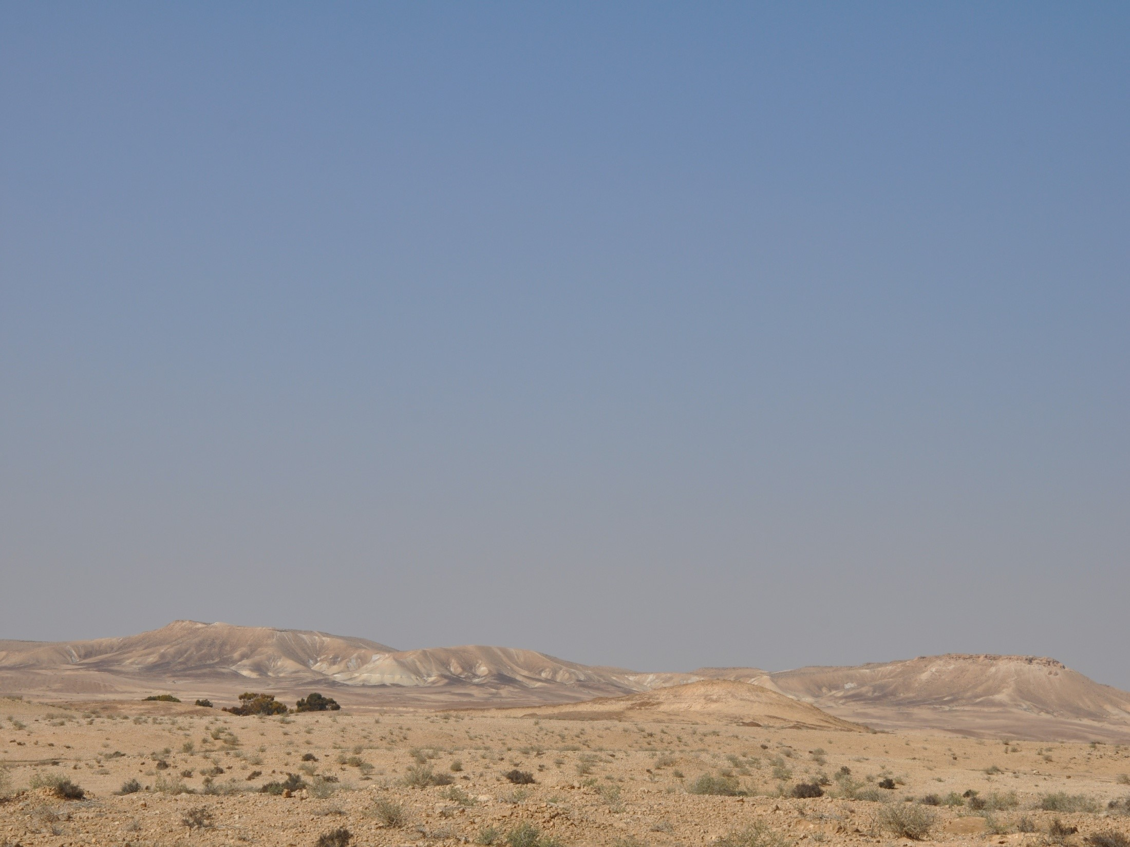
The Dryland Decomposition Conundrum
or
Facilitators of decomposition on the desert surface
Abiotic weathering
Non-rainfall moisture
Soil-litter mixing
“Important role for ‘macrodecomposition’ by detritivorous arthropods”
(Noy-Meir 1974)
Notes:
Giving rise to the so-called Dryland Decomposition Conundrum
Current attempts to resolve it focus on various mechanisms that facilitate decomposition under harsh conditions that prevail upon the desert surface.
However, this is relevant only for the litter that remains on the surface, whereas much of it may be removed by detritivorous fauna.

Slide 4
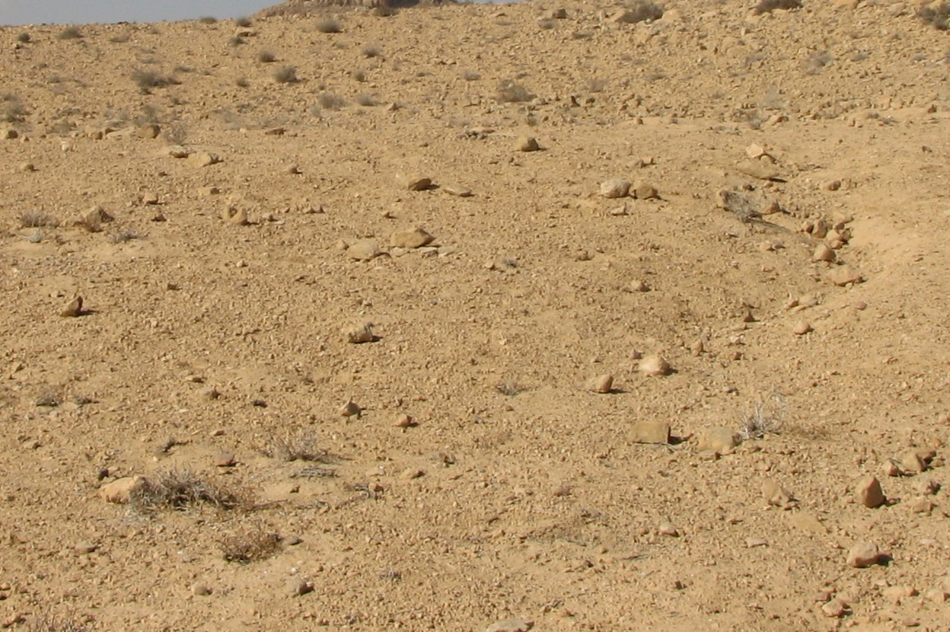

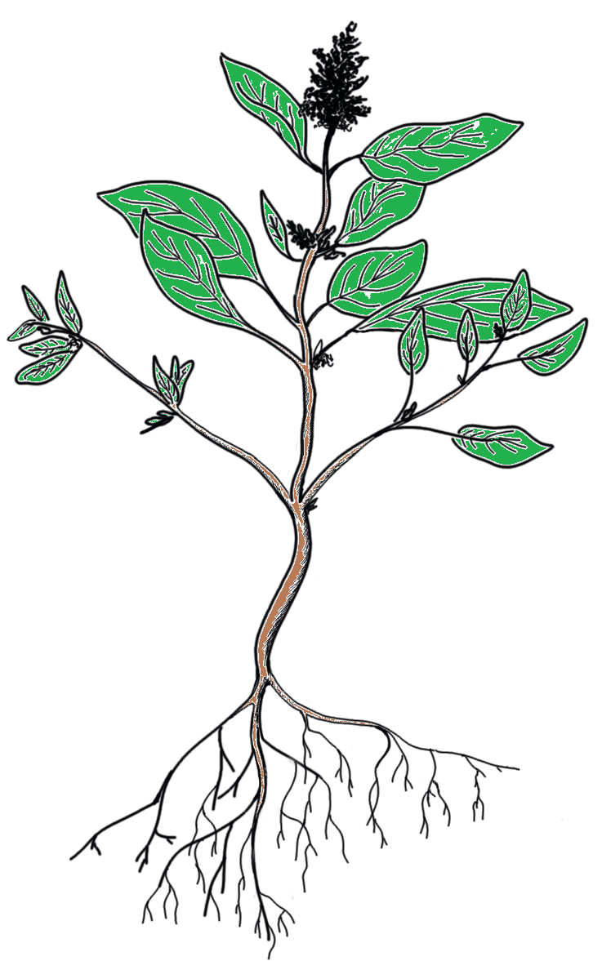


Facilitation of decomposition via litter redistribution to favorable environments
Notes:
These animals redistribute organic matter to their burrows, where favorable conditions may facilitate decomposition.

Slide 5




Facilitation of decomposition via litter redistribution to favorable environments
Climatic Facilitation – buffering extreme surface conditions
Nutrient Facilitation – priming effect
Nutrients +
Moisture +
Microbial Decomposition
Temperature
Organic Matter
Inorganic Nutrients
Notes:
This can be manifested in two pathways:
Climatic facilitation – where burrows can buffer the harsh surface climatic conditions
And nutrient facilitation – where elevated nutrient contents can have a priming effect on the microbial community.

Slide 6
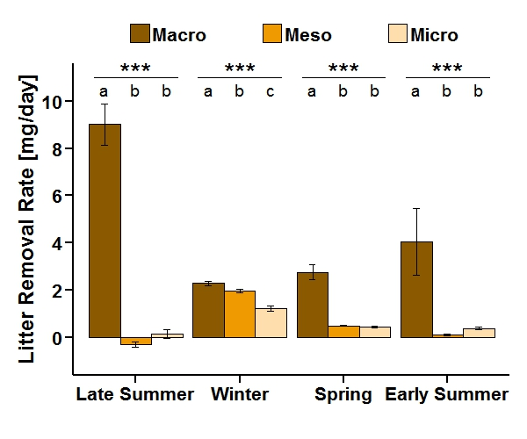



Macro-detritivores dominate litter clearing from the surface in the Negev Desert
Macro-detritivores accounted for 89% of daily litter removal from the surface
Hemilepistus reaumuri
Notes:
In a previous study, we have found that macrofauna dominates litter clearing from the surface in the Negev Desert, accounting for almost 90% of litter loss, especially in the dry summer.
The most prominent species in this system is the desert isopod Hemilepistus reaumuri. Then we asked what happens to this removed litter when it reaches the burrow.

Slide 7
Study goal
To explore whether and how isopods facilitate microbial litter decomposition, via both climatic and nutrient facilitation.
Nutrients +
Moisture +
Microbial Decomposition
Temperature
Organic Matter
Inorganic Nutrients
Notes:
The goal of the following study was to explore whether and how desert isopods facilitate microbial decomposition, via both climatic and nutrient facilitation.

Slide 8
Methods:
Fine mesh litter bags in different habitats
4 Micro-environments
Isopod burrow
Artificial burrow
Fecal mound
Soil surface
litter bag
Notes:
To do this we placed fine mesh litter bags in four different habitats:

Slide 9


Methods:
Fine mesh litter bags in different habitats
 |  |  |  | Climatic facilitation
 |  |  |  | Nutrient facilitation
Isopod burrow
Artificial burrow
Fecal mound
Soil surface
Notes:
(1) in empty burrows of desert isopods, providing both climatic and nutrient facilitation.
(2) in artificial burrows, which are holes we drilled in the ground that mimic the physical conditions of isopod burrows but provide only climatic facilitation.
(3) on feces mounds outside isopod burrows, providing only nutrient facilitation.
and (4) on the soil surface, as an aboveground control.

Slide 10
Methods:
Measure carbon respiration from litter
Metabolic Chambers
Notes:
To measure litter decomposition in real time, we constructed metabolic chambers around these micro-environments

Slide 11
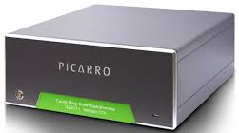
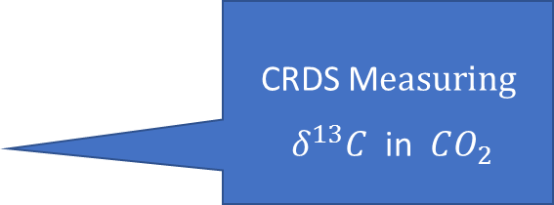
Methods:
Separate litter mineralization
from background soil respiration
¹³C-labeled litter bag
CRDS M$easuring$
$δ^{13}C$ in $CO_{2}$
Notes:
And connected them to a cavity ring-down spectrometer. The litter was isotopically labeled, and we measured isotopic ratio in the respired CO₂ to differentiate litter mineralization from background soil respiration.

Slide 12
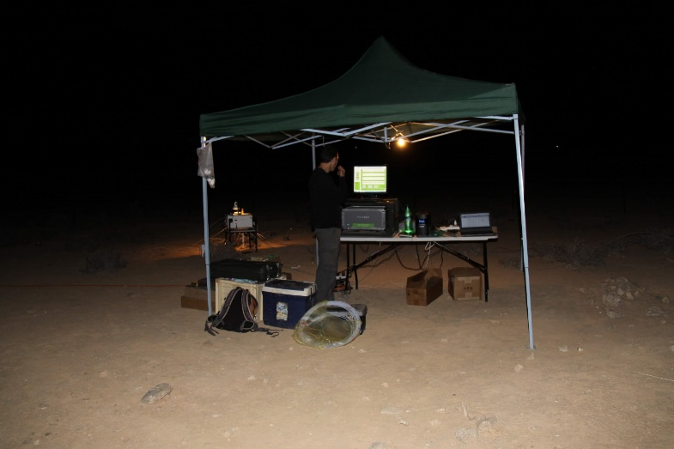
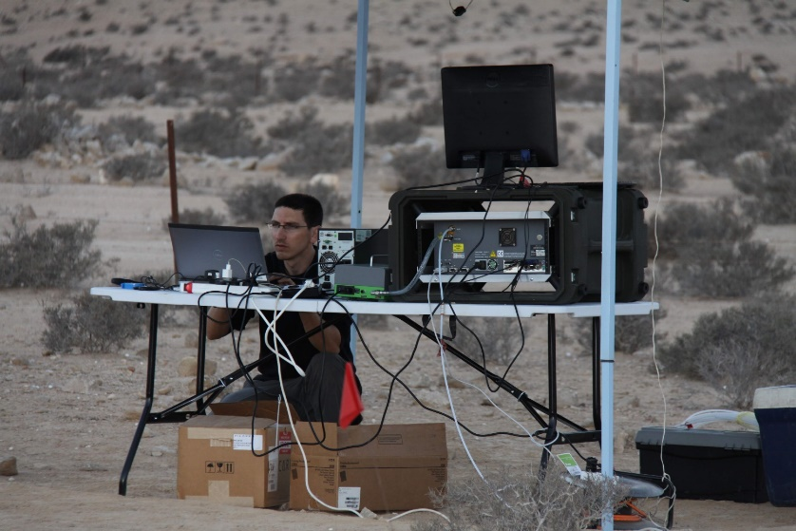
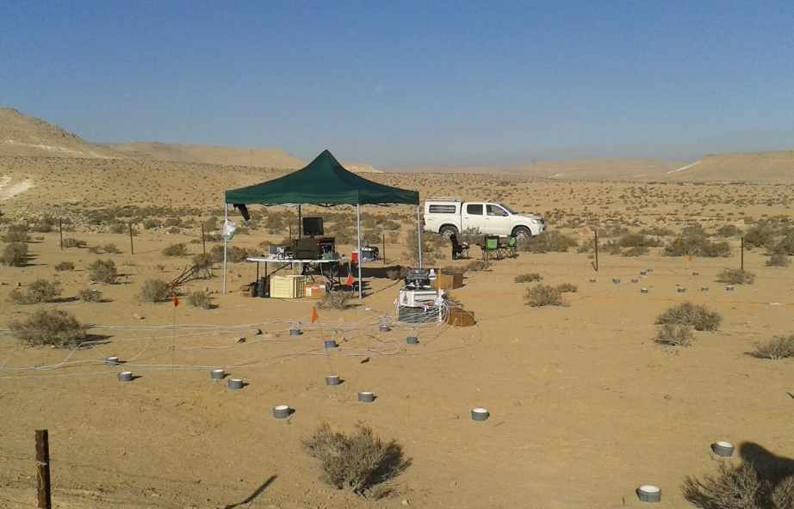
Field measurements:
Monthly interval (10 months)
Increased frequency following rain events
Quantified also total litter mass loss
Notes:
We performed these measurements in a monthly interval
with increased sampling frequency following rain events
after ten months we collected the litter bags to measure total litter mass loss.

Slide 13
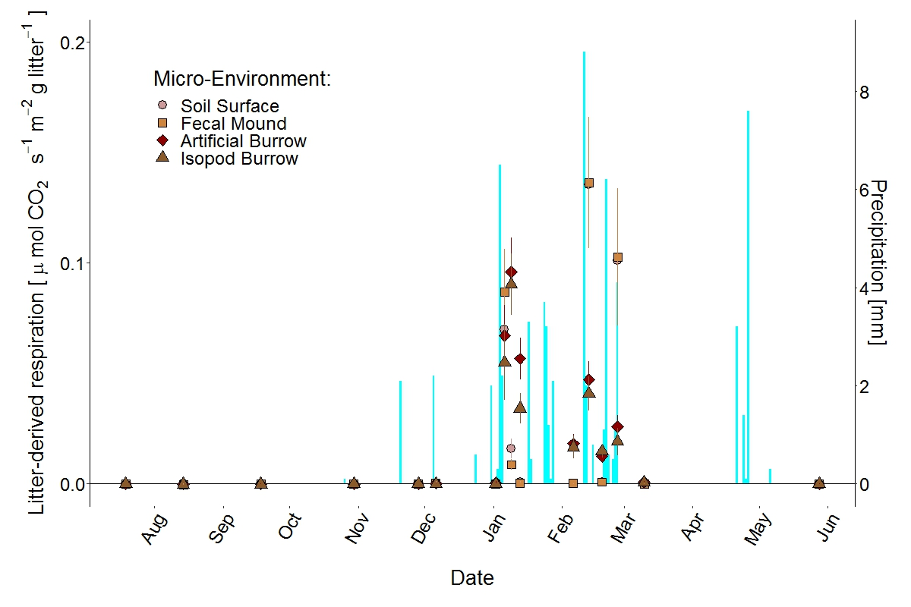

Litter decomposition restricted to the wet season in all micro-environments
C mineralization
Notes:
Here we can see decomposition dynamics during all 16 measuring trials. Different habitats are represented by different symbols and precipitation level is represented by pale blue bars.
We detected no decomposition during the dry periods from all micro-environments.

Slide 14
Small rain events do not stimulate decomposition
C mineralization
Notes:
Even small rain events did not stimulate decomposition.
A closer look at a single rain event in early January reveals interesting dynamics.

Slide 15
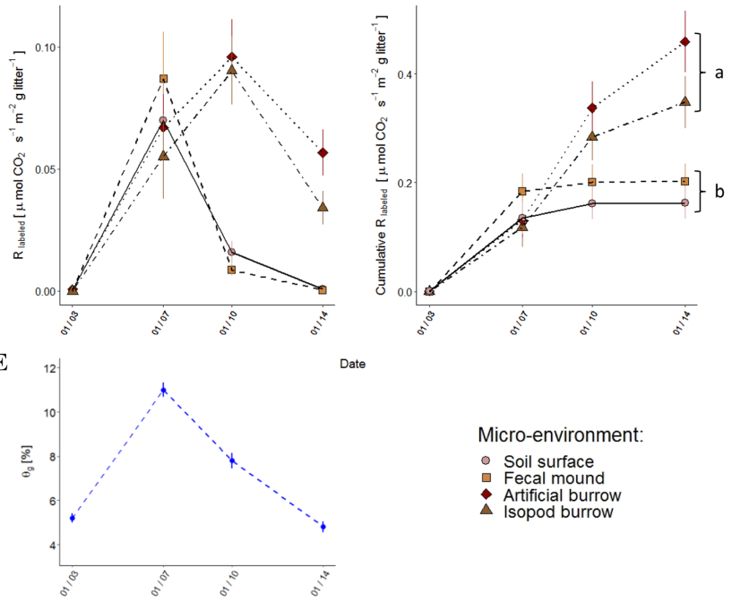
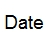
Extended decomposition belowground following rain event
Rain event
C mineralization
Cumulative C mineralization
Soil moisture [%]
3.1
7.1
10.1
14.1
Date
Notes:
Belowground decomposition (in isopod and artificial burrows) lasted longer than on the surface, proceeding when aboveground decomposition had already ceased.
Cumulative decomposition following this rain event was significantly higher belowground than on the surface.

Slide 16
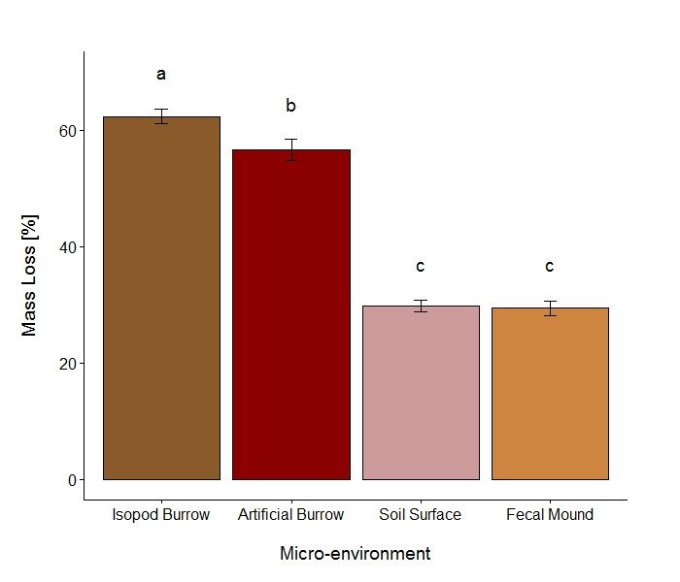
Mass loss throughout the whole experiment (10 months)
X 2
Notes:
Looking at litter mass loss during ten months in the field
We see mass loss belowground twofold higher than on the surface

Slide 17
Mass loss throughout the whole experiment (10 months)
Notes:
And significantly higher mass loss in isopod burrows compared to artificial ones.
Whereas no difference was found between feces mounds and the control plots.

Slide 18
Conclusions
No stimulation of decomposition by alternative moisture sources.
Evidence for climatic facilitation.
Evidence for nutrient facilitation, but only when coupled with climatic facilitation.
Notes:
To conclude:
We did not detect any litter decomposition during the dry periods, despite observed dew deposition and high air moisture measured during the nights.
We did find evidence for climatic facilitation of microbial decomposition within isopod burrows.
And for nutrient facilitation, but only when coupled with climatic facilitation.

Slide 19



The Vertical Nutrient Recycling Loop (VRL) hypothesis
Litter
Soil crust
Nutrients +
Moisture +
Microbial Decomposition
Temperature
Fragmented Litter
Inorganic Nutrients
Feces
Excretions
Nutrient Reservoirs
Nutrient Fluxes
Regulation
Notes:
This work explored one mechanism which is part of a more general hypothesis on how macro-detritivores regulate nutrient cycling in deserts.

Slide 20
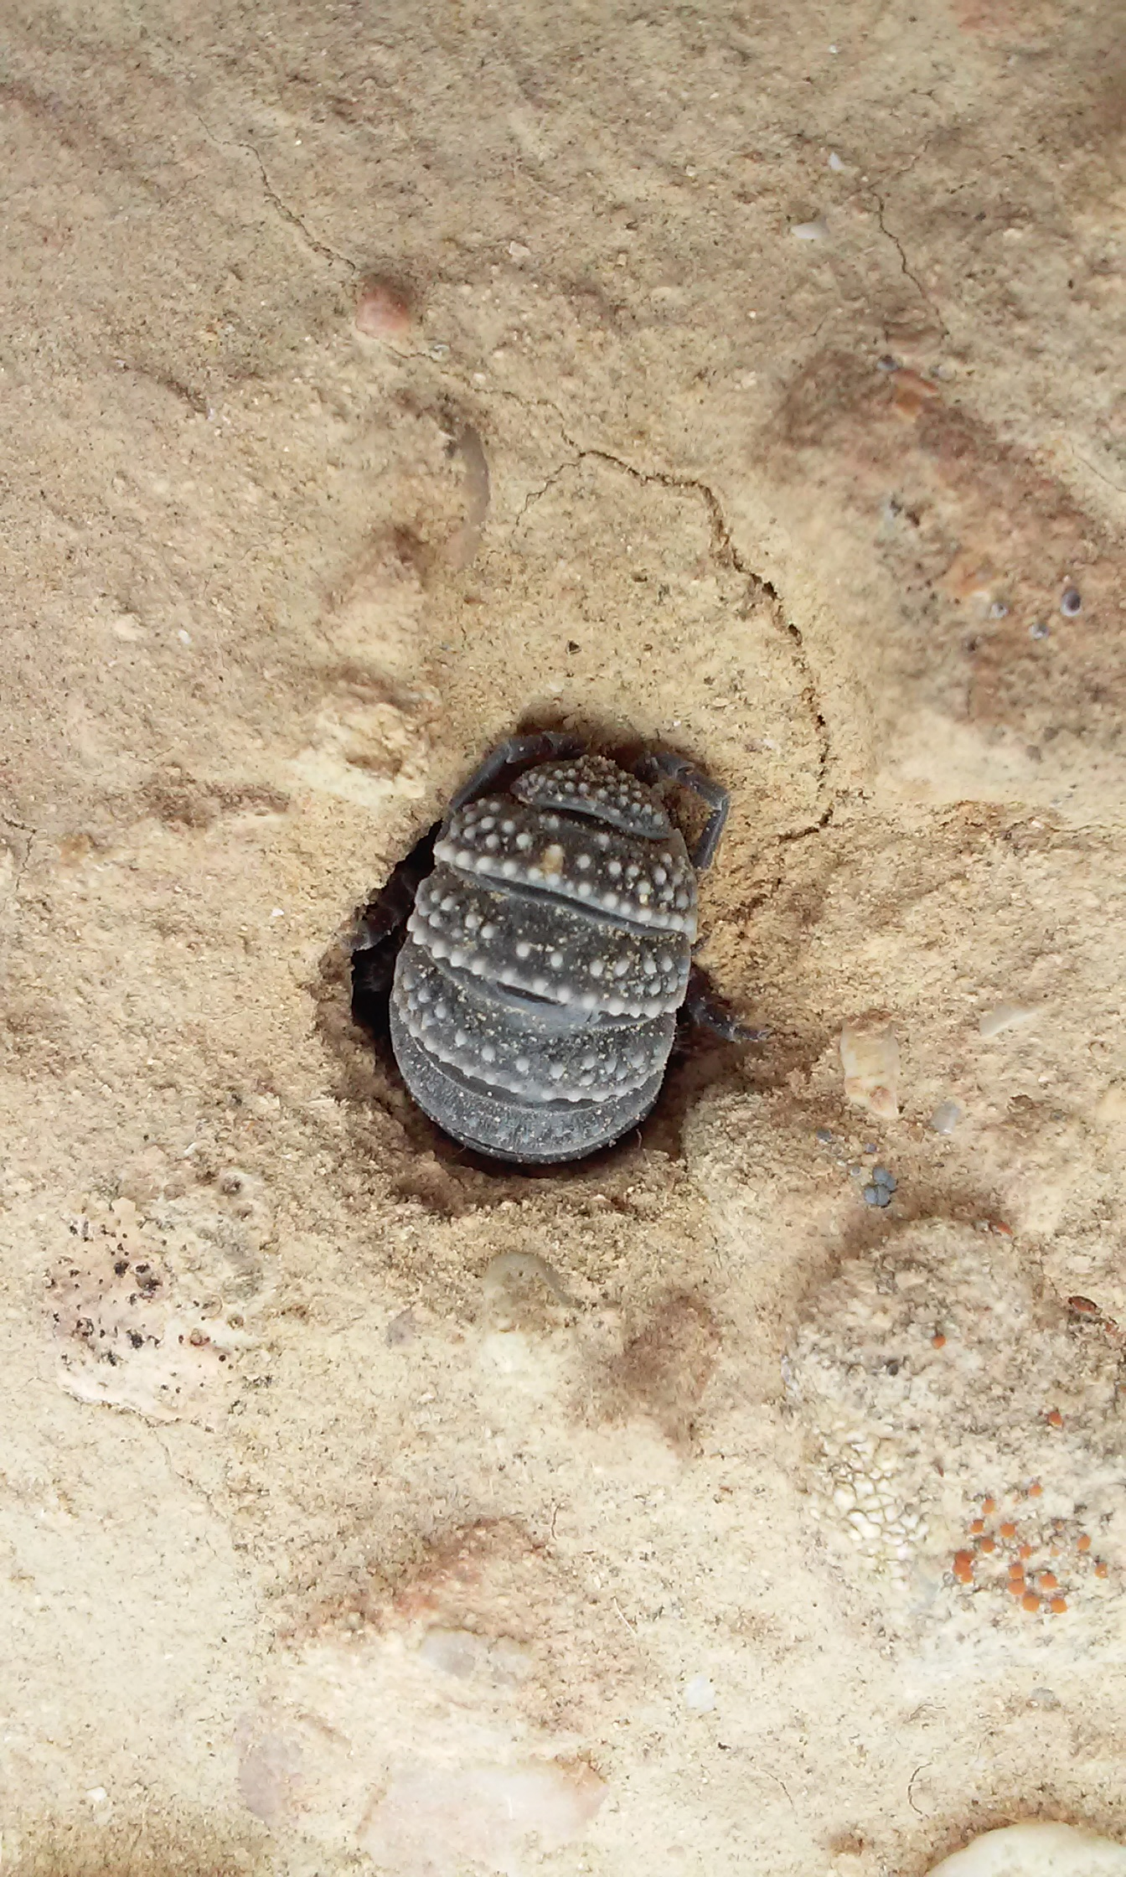


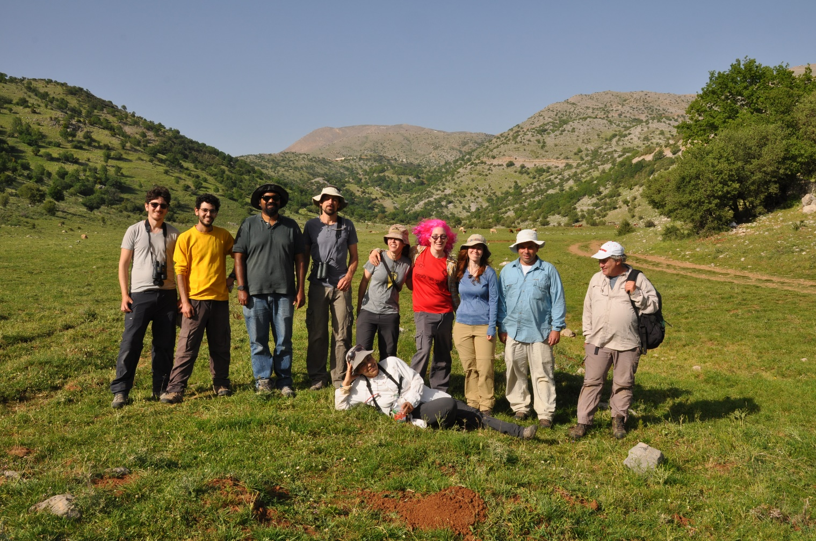



Thanks!
@NevoSagi
nevo.sagi@mail.huji.ac.il
Notes:
I want to thank you for listening and to acknowledge the contribution of all my lab colleagues that helped during this study. Thanks also to the funding agencies.
And I will be happy to take questions…

