Slide 1
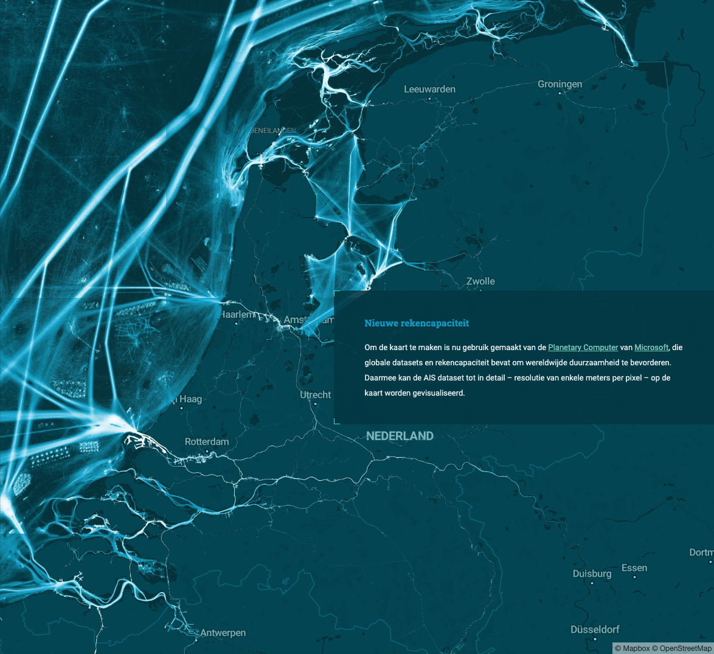



Drukte op de Noordzee
“Hustle and bustle on the North Sea”
Van der Werff et al., 2021
Do tidal sand waves always regenerate
after dredging? Krabbendam et al.

Slide 2
Drukte op de Noordzee
“Hustle and bustle on the North Sea”
Van der Werff et al., 2021
Do tidal sand waves always regenerate
after dredging? Krabbendam et al.

Slide 3
Do tidal sand waves always regenerate
after dredging? Krabbendam et al.

Slide 4
Do tidal sand waves always regenerate after dredging?
Janneke Krabbendam¹, Marc Roche², Vera Van Lancker³, Abdel Nnafie¹, Nathan Terseleer³, Koen Degrendele²,
Huib De Swart¹
¹IMAU, Utrecht University ²Continental Shelf Service, FPS Economie ³OD Nature, Royal Belgian Institute of Natural Sciences
Do tidal sand waves always regenerate
after dredging? Krabbendam et al.

Slide 5
Do tidal sand waves always regenerate
after dredging? Krabbendam et al.

Slide 6
Do tidal sand waves always regenerate
after dredging? Krabbendam et al.

Slide 7
Do tidal sand waves always regenerate
after dredging? Krabbendam et al.

Slide 8
Do tidal sand waves always regenerate
after dredging? Krabbendam et al.

Slide 9
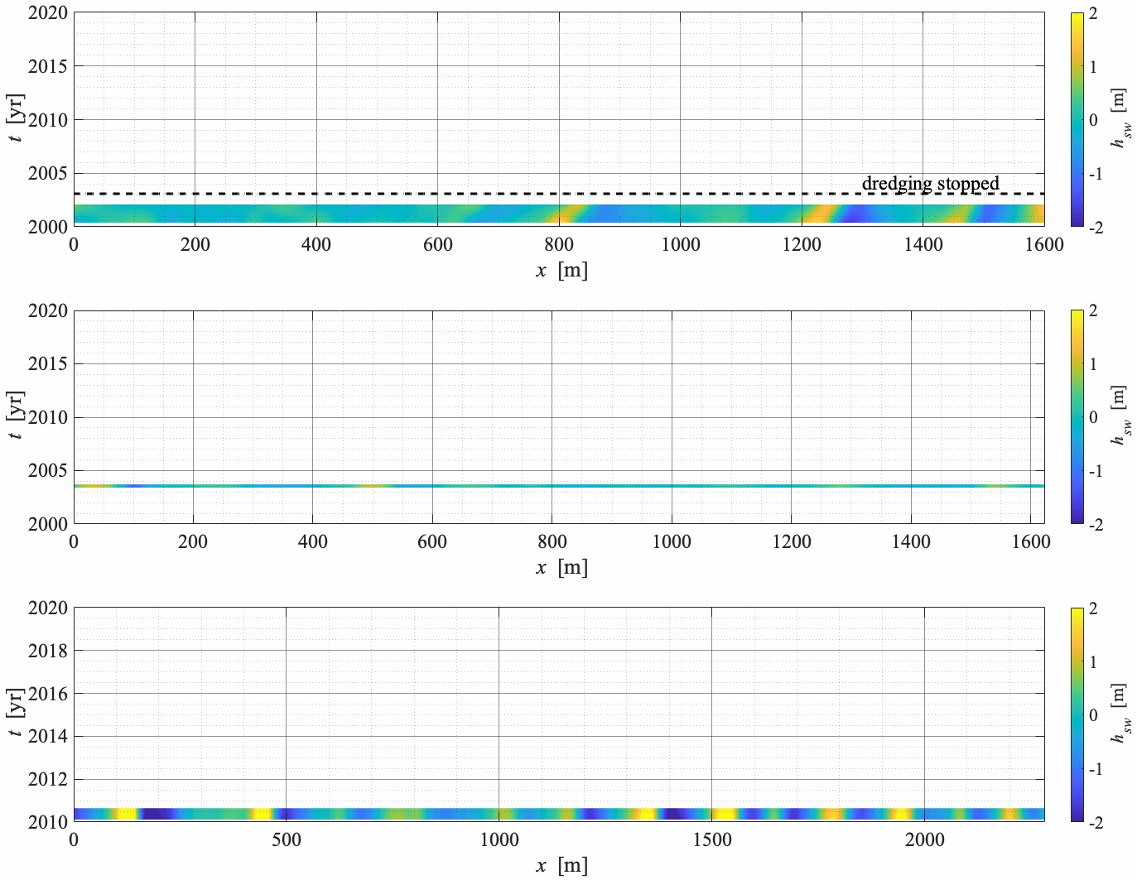
1
2
3
2
3
1
Do tidal sand waves always regenerate
after dredging? Krabbendam et al.

Slide 10
water depth
shallowest water depth in area 1
Do tidal sand waves always regenerate
after dredging? Krabbendam et al.

Slide 11
water depth
sand availability
little Holocene sand left in areas 2 and 3
Do tidal sand waves always regenerate
after dredging? Krabbendam et al.

Slide 12
water depth
sand availability
channelisation of current
intensification of current in recovering area 1
Do tidal sand waves always regenerate
after dredging? Krabbendam et al.

Slide 13
water depth
sand availability
channelisation of current
dredging strategy?
data gaps in dredged volumes of areas 1 and 2,
so effect unkown
Do tidal sand waves always regenerate
after dredging? Krabbendam et al.

Slide 14
water depth
sand availability
Sand waves in only one of the areas are regenerating (within observational period)
Different responses likely related to:
water depth
availability of local sand
channelisation of current
dredging strategy?
Do tidal sand waves always regenerate
after dredging? Krabbendam et al.

Slide 15
1
Thanks for your attention! Are there any questions?
2
3
2
3
1
Do tidal sand waves always regenerate
after dredging? Krabbendam et al.

Slide 16
Appendix
Study areas
Do tidal sand waves always regenerate
after dredging? Krabbendam et al.
Notes:
So these are the areas that we will focus on. We focus on the areas that have deepened the most, which are called the depression. So in the areas on the KwinteBank are called the central and nothern depression by my Belgian colleagues, to I will stick to the same names. And the one in Buiten Ratel, we call the western depression. And we will focus on the sand waves along transects in the middle of these depressions.

Slide 17
Appendix
Methodology
Window
Fourier transform
Filter high frequencies
Interpolate on transects
Gaussian moving average
Do tidal sand waves always regenerate
after dredging? Krabbendam et al.
Notes:
So this is the methodology with which I separated to the tidal sand waves from the smaller and larger bed forms.

Slide 18
KBMA
Appendix
Result from high pass filter = (mega)-ribbles
Difference = sand banks + sand waves
Original bed level
Do tidal sand waves always regenerate
after dredging? Krabbendam et al.
Notes:
If I then convert back to the spatial domain. In the left panel, you see the original bed level and in the middle the result from the high pass filter, which I consider to be the ripples and megaripples. These ripples and meagaripples I subtracted from the original bed level, so I am left with sand banks and sand waves. And you see that in the right most panel. I tried different windows, differenf filters and different cuttoff frequencies and I always obtain more or less the same result. Only small quantitative differences.

Slide 19
Central depression
Appendix
Do tidal sand waves always regenerate
after dredging? Krabbendam et al.
Notes:
And then this is the final result. In the top panel are two profiles obtained just after closure in dashes, and the black solid line was the profile of 2019. The shaded areas are the crest and trough volumes I will consider later. But the sum of all the red areas I call crest volume, which is in fact a volume per unit width. And all the blue areas are the trough volumes. IN the lower panel you see a hovemoller type plot of the sand wave height. So on the y-axis is time, x-axis is distance and the colors denote the sand wave heights. The yellow parts are the crests and the blue the troughs. This dashed line is when the area was closed to sand extraction. In the left half, you see that there are hardly any sand waves left, but here they start to grow again. Approximately 5 years after closure. And in this part of the domain, you see that they adjusted there migration rate, it actually decreased a lot.

Slide 20
Northern depression
Appendix
Do tidal sand waves always regenerate
after dredging? Krabbendam et al.
Notes:
So now we look at the northern depression. This area was closed in 2010, that is this and this dashed line. And here you also see the last profile obtained in 2019. And there is not a lot of difference. Before closure, you see the sand wave height decrease, but it remaines quite constant in the 9 years since closure.

Slide 21
Northern depression
Appendix
Do tidal sand waves always regenerate
after dredging? Krabbendam et al.
Notes:
And then finally the western depression. This area was closed in early 2015. So you see the sand wave height decrease before that. And small amplitude sand waves remain since closure. But in the next five years, nothing really happens, they only migrated with a meter per year or so. But no changes in amplitude.

Slide 22
Appendix
Do tidal sand waves always regenerate
after dredging? Krabbendam et al.
Notes:
And then finally these are the crest and troughs volumes. Which I call volumes, but are in fact volumes per m width. And you see that they behave in the quite a simialr way, they btoh change in the same rate. And they increase both in KBMA. This suggests to us that the sand necessary for the crests, comes from the troughs, it is eroded there.

Slide 23
Local availability of sand
Appendix
Average bed level in central depression and surrounding areas not changing
Same changes in crest and trough volume
No change in sand wave height of neighbouring sand waves, but there is a change in width
No change in backscatter signal
Do tidal sand waves always regenerate
after dredging? Krabbendam et al.

Slide 24
Local availability of sand
Appendix
Average bed level in central depression and surrounding areas not changing
Same changes in crest and trough volume
No change in sand wave height of neighbouring sand waves, but there is a change in width
No change in backscatter signal
Regeneration the result of local redistribution of sand:
erosion at the troughs and deposition at the crests
Do tidal sand waves always regenerate
after dredging? Krabbendam et al.

Slide 25
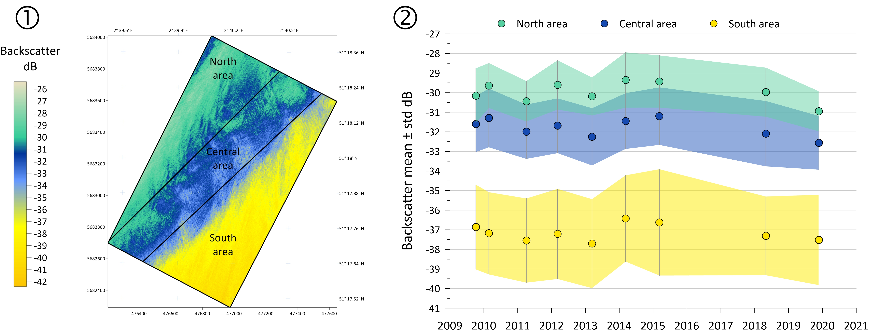
Backscatter KBMA
Appendix
Continental Shelf Service, Belgium, 2022
Do tidal sand waves always regenerate
after dredging? Krabbendam et al.

Slide 26
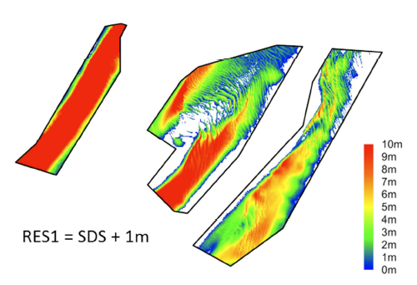
Sediment availability
Appendix
Northern depression
Western depression
Central depression
Remaning thickness of Holocene sand
Continental Shelf Service, Belgium, 2017
Do tidal sand waves always regenerate
after dredging? Krabbendam et al.

Slide 27
Tide
Very similar in all three locations
Channelisation in central dep.
Water depth
Northern (+4 m) and western (+6 m) significantly deeper than central dep.
Dredging strategy
In BRMC highest volumes before closure
Dredged volumes before 1999 unknown
Sediment
Smallest grain size in central dep.
Largest availability of sand in central dep.
Do tidal sand waves always regenerate
after dredging? Krabbendam et al.

Slide 28
Linear stability analysis
Appendix
Default settings: central depression
→ e-folding time scale of a few years
Channelisation of current
Depth-averaged current amplitude +5% →
e-folding -25%
Water depth
Depth to northern (+4 m) → e-folding times 2
Grain size
Changes in grain size
→ e-folding changes <5 %
Depth to northern (+6 m) → e-folding times 3
Do tidal sand waves always regenerate
after dredging? Krabbendam et al.

