Slide 1


A new set of overprinting slip-data along Manisa Fault in Aegean Extensional Province, Western Anatolia
Taner Tekin, Taylan Sançar, and Bora Rojay
For further questions: ttekin@metu.edu.tr
May, 2022

Slide 2
Resulting in complex large scale crustal deformational domain
- Horst with intervening E-W trending grabens (Gediz-Alaşehir, Büyük Menderes, Küçük Menderes).
Aegean Extensional province directly under the influence of major structures;
-Northward motion of African plate
-South Aegean Volcanic Arc
-Major Fault Zones (North Anatolian Fault Zone, East Anatolian Fault Zone)

Slide 3
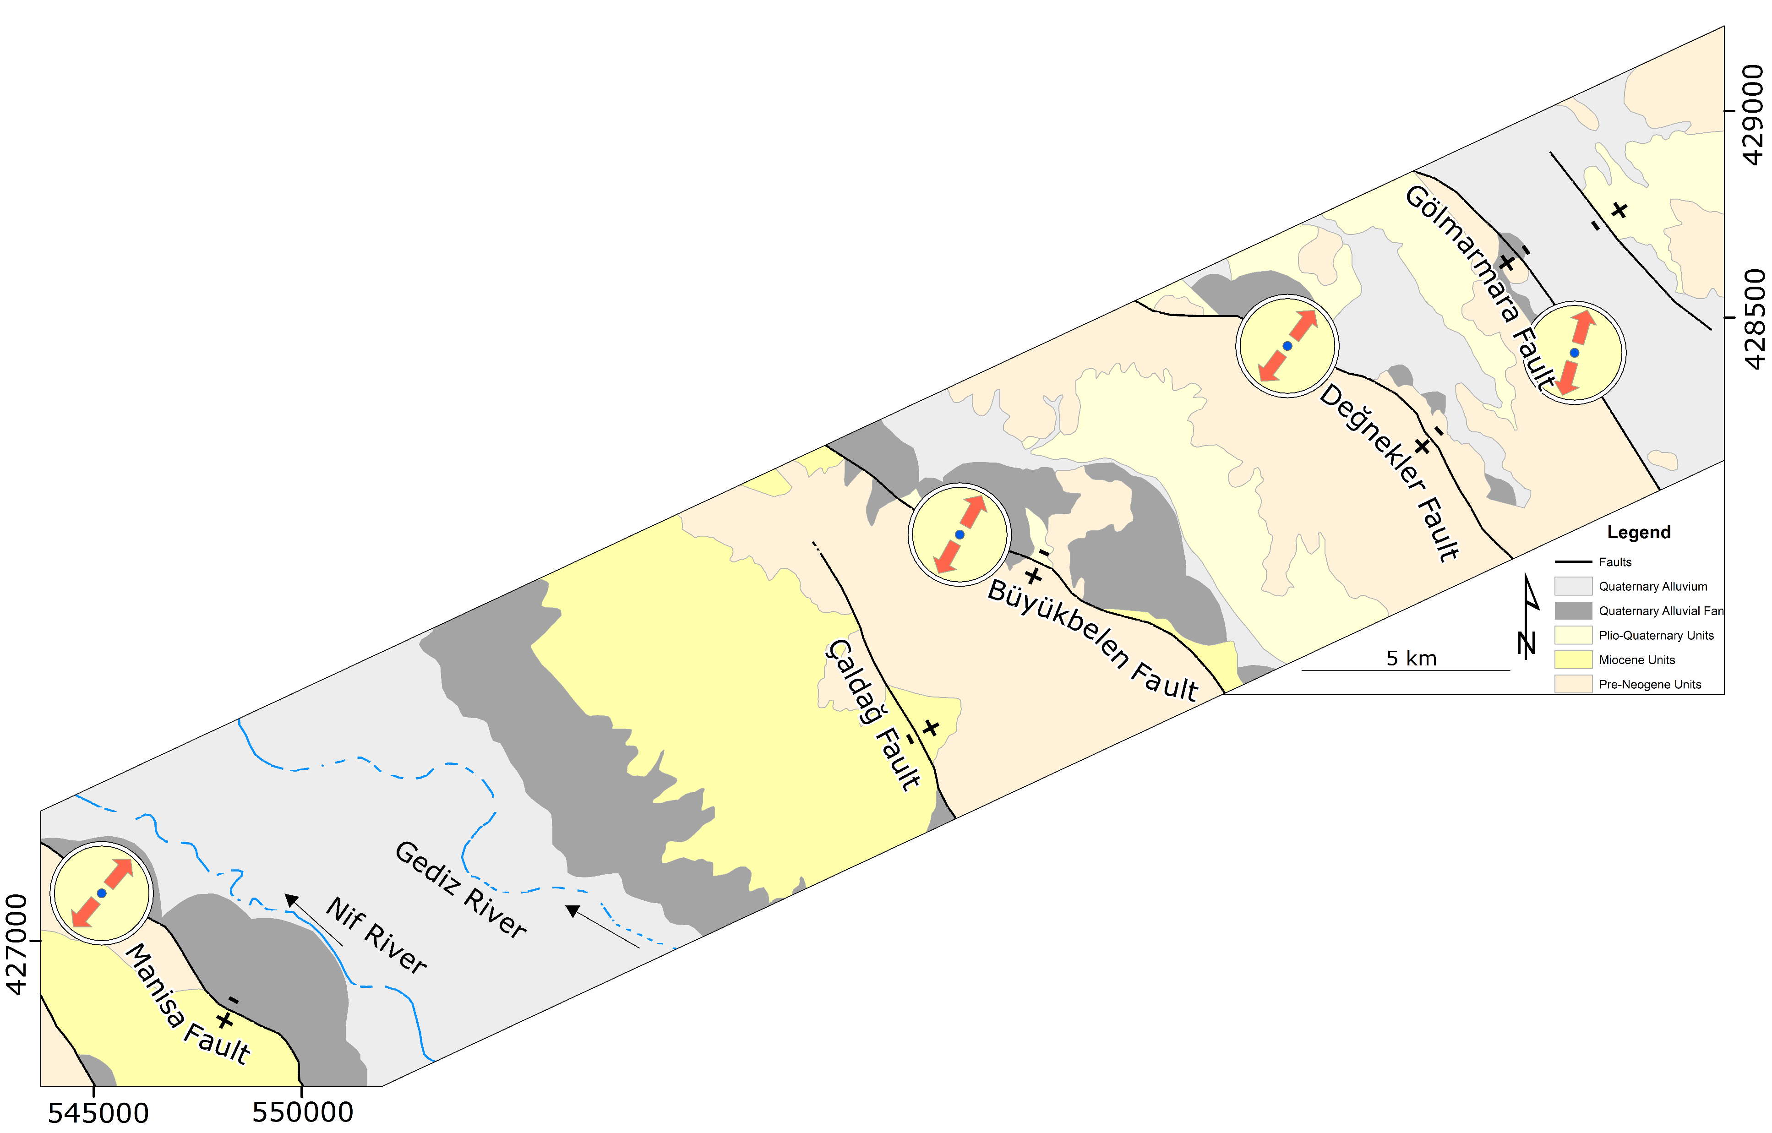
Rojay & Toprak, 2001
Bozkurt & Sözbilir, 2006
Dönmezoğulları, 2019
Studies in the vicinity of Gediz-Alaşehir Graben(GAG);
-Representing NW-SE trending normal faults.
-Pure NE-SW extension.
-Importance of Manisa fault on the role of GAG evolution.

Slide 4
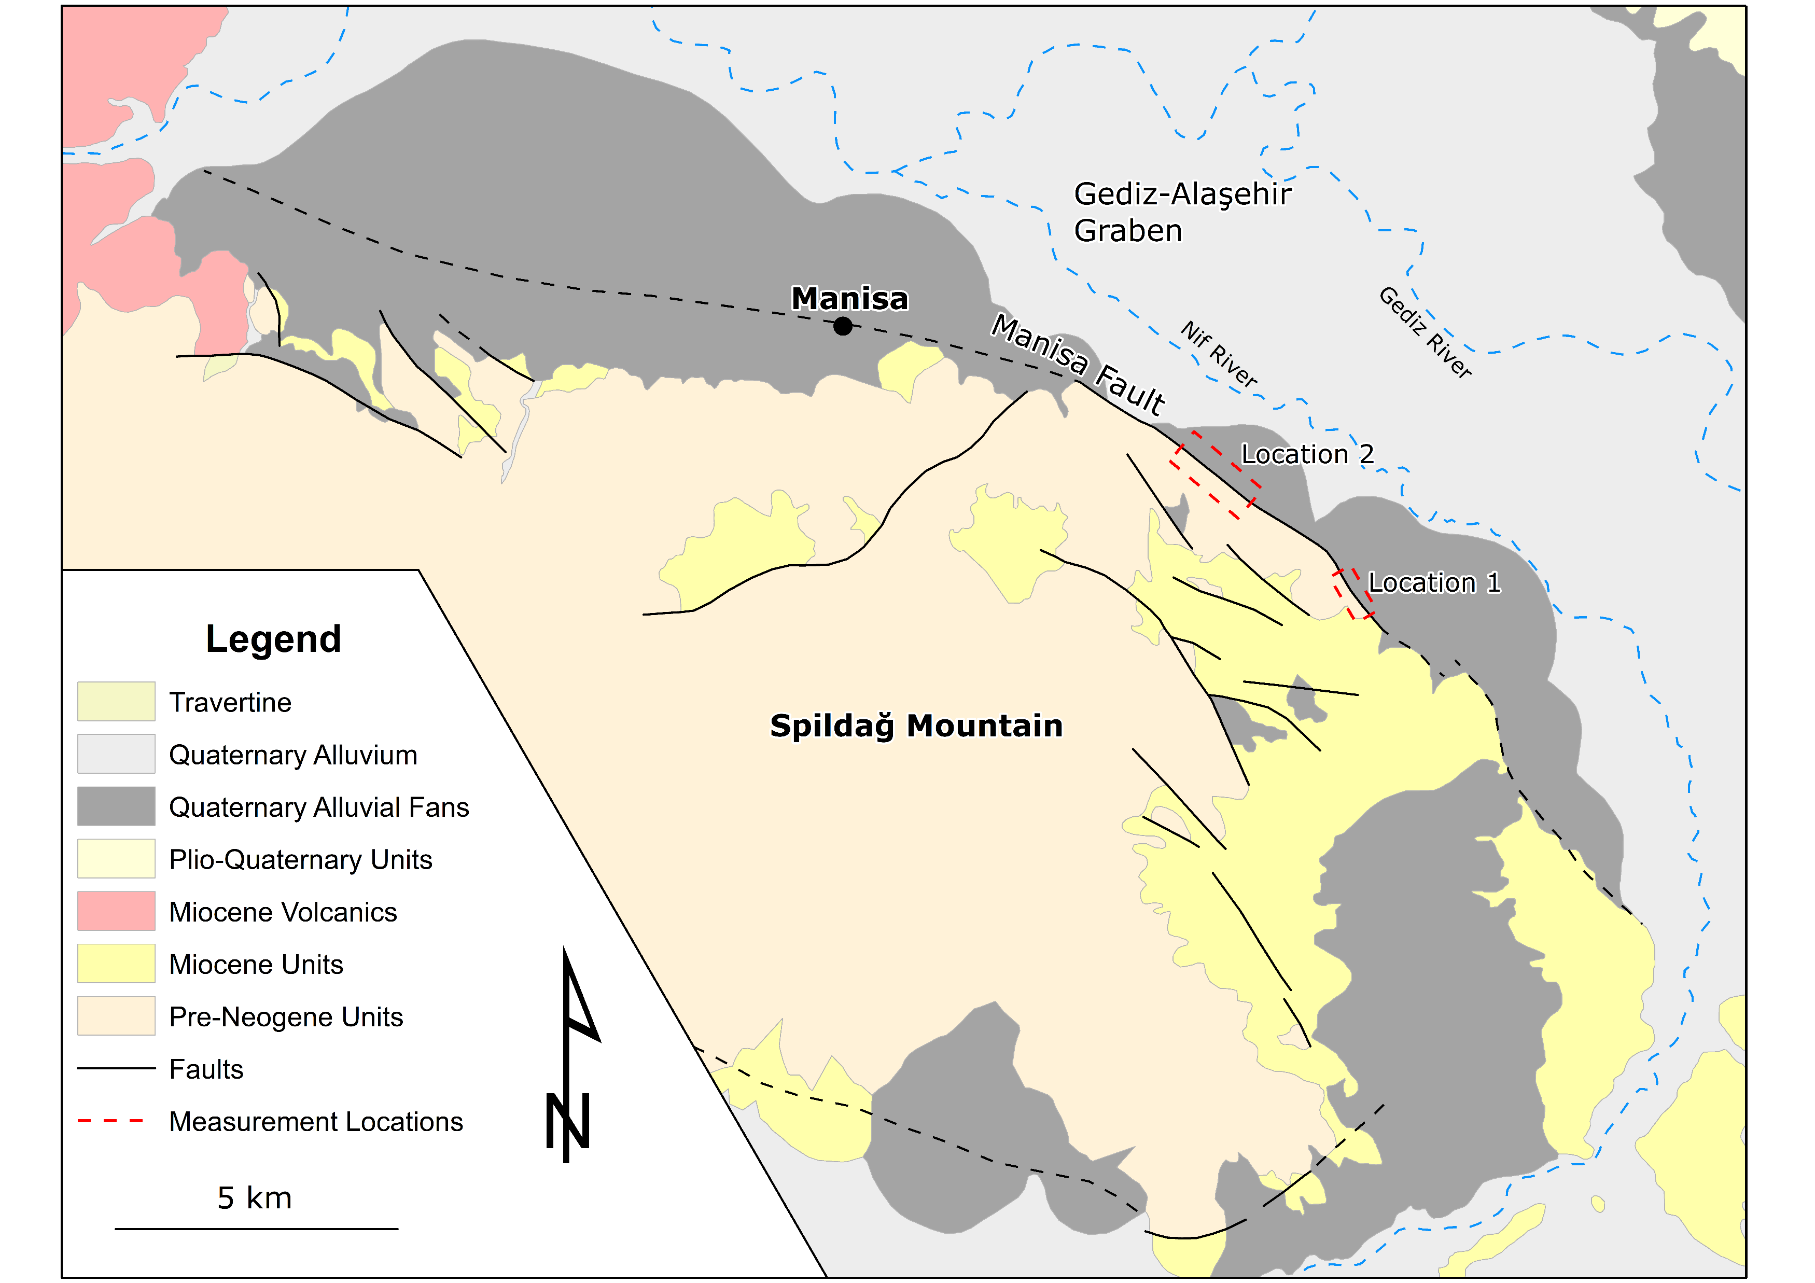
Characteristics of Manisa Fault;
-NW-SE trending high angle normal fault.
-Active fault geomorphology.
-Both dextral(western part) and sinistral(eastern part) slip-data overprinted onto normal slip exist.

Slide 5
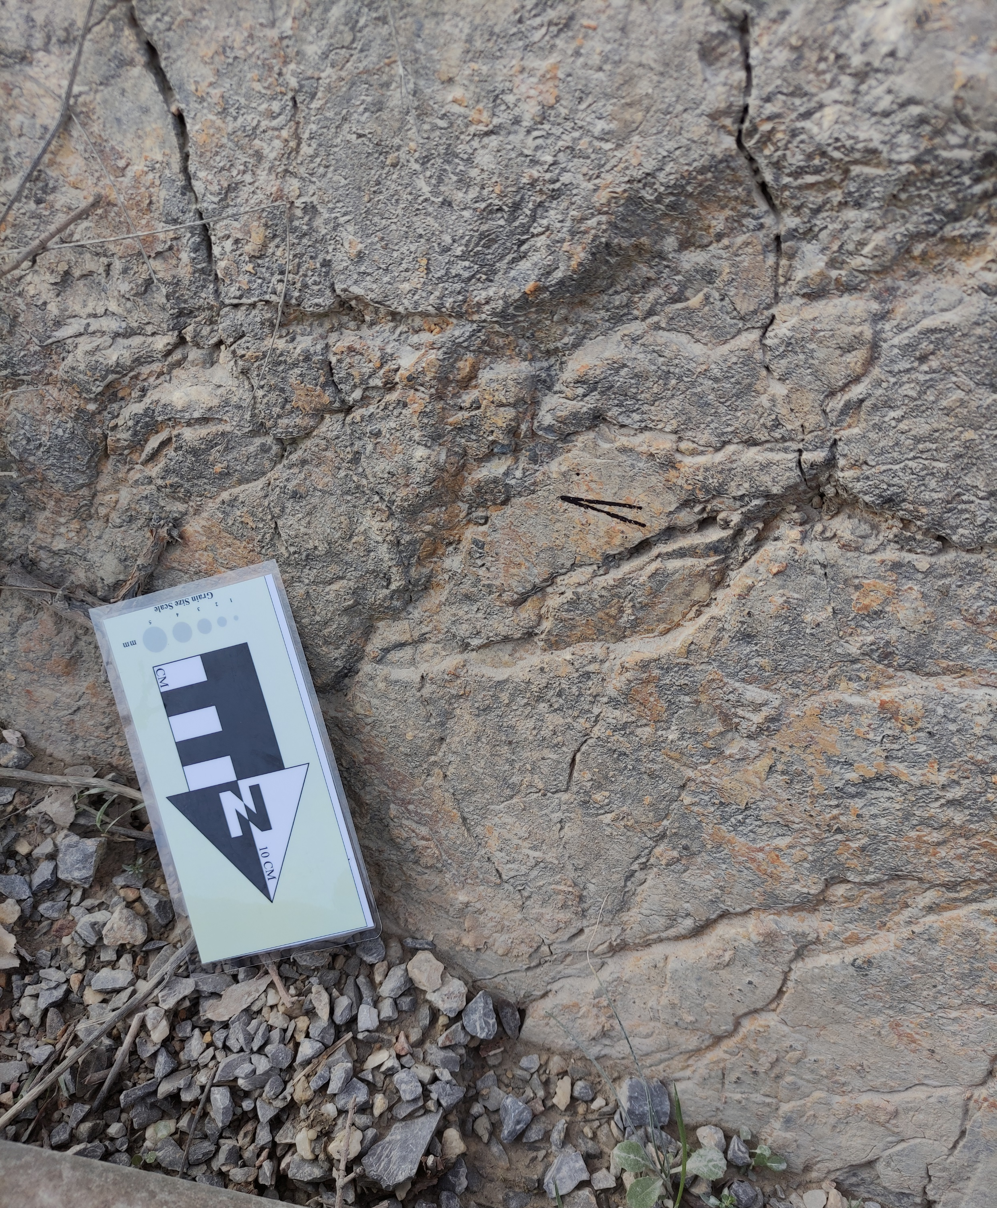
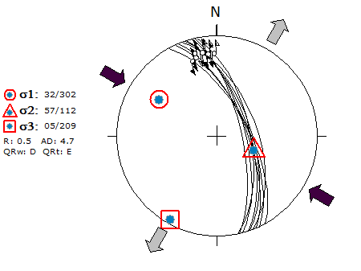

Location 1

Slide 6
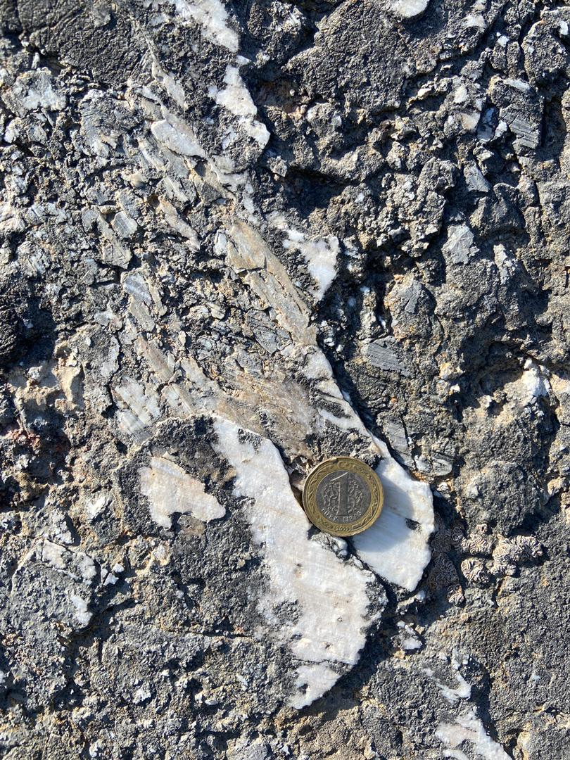
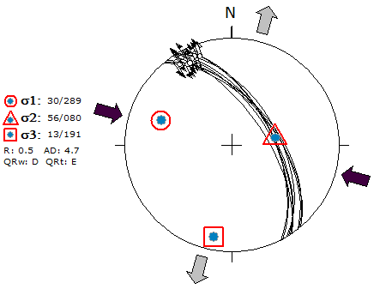

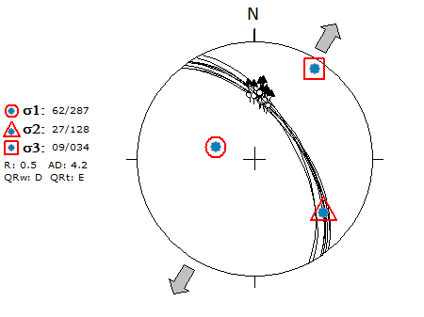

Location 2

Slide 7
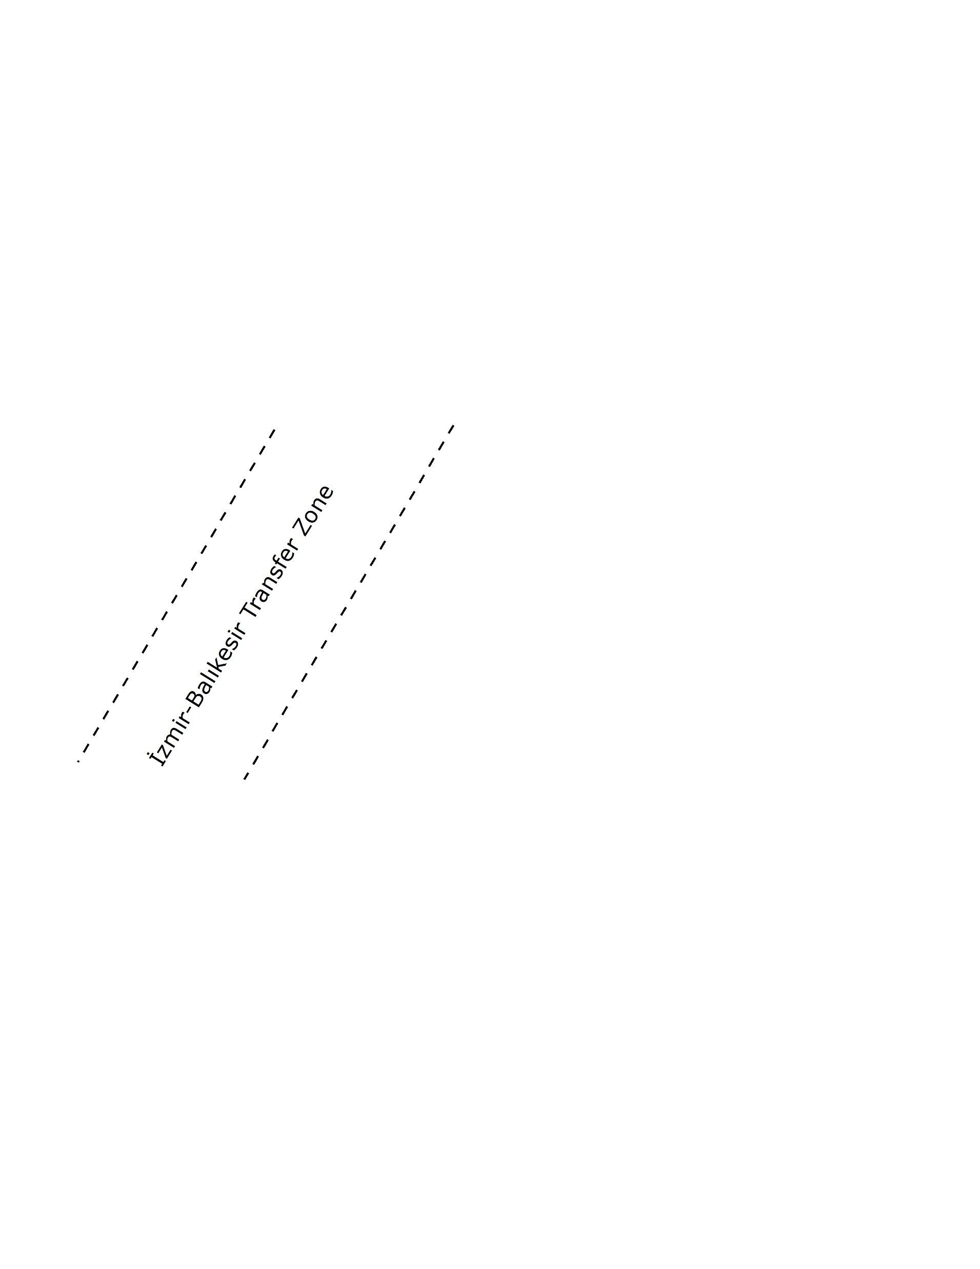
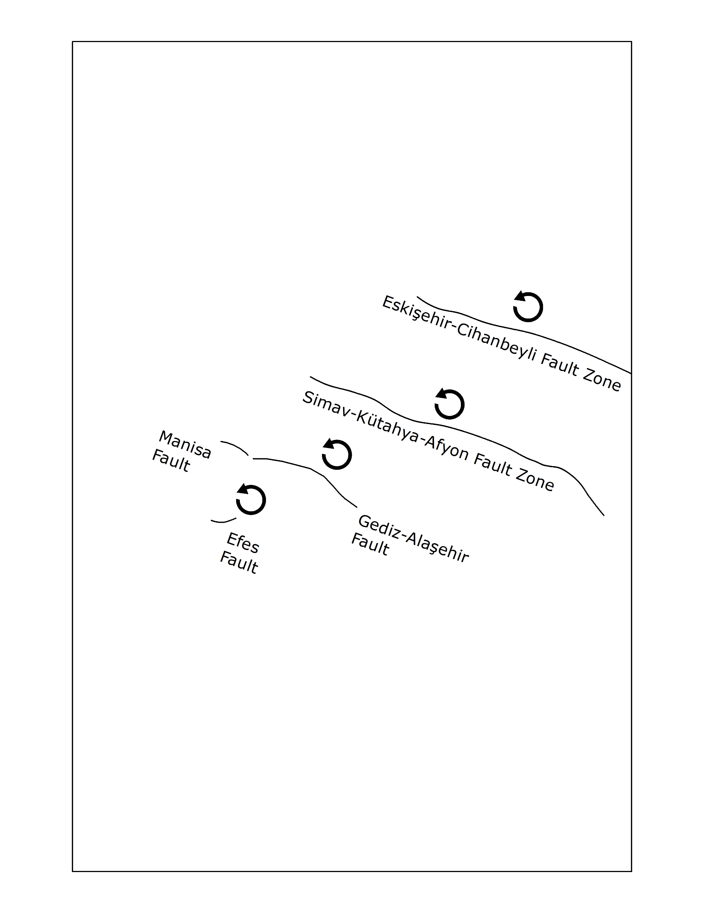
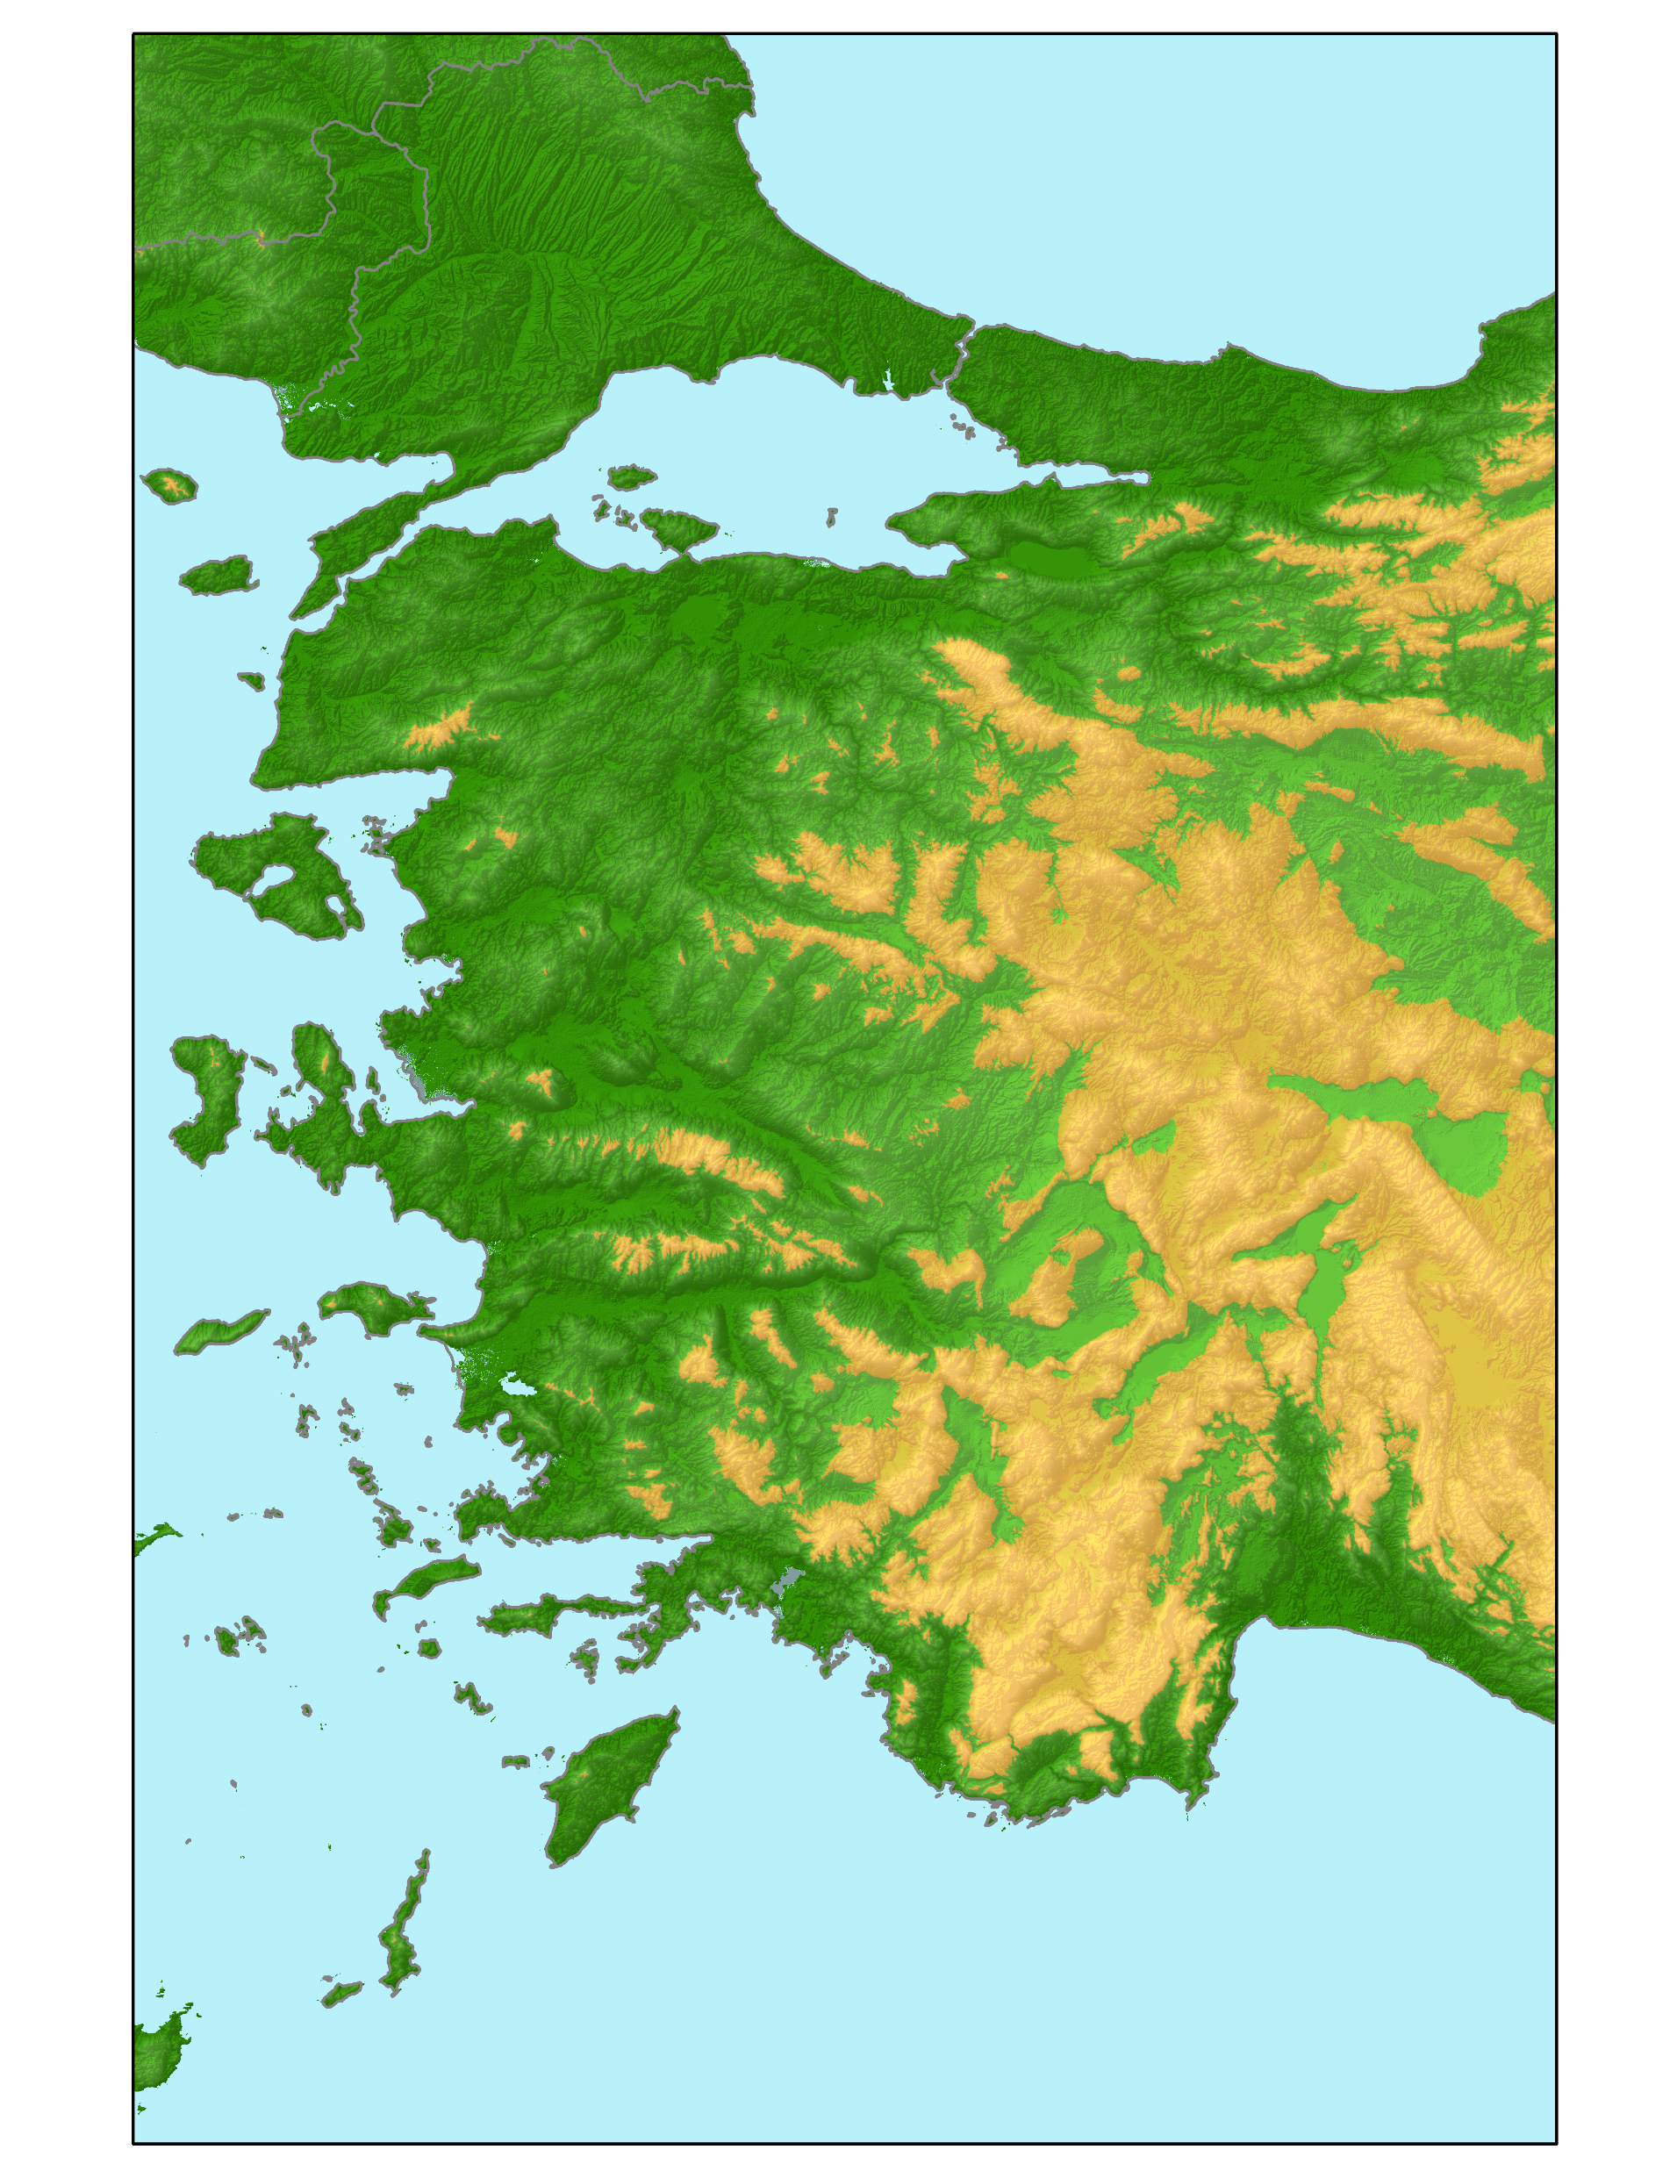
Interpretation of Results
Possibilities for development of lateral motion overpringting on normal motion can be,
The motion along İzmir-Balıkesir Transfer Zone
Regionwide counterclockwise rotation (≈30°)
Or both of them
Sözbilir & Uzel, 2008
Rojay & Özsayın, 2013
Further Steps
Dating of those motions by U/Th and U/Pb series dating from striated calcites and put those motions together with their relationships on a geologic time constraint.

Slide 8
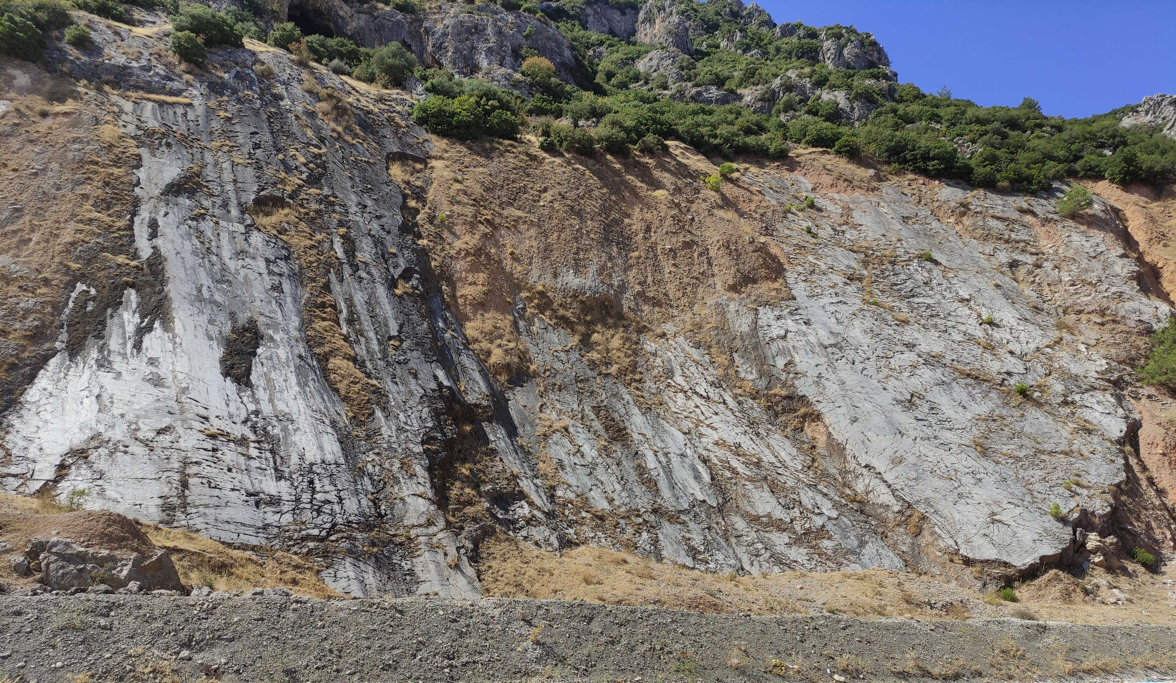
Thank you

Slide 9
References
Bozkurt, E. & Sözbilir, H. (2006). Evolution of the Large-scale Active Manisa Fault, Southwest Turkey: Implications on Fault Development and Regional Tectonics. Geodinamica Acta, 19(6), 427-453. https://doi.org/10.3166/ga.19.427-453
Delvaux, D. (1993). The TENSOR program for paleostress reconstruction: examples from the east African and the Baikal rift zones. EUGVII Strasbourg, France, 4-8 April 1993. Terra Nova, 5, 216.
Dönmezoğulları, T. (2019). Morphotectonic analysis and kinematic evolution of the Central Gediz Alaşehir graben, Western Anatolia, Turkey. M.Sc. Thesis, Middle East Technical University. Geological Engineering Department. 81 p (unpublished).
Rojay, B. & Toprak, V. (2001). Neogene Evolution of the Gediz Graben, Western Anatolia, Turkey. Riotur Internal Report.
Rojay, B & Özsayın, E. (2013). Post-Miocene extension in Central Anatolia; It's linkage to Aegean extension.
Sözbilir, H. & Uzel, B. (2008). A First Record of a Strike-slip Basin in Western Anatolia and Its Tectonic Implication: The Cumaovası Basin. Turkish Journal of Earth Sciences.

