Slide 1

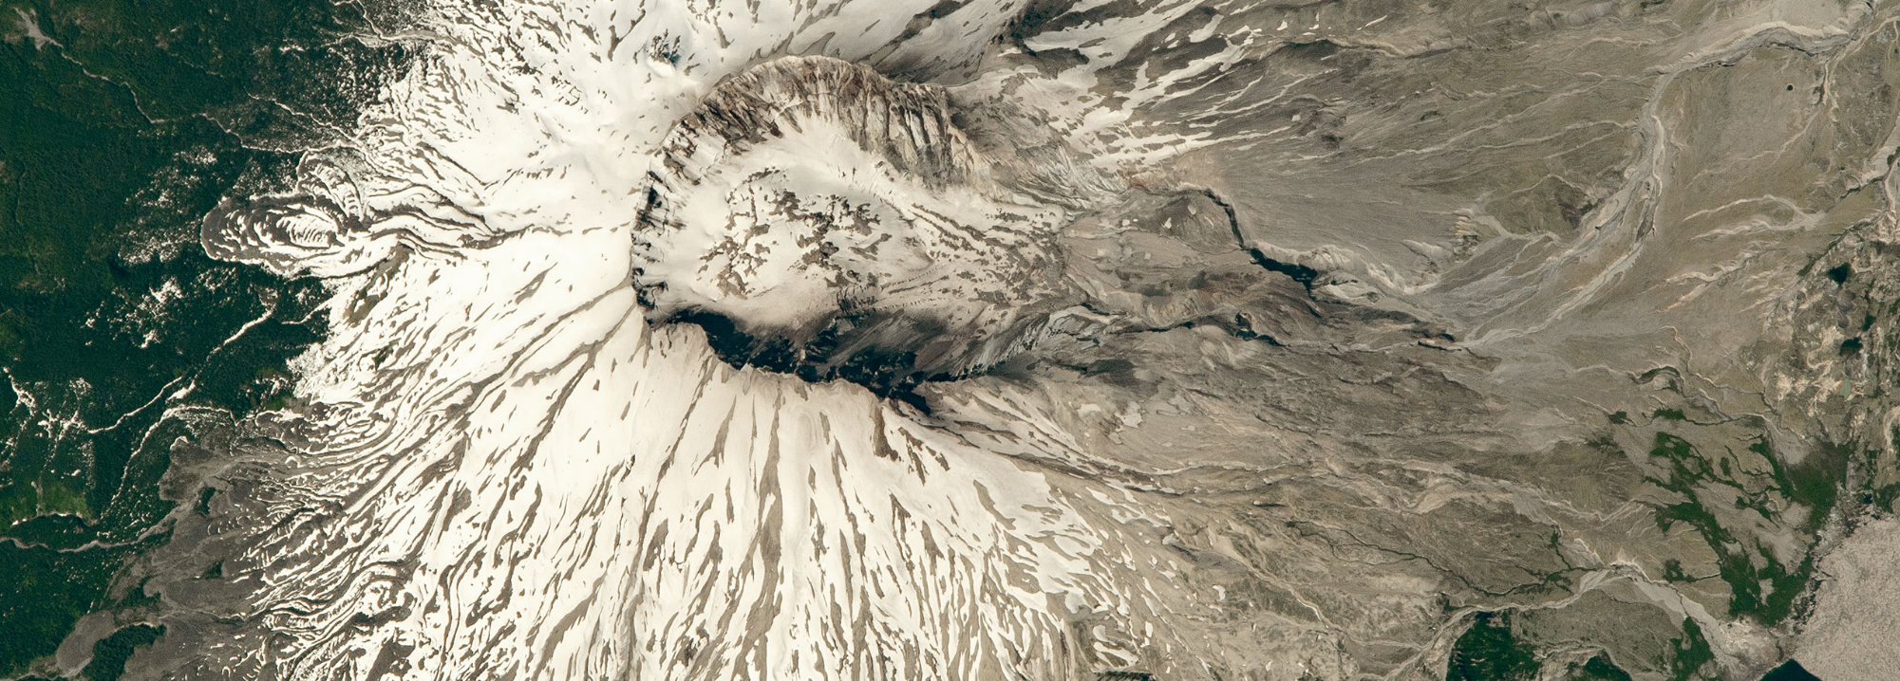



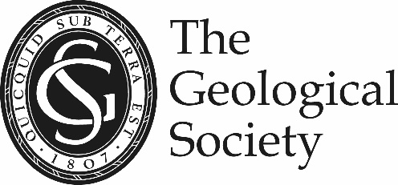
Evidence of volcanic debris avalanche dynamics from sedimentological analysis of the Tenteniguada and Abona deposits, Canary Islands
Symeon Makris^{1*}, Matteo Roverato², Alejandro Lomoschitz³, Paul Cole¹, Irene Manzella^{1,4}
¹ University of Plymouth, ² University of Geneva, ³ Universidad de Las Palmas de Gran Canaria, ⁴ University of Twente
* symeon.makris@plymouth.ac.uk
NASA Earth Observatory (2016) World of Change: Devastation and Recovery at Mt. St. Helens

Slide 2
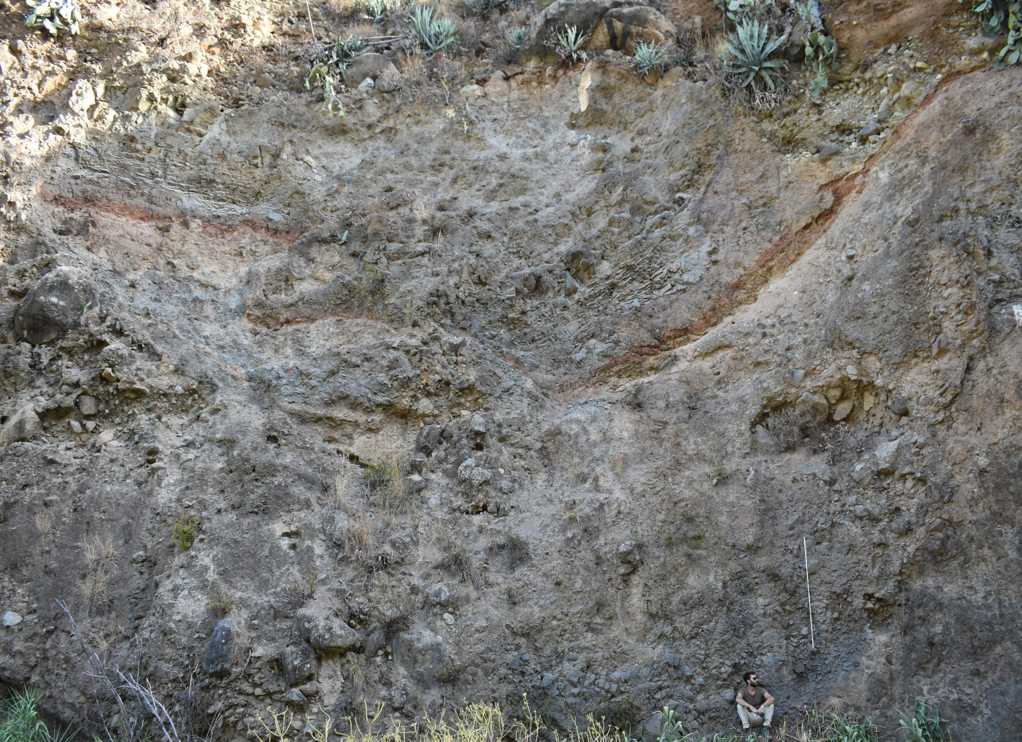
Presentation outline (3 parts)
METHODS: Indurated volcanic debris avalanche sedimentological analysis
DEPOSIT EXAMINATION: Tenteniguada and Abona volcanic debris avalanches
COMPARISON: Propagation mechanisms, stress accommodation, structure, sedimentology
    = function of lithological properties

Slide 3
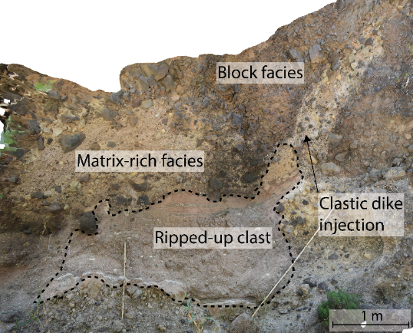
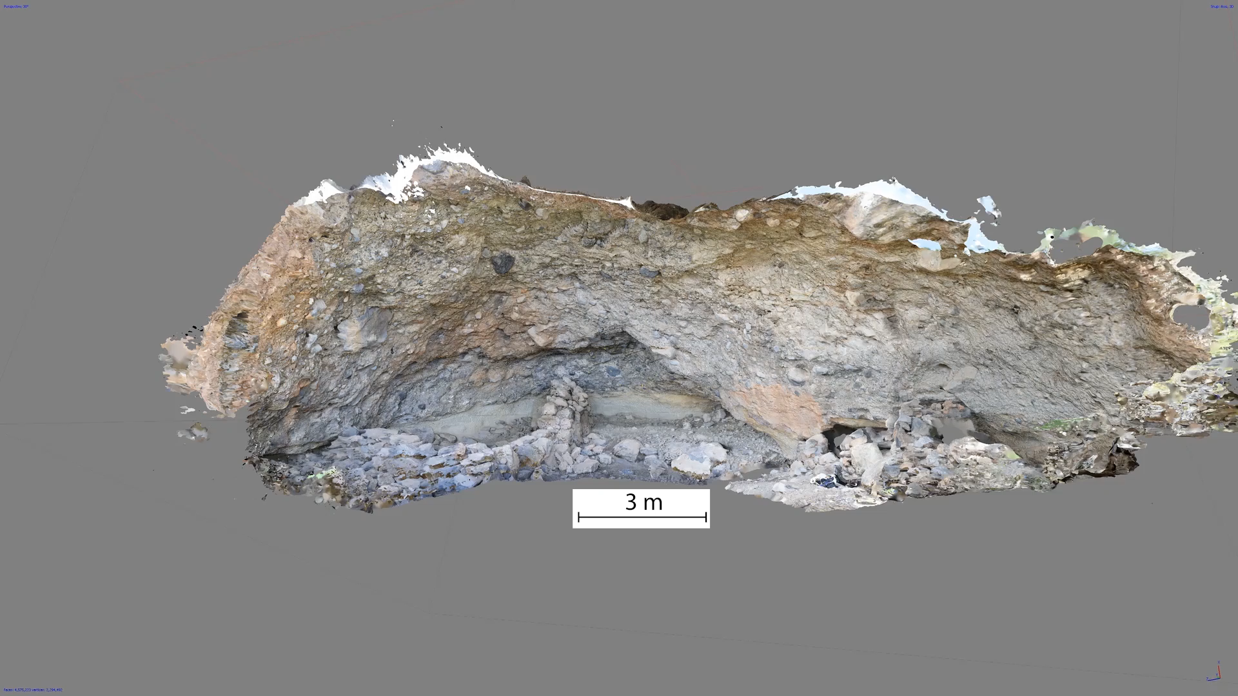
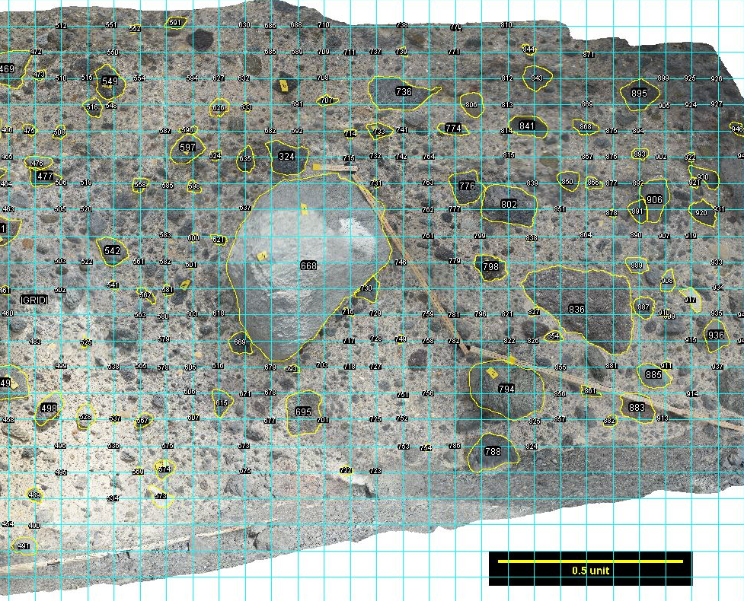

1. Sedimentological analysis of indurated deposits
Structure from motion photogrammetry
4.97 mm/pixel
Outcrop scale
interpretation
0.95 mm/pixel
Grid-sampling
on smaller sample window
0.14 mm/pixel

Slide 4
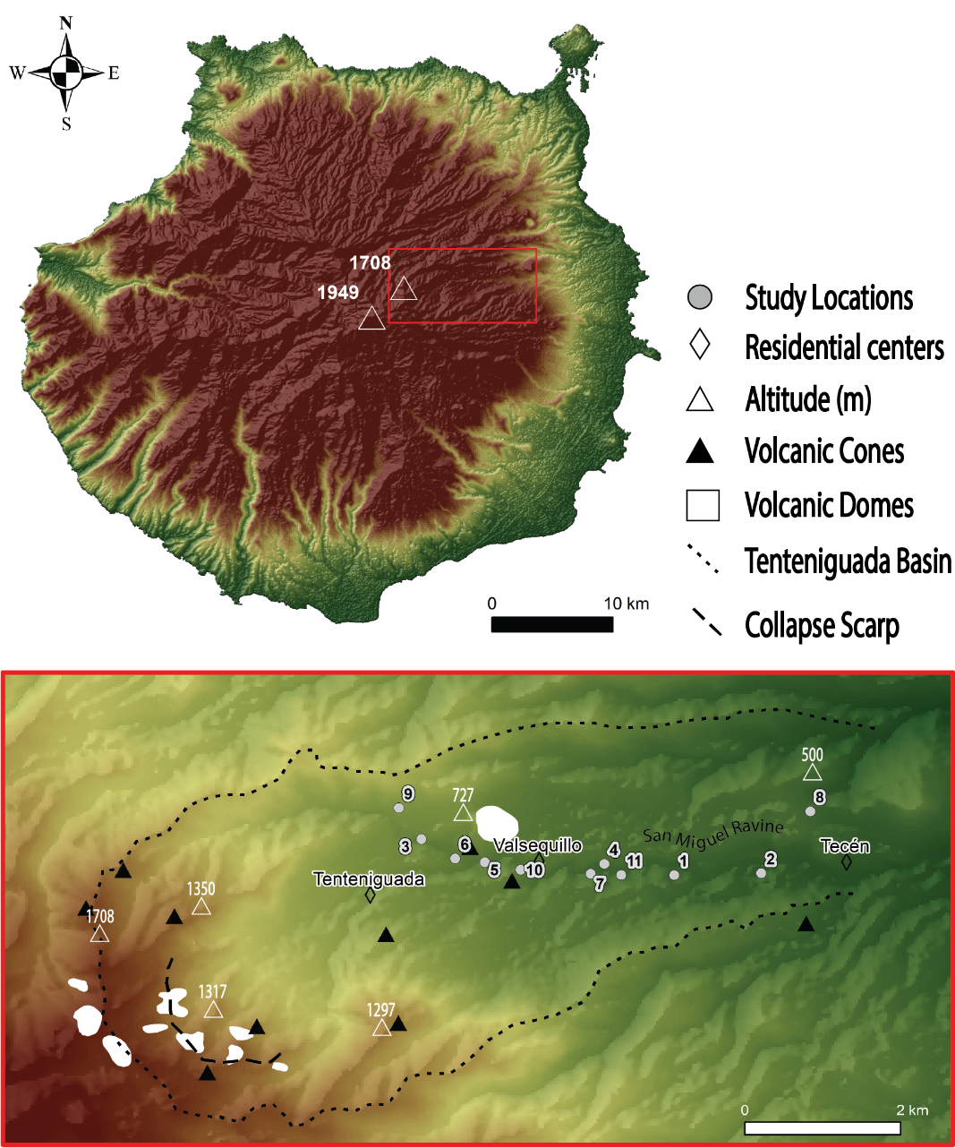
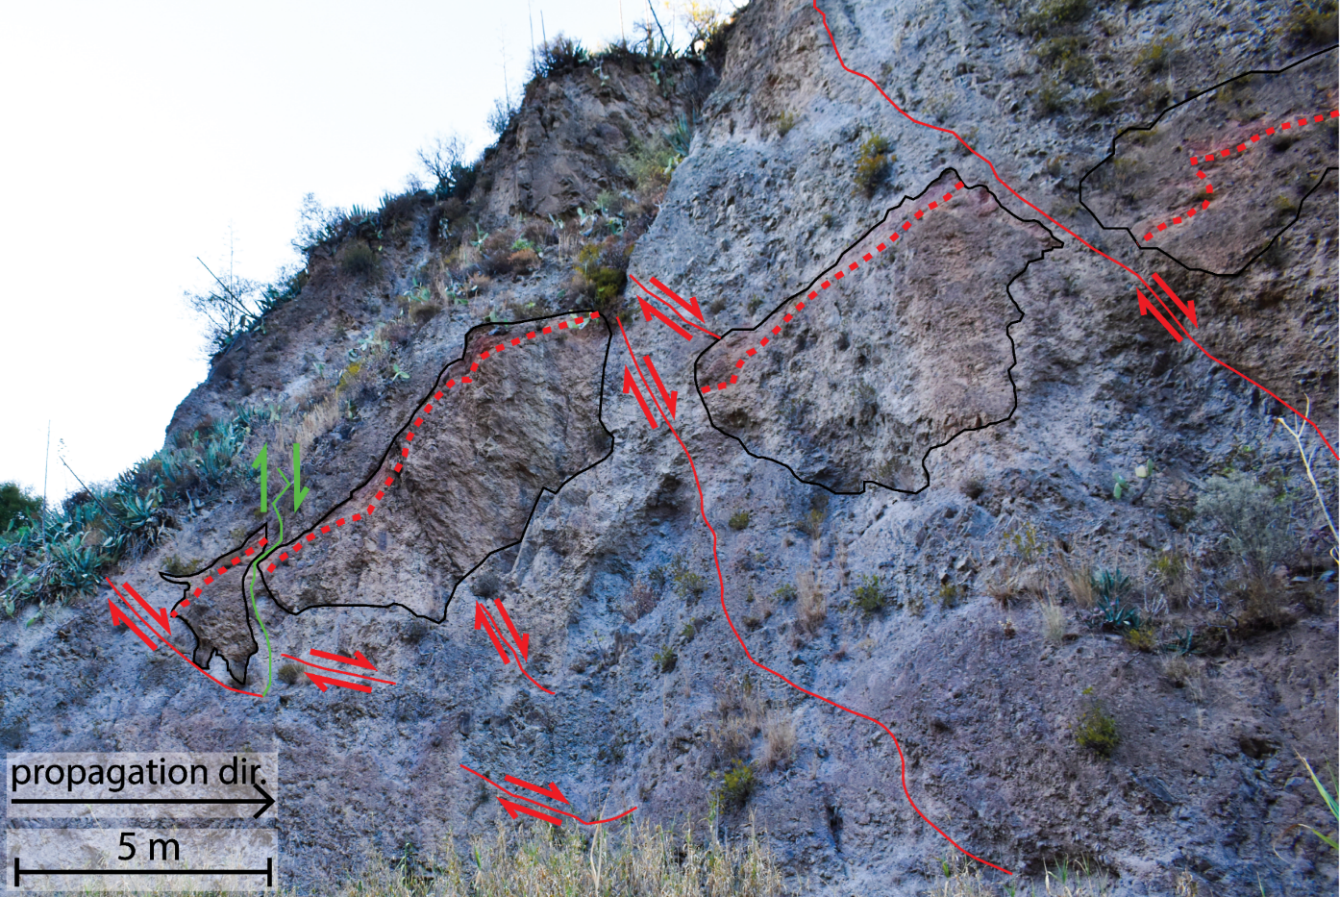
2. Tenteniguada – Normal Faults, preserved stratigraphy
Dominated by lava lithologies; minor component of pyroclastic
material
Edifice blocks with preserved stratigraphy

Slide 5
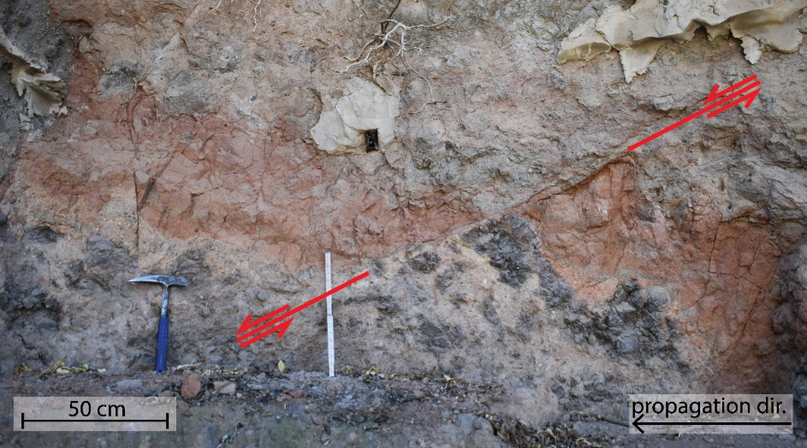
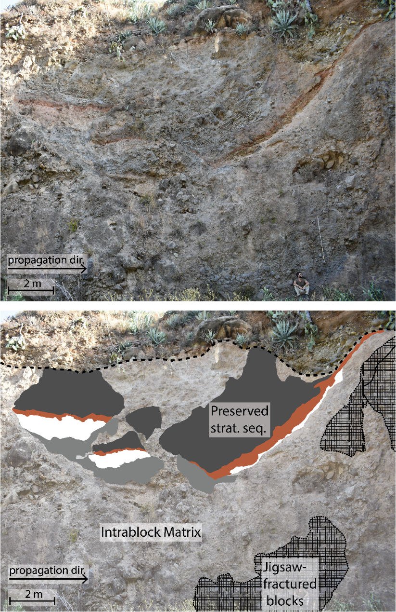
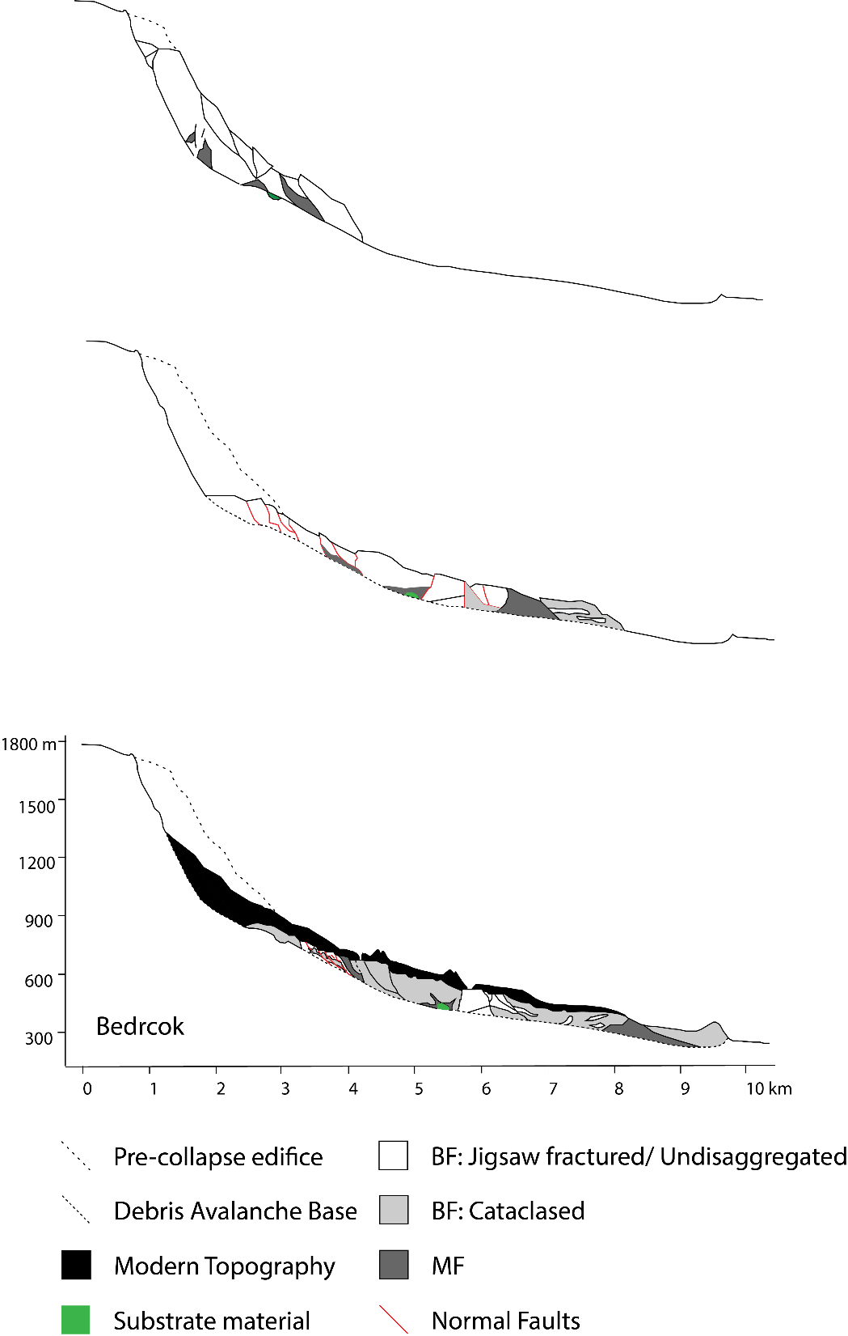
2. Tenteniguada – Normal-fault accommodated extension
Coarse disaggregation
Collapse
Normal fault activation
Propagation
Emplacement

Slide 6
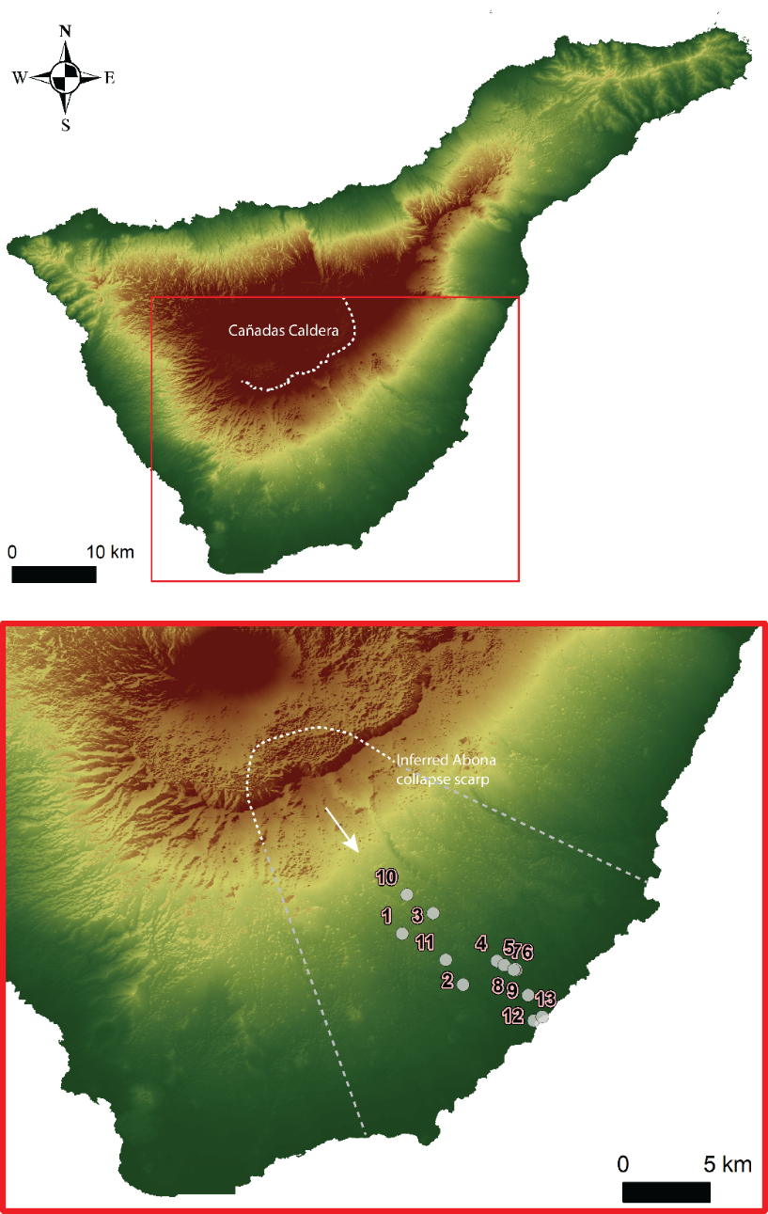
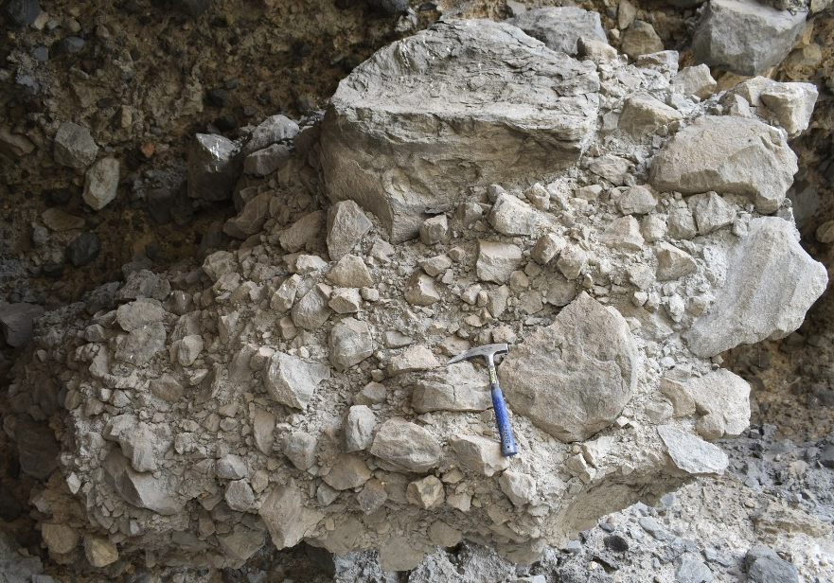
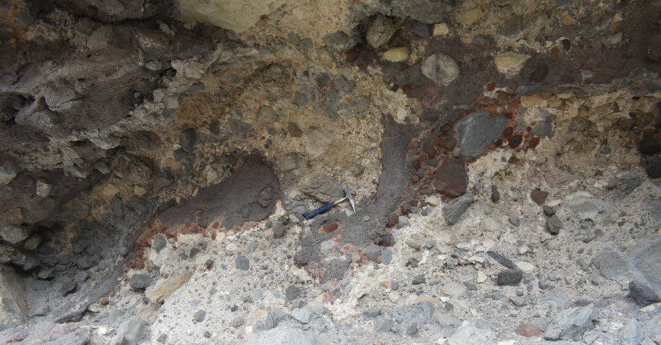
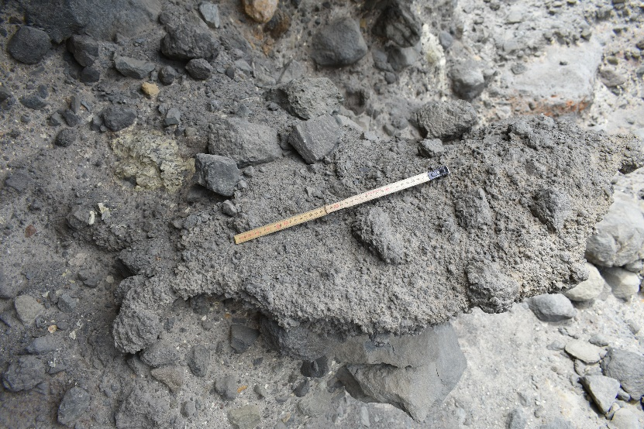
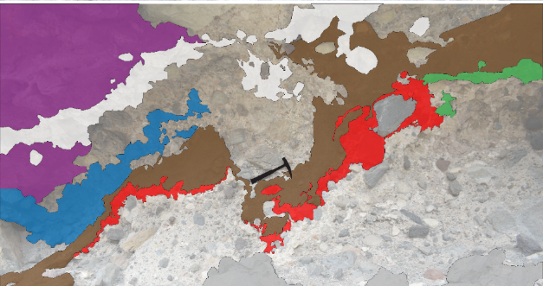
2. Abona- Cataclased Fluidised Granular Debris Avalanche
Cataclased
Fluidal features

Slide 7
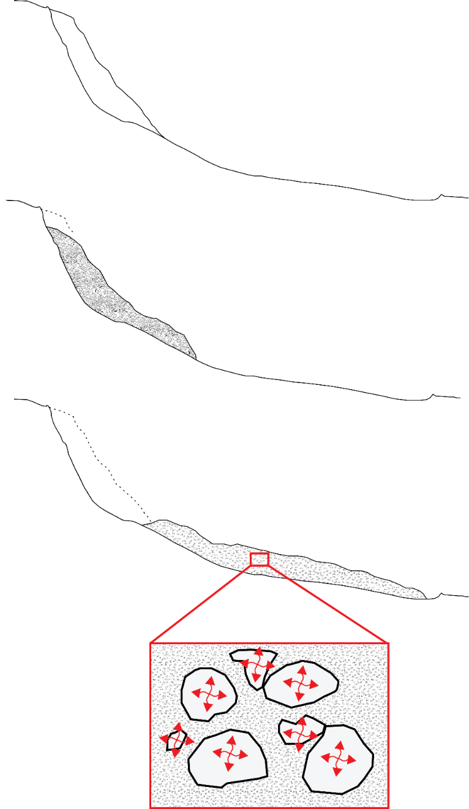
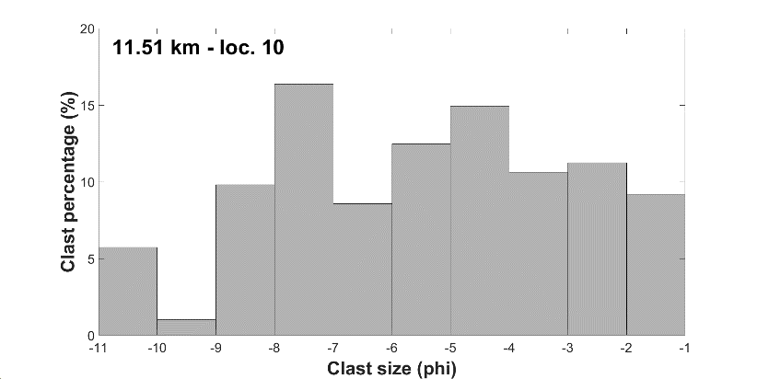
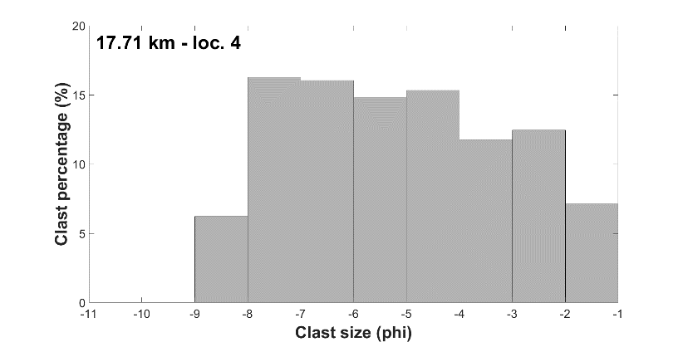
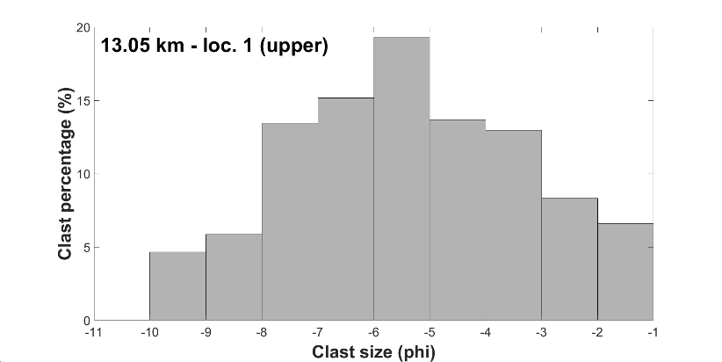
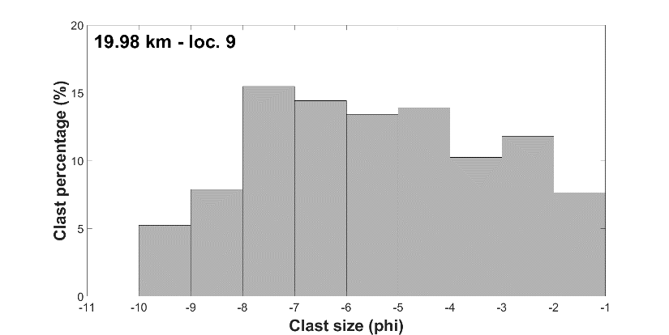
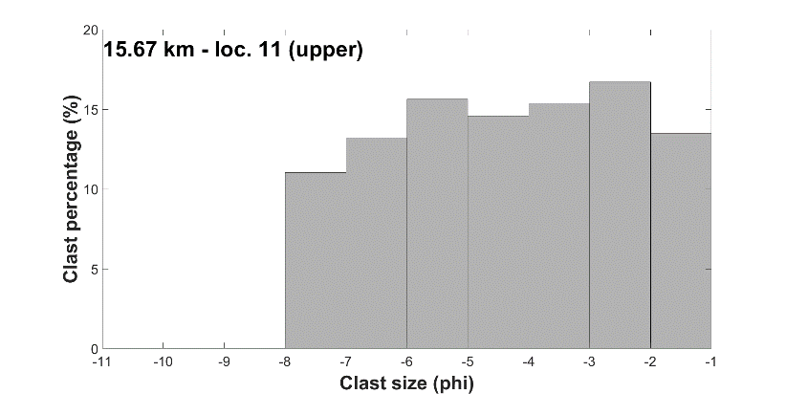
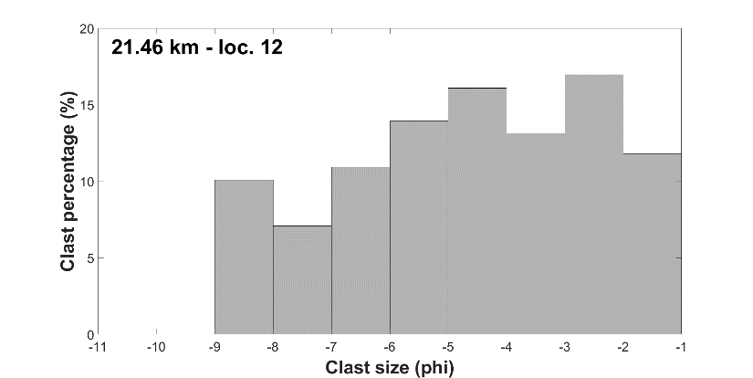
2. Abona – Unsystematic Clast Size Variation
52.4% matrix
52.6% matrix
59.1% matrix
64.9% matrix
Distributed shear
35.6% matrix
50.8% matrix

Slide 8
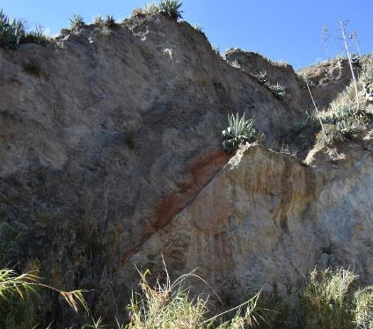
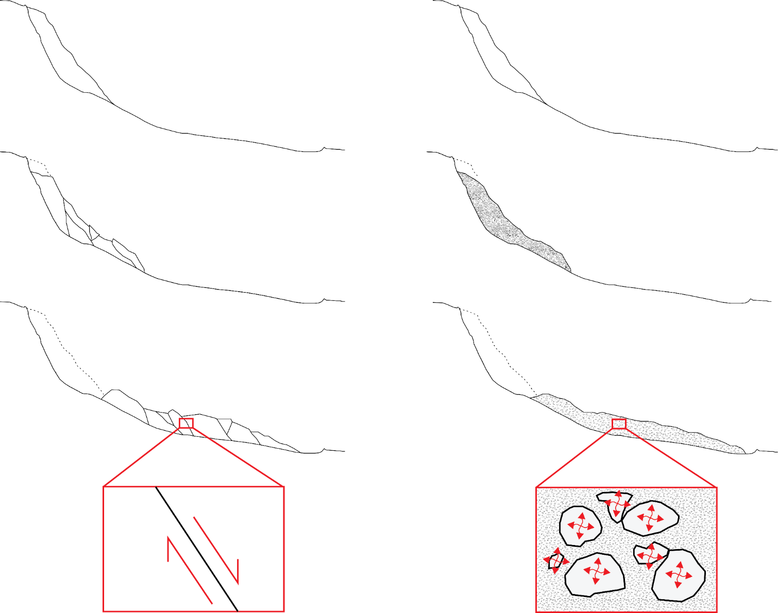
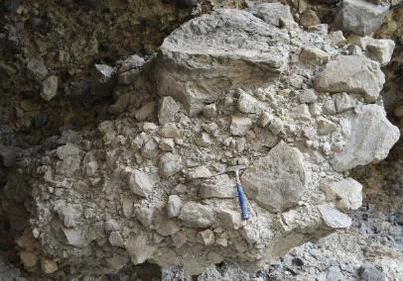

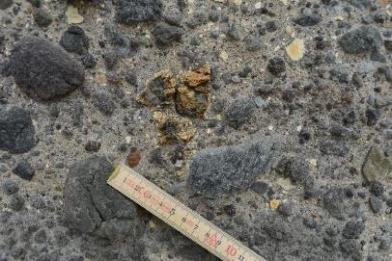
3. Comparison and Propagation Dynamics
propagation mechanisms
stress accommodation
Sedimentology
structure
TENTENIGUADA
ABONA
Dominated by competent lava lithologies
Dominated by pyroclastic deposits
Normal-fault accommodated spreading
Agitated fluidized granular flow

Slide 9



Evidence of volcanic debris avalanche dynamics from sedimentological analysis of the Tenteniguada and Abona deposits, Canary Islands
Evidence of volcanic debris avalanche dynamics from sedimentological analysis of the Tenteniguada and Abona deposits, Canary Islands
symeon.makris@plymouth.ac.uk
@simosmakris
Thank you!

