Slide 1


Assessing the effects of climate and land use changes on the distribution and growth of important plants species for pollinators
Benjamin lanssens

Slide 2
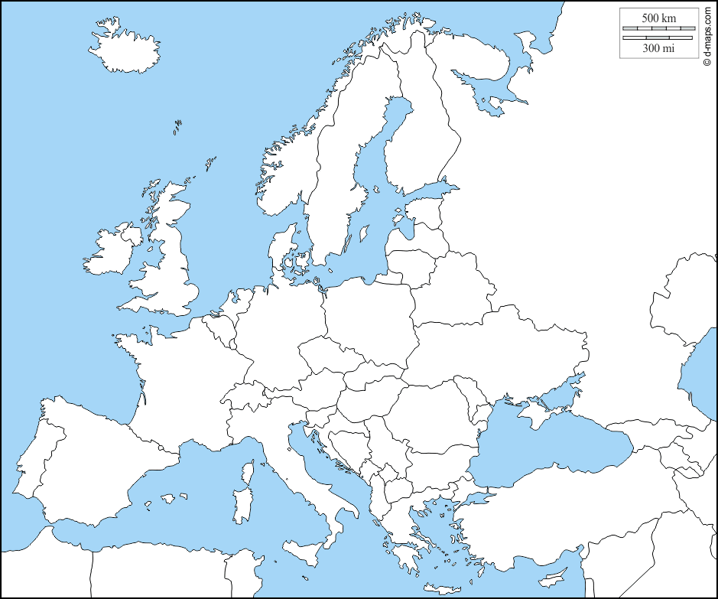
MAPPY : Multisectoral Analysis of climate and land use change impacts on Pollinators, Plant diversity and crops Yields
Study sites : Belgium, Austria, Germany, Spain, Netherlands
Objective : study quantitatively feedback processes linking pollinators, plant diversity and crop yields in the context of climate and land use changes
x
Deliverables :
x
x
Estimates of forest openness (LAI or tree density)
Forest plant richness
Host plant species maps
x
x

Slide 3
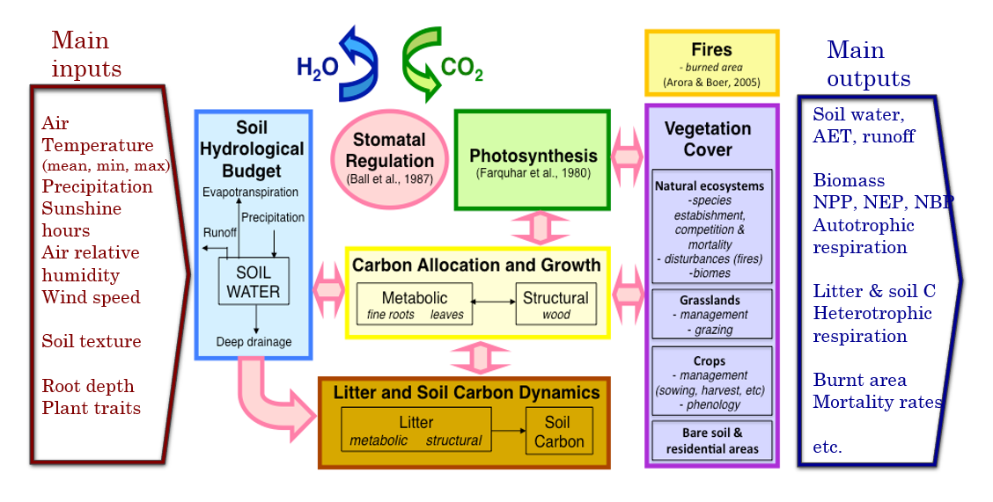
CARAIB : CARbon Assimilation In the Biosphere

Slide 4

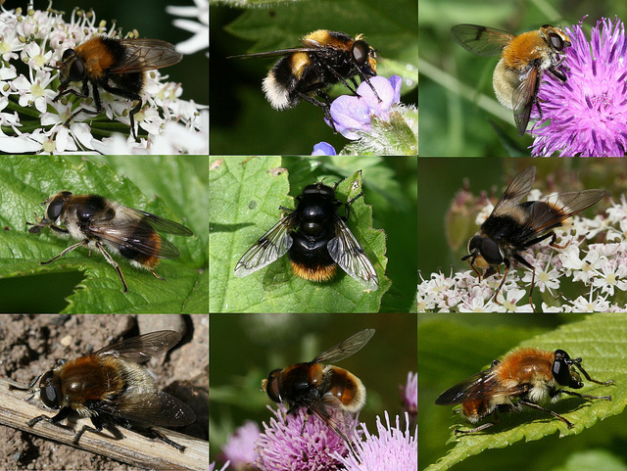
Interesting plant species for
Need of continuous food supply
Good quality of nectar, honey dew and pollen
Flowering trees as food source (e.g. Tilia cordata, Acer platanoides)
Flower-rich forests and forest edges during spring and summertime (e.g. Allium ursinum)

Slide 5
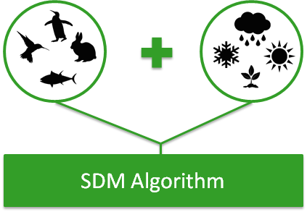
Species Distribution Model (SDM)
Observed species distribution : GBIF
Selection of pseudo-absence
Environmental variables : WorldClim for climate and LUCAS-Topsoil for soil
Modeling algorithm : GLM and MaxEnt
Predicted species distribution

Slide 6
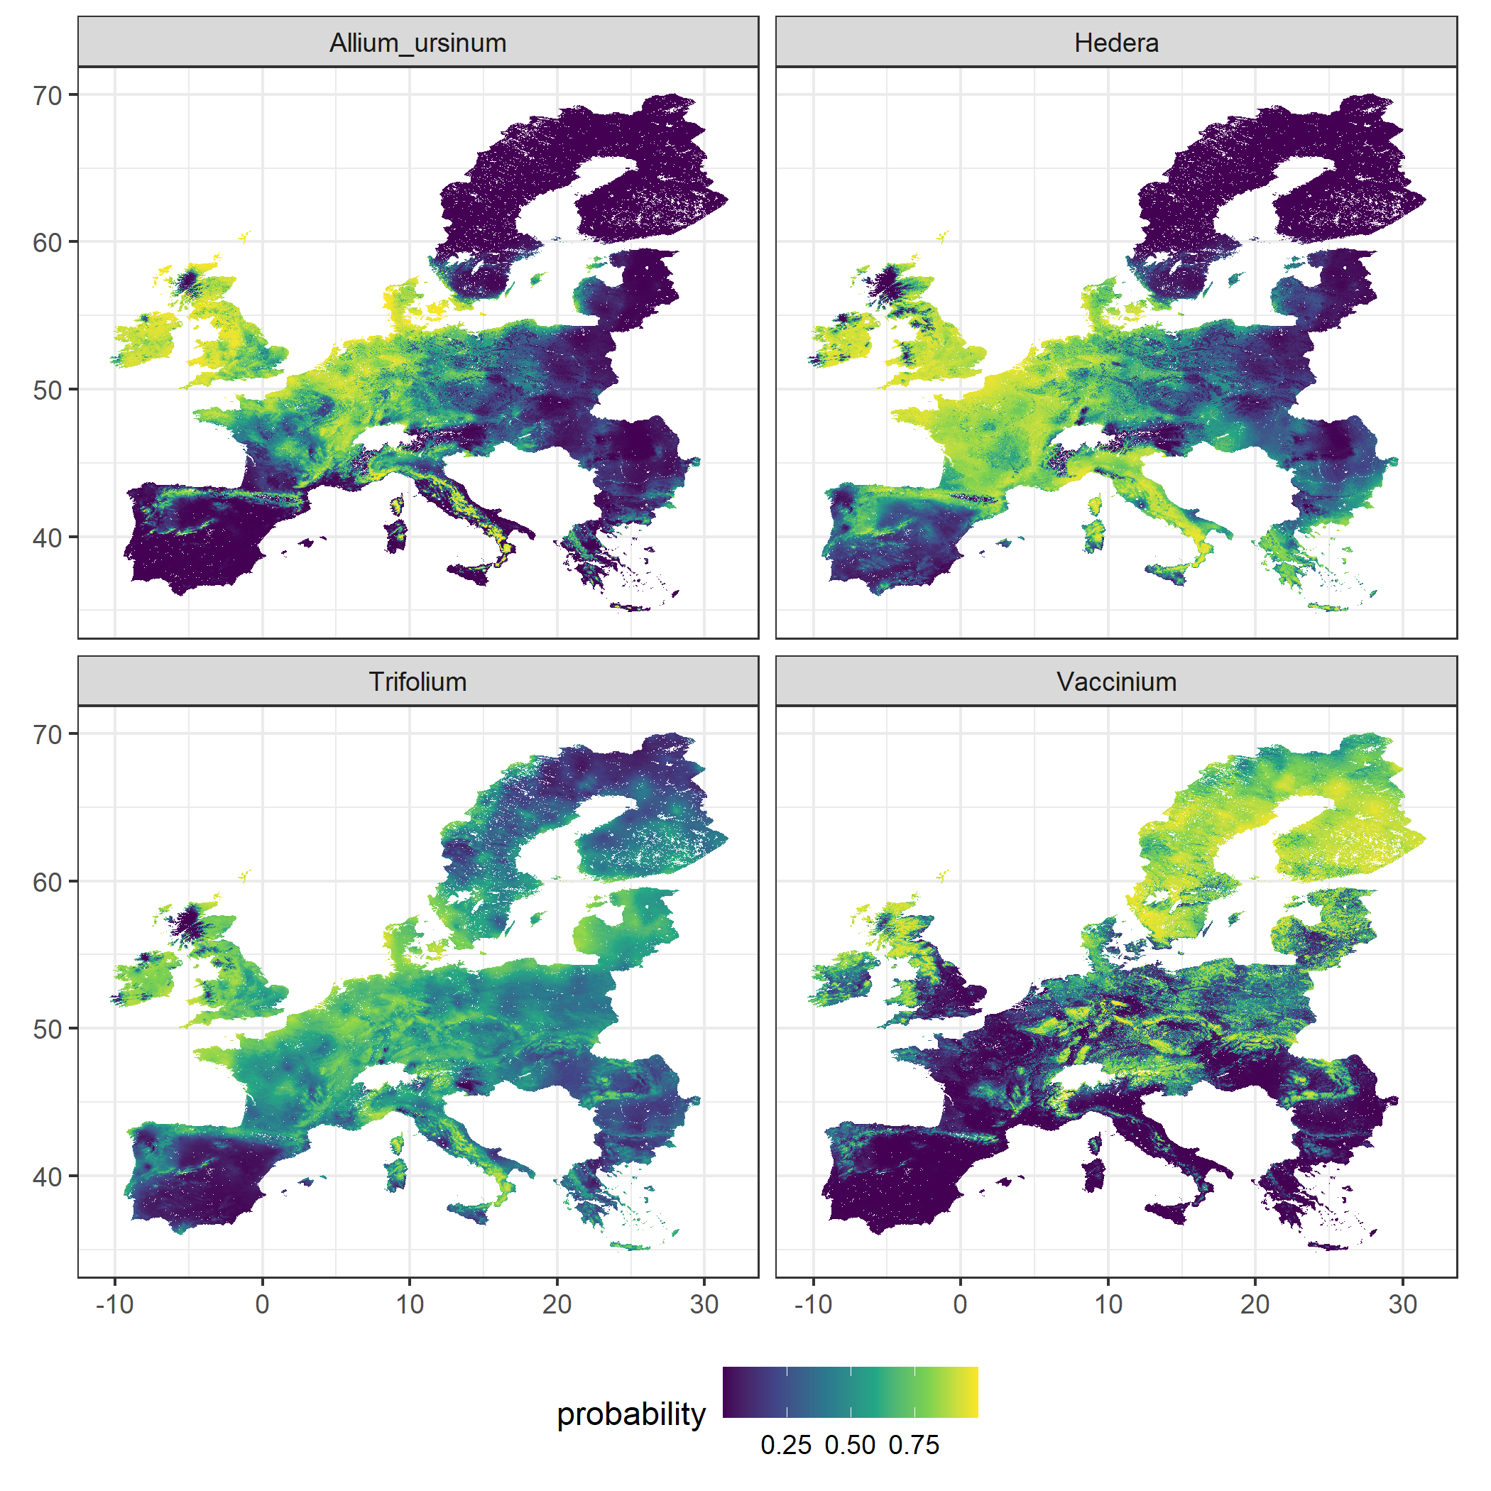
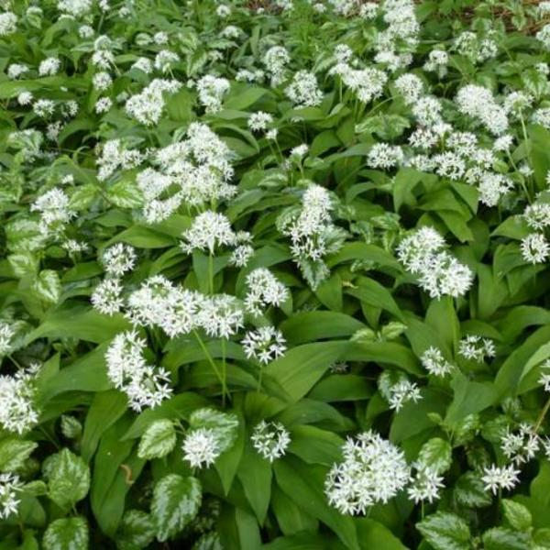
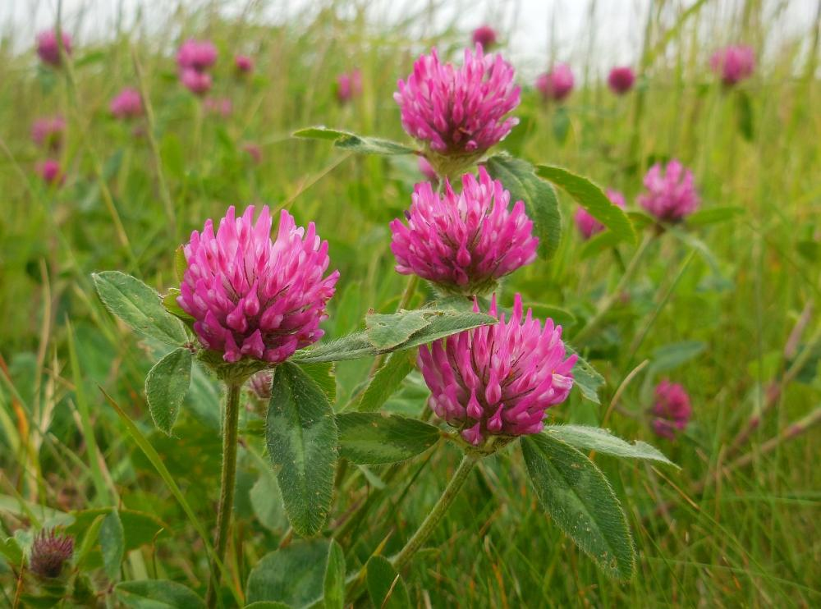
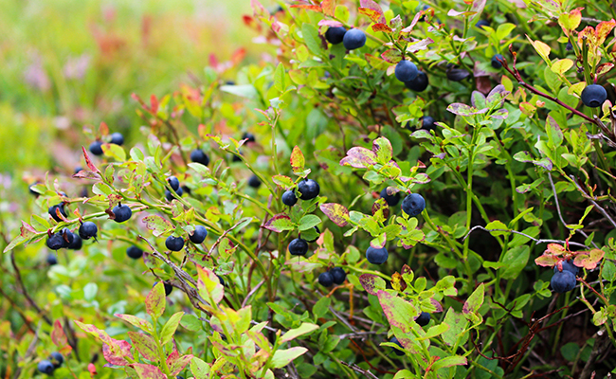
Example of SDM results
Map of species probability of presence
Threshold based on model statistics

Slide 7
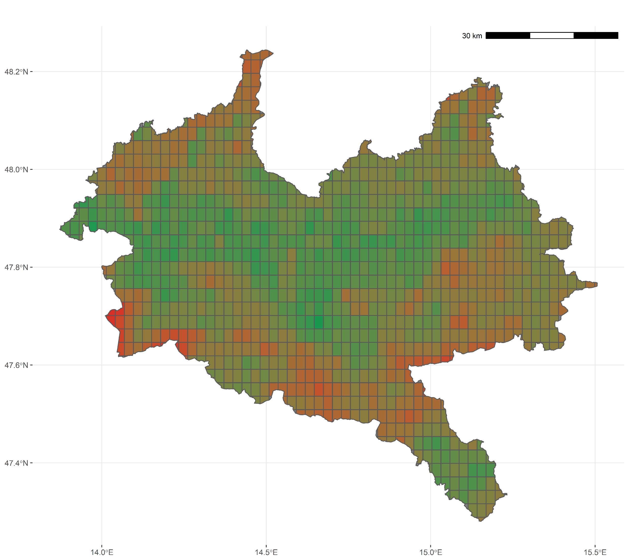
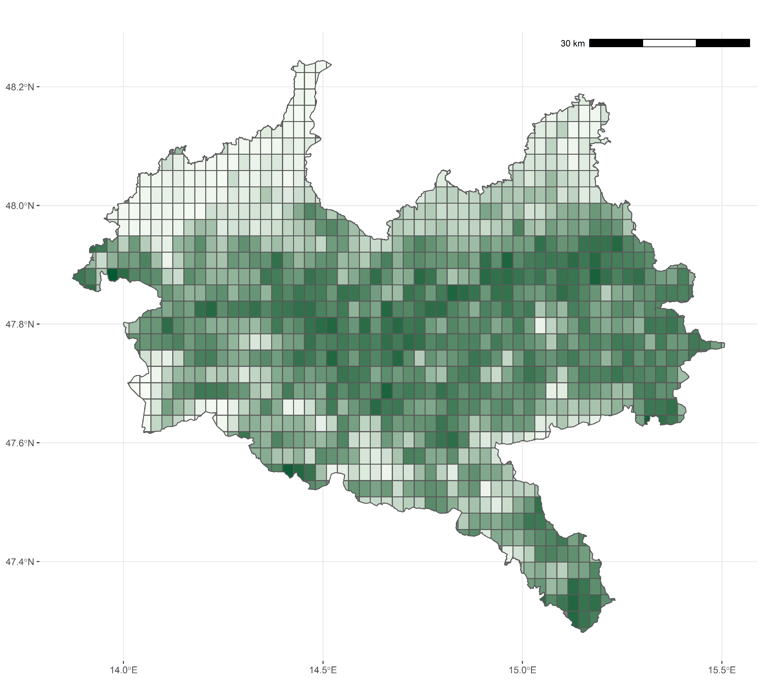
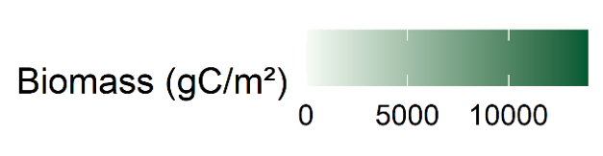
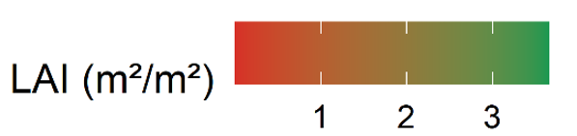
CARAIB results : Eisenwurzen region (Austria)
Annual mean biomass (2020)
Max mean LAI (2020)

Slide 8
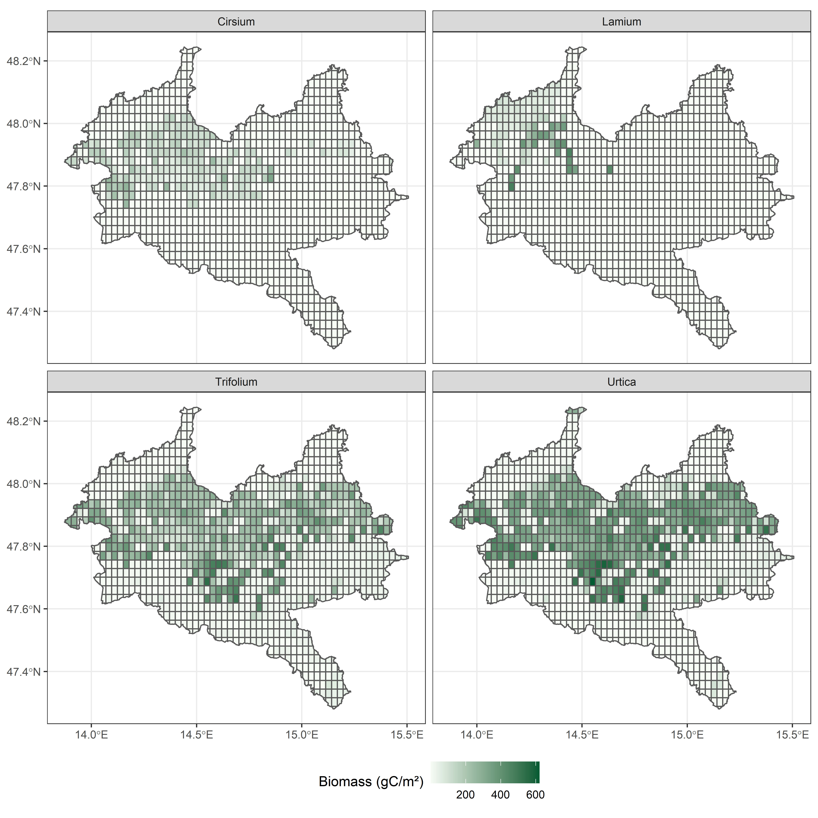

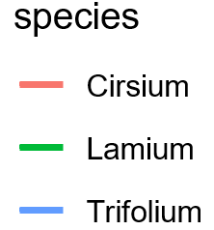
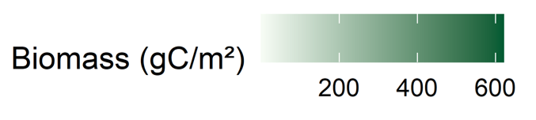
CARAIB results : Eisenwurzen region (Austria)
Biomass distribution (2020)
Net Primary Productivity
600
400
200
1900
1950
Years
2000
2050

Slide 9
Thank you for attention

