Slide 1
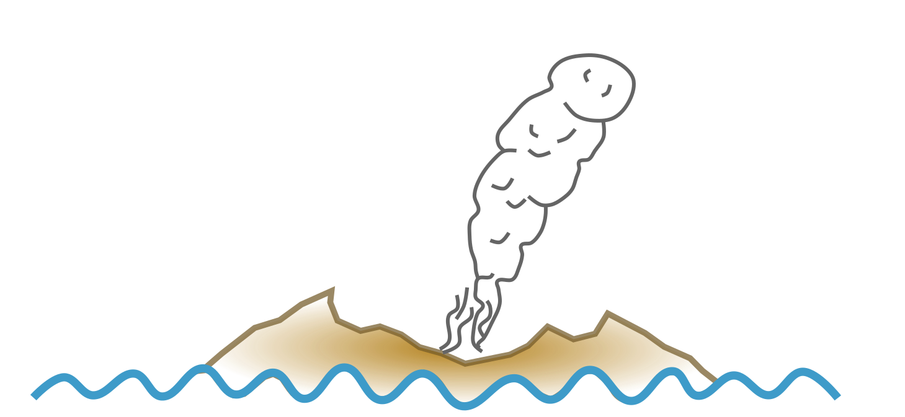
Can climate crisis evoke explosive eruptions?
The potential impact of sea level rise on phreatic eruptions
By Emma-Katherine Kluge
Johannes Gutenberg Universität Mainz
emma.kluge@uni-mainz.de
1

Slide 2
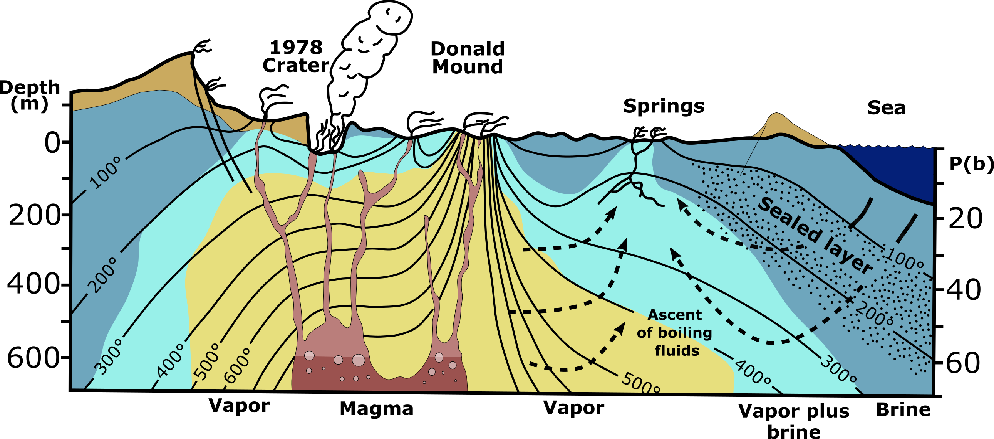
Overview: cross-section of a hydrothermal system
Sealing clay layers limit recharge and create confining pressures
Excess pore pressures can cause hydrofracturing
Fluid recharge requires permeable conduits
Modified after Giggenbach, W.F. et al., 2003 and Mayer et al., 2015.
2
Notes:
Hello, my name is Emma Kluge and this my presentation: Can climate crisis evoke explosive eruptions?
I am a new PhD student at the Johannes Gutenberg University in Mainz. I am giving this talk today to outline the scientific hypothesis I will explore during the thesis I am currently developing.
So, let’s get started. My project focuses on near-coastal volcanic hydrothermal systems, and potential for sea level rise to trigger phreatic eruptions.
I’m sure most of you here are familiar with this type of schematic, which is a cross-section of the hydrothermal system at White Island, New Zealand. I would like to draw your attention to the sealed zone, here.
Hydrothermal systems experience limited external fluid recharge and pore pressurization due to sealing from alteration clay layers.
If, and when, external fluids do enter high pore-pressure zones, it may lead to hydrofracturing, aka phreatic eruptions.
Such recharge fluids can be transported into these confined pressure zones through permeable conduits like active faults and fractures, and by acid-leaching related porosity. Or at least, until they are resealed by precipitation of new minerals, which can happen on relatively rapid time scales.

Slide 3
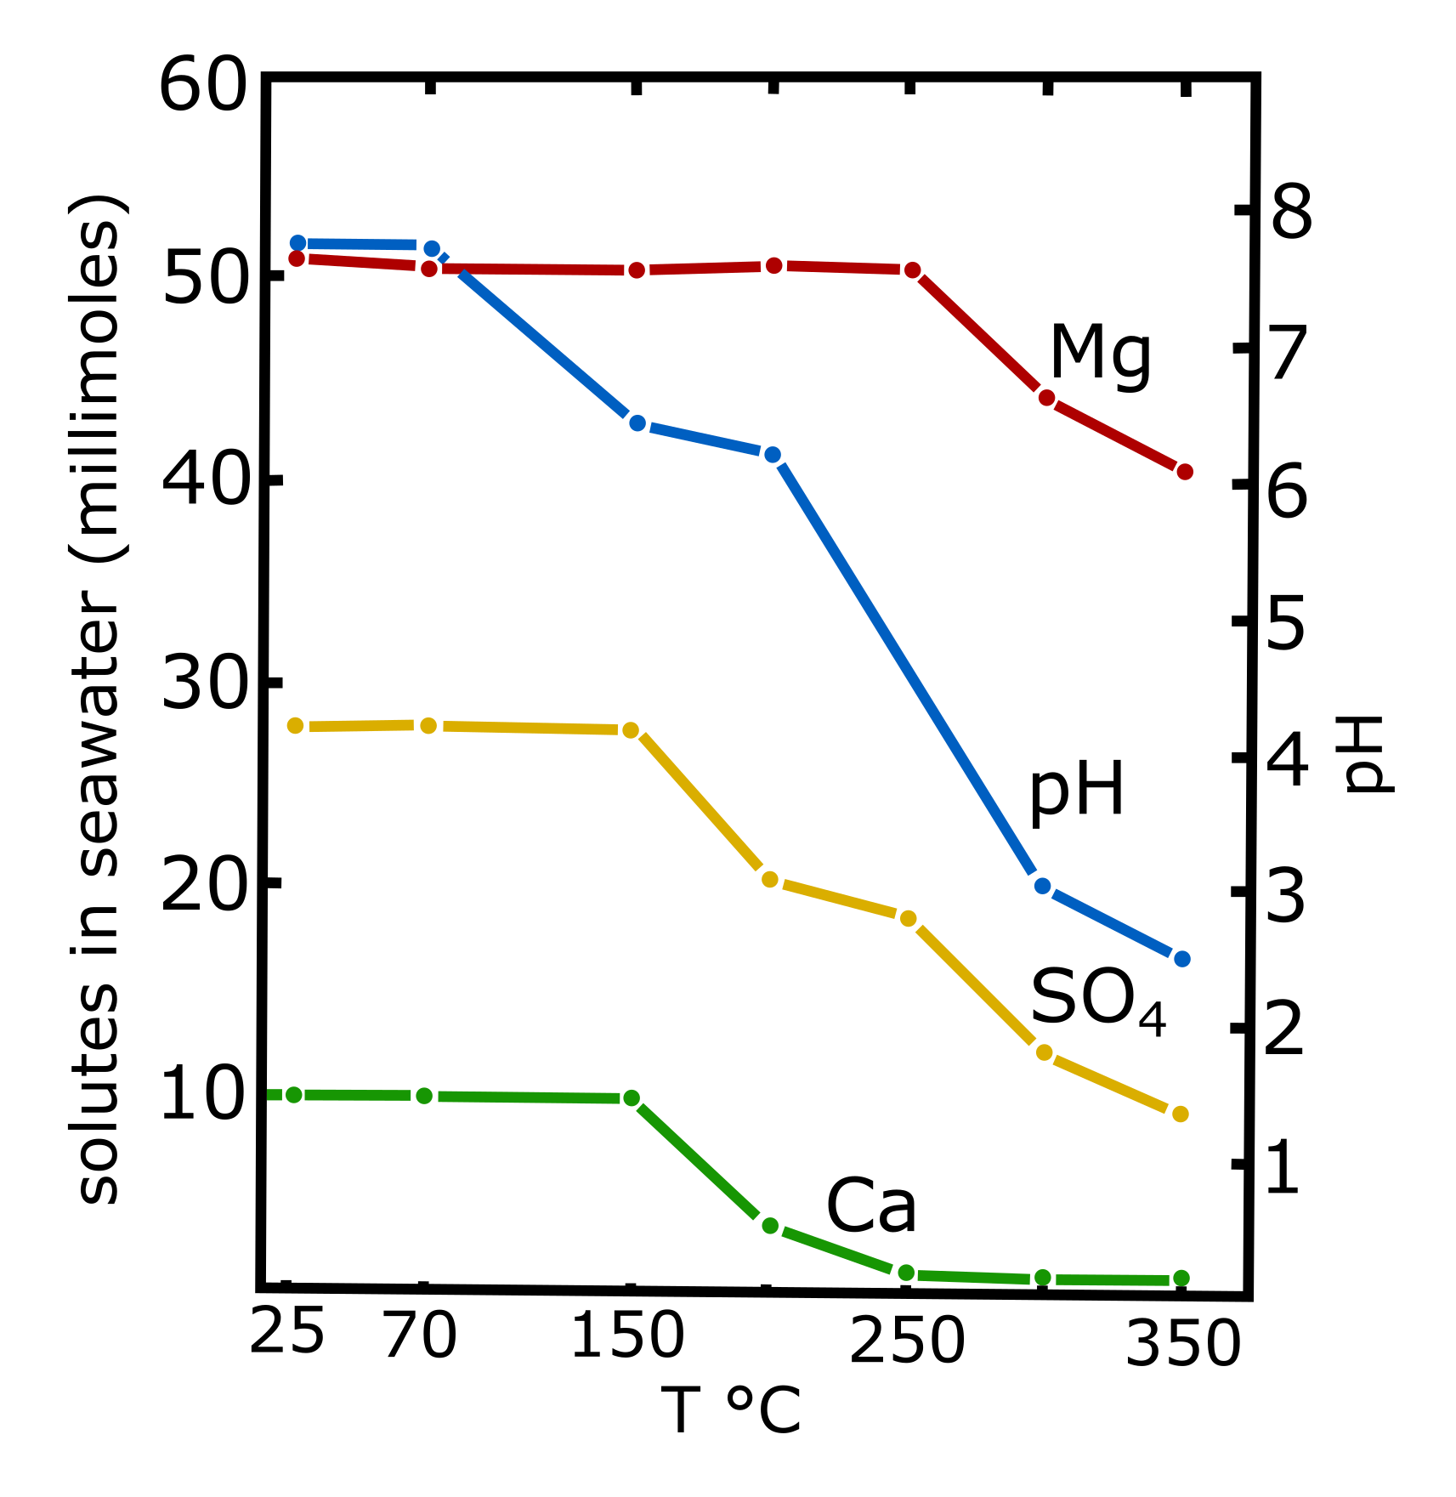
Precipitates from heated seawater
Heated seawater precipitates decrease confining hydrothermal layer permeabilities
Consists of anhydrite (Anh), brucite, sulfides, etc. (3)
Anh starts precipitating at 150 °C (4)
1 kg seawater forms 1 g Anh at 200° - 250°C (4)
3
Modified from Bischoff, J. and Seyfried, W., 1978.
Notes:
In addition, to clay alteration minerals, near-coastal hydrothermal systems are additionally sealed to recharge from ocean reservoirs by minerals such as anhydrite, brucite and sulfides (Teagle et al., 1998).
Anhydrite, which is probably the most significant permeability-decreasing mineral from heated seawater, begins to precipitate at 150°C, which is a relatively low temperature in these systems.
With its present composition and mineral solute concentration, it takes 1 kilogram of seawater to precipitate 1 g of anhydrite at temperatures between 200° and 250°C (Bischoff, 1978).

Slide 4
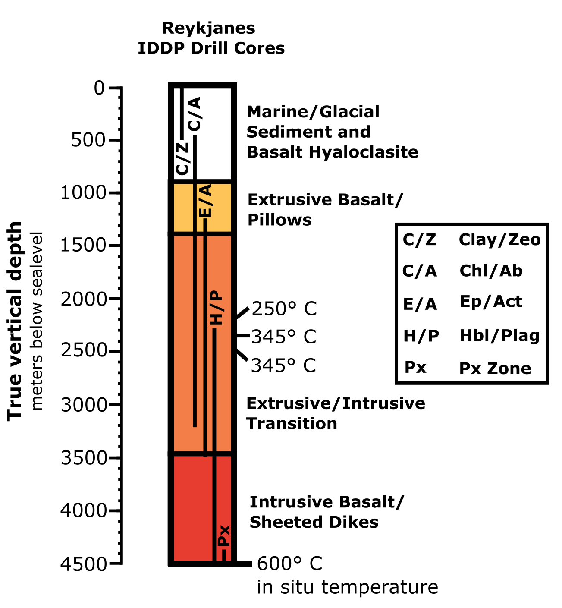
Seawater-derived hydrothermal fluids
Zierenberg et al., 2021 found seawater-derived hydrothermal fluids in the IDDP-2 borehole at 4,500 m, 430°C and 340 bars (5,6)
Borehole had moderate to good permeability (5)
Kluge et al., 2022 found low porosity metamorphic rocks may also mobilize fluids at high pressures and temperatures (7)
4
Modified from Zierenberg, R., et al. 2021.
Notes:
But, if these sealing layers are so efficient, especially with seawater precipitants, do fluids ever penetrate to significant depths in hydrothermal systems? Let’s consider some real-world examples.
A study by Zierenberg et al., 2021 found seawater-derived hydrothermal fluids in the IDDP-2 borehole in Reykjanes, Iceland, at depths below 4,500 m and at 430°C and 340 bars .
Despite being near the brittle-ductile transition, the borehole also experienced significant loss of drill fluids, indicating moderate to good permeability, even under those conditions.
And perhaps, grain-scale and fracture permeability isn’t the only answer to this riddle. Kluge et al., 2022 found, based on electrical conductivity signatures, that some fluids do transport through low porosity metamorphic rocks at similarly high confining pressures.

Slide 5
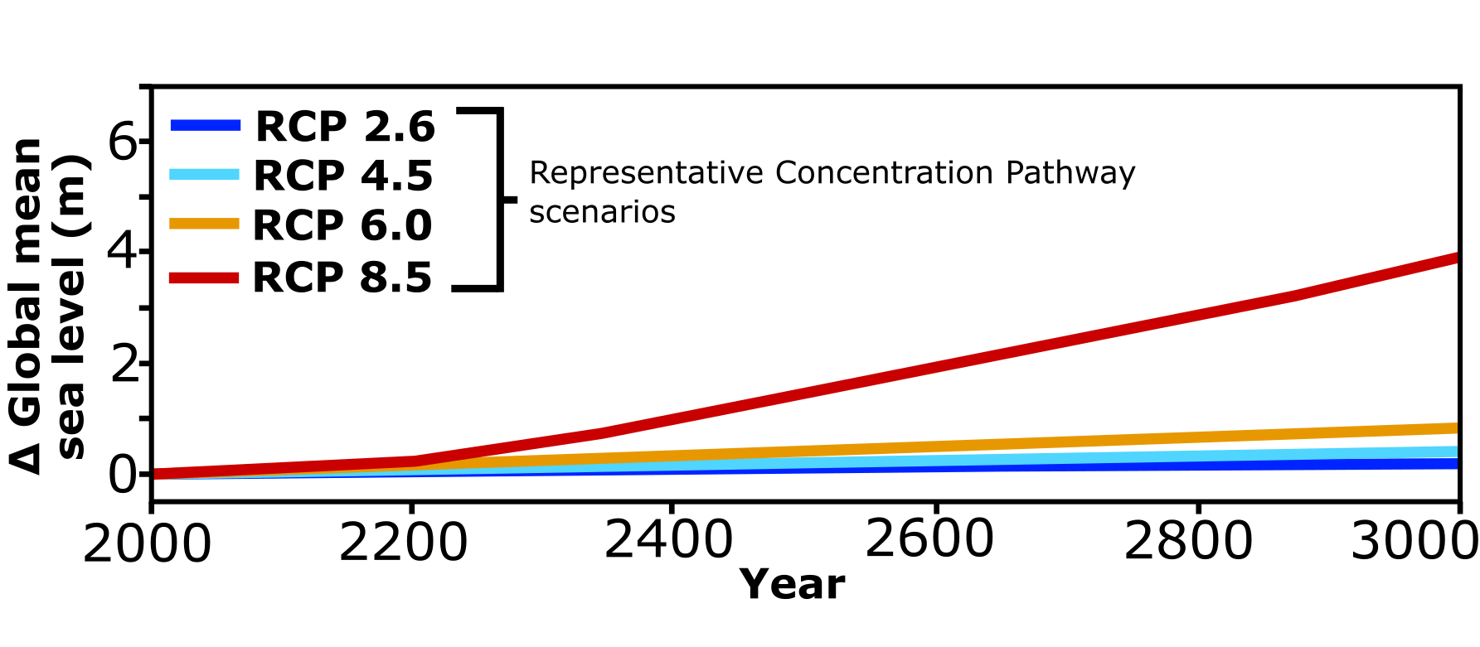
Effects of sea level rise
5
Modified from Bulthuis, K., et al., 2019.
Notes:
SO, how does Anthropocene sea level rise factor into all this? With catastrophic melt of the polar ice caps, the sea level may rise as much as 60 m (Bulthuis et al., 2019).
The addition of such a large volume of fresh water would dilute the salinity of the shallow oceans, which would decrease the concentration of mineral solutes available to seal potential permeable pathways.
Seawater dilution could increase time scales and fluid flux required to seal recharge zones, which may increase the likelihood of fluid incursion to depth and consequently, phreatic eruptions.

Slide 6
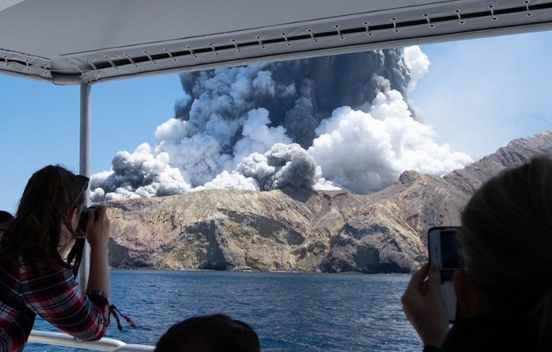
Project questions
Are there continuous fluid recharge zones between oceans and hydrothermal systems?
Could MT or ERT be used for detection?
What fluid flux, T and P, and time scales are needed to deposit minerals from diluted seawater?
How do precipitated minerals affect the fracture properties of hydrothermal host rocks?
Credit: Michael Schade/Xinhua News Agency/eyevine Why deadly New Zealand volcano eruption was hard to predict
6
Notes:
So, some of the questions my project will focus on are:
Can magnetotellurics or electrical resistivity tomography detect any continuous fluid recharge zones between the ocean and the hydrothermal systems?
How much fluid flux, at what temperatures and pressures, and over what time scales are required to deposit permeability decreasing mineral precipitates from increasingly diluted sea water?
How do these precipitated minerals affect the fracture properties of hydrothermal host rocks?
In conclusion, my proposed project aims to outline an overview of how near-coastal volcanic hydrothermal systems will equilibrate to rising sea levels, with regards to rock-seawater interactions and the mechanical consequences for phreatic eruptions.

Slide 7
References
1. Giggenbach, W.F., Shinohara, H., Kusakabe, M., Ohba, T., 2003. Formation of acid volcanic brines through interaction of magmatic gases, seawater and rock within the White Island volcanic–hydrothermal system, New Zealand. Soc. Econ. Geol. Spec. Publ. 10,19–40.
2. Mayer, K.; Scheu, B.; Gilg, H.; Heap, M.; Kennedy, B.; Lavallée, Y.; Letham-Brake, M.; Dingwell, D. (2015). Experimental constraints on phreatic eruption processes at Whakaari (White Island volcano). Journal of Volcanology and Geothermal Research, 302, 150–162. doi:10.1016/j.jvolgeores.2015.06.014
3. Teagle, D., Alt, J., & Halliday, A. (1998). Tracing the chemical evolution of fluids during hydrothermal recharge: Constraints from anhydrite recovered in ODP Hole 504B. Earth and Planetary Science Letters, 167-182.
4. Bischoff, J. L.; Seyfried, W. E. (1978). Hydrothermal chemistry of seawater from 25 degrees to 350 degrees C. American Journal of Science, 278(6), 838–860.
5. Zierenberg, R. A., Friðleifsson, G. Ó., Elders, W. A., Schiffman, P., & Fowler, A. P. G. (2021). Active basalt alteration at supercritical conditions in a seawater-recharged hydrothermal system: IDDP-2 drill hole, Reykjanes, Iceland. Geochemistry, Geophysics, Geosystems, 22, e2021GC009747. https://doi.org/10.1029/2021GC009747
6. Friðleifsson, G. Ó., Elders, W. A., Zierenberg, R. A., Fowler, A. P. G., Weisenberger, T. B., Mesfin, K. G., et al. (2020). The Iceland Deep Drilling Project at Reykjanes: Drilling into the root zone of an analog of a black smoker. Journal of Volcanology and Geothermal Research, 391. https://doi.org/10.1016/j.volgeores.2018.08.013
7. Kluge, E.-K.; Toy, V.; Lockner, D. Electrical Properties and Anisotropy of Schists and Fault Rocks from New Zealand’s Southern Alps under Confining Pressure. Geosciences 2022, 12, 121. https://doi.org/10.3390/geosciences12030121.
8. Bulthuis, K., Amst, M., Sun, S. & Pattyn, F. Uncertainty quantification of the multi-centennial response of the Antarctic ice sheet to climate change. The Cryosphere 13, 1349-1 380, doi:10.5194/tc-13-1349-2019 (2019).
9. Photo Credit: Michael Schade/Xinhua News Agency/eyevine. Why deadly New Zealand volcano eruption was hard to predict. Nature (Nature) ISSN 1476-4687 (online) ISSN 0028-0836 (print)

