Slide 1
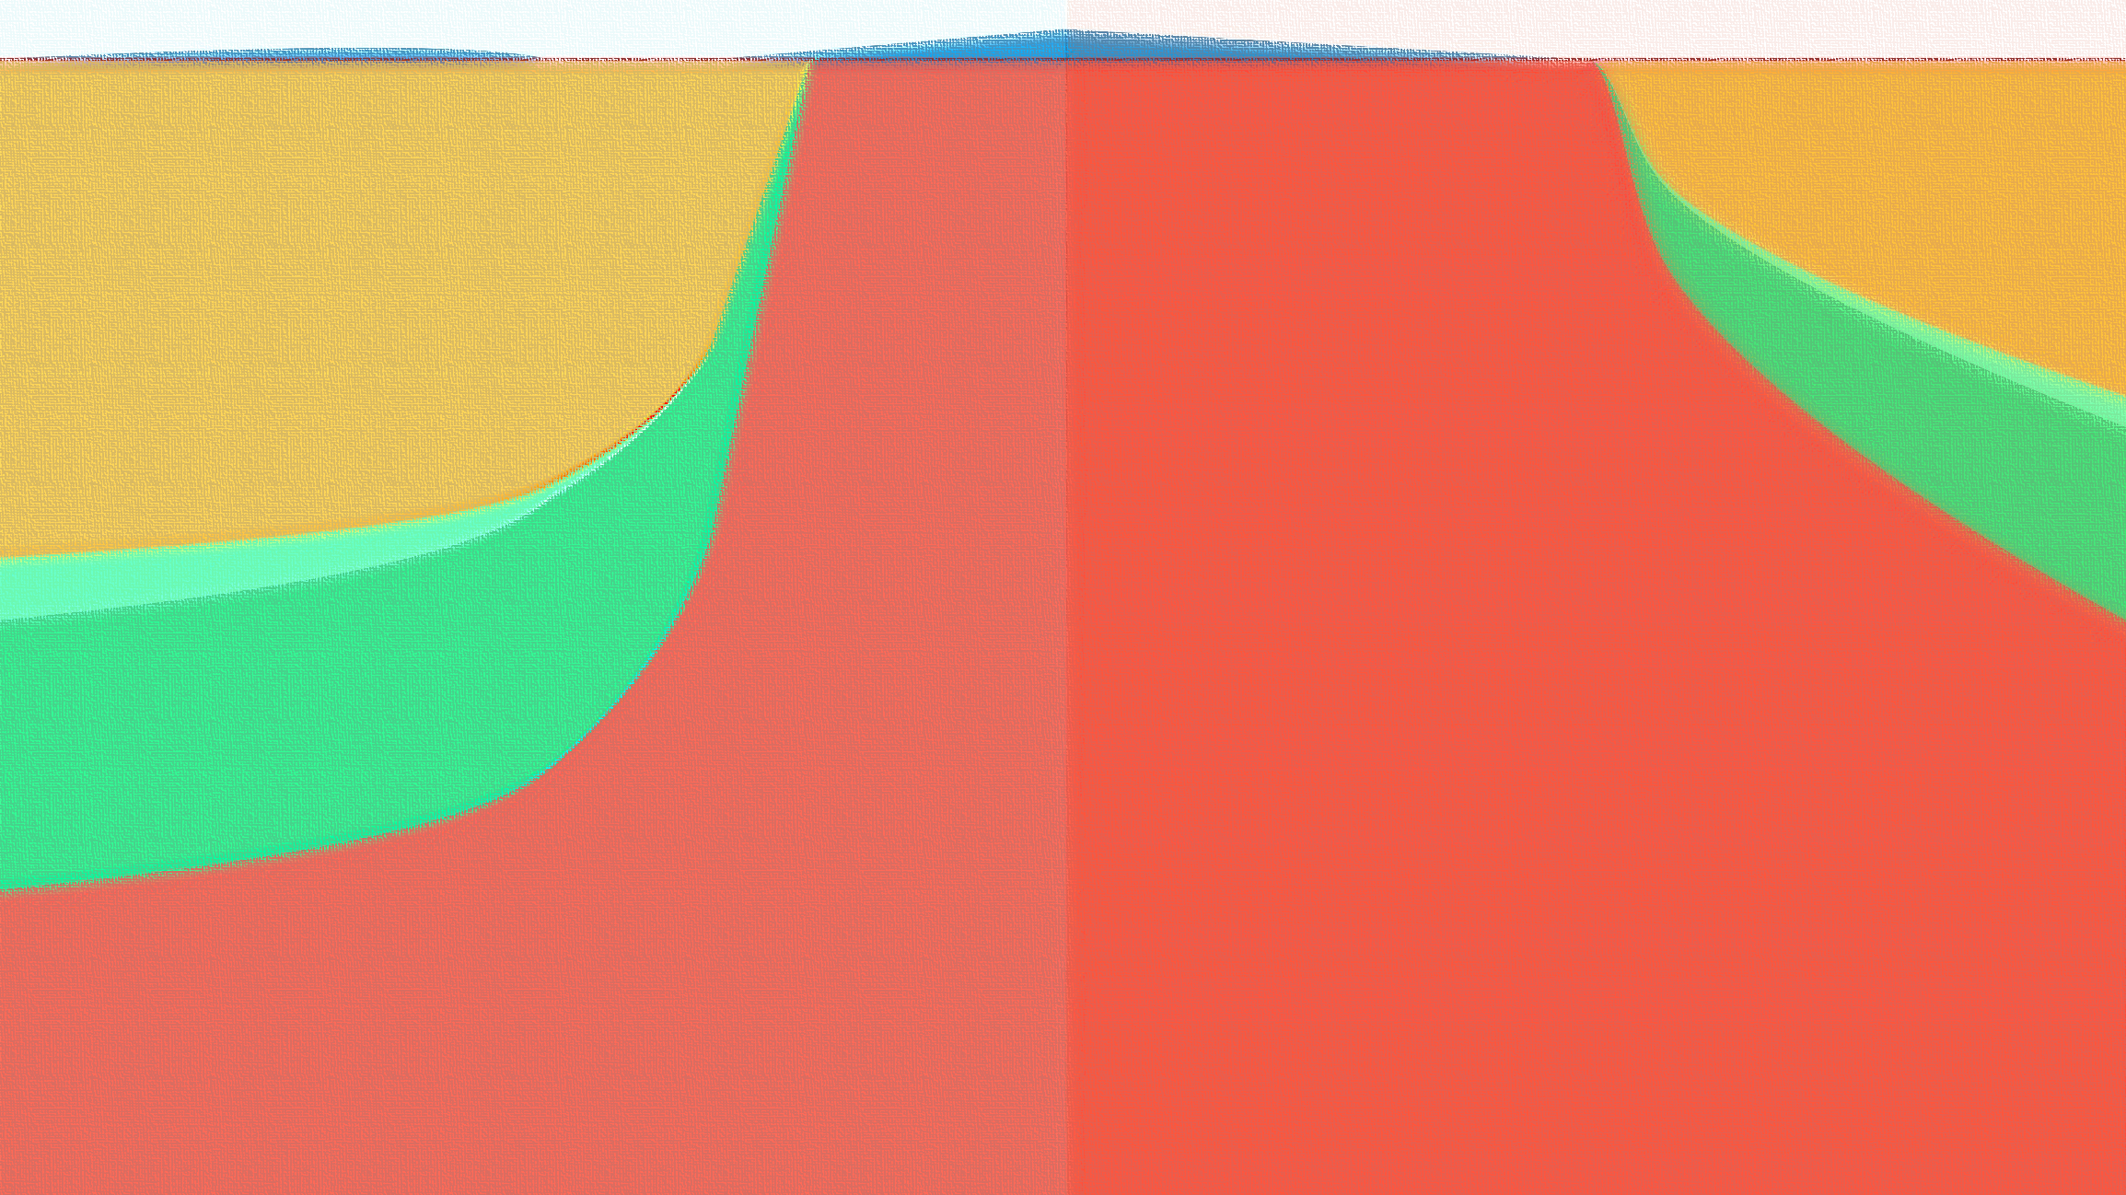



A novel Conceptualization to estimate Unsaturated Zone mass-fluxes and Integrate pre-existing Surface- and Ground- Water Models
Faculty of Science, Charles University
Veethahavya Kootanoor Sheshadrivasan, Jakub Langhammer, Holger Class, and Ulrich Lang
Notes:
This presentation is an overview of a novel conceptualization that tries to describe the distributed quantification of GW-SW exchanges

Slide 2
Overview
Motivation
Identified Research Gap
Objectives of the model – GWSWEX
Methodology
Model Behaviour
Past and Future of the study

Slide 3
Motivation
Advancing numerical modelling of hydrosystems to aid decision making in building resilience against climate change
Climate- (& Land-use-) Change → unreliable climate periodicity → disruption of systems built around it ^{[1]}
Frequent climate extremes → frequent droughts and floods ^{[2]}
Computational advancements + Numerical modelling = viewing various versions of the future → informed decision making
Ability to make predictions & simulate potential interventions
Highlight: Role of groundwater replenishment in building climate resilience in the hydrosphere, especially in India where the monsoon is shortening and intensifying ^{[2]}
Notes:
The primary motivation of this study is to make advances in the field of numerical modelling of hydrosystems to aid decision making in building resilience against climate change.
It is now well established that the stability and periodicity of cycles in the hydrosphere have been modified. And by extension, there is a dire need to build resilience in the systems that were designed on the guarantee of said stability and periodicity.
Managing groundwater resources plays in integral part in doing this.

Slide 4
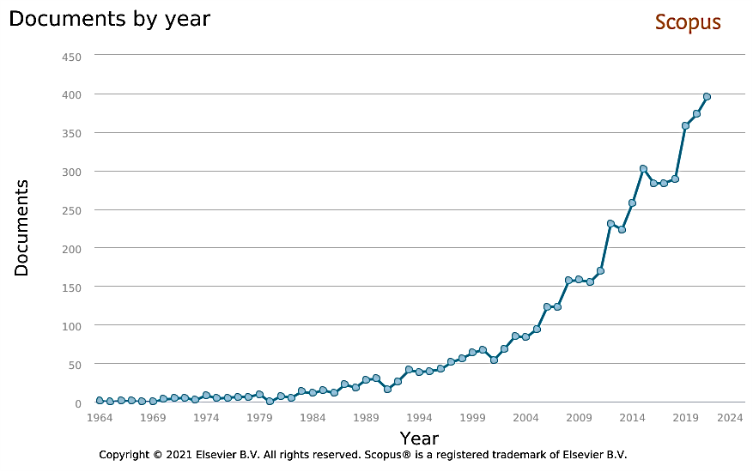
Interest in Integrated GW-SW Modelling
keyword phrases: “integrated groundwater-surface water modelling”, “coupled groundwater-surface water modelling”, coupled hydrological modelling
Notes:
Increased especially after call for increased study/consideration in EU WFD (Water Framework Directive)

Slide 5
Identified Research Gap
Most* integrated GW-SW physical models employ the Richards’ equation to model unsaturated zone (UZ) fluxes ^{[3, 4, 5, 6]}
Richards’ eqn. is a PDE with no analytical solution
its solution is computationally expensive and unreliable
demands extensive input data
e.g. MODFLOW, HydroGeoSphere, GSFLOW, etc.
*MIKE SHE offers simplified methods, but is not Open Source
Conceptual models offer a computationally cheap way to couple GW and SW models, although leveraging accuracy
most that set out to model the UZ, or to couple GW and SW models are generally build for specific applications [7,8,9]
e.g. LISFLOOD, SWAT, MOBIDIC (and -U)
Notes:
There are lack of resources to couple existing GW and SW models – i.e. a general purpose computationally cheap model to estimate UZ fluxes to couple GW and SW models.

Slide 6
Objectives of the model – GWSWEX
To build a model to estimate UZ in- and out- fluxes with the primary aim of coupling existing GW and SW models
Desired attributes:
general purpose
computationally cheap
distributed
optimize model physics to:
adequately describe UZ in- and out- fluxes
ignore the fluxes within the UZ
explicit coupling scheme
flexible I/O

Slide 7
Methodology

Slide 8
Global Simulation Period
timing control
ts 1
ts 2
ts 3
ts 4
ts 5
ts 6
ts 7
ts 8
ts 9
ts 10
ts 11
ts 12
ts 13
ts 14
…
ts n
Local Simulation Period
elem 1
elem 2
elem 3
elem 4
elem 5
elem 6
elem 7
elem 8
elem 9
elem 10
elem 11
elem 12
elem 13
elem 14
…
elem n
GW Model Run (ts n-1)
SW Model Run (ts n-1)
GW heads
SW levels
P
ET
CHD
GWSWEX Model
ts 1
ts 2
ts 3
ts 4
ts 5
ts 6
ts 7
ts 8
ts 9
ts 10
ts 11
ts 12
ts 13
ts 14
…
ts n
GW discharges
SW discharges
GW Model
SW Model
result accumulation and output

Slide 9
Global Simulation Period
timing control
ts 1
ts 2
ts 3
ts 4
ts 5
ts 6
ts 7
ts 8
ts 9
ts 10
ts 11
ts 12
ts 13
ts 14
…
ts n
Local Simulation Period
elem 1
elem 2
elem 3
elem 4
elem 5
elem 6
elem 7
elem 8
elem 9
elem 10
elem 11
elem 12
elem 13
elem 14
…
elem n
GW Model Run (ts n-1)
SW Model Run (ts n-1)
GW heads
SW levels
P
ET
CHD
GWSWEX Model
ts 1
ts 2
ts 3
ts 4
ts 5
ts 6
ts 7
ts 8
ts 9
ts 10
ts 11
ts 12
ts 13
ts 14
…
ts n
GW discharges
SW discharges
GW Model
SW Model
result accumulation and output

Slide 10
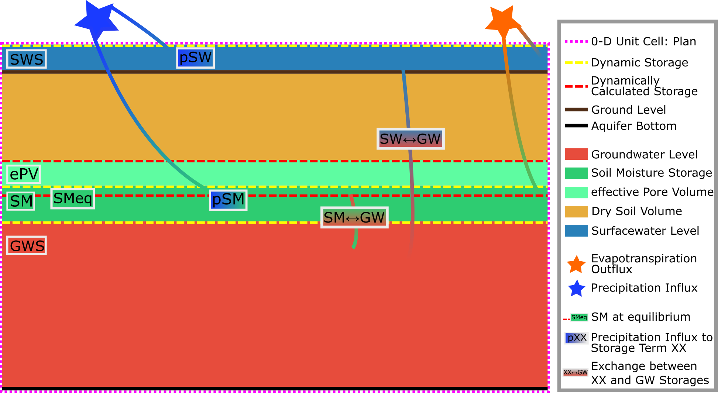
Illustration of the exchange processes per model element: GWSWEX
Notes:
Stage-storage terms per model element. Therefore higher resolution, where necessary gives better results.

Slide 11
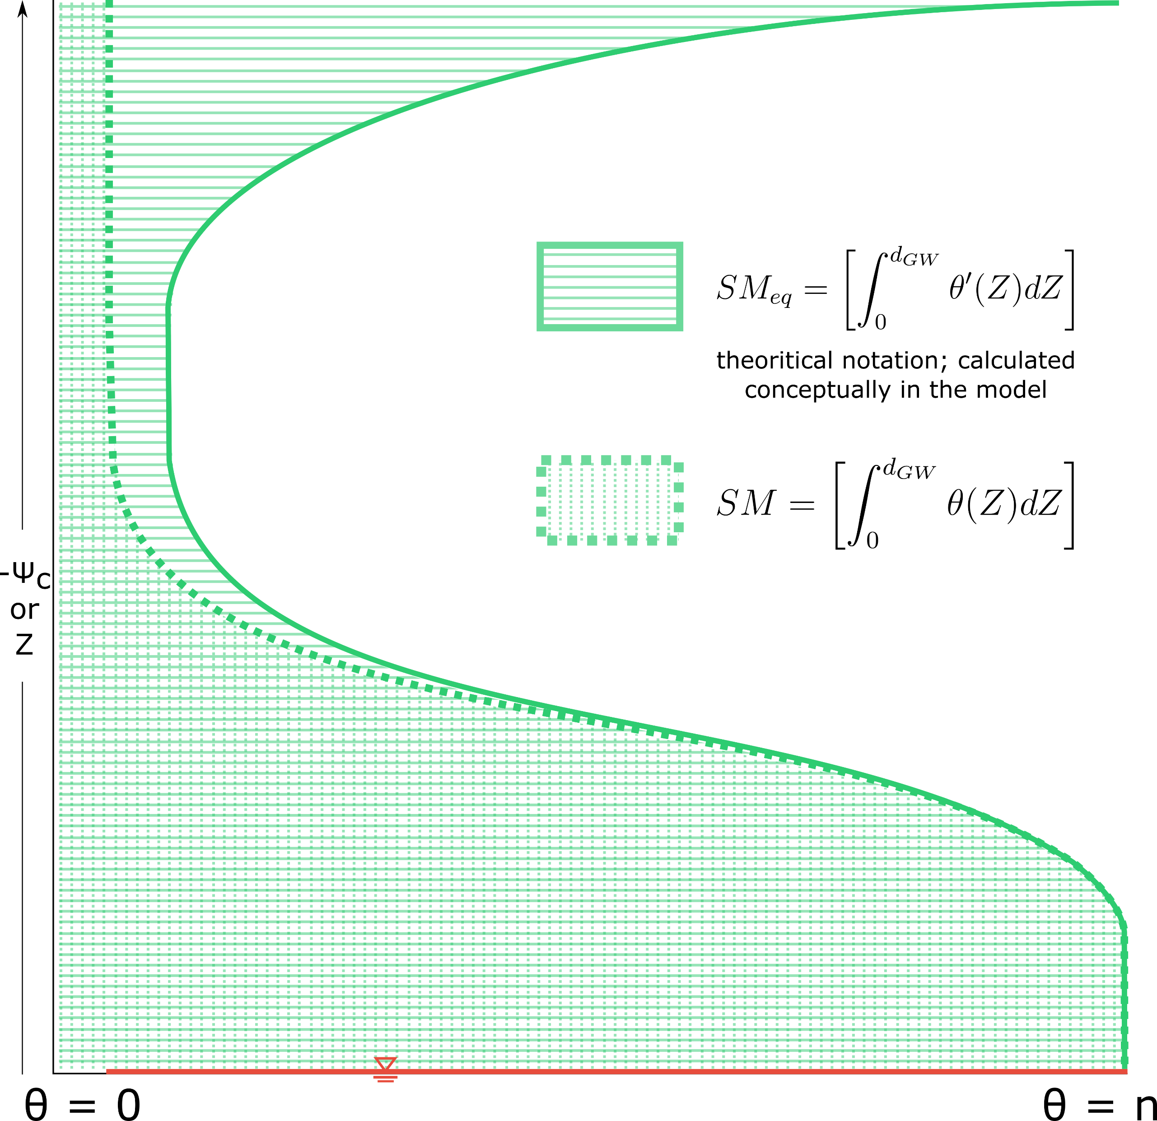
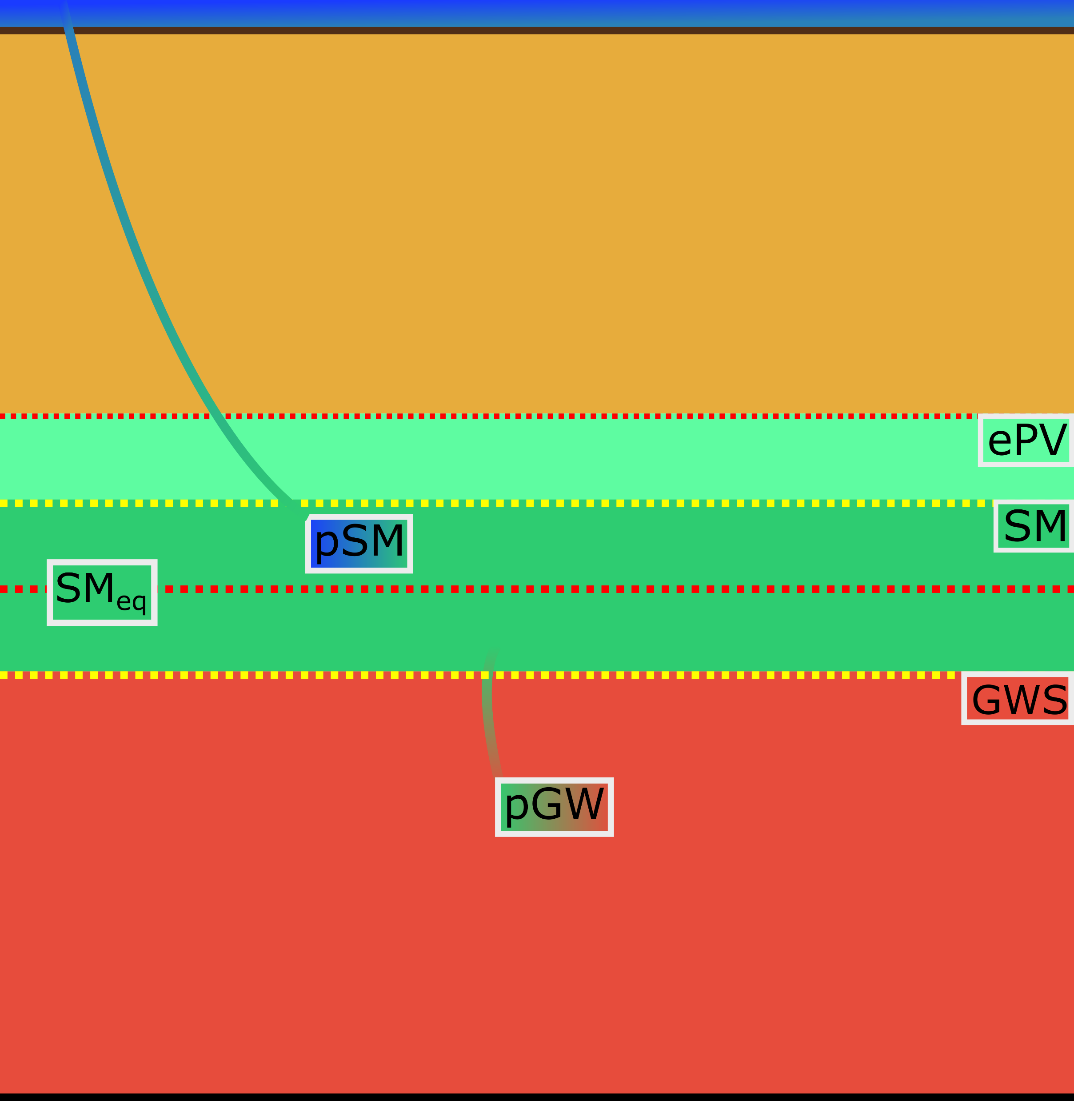


Model Physics: conceptualizing the Van Genuchten^{[10]} – Mualem Model ^{[11]}
mass available for infiltration into GW = SM - SM_{eq}

Slide 12
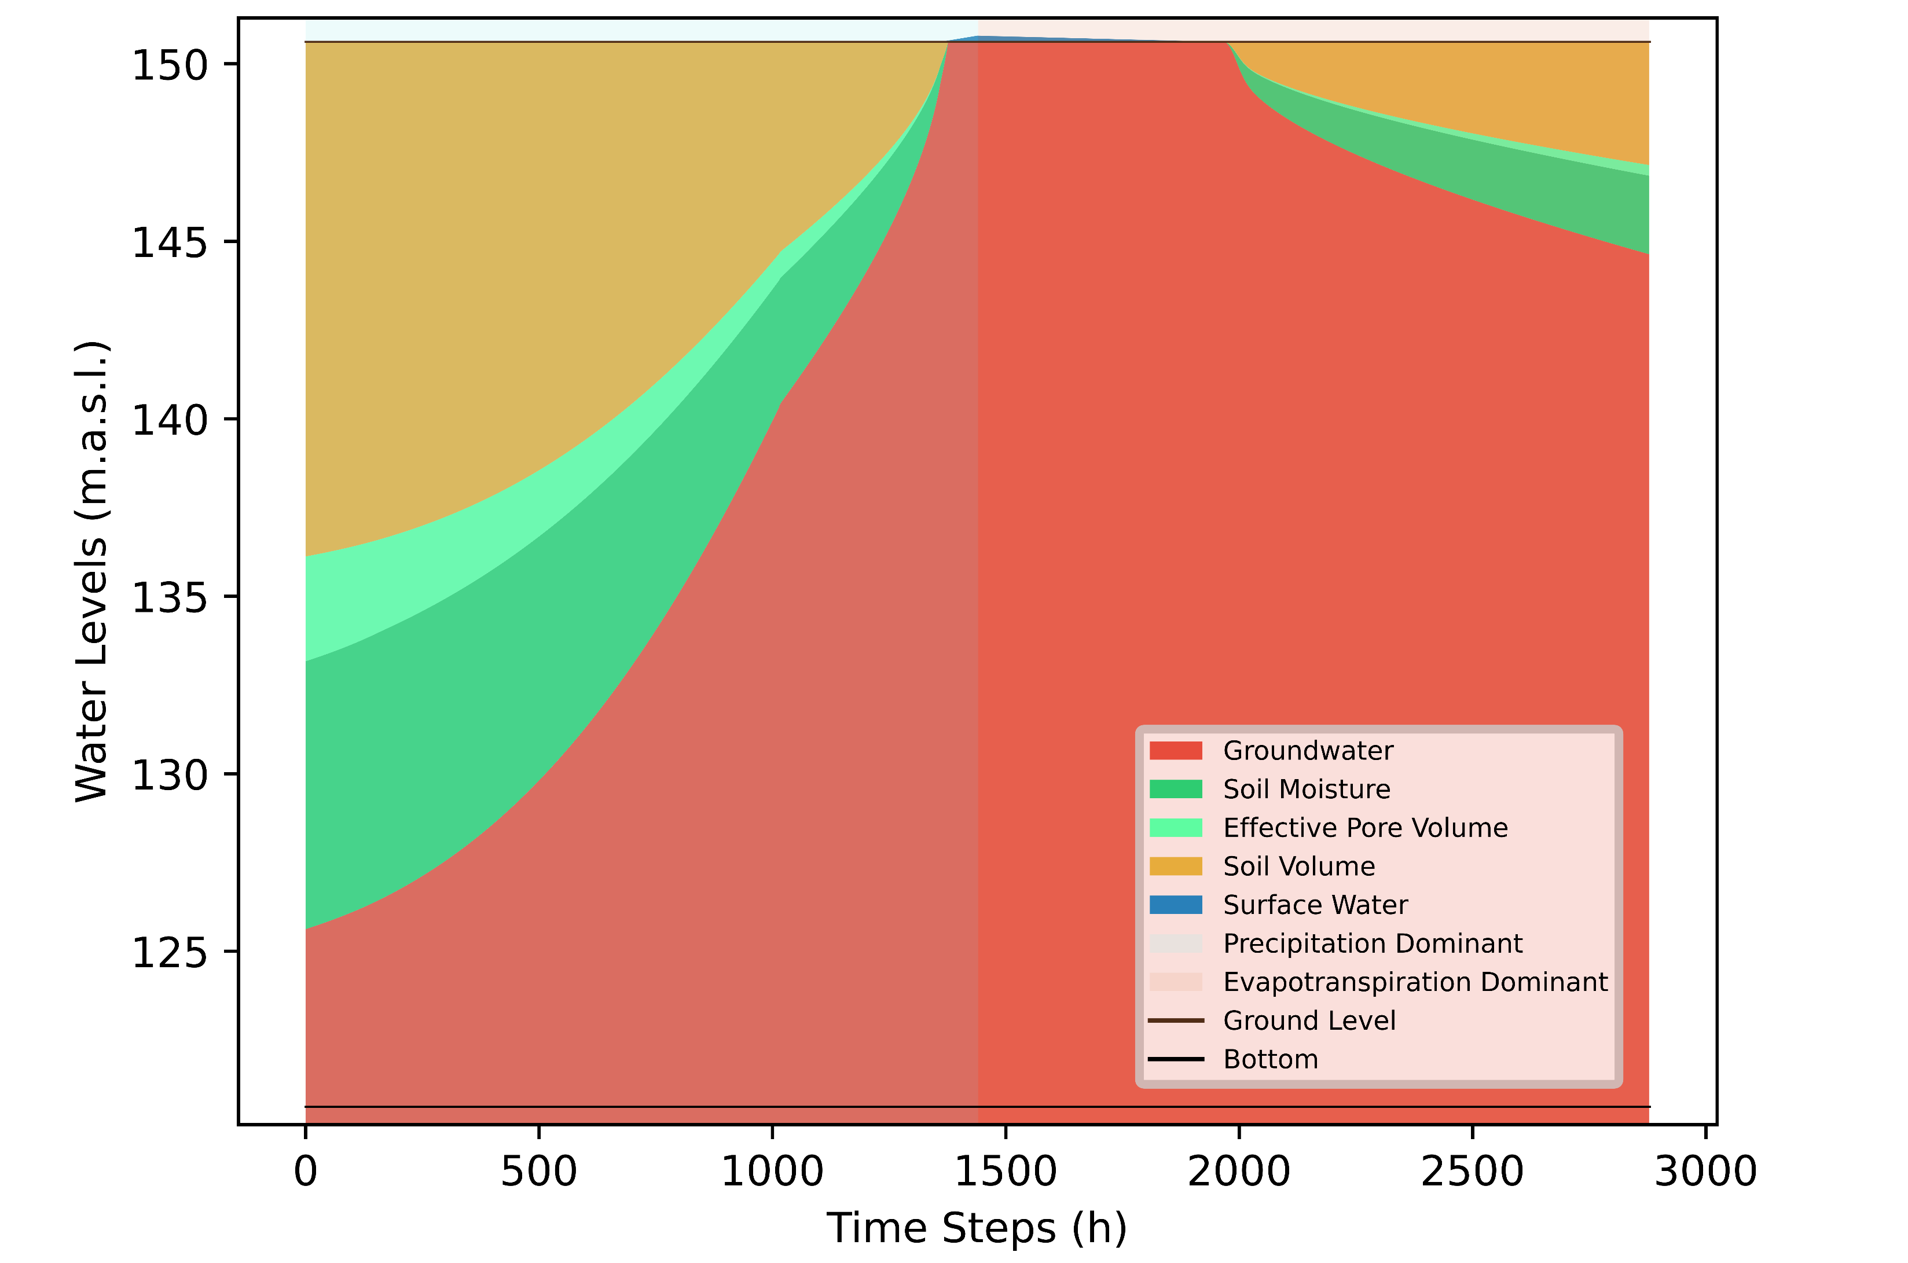
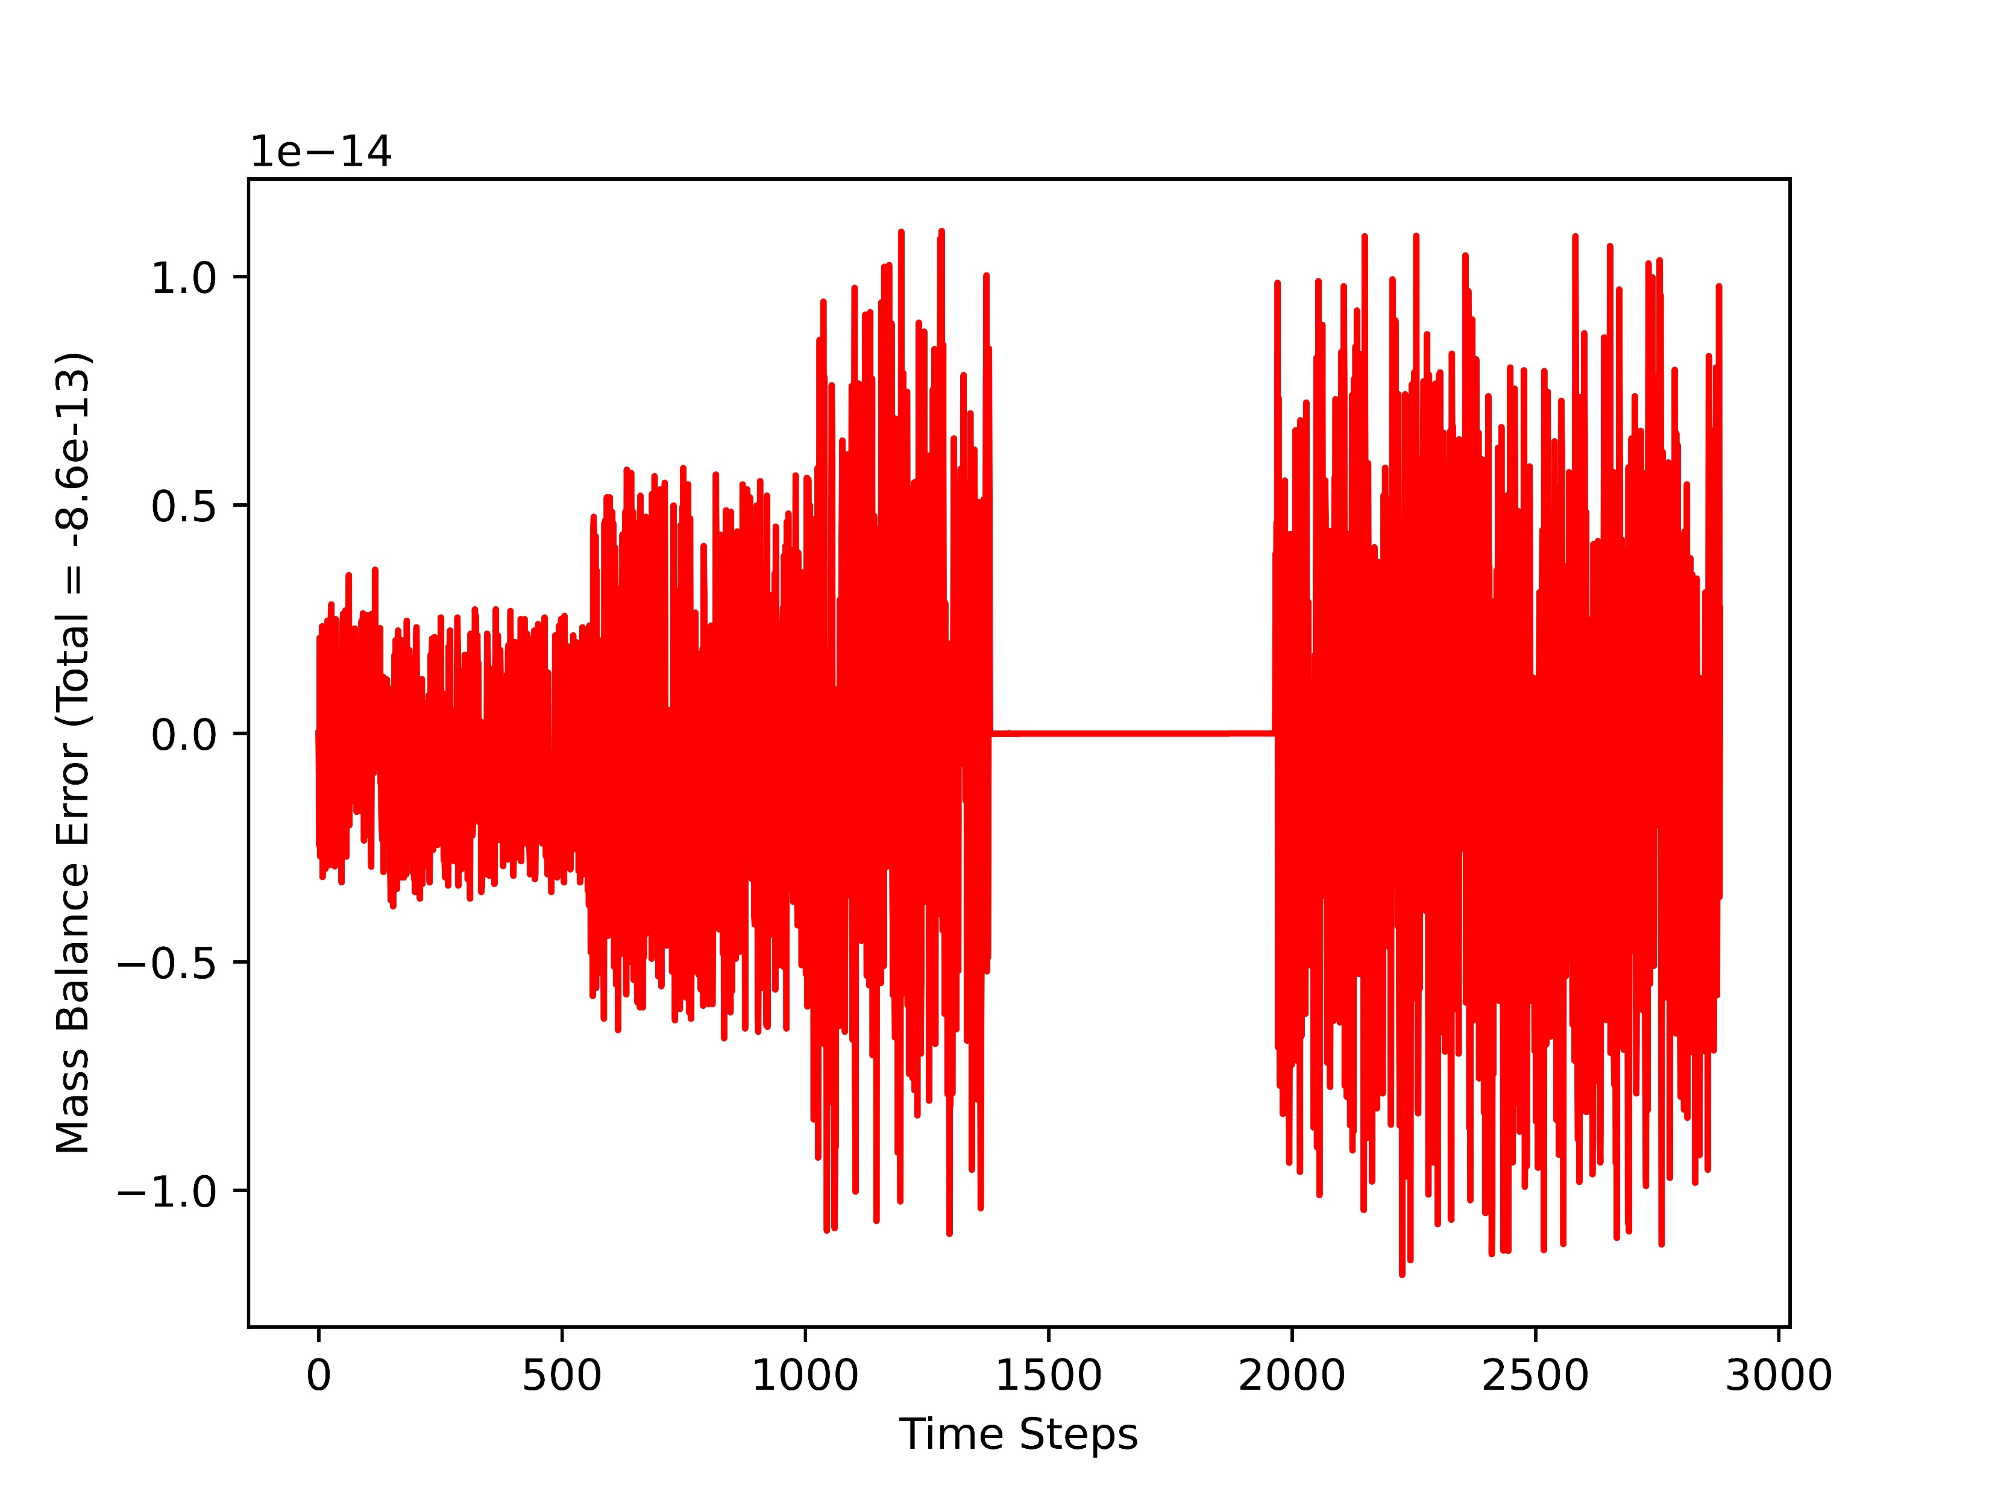









Model Behaviour: Sample model element
Buildable as a standalone Fortran 90 program or as a python importable Fortran module (f2py)
Average execution time for a model with 10,000 model elements, and 3000 time-steps is ~90 min with no parallelization
Parallelization can drastically reduce runtimes
Notes:
Standalone model run for a duration of 4 months, for typical coarse-grained sand unconfined aquifer, for a constant ET rate of 0.33 mm/h and a precipitation rate of 2.5 mm/h for the first 2 months and dry thereafter

Slide 13
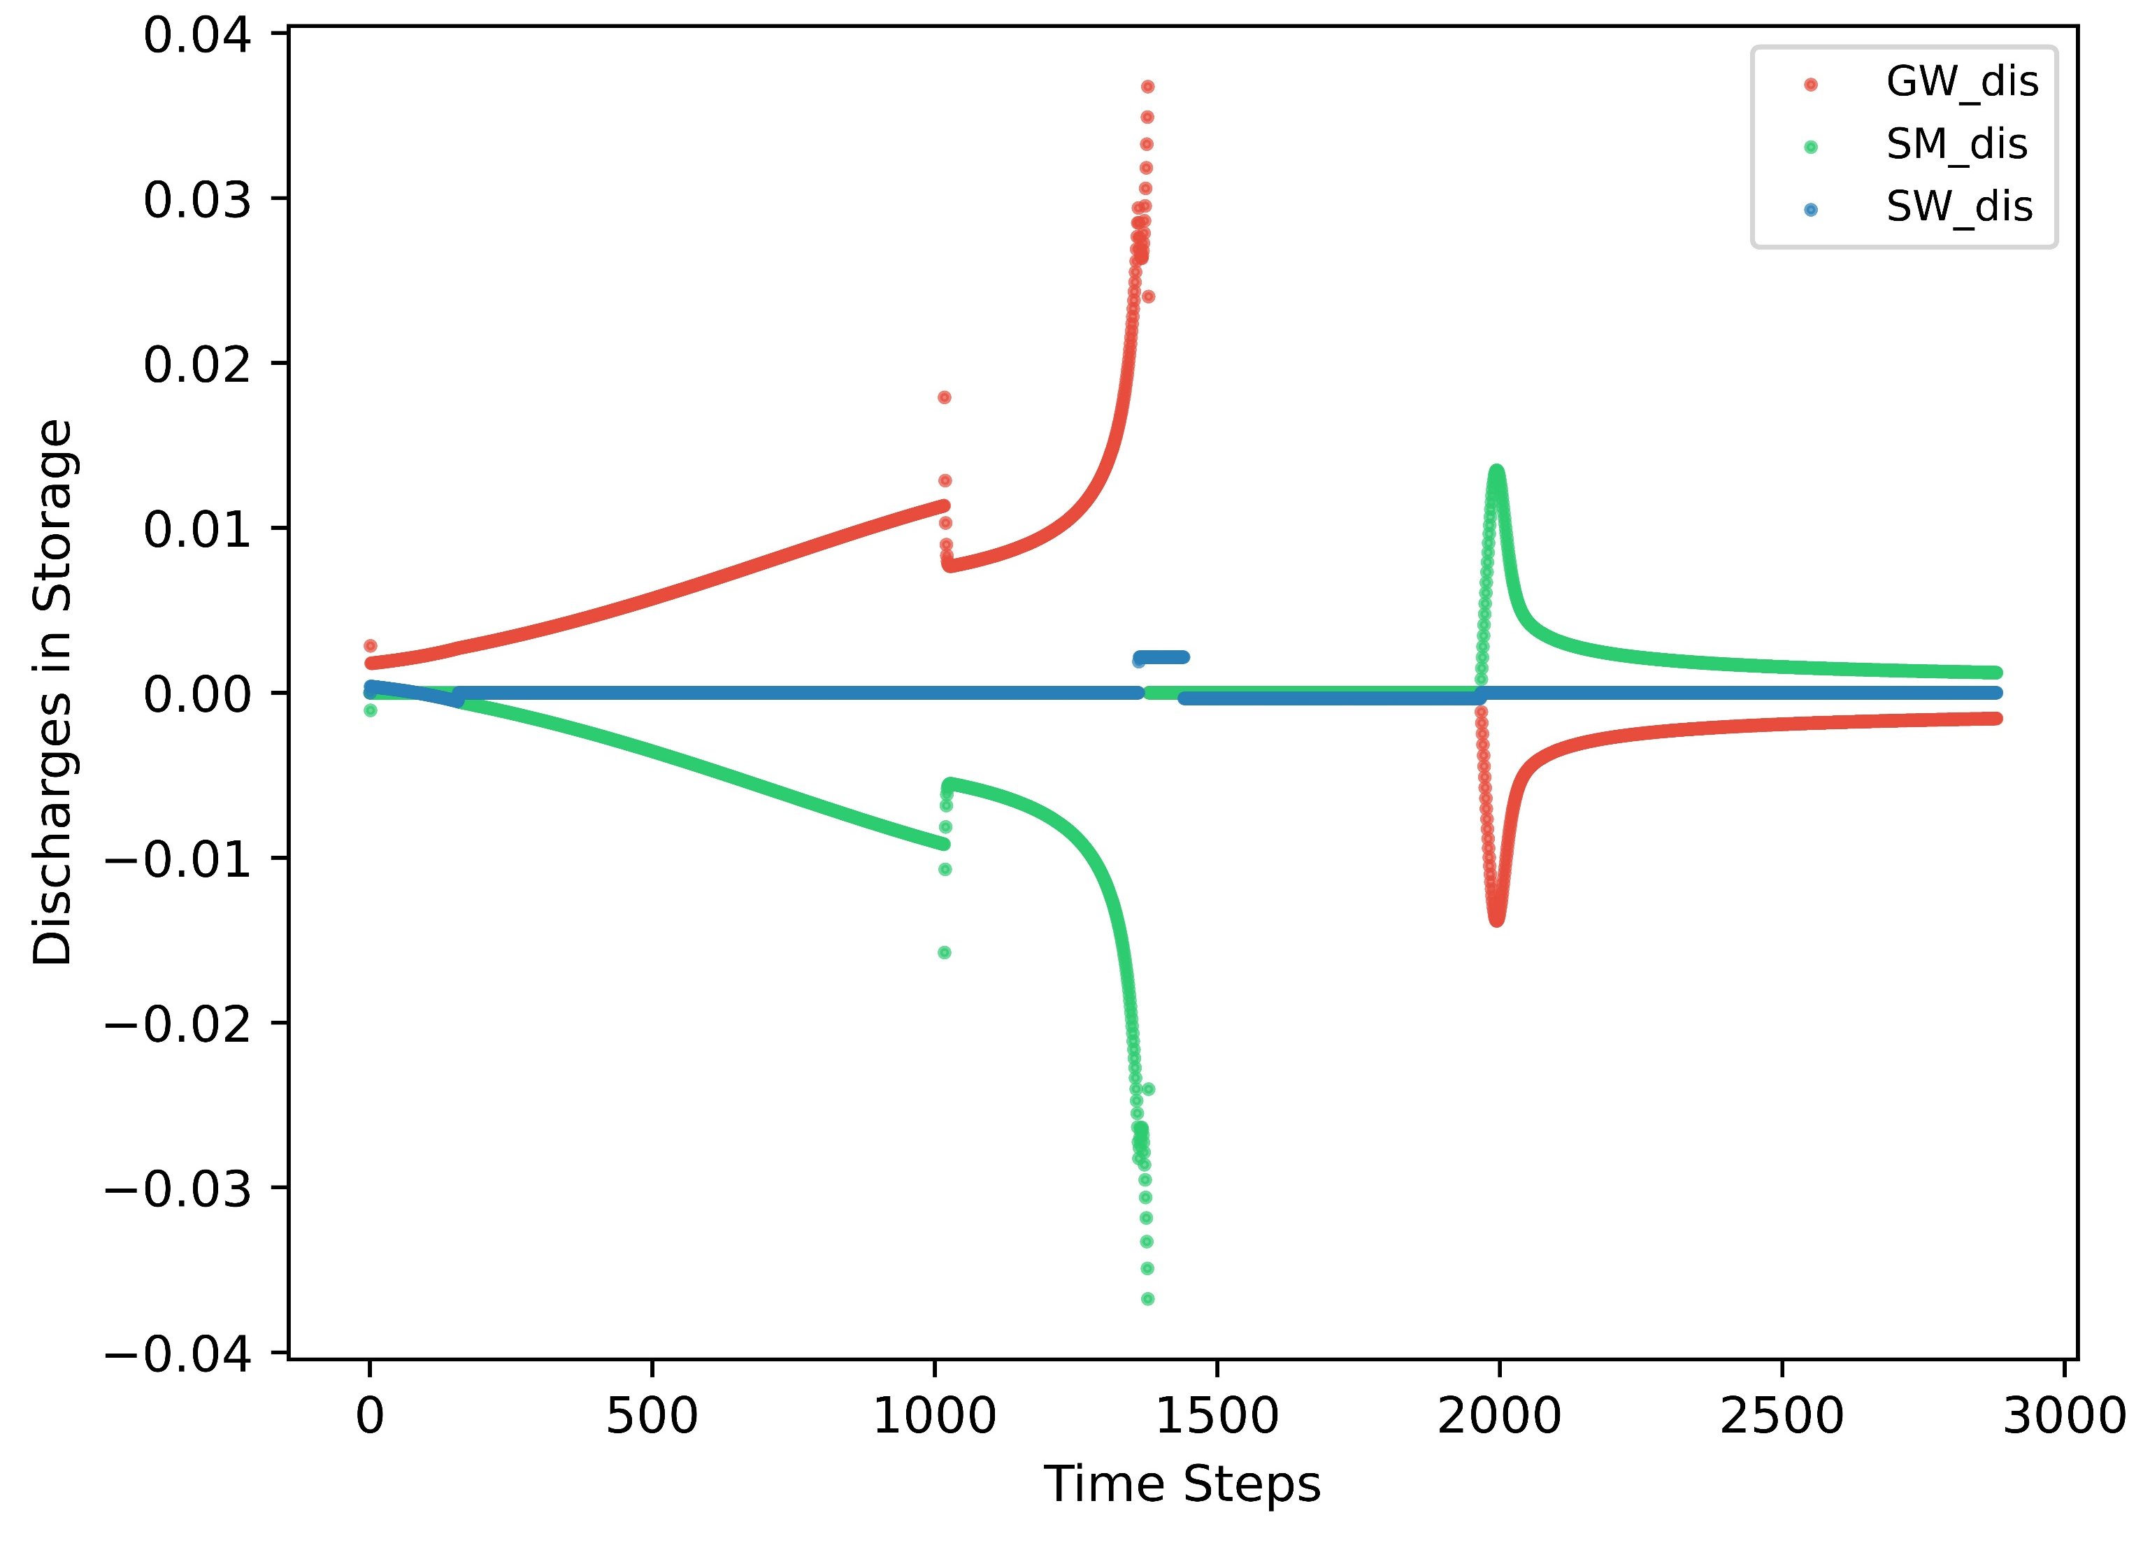








Slide 14
Past and Future of the Study
The presented results are indeed tested for hypothetical behavioural cases
However, a previous iteration of the model has demonstrated promising results, in simulating the UZ (applied for a peat-wetland nature protection zone in southern Germany; coupled Delft-FM and MODFLOW 6 using GWSWEX), as a part of my Masters Thesis (available for review on request)
The model will soon be tested and verified at the experimental catchment in the montane peatlands of Bohemian forest in the coming months
Any interest in collaboration is welcome!

Slide 15
References
Climate Extremes and Their Implications for Impact and Risk Assessment, Jana Sillmann, Sebastian Sippel and Simone Russo, 2019. https://doi.org/10.1016/C2017-0-01794-9
IPCC, 2022: Climate Change 2022: Impacts, Adaptation, and Vulnerability. Contribution of Working Group II to the Sixth Assessment Report of the Intergovernmental Panel on Climate Change [H.-O. Pörtner, D.C. Roberts, M. Tignor, E.S. Poloczanska, K. Mintenbeck, A. Alegría, M. Craig, S. Langsdorf, S. Löschke, V. Möller, A. Okem, B. Rama (eds.)]. Cambridge University Press. In Press
Farthing, M. W. and Ogden, F. L. Numerical Solution of Richards’ Equation: A Review of Advances and Challenges. Soil Science Society of America Journal, 81(6):1257–1269, 2017
Germann, P. Comment on “Theory for Source-Responsive and Free-Surface Film Modeling of Unsaturated Flow”. Vadose Zone Journal, 9(4):1100–1101, 2010
Gray, W. G. and Hassanizadeh, S. M. Paradoxes and Realities in Unsaturated Flow Theory. Water Resources Research, 27(8):1847–1854, 1991
Miller, C. T., Williams, G. A., Kelley, C. T., and Tocci, M. D. Robust solution of Richards’ equation for nonuniform porous media. Water Resources Research, 34(10):2599–2610, 1998
Van Der Knijff, J. M., Younis, J. and De Roo, A. P. J.(2008)'LISFLOOD: a GIS-based distributed model for riverbasin scale water balance and flood simulation’, International Journal of Geographical Information Science, DOI: 10.1080/13658810802549154
Arnold, Jeffrey G., et al. "SWAT: Model use, calibration, and validation." Transactions of the ASABE 55.4 (2012): 1491-1508.
Bizhanimanzar, M.; Leconte, R.; Nuth, M. Catchment-Scale Integrated Surface Water-Groundwater Hydrologic Modelling Using Conceptual and Physically Based Models: A Model Comparison Study. Water 2020, 12, 363. https://doi.org/10.3390/w12020363
van Genuchten, M. Th., & Dalton, F. N. (1986). Models for simulating salt movement in aggregated field soils. In Geoderma (Vol. 38, Issues 1–4, pp. 165–183). Elsevier BV. https://doi.org/10.1016/0016-7061(86)90013-3
van Genuchten, M.T. (1980), A Closed-form Equation for Predicting the Hydraulic Conductivity of Unsaturated Soils. Soil Science Society of America Journal, 44: 892-898. https://doi.org/10.2136/sssaj1980.03615995004400050002x

Slide 16


Access/Contact
GitHub repository: github.com/veethahavya-CU-cz/GWSWEX
Contact: veethahavya@natur.cuni.cz

