Slide 1



Dynamic weakening in carbonate-built seismic faults: insights from laboratory experiments with fast and ultra-localized temperature measurements
Stefano Aretusini, Arantzazu Nuñez Cascajero, Chiara Cornelio, Xabier Barrero Echevarria, Elena Spagnuolo, Alberto Tapetado, Carmen Vazquez, Massimo Cocco, and Giulio Di Toro
Vienna, 24/05/2022

Slide 2
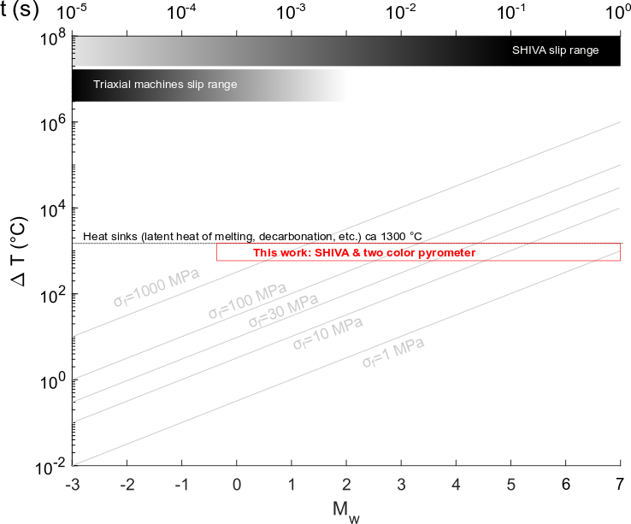
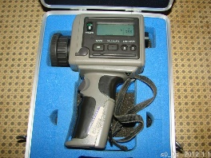
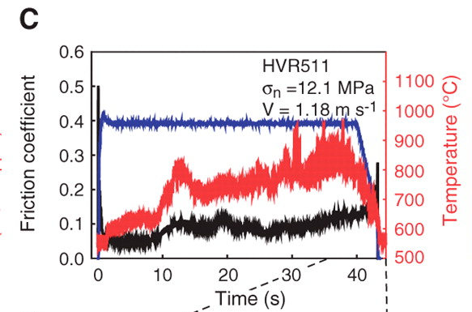
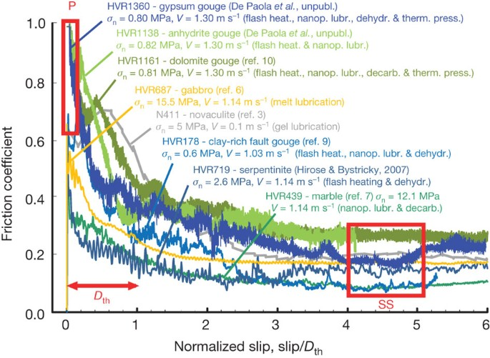
Temperature anomaly produced during earthquakes
Given the high slip rate, thin thickness of the sheared layer and the low thermal conductivity of rocks, the system is considered as closed (adiabatic): bulk temperature rapidly increases (~1000 °C in < 1 s) during seismic faulting.
T with IR thermometer
depth
Kanamori & Heaton, 2000
The separation of the stress from temperature variable is necessary to define:
constitutive laws, τ=f(T,slip,slip velocity)
the energy budget during earthquake slip, the partitioning of mechanical energy into heat ± grain comminution
Han et al., 2007

Slide 3
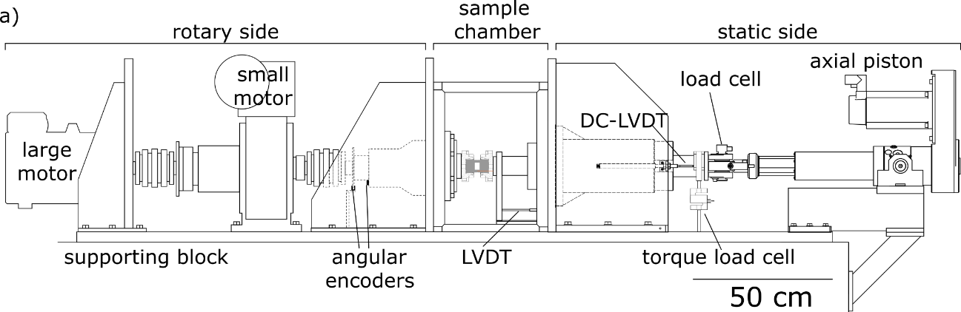
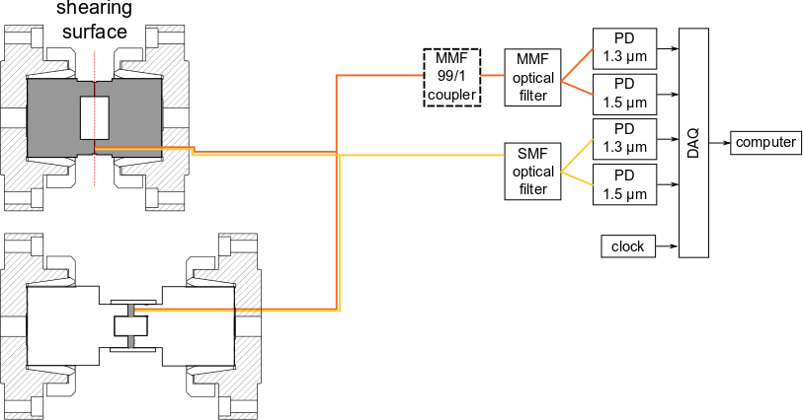
Optical fibers T-measurements during simulated seismic slip
The SHIVA sample area
Bare rock surfaces
Powdered rocks (fault gouge)
Two color pyrometer:
1 kHz sampling rate
Measured T spot diameter (at 0.1 mm):
  SMF fiber: 40 µm
  MMF fiber: 120 µm
IR from inside the shearing surface
Di Toro et al., 2010; Aretusini et al., 2021
Tapetado et al., 2016; Nunez-Cascajero et al., 2020

Slide 4
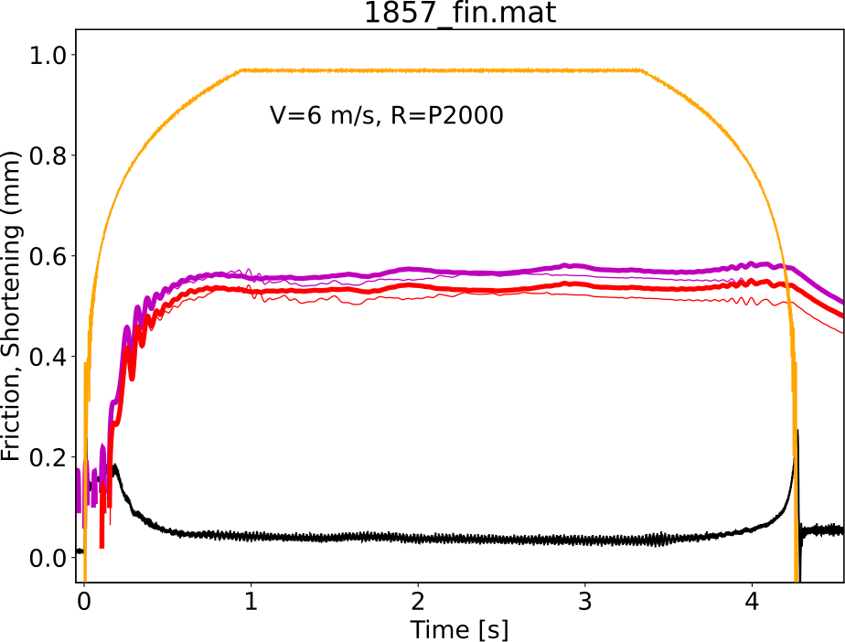
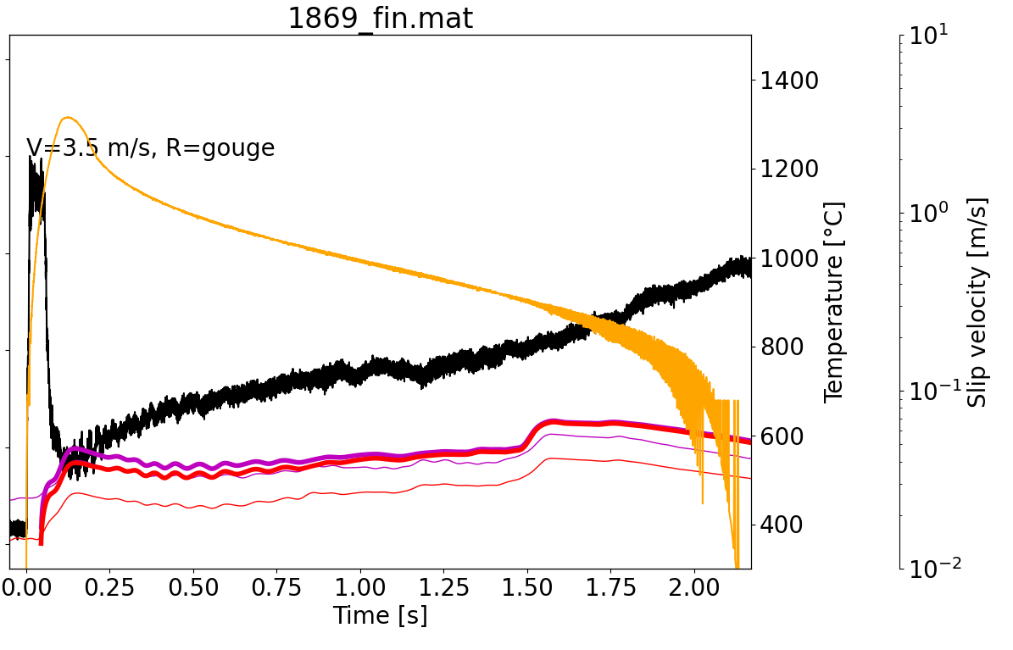
Independent measures of shear stress and temperature
Bare rock surface
Fault gouge
velocity
velocity
temperature λ
friction
friction
temperature λ
See also: Harbord et al., 2021
During the fast acceleration typical of earthquake slip:
Friction = shear stress / normal stress, decrease within few milliseconds
Temperatures increase in the same time span up to 600-1000 °C
Han et al., 2007

Slide 5
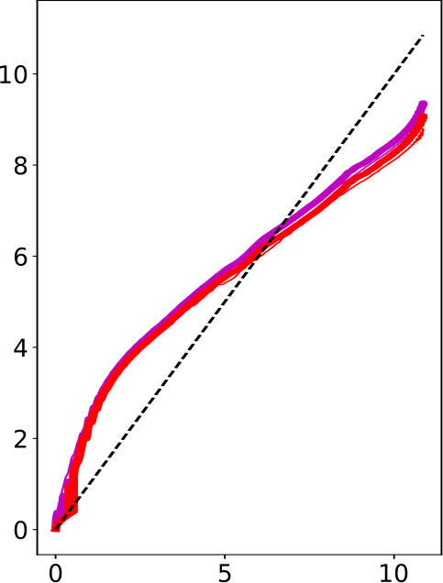
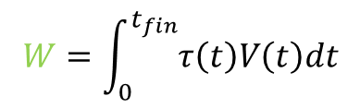

Energy budget in bare rocks surfaces
$$W=\int_{0}^{t_{fin}}{τ\left(t\right)V\left(t\right)dt}$$
$$Q(t)=ρ(c T(t)+L)\sqrt{πα_{th}t}$$
Aubry et al., 2018
Nearly 100% of frictional work is converted into heat but with fluctuations above and below the 1:1 line.
Excess heat / frictional work providing negative enthropy increase might suggest that an open system is more valid to describe our thermodynamic case
temperature λ
Heat density (MJ/m²)
Frictional work density (MJ/m²)

Slide 6

Conclusions
Temperature increase during earthquakes affects the shear stress evolution and therefore the slip propagation process
Temperature measurements are extremely demanding in terms of range, frequency and spatial resolution
We propose a coupled system to simulate earthquake slip and measure at high sampling frequency all the significant variables, in particular shear stress independently from temperature
Results compared to numerical models suggest that the measured temperatures are on the edge between asperity scale and bulk temperatures at the onset of slip.
Results allowed us to assess the validity of existing and available models during earthquake slip:
  Energy balance should be considered in an open system case
  Modelling of the switch from asperity to bulk weakening mechanisms needs further methodological development (e.g. Cornelio et al., under review in JGR, thursday)

Slide 7
Thank you for the attention!
Funding:
ERC Synergy Grant 856559 FEAR
ERC Consolidator grant 614705 NOFEAR
Grant RTI2018-094669-B-C32 SMART-OF
Juan de la Cierva grant FJCI-2017-31677
Community of Madrid grant S2018/NMT-4326 SINFOTON2-CM.

Slide 8
Reference list
Aretusini, S., Núñez‐Cascajero, A., Spagnuolo, E., Tapetado, A., Vázquez, C., & Di Toro, G. (2021). Fast and localized temperature measurements during simulated earthquakes in carbonate rocks. Geophysical research letters, 48(9), e2020GL091856.
Aubry, J., Passelègue, F. X., Deldicque, D., Girault, F., Marty, S., Lahfid, A., ... & Schubnel, A. (2018). Frictional heating processes and energy budget during laboratory earthquakes. Geophysical Research Letters, 45(22), 12-274.
Cascajero, A. N., Tapetado, A., & Vazquez, C. (2020). High spatial resolution optical fiber two color pyrometer with fast response. IEEE Sensors Journal, 21(3), 2942-2950.
Di Toro, G., Han, R., Hirose, T., De Paola, N., Nielsen, S., Mizoguchi, K., ... & Shimamoto, T. (2011). Fault lubrication during earthquakes. Nature, 471(7339), 494-498.
Han, R., Shimamoto, T., Hirose, T., Ree, J. H., & Ando, J. I. (2007). Ultralow friction of carbonate faults caused by thermal decomposition. Science, 316(5826), 878-881.
Harbord, C., Brantut, N., Spagnuolo, E., & Di Toro, G. (2021). Fault friction during simulated seismic slip pulses. Journal of Geophysical Research: Solid Earth, 126(8), e2021JB022149.
Kanamori, H., & Heaton, T. H. (2000). Microscopic and macroscopic physics of earthquakes. Geophysical Monograph-American Geophysical Union, 120, 147-164.
Tapetado, A., Diaz-Alvarez, J., Miguelez, M. H., & Vazquez, C. (2016). Two-color pyrometer for process temperature measurement during machining. Journal of Lightwave Technology, 34(4), 1380–1386. https://doi.org/10.1109/JLT.2015.2513158.

